Slide 1
A fresh future for Child Nutrition Programs
Features, Workflows, and Professional Services Configurations
Notes:
Welcome and set context. This deck has two parts: the customer-facing story about what we're building and why it matters — this is what a state agency would see. Then we'll transition into the technical architecture for the engineering team. Use the first 12 slides to make sure everyone has the same mental model of the product before we get into how it's built.

Slide 2


A look at what we're building...
A new platform replacing CTS and DIS, managing
Child Nutrition Programs across multiple states that will manage every step of the program cycle, including:
sponsor applications
site approvals
monthly claims
administrative reviews
corrective actions, and appeals
Built from the ground up as a single platform that adapts to each state's rules without custom development.
© EMS LINQ, LLC. All rights reserved.
2
Notes:
Single platform, full program lifecycle. The key message: this isn't a point solution — it manages everything from sponsor applications through claim payment in one system. Replacing CTS and DIS across multiple states. Worth noting that most state CNP systems today are a collection of disconnected tools — this is a greenfield platform built to handle everything in one place.

Slide 3
Four Guiding Principles
01
02
03
04
Configuration
Federal Protections
Isolation
Immutability
States choose how their program works,within boundaries they cannot cross. Three tiers: self-service in the portal, LINQ-guided setup, or a platform build for code-level changes.
IsFederal is not a setting. It is an architectural constraint enforced at three independent layers: UI, API, and database trigger. No role, script, or direct database write can override it.
At the database level, each state operates in its own PostgreSQL schema
At the API level, every request carries a JWT issued by Harmony Auth that contains the state tenant scope. The application validates that scope before executing any query
At the document storage level, S3 keys include the state code in the path, and presigned URLs are generated at read time
Nothing disappears quietly. EntitySnapshots capture full record state. FieldChangeLog records every delta. S3 Object Lock (WORM) enforces retention. Auditors get complete chains.
Configuration is a first-class architectural concern.
Federal math and requirements are not configurable.
No cross-state reads. No shared mutable state.
Audit records are append-only.
Notes:
1. This is an expectation from our clients
2. The IsFederal flag is the clearest expression of this: it is enforced at three independent points. The UI suppresses the control entirely for users without the flag. The API validates the flag on every write before the record is persisted. A database trigger rejects any direct write that attempts to set IsFederal = true without meeting the structural preconditions — meaning even a DBA with direct database access cannot override it without triggering a constraint violation.
3. cross-state data access requires simultaneously defeating the JWT validation layer, the application query layer, and the database schema boundary
4. . FERPA and USDA audit requirements make this non-negotiable, and it's a meaningful architectural decision (append-only audit is a constraint that shapes everything above it).

Slide 4
Domains
1 · AUTHORITATIVE
hold legal, financial & enforcement authority
Claims & Reimbursement · Accounting & Disbursement · Compliance & Administrative Review · Eligibility & Direct Certification
── AUTHORITY BOUNDARY — nothing below decides money, eligibility, or enforcement ──
constrain inputs; never decide outcomes
2 · FOUNDATIONAL
Identity & Access · Configuration & Tenant · Site & Sponsor Management · Applications & Agreements · Program Registry
── SPECIALIST BOUNDARY — business-critical, not authoritative ──
3 · OPERATIONAL
own program rules & integration surfaces
PROGRAM DOMAINS
SNP · CACFP · DCH · SFSP · FFVP · SSFO · CEP
MODULES
VCA Checklist · Budget · Contracts · Risk Management · Training & Tech Assist · Waivers · Food Distribution ⚠
PLATFORM SERVICES
Forms Engine · Workflow & Task Mgmt · Integration & Data Exchange · Document Library
── OBSERVATIONAL BOUNDARY — downstream consumes facts; never influences decisions above ──
4 · OBSERVATIONAL
read models & outbound services only
Reporting & Analytics → Snowflake · Audit & Observability · Notifications & Communications · Reference Data & Transparency
Notes:
31 domains. 4 tiers
Authoritative: they are the only domains that decide whether a claim is paid, whether a sponsor is compliant, or whether a household qualifies.
Foundational: These domains constrain inputs and establish the structures that authoritative decisions operate on, but they never produce outcomes themselves; they are business-critical without being authoritative.
Operational: These domains generate the facts and transactions that flow upward to be adjudicated, but they do not adjudicate.
Observational: It reads facts produced by the layers above and surfaces them outward, but it never writes back into a decision process.

Slide 5
Multiple Domains, one container
Wrong boundaries cost more in microservices
In a monolith, a wrong boundary involves renaming a namespace and moving classes.
In microservices, it means a new API contract, a data migration, and distributed transaction complexity.
We can extract services when the evidence says to
Every domain is already isolated by namespace and database schema. When usage patterns show us a domain needs independent scaling or deployment, we can pull it out.
Boundaries are a hypothesis
We drew the domain lines carefully, but the boundaries may not survive contact with real usage. A monolith lets us adjust those lines based on what we learn before we've locked them into service contracts.
Every domain in this platform is already isolated. They each have their own database tables, don’t reach into another domain's data directly, and communicate through defined interfaces.
Notes:
Modular Monolith

Slide 6
Architecture Overview
Phase 2
FRONTEND
Angular Frontend
Caseworker · Admin · Snackpaq
Config Admin UI
Workflows · Forms · Notifications
Mobile
Field staff · SFSP
NLP Query Interface
IDENTITY
Risk Scoring · Anomaly Detection
Harmony Auth · OIDC / OAuth 2.0 · JWT carries roles + tenant scope · Multi-Factor Authentication · Commonwealth identity provider
CORE
ENGINES
New State Config Assist
Policy Change Detection
Workflow Engine
Form Engine
Review Instrument
Engine
Rights Model
Configurable state machine
Approval routing · Named hooks
Schema-driven · Conditional logic
VDOE-configurable fields
Data-driven instruments
Configurable scoring
Role-based · Per-object rights
Federal override prevention
Federal guardrail enforced
Federal guardrail enforced
Analytics Warehouse
DOMAIN
SERVICES
Applications
& Agreements
Claims &
Reimbursement
Eligibility
& DC
Compliance
& Review
Accounting
& Finance
Programs
Sponsors · Sites
Renewals
FA1–FA4
Claims frozen
Direct Cert
Verification
Procurement
Audit Reviews
FNS-10/418/44
Export Adapter
NSLP · SBP · CACFP
SFSP · SMP · CEP
AUDIT
Audit & Observability · Append-only event log · Full state capture at every action · Field-level change history · 100% write coverage
DATA
cnp_global — Aurora PostgreSQL
cnp_ops × N states — Aurora PostgreSQL
Rates · Lookup codes · Workflow definitions · Rule definitions · Feature flags
Claims · Applications · DC · Compliance · Users · Audit · Schema = state boundary · No cross-state reads
INTEGRATIONS
DC Feeds
State Financial
Ed-Fi / SIS
FNS Policy
LaunchDarkly
SNAP · Medicaid · TANF
SFTP / REST / PGP
Oracle Financials
Grant drawdown
Student data standards
State-specific impl.
Federal Register API
Daily monitoring
Feature flags
47 module-level flags
Notes:
Transition point. Everything before this was the customer story. This and everything after is the technical architecture. Walk the layers top to bottom: Frontend → Identity → Core Engines → Domain Services → Audit → Data → Integrations. The AI panel on the right is Phase 2 — designed but not yet built. Single ECS Fargate container, ASP.NET Core 8 modular monolith, Angular frontend, Aurora PostgreSQL.

Slide 7
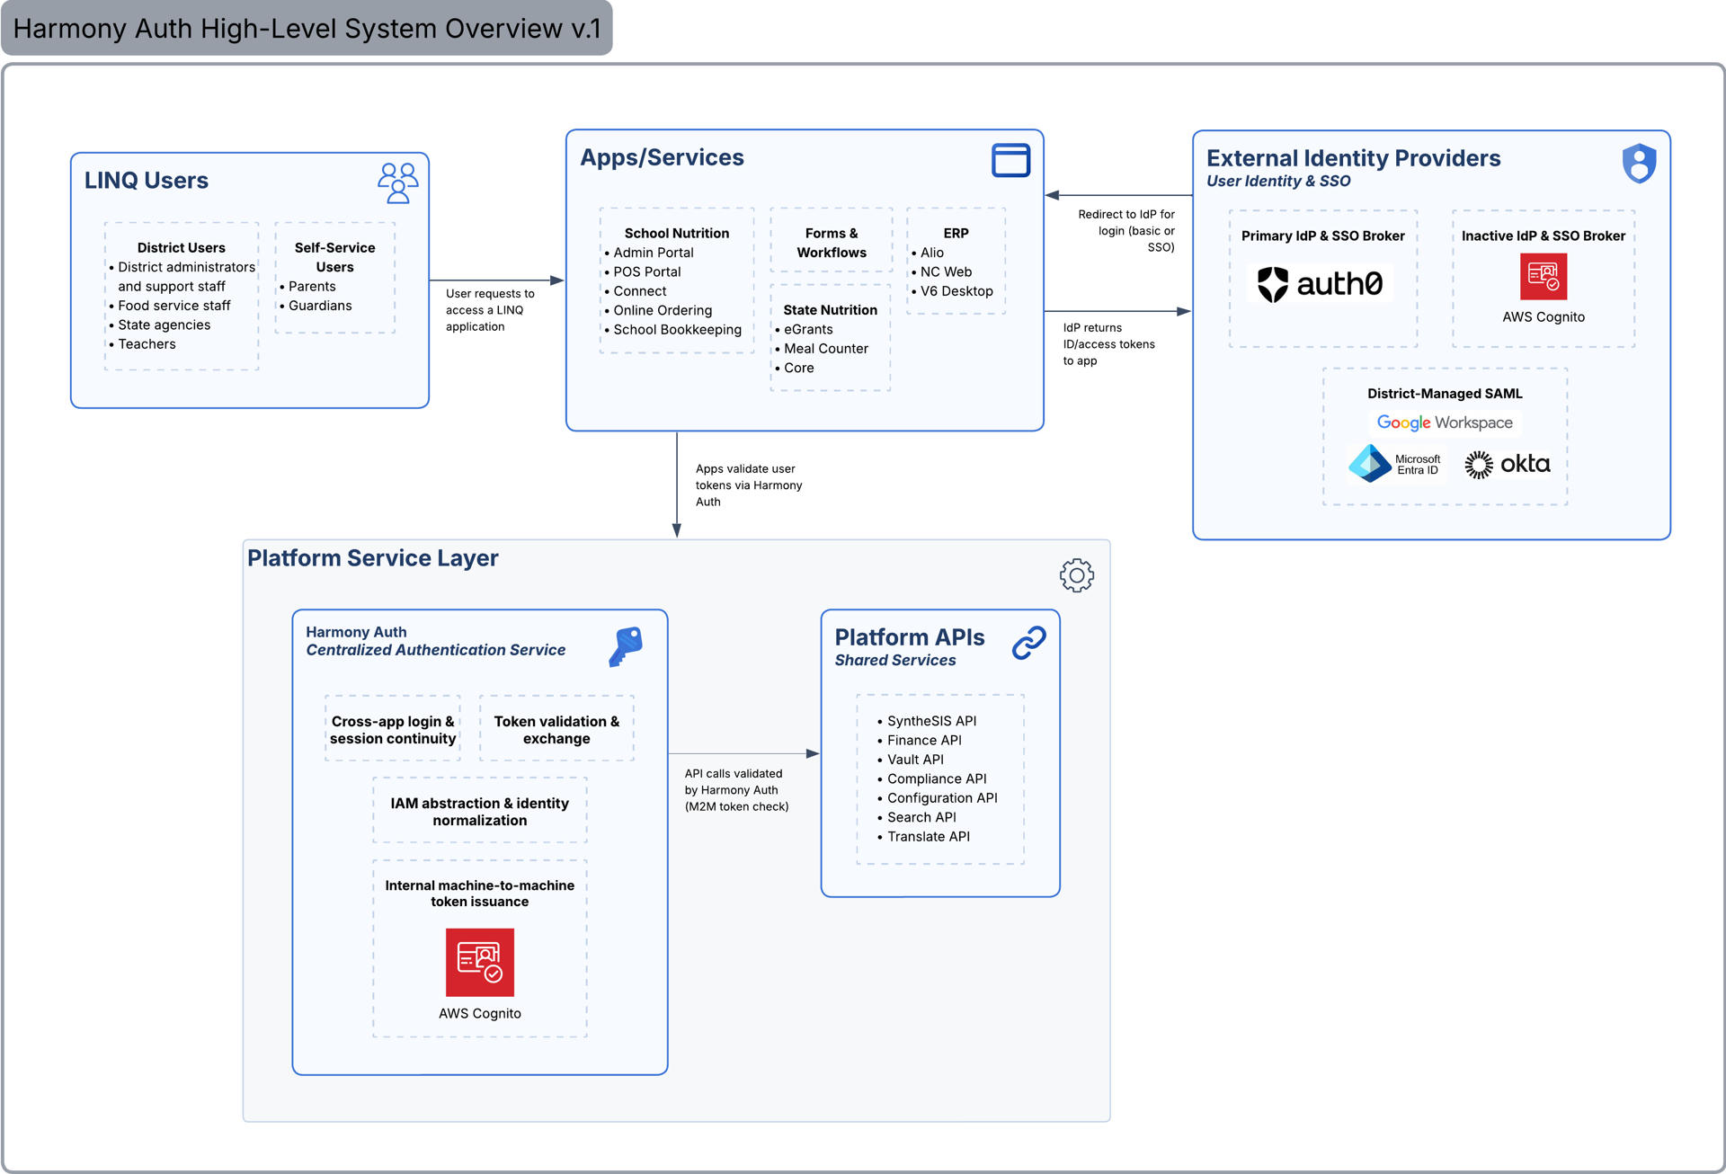
Identity & Security
Harmony Auth · LINQ-wide authentication
OIDC / OAuth 2.0 · JWT tokens carry roles + state scope · Multi-Factor Authentication enforced
Identity & Security
Federal Guardrail
Certain permissions are locked
by the IsFederal flag.
No role, script, or admin action
can override them.
Notes:
Harmony Auth is LINQ's centralized authentication service built on Okta and AWS Cognito. All LINQ apps authenticate through it. OIDC/OAuth 2.0 flow: user hits the app, redirects to IdP for login, Harmony Auth returns ID and access tokens, app validates them via Harmony Auth. JWT carries both the user's roles AND their state scope — a Virginia user literally cannot make a request that touches Alabama data. MFA enforced for all users with no admin override.

Slide 8
Core Engines
Workflow Engine
Form Engine
Review Instrument Engine
Rights Model
Governs every approval process on the platform.
Reads a table, evaluates conditions, checks permissions, and fires actions.
Data-driven review instruments: questions, scoring, and applicability rules
Renders and processes the forms that sponsors and caseworkers fill out.
Forms have conditional logic that’s evaluated at runtime based on program, scenario, and user role.
Every page and function is a securable object with individually assignable view, add, modify, delete, and admin rights.
Starts with 9 base roles; fully customizable from there.
✓ What Clients can configure:
Add approval steps, assign roles to states, configure routing rules, and set notification triggers.
✓ What Clients can configure:
✓ What Clients can configure:
✓ What Clients can configure:
Field visibility, required/optional rules, and validation for fields the code doesn't branch on.
Add questions, edit text, configure scoring criteria, and define which instruments apply to which reviews.
Create roles, assign rights to roles, and assign users — fully self-service. can create
Fields that drive form behavior (e.g. site type) are set at implementation.
✕ What requires development:
✕ What requires development:
✕ What requires development:
✕ What requires development:
New platform objects (new pages, new functions) can only be added through a code deployment.
Review workflow structure (on-site vs. desk, findings flow) is set at implementation.
Federal approval requirements cannot be removed.
States with claiming consequences require development.
Anything flagged as isFederal can ONLY be changed via code
Notes:
The four engines are program-agnostic — they don't know if they're running an SNP claim or a CACFP review. What makes them behave correctly for each program is configuration, not code.
Workflow Engine: any process with approval steps runs through this — claim submission and site application are both driven by the same engine, with different configurations.
Form Engine: any data collection uses this. A form in SNP and a form in CACFP are both built and rendered by the same engine. When a federal form changes, the configuration updates, not the code.
Review Instrument Engine: the structured checklist tool for compliance monitoring. Different programs have different instruments; the same engine renders, scores, and records findings for all of them.
Rights Model: every page and function is a securable object with view, add, modify, delete, and admin rights. Starts with 9 base roles — fully customizable from there. Anything flagged isFederal can only be changed via code, enforced at the database level.

Slide 9
Configuration Boundaries
Client Self-Service
LINQ Implementation Team
Development Required
Clients can do this today, without calling us
Configured at onboarding and on request
This requires a code change and a release
· Workflow routing and approval steps
· System-wide settings (CnpDefaults)
· New transaction types
· Form field visibility and required rules
· Federal report field mappings
· Site/sponsor types that change form behavior
· Notification content and thresholds
· Program year activation
· New validation error logic
· Review instrument questions and scoring
· Feature flag configuration
· New field types in the Form Engine
· User roles and permission assignments
· Schema provisioning for new states
· Claiming calculation rules
· Document requirements and expiration rules
· Integration endpoint configuration
· New program types
Notes:
Three tiers engineers need to understand when building or modifying features. Client self-service lives in the Config Admin UI and takes effect immediately — workflow routing, form rules, roles, notifications, document requirements, review instrument questions. LINQ Implementation Team tier covers things set at onboarding or changed on a service request — CnpDefaults, federal report mappings, schema provisioning for new states, feature flags. Development Required is anything where the code has to branch differently based on the value — new transaction types, new field types, claiming calculation changes, new program types. The rule: if the code cares about the value, it's a dev ticket.

Slide 10
Domain Services
Applications & Agreements
Claims & Reimbursement
Eligibility & Direct Certification
· Sponsor and site applications
· Monthly claims entry FA1–FA4
· Direct Certification via VDSS feed
· Annual renewals and amendments
· Claim validation and error feedback
· Household applications
· Pre-screening and eligibility packets
· Automated reimbursement calculation
· Verification processing
· Multi-year version history
· Claim freeze and lock controls
· CEP administration
· Bulk approvals and returns
· Federal report generation (FNS-10/418/44)
· Multi-year eligibility history
Compliance & Review
Accounting & Finance
Programs
· Administrative reviews
· Payment processing
· NSLP · SBP · CACFP
· Procurement reviews
· Offset and recovery tracking
· SFSP · SMP · CEP
· Configurable review instruments
· Oracle Financials export adapter
· Cross-program participation
· Findings, CADs, recommendations
· Grant drawdown reporting
· Program-specific rules enforced
· Correspondence tracking
· Prior-year fiscal actions
· IsFederal guardrail per program
Notes:
Six domain groupings covering the full program lifecycle. These are business capability boundaries, not microservices — everything runs in one container but each domain has its own namespace and its own database tables. Claims & Reimbursement covers FA1-FA4 claims entry, edit checks, freeze-on-approval, and FNS federal report generation. Compliance & Review covers both administrative and procurement review workflows — both use the Review Instrument Engine. Eligibility & DC handles the VDSS feed and household applications. Accounting covers Oracle Financials integration and payment tracking.

Slide 11
Audit
Every write operation on the platform (save, submit, approve, reject, and override) is captured automatically.
What Gets Captured
What You Can Do With It
How It's Protected
Full state snapshot at each event
Reconstruct the full history of any record
Append-only. Records cannot be modified
Every field that changed, before and after
Answer "who approved this and when?"
S3 Object Lock (WORM) for long-term retention
Who made the change (user + role)
Produce audit trails for federal reviewers
No admin or script can delete audit records
When it happened (timestamp)
Support compliance investigations
Retained per compliance retention policy
What workflow state the record was in
Query point-in-time state for any entity
Tamper-evident by design

Slide 12
Integrations
DC Feeds
State Financial
Systems
Ed-Fi / SIS
FNS Policy Feeds
LaunchDarkly
Direct Certification
Oracle Financials / VASNP
Student Information Systems
USDA Federal Register
Feature Flag Service
· Automated SFTP retrieval from VDSS
· Nightly accounting export adapter
· Student enrollment and demographic data
· Federal Register API monitoring
· 47 module-level feature flags
· SNAP, Medicaid, and TANF eligibility files
· Grant drawdown and payment data
· Per-tenant adapter configuration
· Reimbursement rate updates
· Per-state flag configuration
· Nightly processing with error handling
· Reconciliation-ready format
· State-specific SIS implementations
· Daily automated check
· Gradual rollout and A/B testing
· PGP-encrypted in transit
· Config data only. No code in payload
· Meal count and eligibility cross-reference
· Phase 2: LLM-assisted change classification
· Local cache in FlagDefs table
· Results stored per state schema
· State-specific account code mapping
· Ed-Fi data standards compliant
· Human review before any platform update
· Zero-downtime feature activation
Notes:
100% write coverage — every save, submit, approve, reject, and override is captured automatically, with no opt-in required. Two layers working together: EntitySnapshots captures full state at each event, FieldChangeLog captures field-level deltas for every write. Append-only — no admin or script can modify or delete records. S3 Object Lock WORM storage for long-term retention. Point-in-time queryable — we can reconstruct the state of any record at any moment in its history. This is how we answer "who approved this claim and when?" for a federal auditor.

Slide 13
Database Structure
Aurora Postgresql single database
cnp_global single schema
cnp_ops schema per state
cnp_ops_mn
cnp_ops_va
FederalReimbursementRate
Sponsor (district)
Sponsor (district)
FoodItemCode
Claim
Claim
UsdaProgramRule
Application
Application
FederalFiscalYear
Payment
Payment
Role per state that only has permissions on its own schema. Even if a query tried to cross schemas, the database would reject it.
App resolves the tenant (state) at the start of every request from the authenticated user's session and constructs all queries against that state's schema.
Notes:
We are not diving headfirst into microservices. The modular monolith lets us learn the right boundaries from real usage before we lock them into service contracts.
In a monolith, a wrong boundary is a namespace rename and moving some classes. In microservices, it's a new API contract, a data migration, and distributed transaction complexity.
Every domain is already namespace-isolated and schema-isolated. When the evidence says a domain needs independent scaling or deployment, we can extract it cleanly. The four authoritative domains — Claims, Accounting, Compliance, Eligibility — are the most likely candidates to move first. They have the clearest ownership and the most to gain from independent deployment.

Slide 14
Phase 2 – AI layer
Every AI output requires human review before any platform action is taken.
NLP Query Interface
Risk Scoring AI
Authorized directors, finance staff, and VDOE administrators ask questions in plain English.
Gradient-boosted model scores sponsors and sites for compliance risk before review selection.
Intent classified → parameters extracted → curated views queried → results returned.
6 signal groups · Nightly refresh · Quarterly retrain on outcomes. SHAP explainability shows top 3 factors.
⚠ Queries restricted to an approved catalog. No raw SQL. No PII in results.
⚠ Informational only. Never auto-triggers a review. Human decides next step.
Anomaly Detection
New State Config Assist
Identifies unusual patterns in claims, DC match rates, and submission timing across the state.
When onboarding a new state, AI scaffolds initial configuration by matching against similar existing states.
Claim spikes, disbursement outliers, late submission clusters — surfaced to state administrators.
POST /tenants/{code}/scaffold?similarTo= · Onshore team reviews and approves all suggestions.
⚠ No auto-actions. Flags are informational. A human decides what to do.
⚠ Zero deployments to add a state. All suggestions require explicit onshore approval.
EO 30 compliance: the NLP Query Interface must be registered with VITA via EA-225 before deployment. AI is a Phase 2 investment contingent on Phase 1 go-live.
© EMS LINQ, LLC. All rights reserved.
14
Notes:
All AI capabilities are Phase 2 — designed but not yet built. Every AI output requires human review before any platform action is taken.
Natural Language Processing Query Interface: plain-English questions from directors and finance staff, answered by querying curated Snowflake views. No raw SQL, no PII in results. Must be registered with VITA via EA-225 before deployment per Virginia EO 30.
Risk Scoring: gradient-boosted model scores sponsors and sites for compliance risk. SHAP explainability shows top 3 factors. Informational only — never auto-triggers a review.
Anomaly Detection: flags unusual patterns in claims, DC match rates, and submission timing. No auto-actions.
New State Config Assist: AI scaffolds initial configuration when onboarding a new state, matching against similar existing states. All suggestions require explicit onshore approval before anything is applied.
The human review gate is non-negotiable on all four capabilities.

Slide 15
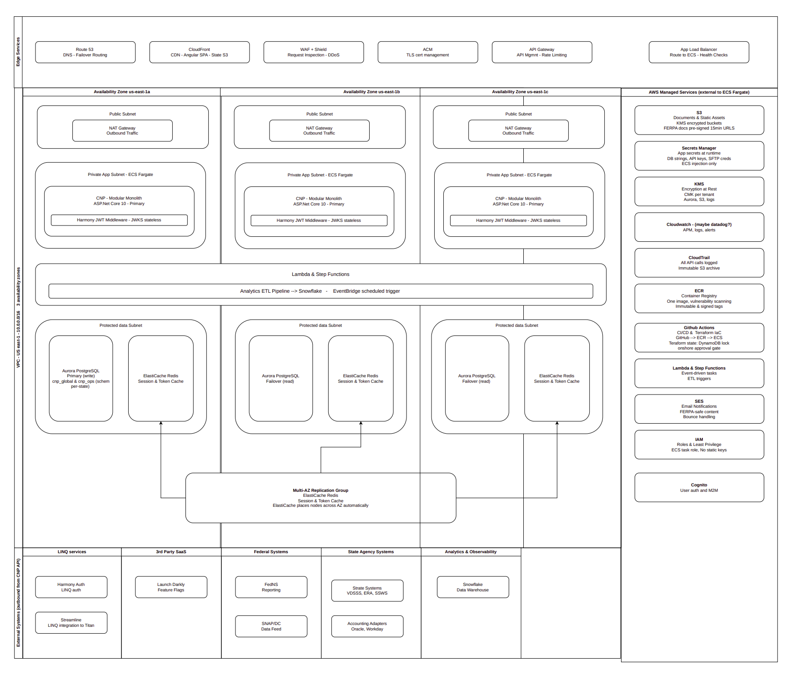
AWS Architecture

Slide 16
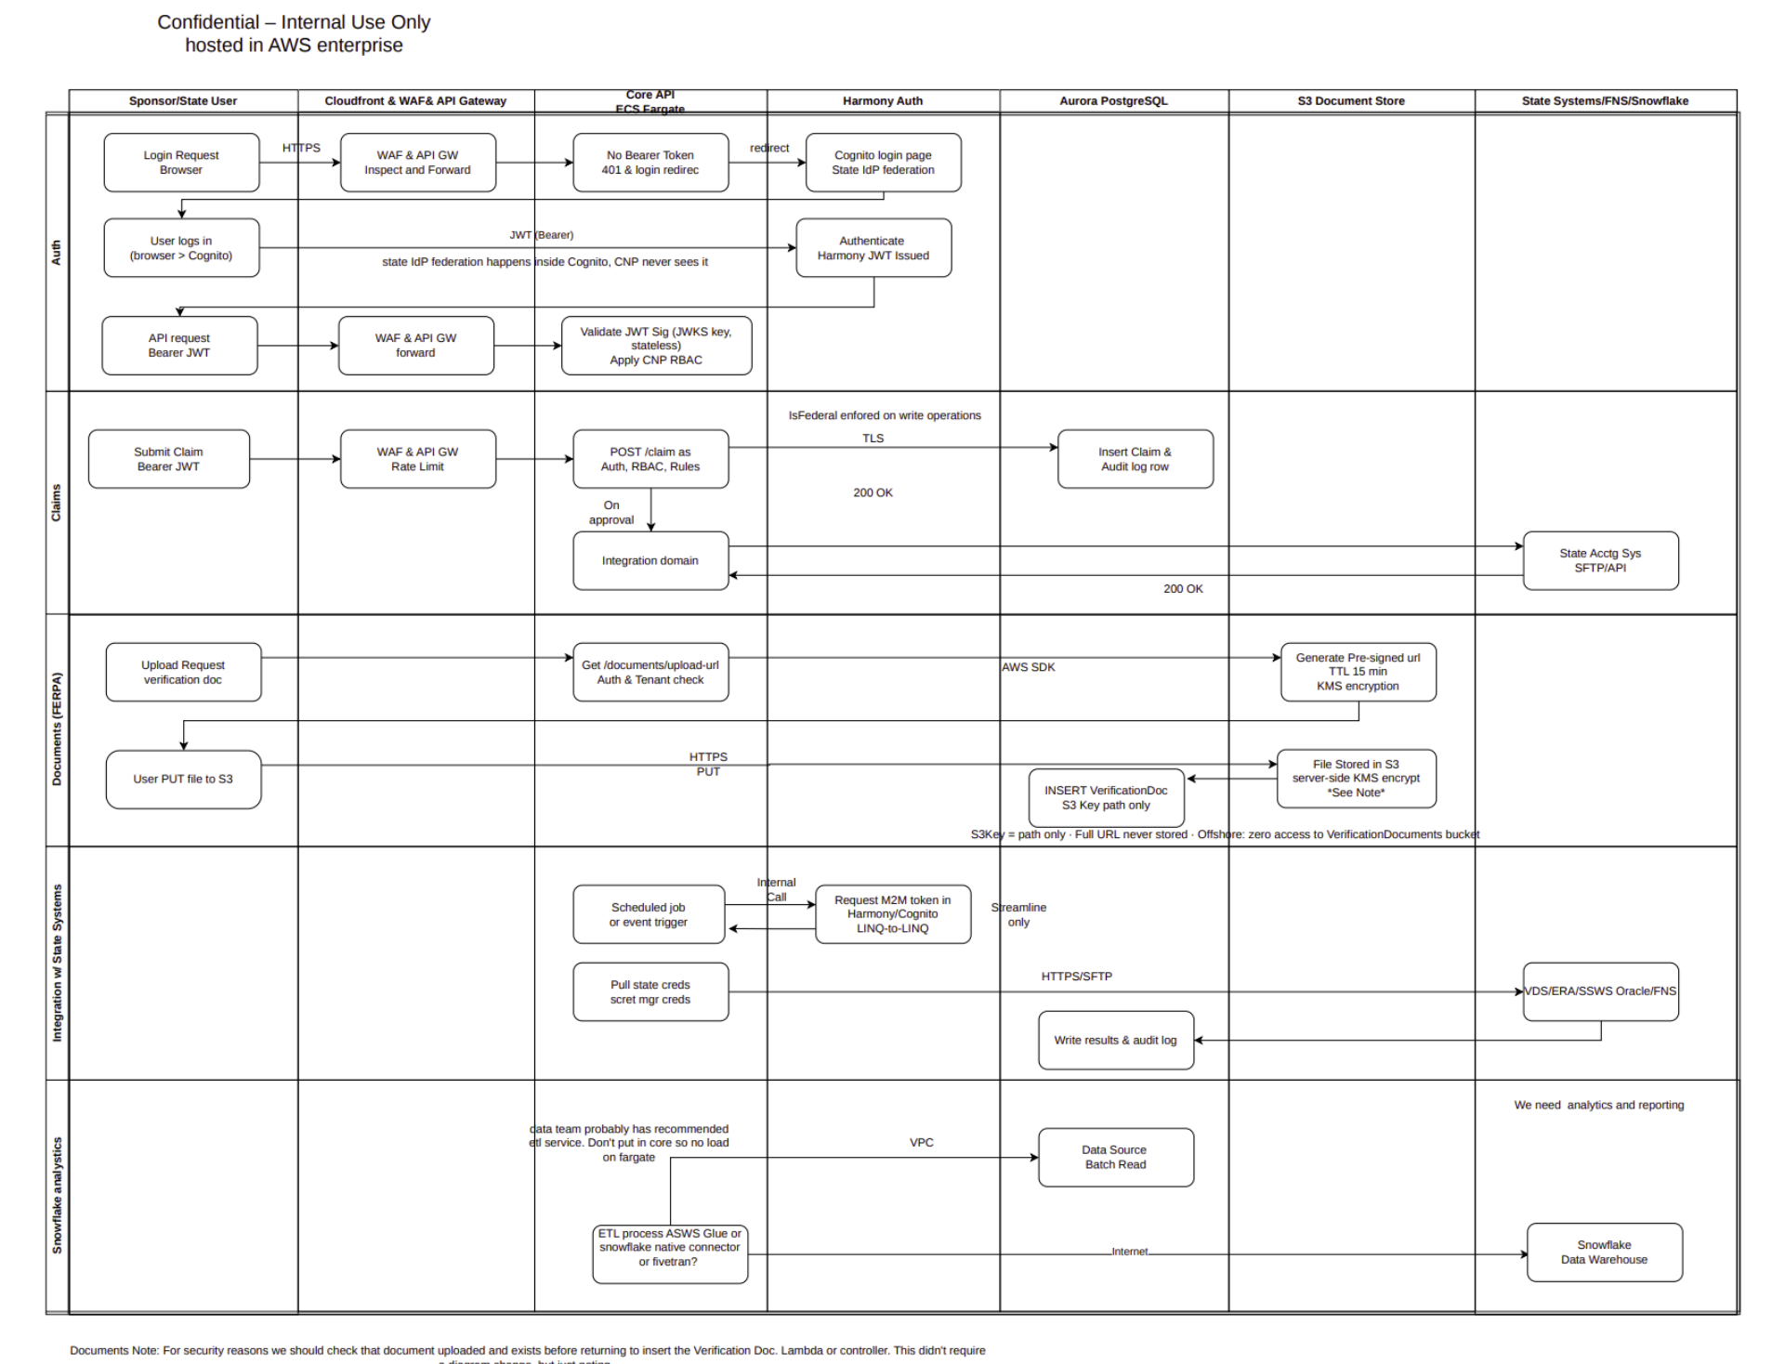
Data Flow

Slide 17
Q&A

