Slide 1

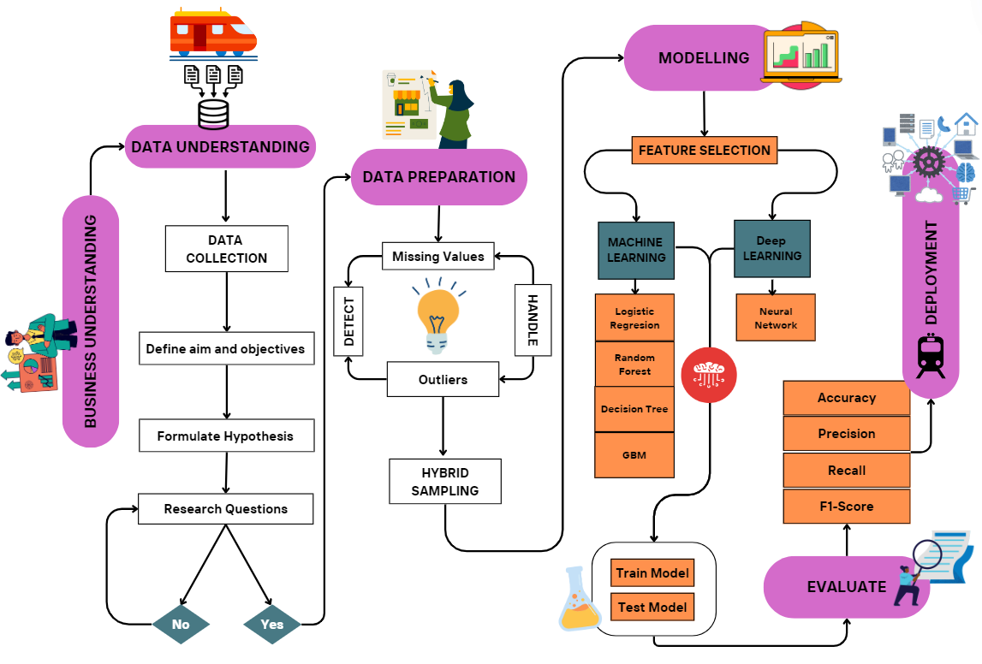
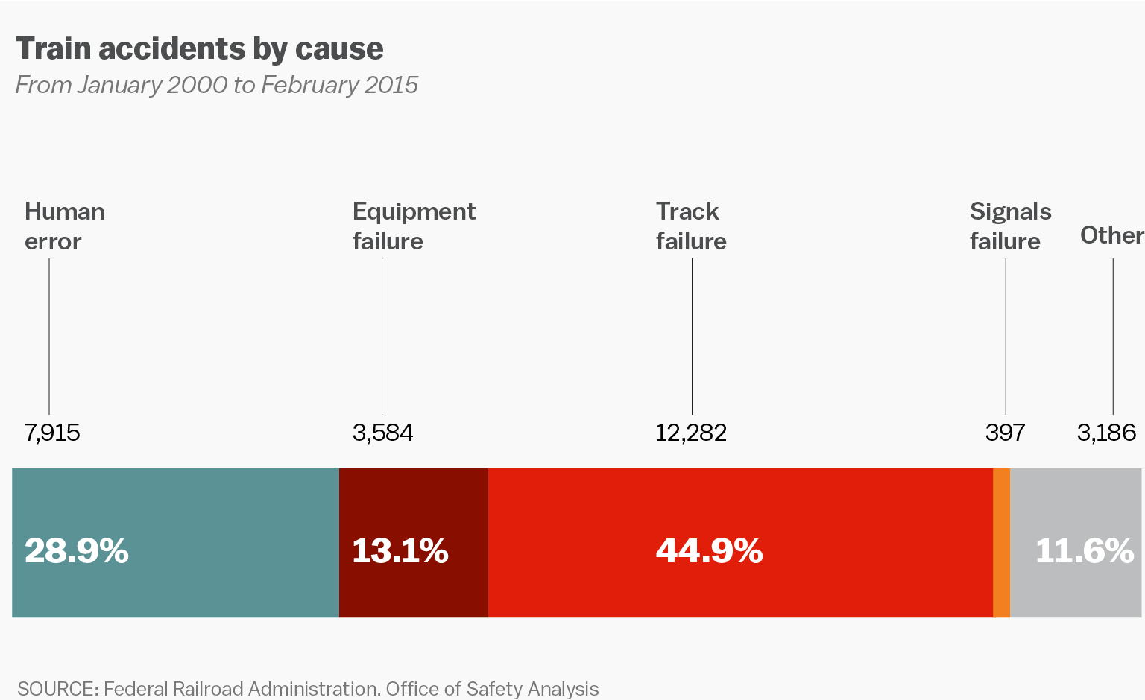
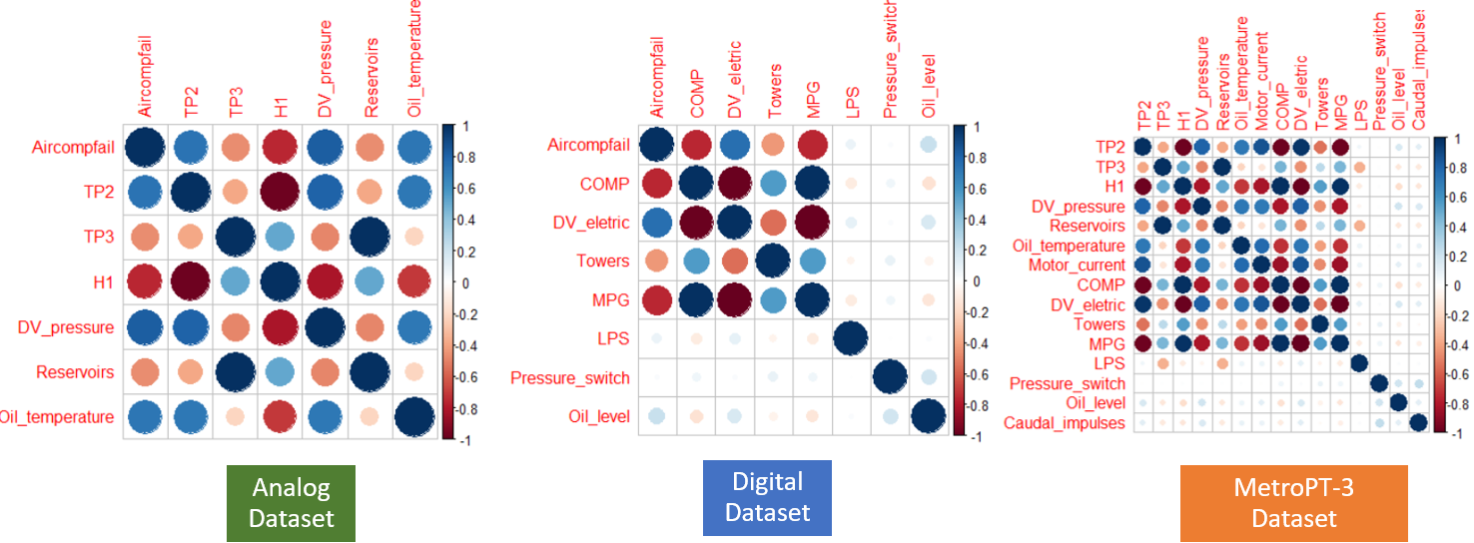
ENHANCING AND OPTIMIZING ASSET AND EQUIPMENT LIFECYCLE MANAGEMENT THROUGH PREDICTIVE MAINTENANCE TECHNIQUES
Name : Oluwatosin Ayokunle Ojo
Supervisor Name: Ibtisam Mogul
Course: MSc. Data Analytics and Technologies
Background
Reactive maintenance in organizations like data centres, metro railways, and hospitals results in prolonged downtimes, higher costs, and inefficient resource use.
These unsustainable strategies cause operational inefficiencies. Many struggle to adopt predictive maintenance due to challenges with big data, integration, and accuracy.
This study aims to predict equipment failures and optimize maintenance to reduce downtime and improve resource allocation.
METHODOLOGY
Significant increase in the use of big data and machine learning for optimizing Asset and Equipment Lifecycle Management.
Predictive maintenance techniques like Random Forest, Decision Tree, Neural Networks, etc., improve operational efficiency and reduce downtime.
Best Dataset: The Analogue dataset
Best Performing Model: Improved Accuracy score of 98.83%, Precision of 98.2%, Recall of 99.5% and F1-score of 98.9%
Hybrid Model Approach (Random Forest and Neural Network) Accuracy – 93.9 % (Second best model)
CONCLUSION
Limitations:
Ethical concerns related to data privacy and security in predictive maintenance applications.
Lack of transparency, fairness, and model interpretability may impact model effectiveness and adoption.
Lack of computational power to run more models
Recommendations and Future Work:
Integrate diverse data sources to further enhance machine learning and deep learning models.
Explore more advanced deep learning techniques such as RNN, CNN, LSTM, and Autoencoders.
REFERENCES
Dataset: MetroPT-3 has over 1 million rows and 16 columns.
Exploratory Data Analysis (EDA): Explore patterns, trends, and variables relationship.
Data Pre-processing: Ensure data quality and reliability.
Feature Engineering: classified in 1,0.
Data Sampling: Hybrid Data Sampling approach.
Models: Logistic Regression, Decision Tree, Random Forest, Gradient Boosting Machine, Neural Networks and a Hybrid Model.
Model Evaluation: Evaluate - Accuracy, Precision, Recall and F1-score
Amram, M., Dunn, J., Toledano, J. J. and Zhuo, Y. D. (2021b) ‘Interpretable predictive maintenance for hard drives.’ Machine Learning with Applications, 5, September, p. 100042.
Davari, N., Veloso, B., Ribeiro, R. P., Pereira, P. M. and Gama, J. (2021) ‘Predictive maintenance based on anomaly detection using deep learning for air production unit in the railway industry.’ In 2021 IEEE 8th International Conference on Data Science and Advanced Analytics (DSAA). Porto, Portugal: IEEE, pp. 1–10.
Lohr, S. L. (2022) Sampling: design and analysis. Third edition, Boca Raton London New York: CRC Press, Taylor & Francis Group (Chapman & Hall/CRC texts in statistical science)
Nair, Vishak, Premalatha M, Srinivasa Perumal R, and Braveen M. “Enhancing Metro Rail Efficiency: A Predictive Maintenance Approach Leveraging Machine Learning and Deep Learning Technologies,” May 23, 2024. https://doi.org/10.21203/rs.3.rs-4319916/v1.
Aim & Objectives
Aim
The research aim is to is to develop an Equipment Lifecycle Management System that integrates various machine learning and deep learning techniques to predicting failures and improve equipment maintenance.
Objectives
Conduct a literature review on technological advancements in big data, ML, and AI for Equipment Lifecycle Management.
Identify challenges in applying big data and ML to Equipment Lifecycle Management.
Develop and implement models using ML and deep learning to optimize lifecycle management.
Assess model performance, noting strengths, weaknesses, and potential areas for improvement.
RESULTS
The features most indicative of potential failures in the MetroPT-3 dataset are:
 | Model Ranking
S/N | MODEL | MetroPT-3 Dataset |  | Analogue Sensor Dataset |  | Digital Sensor Dataset
 |  | Accuracy | F1-Score | Accuracy | F1-Score | Accuracy | F1-Score
1 | LogR | 0.932 | 0.934 | 0.917 | 0.919 | 0.702 | 0.760
2 | DT | 0.928 | 0.930 | 0.930 | 0.934 | 0.695 | 0.755
3 | RF | 0.943 | 0.946 | 0.988 | 0.988 | 0.702 | 0.760
4 | GBM | 0.933 | 0.936 | 0.934 | 0.937 | 0.695 | 0.755
5 | NN | 0.938 | 0.940 | 0.937 | 0.940 | 0.702 | 0.760
6 | Hybrid (RF+NN) | N/A |  | 0.939 | 0.942 | N/A
CONTACT
Mail- tosinayoojo@gmail.com
GitHub- https://github.com/Tosinayoojo/Data-Engineering-Projects

