Slide 1
CENG 317 – Project Presentation
Tosin Ajayi

Slide 2
Proposal: Parts Crib Database
Introduction
Using Non-usb Barcode scanner

Slide 3
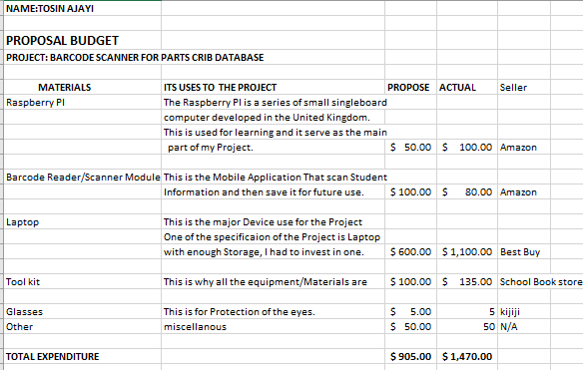
Budget

Slide 4
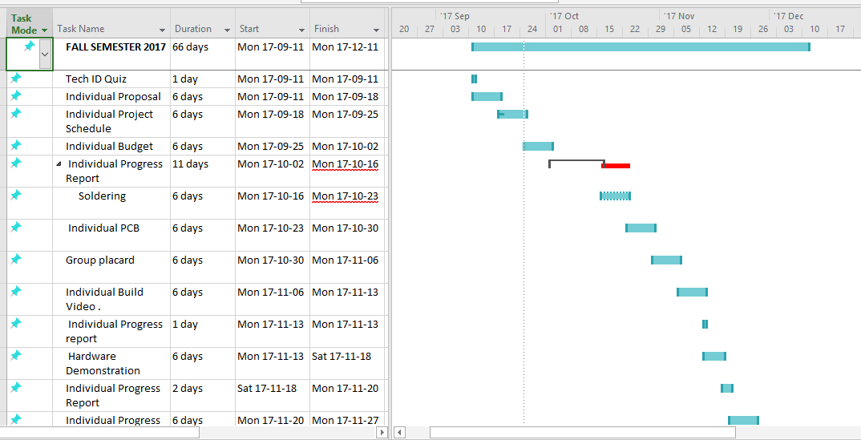
Project Schedule

Slide 5
Demonstration
The real life demonstration of using the Barcode scanner, that is when scanning the student Id card the number will pop on the screen.

Slide 6
Course Knowledge utilized
Network Programming
Software Engineering
Digital interfacing
Writing skills
Java
Database
Intro to Electrical
Pc Hardware Operating system

