Slide 1
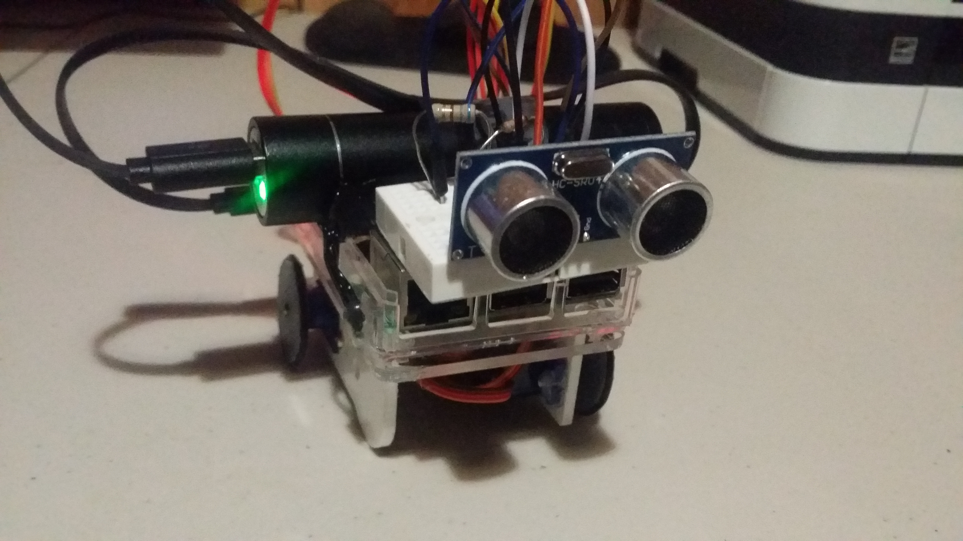
PiRover
RaspberryPi rover

Slide 2
Introduction
PiRover is a rover controlled by a raspberry pi. It is integrated with Bluetooth connection using an Android app called “PiRover”. This project can be used for emergency purposes and any exploration activities. The PiRover can be controlled manually and automatically.

Slide 3
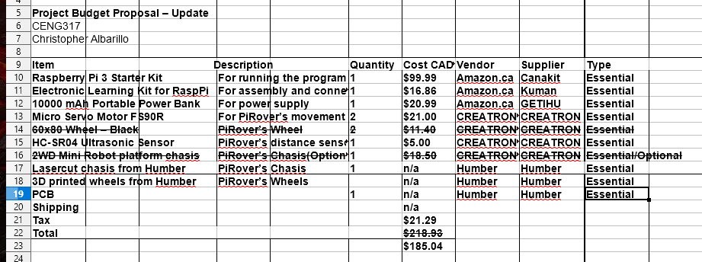
Budget (saved $33.79)

Slide 4
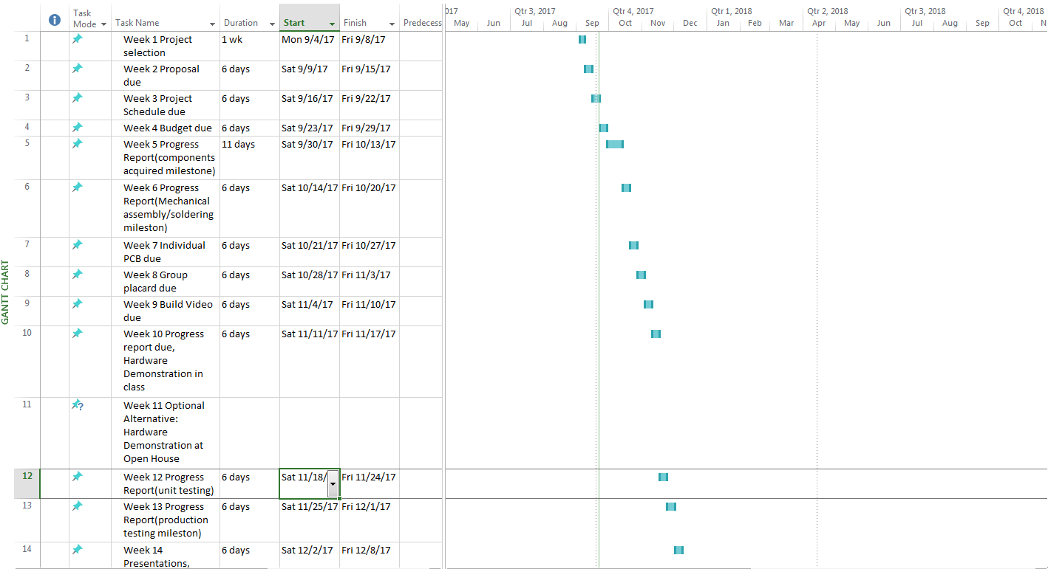
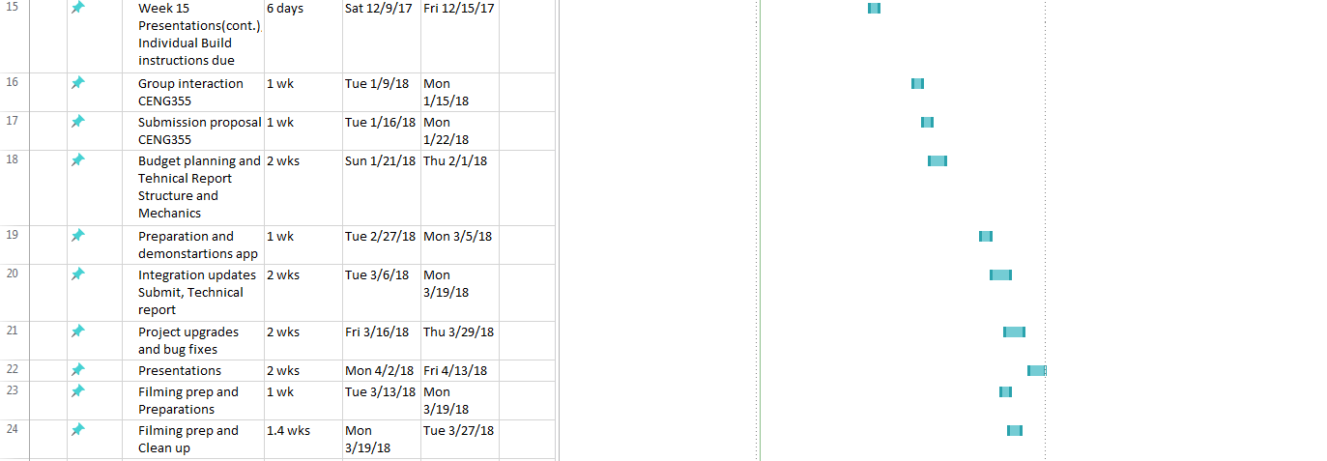
Schedule
The project is right on schedule as planned(strike days added). There were some changes that happened during the progress of making the project due to the strike. It gave me additional time to work on my hardware and software project.

Slide 5
Backup Demo
PiRover Demo video link
https://www.youtube.com/watch?v=DTNT1y5OaBA
PiRover Build video link
https://www.youtube.com/watch?v=hWkuDr1-n2Y

Slide 6
Course Knowledge utilized from previous courses
Technical C
Electric Circuit
Java Programming
Internet Programming
Database with Java

