Slide 1

Python

Slide 2

Introduction
Python is an interpreted high-level general-purpose programming language. Its design philosophy emphasizes code readability with its use of significant indentation. Its language constructs as well as its object-oriented approach aim to help programmers write clear, logical code for small and large-scale projects.

Slide 3
Hestory
Python was conceived in the late 1980s^{[40]} by Guido van Rossum at Centrum Wiskunde & Informatica (CWI) in the Netherlands as a successor to the ABC programming language, which was inspired by SETL,^{[41]} capable of exception handling and interfacing with the Amoeba operating system.^{[11]} Its implementation began in December 1989.^{[42]} Van Rossum shouldered sole responsibility for the project, as the lead developer, until 12 July 2018, when he announced his "permanent vacation" from his responsibilities as Python's "benevolent dictator for life", a title the Python community bestowed upon him to reflect his long-term commitment as the project's chief decision-maker.^{[43]} In January 2019, active Python core developers elected a five-member "Steering Council" to lead the project.^{[44][45]}
Python 2.0 was released on 16 October 2000, with many major new features, including a cycle-detecting garbage collector (in addition to reference counting) for memory management and support for Unicode.^{[46]}
Python 3.0 was released on 3 December 2008. It was a major revision of the language that is not completely backward-compatible.^{[47]} Many of its major features were backported to Python 2.6.x^{[48]} and 2.7.x version series. Releases of Python 3 include the 2to3 utility, which automates the translation of Python 2 code to Python 3.^{[49]}
Python 2.7's end-of-life date was initially set at 2015 then postponed to 2020 out of concern that a large body of existing code could not easily be forward-ported to Python 3.^{[50][51]} No more security patches or other improvements will be released for it.^{[52][53]} With Python 2's end-of-life, only Python 3.6.x^{[54]} and later are supported.
Python 3.9.2 and 3.8.8 were expedited^{[55]} as all versions of Python (including 2.7^{[56]}) had security issues, leading to possible remote code execution^{[57]} and web cache poisoning.^{[58]}

Slide 4
Design philosophy and features
Python is a multi-paradigm programming language. Object-oriented programming and structured programming are fully supported, and many of its features support functional programming and aspect-oriented programming (including by metaprogramming and metaobjects (magic methods)). Many other paradigms are supported via extensions, including design by contract and logic programming.
Python uses dynamic typing and a combination of reference counting and a cycle-detecting garbage collector for memory management. It also features dynamic name resolution (late binding), which binds method and variable names during program execution
The language’s core philosophy is summarized in the document The Zen of Python , which includes aphorisms such as: Beautiful is better than ugly. Explicit is better than implicit. Simple is better than complex. Complex is better than complicated. Readability counts..

Slide 5
Syntax and semantics
Python is meant to be an easily readable language. Its formatting is visually uncluttered, and it often uses English keywords where other languages use punctuation. Unlike many other languages, it does not use curly brackets to delimit blocks, and semicolons after statements are allowed but are rarely, if ever, used. It has fewerPython uses whitespace indentation, rather than curly brackets or keywords, to delimit blocks. An increase in indentation comes after certain statements; a decrease in indentation signifies the end of the current blbloc Thus, the program's visual structure accurately represents the program's semantic structure. This feature is sometimes termed the off-side rule, which some other languages share, but in most languages indentation does not have any semantic meaning. The recommended indent size is four spaces. syntactic exceptions and special cases than C or Pascal.

Slide 6
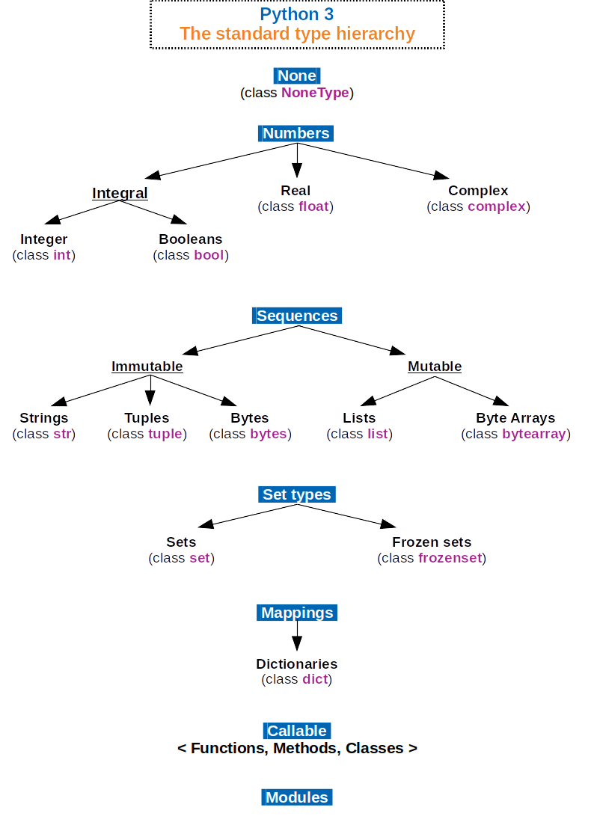
Methods

Slide 7
Libraries
Python’s large standard library, commonly cited as one of its greatest strengths,[115] provides tools suited to many tasks. For Internet-facing applications, many standard formats and protocols such as MIME and HTTP are supported. It includes modules for creating graphical user interfaces, connecting to relational databases, generating pseudorandom numbers, arithmetic with arbitrary-precision decimals,[116] manipulating regular expressions, and unit testing.
As of September 2021, the Python Package Index (PyPI), the official repository for third-party Python software, contains over 329,000[118] packages with a wide range of functionality, including: Automation Data analytics Databases Documentation Graphical user interfaces Image processing Machine learning Mobile apps Multimedia

Slide 8
Naming
Python’s name is derived from the British comedy group Monty Python, whom Python creator Guido van Rossum enjoyed while developing the language. Monty Python references appear frequently in Python code and culture;[167] for example, the metasyntactic variables often used in Python literature are spam and eggs instead of the traditional foo and bar.[167][168] The official Python documentation also contains various references to Monty Python routines.[169][170] The prefix Py- is used to show that something is related to Python. Examples of the use of this prefix in names of Python applications or libraries include Pygame, a binding of SDL to Python (commonly used to create games); PyQt and PyGTK, which bind Qt and GTK to Python respectively; and PyPy, a Python implementation originally written in Python.

Slide 9
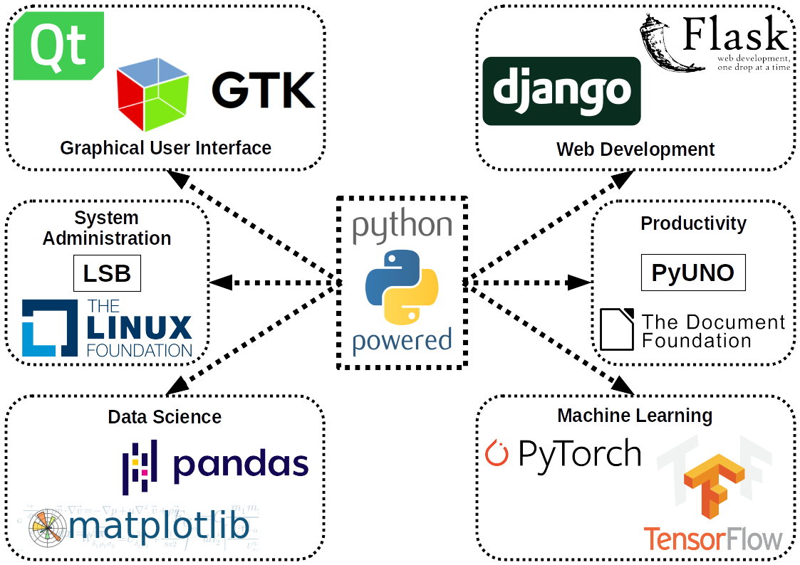
Uses

Slide 10
Uses
Python can serve as a scripting language for web applications, e.g., via mod_wsgi for the Apache web server. With Web Server Gateway Interface, a standard API has evolved to facilitate these applications. Web frameworks like Django, Pylons, Pyramid, TurboGears, web2py, Tornado, Flask, Bottle and Zope support developers in the design and maintenance of complex applications. Pyjs and IronPython can be used to develop the client-side of Ajax-based applications. SQLAlchemy can be used as a data mapper to a relational database. Twisted is a framework to program communications between computers, and is used (for example) by Dropbox
Python is commonly used in artificial intelligence projects and machine learning projects with the help of libraries like TensorFlow, Keras, Pytorch and Scikit-learn As a scripting language with modular architecture, simple syntax and rich text processing tools, Python is often used for natural language processing.
Python is used extensively in the information security industry, including in exploit development.

Slide 11
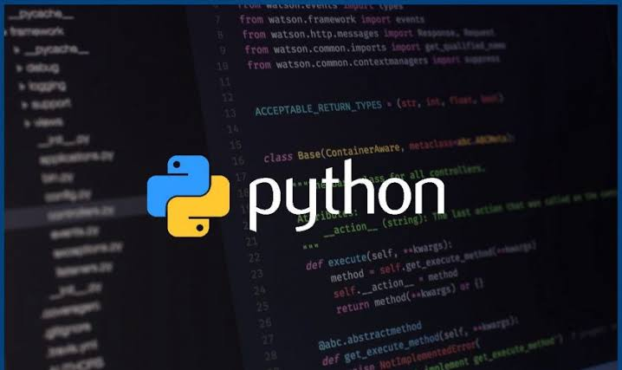

Slide 12
1)Shimaa saber kenawy
2) Shimaa abdlbasset Mohamed
3)Shimaa Ali sayed
4) Toson abdeluahab Hassan
5)Hamad Ayman Hassan
6) sherry matta akladious

