Slide 1
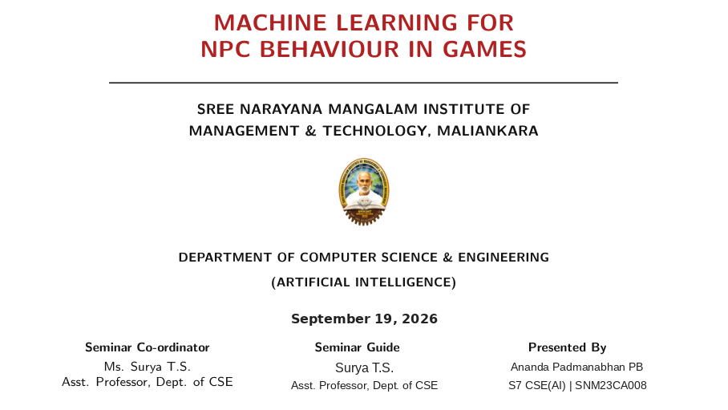
MULTIMODAL AI WITH
COMPUTER VISION
MULTIMODAL AI WITH
COMPUTER VISION

Slide 2
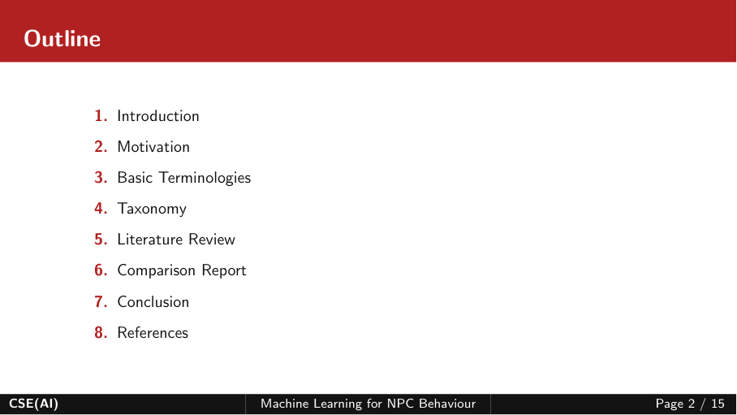
Outline
1.
Introduction
2.
Motivation
3.
Basic Terminologies
4.
Taxonomy
5.
Literature Review
6.
Comparison Report
7.
Conclusion
8.
References
CSE(AI)
Multimodal AI with Computer Vision
Page 2 / 15

Slide 3
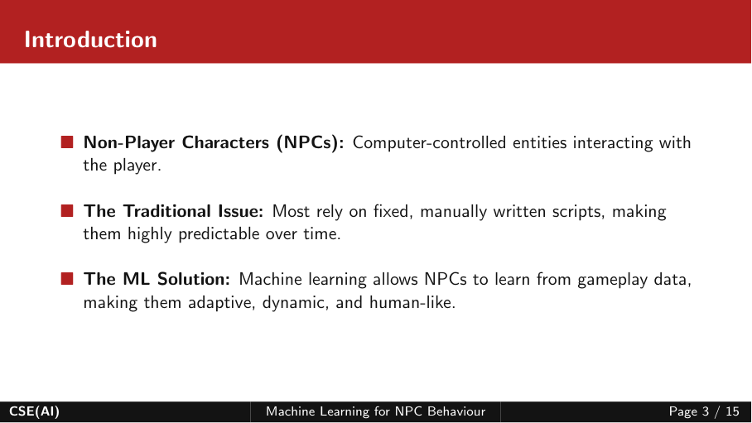
Introduction
■ Multimodal AI: AI systems that learn from and reason across multiple modalities such as text, images, audio and video.
■ Vision-Language Models: Models that connect visual information with language for tasks such as visual question answering and image understanding.
■ Computer Vision Link: Vision encoders extract visual features, while language models provide semantic understanding and reasoning.
Goal: Combine visual perception with language-based understanding and reasoning.
CSE(AI)
Multimodal AI with Computer Vision
Page 3 / 15

Slide 4
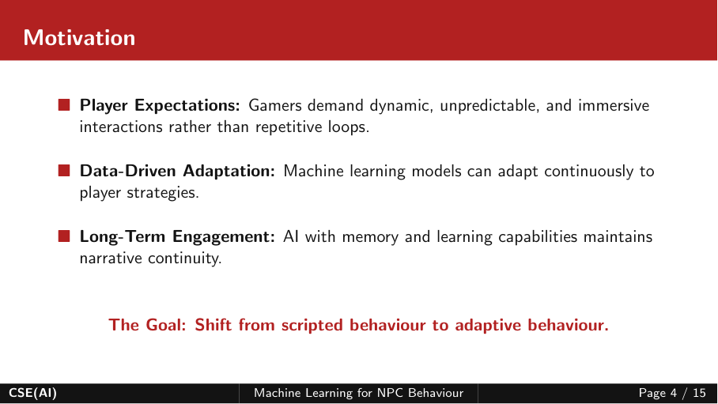
Motivation
■ Unified Understanding: Many real-world tasks require both visual evidence and language context.
■ Task Generalization: VLMs transfer knowledge across multiple visual recognition and multimodal tasks.
■ Better Visual Reasoning: Recent methods add depth, bounding-box or latent visual information when language alone is insufficient.
The Goal: Move from separate vision and language processing to integrated multimodal reasoning.
CSE(AI)
Multimodal AI with Computer Vision
Page 4 / 15

Slide 5
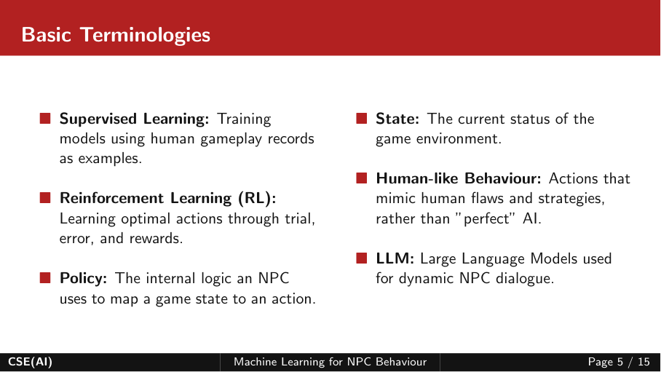
Basic Terminologies
■ VLM: Vision-Language Model combining image and text representations.
■ Vision Encoder: Network that converts an image into visual features or tokens.
■ Visual Token: Discrete representation of visual information used by a multimodal model.
■ Cross-Modal Alignment: Learning correspondence between visual and language features.
■ Zero-Shot Learning: Applying learned vision-language knowledge to a task without task-specific training.
■ Multimodal Reasoning: Using information from more than one modality to reach an answer.
CSE(AI)
Multimodal AI with Computer Vision
Page 5 / 15

Slide 6
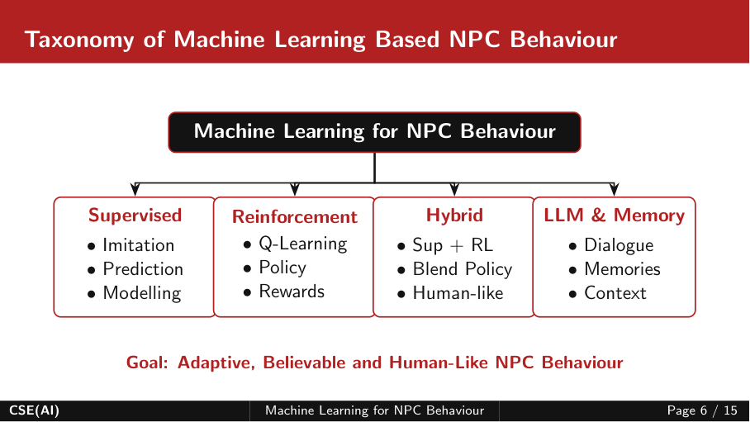
Taxonomy of Multimodal AI with Computer Vision
Multimodal AI with
Computer Vision
Vision-Language Models
• VQA
• Captioning
• Recognition
Perception-Enhanced
• Depth tokens
• Boxes
• Segmentation
Efficient VLMs
• Token sparsity
• Sparse attention
• KV compression
Latent Visual Reasoning
• Latent tokens
• Visual thoughts
• Spatial reasoning
Goal: Accurate, efficient and reasoning-capable multimodal visual intelligence.
Fig 1: Taxonomy of Multimodal AI with Computer Vision
CSE(AI)
Multimodal AI with Computer Vision
Page 6 / 15

Slide 7
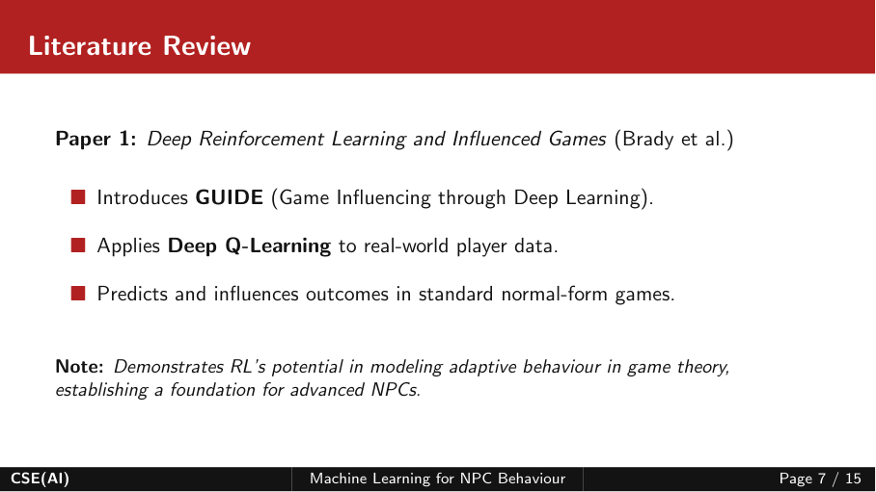
Literature Review
Paper 1: Vision-Language Models for Vision Tasks: A Survey
Web-scale
Image–Text Data
■ Scope: Systematic review of VLMs for image classification, object detection and semantic segmentation.
■ Foundations: Covers architectures, pre-training objectives, downstream tasks and widely used datasets.
■ Learning Strategies: Reviews VLM pre-training, transfer learning and knowledge distillation.
Vision–Language
Model
Visual Recognition
Tasks
Classification • Detection • Segmentation
Base Paper — provides the survey-level foundation for the topic.
Fig 2: Vision-Language Model Pipeline
CSE(AI)
Multimodal AI with Computer Vision
Page 7 / 15

Slide 8
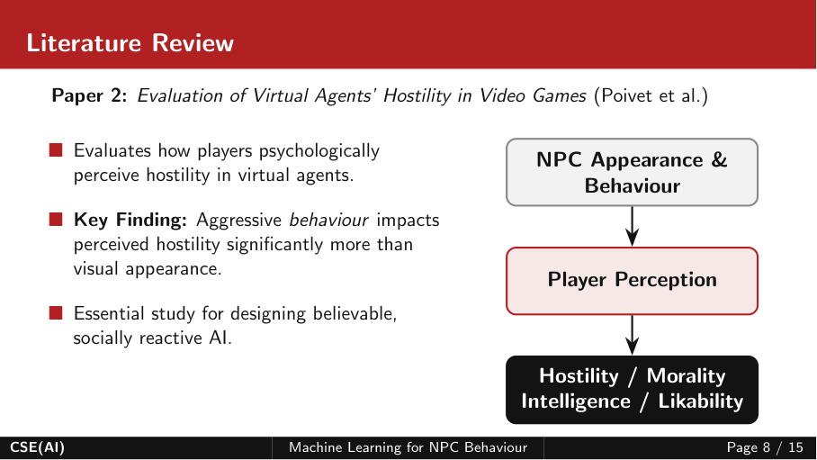
Literature Review
Paper 2: Perception Tokens Enhance Visual Reasoning in Multimodal Language Models
■ Problem: MLMs struggle with perception-heavy tasks such as depth reasoning and object counting.
■ Method: AURORA adds perception tokens representing depth maps and bounding boxes as intermediate reasoning steps.
■ Training: Uses VQVAE tokenization, multi-task learning and curriculum learning.
■ Results: Reported +6.4% on BLINK relative depth and +10.8%, +11.3%, +8.3% on BLINK, CVBench and SEED-Bench counting.
Image
Perception
Tokens
Visual
Reasoning
Fig 3: Perception Tokens for Visual Reasoning
CSE(AI)
Multimodal AI with Computer Vision
Page 8 / 15

Slide 9
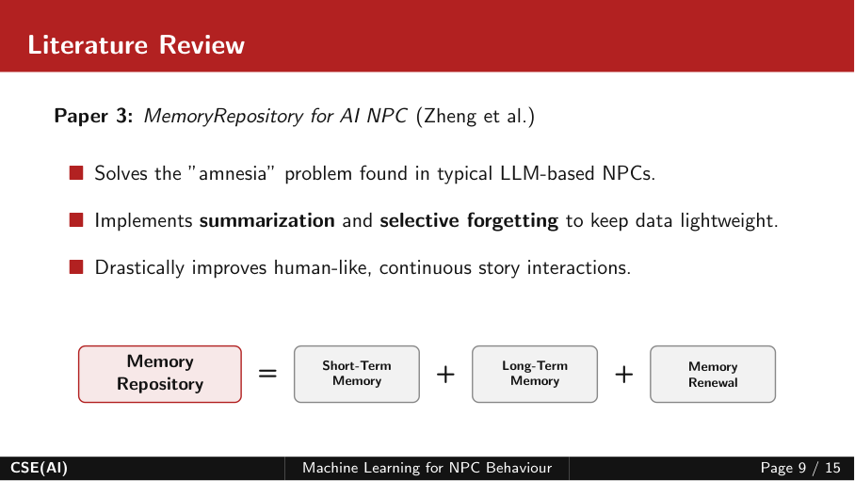
Literature Review
Paper 3: ZipVL: Accelerating Vision-Language Models through Dynamic Token Sparsity
■ Problem: High-resolution images and videos create many visual tokens, causing prefill compute and decoding memory bottlenecks.
■ Method: Dynamically allocates important-token ratios layer by layer using attention-score distributions.
■ Optimization: Selected important tokens drive sparse attention and KV-cache compression.
■ Results: Reported 2.3× prefill acceleration and 2.8× decoding throughput improvement, with 0.5% accuracy reduction on VQAv2 for LLaVA-Next-13B.
Attention
Scores
Dynamic
Ratio
Important
Tokens
Sparse Attention
+ KV Cache
Adaptive token sparsity improves efficiency while retaining important visual information.
Fig 4: Dynamic Token Sparsity and KV Cache Compression
CSE(AI)
Multimodal AI with Computer Vision
Page 9 / 15

Slide 10
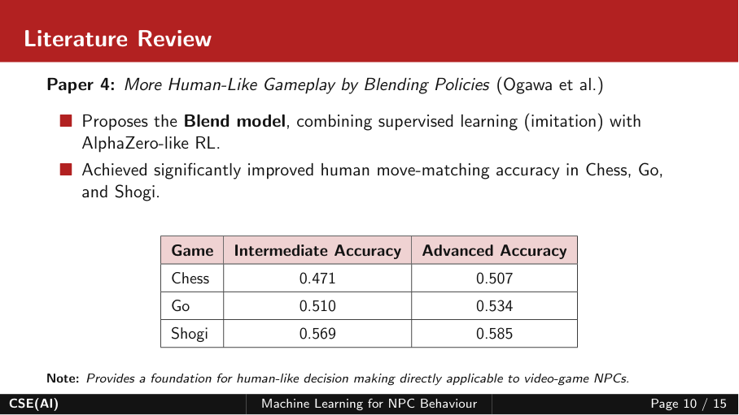
Literature Review
Paper 4: Machine Mental Imagery: Machine Mental Imagery: Empower Multimodal Reasoning with Latent Visual Tokens Tokens
Text
■ Problem: Text-only decoding can limit VLMs on tasks requiring visual imagination and spatial reasoning.
■ Mirage: Interleaves compact latent visual tokens with ordinary text without generating pixel-level images.
■ Training: Two-stage supervision anchors latent tokens to visual embeddings, then text-only supervision lets them adapt; RL further refines reasoning.
■ Results: Experiments report consistent gains across spatial reasoning benchmarks and transfer to smaller VLMs.
<latent>
visual cue
Text
Answer
Compact visual cues are woven into the reasoning trajectory.
Fig 5: Latent Visual Tokens in Multimodal Reasoning
CSE(AI)
Multimodal AI with Computer Vision
Page 10 / 15

Slide 11
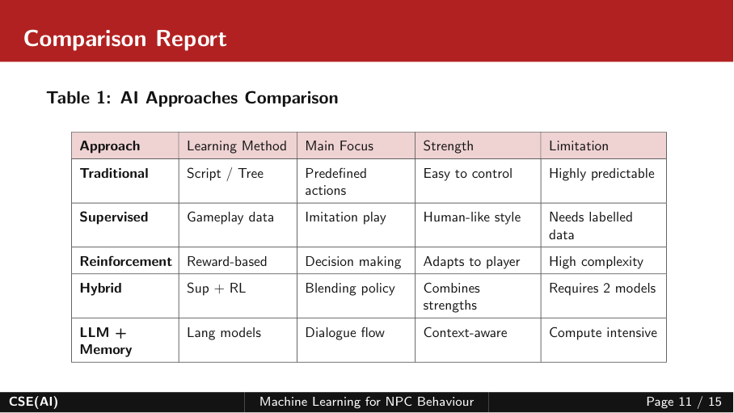
Comparison Report
Paper / Approach | Main Focus | Key Technique | Reported Result / Contribution | Main Scope
Vision-Language Models for Vision Tasks: A Survey | VLM for vision tasks | Pre-training, transfer, distillation | Systematic taxonomy and research directions | Visual recognition
Perception Tokens Enhance Visual Reasoning in Multimodal Language Models | Visual reasoning | AURORA + perception tokens | Depth and counting improvements | 2D / 3D perception
Accelerating Vision-Language Models through Dynamic Token Sparsity | Inference efficiency | Dynamic token sparsity + KV compression | 2.3× prefill; 2.8× decoding | Image / video LVLMs
Machine Mental Imagery: Empower Multimodal Reasoning with Latent Visual Tokens | Multimodal reasoning | Latent visual tokens + 2-stage training | Consistent gains on spatial reasoning | Interleaved visual-text reasoning
CSE(AI)
Multimodal AI with Computer Vision
Page 11 / 15

Slide 12
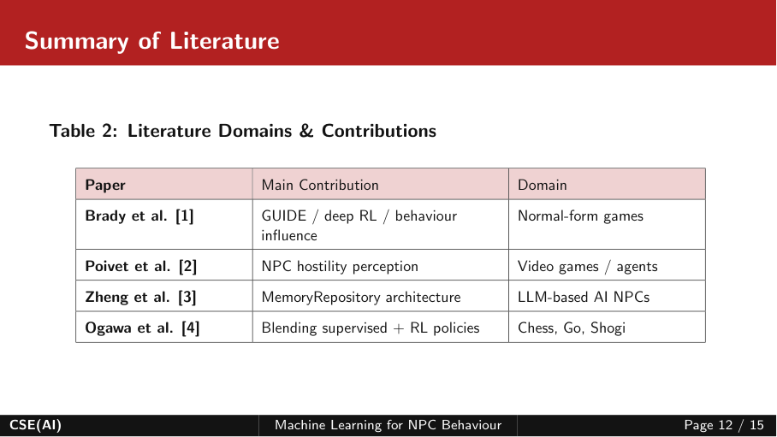
Literature Summary & Research Gap
Paper | Main Contribution | Domain
Vision-Language Models for Vision Tasks: A Survey | Systematic VLM taxonomy and research directions | Visual recognition
Perception Tokens Enhance Visual Reasoning in Multimodal Language Models | AURORA perception-token reasoning | Depth and object counting
Accelerating Vision-Language Models through Dynamic Token Sparsity | Dynamic token sparsity for efficient LVLM inference | Image and video understanding
Machine Mental Imagery: Empower Multimodal Reasoning with Latent Visual Tokens | Latent visual tokens for multimodal reasoning | Spatial / multimodal reasoning
Research gap: current approaches address perception, inference efficiency, and visual reasoning through different mechanisms.
Overall direction: richer visual representations + efficient multimodal reasoning.
CSE(AI)
Multimodal AI with Computer Vision
Page 12 / 15

Slide 13
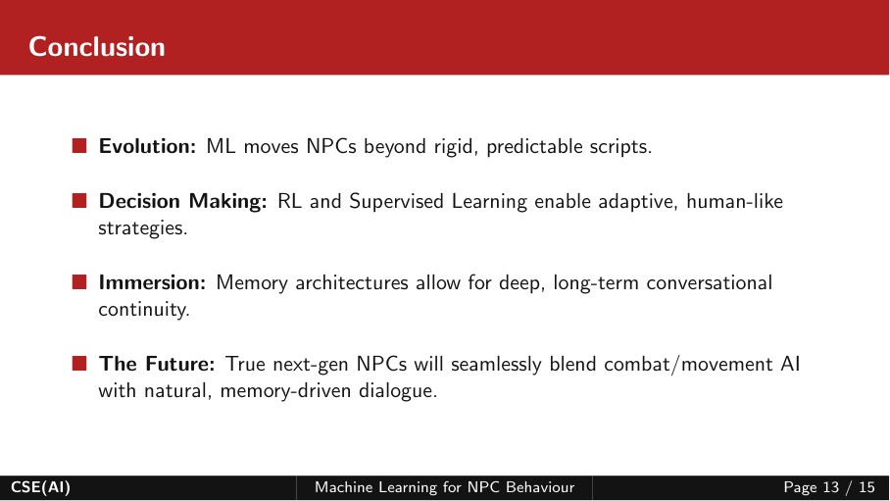
Conclusion
■ Integration: Multimodal AI connects computer vision with language-based understanding.
■ Perception: Perception tokens provide intermediate visual information such as depth and bounding boxes.
■ Efficiency: Dynamic token sparsity reduces computation and KV-cache memory for large vision-language models.
■ Reasoning: Latent visual tokens allow compact visual cues to participate directly in multimodal reasoning.
Key takeaway: the field is moving toward multimodal systems that can perceive, reason and generate more efficiently.
CSE(AI)
Multimodal AI with Computer Vision
Page 13 / 15

Slide 14
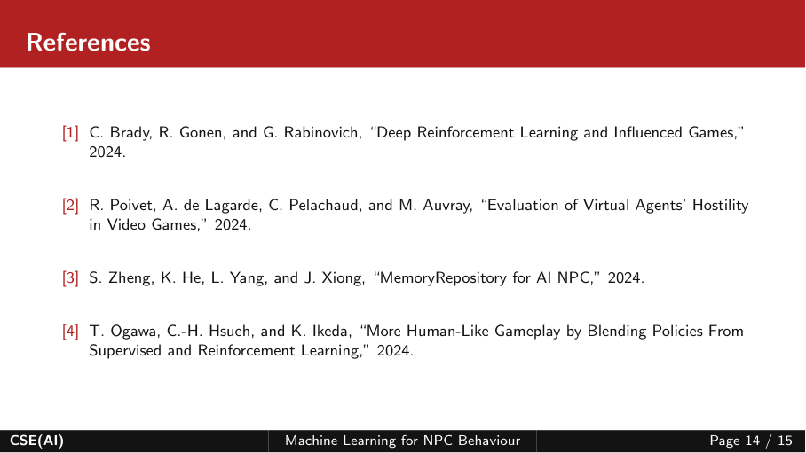
References
[1]
Z. Yang, X. Yu, D. Chen, M. Shen, C. Gan, “Machine Mental Imagery: Empower Multimodal Reasoning with Latent Visual Tokens,” CVPR, 2026.
[2]
M. Bigverdi, Z. Luo, C.-Y. Hsieh, E. Shen, D. Chen, L. G. Shapiro, R. Krishna, “Perception Tokens Enhance Visual Reasoning in Multimodal Language Models,” CVPR, 2025.
[3]
Y. He, F. Chen, J. Liu, W. Shao, H. Zhou, K. Zhang, B. Zhuang, “ZipVL: Accelerating Vision-Language Models through Dynamic Token Sparsity,” ICCV, 2025.
[4]
J. Zhang, J. Huang, S. Jin, S. Lu, “Vision-Language Models for Vision Tasks: A Survey,” IEEE TPAMI, 46(8), 5625–5644, 2024.
CSE(AI)
Multimodal AI with Computer Vision
Page 14 / 15

Slide 15
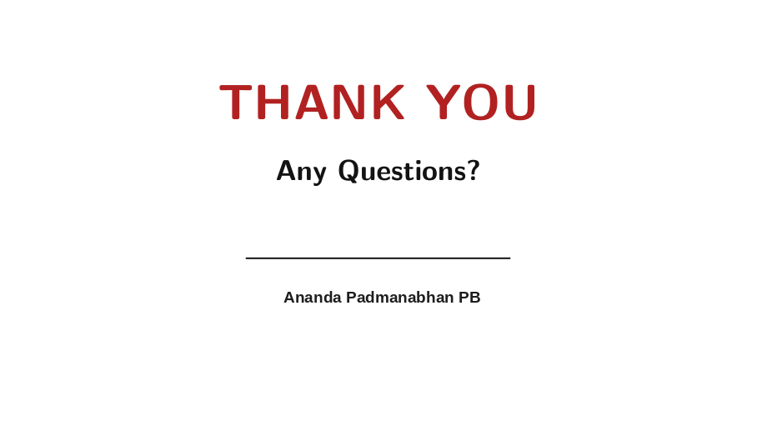
THANK YOU
Any Questions?

