Slide 1
Classification and Feature Selection
Relevance vs. “Predictiveness”
Stefano Monti
Thu. Mtg. 8/3/06

Slide 2
Synopsis
Feature selection beyond classification.
  for identification of relevant genes
  for dimensionality reduction
  for classification.
Beyond univariate feature selection.
  Step-wise (greedy) feature selection (SWFS)
  Arcing classifiers
    Random and non-random forests
    Naïve-Bayes’ ensembles
    …
Evaluation on simulated and real data
Notes:
Alternative for extracting “relevant” dimensions: data projection and dimensionality reduction

Slide 3
Motivation
We are still mostly using feature selection methods based on univariate scores (SNR, t-score, etc.)
  Variable interaction is not modeled.
  Possibly miss co-dependent features (e.g., noisy and-gate)
Identification of markers w/ large interaction effects but small marginal effects.
…
Notes:
When genes/features have large interaction effects but small marginal effects, they are unlikely to be ranked high by standard univariate scores such as t-score, SNR, etc.

Slide 4
Classification feature/gene selection
Univariate features selection:
  Select top n genes/class (by t-score, SNR, correlation, etc.)
  Same as for differential analysis.
Cons
  Selection of redundant features.
  Cannot capture feature interaction.
Pros
  Selection of redundant features.
  Simple and fast.

Slide 5
Classification feature/gene selection
Step-wise feature selection (greedy search)
    Begin (input: dataset D_{m,n+1})
    Feature set G=Ø, predictive score S(D,G)
    Repeat:
      Find feature g_{best} = argmax_{g} [S(D,g∪G)]
      Add feature: G=g_{best}∪G
      Find feature g_{best} = argmax_{g} [S(D,G ─ g)]
      Delete feature: G=G ─ g_{best}
    Until no more improvement
    End
Pros/Cons complementary to 1st approach.
Forward step
Backward step

Slide 6
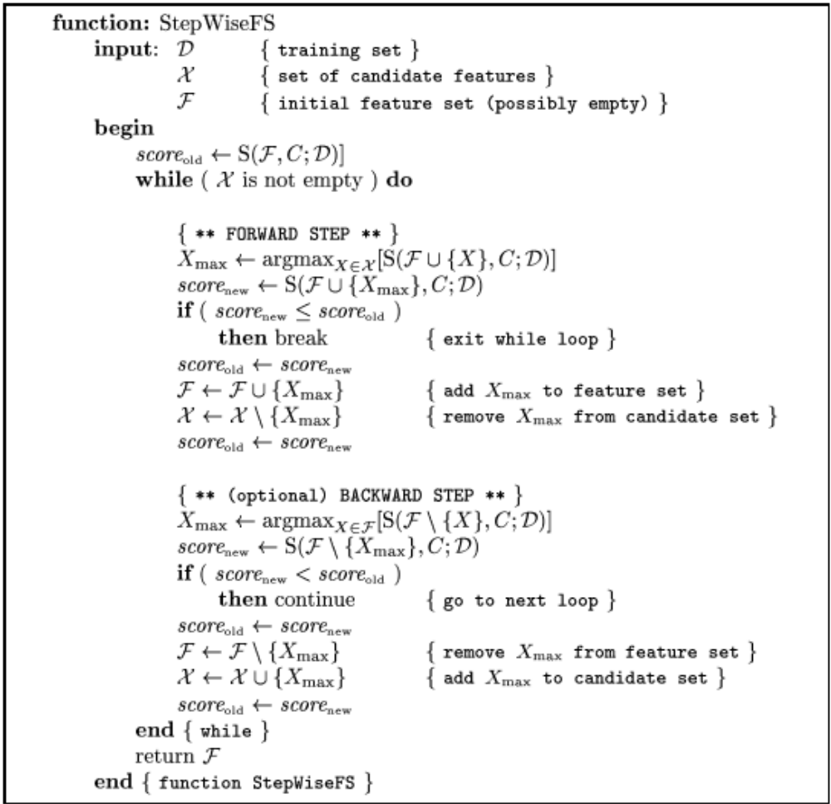
Step-wise Feature Selection greedy search

Slide 7
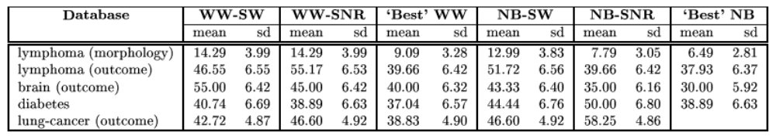
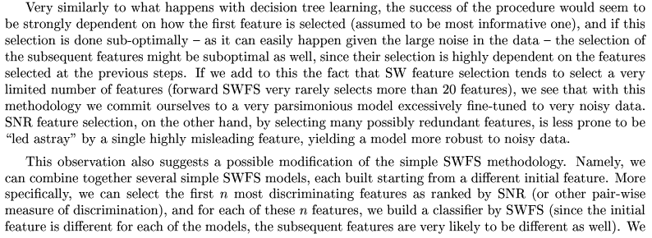
Some old results
Comparison of naïve‑Bayes classification results with different feature selection methods
Notes:
Very similarly to what happens with decision tree learning, the success of the procedure would seem to be strongly dependent on how the first feature is selected (assumed to be the most informative one), and if this selection is done sub-optimally – as it can easily happen given the large noise in the data – the selection of subsequent features might be suboptimal as well, since their selection is highly dependent on the features selected at the previous steps. If we add to this the fact that SW feature selection tends to select a very limited number of features (forward SWFS very rarely selected more than 20 features), we see that this methodology…

Slide 8
Arcing classifiers

Slide 9
Classification Trees

Slide 10
Classification Forest

Slide 11
Random Forest

Slide 12
Naïve-Bayes ensemble

Slide 13
Simulated data
Simulating interacting genes
Notes:
Variable importance: for each tree, the prediction accuracy on the out-of-bag portion of the data is recorded. Then the same is done after permuting each predictor variable. The difference between the two accuracies are then averaged over all trees, and normalized by the standard error. For regression, the MSE is computed on the out-of-bag data for each tree, and then the same computed after permuting a variable.

Slide 14
Evaluation
Differential analysis vs. multivariate feature selection
Classification accuracy (and calibration) on real data:
  Simple Classification Tree
  Classification forests
    w/ bootstrapping
    w/ feature elimination (first, all)
    w/ boostrapping + random (Random Forests)
  Naïve-Bayes w/ univariate feature selection (by t-score)
  Simple stepwise-fs naïve-Bayes.
  Naïve-Bayes ensemble
    w/ bootstrapping
    w/ feature elimination (first, all)
    w/ bootstrapping + random (equivalent to Random Forests)

Slide 15
Experimental evaluation what to evaluate?
Classification performance:
  Accuracy (zero-one loss, ROC, TPR, TNR,…)
  Calibration (log-score, breier statistics, …)
Relevance and “coverage”:
  discovery of relevant genes (very elusive)

Slide 16
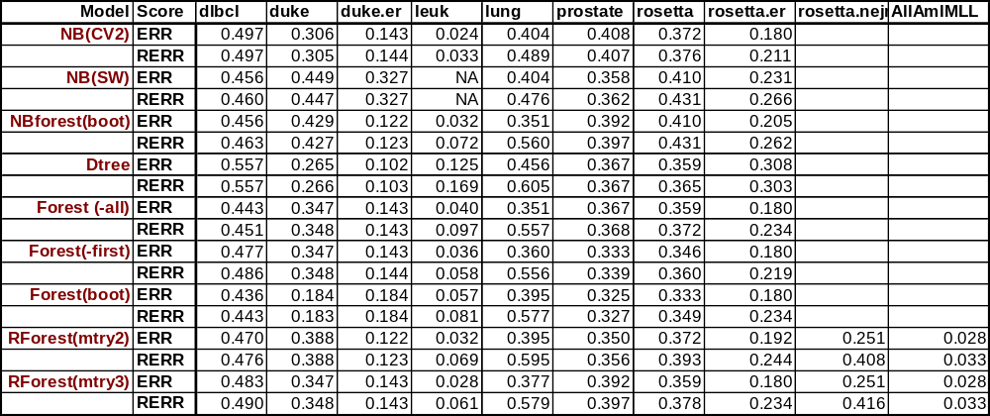
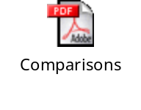
Experimental Summary

Slide 17
Naïve-Bayes ensemble extension

