Slide 1
Mental Health in the US
By: Brian, Hugo, Mukta

Slide 2
Objectives
Study the prevalence of mental health issues in US and compare it with various socio-economic factors.
Severity of mental health issues in various states in the US
% Population with mental health issues
Suicide Rates
Disposable Income
GDP
Unemployment
Poverty
Presence of medical coverage

Slide 3
Data sources
BEA (Bureau of Economic Analysis):
Personal income
GDP
CDC (Center for Disease Control and Prevention):
Suicide rates
US Census Data
Unemployment
Poverty status
Home ownership
Medical coverage status
Data.gov:
Severity of mental illness by state
SAMHDA (Substance Abuse and Mental Health Data Archive):
Mental illness by state

Slide 4
Challenges
Data cleaning
Syntax familiarity
Learning new libraries
Finding data we can actually work with
Using API
Interpreting statistics

Slide 5
Interactive map of Mental Health in the US by State
Link
States with highest severity:
Oregon
Alabama
Kentucky

Slide 6
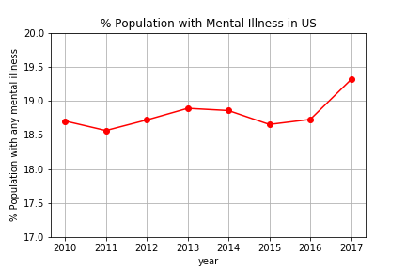
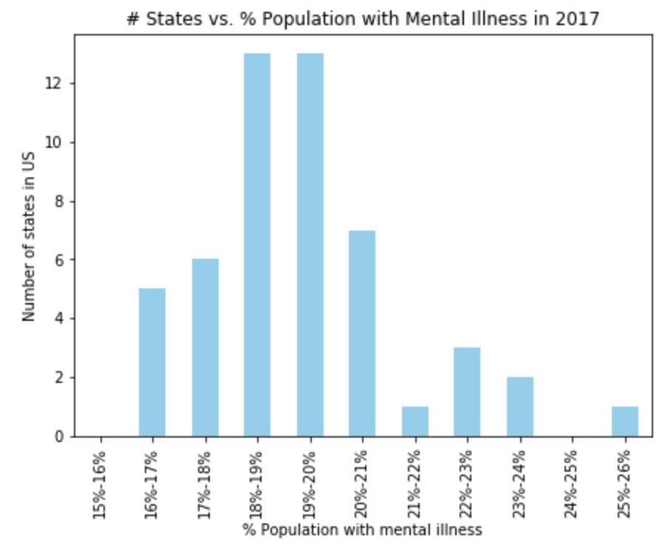
Mental Illness in US
Overall, approx. 1 in 5 adults in US experience mental illness in a year.

Slide 7
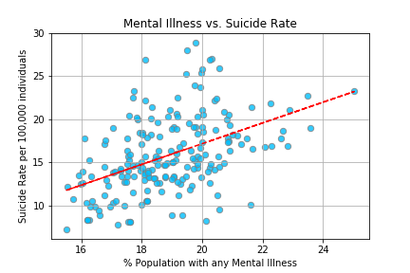
Mental Illness and Suicide Rates
States with higher percentage of population with mental illnesses have higher suicide rates.
Correlation coefficient: 0.46

Slide 8
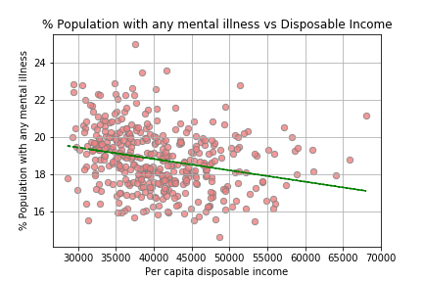
Mental Illness and Income
Weak negative correlation- States with higher income have lower percentage of population with mental illness.
Correlation coefficient:
-0.25

Slide 9
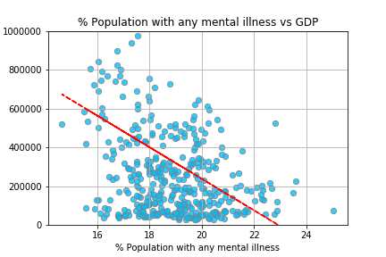
Mental Illness and GDP
Weak negative correlation- States with lower percentage of population with mental illness have higher GDP.
Correlation coefficient:
-0.31

Slide 10
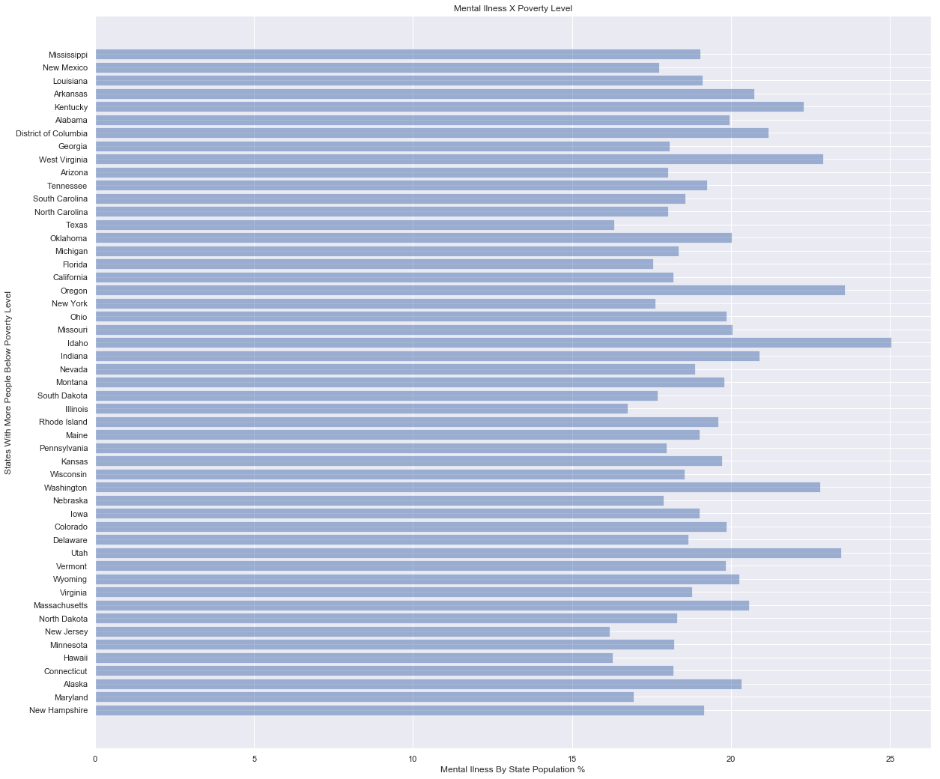
Mental Illness and Poverty
States with greater poverty are NOT [necessarily] states with higher rates of mental illness

Slide 11
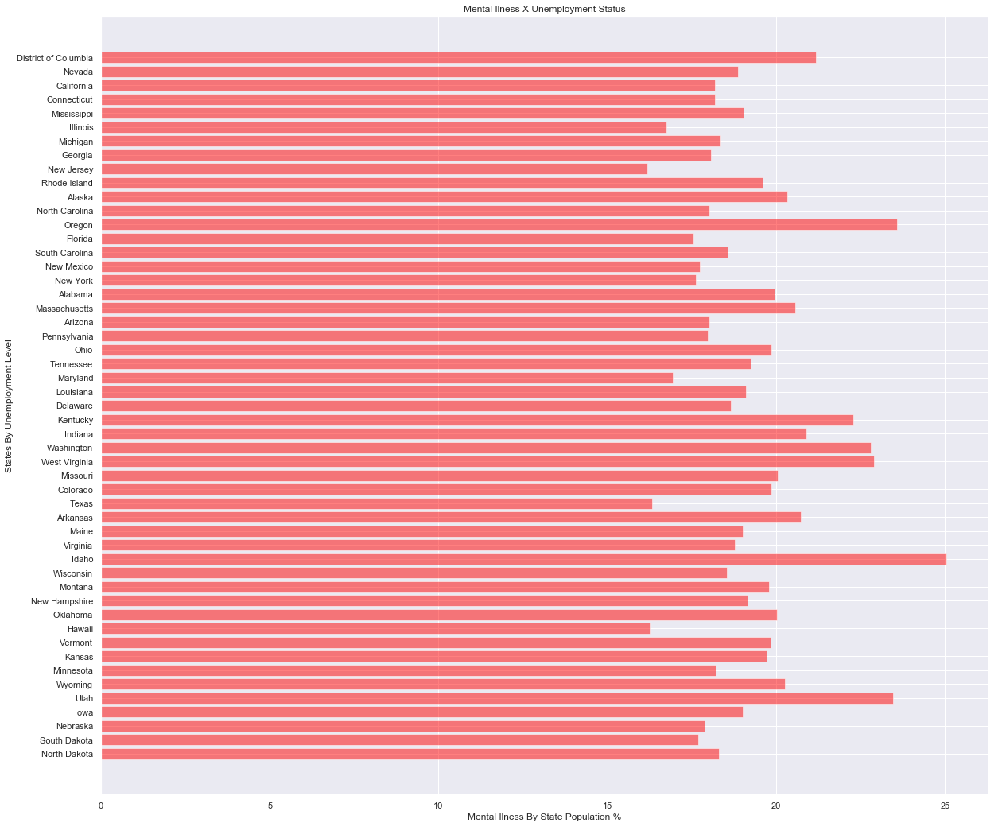
Mental Illness and Employment
States with greater unemployment are NOT [necessarily] states with higher rates of mental illness

Slide 12
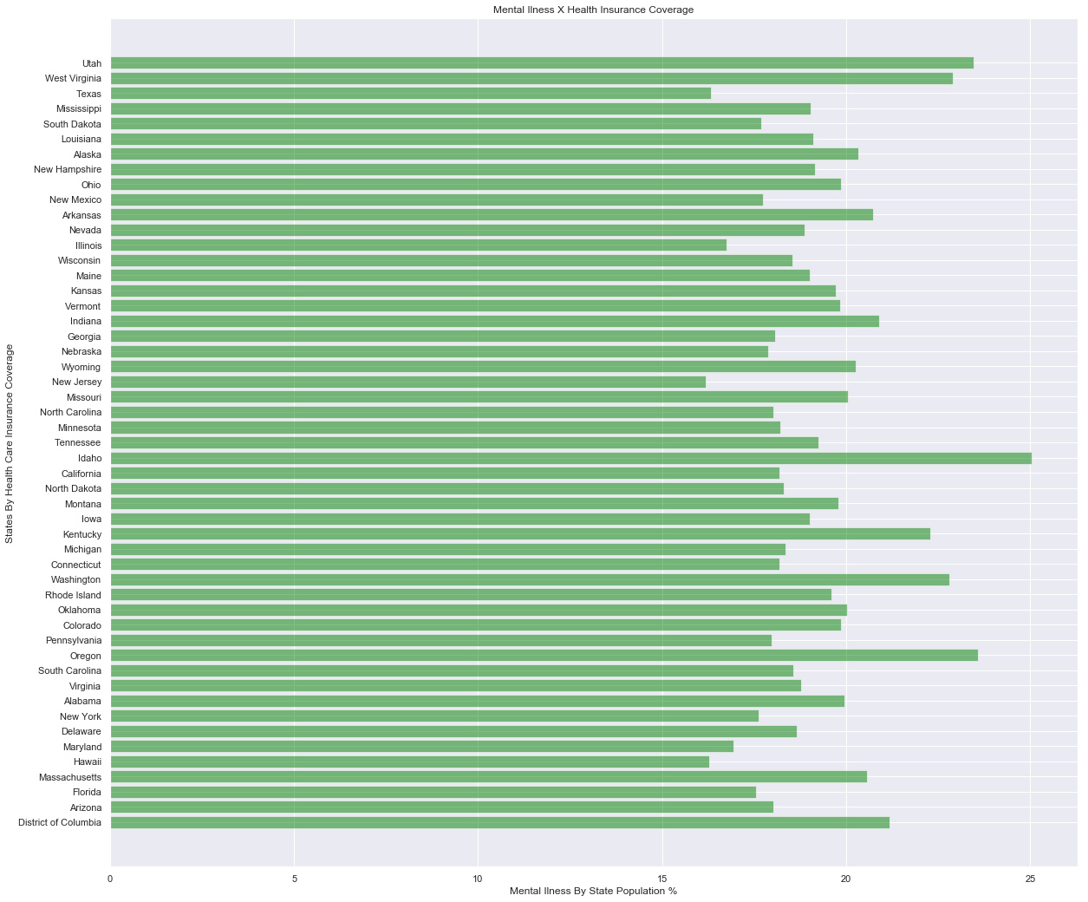
Mental Illness and Health Insurance
States with greater uninsured are NOT [necessarily] states with higher rates of mental illness

