Slide 1
Truthy vs Falsy Values?
Python’s inherent ‘truth values’: Pythonic gatekeeper & filtering ‘Ops
Falsy Values — evaluate to False
Truthy Values — evaluate to True
?
?
Using bool(x) converts any object to True or False
Notes:
Now, this is probably the most important slide in the entire presentation, because everything about all() and any() depends on understanding truthy and falsy values.
In Python, every single object has an inherent truth value. When Python needs to evaluate something as True or False — like in an if statement — it uses these rules.
On the left, you can see all the falsy values: None, the boolean False, zero in any numeric type, and any empty collection — empty string, empty list, empty tuple, empty dict, empty set, and empty range.
On the right, everything else is truthy. Any non-zero number, any non-empty string — even a string with just a space counts — any non-empty collection, and custom objects by default.
The underlying mechanism is simple: Python calls bool() on the value. bool() converts anything to True or False, and both all() and any() use this under the hood.
Memorize the falsy values list — it's short and it will save you from a lot of bugs.

Slide 2
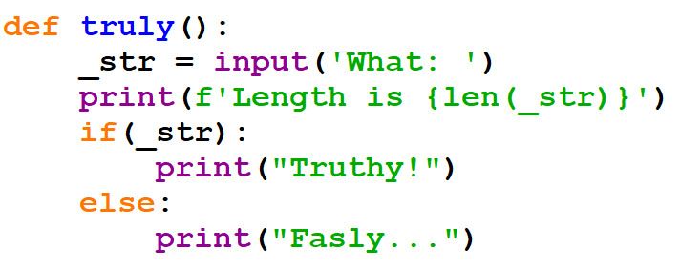
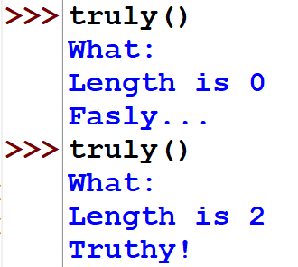

Slide 3
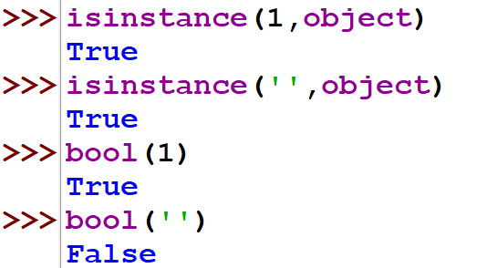

Slide 4
Truthy vs Falsy Values?
Python’s inherent ‘truth values’: The key to understanding gatekeeper & filtering ‘Ops
Falsy Values — evaluate to False
Truthy Values — evaluate to True
None the null object
False the boolean False
0 0.0 zero in any numeric type
"" empty string
{}[]() any empty collections
range(0) empty range (et al.)
True the boolean True
1 -3 3.14 any non-zero number
"hello" " " any non-empty string
[1, 2] [0] any non-empty list
{"a": 1} any non-empty dict
object() custom objects (by default)
lambda: ... functions and classes
Everything not in the falsy list is truthy!
Using bool(x) converts any object to True or False
Notes:
Now, this is probably the most important slide in the entire presentation, because everything about all() and any() depends on understanding truthy and falsy values.
In Python, every single object has an inherent truth value. When Python needs to evaluate something as True or False — like in an if statement — it uses these rules.
On the left, you can see all the falsy values: None, the boolean False, zero in any numeric type, and any empty collection — empty string, empty list, empty tuple, empty dict, empty set, and empty range.
On the right, everything else is truthy. Any non-zero number, any non-empty string — even a string with just a space counts — any non-empty collection, and custom objects by default.
The underlying mechanism is simple: Python calls bool() on the value. bool() converts anything to True or False, and both all() and any() use this under the hood.
Memorize the falsy values list — it's short and it will save you from a lot of bugs.

Slide 5
Evaluation Framework
The priority chain Python follows when bool() is called on any object
bool(obj)
__bool__?
Use __bool__
Highest priority
No
__len__?
Use __len__
0 = falsy
No
Default: True
Totally Pythonic Logic!
Notes:
Let's put it all together with this priority chain diagram. When Python calls bool() on any object, it follows three steps in order.
Step one: does the object have a __bool__ method? If yes, use it. This has the highest priority. That's our Wallet example.
Step two: if there's no __bool__, does it have __len__? If yes, use that — length zero means falsy, anything else means truthy. That's our Playlist example.
Step three: if neither __bool__ nor __len__ exists, the object defaults to True. A plain object() with no special methods is always truthy.
This chain isn't just used by all() and any() — it applies everywhere in Python: if/else statements, while loops, filter(), and boolean operators like 'and' and 'or'.
Understanding this chain means you'll never be surprised by how Python evaluates truthiness.

Slide 6
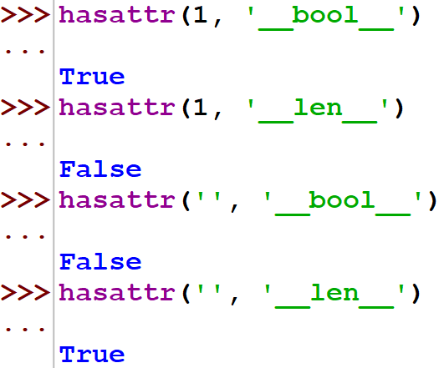

Slide 7
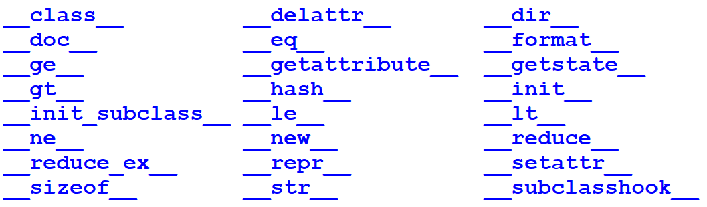
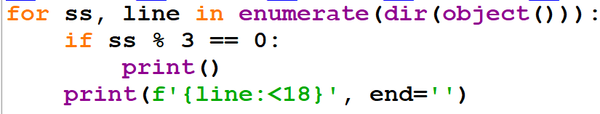

Slide 8
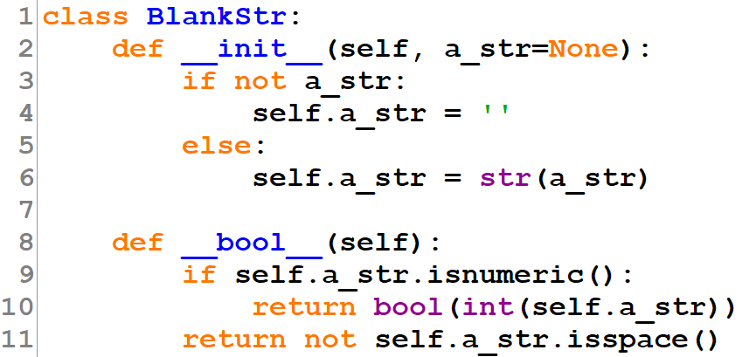
D.I.Y Truth: __bool__
Classes can define their own truth value by implementing __bool__ (or __len__)
Fallback: if __bool__ is not defined, Python checks __len__ — an object with length 0 is falsy
Notes:
Here's something really powerful: you can define your own truth rules for custom classes by implementing the dunder bool method.
Look at this Wallet class. We've defined __bool__ to return True when the balance is greater than zero, and False otherwise.
So when you write bool(Wallet(50)), Python calls the __bool__ method, sees the balance is 50, and returns True. bool(Wallet(0)) returns False.
And here's the beautiful part — this works seamlessly with all() and any(). If you have a list of wallets and call all() on them, Python checks each wallet's __bool__ method.
In the example, a list of wallets all with positive balances returns True for all(). But mix in a wallet with zero balance, and all() returns False while any() still returns True.
There's also a fallback: if you don't define __bool__, Python will check for __len__ instead. We'll cover that next.

Slide 9
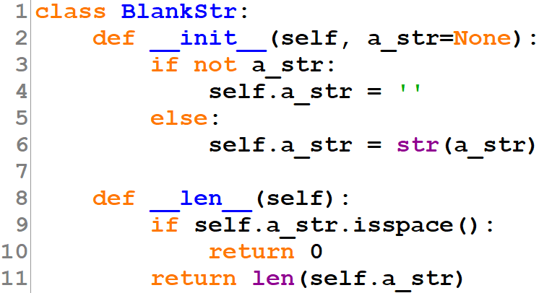
The __len__ Fallback
When __bool__ isn't defined, Python uses __len__ to determine truth value
No __bool__? Python falls back to __len__ — if length is 0, the object is falsy; otherwise truthy
Notes:
This slide shows the __len__ fallback mechanism. When your class doesn't define __bool__, Python looks for __len__ as a backup.
Here's a Playlist class that only defines __len__. It returns the number of songs in the playlist.
The rule is straightforward: if __len__ returns zero, the object is falsy. If it returns anything greater than zero, the object is truthy.
So a playlist with two songs — bool() gives True. An empty playlist — bool() gives False.
This is why empty lists, empty strings, and empty dicts are all falsy — they all have length zero!
And just like with __bool__, this integrates perfectly with all() and any(). A list of non-empty playlists passes all(). Mix in an empty one, and all() fails but any() still succeeds.
The key takeaway: Python gives you fine-grained control over how your objects behave in boolean contexts.

Slide 10
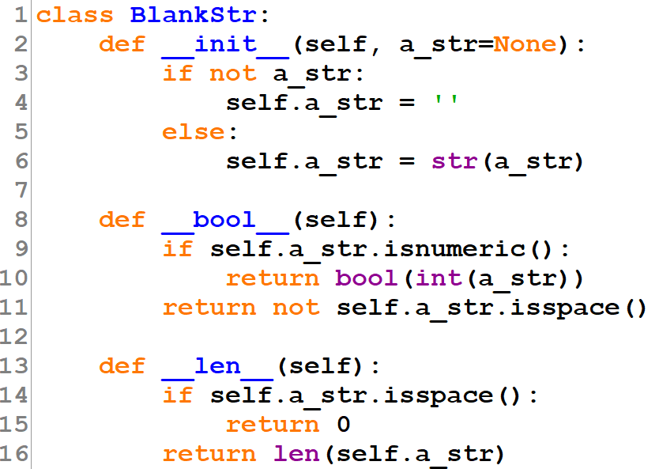
Classic “Wrapper Class”

Slide 11
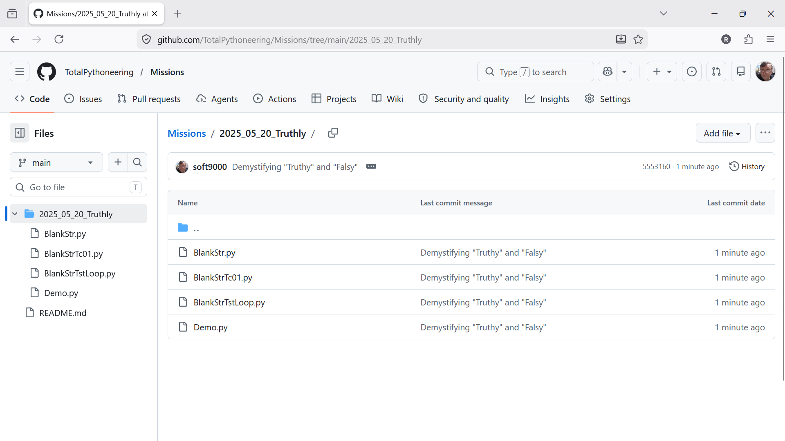

Slide 12
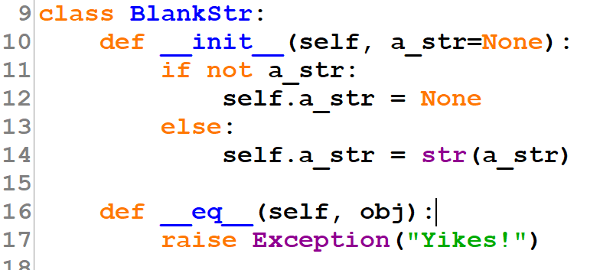
Caveat: “Operator Overloading”

Slide 13
Thank You!
Go write something Truthy!
Questions? Let's discuss!
Notes:
Thank you all for attending today's session on all() and any()!
I hope you now feel confident using these two powerful built-in functions in your own code.
The best way to solidify this knowledge is to practice: go refactor some existing code that uses for loops with boolean flags, and see if you can replace them with all() or any().
Are there any questions? I'm happy to discuss specific use cases, edge cases, or anything else related to what we covered today.
If you'd like to dive deeper, I recommend checking out the Python documentation for built-in functions — there are plenty of other gems in there beyond all() and any().

Slide 14
class BlankStr:
def __init__(self, a_str=None):
if not a_str:
self.a_str = None
else:
self.a_str = str(a_str)
##
## def __bool__(self):
## if not self.a_str: return False
## if self.a_str.isnumeric():
## return bool(int(self.a_str))
## return not self.a_str.isspace()
def __len__(self):
if not self.a_str:
return 0
if self.a_str.isspace():
return 0
return len(self.a_str)
if bool(BlankStr(0)) == True: print("Error 001")
if bool(BlankStr(0j)) == True: print("Error 002")
if bool(BlankStr(0.0)) == True: print("Error 003")
if bool(BlankStr(0x00)) == True: print("Error 004")
if bool(BlankStr(' ')) == True: print("Error 005")
if bool(BlankStr('\n')) == True: print("Error 006")
if bool(BlankStr(' \t')) == True: print("Error 007")
if bool(BlankStr(1)) == False: print("Error 011")
if bool(BlankStr(1j)) == False: print("Error 012")
if bool(BlankStr(0.001)) == False: print("Error 013")
if bool(BlankStr(0x000001)) == False: print("Error 014")
if bool(BlankStr('?')) == False: print("Error 015")
if bool(BlankStr(' ')) != False: print("Error 016")
if bool(BlankStr('\n')) != False: print("Error 017")
if bool(BlankStr('\t')) != False: print("Error 018")
print("Testing Success")
##while True:
## if input("Which: "):
## print("is true")
## else:
## print("is false")
##
##while True:
## if bool(BlankStr(input("Which: ")):
## print("Truly")
## else:
## print("Flasy")

