Slide 1

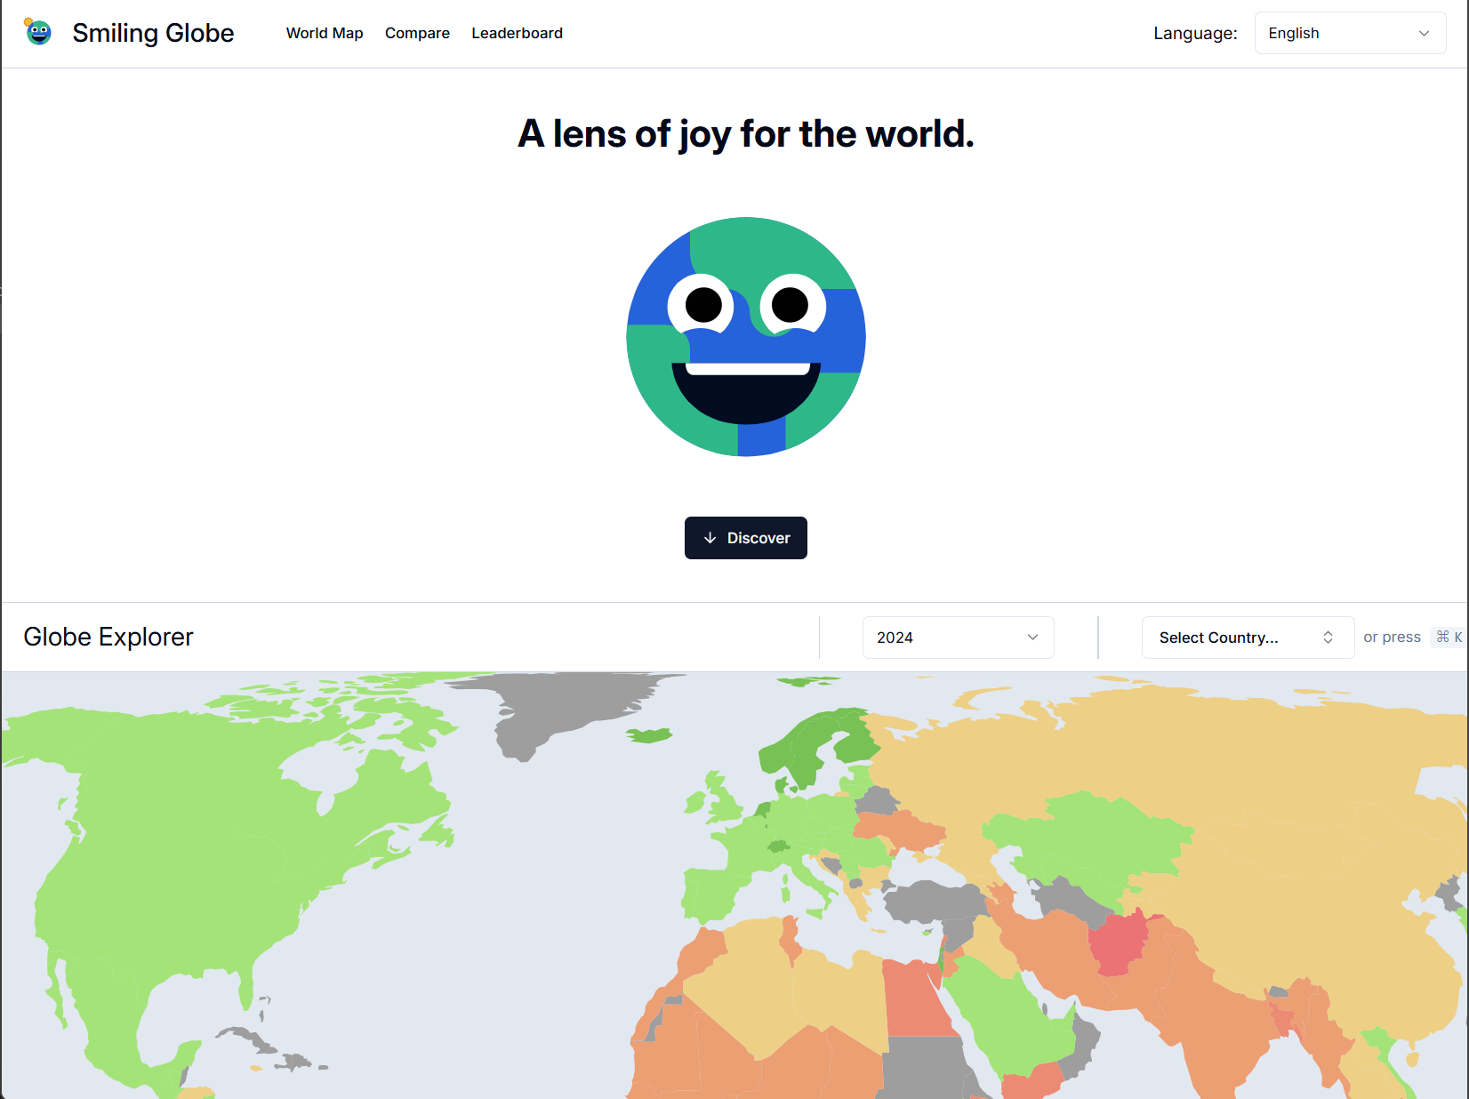

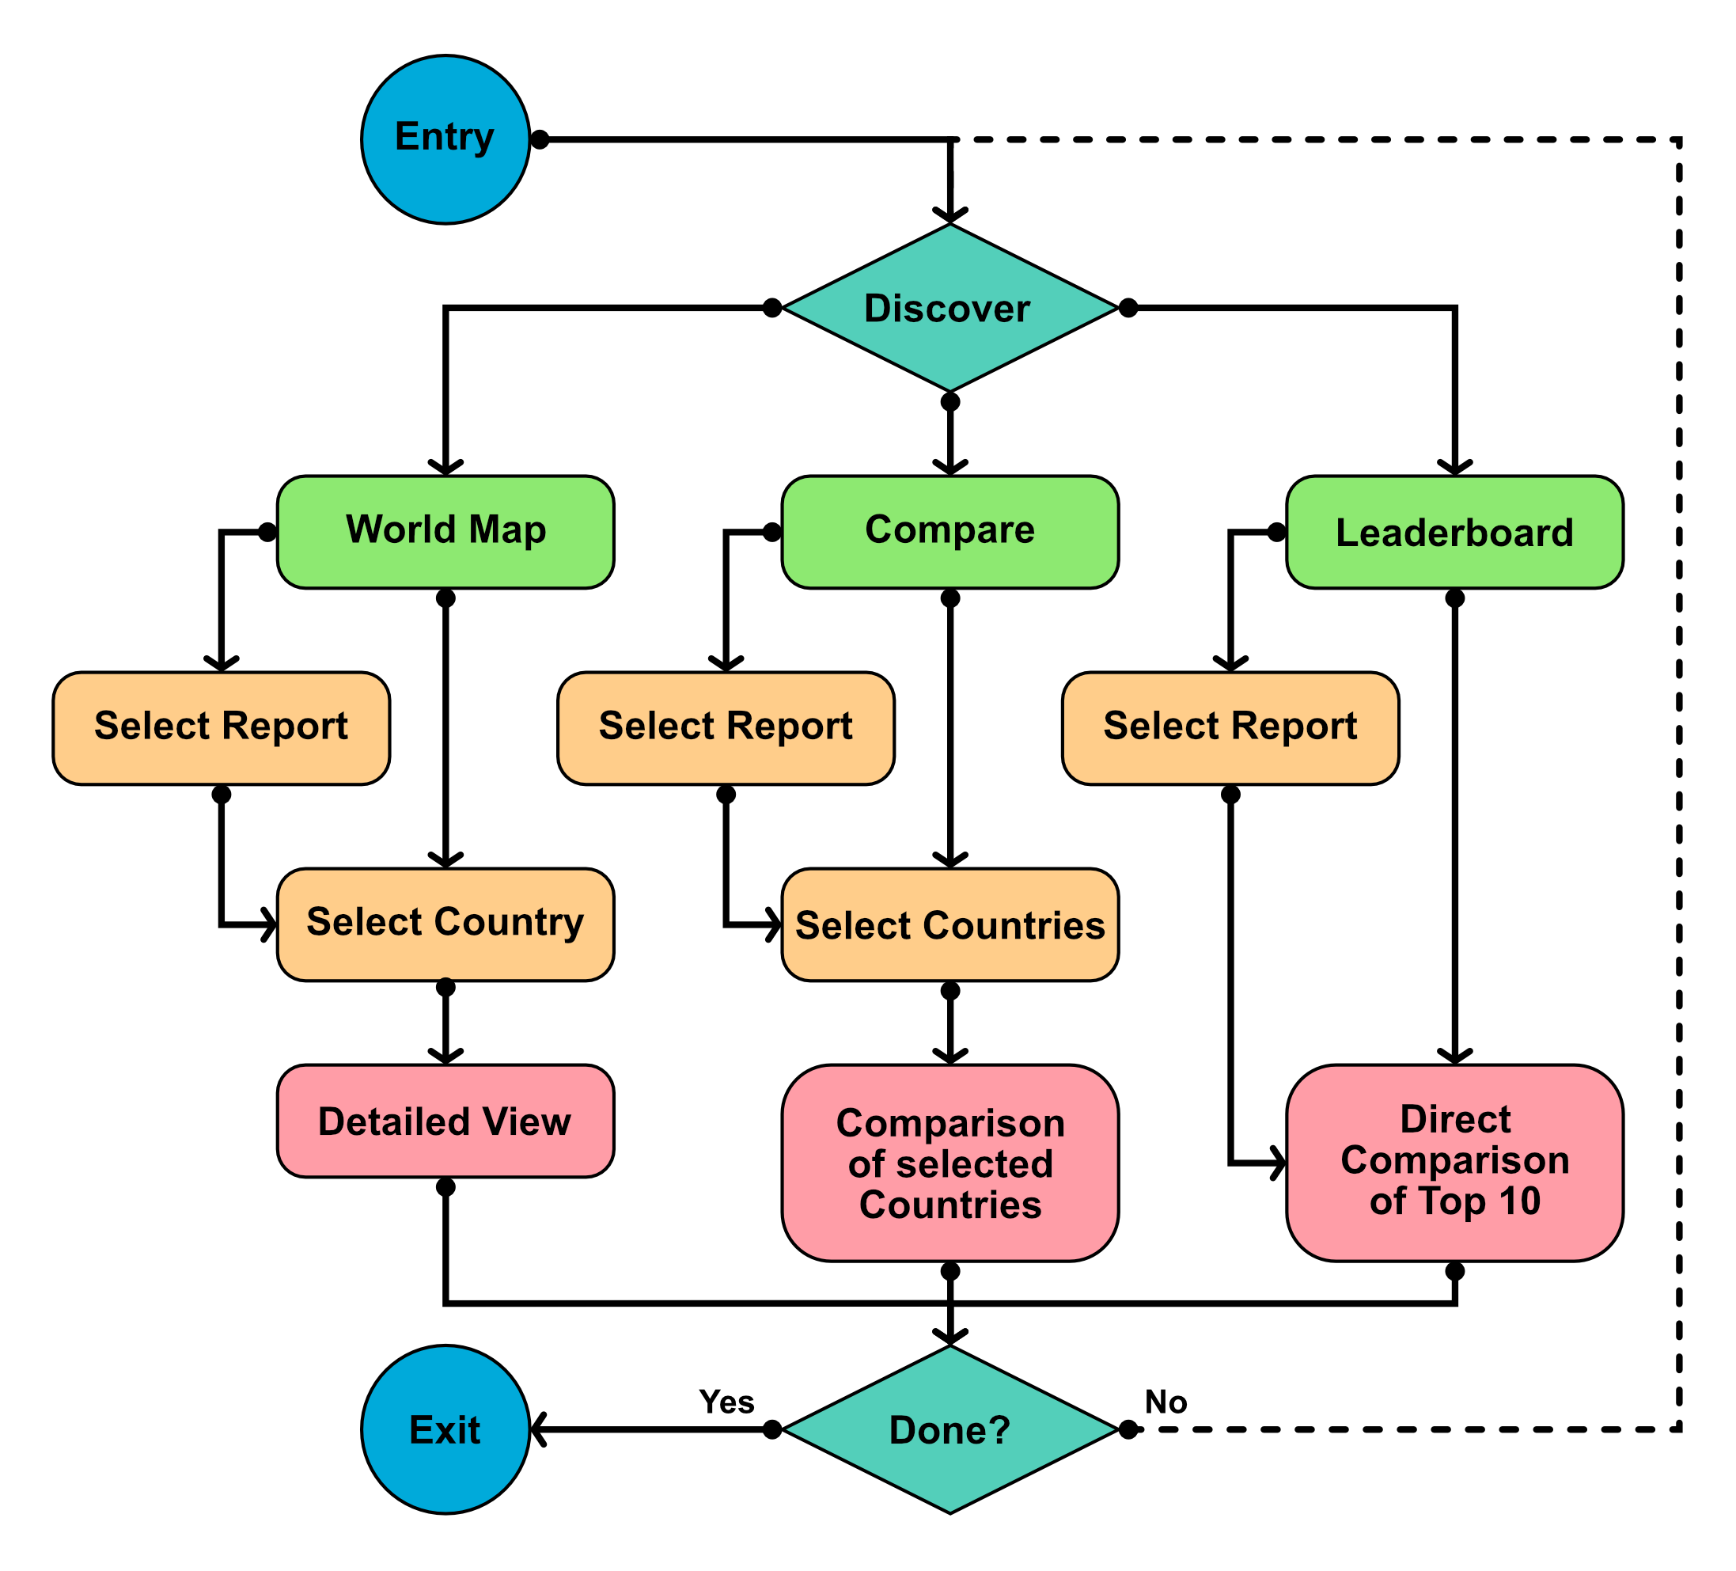



Smiling Globe
Tamás Nemes, Tianjian Yi, Ian Wimmer, Rui Zhang
D-INFK, ETH Zürich
1 Introduction
4 Interface
A lens of joy for the world. With this motto in mind, we have developed Smiling Globe, an interactive, responsive and accessible website designed for individuals seeking a comprehensive overview of happiness across the globe. Using the World Happiness Index, we ranked countries based on their happiness scores, providing an engaging experience through a dynamic map where users can explore and compare the happiness levels of different nations across time.
We designed the website with a focus on consistency and inclusion, utilizing the sleek components of shadcn/ui alongside custom-designed elements for a unified and visually harmonious aesthetic across all pages. The website is fully responsive, offering a seamless experience across devices, including phones, tablets, and PCs. Interactivity takes center stage, featuring an engaging custom map for dynamic exploration and interaction. To ensure accessibility for all users, we implemented robust keyboard navigation and accessibility features in diagrams, making the website inclusive and easy to use for everyone.
2 Used Tools
The website's frontend was crafted using Next.js¹, leveraging the sleek and sophisticated components of shadcn/ui², complemented by custom-designed elements aligned with the shadcn/ui aesthetic.
The backend is powered by Supabase³, providing a robust and scalable infrastructure, integrating database management and API capabilities to support the website’s dynamic functionality.
3 User interaction workflow
Landing page of Smiling Globe with report of 2024 selected.
For our website we decided to go with a simple yet effective navigation bar at the top for an easy user workflow.
5 Problems Solved
We consolidated essential information into a single, user-friendly website, eliminating the need to scour multiple sources.
By presenting a clear and comprehensive overview, we save users countless hours of searching the internet, simplifying their journey to understanding the topic.
We transformed the complexity of scattered data into an organized, visually appealing format, reducing information overload and ensuring an intuitive and engaging user experience.
Our approach not only simplifies data accessibility but also empowers users with meaningful insights through a clean and structured representation.
Links
To visit our website, follow this link: https://happiness-explorer.vercel.app/ or use the QR code on the side
https://nextjs.org/
https://ui.shadcn.com/
https://supabase.com/
User interaction workflow diagram. General workflow, it is always possible to switch between sites (green tiles) using the mentioned navigation bar.

