Slide 1
CS533 Mobile Computing Presentation by: Group - 2

Slide 2
About the App
The app was developed by a company specializing in providing bulk products on demand to hotel chains. It features a simple user interface that allows hotels to easily browse and purchase the necessary goods.

Slide 3
Sdlc overview
Objective: Develop a mobile app enabling hotels to purchase bulk items.
SDLC: Structured approach ensuring successful development, deployment, and maintenance.
Phases:
Planning
Define objectives, scope, milestones, and feasibility.
Analysis
Gather and document FR and NFR.
Design
Create system architecture, database design, user interface, and security measures.
Implementation
Develop code, conduct reviews, integrate modules, and document the code base.
Testing
Plan tests, perform system and user acceptance testing, fix bugs.
Deployment
Prepare the environment, migrate data, and verify deployment.
Maintenance
Provide ongoing support, monitor feedback, apply updates, and plan enhancements.
SDLC – Software Development Life Cycle.
Notes:
Planning
Objective: Develop an app for bulk purchasing.
Scope: User registration, item browsing, order processing, payment, reporting.
Project Plan: Milestones, timeline, feasibility study.
Analysis
Requirement Gathering: Client meetings.
Functional & Non-functional Requirements: Performance, security, usability.
Gap Analysis: Identify missing/conflicting requirements.
Design
System Architecture: Client-server setup, database design, application layers.
Database Design: Schema for users, items, orders.
User Interface: Mobile interface mockups.
Security Measures: Data encryption, authentication, authorization.
Implementation
Coding: Develop application based on design.
Code Reviews: Ensure quality and standards.
Integration: Seamless module integration.
Documentation: Maintain detailed code documentation.
Testing
Test Planning: Develop test plans and cases.
System Testing: Overall functionality.
User Acceptance Testing: Ensure client needs are met.
Bug Fixing: Identify and resolve issues.
Deployment
Preparation: Deployment environment setup.
Data Migration: Migrate necessary data.
Post Deployment: Verify and conduct final testing.
Maintenance
Support: Ongoing issue resolution.
Monitoring: System feedback.
Updates and Patches: Regular updates.
Enhancements: Plan improvements.
Conclusion
Overview: Detailed SDLC for successful app development, deployment, and maintenance.

Slide 4
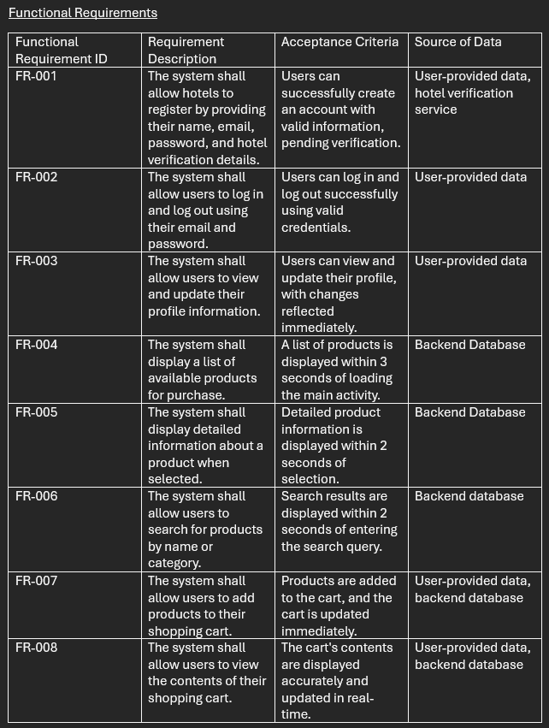
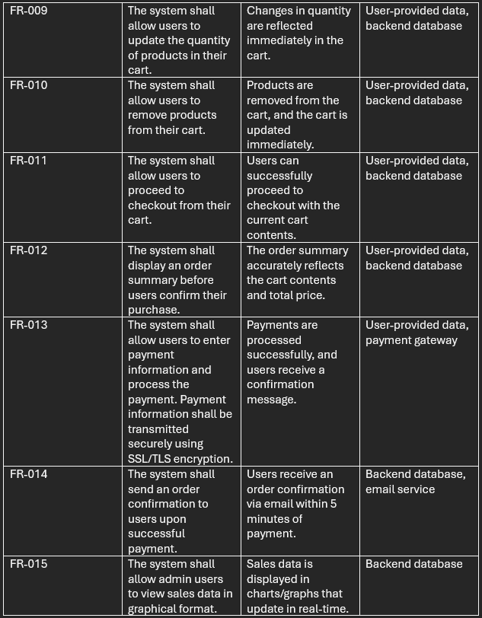
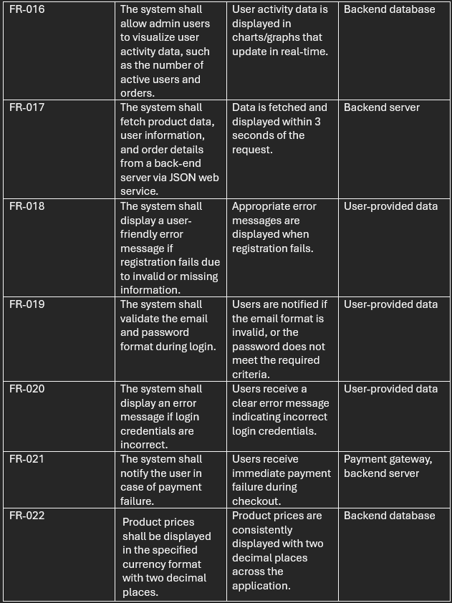
Functional requirements
Notes:
Functional requirements specify what the system should do, outlining the key features and capabilities of the software. For our Hotel Bulk Purchasing Mobile Application, these requirements include user registration, login/logout, and profile management. Users can browse and search for products, add them to their cart, update quantities, and proceed to checkout. The system ensures secure payment processing and sends order confirmations. Admin users have access to sales and user activity data presented in real-time graphs. Error handling is robust, providing clear messages for registration issues, login errors, and payment failures. These requirements ensure a seamless and efficient user experience by defining the necessary functionalities the application must provide.

Slide 5
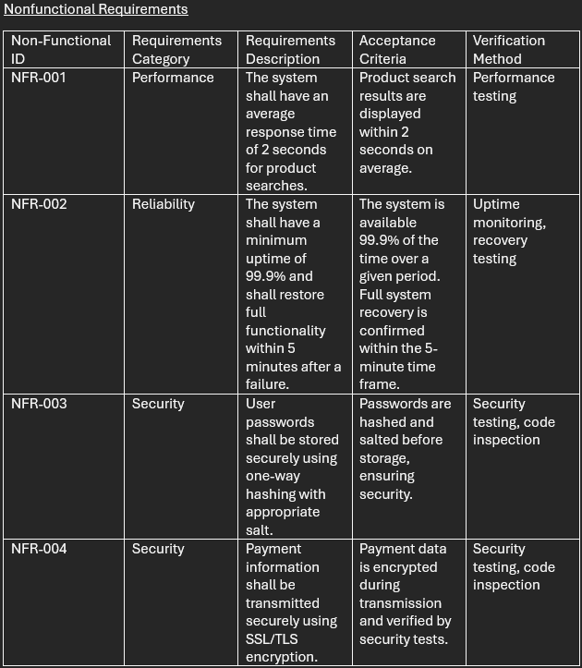
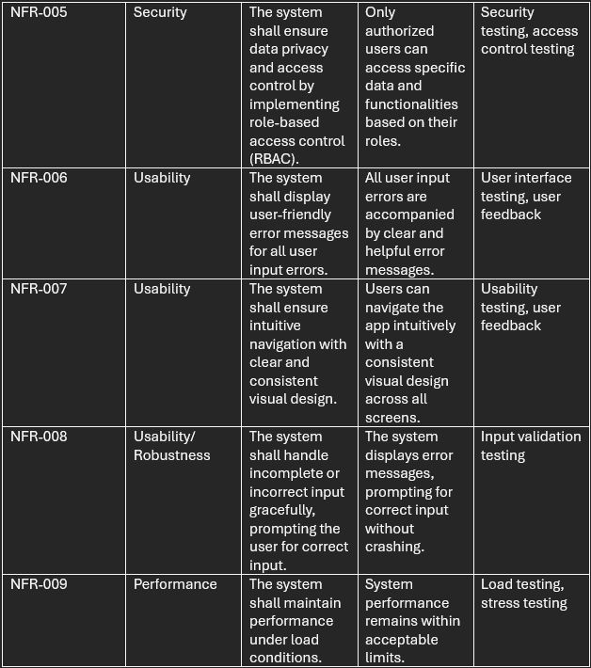
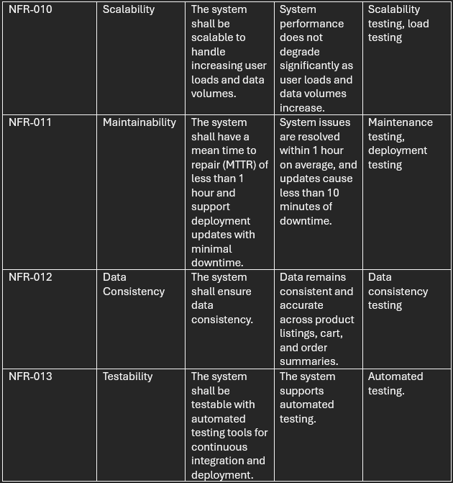
Nonfunctional requirements
Notes:
Nonfunctional requirements define how a system performs its functions, focusing on the quality attributes like performance, reliability, and security. For our Hotel Bulk Purchasing Mobile Application, we aim for an average response time of 2 seconds for product searches, and a minimum uptime of 99.9%, with recovery within 5 minutes after a failure. Security is critical, with secure password storage using one-way hashing and SSL/TLS encryption for payment information. Usability ensures user-friendly error messages and intuitive navigation. The system also handles input errors gracefully and maintains performance under load. Scalability, maintainability, data consistency, and testability with automated tools are essential to ensure the system's robustness and longevity. These nonfunctional requirements ensure our application is not only functional but also reliable, secure, and user-friendly.

Slide 6
Alternative solution analysis

Slide 7
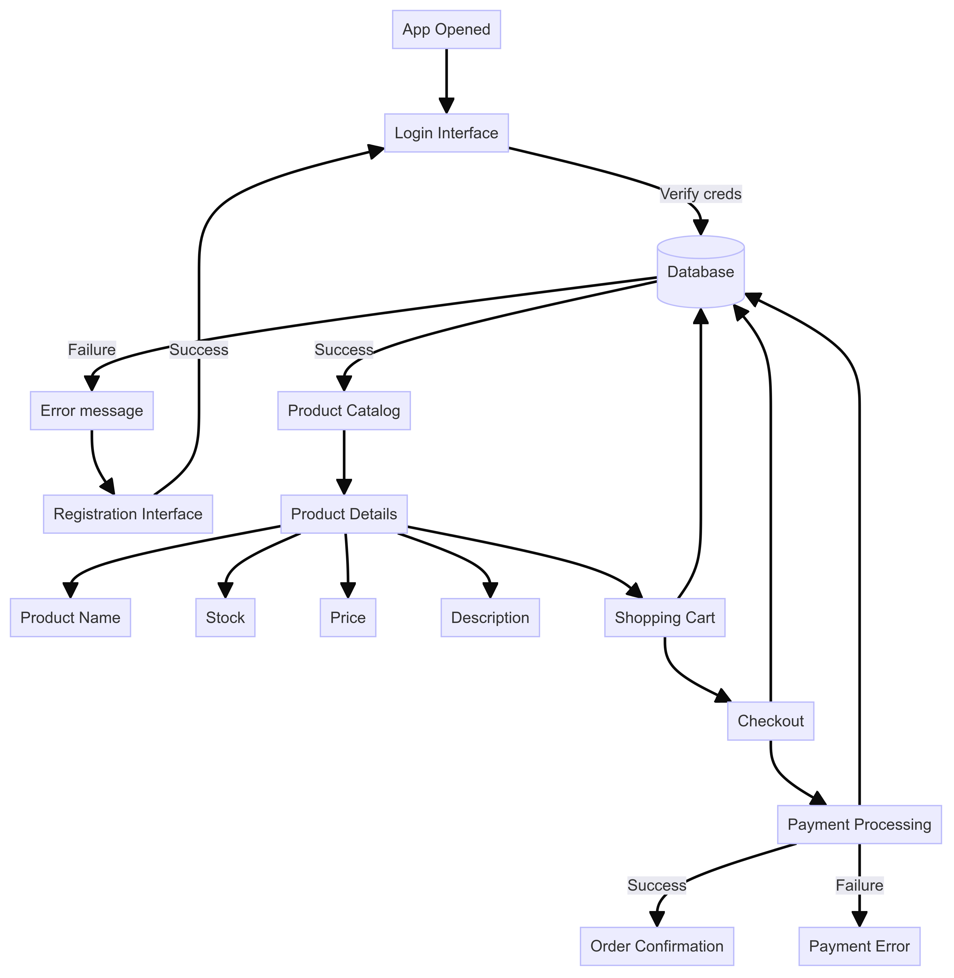
System Diagram
App Initialization
Login Interface
Registration
Product Catalog
Product Details
Shopping cart
Checkout and payment
Order confirmation
Data flow
Notes:
Our system diagram illustrates the user journey within the Hotel Bulk Purchasing Mobile Application. It starts with users opening the app and logging in, where credentials are verified by the database. Successful logins lead to the product catalog, while failures prompt error messages and options for registration. Users can browse products, view detailed information, and add items to their shopping cart. At checkout, payment processing is initiated, with the system verifying payment details through the database. Successful transactions result in order confirmations, while failures display payment error messages. This diagram effectively showcases the seamless flow and robust error handling throughout the user experience.

Slide 8

Thank you
Group - 2

