Slide 1

Windows PowerShell
System administration and automation in a Windows environment
- Graphical User Interfaces -
Karin De Maertelaere, Jochen Mariën

Slide 2
Graphical User Interfaces
PowerShell is basically a dotNet language
That means that you have a couple of options to allow for user interaction:
A simple message box
A not so simple message box
Standard dialog windows
Create a native form
Building a XAML GUI
ShowUI
The future
Do note: when building a GUI your script may(/will) not work on a server core anymore

Slide 3
A simple message box
The easiest way to display a message box is by the shell script
It’s easy because you don’t have to load any assemblies
You don’t have a lot of options, but it works
$wshell = New-Object -ComObject Wscript.Shell
$wshell.Popup("Operation Completed",0,"Done",0x1)
Notes:
https://blogs.technet.microsoft.com/heyscriptingguy/2014/04/04/powertip-use-powershell-to-display-pop-up-window/

Slide 4
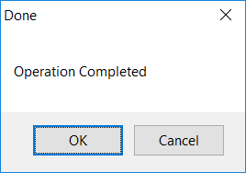
A simple message box
Advantages
Simple
Disadvantages
You can’t input data, just display messages

Slide 5
A not so simple message box
This is still just a messagebox, but with more options
You can choose the type of messagebox, and the buttons that will be shown
The user still can’t input text, but you check what button was pushed
[System.Reflection.Assembly]::LoadWithPartialName("System.windows") | Out-Null
$input = [System.Windows.MessageBox]::Show('This is text!',`
'A messagebox','YesNo','Error')
if($input -eq 'Yes')
{
Write-host "Yes!"
}

Slide 6
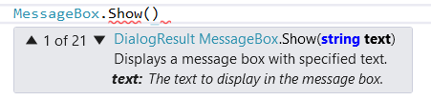
A not so simple message box
This is great, but it requires some prior knowledge
What types of buttons/combinations of buttons are available?
What types of messageboxes are available?
To check this, open visual studio (the real one, not VSCode) an start a new windows forms project
Start typing “MessageBox.Show(“ and watch the suggestions

Slide 7
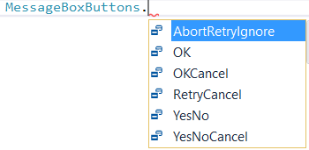
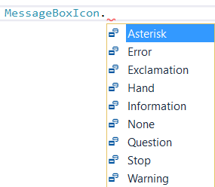
A not so simple message box
Enumerations in C#:

Slide 8
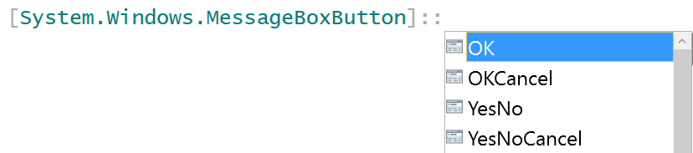
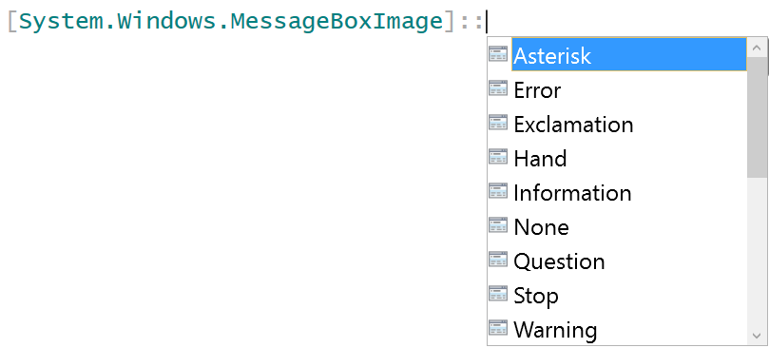
A not so simple message box
Enumerations in PowerShell:
Note: not all buttons are available, but all imagetypes are available

Slide 9
A not so simple message box
Advantages
Simple
Some user input is available
Disadvantages
Still no actual input of information
A bit more limited than the C# messagebox

Slide 10
Standard dialog windows
First, you need to load the assembly
Then, you need to create an instance of a dialogbox
Next, set some settings for the open file dialog
Finally, show the dialog and store the value
[System.Reflection.Assembly]::LoadWithPartialName("System.windows.forms") | Out-Null
$OpenFileDialog = New-Object System.Windows.Forms.OpenFileDialog
$OpenFileDialog.initialDirectory = $IsoPathFile
$OpenFileDialog.filter = "ISO (*.iso)| *.iso"
$OpenFileDialog.ShowDialog() | Out-Null
$file = $OpenFileDialog.FileName
Notes:
http://www.workingsysadmin.com/open-file-dialog-box-in-powershell/

Slide 11
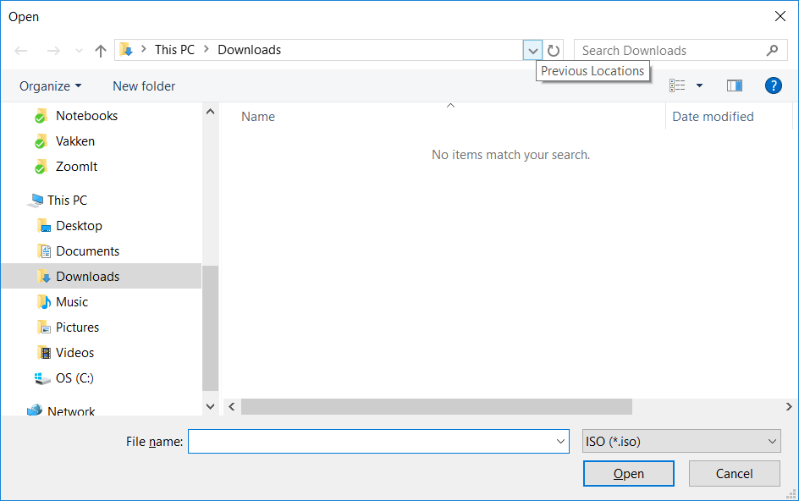

Slide 12
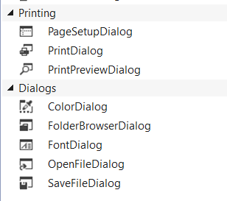
Other dialogs
Get back to visual studio, the windows form project
Select the form and search for “Dialog” in the toolbox-pane

Slide 13
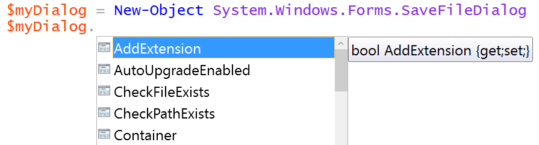
Standard dialog windows
What options are available? Depends on the type of dialog…
To check: ctrl – space
Also check: msdn (programming reference for .Net)
https://msdn.microsoft.com/en-us/library/system.windows.forms.savefiledialog(v=vs.110).aspx

Slide 14
Standard dialog windows
Advantages
Still quite simple
User input is available
Looks quite professional
Disadvantages
Only the default options (open file, save file, …), no custom GUI

Slide 15
Native forms
When creating a native form, you have to build it by loading the components and positioning them on a form
When you want an eventhandler, you have to create it
The next link makes for some very interesting reading:
https://technet.microsoft.com/en-us/library/ff730941.aspx
Notes:
https://technet.microsoft.com/en-us/library/ff730941.aspx

Slide 16
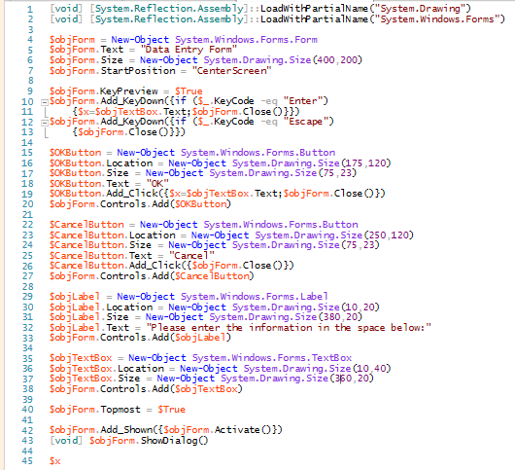
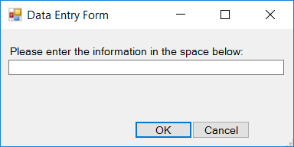
Native forms
Write this code:
Get this form:

Slide 17

A fork:
Keep on reading
Skip the next 6 slides

Slide 18
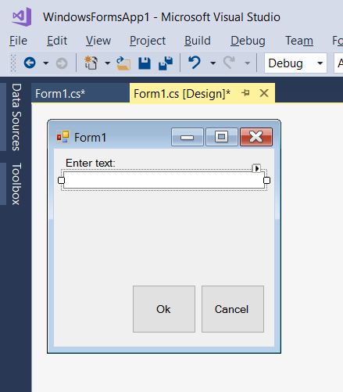
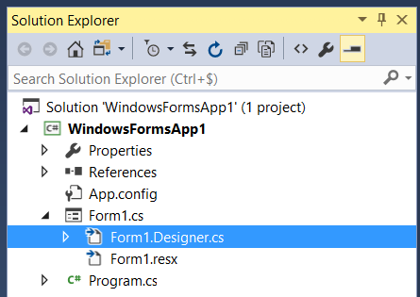
Native forms
Or, draw this form in visual studio:
And open the following file:

Slide 19
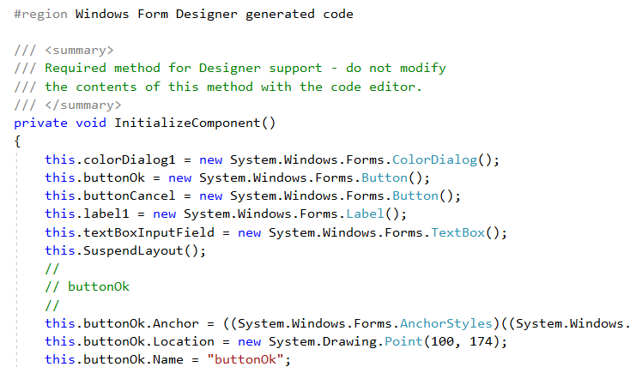
Native forms
Copy the “Windows Form Designer generated code” to the PS ISE

Slide 20
Adapting code
Replace “//” by “#”
Remove “private void InitializeComponent() {“ and the ending “}”
Add the following lines:
Replace “this.” by “$”
Replace “ new ” by “ new-object ”
Remove the “();” and “;” at the ends of lines
Replace “true” by “$true” and “false” by “$false”
[void] [System.Reflection.Assembly]::LoadWithPartialName("System.Drawing")
[void] [System.Reflection.Assembly]::LoadWithPartialName("System.Windows.Forms")
$objForm = New-Object System.Windows.Forms.Form

Slide 21
Adapting code (continued)
Remove the following lines
In the “Form1” section:
Replace “$” with “$objForm.” at the beginning of the line
Remove
Remove all eventhandlers
Add
$SuspendLayout() #top
$ResumeLayout(false) #bottom
$PerformLayout() #bottom
$objForm.AutoScaleDimensions = new-object System.Drawing.SizeF(8F, 16F)
$objForm.AutoScaleMode = System.Windows.Forms.AutoScaleMode.Font
... += new-object System.EventHandler(...)
$objForm.ShowDialog()

Slide 22
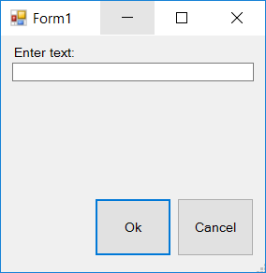
Adapting code (result)
You now have a form that looks just like the one in visual studio
Code in notes below
But it doesn’t do anything…
Add eventhandler for, for instance, the button:
Notes:
[void] [System.Reflection.Assembly]::LoadWithPartialName("System.Drawing")
[void] [System.Reflection.Assembly]::LoadWithPartialName("System.Windows.Forms")
$objForm = New-Object System.Windows.Forms.Form
$buttonOk = new-object System.Windows.Forms.Button
$buttonCancel = new-object System.Windows.Forms.Button
$label1 = new-object System.Windows.Forms.Label
$textBoxInputField = new-object System.Windows.Forms.TextBox
#
# buttonOk
#
$buttonOk.Location = new-object System.Drawing.Point(100, 174)
$buttonOk.Name = "buttonOk"
$buttonOk.Size = new-object System.Drawing.Size(82, 62)
$buttonOk.TabIndex = 0
$buttonOk.Text = "Ok"
$buttonOk.UseVisualStyleBackColor = $true
#
# buttonCancel
#
$buttonCancel.Location = new-object System.Drawing.Point(188, 174)
$buttonCancel.Name = "buttonCancel"
$buttonCancel.Size = new-object System.Drawing.Size(82, 62)
$buttonCancel.TabIndex = 1
$buttonCancel.Text = "Cancel"
$buttonCancel.UseVisualStyleBackColor = $true
#
# label1
#
$label1.AutoSize = $true
$label1.Location = new-object System.Drawing.Point(12, 9)
$label1.Name = "label1"
$label1.Size = new-object System.Drawing.Size(72, 17)
$label1.TabIndex = 2
$label1.Text = "Enter text:"
#
# textBoxInputField
#
$textBoxInputField.Location = new-object System.Drawing.Point(12, 29)
$textBoxInputField.Name = "textBoxInputField"
$textBoxInputField.Size = new-object System.Drawing.Size(258, 22)
$textBoxInputField.TabIndex = 3
#
# Form1
#
# $objForm.AutoScaleDimensions = new-object System.Drawing.SizeF(8F, 16F)
# $objForm.AutoScaleMode = System.Windows.Forms.AutoScaleMode.Font
$objForm.ClientSize = new-object System.Drawing.Size(282, 253)
$objForm.Controls.Add($textBoxInputField)
$objForm.Controls.Add($label1)
$objForm.Controls.Add($buttonCancel)
$objForm.Controls.Add($buttonOk)
$objForm.Name = "Form1"
$objForm.Text = "Form1"
# $objForm.Load += new-object System.EventHandler($Form1_Load)
$objForm.ShowDialog()

Slide 23
Eventhandler
An eventhandler handles a certain event
For instance, clicking the Ok button:
Note
Behind the brackets, add curly brackets
You can refer to other items on the form
Close the form: close-method on the form-object ($objForm)
$buttonOk.Add_Click( {
write-host "Ok clicked"
} )
$textBoxInputField.Text = $textBoxInputField.Text.ToUpper()

Slide 24
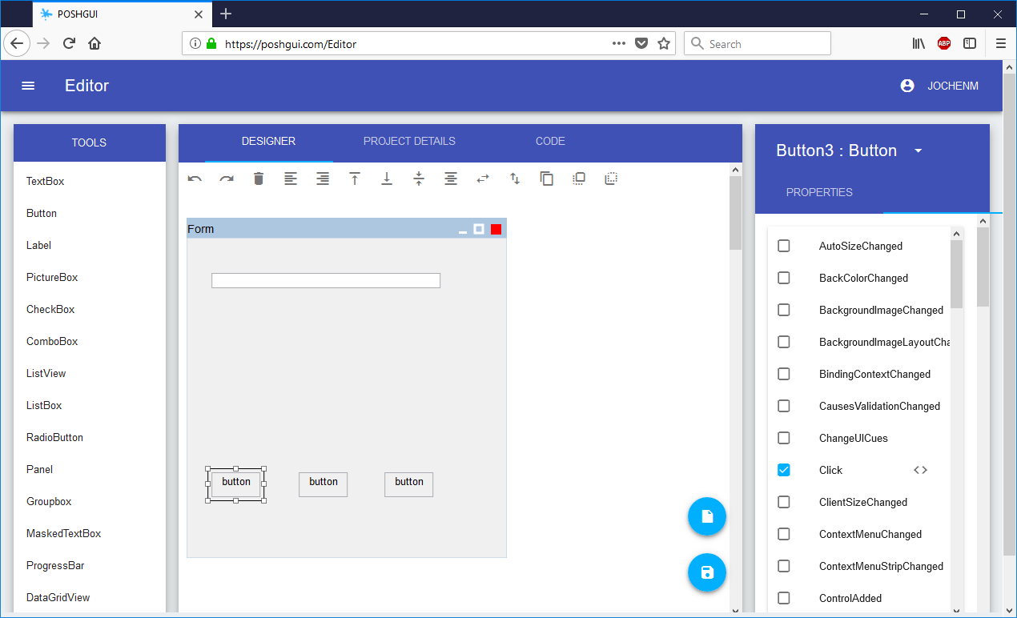
… or use PoshGui
A website that helps you create a native GUI form
Allows to add events
Allows easy alignment of controls
Gives the PowerShell-code

Slide 25
Native forms
Advantages
Anything is possible
User input is available
Can be made to look like anything
Disadvantages
Not programmer-friendly at all
No separation of code and GUI
Impossible to alter the form graphically

Slide 26
XAML forms
Extensible Application Markup Language
XAML is a declarative markup language
Typically used to create user interfaces
Started in 2006, introduced as part of .Net framework 3
Can also be used with C# to create Android applications
To create a form:
Type XML
Use visual studio

Slide 27
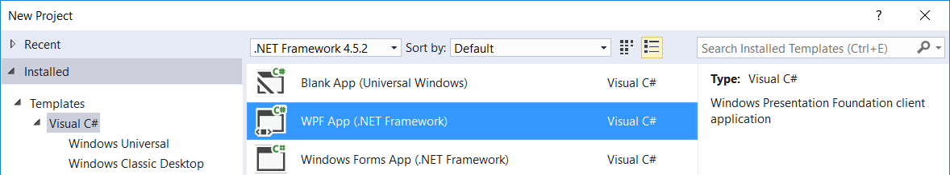
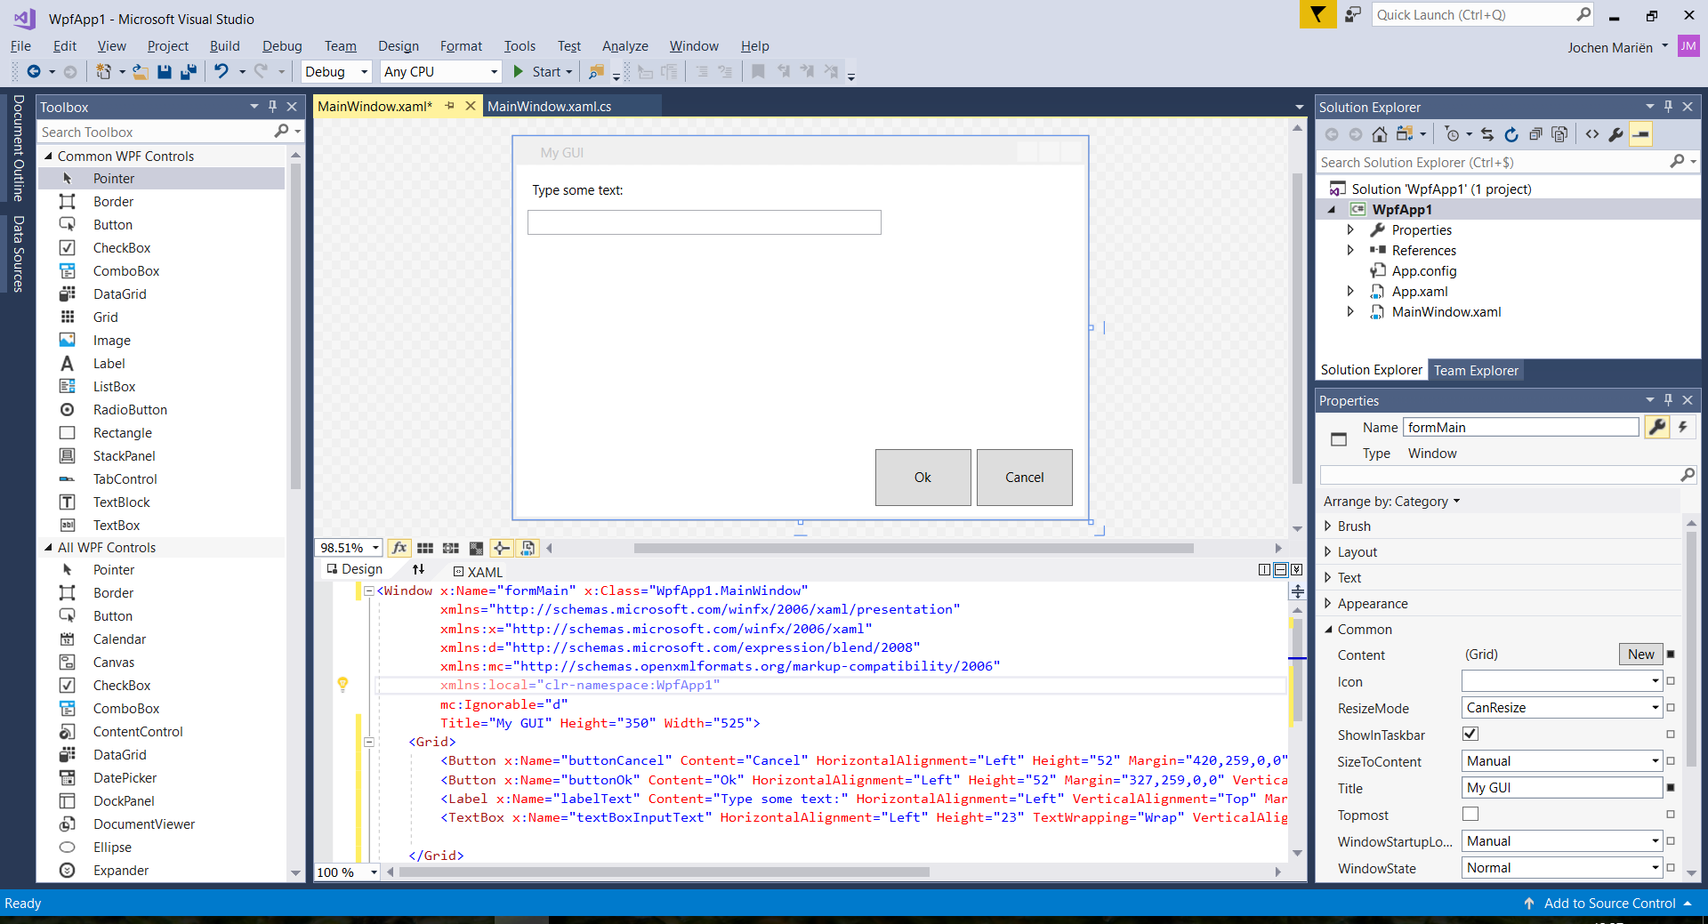
Create the form
Create a new WPF-project
Draw a form using the toolbox
Notes:
https://foxdeploy.com/2015/04/10/part-i-creating-powershell-guis-in-minutes-using-visual-studio-a-new-hope/

Slide 28
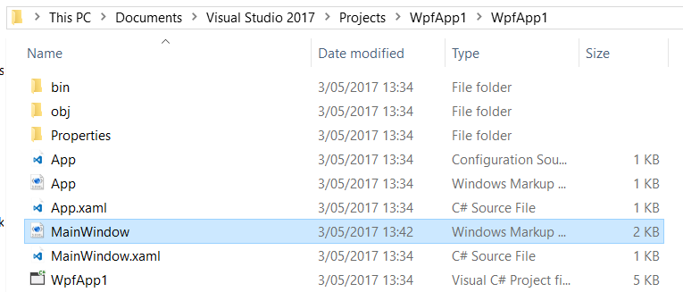
Use the form
When the form is created, the XML-code for that form is shown on the bottom of the screen
It is also saved in the following file

Slide 29
Import the form in PowerShell
There are two options
Copy the XAML-code, and paste it in a PS1-file
Ok for a small form that you don’t want to change
Reference (a copy of) the XAML-file
Better when you have a large form subject to changes
We’ll be doing this…
Unfortunately, the XAML form isn’t quite ready for PowerShell
“mc:Ignorable="d"” isn’t allowed
An “x” in front of an attribute isn’t needed
All problems are fixed by the following line:
$inputXML = $inputXML -replace 'mc:Ignorable="d"','' -replace "x:N",'N' -replace '^<Win.*', '<Window'

Slide 30
Import the XAML as XML
We need to:
Import the presentation framework
Convert the file that was read to XML
Store it in an XML-object called $Form
In a try-catch to catch a badly formed XAML-document
Add “WPF” in front of all elementnames
Show the form elements
Show the form
Code in notes below
Notes:
$inputXML = Get-Content -Path C:\Scripts\MainWindow.xaml
$inputXML = $inputXML -replace 'mc:Ignorable="d"','' -replace "x:N",'N' -replace '^<Win.*', '<Window'
[void][System.Reflection.Assembly]::LoadWithPartialName('presentationframework')
[xml]$XAML = $inputXML
#Read XAML
$reader=(New-Object System.Xml.XmlNodeReader $xaml)
try
{
$Form=[Windows.Markup.XamlReader]::Load( $reader )
}
catch
{
Write-Host "Unable to load Windows.Markup.XamlReader. Double-check syntax and ensure .net is installed."
}
#===========================================================================
# Load XAML Objects In PowerShell
#===========================================================================
$xaml.SelectNodes("//*[@Name]") | %{Set-Variable -Name "WPF$($_.Name)" -Value $Form.FindName($_.Name)}
Function Get-FormVariables{
if ($global:ReadmeDisplay -ne $true){Write-host "If you need to reference this display again, run Get-FormVariables" -ForegroundColor Yellow;$global:ReadmeDisplay=$true}
write-host "Found the following interactable elements from our form" -ForegroundColor Cyan
get-variable WPF*
}
Get-FormVariables
#===========================================================================
# Actually make the objects work
#===========================================================================
#Sample entry of how to add data to a field
#$vmpicklistView.items.Add([pscustomobject]@{'VMName'=($_).Name;Status=$_.Status;Other="Yes"})
#===========================================================================
# Shows the form
#===========================================================================
write-host "To show the form, run the following" -ForegroundColor Cyan
$Form.ShowDialog() | out-null

Slide 31
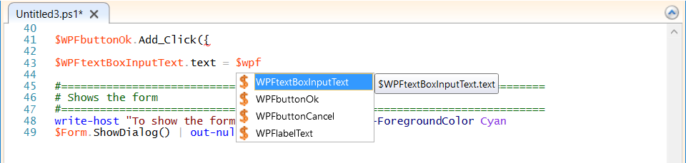
Add events
When you’ve shown this form once (without any eventhandlers) the elements of the form are loaded in the ISE-memory
So you can ctrl-space all the elementnames…
Working with the elements is quite the same as when referencing them in C# in a WPF-application
And almost the same as in a regular windows-forms application
Notes:
$WPFbuttonOk.Add_Click({
Write-host "hello"
$WPFtextBoxInputText.text = $WPFtextBoxInputText.Text.ToUpper()
})
$WPFbuttonCancel.Add_Click({
$Form.Close()

Slide 32
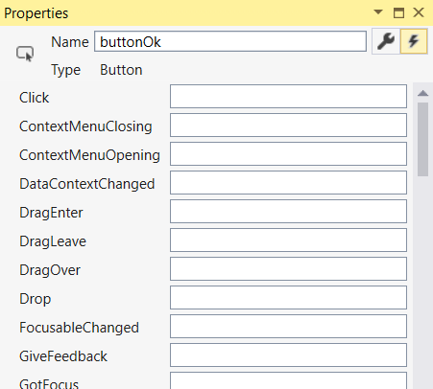
Add events
Events aren’t in the ctrl-space-list!
Solution: in visual studio, select the item, and click the lightning bolt in the properties screen
All these events are available in PS

Slide 33
The alternative: Visual Studio
Visual Studio is the Microsoft IDE for C# and…
https://www.visualstudio.com/vs/community/
You can extend it with the PowerShell tools
https://marketplace.visualstudio.com/items?itemName=AdamRDriscoll.PowerShellToolsforVisualStudio2017-18561
(Free, but not enough)
https://marketplace.visualstudio.com/items?itemName=AdamRDriscoll.PowerShellProToolsforVisualStudio2017
(Not free, but enough)
This allows you to develop PowerShell in Visual Studio, and draw PowerShell Xaml-forms
Notes:
https://wandering.life/building-windows-forms-powershell-visual-studio-2017/

Slide 34
The module: PSGUI
Install-Module PSGUI
The PSGUI module facilitates a lot of the work we did before
It’s a custom module, and includes an entire GUI manager
Is however a user created module, that hasn’t recently been updated
Notes:
https://github.com/ddneves/PSGUI

Slide 35
XAML forms
Advantages
Anything is possible
User input is available
Can be made to look like anything
Reasonable programmer friendly
Some separation of code and GUI
Possible to alter the form graphically
Disadvantages
Not as simple as the existing dialog boxes

Slide 36
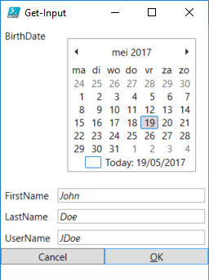
Show-UI
Install-Module ShowUI
A module written to create easy forms
However, another user created module that hasn’t been updated recently
$User = [ordered]@{
FirstName = "John"
LastName = "Doe"
BirthDate = [DateTime]
UserName = "JDoe"
}
Get-Input $User -Show
Notes:
https://github.com/showui/showui

Slide 37
The future
https://www.youtube.com/watch?v=azDHOf88_S4&t=825s
PowerShell Conference Hannover, may 2017
Will allow you to show a UI as an application or as a webpage
Works crossplatform
https://github.com/PowerShell/Phosphor/
But still a proof of concept
And no real intention of becoming more

Slide 38
A GUI in PowerShell
Is not necessary for every script you write
But is a nice touch for some, and also pretty powerful
Use just enough GUI:
Messageboxes (annoying, but sometimes useful)
Dialog boxes (Always useful, but beware of server cores)
PoshGui or XAML forms (when you’ve got a week to spare and need a really nice script)

Slide 39
Read on…
Pop-up windows: https://blogs.technet.microsoft.com/heyscriptingguy/2015/11/02/creating-pop-ups-by-using-powershell/

