Slide 1
Trajectory-Based Computational Methods for Quantum Mechanics
Dr. Ivan Ivanov, Tomer Moran, Jeffrey Morais, Nicolas Desjardins, Mohamed Ben Mekki

Slide 2
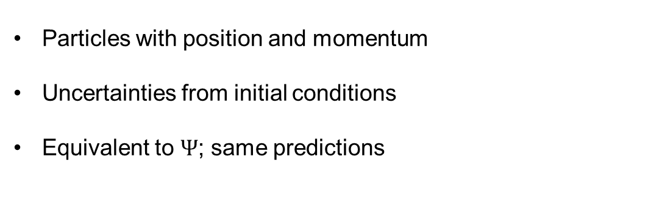
Features of Trajectory-Based Methods
Particles with position and momentum
Uncertainties from initial conditions
Equivalent to $Ψ$; same predictions

Slide 3
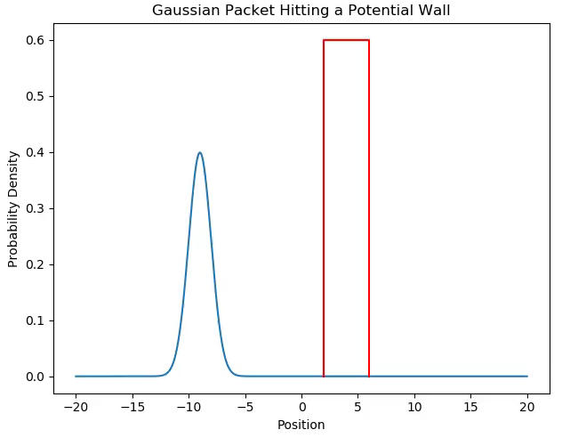
Crank-Nicolson Method for TDSE

Slide 4
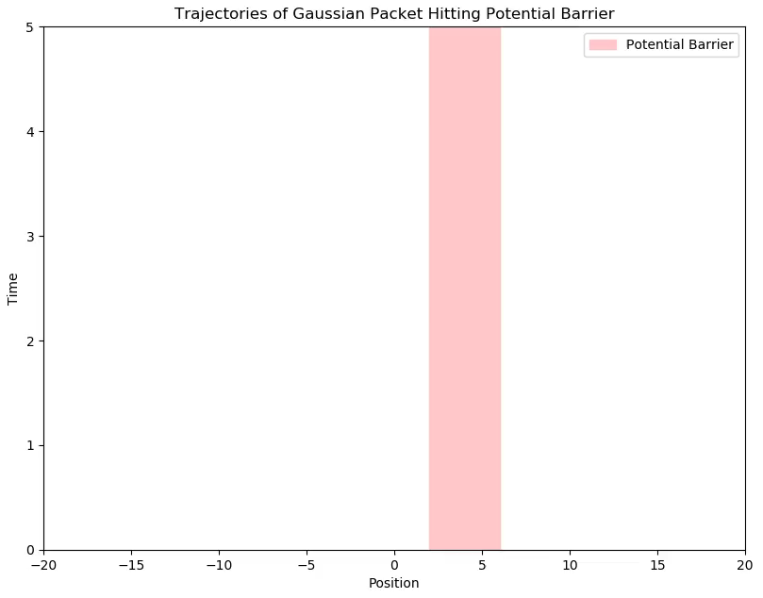

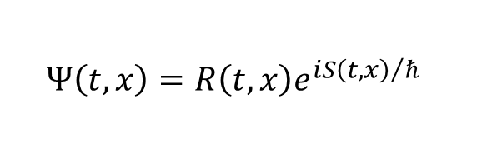
Extracting trajectories from $Ψ$
$$Ψ\left(t, x\right)=R\left(t, x\right)e^{{iS\left(t, x\right)}/ℏ}$$
$$v=\frac{∇S}{m}$$

Slide 5
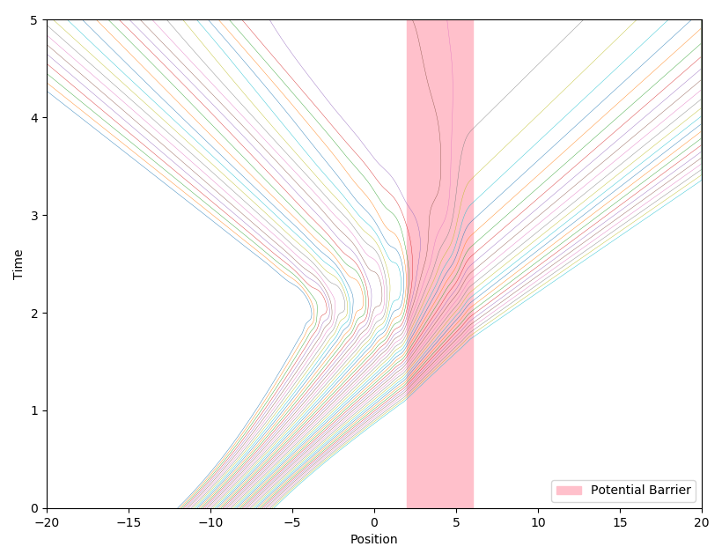
Training an AI to predict trajectories
Example animation of predicted trajectories

Slide 6
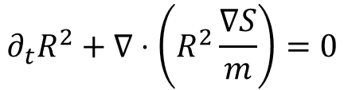
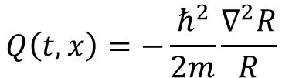
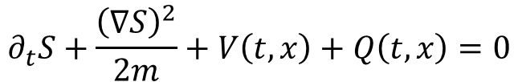
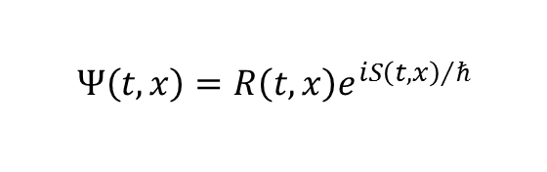
Decomposing the TDSE
$$Ψ\left(t, x\right)=R\left(t, x\right)e^{{iS\left(t, x\right)}/ℏ}$$
$$∂_{t}R^{2}+∇⋅\left(R^{2}\frac{∇S}{m}\right)=0$$
Continuity Equation
$$∂_{t}S+\frac{{\left(∇S\right)}^{2}}{2m}+V\left(t, x\right)+Q\left(t, x\right)=0$$
Quantum Hamilton-Jacobi
$$Q\left(t, x\right)=−\frac{ℏ^{2}}{2m}\frac{∇^{2}R}{R}$$
Quantum Potential

Slide 7

Bill Poirier’s trajectory-based approach
Solve directly for $x=x\left(t, C\right)$

Slide 8
Bill Poirier’s trajectory-based approach
x = function of t and C
Rho = 1/x’
ma - F + (ugly term to the right) = 0

Slide 9
Simulating the Poirier-Schiff equation
Image of a Gaussian packet breaking up for no reason

Slide 10
References
“Overview of Bohmian Mechanics.” Xavier Oriols & Jordi Mompart. 2013.
“Bohmian mechanics without pilot waves.” Bill Poirier, J. Chem. Phys. 2010.
“Communication: Quantum mechanics without wavefunctions.” Jeremy Schiff & Bill Poirier. J. Chem. Phys. 2012

