Slide 1
Trajectory-Based Computational Methods for Quantum Mechanics
Dr. Ivan Ivanov, Tomer Moran, Jeffrey Morais, Nicolas Desjardins, Mohamed Ben Mekki

Slide 2
Features of Trajectory-Based Methods
Particles with position and momentum
Uncertainties from initial conditions
Same predictions as Copenhagen QM

Slide 3
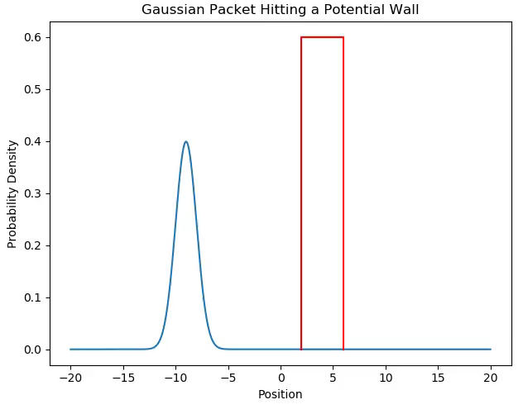
Crank-Nicolson Method for TDSE

Slide 4
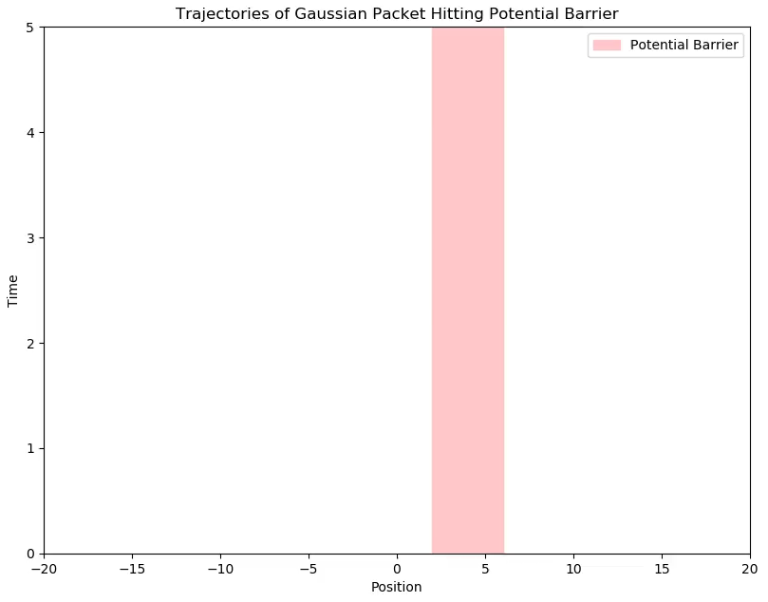

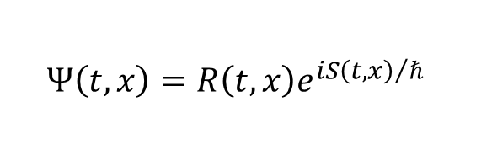
Extracting trajectories from $Ψ$
$$Ψ\left(t, x\right)=R\left(t, x\right)e^{{iS\left(t, x\right)}/ℏ}$$
$$v=\frac{∇S}{m}$$

Slide 5
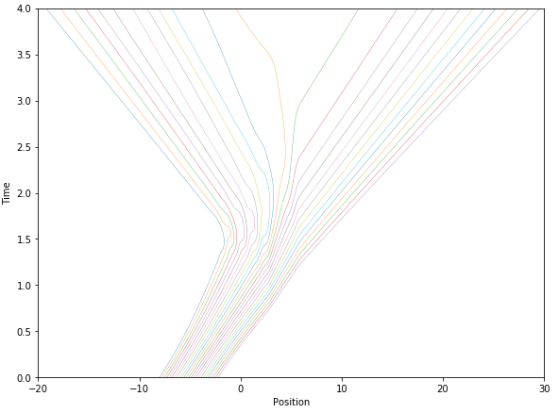
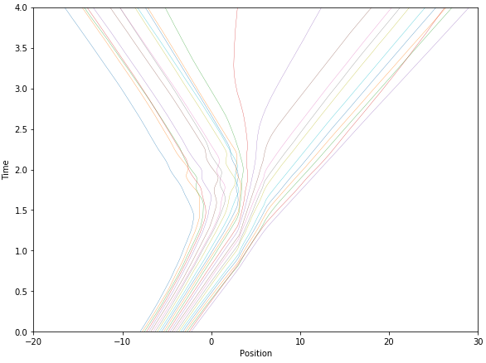
Training an AI to predict trajectories
True trajectories
AI-predicted trajectories

Slide 6
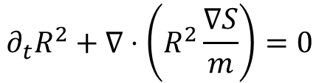
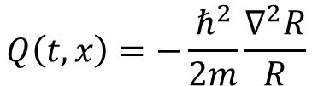
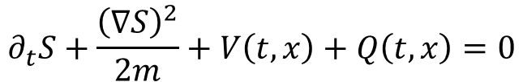
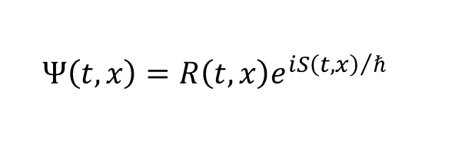
Decomposing the TDSE
$$Ψ\left(t, x\right)=R\left(t, x\right)e^{{iS\left(t, x\right)}/ℏ}$$
$$∂_{t}R^{2}+∇⋅\left(R^{2}\frac{∇S}{m}\right)=0$$
Continuity Equation
$$∂_{t}S+\frac{{\left(∇S\right)}^{2}}{2m}+V\left(t, x\right)+Q\left(t, x\right)=0$$
Quantum Hamilton-Jacobi
$$Q\left(t, x\right)=−\frac{ℏ^{2}}{2m}\frac{∇^{2}R}{R}$$
Quantum Potential

Slide 7


Bill Poirier’s trajectory-based approach
Solve directly for $x=x\left(t, C\right)$ with $\dot{x}≡\frac{∂x}{∂t}$ and $x^{′}≡\frac{∂x}{∂C}$
$$ℒ=\frac{1}{2}m{\dot{x}}^{2}−V\left(x\right)−\frac{ℏ^{2}}{2m}\left(\frac{x^{′′′}}{{x^{′}}^{3}}−\frac{5}{2}\frac{{x^{′′}}^{2}}{{x^{′}}^{4}}\right)$$
$$\frac{∂ℒ}{∂x}−\frac{d}{dt}\left[\frac{∂ℒ}{∂\dot{x}}\right]−\frac{d}{dC}\left[\frac{∂ℒ}{∂x^{′}}\right]+\frac{d^{2}}{dC^{2}}\left[\frac{∂ℒ}{∂x^{′′}}\right]−\frac{d^{3}}{dC^{3}}\left[\frac{∂ℒ}{∂x^{′′′}}\right]=0$$

Slide 8
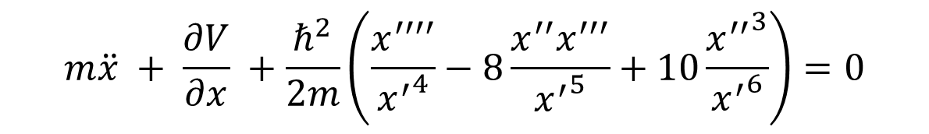

Bill Poirier’s trajectory-based approach
$$m\ddot{x} + \frac{∂V}{∂x} +\frac{ℏ^{2}}{2m}\left(\frac{x^{′′′′}}{{x^{′}}^{4}}−8\frac{x^{′′}x^{′′′}}{{x^{′}}^{5}}+10\frac{{x^{′′}}^{3}}{{x^{′}}^{6}}\right)=0$$
$$\underset{Quantum force}{\underbrace{ }}$$

Slide 9
Next Steps: Hybrid Approach
Use NN for initial “guesses”
Run BVP solver to refine predictions
Use information from both for more stability & accuracy

Slide 10
References
“Overview of Bohmian Mechanics.” Xavier Oriols & Jordi Mompart. 2013.
“Bohmian mechanics without pilot waves.” Bill Poirier, J. Chem. Phys. 2010.
“Communication: Quantum mechanics without wavefunctions.” Jeremy Schiff & Bill Poirier. J. Chem. Phys. 2012

