Slide 1
IT'S SHOWTIME
A cinema showings project
BY SHAMAR WOODBYRNE

Slide 2
Project Introduction
The project is meant to showcases showtimes of cinemas.
Application uses an API to scrape cinema/film information.
It will show :
Nearby cinemas.
What are the viewings for the day at specific cinemas.
Films that are currently being shown in cinemas.
Where the closest viewing of a film is.
Ability to save favorite cinemas.

Slide 3





What Technology Is Used?
Backend:
Java – Maven – Spring Boot Framework
JDBC Template
Database:
MySQL
Frontend:
HTML/CSS
Thymeleaf
Version Control:
Git/Github

Slide 4
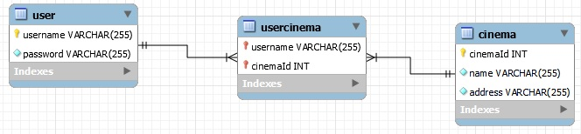
Database ERD Diagram

Slide 5
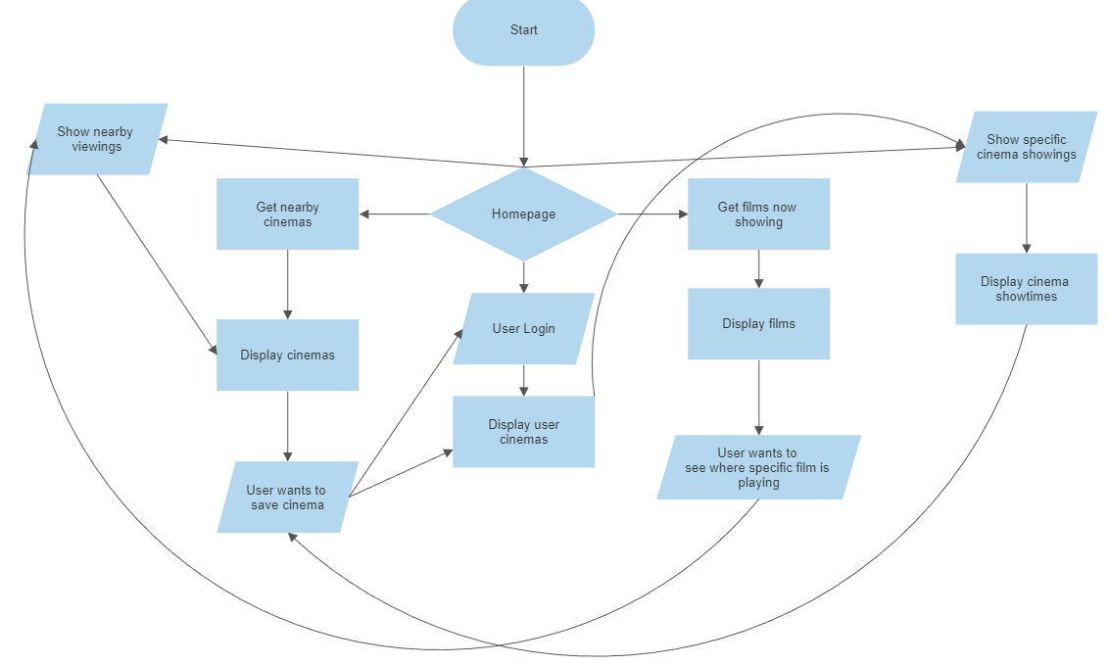
Flowchart

Slide 6
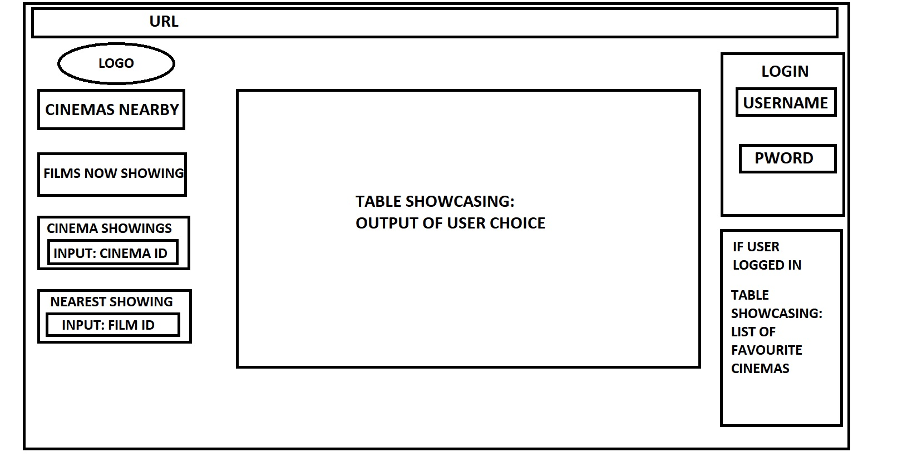
Frontend Wireframe

Slide 7
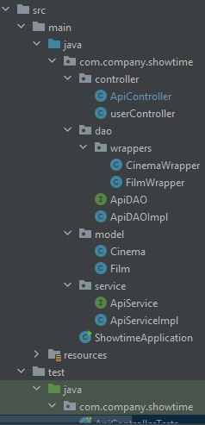
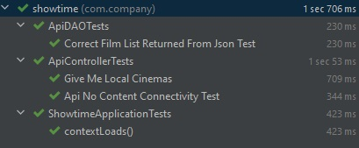
Structure and Testing
Following MVC structure
Unit tests currently done on ApiController and DAO.

Slide 8
Did I Encounter Problems?
Yes!
Several!

Slide 9








Problem: Getting The Right API

Slide 10


Problem: The API Worked Yesterday, Why Not Today?
The API requires the device to have today's date, whatever time.
Format the current DateTime for the API endpoint to the API's requirement.

Slide 11

Problem: The API Code Should Work The Code Is Correct
Created a successful block of code that contacted the API correctly.
Copy/Paste didn't work for a separate method.
There was a typo.
ALWAYS CHECK YOUR CODE!!!

Slide 12
Quick Demo

Slide 13


What Have I Learnt At This Stage?
Java HTTPClient
JSON Files
How to use an API
Server Errors
How to check code
Perseverance
ALWAYS CHECK FOR SPELLING
There's no need to panic

Slide 14
Future Plans – With More Time
Frontend Creation
User-login verification
Server code handling
Adding User Location Input

Slide 15
Questions?

Slide 16
A Couple Useful Websites
https://spring.io/guides/gs/securing-web/
https://javatutorial.net/implementing-controllers-in-spring/
https://www.baeldung.com/jackson-json-node-tree-model

