Slide 1
ATDB
Shotgun metadata database

Slide 2





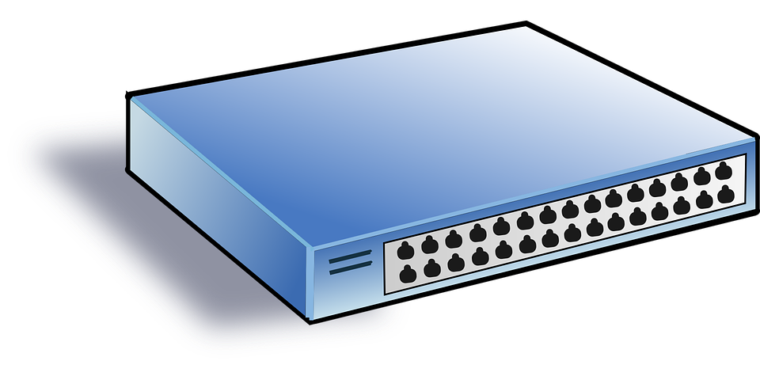

Network Latency
Client 1
Client 2
Client 1
Client 2
Client 1 : Data Entry UI
Client 2 : Automated SW
Allen Inst.
LAN
AWS
DB Server (PostgresSQL)
DB Server (PostgresSQL)

