Slide 1

mySoftwareBookList
Sprint 1

Slide 2
The Project
Our main objective is to make it easier for people to gain insight from others about software books
For this Sprint we covered creating our ERD, wireframes, and project scope, setting up API calls for our project, and creating a baseline ASP.NET solution

Slide 3
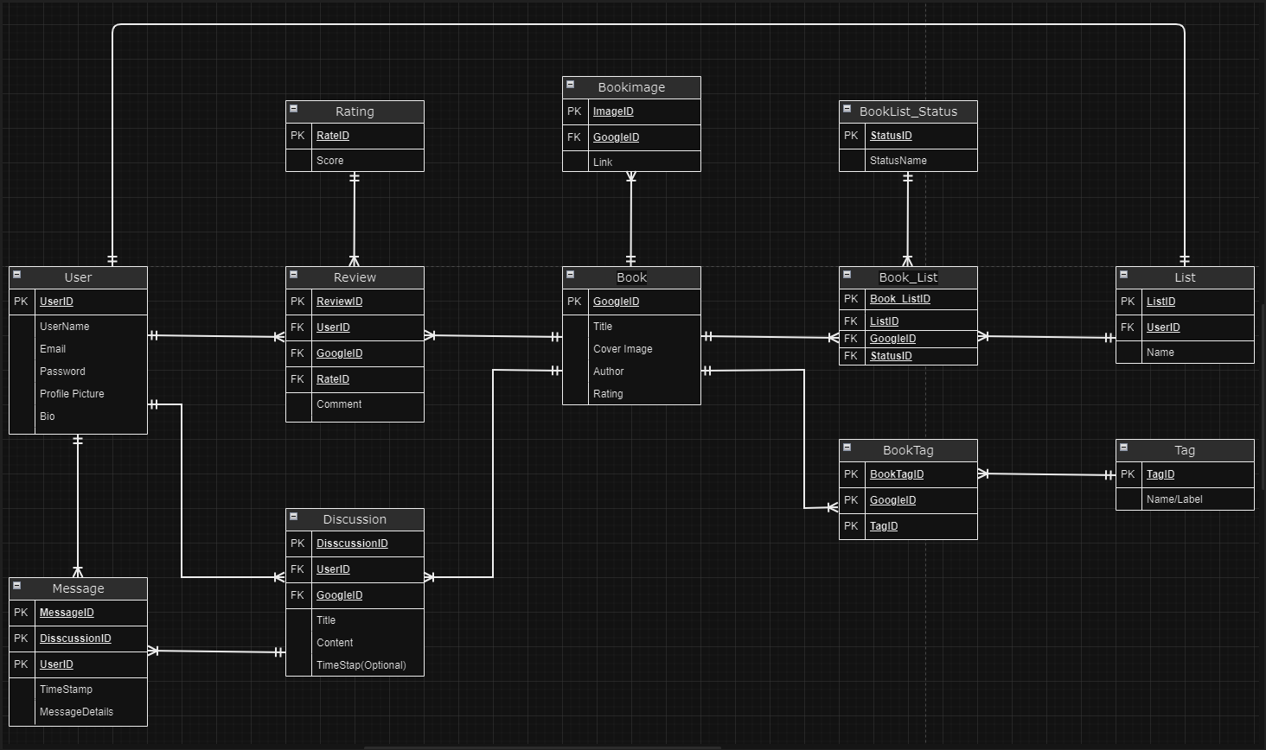
ERD
Notes:
Google Book API influenced a lot of our tables
Our plan for the BookID is the BookID that google gives us
BookList_Status acts like a list for the users to organize their own list of books into sublists, such as books “I’ve read”, “I Want to Read”, etc.
There can be many messages in one discussion, both can be identified. A discussion can be checked for multiple messages inside. Messages = “Comments” within discussions
We have 2 bridge tables, “BookTag:”, a bunch of keys within, and then we have Book_List as a bridge table. Keys create object
Book Images are given through a string within an API call for thumbnail images.
Rating score is based out of 10 and only whole numbers, Book ratings will be averaged and therefore made a decimal.
User has one list, and has sublists inside of it.

Slide 4
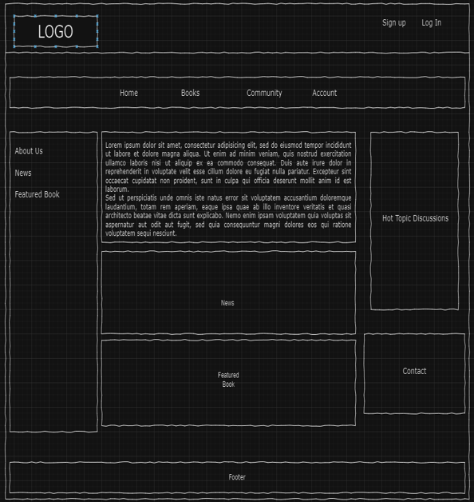
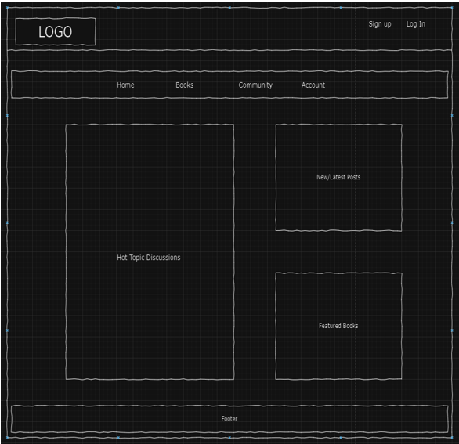
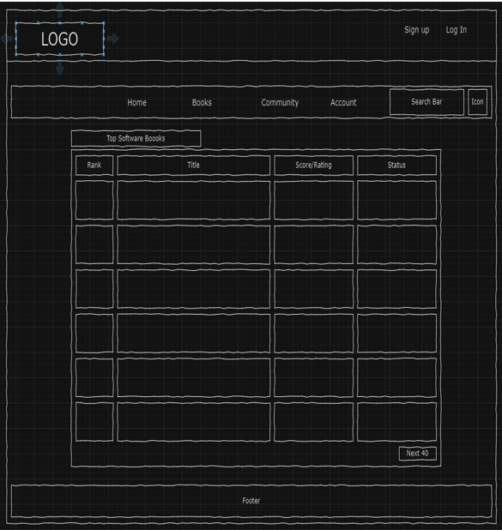
Wireframes
Notes:
Home Page, Community, Books Page
Our community page is likely to have a forum, clubs, and blogs.
The community page could have a specific page named “Discussions”
To clean up the review vs. discussion page, we can have the discussion comments linked within a specific book as “Discussion” and take you to the community page within the discussion tabs. The discussion would be linked to a specific book and nested within a specific page. Everyone can review a book ONCE! You can thumbs up or thumbs down a review or discussion that could be a feature later on.

Slide 5
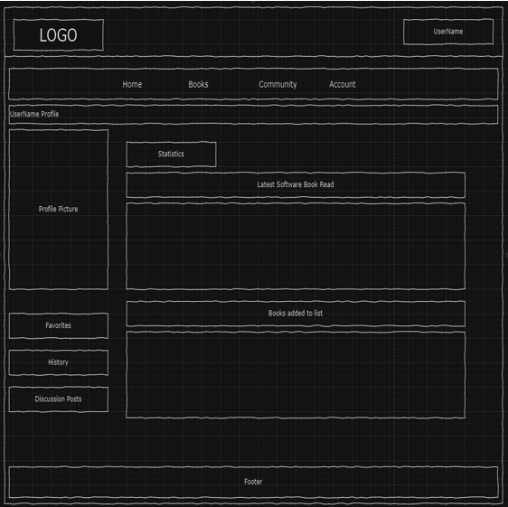
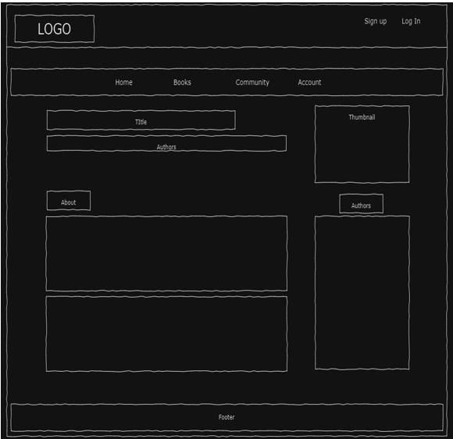
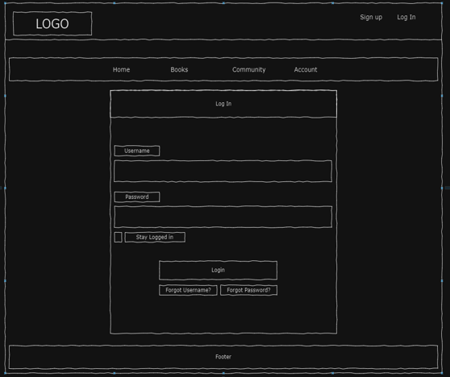
Wireframes
Notes:
Account, Book Details, Log in/Sign Up Page
Within the Book Detail page, there will be more in-depth information about the book, that’s given to us through he API
You can filter or sort reviews by newest, most upvoted, etc
Long term within the project, we may want a where to buy option for individual books. This could be E-Book or physical book.

Slide 6
User Stories and Features
LogIn/SignUp - As a registered user, I want to log in to my account so that I can access personalized content and participate in discussions.
Search Bar - As a user, I want to search for software books by title, author, or topic to find relevant discussions and reviews.
Leave Review - As a member, I want to post a book review with a star rating and comments to share my thoughts on a particular software book.
Sort Books by Rating - As a user, I want to access a list of top-rated software books and see which ones are trending in the community.
Sort Books by Tag – As a user, I want to find books by a specific tag and see which ones are highest rated with that specific tag.

Slide 7
Web Application
https://mysoftwarebooklist.azurewebsites.net/

