Slide 1
How to use ppt presenter
Haonan Chen
https://chaonan99.github.io/about
Notes:
Today, we’ll introduce how to use ppt presenter to create demo video from power point slides.

Slide 2
Install required package
Repo: https://github.com/chaonan99/ppt_presenter
Notes:
You need to have Python to run the script. First, follow instructions in README to install required packages.

Slide 3
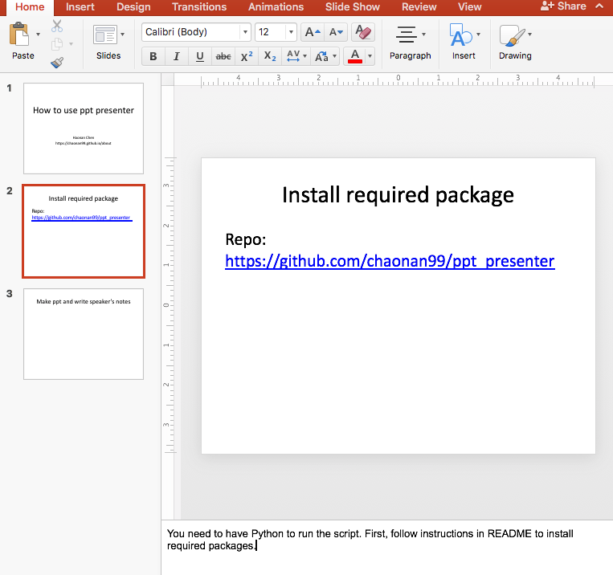
Make ppt and write speaker’s notes
Presentation
Speaker’s notes
Notes:
Next, make your slides and take speaker’s note.

Slide 4
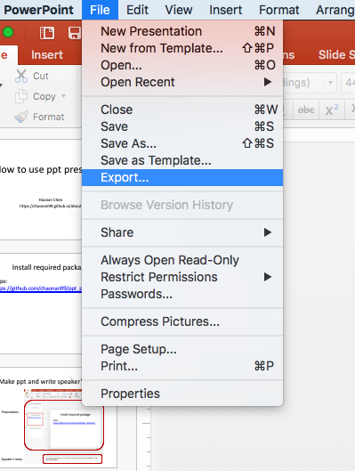
Save ppt and export to pdf
Export to pdf
Notes:
When you are finished, save your presentation, and also export your presentation into pdf format.

Slide 5
Run the script
$ python ppt_presenter.py --pptx test.pptx --pdf test.pdf -o test.mp4
Notes:
Finally, run the script specifying the path of your pptx and pdf files. You can run python, ppt presenter dot PY dash h to get help information.

Slide 6
Contact me
Notes:
You can open an issue on GitHub, if you encounter any problem.

