Slide 1
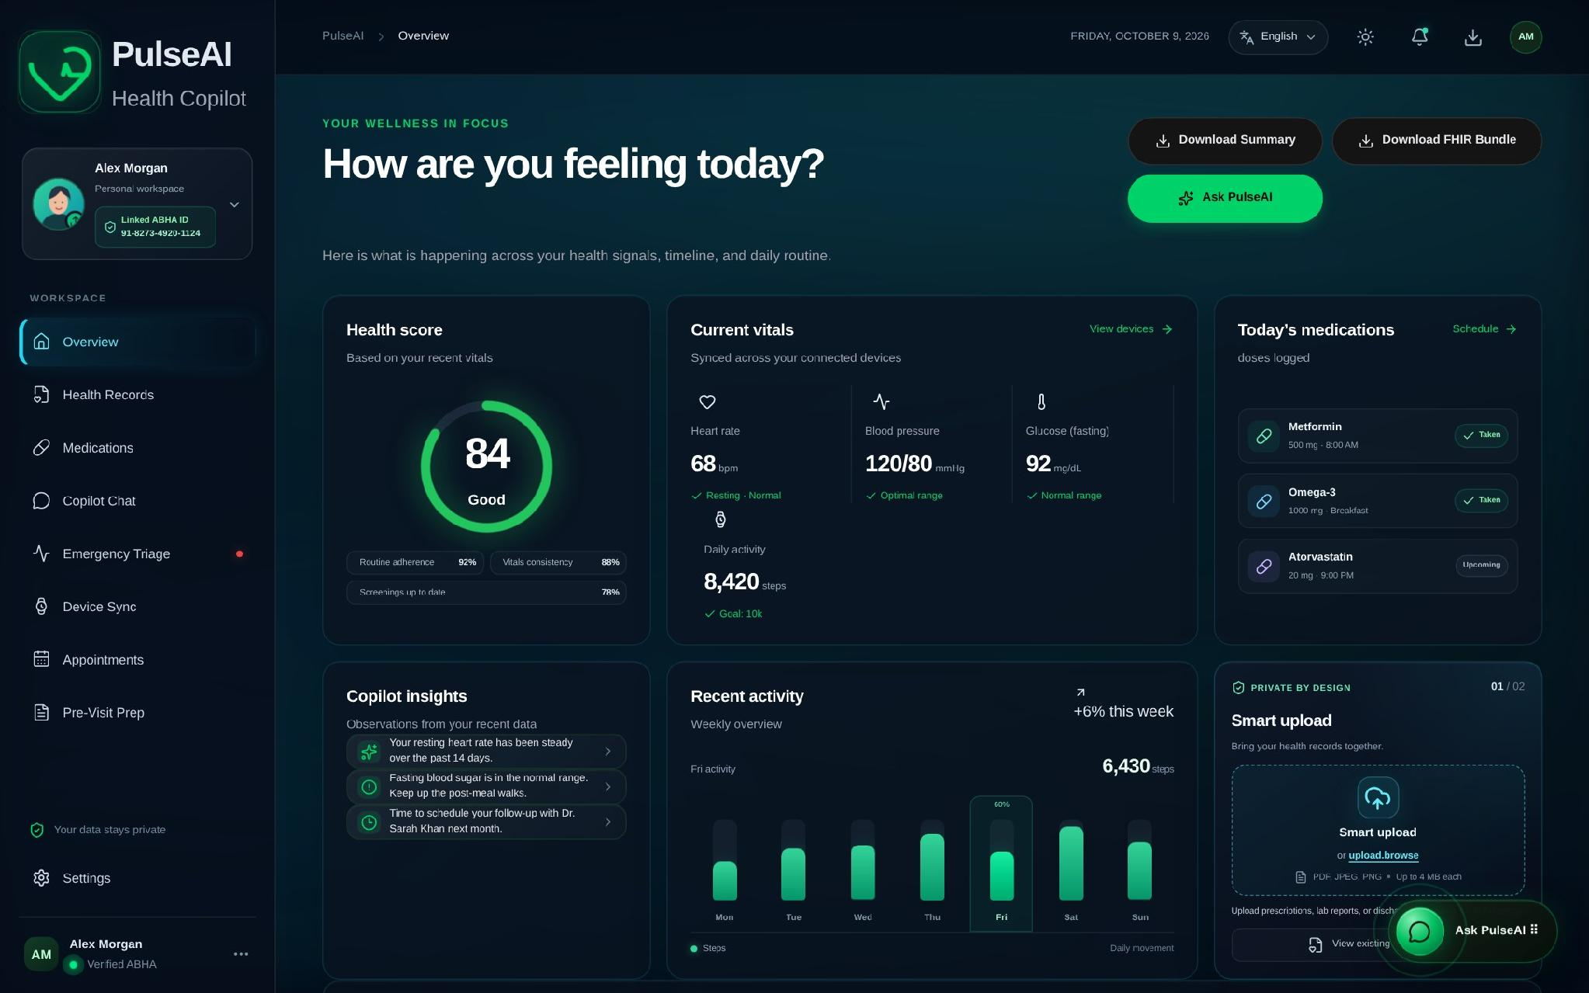
PulseAI
HACXLERATE 2026 | ALTRIX LABS HEALTHTECH CHALLENGE
Your AI-powered Personal Health Copilot
Turning lab reports, discharge summaries and handwritten prescriptions into plain-language, ABDM-ready health records.
TEAM | CODE REDS
TEAM LEAD
Mohammad Toufeeq Shaik
Satya Karthik
Namratha
Prathyusha
Shanmukha
Notes:
Opening. Introduce the team and the project: PulseAI, an AI-powered Personal Health Copilot built for the HacXLerate 2026 Altrix Labs HealthTech challenge. One-line pitch: it turns confusing medical documents into plain-language, ABDM-ready records. Replace the bracketed placeholders with your team name and member names.
The screenshot is the live PulseAI dashboard overview.

Slide 2





Patients can't read their own health records
Scattered records
Written for clinicians
Lab tests, discharge summaries and handwritten prescriptions live in separate places.
Jargon and raw values leave patients guessing which results actually matter.
The gap between medical documents and patient understanding
Language barriers
No single timeline
PulseAI closes it.
Records rarely speak the patient's own language, so key instructions get lost.
No unified view of conditions, medicines and results in a shareable standard format.
Notes:
The problem: health information is fragmented across lab tests, discharge summaries and handwritten prescriptions. It is written for clinicians, often not in the patient's language, and there is no single longitudinal view. This is the communication gap between medical documentation and patient understanding.

Slide 3



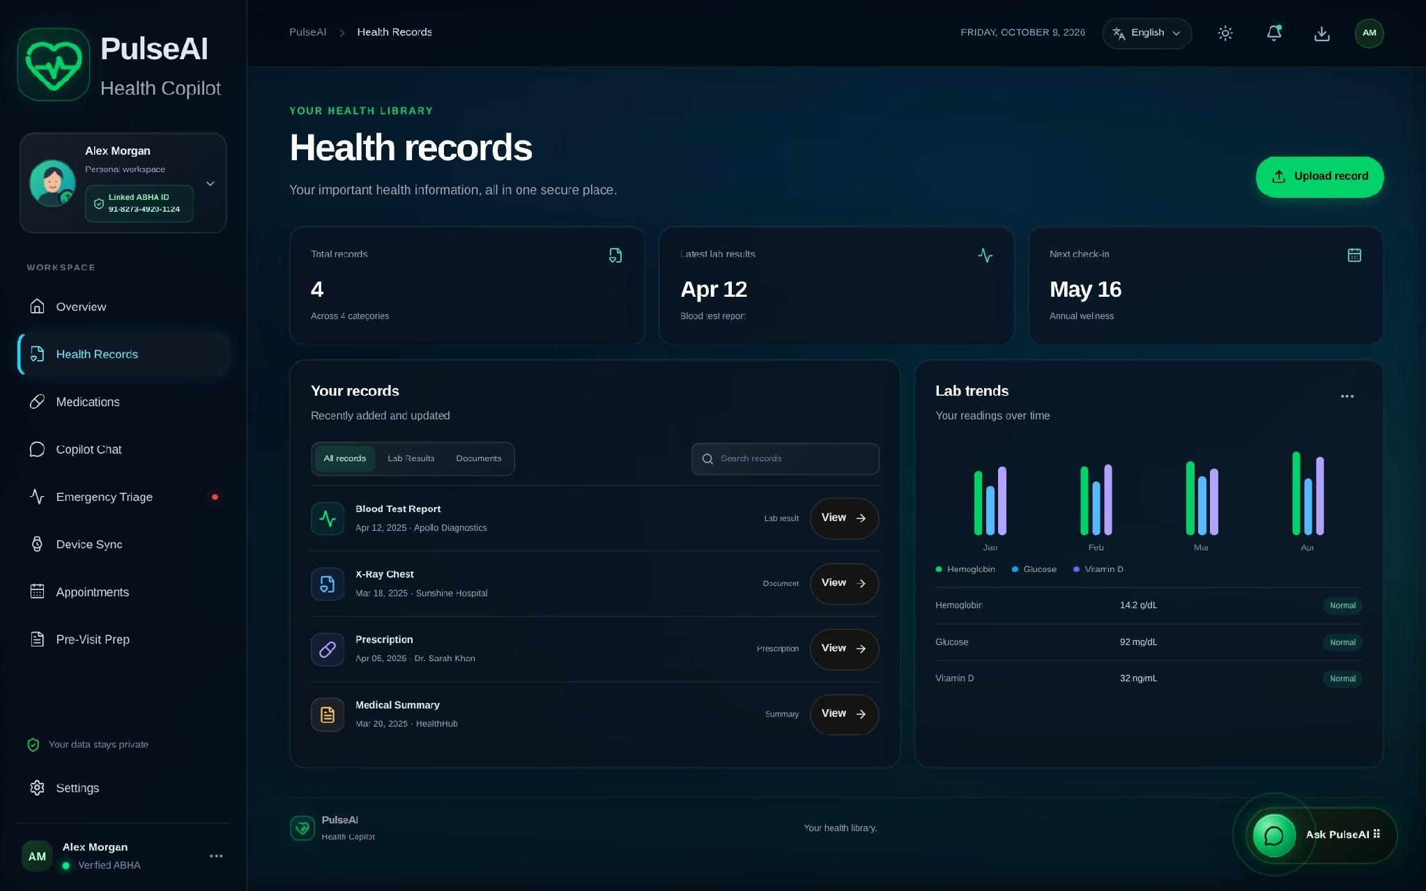
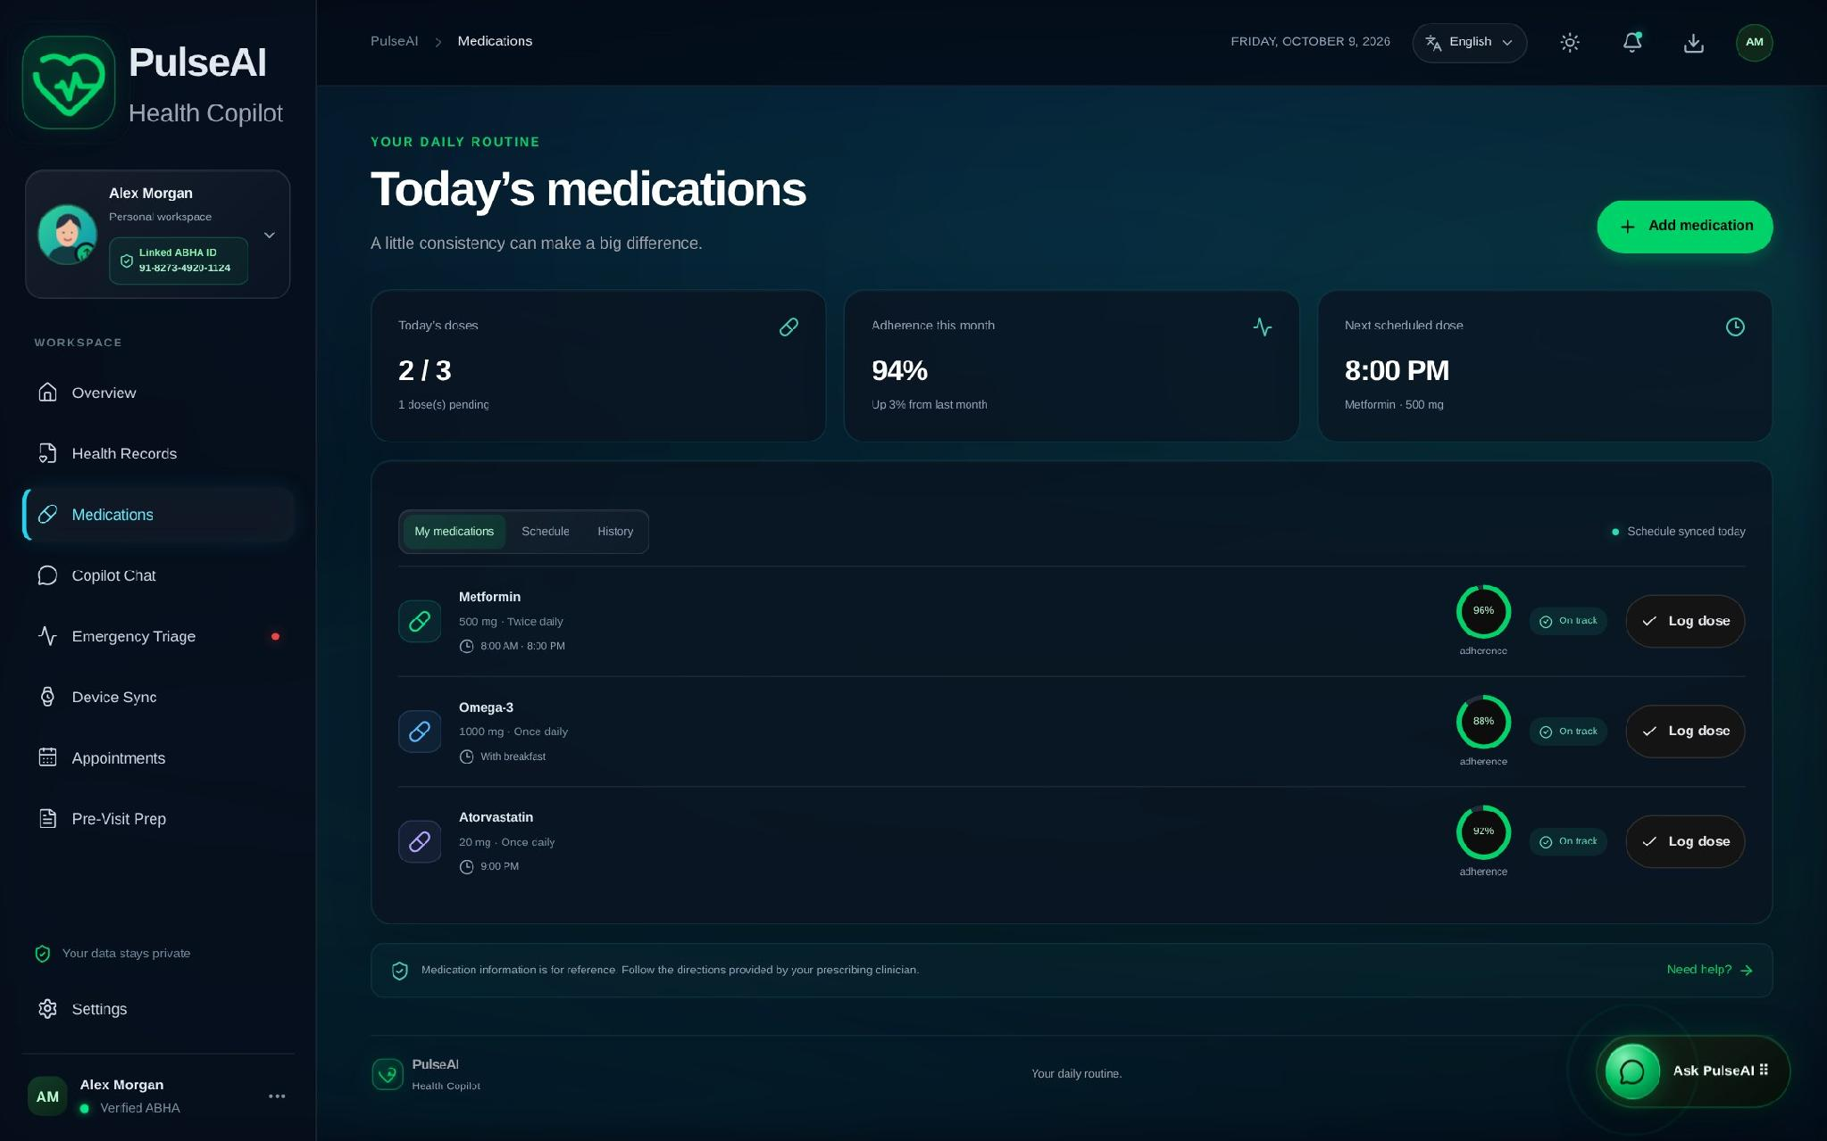
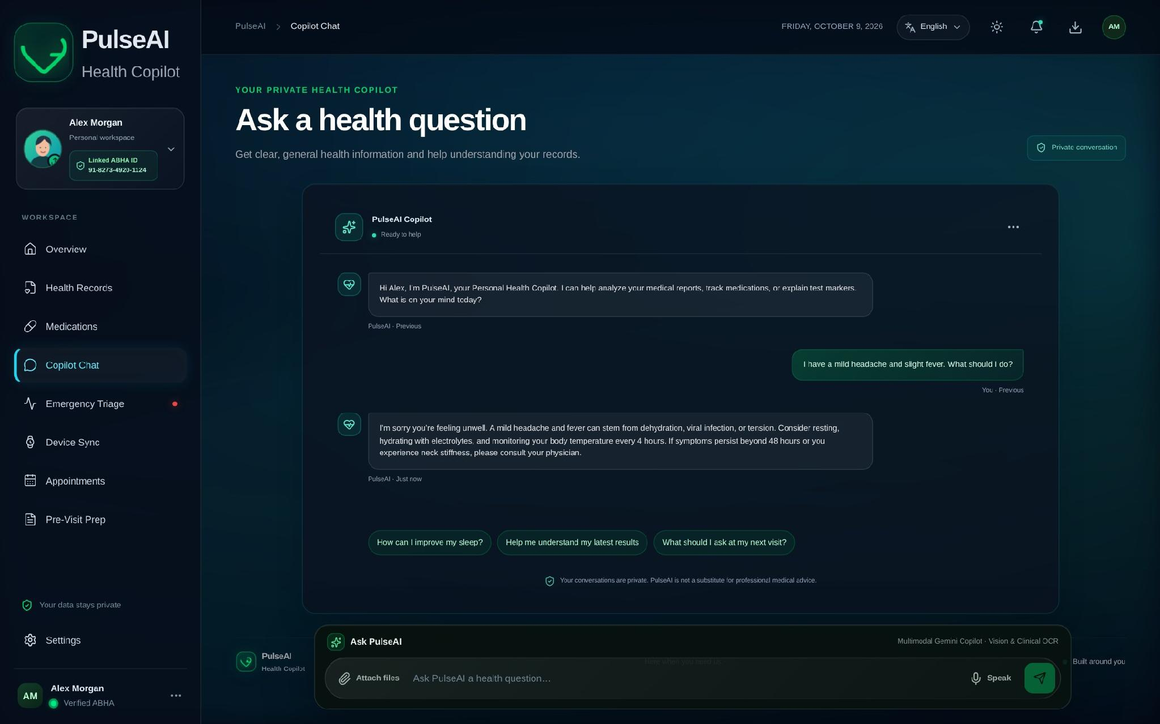
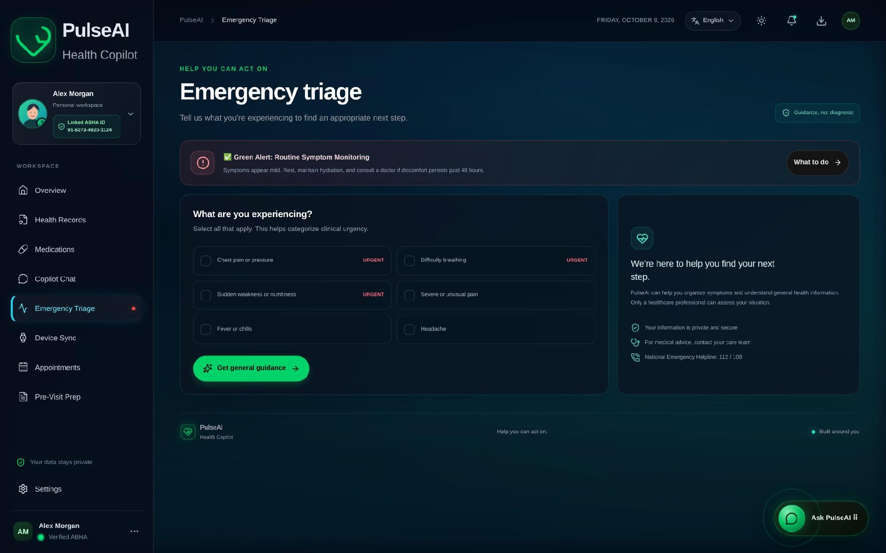
Meet PulseAI: one copilot, four steps
PulseAI ingests lab tests, discharge summaries and prescriptions and converts them into structured, FHIR R4-compliant health records for the Ayushman Bharat Digital Mission (ABDM) ecosystem.
STEP 01
STEP 02
STEP 03
STEP 04
Upload
Extract
Explain
Act
Drop in PDF, JPG or PNG reports, including scans and handwritten notes.
Gemini vision reads summary, medicines, test values and diagnoses.
Plain-language summaries flag abnormal values in four languages.
Unified timeline, triage guidance, chat and FHIR export.
Notes:
The solution in four steps: Upload, Extract, Explain, Act. Patients upload a report, Gemini vision extracts the structured data, the app explains it in plain language in English, Hindi, Telugu or Tamil, and then the patient can act on it through the timeline, triage, chat and FHIR export.
Under the hood (pipeline): Follow one record end to end. 1) The patient drops in a PDF, JPEG or PNG, up to 4 MB. 2) POST /api/process-record parses the multipart form and stores the file in a private Supabase bucket. 3) Gemini vision extracts the summary, medicines, test values with abnormal flags, and diagnoses, in the language the user selected. 4) The structured result is saved in the health_timeline table as JSONB. 5) The UI shows it on the timeline with plain-language explanations, and offers FHIR export and a printable summary. If Gemini is not configured, uploads are saved for manual review rather than faking results.
Screenshots, left to right: Health Records (upload), Medications (extracted medicines), Copilot Chat (plain-language explanation), Emergency Triage (act).

Slide 4
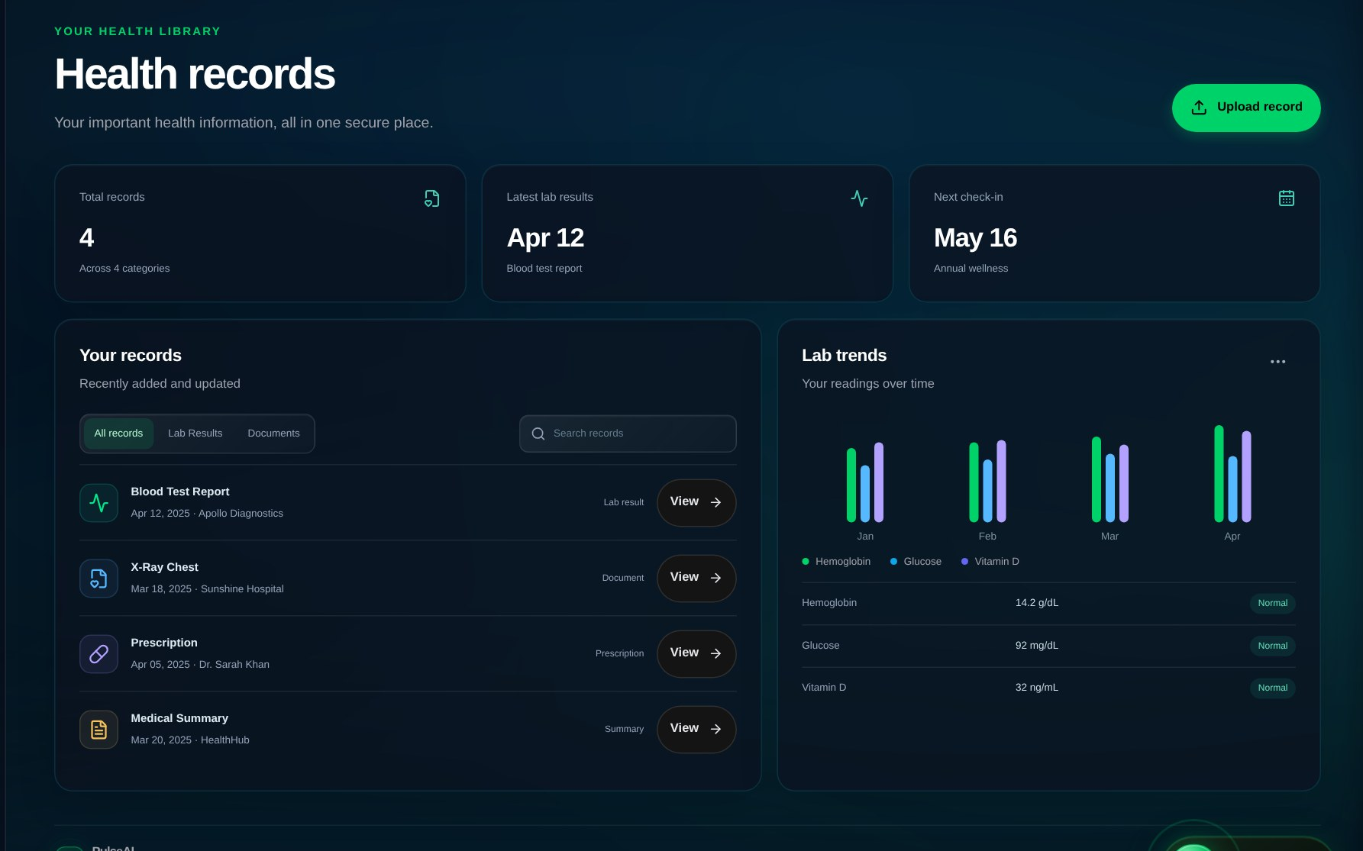


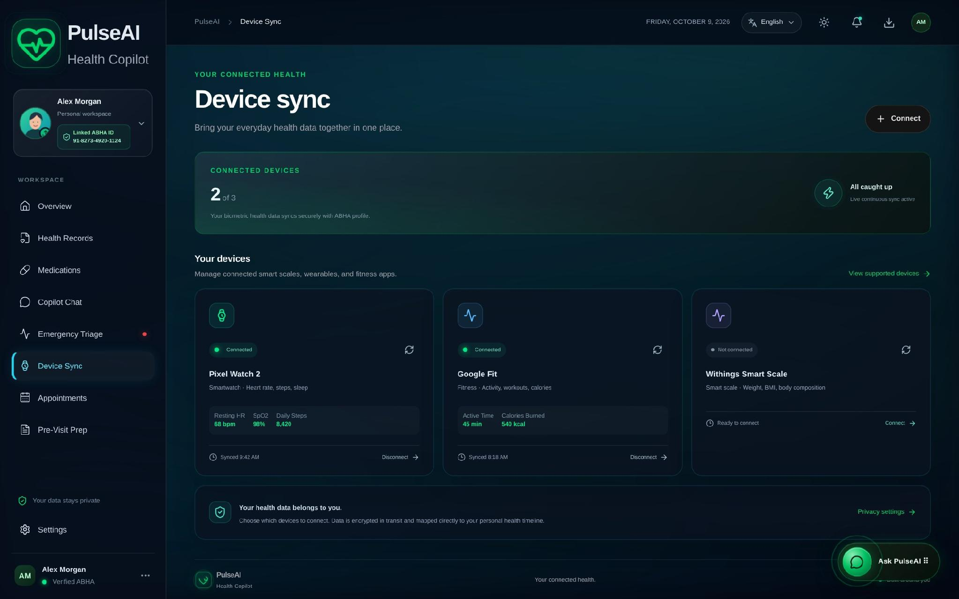


Everything the challenge asked for
Upload & extraction
Plain-language summaries
PDF, JPEG or PNG in; medicines, test values, diagnoses and dates out, via Gemini vision.
Patient-friendly explanations with abnormal values flagged and explained.
Unified health timeline
Regional languages
Every record in one Supabase-backed timeline, linked to the patient's ABHA ID.
English, Hindi, Telugu and Tamil across the UI, extraction and translation.
ABDM / FHIR export
Interactive modules
JSON Bundle with Patient, MedicationRequest, Observation and DiagnosticReport.
Emergency triage, medication adherence, wearable sync, chat and printable summary.
Notes:
Six capabilities, mapped directly to the challenge scope: record upload and extraction, plain-language summaries, a unified profile and timeline, regional language support, ABDM/FHIR export, and interactive demo modules (emergency triage, medication adherence, wearable simulation, chat and a printable summary).
Screenshots: unified records with lab trends (top) and device sync (bottom).

Slide 5





System architecture
CLIENT
Drag & drop upload
Copilot chat dock
Emergency triage & sync
HTTPS
API LAYER
NEXT.JS 16 API BACKEND ROUTER
POST /api/process-record
POST /api/chat
POST /api/translate
Multipart parser, storage key, validated OCR extraction
Message normalizer, multimodal attachments, truthful failures
Clinical dictionary and Gemini translation
SERVICES
Supabase Storage
PostgreSQL DB
Google Gemini
i18n Engine
Private bucket: medical_records
health_timeline with JSONB records
Gemini 3.8 Flash: multimodal OCR and chat
lib/i18n.ts: en, hi, te, ta
Notes:
Walk top to bottom. The patient uses a web or mobile PWA view with three entry points: drag-and-drop upload, the Copilot chat dock, and emergency triage and sync. Requests go over HTTPS to the Next.js 16 API router, which exposes three routes: process-record, chat and translate. Behind it sit Supabase Storage (private bucket), PostgreSQL with the health_timeline JSONB table, Google Gemini for multimodal OCR and chat, and the client-side localization engine for English, Hindi, Telugu and Tamil.

Slide 6
APIs and data model
POST
POST
POST
/api/process-record
/api/chat
/api/translate
In: Multipart form: file (PDF, JPEG, PNG up to 4 MB) and optional ABHA ID.
Out: Saved record with AI summary, medicines, test values and diagnoses.
In: JSON: message, history and an optional base64 report image.
Out: Assistant reply, with a safe offline fallback.
In: JSON: text and target language (hi, te, ta).
Out: Clinically translated text for summaries and instructions.
health_timeline PostgreSQL table on Supabase
ABDM FHIR R4 export
id
mock_abha_id
document_url
document_type
Patient / ABHA ID
MedicationRequest
Observation
DiagnosticReport
ai_summary_english
fhir_data (JSONB)
created_at
Notes:
Three REST endpoints. process-record takes a multipart file and returns the saved record with AI summary and structured data. chat takes a message, history and an optional base64 image. translate converts summaries into Hindi, Telugu or Tamil. Records live in a health_timeline PostgreSQL table where the fhir_data JSONB column holds the structured extraction. The FHIR export is a client-side JSON Bundle with Patient/ABHA, MedicationRequest, Observation and DiagnosticReport resources.

Slide 7




Tech stack
Frontend
Next.js 16 + TypeScript
Responsive dashboard in four languages, built with Turbopack.
AI engine
Google Gemini 3.8 Flash
Multimodal vision OCR, plain-language summaries and chat.
Backend
Next.js API routes
Serverless handlers for upload, chat and translation.
Data and storage
Supabase
PostgreSQL JSONB timeline and private file storage.
Standards
ABDM FHIR R4
Interoperable Patient, Observation and DiagnosticReport resources.
Deployment
Vercel
One-click deploy; the demo runs even without credentials.
Notes:
The stack: Next.js 16 with TypeScript and Turbopack for the UI and API routes, Google Gemini 3.8 Flash for multimodal extraction, summaries and chat, Supabase for PostgreSQL and private storage, ABDM FHIR R4 as the interoperability standard, and Vercel for deployment. The dashboard demo and offline chat work even without external credentials.

Slide 8





Safe, private and honest by design
Private by default
Secrets stay server-side
Prototype scope
Records sit in a private bucket and are shared only through time-limited signed links.
Gemini and Supabase service keys are never exposed with a public prefix.
Wearable and scale readings are simulated
ABHA ID is a mock identifier
Not connected to a live ABDM gateway or clinical system
Uploads capped at 4 MB (records) and 3 MB (chat)
Clinically safe
Truthful failures
No diagnoses or prescription changes. Emergencies point to 112 / 108.
Missing AI or database credentials give honest fallbacks, never fake output.
Notes:
Trust matters in health tech. Records are stored in a private bucket and shared only via time-limited signed links. Service keys stay server-side. PulseAI never diagnoses or changes prescriptions and escalates emergencies to 112/108. When AI or database credentials are missing, it fails truthfully. Be upfront about prototype scope: device readings are simulated, ABHA is a mock ID, and there is no live ABDM gateway connection yet.

Slide 9

Thank you. Questions?
WHAT'S NEXT
TRY IT LIVE
Live ABDM integration
Replace the mock ABHA ID with a real gateway connection.
ai-powered-personal-health-copilot-sigma.vercel.app
Real device sync
Swap simulated wearable readings for live data.
SOURCE CODE
github.com/Toufeeqshaik/AI-Powered-Personal-Health-Copilot
Large-file uploads
Direct-to-storage flow beyond the 4 MB limit.
TEAM | CODE REDS
TEAM LEAD
Mohammad Toufeeq Shaik
Satya Karthik
Namratha
Prathyusha
Shanmukha
Notes:
Close with what's next: connect to a real ABDM gateway, replace simulated device readings with live sync, and add a direct-to-storage upload flow for larger files. Point judges to the live demo and the GitHub repository, then open for questions. Replace the bracketed placeholders with your names.

