Slide 1

Course code : SWE2008
Course title : Object Oriented Analysis and Design
Module-6
Architectural Modeling

Slide 2
Module-6
Architectural Modeling:
Component, Deployment, Component diagrams and deployment diagrams.

Slide 3
Components
A component is a physical and replaceable part of a system that conforms to and provides the realization of a set of interfaces.
You use components to model the physical things that may reside on a node, such as executables, libraries, tables, files, and documents.
A component typically represents the physical packaging of otherwise logical elements, such as classes, interfaces, and collaborations.
In the UML, all these physical things are modeled as components. A component is a physical thing that conforms to and realizes a set of interfaces.
The UML provides a graphical representation of a component, as below figure shows.

Slide 4
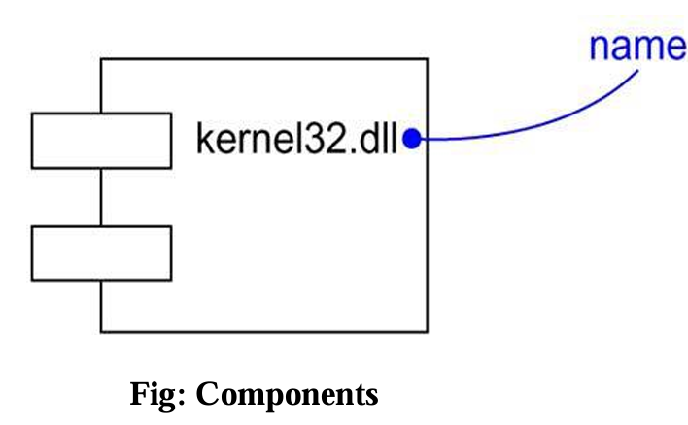
Graphically, a component is rendered as a rectangle with tabs.

Slide 5
Terms and Concepts
A component is a physical and replaceable part of a system that conforms to and provides the realization of a set of interfaces.
Graphically, a component is rendered as a rectangle with tabs.
1. Names:
Every component must have a name that distinguishes it from other components.
A name is a textual
A path name is the component name prefixed by the name of the package in which that component lives. That name alone is known as a simple name.

Slide 6
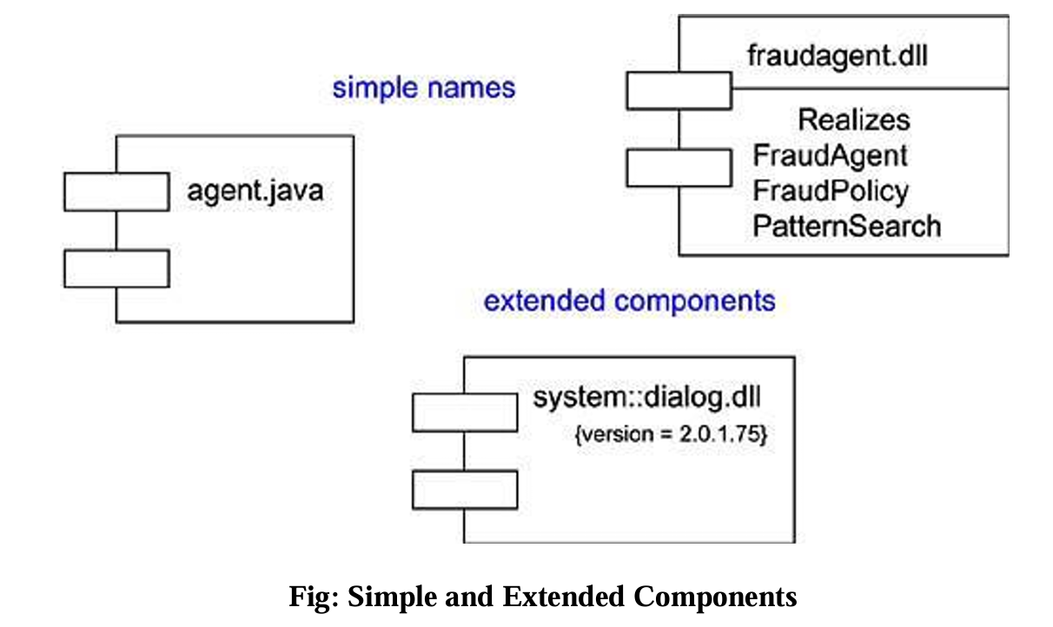
A component is typically drawn showing only its name, as in below figure. Just as with classes, you may draw components adorned with tagged values or with additional compartments to expose their details, as you see in the figure.

Slide 7
2. Components and Classes:
In many ways, components are like classes:
Both have names;
Both may realize a set of interfaces;
Both may participate in dependency, generalization, and association relationships;
Both may be nested;
Both may be participants in interactions.
However, there are some significant differences between components and classes.
Classes represent logical abstractions; components represent physical things that live in the world of bits. In short, components may live on nodes, classes may not.
Components represent the physical packaging of otherwise logical components and are at a different level of abstraction.
Classes may have attributes and operations directly. In general, components only have operations that are reachable only through their interfaces.

Slide 8
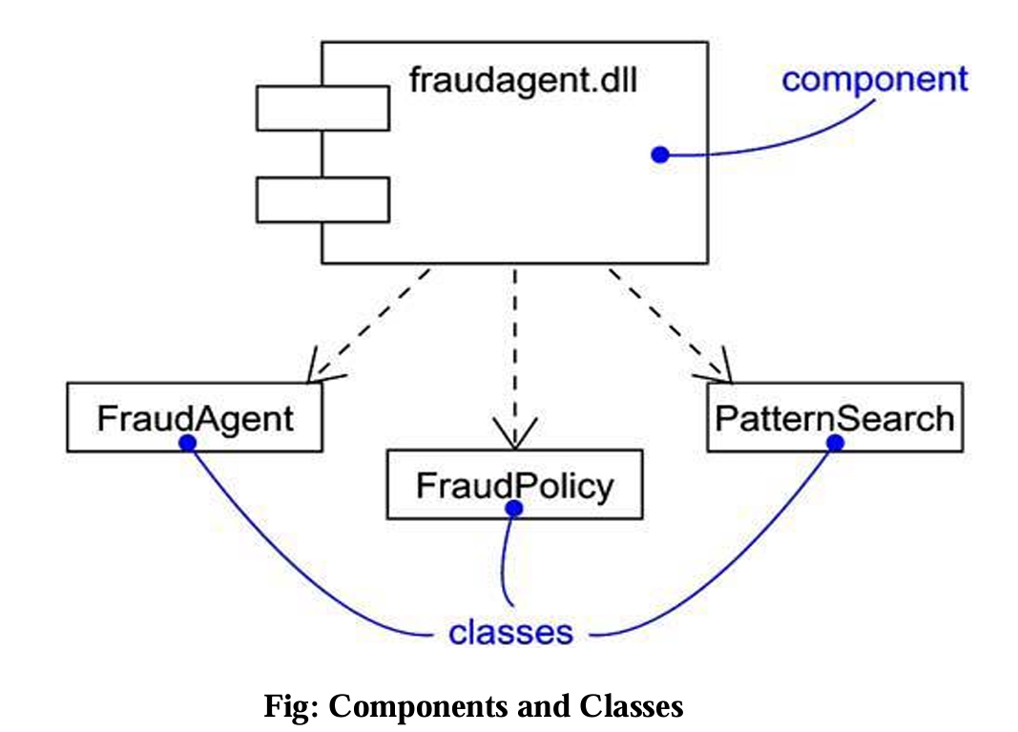
As below figure shows, the relationship between a component and the classes it implements can be shown explicitly by using a dependency relationship. Most of the time, you'll never need to visualize these relationships graphically. Rather, you will keep them as a part of the component's specification.

Slide 9
3. Components and Interfaces:
An interface is a collection of operations that are used to specify a service of a class or a component. The relationship between component and interface is important.
An interface that a component realizes is called an export interface, meaning an interface that the component provides as a service to other components. A component may provide many export interfaces. The interface that a component uses is called an import interface, meaning an interface that the component conforms to and so builds on. A component may conform to many import interfaces. Also, a component may both import and export interfaces.
A given interface may be exported by one component and imported by another.

Slide 10
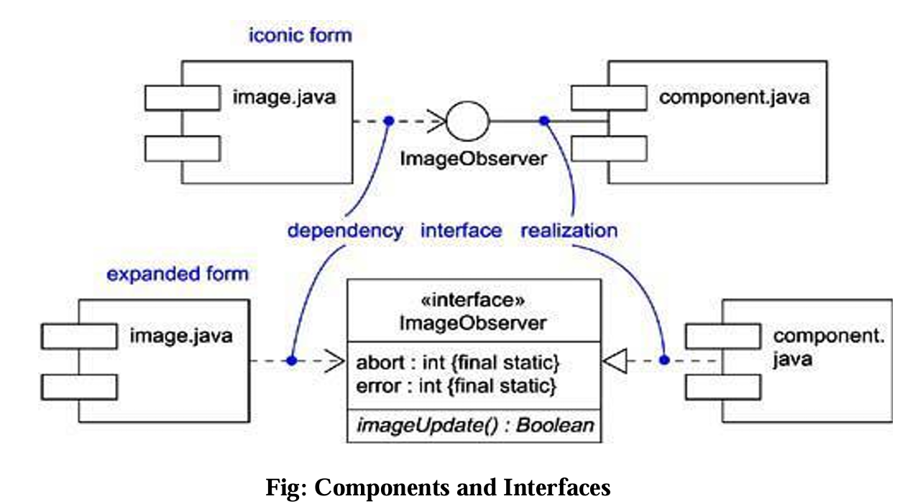

Slide 11
4. Binary Replaceability:
A component is a physical and replaceable part of a system that conforms to and provides the realization of a set of interfaces.
First, a component is physical. It lives in the world of bits, not concepts.
Second, a component is replaceable.
Third, a component is part of a system.
Fourth, as discussed in the previous section, a component conforms to and provides the realization of a set of interfaces.

Slide 12
5. Kinds of Components:
Three kinds of components may be distinguished.
First, there are deployment components. These are the components necessary and sufficient to form an executable system, such as dynamic libraries (DLLs) and executables (EXEs).
Second, there are work product components. These components are essentially the residue of the development process, consisting of things such as source code files and data files from which deployment components are created.
Third are execution components. These components are created as a consequence of an executing system, such as a COM+ object, which is instantiated from a DLL.

Slide 13
6. Organizing Components:
You can also organize components by specifying dependency, generalization, association (including aggregation), and realization relationships among them.

Slide 14
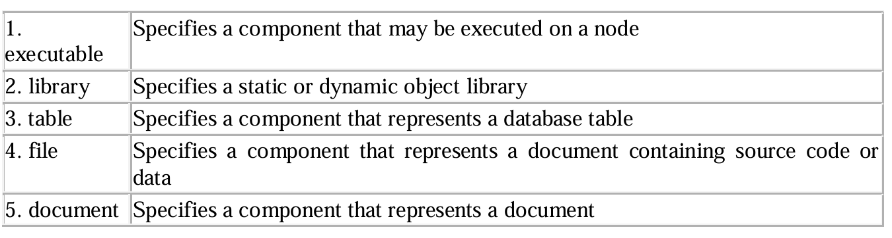
7. Standard Elements:
The UML defines five standard stereotypes that apply to components:

Slide 15
Common Modeling Techniques : Component
Modeling Executables and Libraries
Modeling Tables, Files, and Documents
Modeling an API
Modeling Source Code

Slide 16
Modeling Executables and Libraries
For most systems, these deployment components are drawn from the decisions you make about how to segment the physical implementation of your system

Slide 17
Modeling Executables and Libraries
To model executables and libraries,
Identify the partitioning of your physical system. Consider the impact of technical, configuration management, and reuse issues.
Model any executables and libraries as components, using the appropriate standard elements. If your implementation introduces new kinds of components, introduce a new appropriate stereotype.
If it's important for you to manage the seams in your system, model the significant interfaces that some components use and others realize.
As necessary to communicate your intent, model the relationships among these executables, libraries, and interfaces. Most often, you'll want to model the dependencies among these parts in order to visualize the impact of change.

Slide 18
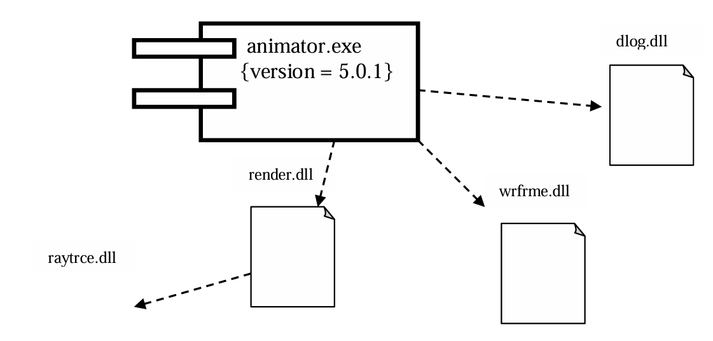

Slide 19
Modeling Tables, Files, and Documents
To model tables, files, and documents,
Identify the ancillary components that are part of the physical implementation of your system.
Model these things as components. If your implementation introduces new kinds of artifacts, introduce a new appropriate stereotype.
As necessary to communicate your intent, model the relationships among these ancillary components and the other executables, libraries, and interfaces in your system. Most often, you'll want to model the dependencies among these parts in order to visualize the impact of change.

Slide 20
For example, below figure builds on the previous figure and shows the tables, files, and documents that are part of the deployed system surrounding the executable animator.exe. This figure includes one document (animator.hlp), one simple file (animator.ini), and one database table (shapes.tbl), all of which use the UML's standard elements for documents, files, and tables, respectively.

Slide 21
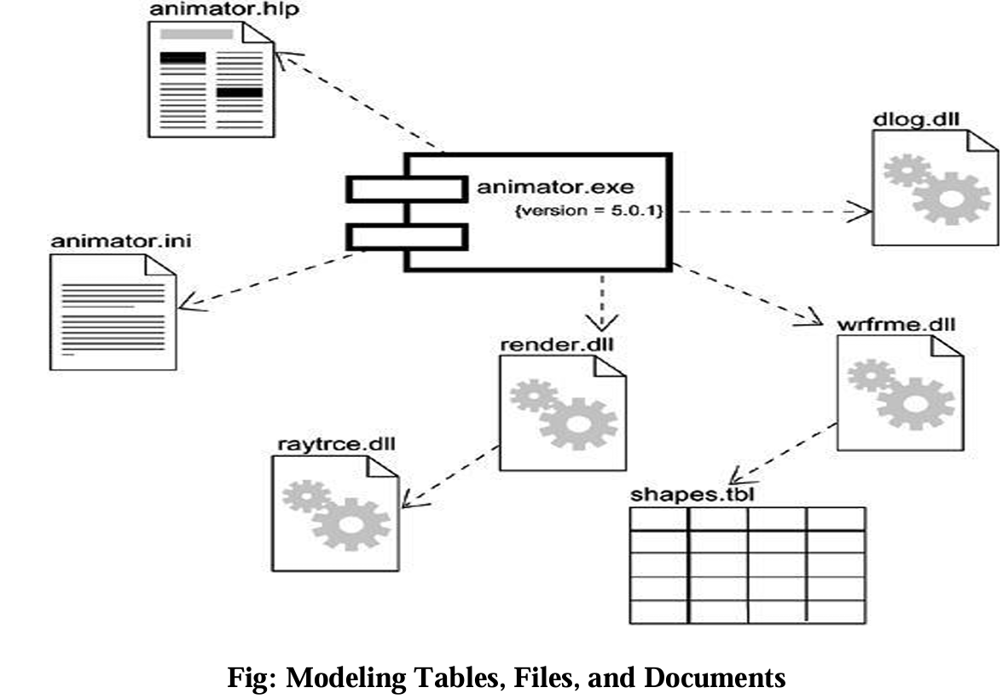

Slide 22
Modeling an API
To model an API ,
Identify the programmatic seams in your system and model each seam as an interface, collecting the attributes and operations that form this edge.
Expose only those properties of the interface that are important to visualize in the given context; otherwise, hide these properties, keeping them in the interface's specification for reference, as necessary.
Model the realization of each API only in so far as it is important to show the configuration of a specific implementation.
Figure exposes the APIs of the executable in the previous two figures. You'll see four interfaces that form the API of the executable: IApplication, IModels, IRendering, and IScripts.

Slide 23
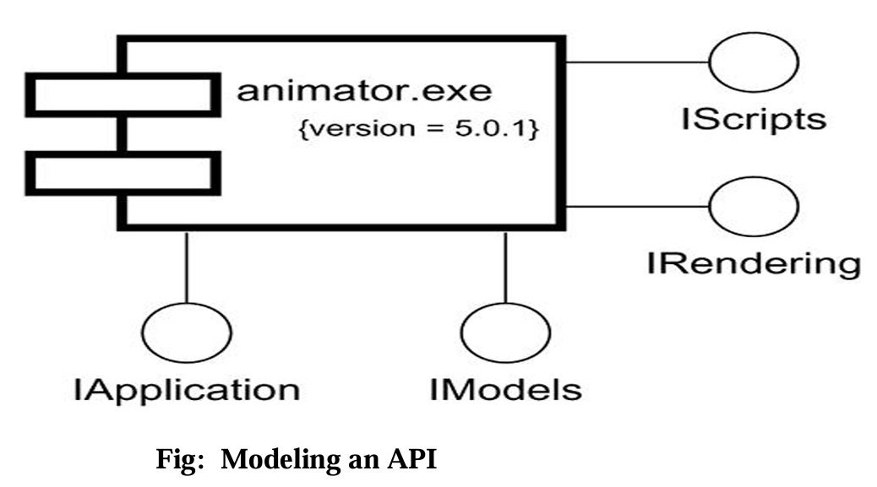

Slide 24
Modeling Source Code
To model source code,
Depending on the constraints imposed by your development tools, model the files used to store the details of all your logical elements, along with their compilation dependencies.
If it's important for you to bolt these models to your configuration management and version control tools, you'll want to include tagged values, such as version, author, and check in/check out information, for each file that's under configuration management.
As far as possible, let your development tools manage the relationships among these files, and use the UML only to visualize and document these relationships.

Slide 25
For example, below figure shows some source code files that are used to build the library render.dll from the previous examples. This figure includes four header files (render.h, rengine.h, poly.h, and colortab.h) that represent the source code for the specification of certain classes. There is also one implementation file (render.cpp) that represents the implementation of one of these headers.

Slide 26
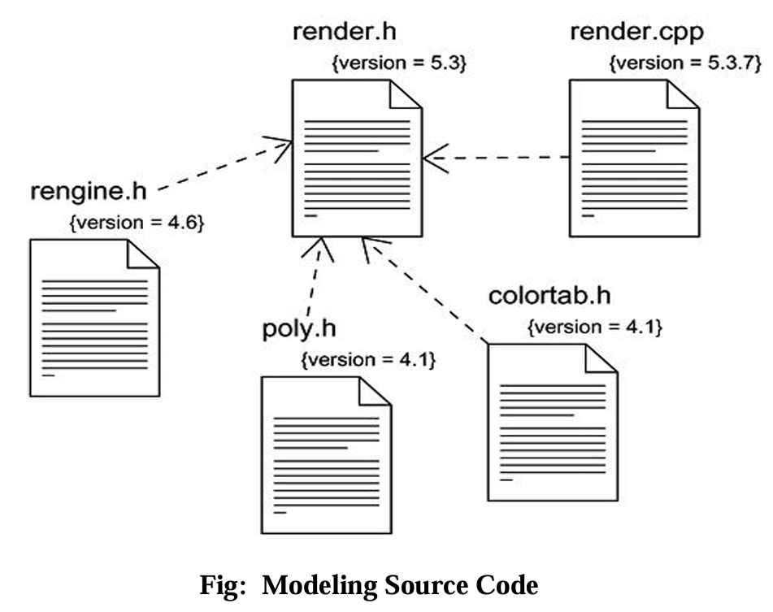

Slide 27
Component Diagrams
Component diagrams are one of the two kinds of diagrams found in modeling the physical aspects of object-oriented systems. A component diagram shows the organization and dependencies among a set of components.
We use component diagrams to model the static implementation view of a system. This involves modeling the physical things that reside on a node, such as executables, libraries, tables, files, and documents. Component diagrams are essentially class diagrams that focus on a system's components.

Slide 28
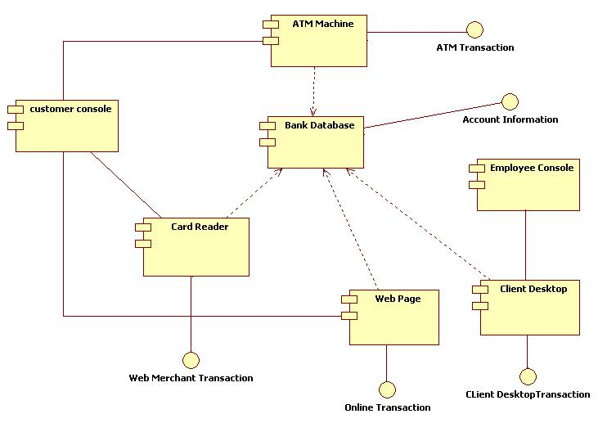
ATM

Slide 29
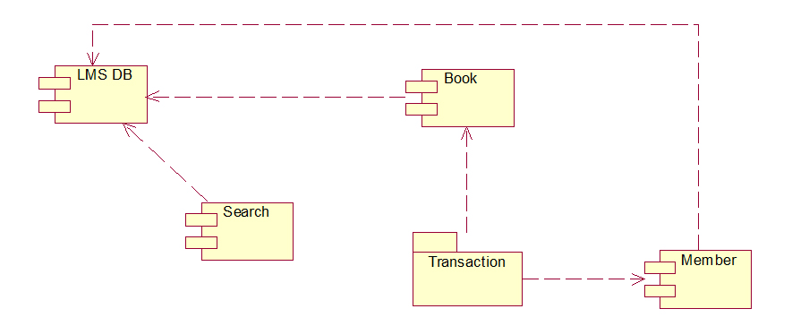
Library Management System:

Slide 30
Deployment
A node is a physical element that exists at run time and represents a computational resource, generally having atleast some memory and, often, processing capability.
You use nodes to model the topology of the hardware on which your system executes.
A node typically represents a processor or a device on which components may be deployed.

Slide 31
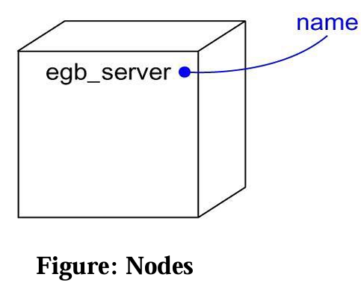

Slide 32
Terms and Concepts
A node is a physical element that exists at run time and represents a computational resource, generally having atleast some memory and, often, processing capability.
Graphically, a node is rendered as a cube.

Slide 33
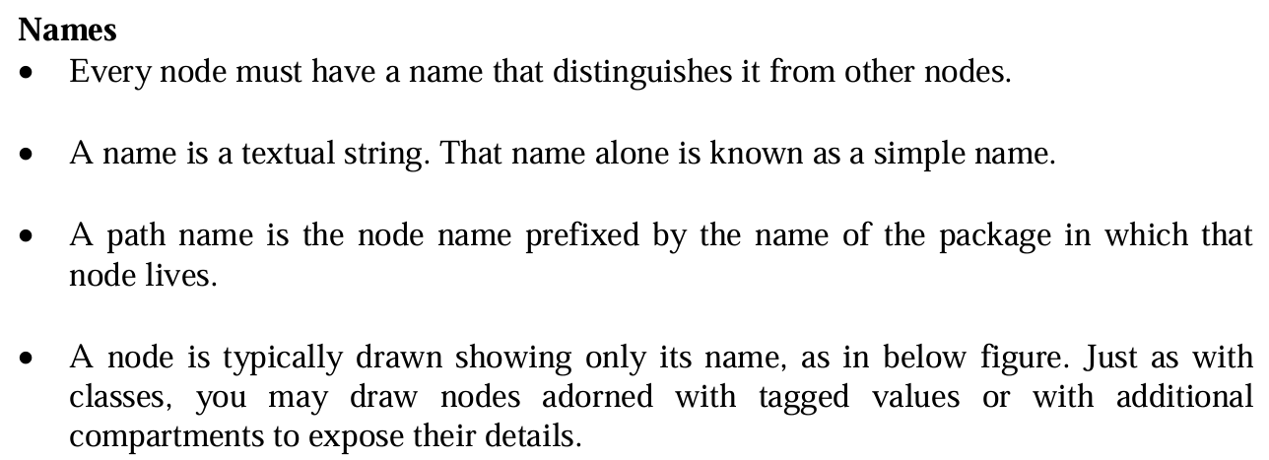

Slide 34
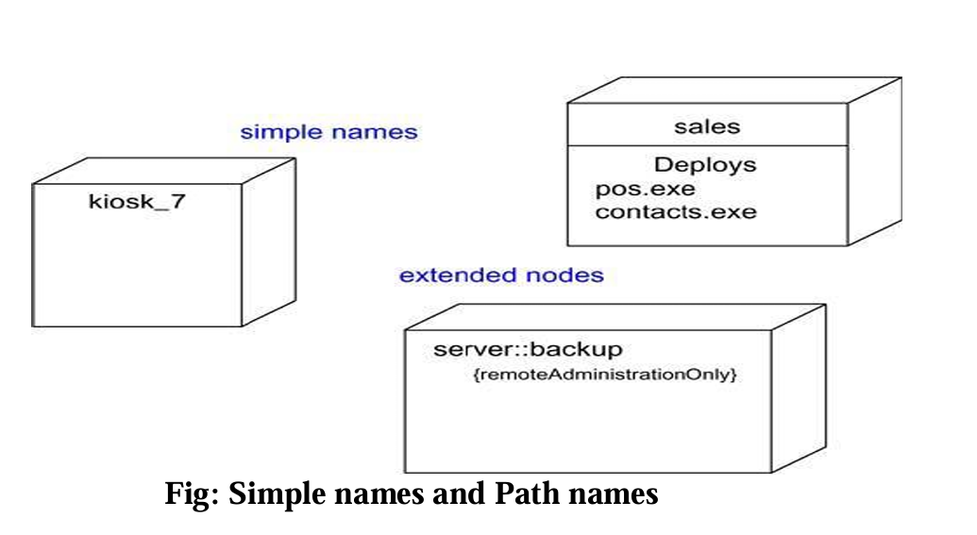

Slide 35
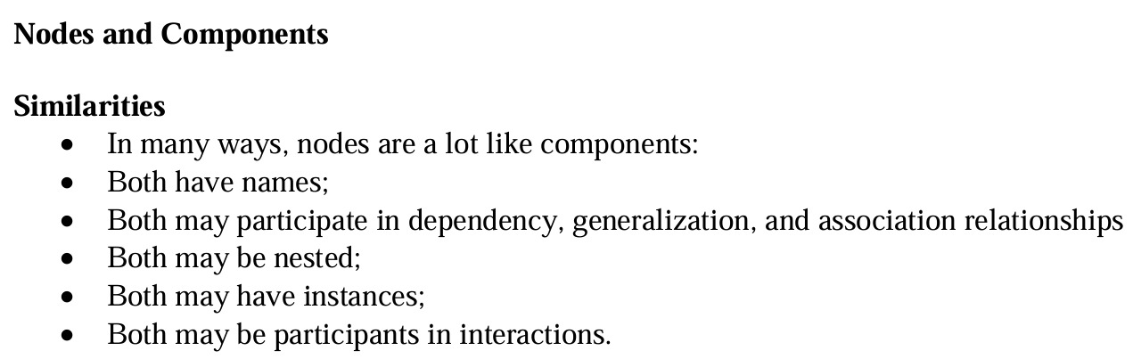

Slide 36
There are some significant differences between nodes and components.
Components are things that participate in the execution of a system; nodes are things that execute components.
Components represent the physical packaging of otherwise logical elements; Nodes represent the physical deployment of components.
This first difference is the most important. Simply put, nodes execute components; components are things that are executed by nodes.

Slide 37
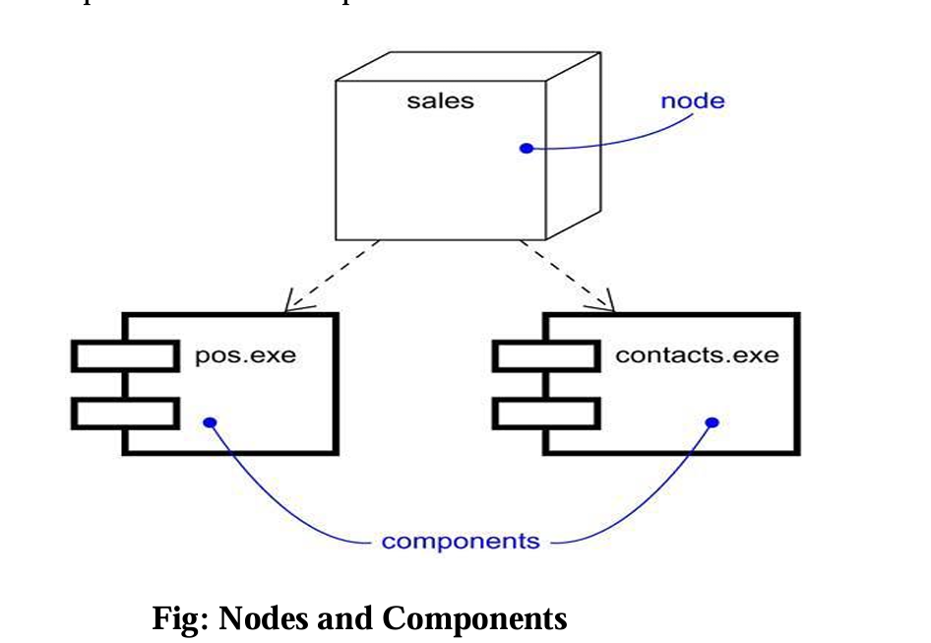

Slide 38
Deployment Diagrams
Deployment diagrams are one of the two kinds of diagrams used in modeling the physical aspects of an object-oriented system. A deployment diagram shows the configuration of run time processing nodes and the components that live on them.
We use deployment diagrams to model the static deployment view of a system. For the most part, this involves modeling the topology of the hardware on which your system executes. Deployment diagrams are essentially class diagrams that focus on a system's nodes.

Slide 39
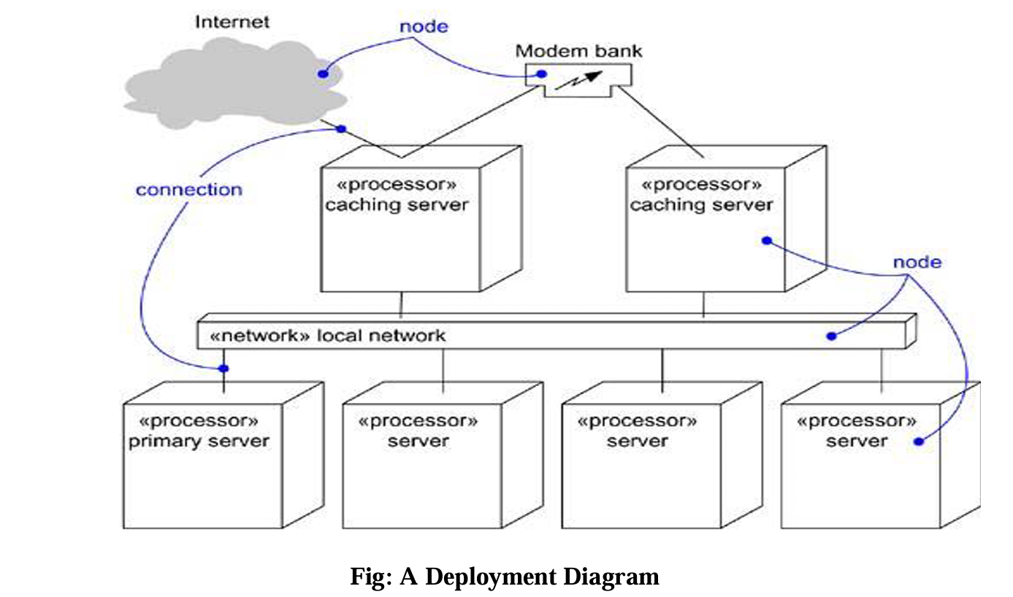

Slide 40
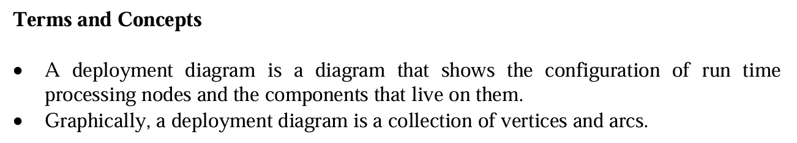

Slide 41
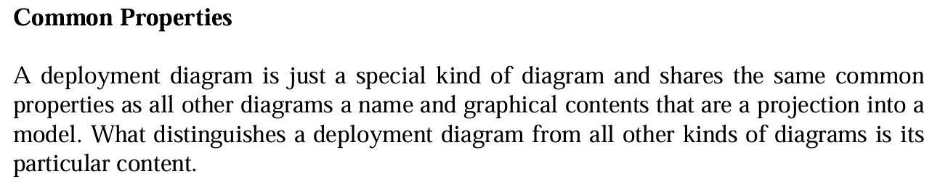

Slide 42
Contents:
Deployment diagrams commonly contain
Nodes
Dependency and association relationships
Like all other diagrams, deployment diagrams may contain notes and constraints.
Deployment diagrams may also contain components, each of which must live on some node.
Deployment diagrams may also contain packages or subsystems,

Slide 43
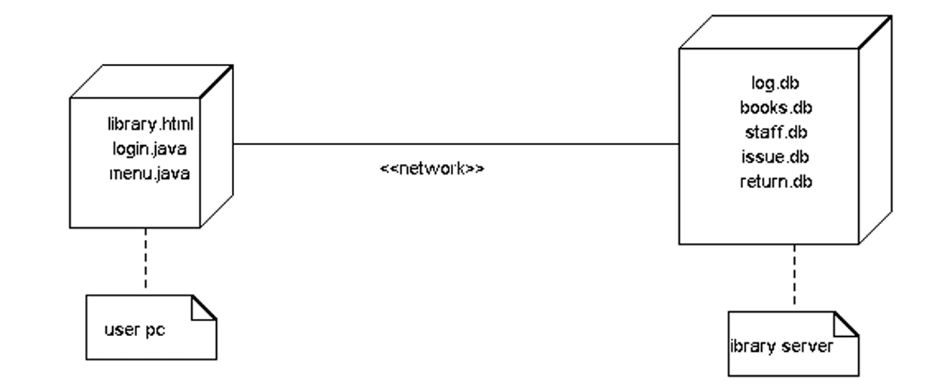
Library system-Deployment Diagram

Slide 44
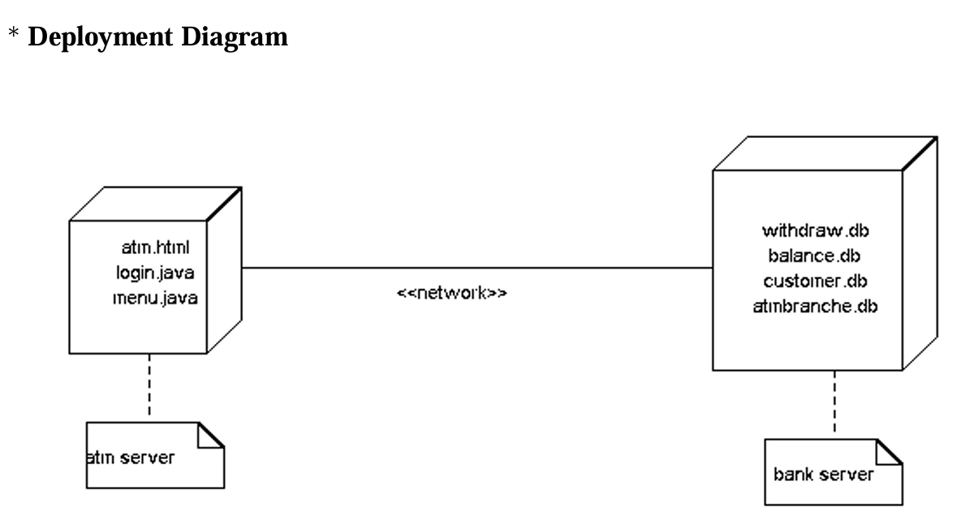
ATM Machine

