Slide 1

EEE 414 Electrical Service Design Laboratory
Group 3
1606135 | M Zafir Sadik Khan 1606179| Md. Shahedul Hasan 1606159 | Md. Toufiqur Rahman
1606166 | Shovon Roy
1606156 | Kanak Kanti Bhowmik 1606160 | Tushar Roy 1606178 | Partho Bhoumik 1606192 | Swagata Goswami Utsha

Slide 2
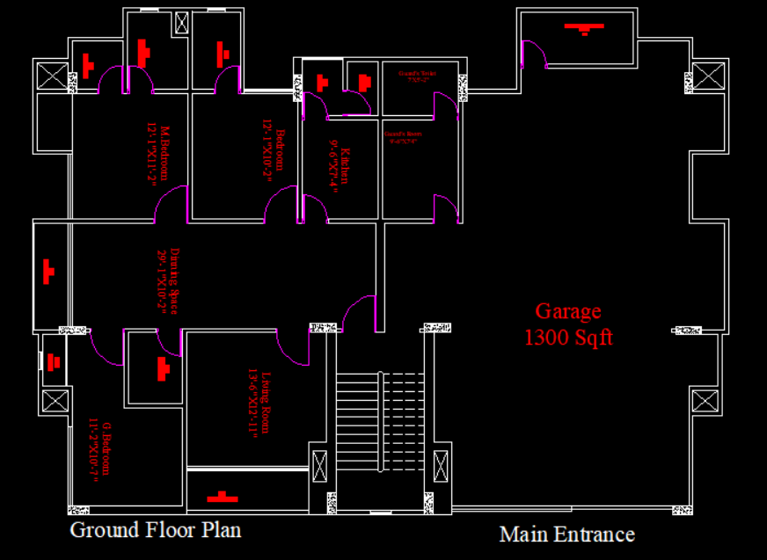

Ground floor and the main entrance

Slide 3
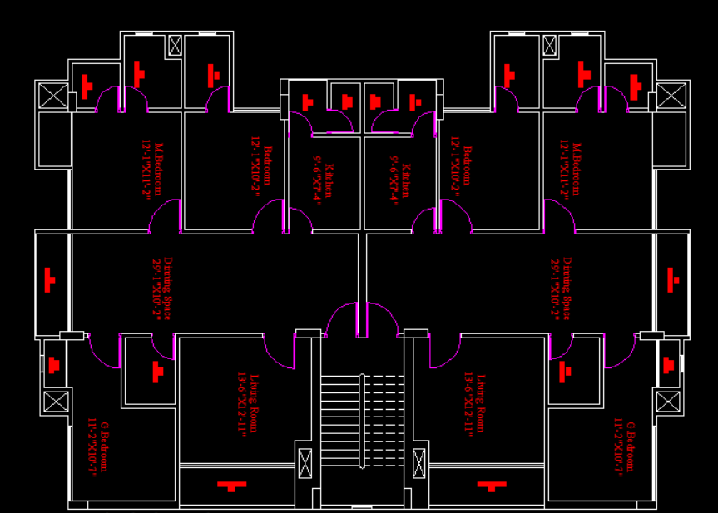
Plan for the 1st floor and same goes for the 2nd one
1st Floor plan

Slide 4

Formula related to the calculation
We know,
$E= \frac{n∗N∗F∗UF∗LLF}{A}, A in m^{2}$
E = Illuminance
n = number of lights per illuminance
N = number of lights required
F = lumen of bulb
LLF = Light Loss Factor
UF = Utilization factor
A = area
$F= \frac{A}{100}, A in sq−ft$
Here,
F = number of fans required
Master Bedroom:
Area= 12’1” x 11’2” = 134.93 sqft = 12.53546 m²
Illuminance, E= 100 Lumen/m²
Light Loss Factor and Utilization Factor, LLF x UF = 0.7
Number of lights per illuminaire, n=1
Flux= 1250 Lumen
Number of Lights, N= 1.4326 ≈ 2
So, 1 light bulb and 1 tube light are required.
Number of Fans= 1.3493 ≈ 1

Slide 5
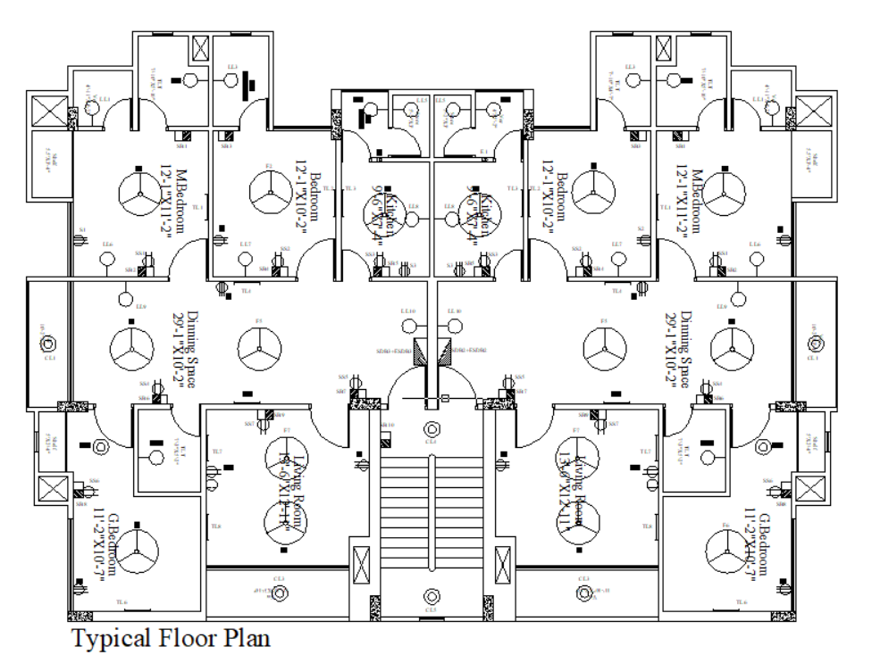
Fixtures and Fittings (Typical Floor)

Slide 6
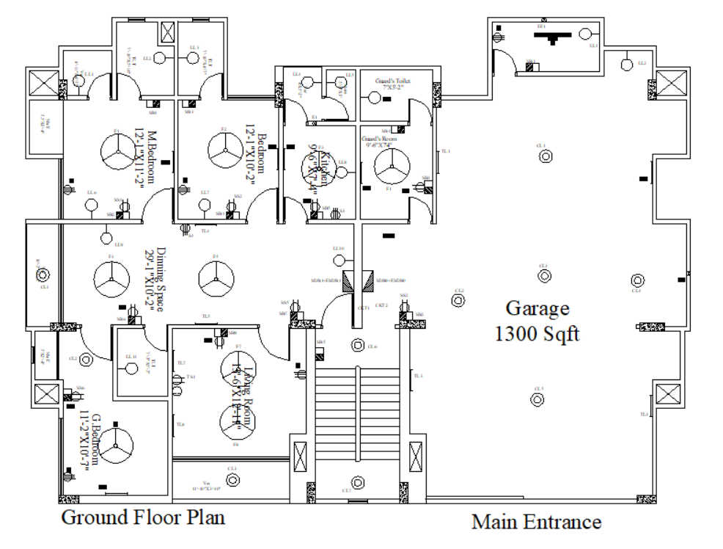
Fixtures and Fittings (Ground Floor)

Slide 7
Calculation of no of Lights and Fans
Room name (Ground Floor) | No of Lights | No of Fans
1. Veranda 1 | 1 | 0
2. Toilet 1 | 1 | 0
3. Toilet 2 | 1 | 0
4. Master Bedroom | 2 | 1
5. Bedroom 1 | 2 | 1
6. Dinning space 1,2 | 2 | 2
7. Kitchen | 2 | 0
8. G. Bedroom | 1 | 1
9. Toilet 3 | 1 | 0
10. Living Room 1,2 | 2 | 2
11. Veranda 2 | 1 | 0
12. Guard’s Room | 1 | 1
14. Guard’s Toilet | 1 | 0
13. Store Room | 1 | 1
14. Garrage | 10 | 2
15. Generator and Pump room | 1 | 1

Slide 8
Calculation of no of Lights and Fans
Room name (First Floor) | No of Lights | No of Fans
1. Veranda 1 | 1 | 0
2. Toilet 1 | 1 | 0
3. Toilet 2 | 1 | 0
4. Master Bedroom | 2 | 1
5. Bedroom 1 | 2 | 1
6. Dinning space 1,2 | 2 | 2
7. Kitchen | 2 | 0
8. G. Bedroom | 1 | 1
9. Toilet 3 | 1 | 0
10. Living Room 1,2 | 2 | 2
11. Veranda 2 | 1 | 0
12. Store Room | 1 | 1

Slide 9
Calculation of no of Lights and Fans
Room name (Second Floor) | No of Lights | No of Fans
1. Veranda 1 | 1 | 0
2. Toilet 1 | 1 | 0
3. Toilet 2 | 1 | 0
4. Master Bedroom | 2 | 1
5. Bedroom 1 | 2 | 1
6. Dinning space 1,2 | 2 | 2
7. Kitchen | 2 | 0
8. G. Bedroom | 1 | 1
9. Toilet 3 | 1 | 0
10. Living Room 1,2 | 2 | 2
11. Veranda 2 | 1 | 0
12. Store Room | 1 | 1

Slide 10
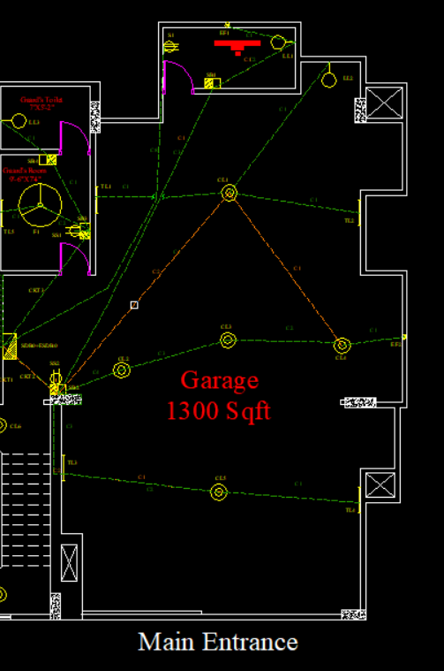
Parking Space Layout
Guard Room & Washroom: 105 sq ft
Generator & Pump Room: 54 sq ft
Garage: 1300 sq ft
Components:
Tubelights – 4
Ceiling mounted lights – 5
Wall mounted lights – 1
Switchboards - 5

Slide 11
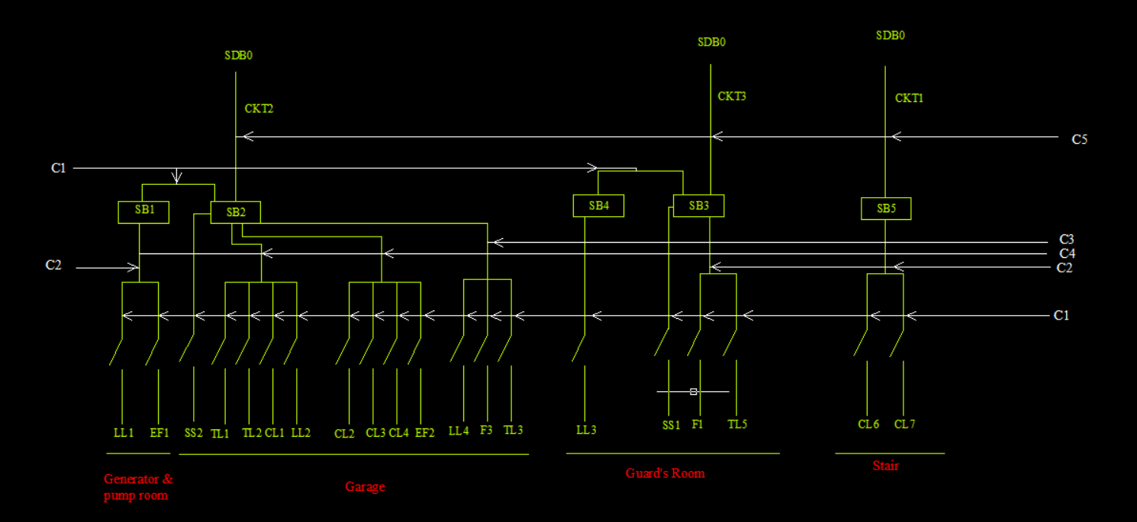
SDB0
Load Current: 14.35 A
Circuit Breaker Rating: 20A
(2 X 6rm BYM + 6rm BYS ECC)

Slide 12
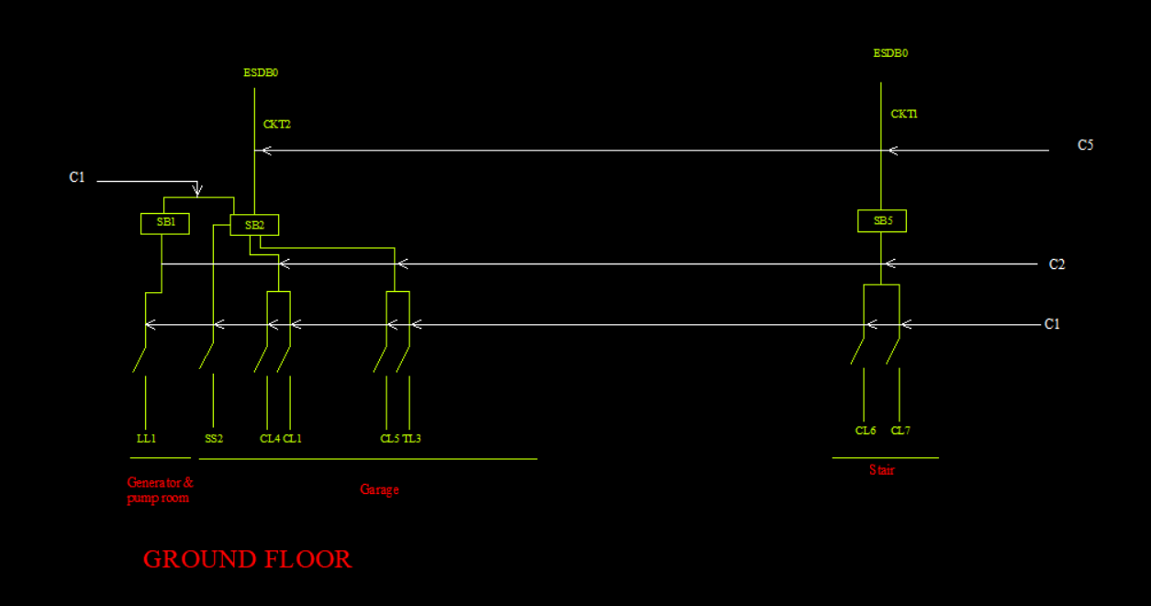
ESDB0
Load Current: 1.247 A
Circuit Breaker Rating: 5A
(2 X 1.5rm BYM + 1.5rm BYS ECC)

Slide 13
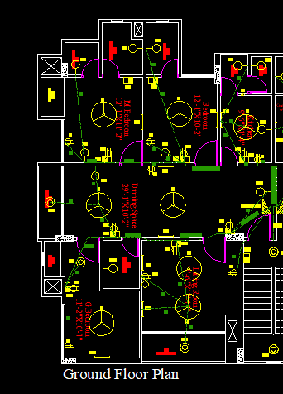
SDB1 WIRING DIAGRAM
*Green line indicates the main line.
Sub Distribution board
1606159

Slide 14
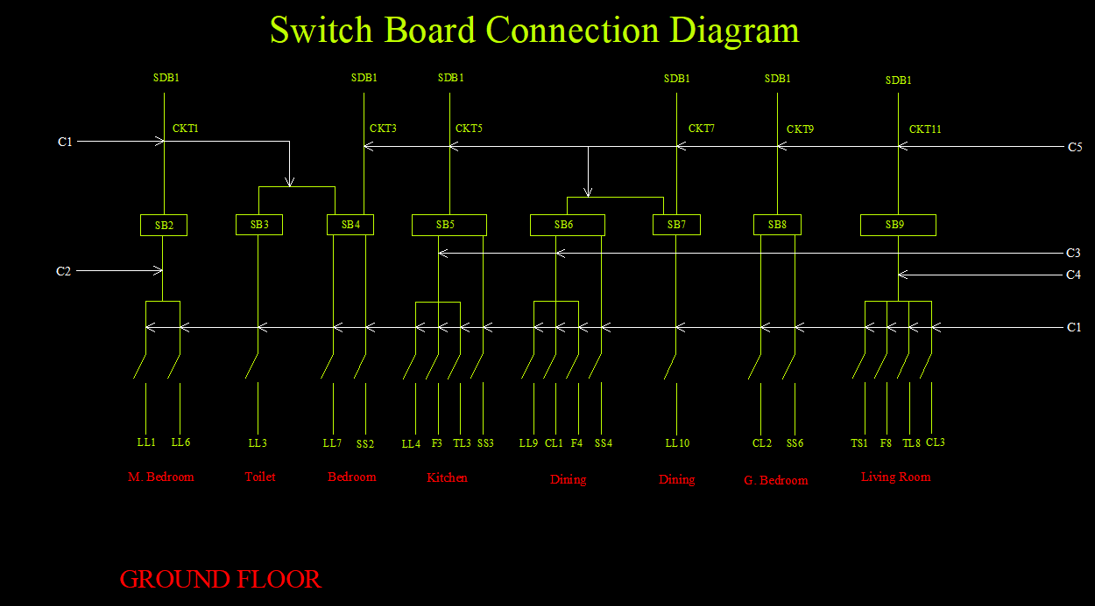
SDB1 CIRCUIT DIAGRAM
1606159

Slide 15
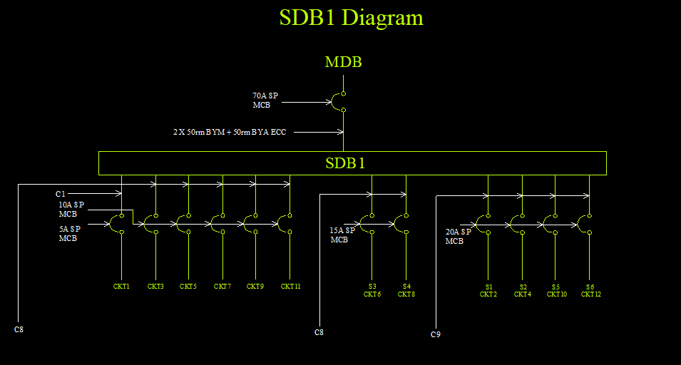
1606159

Slide 16
FOR SDB1
*Total SDB LOAD=9632w
*SDB Current=62.545A
*70 A SP MCB is used for the connection with MDB.
FOR ESDB1
*Total ESDB LOAD=832w
*ESDB Current=5.40A
*10A SP MCB is used for the connection with EMDB.
1606159

Slide 17
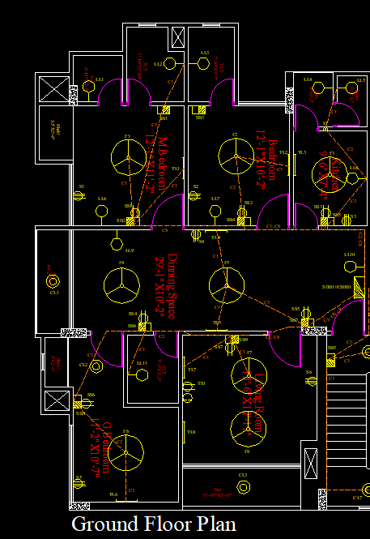
ESDB1 WIRING DIAGRAM
*Red line indicates the Emergency line.
Emergency Sub Distribution board
1606159

Slide 18
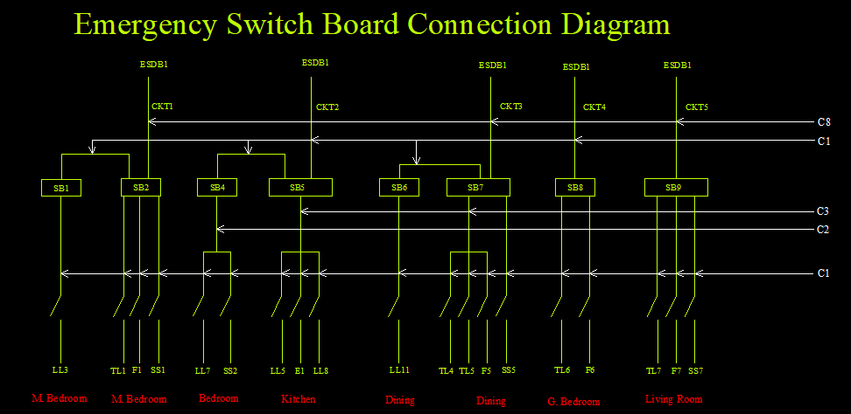
1606159

Slide 19
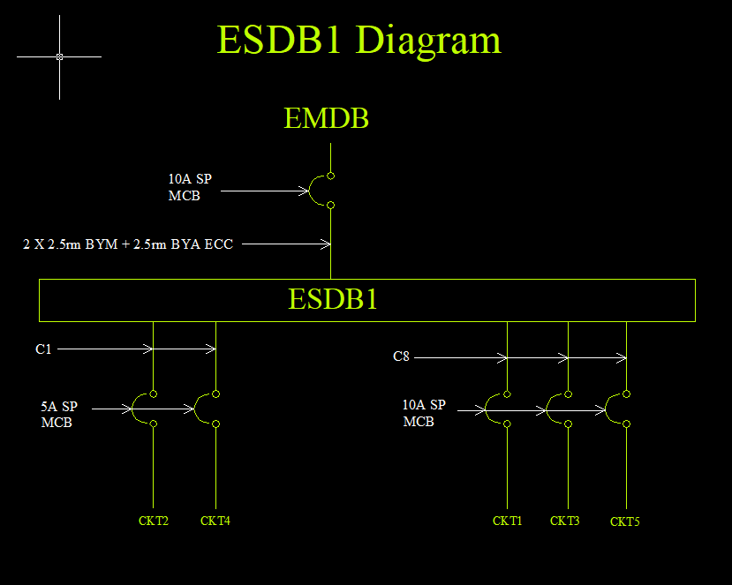
1606159

Slide 20
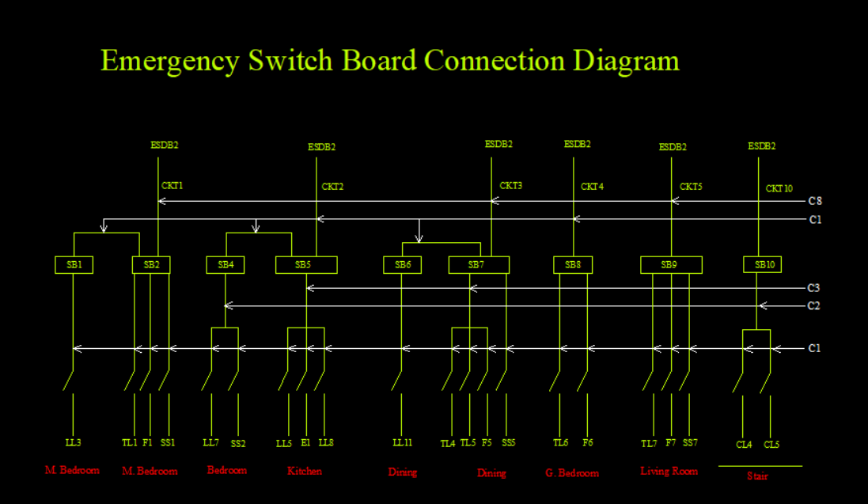

Slide 21

CKT1 Rating
I =$\frac{20+100+100+20}{220∗0.7}$ (A)
=1.55844 A
So, 2 x 1.5 rm BYM + 1.5 BYA ECC are used.

Slide 22
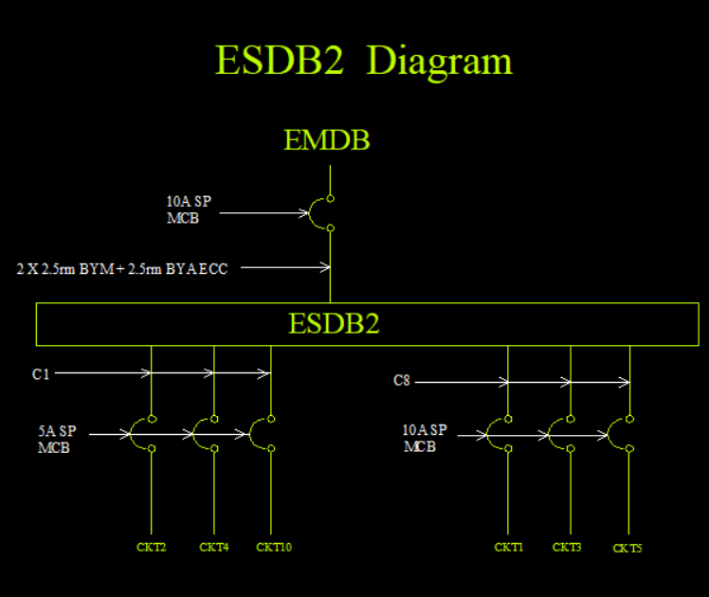
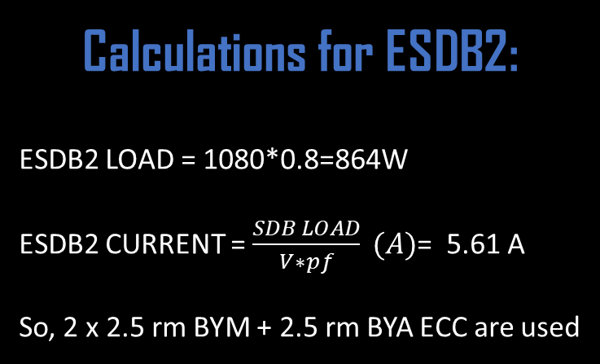
Calculations for ESDB2:
ESDB2 LOAD = 1080*0.8=864W
ESDB2 CURRENT = $\frac{SDB LOAD}{V∗pf} (A)$= 5.61 A
So, 2 x 2.5 rm BYM + 2.5 rm BYA ECC are used

Slide 23
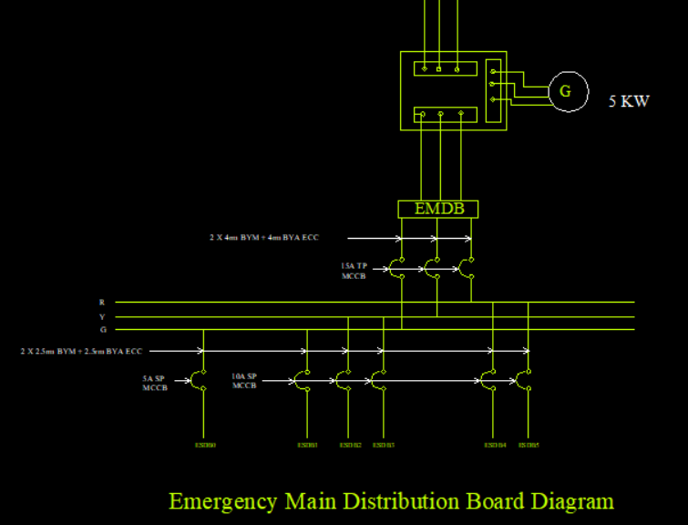


EMDB Current = $\frac{EMDB Load}{\sqrt{3}∗Line Voltage∗pf}$
$=6.69 A$
A 5 KW Generator is used to supply the EMDB Load through an ATS.

Slide 24
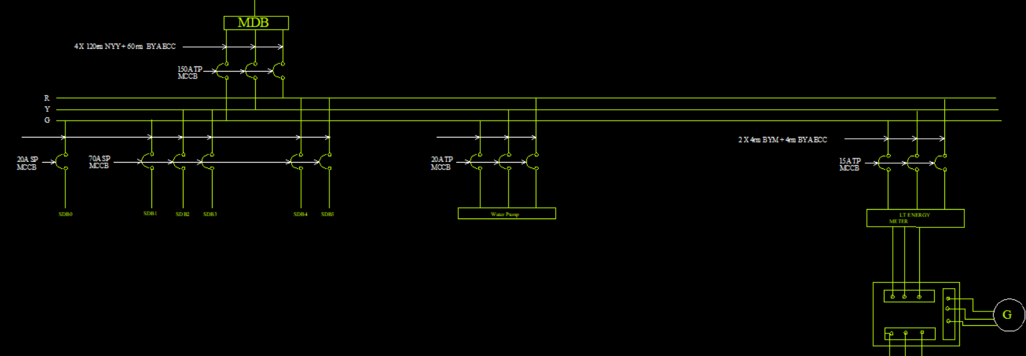

MDB load = Total SDB load x 0.7 + (EMDB load + Pump load) x 0.7
$$MDB current= \frac{40372.4}{\sqrt{3} ×381.05×0.7}=87.386 A$$
So, 150A TP MCCB is needed from MDB to Main Line
= 40372.4 W

Slide 25
Thank You

