Slide 1




Iot Data Logger for Main Line
C
Submitted by – Group C.06
M Zafir Sadik Khan
1606135
Nur Nabila Sadia
1606138
Toufiqur Rahman Shuvo
1606159
Sandip Kollol Dhruba
1606187

Slide 2
Outline
Summary
Background
Methods
Simulation
PCB layout and 3d rendering
Future Outlook

Slide 3
Summary
Analysis of main line
Voltage and current measurement using STM32
Voltage and current logging using ESP8266
Power calculation and logging
Power factor calculation and logging

Slide 4
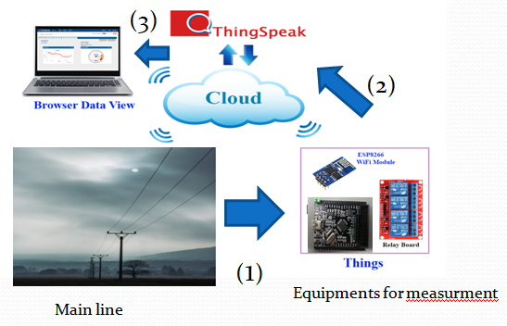
Background
Data loggers use a microprocessor, an internal memory for data storage, and a sensor to collect data.
Data logger input types: Pressure, Temperature, Humidity, Voltage, Current.
Data logger : voltage & current as inputs
Monitoring voltage & current from main line
Uploading data on ThingSpeak server (IoT based)
Accessing data by authorized users.
***Single phase AC supply line of 50Hz frequency is used as a main line***
1606159

Slide 5
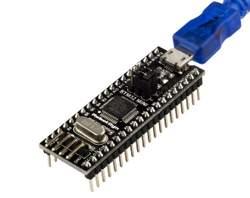
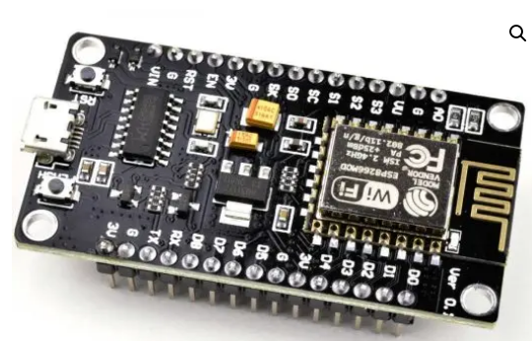
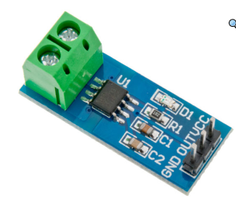
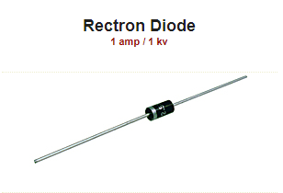
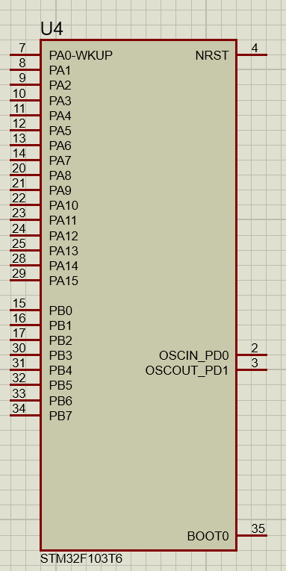
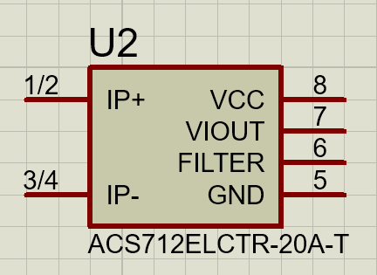
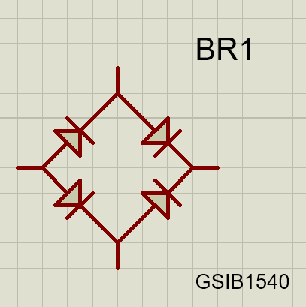
Main Components
Current Sensor : ACS-712
High Voltage Bridge Rectifier
ESP8266 WiFi Module
STM32 microprocessor
ACS712 Full Wave Rectifier STM32 ESP8266
1606159

Slide 6
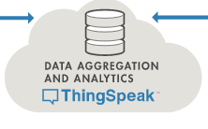
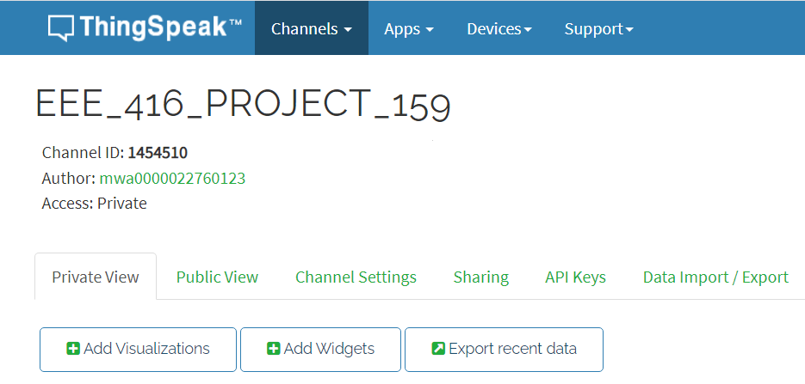
IoT based data logger
ThingSpeak Server ,for uploading & accessing data
1606159

Slide 7
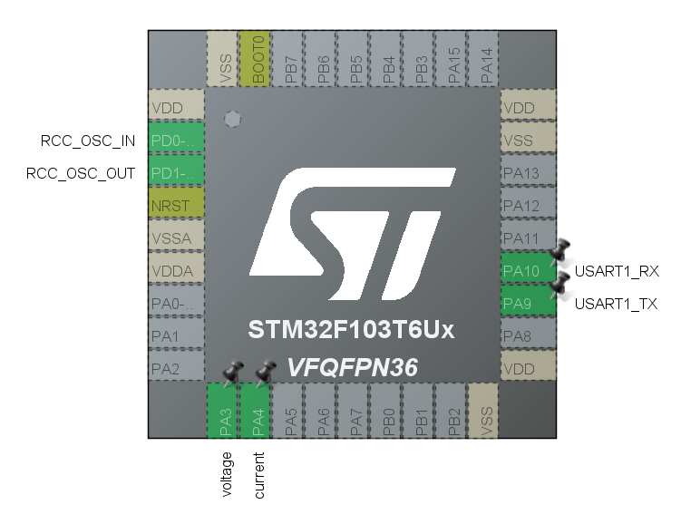
Stm32 configuration
Pins 3 and 4 used as 12 bit ADC pins ( 0 to 4095 for 0 to 3.3V)
Pins 9 and 10 are set for USART communication with esp8266
1606159

Slide 8
Current sensor
Sensitivity ,185mV/A, for ACS712 5A,
Sensitivity ,100mV/A, for ACS712 20A,
Sensitivity ,66mV/A, for ACS712-30A
This gives an output voltage of 2.5V at 0A.
It gives 2.5V+0.1V*every ampere of current
1A -> 2.6V
-1A -> 2.4V
Since stm32 can only take input of upto 3.3V, current setup of project can only take a maximum of 8A current.
1606159

Slide 9
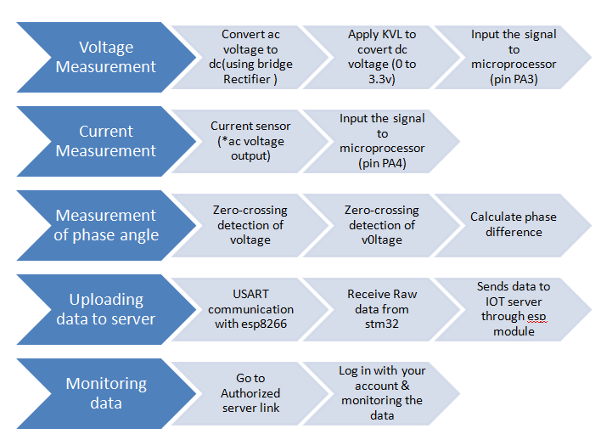
Algorithm: Working principle
INPUT:
Step1 : Voltage Measurement
Step2:Current Measurement
DATA-PROCESSING :
Step3:Measurment of phase angle & power
OUTPUT:
Step4:Uploading data to server
Step5:Monitoring data
1606159

Slide 10
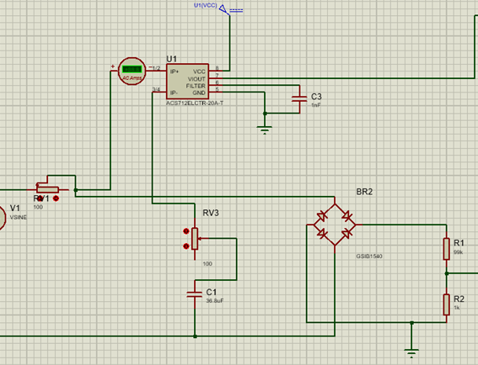
INPUT PART
Current sensor
[2.5±(sensitivity*value of current)]<3.3V
To Pin A4
Bridge Rectifier
LOAD
<3.3V
MAIN LINE
Voltage divider
To Pin A3
Processing part
1606159

Slide 11
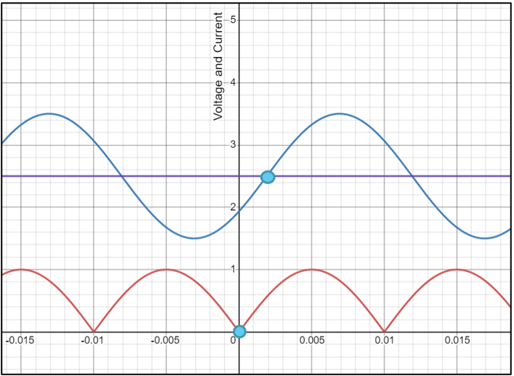
Voltage, Current & Phase
To get the RMS voltage, the stm32 samples the voltage at the ADC (Analog to Digital Pins) 20 times in a cycle of 1/50Hz or 20ms and calculates the RMS
To get the RMS current, the stm32 does the same with a second ADC pin after correcting for the 2.5V offset.
To get the phase, we calculate the time difference between the zero crossings using the inbuilt 16 bit timer which has been set up to increment count by 1 every microsecond.
Current (top) and Voltage vs time
Input going into ADC of stm32
(amplitudes not to scale)
1606135

Slide 12
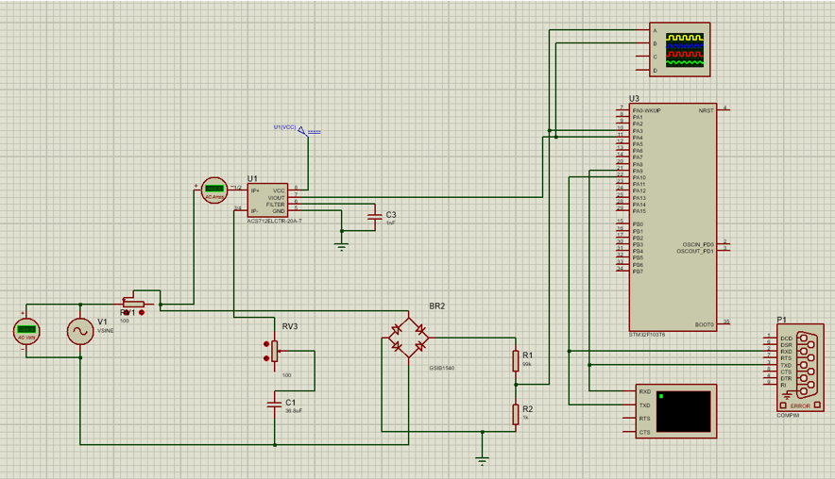
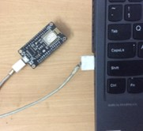

Simulation
1606135

Slide 13
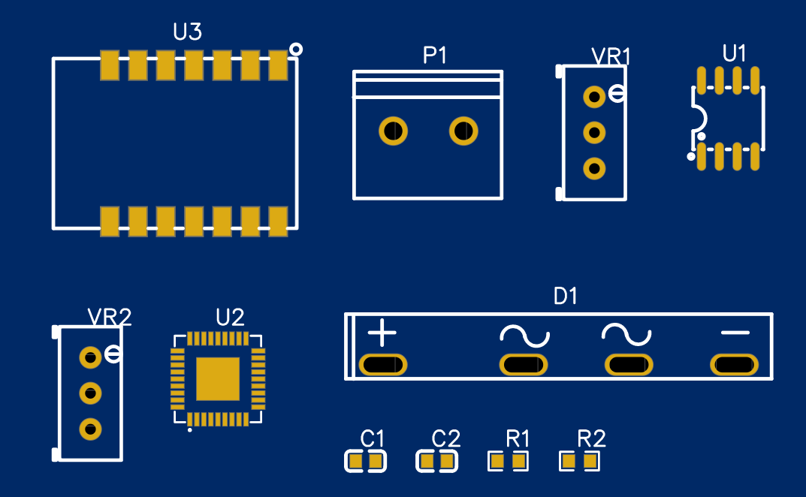
PCB Layout
1606135

Slide 14
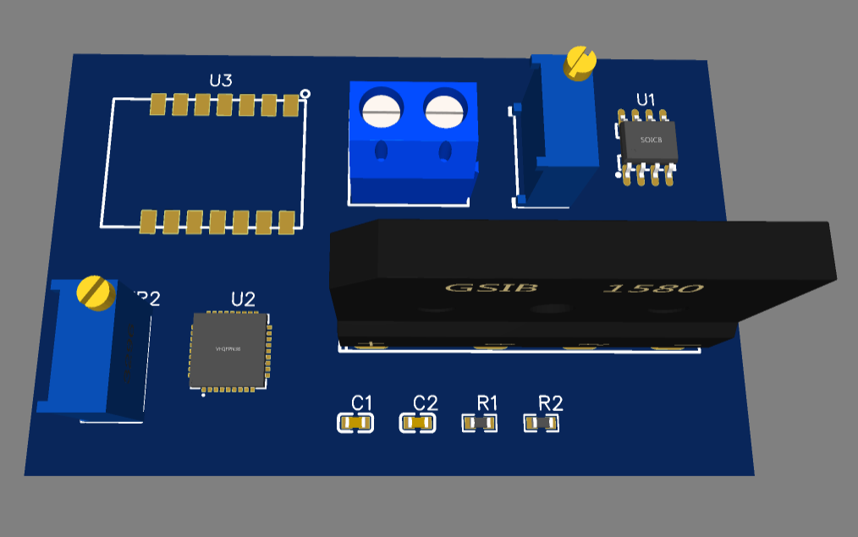
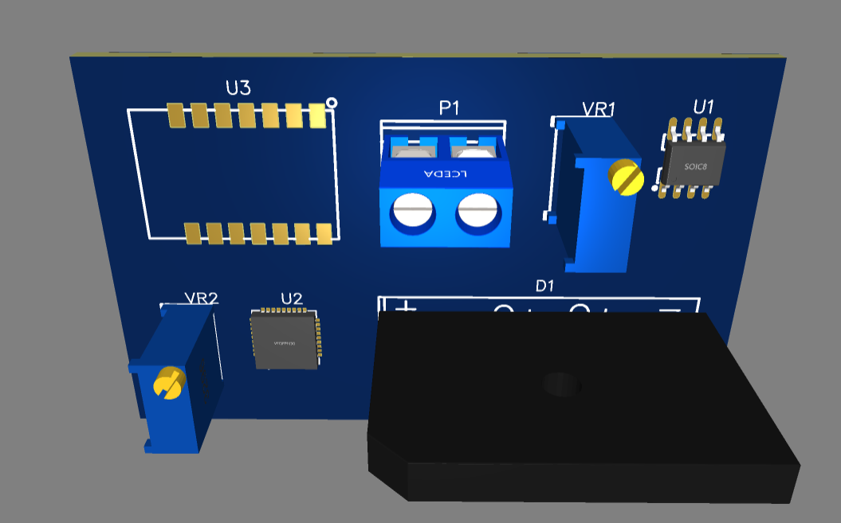
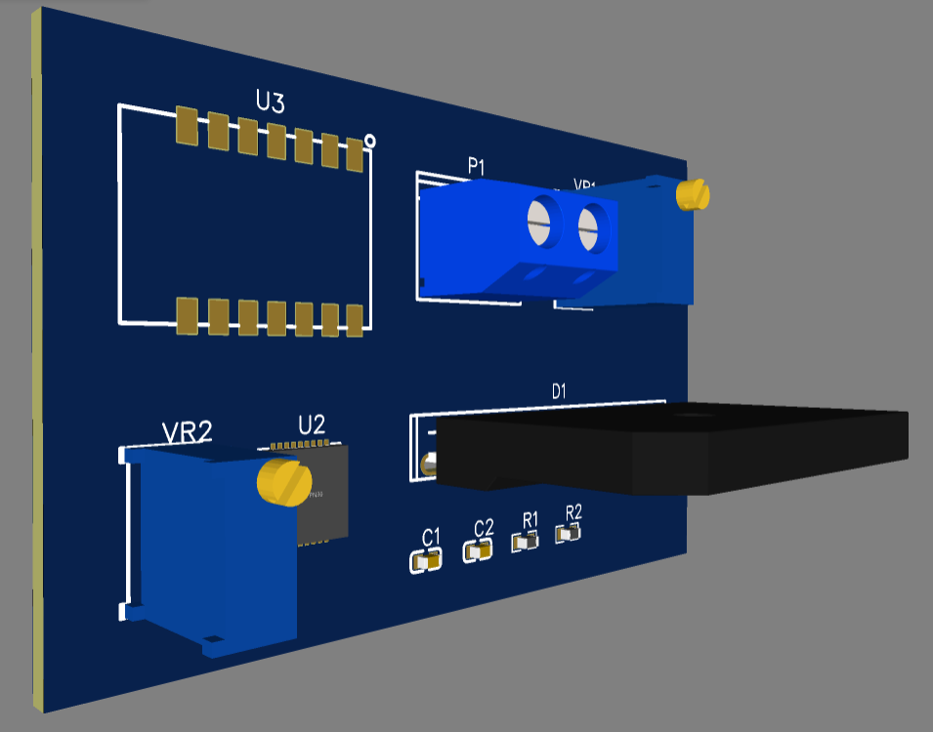
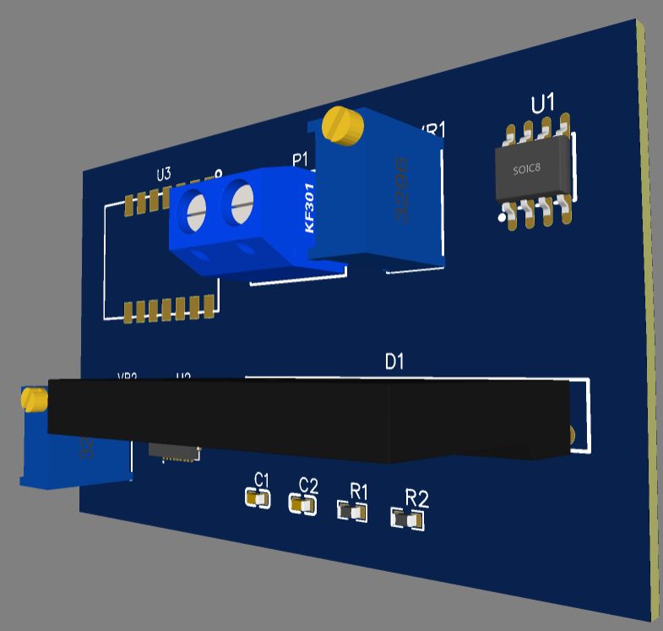
3D Design
1606135

Slide 15
Future Outlook
This project may be implemented in hardware.
Data can be logged from a small area or even city wide to get idea of quality of service provided.
Power engineers then may use the data to improve service sometimes in real time.

Slide 16
Thank You! Questions?

Slide 17
Additional Slides

Slide 18
References
(1) Getting Started with STM32 and Nucleo – YouTube
STM32F103T6 - Mainstream Performance line, Arm Cortex-M3 MCU with 32 Kbytes of Flash memory, 72 MHz CPU, motor control, USB and CAN – STMicroelectronics
GitHub - mathworks/thingspeak-arduino: ThingSpeak Communication Library for Arduino, ESP8266 and ESP32
NodeMCU ESP8266 Pinout, Specifications, Features & Datasheet (components101.com)

Slide 19
Bill of Materials
Parts used in simulation:
STM32 microprocessor model STM32F103T6
High voltage rectifier model GSIB1540
Generic resistors and capacitors
Parts used as hardware:
ESP8266 LiLon MODEMCU V3

Slide 20
Detailed Methods
STM32CubeIDE
Arduino IDE
Proteus version 8.6

Slide 21
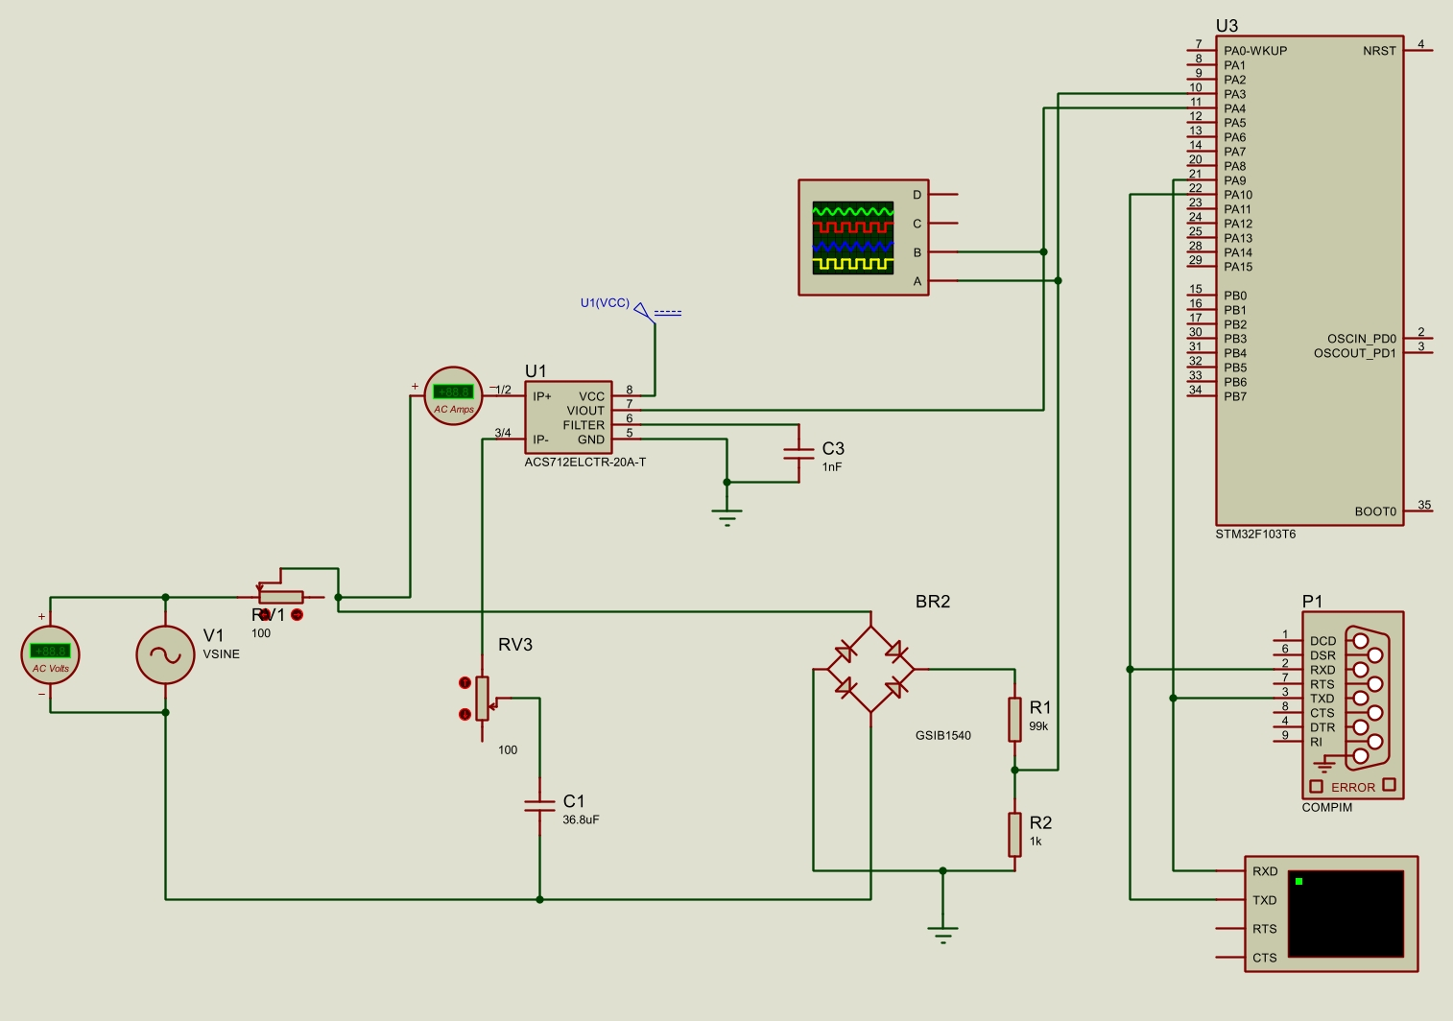
Circuit Diagram

Slide 22
Source Codes
STM32 was programmed with the STM32CubeIDE
ESP8266 was programmed with Arduino IDE

Slide 23
STM32 source code
/* USER CODE BEGIN Header */
/* USER CODE END Header */
/* Includes ------------------------------------------------------------------*/
#include "main.h"
/* Private includes ----------------------------------------------------------*/
/* USER CODE BEGIN Includes */
#include <string.h>
#include <stdio.h>
#include <math.h>
/* USER CODE END Includes */
/* Private typedef -----------------------------------------------------------*/
/* USER CODE BEGIN PTD */
/* USER CODE END PTD */
/* Private define ------------------------------------------------------------*/
/* USER CODE BEGIN PD */
/* USER CODE END PD */
/* Private macro -------------------------------------------------------------*/
/* USER CODE BEGIN PM */
/* USER CODE END PM */
/* Private variables ---------------------------------------------------------*/
ADC_HandleTypeDef hadc1;
TIM_HandleTypeDef htim3;
UART_HandleTypeDef huart1;
/* USER CODE BEGIN PV */
/* USER CODE END PV */
/* Private function prototypes -----------------------------------------------*/
void SystemClock_Config(void);
static void MX_GPIO_Init(void);
static void MX_ADC1_Init(void);
static void MX_USART1_UART_Init(void);
static void MX_TIM3_Init(void);
/* USER CODE BEGIN PFP */
/* USER CODE END PFP */
/* Private user code ---------------------------------------------------------*/
/* USER CODE BEGIN 0 */
void ADC_Select_CH3(void)
{
ADC_ChannelConfTypeDef sConfig = {0};
sConfig.Channel = ADC_CHANNEL_3;
sConfig.Rank = 1;
sConfig.SamplingTime = ADC_SAMPLETIME_1CYCLE_5;
if (HAL_ADC_ConfigChannel(&hadc1, &sConfig) != HAL_OK)
{
Error_Handler();
}
}
void ADC_Select_CH4(void)
{
ADC_ChannelConfTypeDef sConfig = {0};
sConfig.Channel = ADC_CHANNEL_4;
sConfig.Rank = 1;
if (HAL_ADC_ConfigChannel(&hadc1, &sConfig) != HAL_OK)
{
Error_Handler();
}
}
/* USER CODE END 0 */

Slide 24
STM32 source code
/**
* @brief The application entry point.
* @retval int
*/
int main(void)
{
/* USER CODE BEGIN 1 */
int i;
int raw;
int curr_sample;
int vol_sample;
int curr_thresh;
int vol_thresh;
int sum;
int rms1;
int rms2;
int num_of_samp=20;
int avg_timer_val;
uint16_t timer_val;
char msg[20];
/* USER CODE END 1 */
/* MCU Configuration--------------------------------------------------------*/
/* Reset of all peripherals, Initializes the Flash interface and the Systick. */
HAL_Init();
/* USER CODE BEGIN Init */
/* USER CODE END Init */
/* Configure the system clock */
SystemClock_Config();
/* USER CODE BEGIN SysInit */
/* USER CODE END SysInit */
/* Initialize all configured peripherals */
MX_GPIO_Init();
MX_ADC1_Init();
MX_USART1_UART_Init();
MX_TIM3_Init();
/* USER CODE BEGIN 2 */
//Start Timer
HAL_TIM_Base_Start(&htim3);
/* USER CODE END 2 */
/* Infinite loop */
/* USER CODE BEGIN WHILE */
while (1)
{
//get first ADC value
HAL_ADC_Start(&hadc1);
ADC_Select_CH3();
HAL_ADC_PollForConversion(&hadc1, HAL_MAX_DELAY);
//Voltage value sampling
sum=0;i=0;
while (i<num_of_samp)
{
raw = HAL_ADC_GetValue(&hadc1);
sum=sum+raw*raw;
i++;
HAL_Delay(1);
}
rms1=sqrt(sum/(num_of_samp));
ADC_Select_CH4();
sum=0;i=0;
while (i<num_of_samp)
{
raw = HAL_ADC_GetValue(&hadc1);
sum=sum+(raw-3102.27)*(raw-3102.27); //3102 is the equivalent of 2.5V on a scale where 3.3V is 4095
i++;
HAL_Delay(1);
}
rms2=sqrt(sum/(num_of_samp));
curr_thresh = 10; //keep low value to get accurate zero crossing point
vol_thresh = 10;
i=0; avg_timer_val=0;
while (i<3) //sampling phase num_of_samp times
{
curr_sample = 9999; //initial value to get into loop
vol_sample = 9999;
ADC_Select_CH3();
while (vol_sample>vol_thresh)
{
vol_sample= HAL_ADC_GetValue(&hadc1);
}
timer_val = __HAL_TIM_GET_COUNTER(&htim3);
ADC_Select_CH4();
while (curr_sample>3102.27+curr_thresh || curr_sample<3102.27-curr_thresh)
{
curr_sample = HAL_ADC_GetValue(&hadc1);
}
timer_val = __HAL_TIM_GET_COUNTER(&htim3) - timer_val;
avg_timer_val = avg_timer_val +timer_val;
i++;
}
avg_timer_val =avg_timer_val/3;
sprintf(msg, "$%4u %4u %4u\r\n",rms1, rms2 ,avg_timer_val);
HAL_UART_Transmit(&huart1, (uint8_t*)msg, strlen(msg), HAL_MAX_DELAY);
HAL_ADC_Stop(&hadc1);
HAL_Delay(1000);
}
/* USER CODE END WHILE */
/* USER CODE BEGIN 3 */
/* USER CODE END 3 */
}

Slide 25
STM32 source code
/**
* @brief System Clock Configuration
* @retval None
*/
void SystemClock_Config(void)
{
RCC_OscInitTypeDef RCC_OscInitStruct = {0};
RCC_ClkInitTypeDef RCC_ClkInitStruct = {0};
RCC_PeriphCLKInitTypeDef PeriphClkInit = {0};
/** Initializes the RCC Oscillators according to the specified parameters
* in the RCC_OscInitTypeDef structure.
*/
RCC_OscInitStruct.OscillatorType = RCC_OSCILLATORTYPE_HSE;
RCC_OscInitStruct.HSEState = RCC_HSE_ON;
RCC_OscInitStruct.PLL.PLLState = RCC_PLL_NONE;
if (HAL_RCC_OscConfig(&RCC_OscInitStruct) != HAL_OK)
{
Error_Handler();
}
/** Initializes the CPU, AHB and APB buses clocks
*/
RCC_ClkInitStruct.ClockType = RCC_CLOCKTYPE_HCLK|RCC_CLOCKTYPE_SYSCLK
|RCC_CLOCKTYPE_PCLK1|RCC_CLOCKTYPE_PCLK2;
RCC_ClkInitStruct.SYSCLKSource = RCC_SYSCLKSOURCE_HSE;
RCC_ClkInitStruct.AHBCLKDivider = RCC_SYSCLK_DIV1;
RCC_ClkInitStruct.APB1CLKDivider = RCC_HCLK_DIV1;
RCC_ClkInitStruct.APB2CLKDivider = RCC_HCLK_DIV1;
if (HAL_RCC_ClockConfig(&RCC_ClkInitStruct, FLASH_LATENCY_0) != HAL_OK)
{
Error_Handler();
}
PeriphClkInit.PeriphClockSelection = RCC_PERIPHCLK_ADC;
PeriphClkInit.AdcClockSelection = RCC_ADCPCLK2_DIV2;
if (HAL_RCCEx_PeriphCLKConfig(&PeriphClkInit) != HAL_OK)
{
Error_Handler();
}
}
/**
* @brief ADC1 Initialization Function
* @param None
* @retval None
*/
static void MX_ADC1_Init(void)
{
/* USER CODE BEGIN ADC1_Init 0 */
/* USER CODE END ADC1_Init 0 */
//ADC_ChannelConfTypeDef sConfig = {0};
/* USER CODE BEGIN ADC1_Init 1 */
/* USER CODE END ADC1_Init 1 */
/** Common config
*/
hadc1.Instance = ADC1;
hadc1.Init.ScanConvMode = ADC_SCAN_ENABLE;
hadc1.Init.ContinuousConvMode = ENABLE;
hadc1.Init.DiscontinuousConvMode = DISABLE;
hadc1.Init.ExternalTrigConv = ADC_SOFTWARE_START;
hadc1.Init.DataAlign = ADC_DATAALIGN_RIGHT;
hadc1.Init.NbrOfConversion = 1;
if (HAL_ADC_Init(&hadc1) != HAL_OK)
{
Error_Handler();
}
/* USER CODE BEGIN ADC1_Init 2 */
/* USER CODE END ADC1_Init 2 */
}

Slide 26
STM32 source code
/**
* @brief TIM3 Initialization Function
* @param None
* @retval None
*/
static void MX_TIM3_Init(void)
{
/* USER CODE BEGIN TIM3_Init 0 */
/* USER CODE END TIM3_Init 0 */
TIM_ClockConfigTypeDef sClockSourceConfig = {0};
TIM_MasterConfigTypeDef sMasterConfig = {0};
/* USER CODE BEGIN TIM3_Init 1 */
/* USER CODE END TIM3_Init 1 */
htim3.Instance = TIM3;
htim3.Init.Prescaler = 7;
htim3.Init.CounterMode = TIM_COUNTERMODE_UP;
htim3.Init.Period = 65535;
htim3.Init.ClockDivision = TIM_CLOCKDIVISION_DIV1;
htim3.Init.AutoReloadPreload = TIM_AUTORELOAD_PRELOAD_DISABLE;
if (HAL_TIM_Base_Init(&htim3) != HAL_OK)
{
Error_Handler();
}
sClockSourceConfig.ClockSource = TIM_CLOCKSOURCE_INTERNAL;
if (HAL_TIM_ConfigClockSource(&htim3, &sClockSourceConfig) != HAL_OK)
{
Error_Handler();
}
sMasterConfig.MasterOutputTrigger = TIM_TRGO_RESET;
sMasterConfig.MasterSlaveMode = TIM_MASTERSLAVEMODE_DISABLE;
if (HAL_TIMEx_MasterConfigSynchronization(&htim3, &sMasterConfig) != HAL_OK)
{
Error_Handler();
}
/* USER CODE BEGIN TIM3_Init 2 */
/* USER CODE END TIM3_Init 2 */
}
/**
* @brief USART1 Initialization Function
* @param None
* @retval None
*/
static void MX_USART1_UART_Init(void)
{
/* USER CODE BEGIN USART1_Init 0 */
/* USER CODE END USART1_Init 0 */
/* USER CODE BEGIN USART1_Init 1 */
/* USER CODE END USART1_Init 1 */
huart1.Instance = USART1;
huart1.Init.BaudRate = 9600;
huart1.Init.WordLength = UART_WORDLENGTH_8B;
huart1.Init.StopBits = UART_STOPBITS_1;
huart1.Init.Parity = UART_PARITY_NONE;
huart1.Init.Mode = UART_MODE_TX_RX;
huart1.Init.HwFlowCtl = UART_HWCONTROL_NONE;
huart1.Init.OverSampling = UART_OVERSAMPLING_16;
if (HAL_UART_Init(&huart1) != HAL_OK)
{
Error_Handler();
}
/* USER CODE BEGIN USART1_Init 2 */
/* USER CODE END USART1_Init 2 */
}
/**
* @brief GPIO Initialization Function
* @param None
* @retval None
*/
static void MX_GPIO_Init(void)
{
/* GPIO Ports Clock Enable */
__HAL_RCC_GPIOD_CLK_ENABLE();
__HAL_RCC_GPIOA_CLK_ENABLE();
}

Slide 27
STM32 source code
/* USER CODE BEGIN 4 */
/* USER CODE END 4 */
/**
* @brief This function is executed in case of error occurrence.
* @retval None
*/
void Error_Handler(void)
{
/* USER CODE BEGIN Error_Handler_Debug */
/* USER CODE END Error_Handler_Debug */
}
#ifdef USE_FULL_ASSERT
/**
* @brief Reports the name of the source file and the source line number
* where the assert_param error has occurred.
* @param file: pointer to the source file name
* @param line: assert_param error line source number
* @retval None
*/
void assert_failed(uint8_t *file, uint32_t line)
{
/* USER CODE BEGIN 6 */
/* USER CODE END 6 */
}
#endif /* USE_FULL_ASSERT */
/************************ (C) COPYRIGHT STMicroelectronics *****END OF FILE****/

Slide 28
ESP8266 Code
void loop() {
//String a;
//String b;
// Connect or reconnect to WiFi
if(WiFi.status() != WL_CONNECTED){
Serial.print("Attempting to connect to SSID: ");
Serial.println(SECRET_SSID);
while(WiFi.status() != WL_CONNECTED){
WiFi.begin(ssid, pass); // Connect to WPA/WPA2 network. Change this line if using open or WEP network
Serial.print(".");
delay(5000);
}
//Serial.println("\nConnected.");
}
// Write to ThingSpeak. There are up to 8 fields in a channel, allowing you to store up to 8 different
// pieces of information in a channel. Here, we write to field 1.
a.remove(0);
while (a[0]!='$')
{
a.remove(0);
if (Serial.available()>0){
a=Serial.readStringUntil('\r');
//b=Serial.readStringUntil('\r');
}
}
a.remove(0,1);
Vol = ((a.substring(0,4)).toFloat()/4095)*3.3*100;
Curr = ((a.substring(5,9)).toFloat() )/4095*3.3*10;
PF = (a.substring(10)).toFloat();
PF =PF/1000;
if (PF>period/4)
{
PF = period/2-PF;
}
PF = cos((PF/period)*2*3.142) ;
//Power = Vol*Curr;
ThingSpeak.writeField(myChannelNumber, 1, Vol, myWriteAPIKey);
delay(15000);
ThingSpeak.writeField(myChannelNumber, 2, Curr, myWriteAPIKey);
delay(15000);
ThingSpeak.writeField(myChannelNumber, 3, Vol*Curr, myWriteAPIKey);
delay(15000);
ThingSpeak.writeField(myChannelNumber, 4, PF, myWriteAPIKey);
delay(15000);
}
#include <ESP8266WiFi.h>
#include "secrets.h"
#include "ThingSpeak.h" // always include thingspeak header file after other header files and custom macros
char ssid[] = SECRET_SSID; // your network SSID (name)
char pass[] = SECRET_PASS; // your network password
int keyIndex = 0; // your network key Index number (needed only for WEP)
WiFiClient client;
unsigned long myChannelNumber = SECRET_CH_ID;
const char * myWriteAPIKey = SECRET_WRITE_APIKEY;
//int number = 0;
int i;
String a;
float Vol;
float Curr;
float PF;
float period=20; //1/frequency of wave in milliseconds
//float Power;
//String b;
//String Vol;
//String Curr;
//int x;
void setup() {
//pinMode(A0,INPUT);
Serial.begin(9600); // Initialize serial
while (!Serial) {
; // wait for serial port to connect. Needed for Leonardo native USB port only
}
WiFi.mode(WIFI_STA);
ThingSpeak.begin(client); // Initialize ThingSpeak
}

Slide 29
Difficulties
It was difficult to get Proetus to give accurate voltage input and frequency and that’s why output was not exact.

