Slide 1

Loan Repayment Prediction Using Logistic Regression
Group: ASDS 12 Bachelors
Khandoker Toufiq Amin Rumi (Team Leader, 20231235)
Md. Saifullah (20231204)
Moshiur Rahman (20231233)
Kazi Muhtasim Rafid (20231224)
Course: Introduction to Data Science with Python (WM-ASDS04)
Masters in Applied Statistics and Data Science under Weekend Program
Department of Statistics and Data Science
Jahangirnagar University, Savar, Dhaka.

Slide 2

Problem Statement
Will the borrower pay back the loan ?

Slide 3

Background
Defaulted loans in the banking sector of Bangladesh reached an all-time high at Tk 1.45 trillion (Bangladesh Bank, December 2023)
Half of the defaulted loans were risky, the banks failed to assess the risk (Chowdhury & Dhar, 2022)

Slide 4

Objective
Model Development
Develop regression models to predict the likelihood of loan repayment based on borrower attributes.
Analysis Features
Determine the relative importance of different borrower characteristics in predicting loan repayment.

Slide 5
Dataset (Metadata)
Data Collected by LendingClub.com
USA based Platform
9578 Records of Borrower
Time Period 2007-2010

Slide 6
Dataset (variables)
Sl. | Variable | Description
1 | Credit Policy | Whether the borrower meets the credit underwriting criteria of LendingClub.com or not
2 | Purpose | The purpose of the loan (takes values "credit_card", "debt_consolidation", "educational", "major_purchase", "small_business", and "all_other")
3 | Interest Rate | The interest rate of the loan
4 | Installment | The monthly installments owed by the borrower

Slide 7
Dataset (variables)
Sl. | Variable | Description
5 | Logarithm of Annual Income | The natural log of the self-reported annual income of the borrower
6 | Debt-to-Income Ratio | amount of debt divided by annual income of the borrower
7 | FICO Credit Score | The FICO credit score of the borrower
8 | Days with Credit Line | The number of days the borrower has had a credit line

Slide 8
Dataset (variables)
Sl. | Variable | Description
9 | Revolving Balance | Amount unpaid at the end of the credit card billing cycle
10 | Revolving Line Utilization Rate | The amount of the credit line used relative to total credit available
11 | Inquiries in the Last 6 Months | The borrower's number of inquiries in the last 6 months.
12 | Delinquencies in the Last 2 Years | The number of times the borrower had been 30+ days past due in last 2 years
13 | Public Records | The borrower's number of derogatory public records

Slide 9
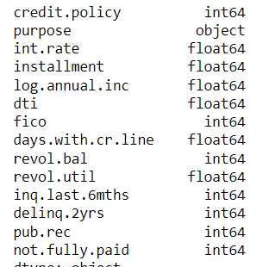
datatypes
Dependent Variable
Independent Variable

Slide 10
Descriptive statistics

Slide 11
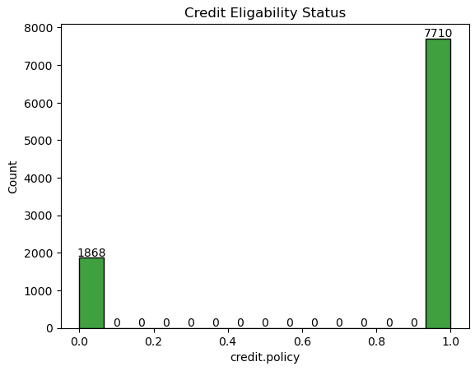
Descriptive statistics

Slide 12
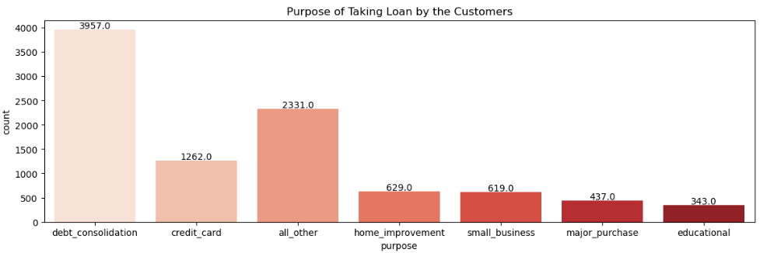
Descriptive statistics

Slide 13
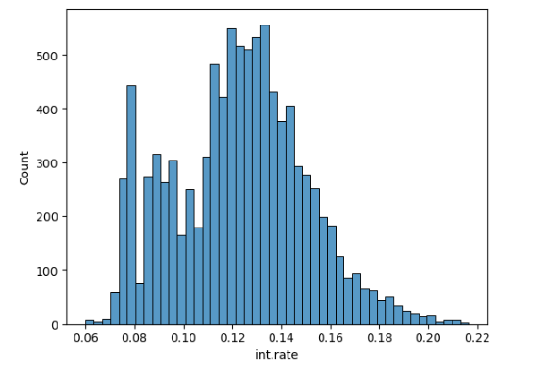
Descriptive statistics

Slide 14
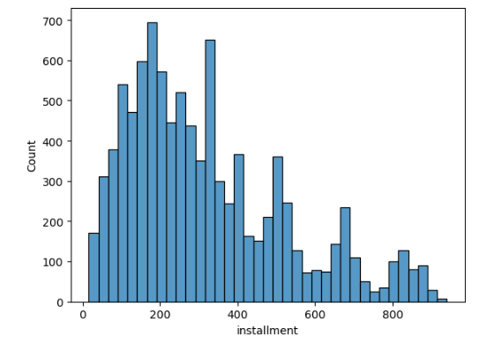
Descriptive statistics

Slide 15
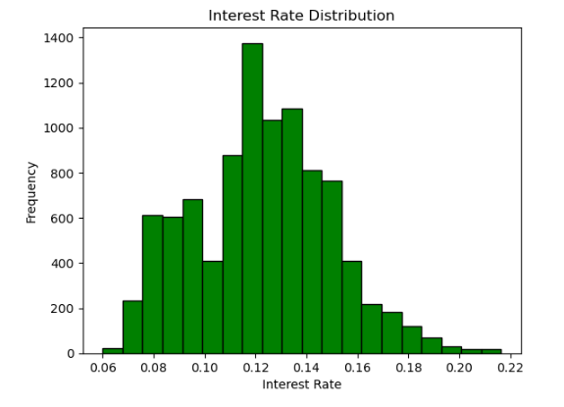
Descriptive statistics

Slide 16
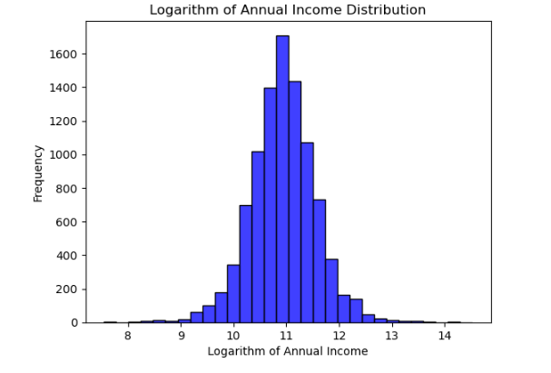
Descriptive statistics

Slide 17
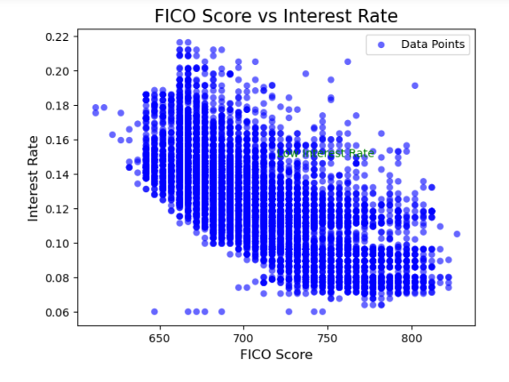
Descriptive statistics

Slide 18
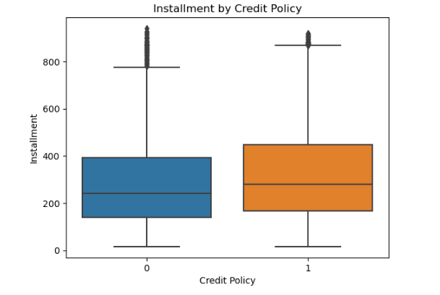
Descriptive statistics

Slide 19
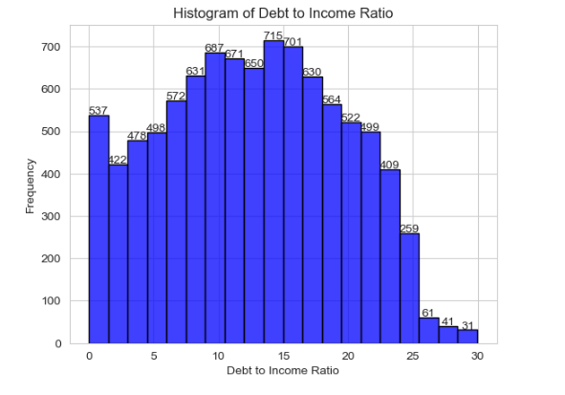
Descriptive statistics

Slide 20
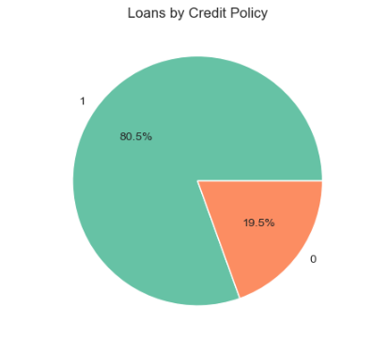
Descriptive statistics

Slide 21
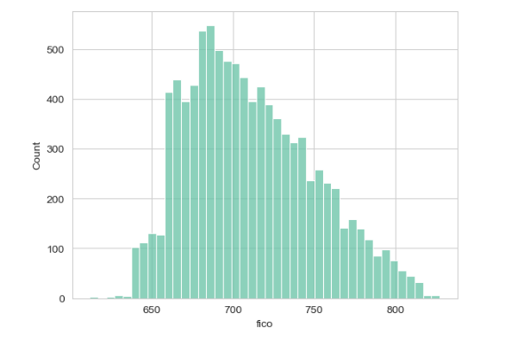
Descriptive statistics

Slide 22
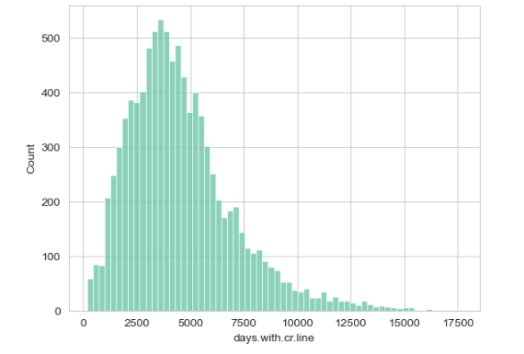
Descriptive statistics

Slide 23
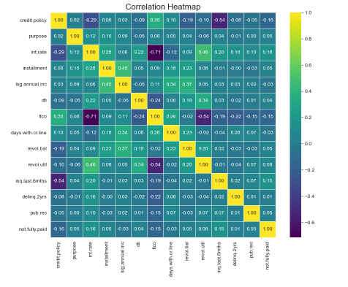
Descriptive statistics

Slide 24
Model
Logistic Regression
Accuracy 87.7 %

Slide 25
Findings
The ML Model’s Accuracy is 87.7 % and it is implying that it correctly predicts loan eligibility for approximately 87.7% of the test instances.
A precision of 0.87 indicates that out of all instances predicted as eligible for a loan, approximately 87% are indeed eligible.
A recall of 0.89 suggests that the model captures approximately 89% of all eligible loan applicants.
In this case, the MSE is approximately 0.123. Since MSE values closer to 0 indicate better model performance, this indicates that, on average, the model's predictions have a squared error of about 0.123.
Confusion Matrix:
Types | Logistic Regression Value count
True Positive (TP) | 158
False Positive (FP) | 25
False Negative (FN) | 21
True Negative (TN) | 170

Slide 26
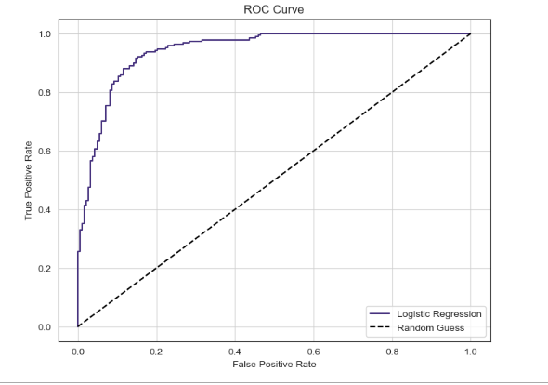
Evaluation

Slide 27
Conclusion
The logistic regression model shows potential for accurately predicting loan eligibility based on the provided features. Future work could involve further refinement of the model, exploration of additional algorithms such as Random Forest and Boosting, and incorporation of additional features to enhance predictive performance and robustness. Overall, leveraging machine learning techniques offers a promising approach to optimizing loan approval processes and minimizing the risk of default for lending institutions.

Slide 28
Reference
Chowdhury, R., & Dhar, B. K. (2012). The perspective of loan default problems of the commercial banking sector of Bangladesh: A closer look into the key contributory factors. University of Science and Technology Annual (USTA), 18(1), 71-87.

Slide 29
Thank you

