Slide 1
HOMEWORK

Slide 2
1. Convert the decimal to binary:
12₁₀
_{12=1*2}³_{+1*2}²_{+0*2}¹_{+0*2}⁰
¹²₁₀ ⁼¹¹⁰⁰₂
2) 34.25₁₀
_{34.25=1*2}⁵_{+0*2}⁴_{+0*2}³_{+0*2}²_{+1*2}¹ _{+0*2}⁰ _{+0*2}⁻¹_{+1*2}⁻²
^{34.25}₁₀ ^{=100010.01}₂

Slide 3
2. Convert the decimal to BCD
325.6₁₀
2) 1985.67₁₀
3 | 2 | 5 | . | 6
0011 | 0010 | 0101 | . | 0110
1 | 9 | 8 | 5 | . | 6 | 7
0001 | 1001 | 1000 | 0101 | . | 0110 | 0111

Slide 4
3. Find the signed magnitude codes, 1’s complement and 2’s complement for the decimal
12₁₀
 | 12
Signed magnitude codes | 0 1100
1’s | 0 1100
2’s | 0 1100

Slide 5
3. Find the signed magnitude codes, 1’s complement and 2’s complement for the decimal
2) -18₁₀
 | -18
Signed magnitude codes | 1 10010
1’s | 1 01101
2’s | 1 01110

Slide 6
1. Simplifying Boolean Functions
F(x,y,z)=∑(0,2,3,4,5,7)
F(a,b,c,d)=∑(0,3,4,5,7,11,13,15)
F(w,x,y,z)=∑(0,1,4,5,9,11,13,15) F(a,b,c,d)=∑(0,1,2,4,5,6,8,9,12,13,14)
F(a,b,c,d)=∑(1,3,4,5,7,8,9,11,15)
F(w,x,y,z)=∑(1,5,7,8,9,10,11,13,15)

Slide 7
1.F(x,y,z)=∑(0,2,3,4,5,7)
Xy z | 0 | 1
00 | 1
01 | 1 | 1
11 |  | 1
10 | 1 | 1
1.1F(x,y,z)=x’z’+yz+xy’

Slide 8
1.F(x,y,z)=∑(0,2,3,4,5,7)
Xy z | 0 | 1
00 | 1
01 | 1 | 1
11 |  | 1
10 | 1 | 1
1.2F(x,y,z)=y’z’+x’y+xz

Slide 9
2.F(a,b,c,d)=∑(0,3,4,5,7,11,13,15)
Ab cd | 00 | 01 | 11 | 10
00 | 1 |  | 1
01 | 1 | 1 | 1
11 |  | 1 | 1
10 |  |  | 1
F(a,b,c,d)=a’c’d’+bd+cd

Slide 10
3.F(w,x,y,z)=∑(0,1,4,5,9,11,13,15)
wx yz | 00 | 01 | 11 | 10
00 | 1 | 1
01 | 1 | 1
11 |  | 1 | 1
10 |  | 1 | 1
F(w,x,y,z)=w’y’+wz

Slide 11
4.F(a,b,c,d)=∑(0,1,2,4,5,6,8,9,12,13,14)
Ab cd | 00 | 01 | 11 | 10
00 | 1 | 1 |  | 1
01 | 1 | 1 |  | 1
11 | 1 | 1 |  | 1
10 | 1 | 1
F(a,b,c,d)=c’+a’cd’+bcd’

Slide 12
5.F(a,b,c,d)=∑(1,3,4,5,7,8,9,11,15)
Ab cd | 00 | 01 | 11 | 10
00 |  | 1 | 1
01 | 1 | 1 | 1
11 |  |  | 1
10 | 1 | 1 | 1
F(a,b,c,d)=cd+a’c’d+a’bc’+ab’c’

Slide 13
6.F(w,x,y,z)=∑(1,5,7,8,9,10,11,13,15)
wx yz | 00 | 01 | 11 | 10
00 |  | 1
01 |  | 1 | 1
11 |  | 1 | 1
10 | 1 | 1 | 1 | 1
F(w,x,y,z)=y’z+wx’+xz

Slide 14
2. Simplifying Boolean Functions
1). V = f(a,b,c,d) = ∑m(2,3,4,5,13,15) + ∑d(8,9,10,11)
2). Y = f(u,v,w,x) = ∑m(1,5,7,9,13,15) + ∑d(8,10,11,14)

Slide 15
1). V = f(a,b,c,d) = ∑m(2,3,4,5,13,15) + ∑d(8,9,10,11)
Ab cd | 00 | 01 | 11 | 10
00 |  |  | 1 | 1
01 | 1 | 1
11 |  | 1 | 1
10 | X | X | X | X

Slide 16
2). Y = f(u,v,w,x) = ∑m(1,5,7,9,13,15) + ∑d(8,10,11,14)
uv wx | 00 | 01 | 11 | 10
00 |  | 1
01 |  | 1 | 1
11 |  | 1 | 1 | X
10 | X | 1 | X | X

Slide 17
要设计在某种情况下发出警报的汽车系统。
1.座位安全带没有系紧且发动机在运转。
2.钥匙没有处于点火位置时车灯亮着。
3.当钥匙处于点火位置，但发动机没有运转且司机的车门又是打开时。
则报警器发声。确定输入和输出的个数，为变量分配名字，并构造一个描述系统的真值表。

Slide 18
c₁ | c₂ | c₃ | c₄ | c₅ | A | c₁ | c₂ | c₃ | c₄ | c₅ | A
0 | 0 | 0 | 0 | 0 | 0 | 1 | 0 | 0 | 0 | 0 | 0
0 | 0 | 0 | 0 | 1 | 1 | 1 | 0 | 0 | 0 | 1 | 1
0 | 0 | 0 | 1 | 0 | 0 | 1 | 0 | 0 | 1 | 0 | 0
0 | 0 | 0 | 1 | 1 | 1 | 1 | 0 | 0 | 1 | 1 | 1
0 | 0 | 1 | 0 | 0 | 0 | 1 | 0 | 1 | 0 | 0 | 0
0 | 0 | 1 | 0 | 1 | 0 | 1 | 0 | 1 | 0 | 1 | 0
0 | 0 | 1 | 1 | 0 | 1 | 1 | 0 | 1 | 1 | 0 | 1
0 | 0 | 1 | 1 | 1 | 1 | 1 | 0 | 1 | 1 | 1 | 1
0 | 1 | 0 | 0 | 0 | 1 | 1 | 1 | 0 | 0 | 0 | 0
0 | 1 | 0 | 0 | 1 | 1 | 1 | 1 | 0 | 0 | 1 | 1
0 | 1 | 0 | 1 | 0 | 1 | 1 | 1 | 0 | 1 | 0 | 0
0 | 1 | 0 | 1 | 1 | 1 | 1 | 1 | 0 | 1 | 1 | 1
0 | 1 | 1 | 0 | 0 | 1 | 1 | 1 | 1 | 0 | 0 | 0
0 | 1 | 1 | 0 | 1 | 1 | 1 | 1 | 1 | 0 | 1 | 0
0 | 1 | 1 | 1 | 0 | 1 | 1 | 1 | 1 | 1 | 0 | 0
0 | 1 | 1 | 1 | 1 | 1 | 1 | 1 | 1 | 1 | 1 | 0
c₁为1时表示安全带系紧
c₂为1时表示发动机在运转
c₃为1时表示钥匙处于点火位置，
c₄为1表示车门打开
c₅为1表示车灯亮着。
A代表报警
A=c₁’c₂+c₃’c₅+c₂’c₃c₄

Slide 19
6.12给出使得4位先行加法器变成5位加法器的附加逻辑电路
6.14根据所示波形，请确定这个比较器的输出波形。
6.22一个七段数码管如图所示，如果图中所示波形加在芯片的输入，请确定显示器现实的数字的顺序。

Slide 20
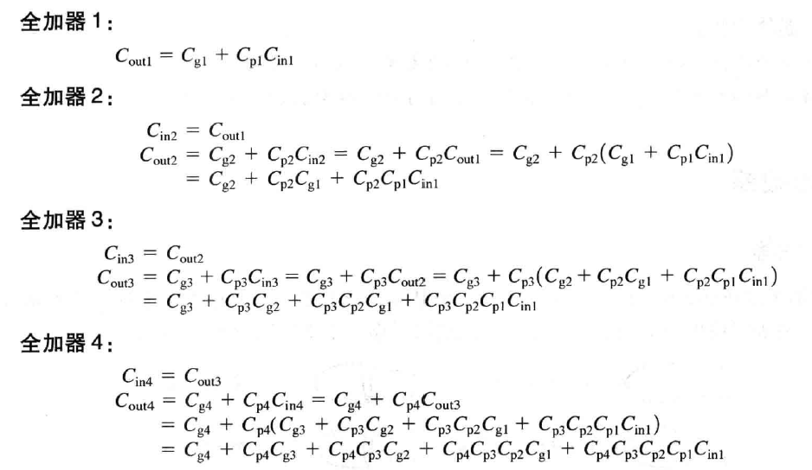
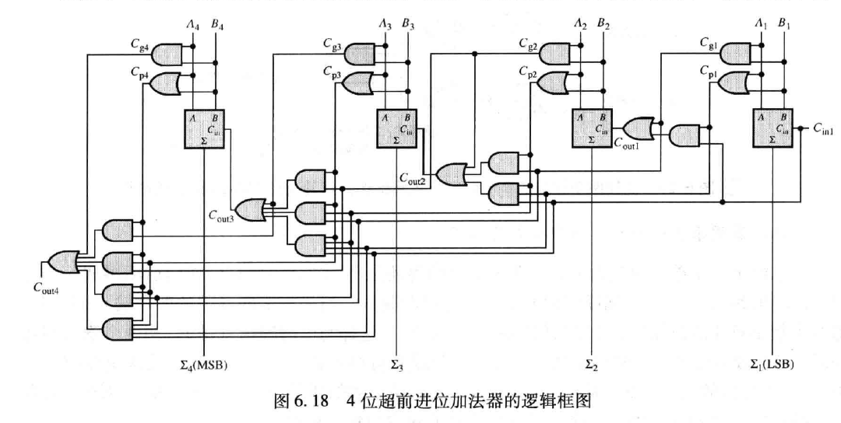
6.12给出使得4位先行加法器变成5位加法器的附加逻辑电路

Slide 21
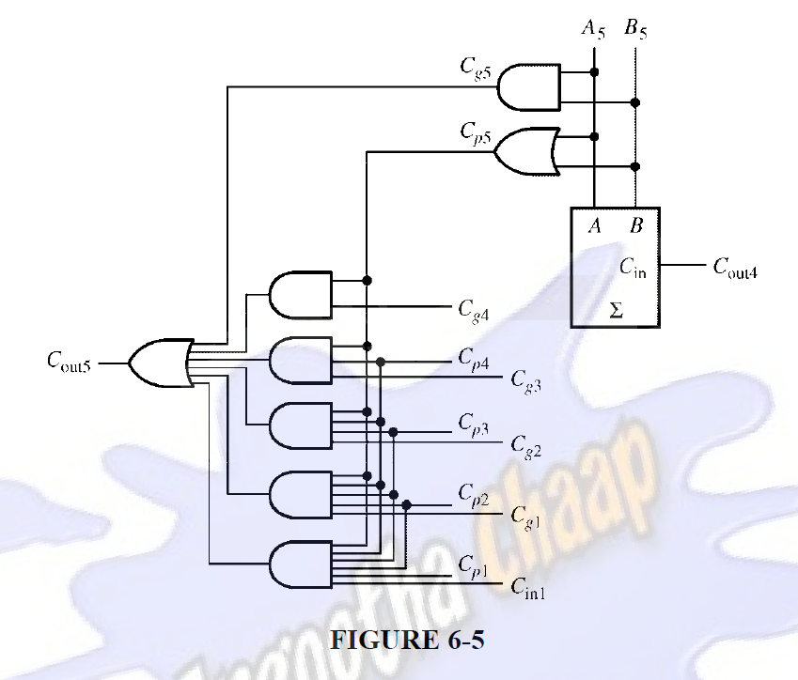
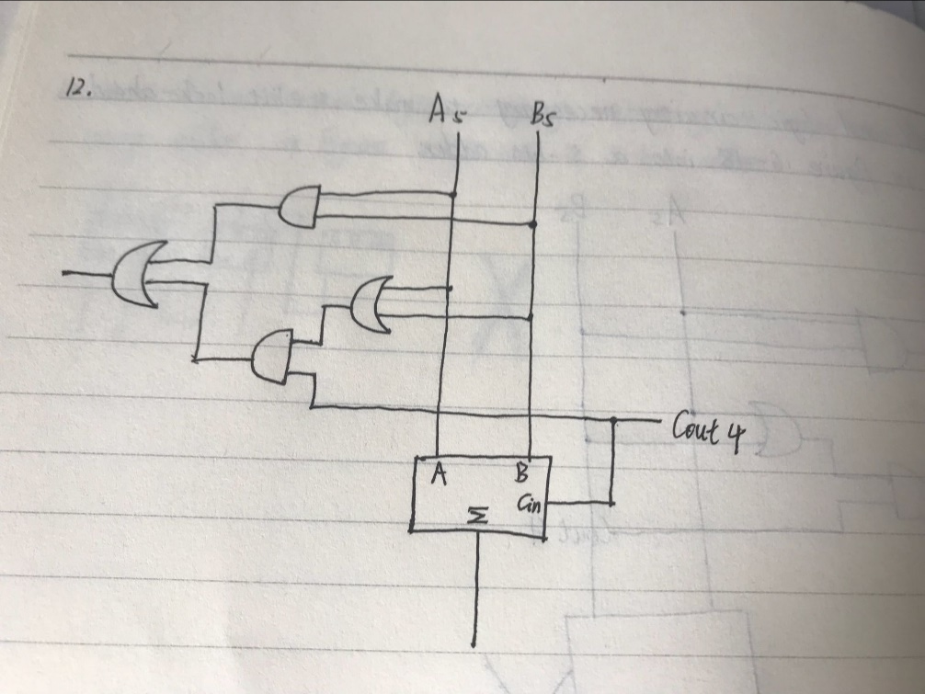

Slide 22
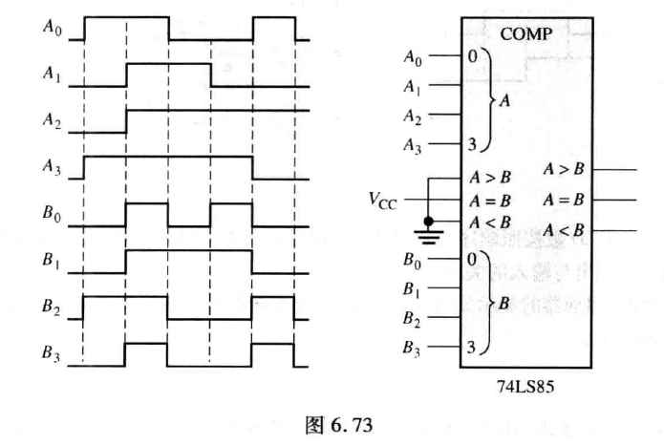
6.14根据所示波形，请确定这个比较器的输出波形。

Slide 23
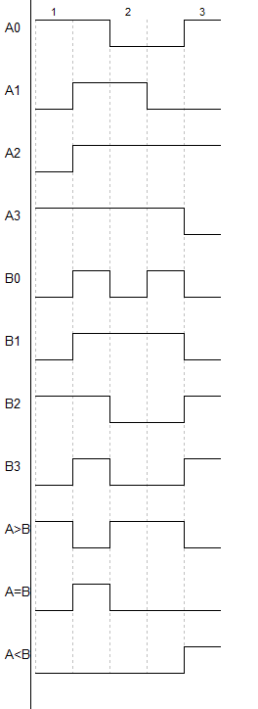

Slide 24
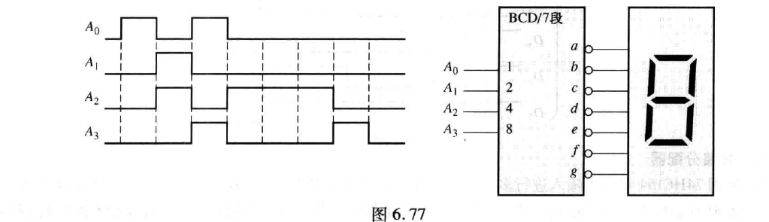
6.22一个七段数码管如图所示，如果图中所示波形加在芯片的输入，请确定显示器现实的数字的顺序。
1,6,9,4,4,4,8,0

Slide 25
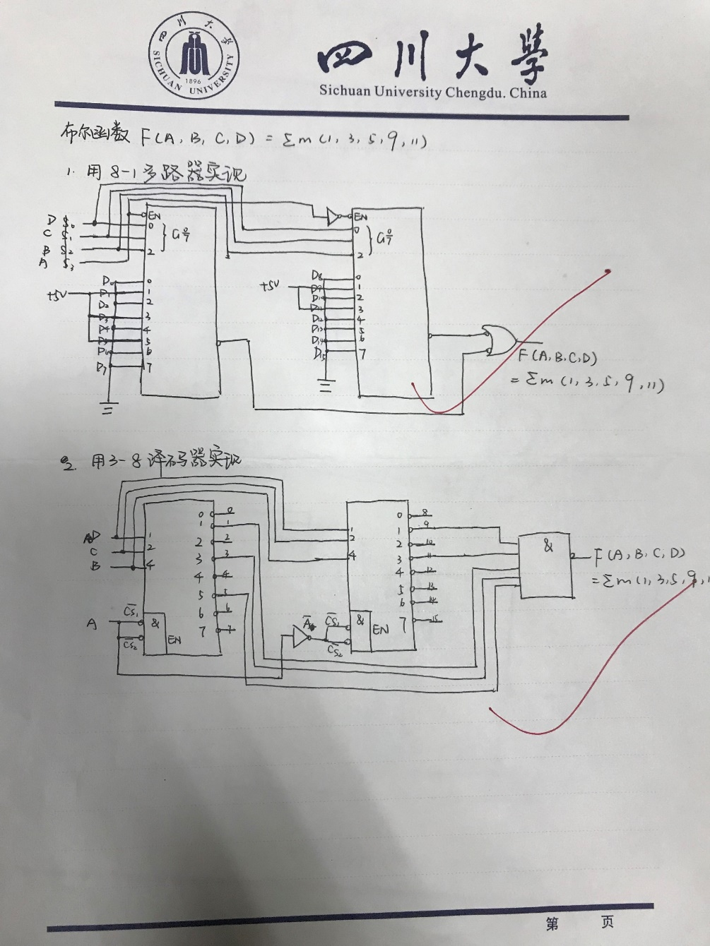
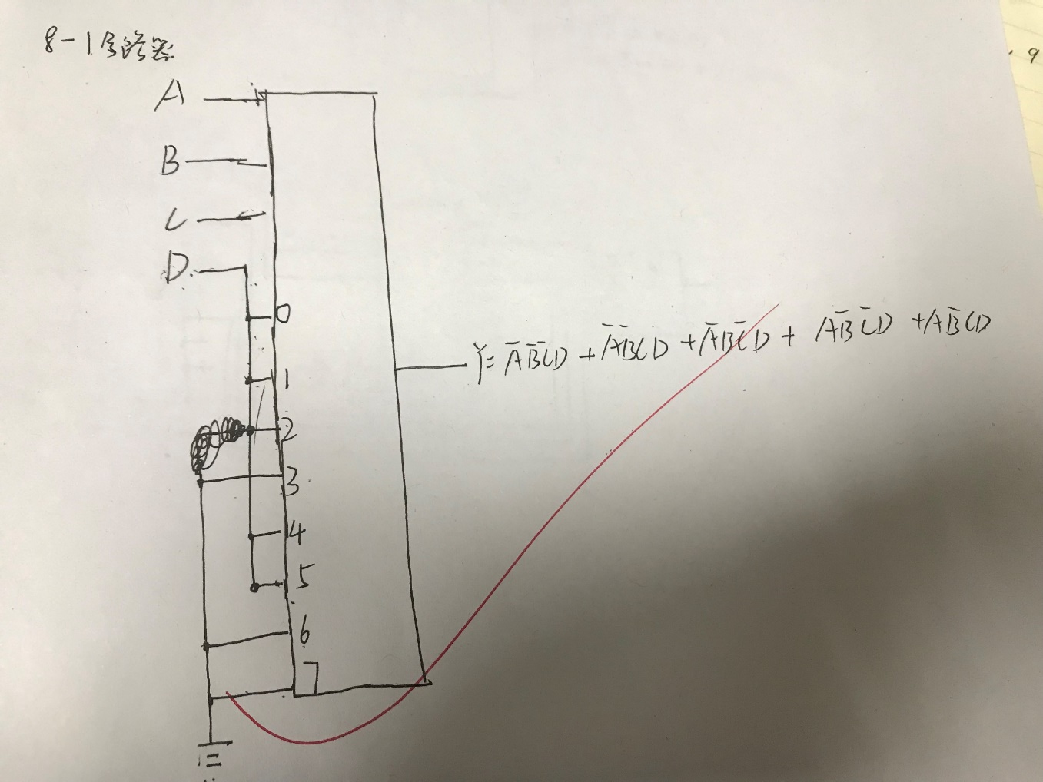
第六次作业
分别用38译码器和数字多路器实现四变量布尔函数。m（1，3，5，9，11）

Slide 26
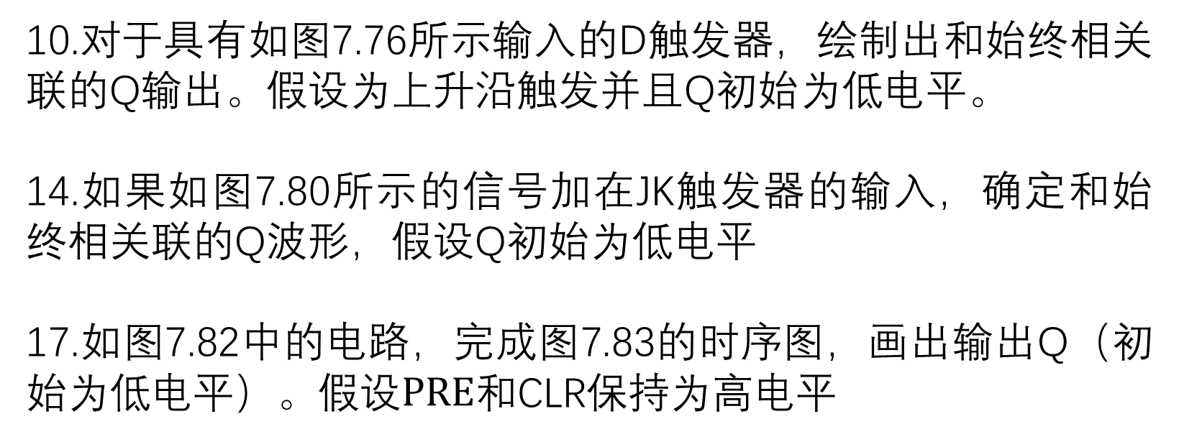
10.对于具有如图7.76所示输入的D触发器，绘制出和始终相关联的Q输出。假设为上升沿触发并且Q初始为低电平。
14.如果如图7.80所示的信号加在JK触发器的输入，确定和始终相关联的Q波形，假设Q初始为低电平
17.如图7.82中的电路，完成图7.83的时序图，画出输出Q（初始为低电平）。假设$PRE$和CLR保持为高电平

Slide 27
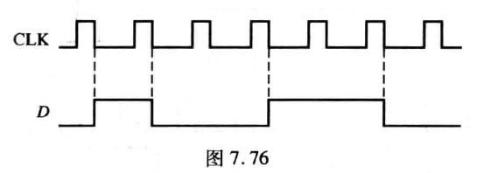
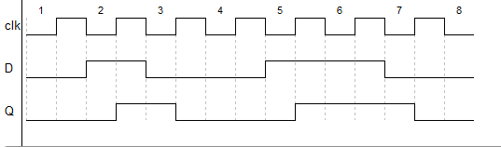
10.对于具有如图7.76所示输入的D触发器，绘制出和始终相关联的Q输出。假设为上升沿触发并且Q初始为低电平。

Slide 28
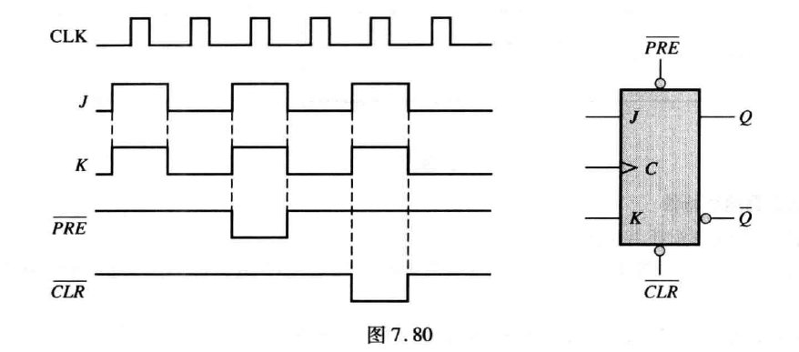
14.如果如图7.80所示的信号加在JK触发器的输入，确定和始终相关联的Q波形，假设Q初始为低电平

Slide 29
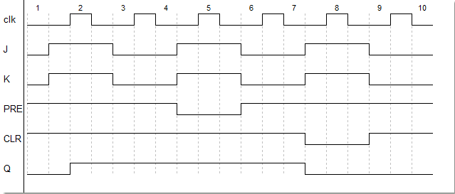

Slide 30
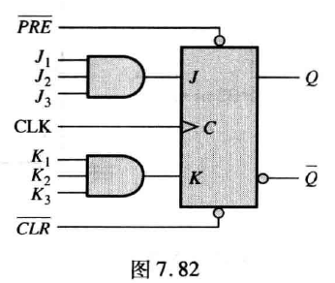
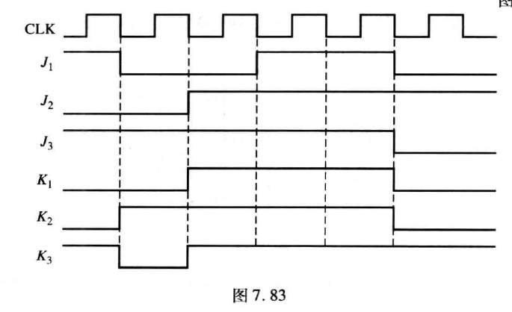

17.如图7.82中的电路，完成图7.83的时序图，画出输出Q（初始为低电平）。假设$PRE$和CLR保持为高电平

Slide 31
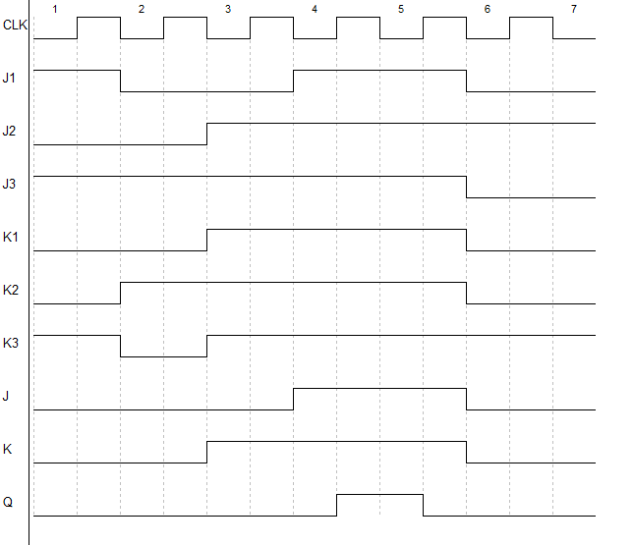

Slide 32
1. Design a modulu-13 binary counter.
1) asynchronous
2) synchronous

Slide 33
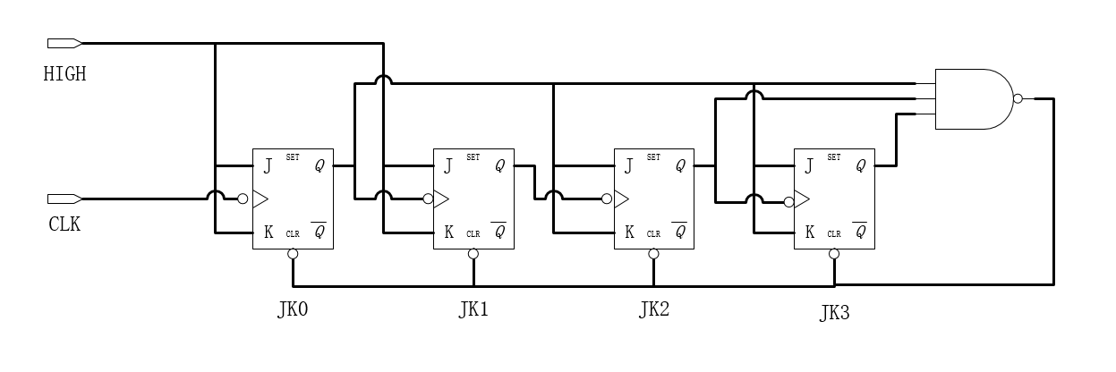
asynchronous

Slide 34
synchronous
D3 | D2 | D1 | D0 | J3 | K3 | J2 | K2 | J1 | K1 | J0 | K0
0 | 0 | 0 | 0 | 0 | X | 0 | X | 0 | X | 1 | X
0 | 0 | 0 | 1 | 0 | X | 0 | X | 1 | X | X | 1
0 | 0 | 1 | 0 | 0 | X | 0 | X | X | 0 | 1 | X
0 | 0 | 1 | 1 | 0 | X | 1 | X | X | 1 | X | 1
0 | 1 | 0 | 0 | 0 | X | X | 0 | 0 | X | 1 | X
0 | 1 | 0 | 1 | 0 | X | X | 0 | 1 | X | X | 1
0 | 1 | 1 | 0 | 0 | X | X | 0 | X | 0 | 1 | X
0 | 1 | 1 | 1 | 1 | X | X | 1 | X | 1 | X | 1
1 | 0 | 0 | 0 | X | 0 | 0 | X | 0 | X | 1 | X
1 | 0 | 0 | 1 | X | 0 | 0 | X | 1 | X | X | 1
1 | 0 | 1 | 0 | X | 0 | 0 | X | X | 0 | 1 | X
1 | 0 | 1 | 1 | X | 0 | 1 | X | X | 1 | X | 1
1 | 1 | 0 | 0 | X | 1 | X | 1 | 0 | X | 0 | X

Slide 35
 | 00 | 01 | 11 | 10
00 | 0 | 0 | 0 | 0
01 | 0 | 0 | 1 | X
11 | X | X | X | X
10 | X | X | X | X
 | 00 | 01 | 11 | 10
00 | X | X | X | X
01 | X | X | X | X
11 | 1 | X | X | X
10 | 0 | 0 | 0 | 0
 | 00 | 01 | 11 | 10
00 | 0 | 0 | 1 | 0
01 | X | X | X | X
11 | X | X | X | X
10 | 0 | 0 | 1 | 0
 | 00 | 01 | 11 | 10
00 | X | X | X | X
01 | 0 | 0 | 1 | 0
11 | 1 | X | X | X
10 | X | X | X | X

Slide 36
 | 00 | 01 | 11 | 10
00 | 0 | 1 | X | X
01 | 0 | 1 | X | X
11 | 0 | X | X | X
10 | 0 | 1 | X | X
 | 00 | 01 | 11 | 10
00 | X | X | 1 | 0
01 | X | X | 1 | 0
11 | X | X | X | X
10 | X | X | 1 | 0
 | 00 | 01 | 11 | 10
00 | 1 | X | X | 1
01 | 1 | X | X | 1
11 | 0 | X | X | X
10 | 1 | X | X | 1
 | 00 | 01 | 11 | 10
00 | X | 1 | 1 | X
01 | X | 1 | 1 | X
11 | X | X | X | X
10 | X | 1 | 1 | X

Slide 37
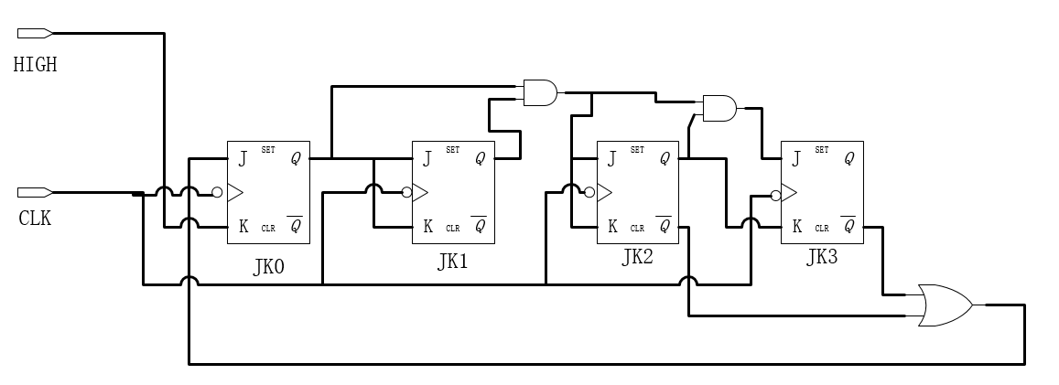
synchronous

Slide 38
2. Design a synchronous counter to produce the 3-bit gray code sequences:000,001,011,010,110,111,101,100,000…
000
001
011
010
110
111
101
100

Slide 39
0 | 0 | 0 | 0 | 0 | 1 | 0 | X | 0 | X | 1 | X
0 | 0 | 1 | 0 | 1 | 1 | 0 | X | 1 | X | X | 0
0 | 1 | 0 | 1 | 1 | 0 | 1 | X | X | 0 | 0 | X
0 | 1 | 1 | 0 | 1 | 0 | 0 | X | X | 0 | X | 1
1 | 0 | 0 | 0 | 0 | 0 | X | 1 | 0 | X | 0 | X
1 | 0 | 1 | 1 | 0 | 0 | X | 0 | 0 | X | X | 1
1 | 1 | 0 | 1 | 1 | 1 | X | 0 | X | 0 | 1 | X
1 | 1 | 1 | 1 | 0 | 1 | X | 0 | X | 1 | X | 0

Slide 40
 | 00 | 01 | 11 | 10
0 | 0 | 0 | 0 | 1
1 | X | X | X | X
 | 00 | 01 | 11 | 10
0 | X | X | X | X
1 | 1 | 0 | 0 | 0
 | 00 | 01 | 11 | 10
0 | 0 | 1 | X | X
1 | 0 | 0 | X | X
 | 00 | 01 | 11 | 10
0 | X | X | 0 | 0
1 | X | X | 1 | 0
 | 00 | 01 | 11 | 10
0 | 1 | X | X | 0
1 | 0 | X | X | 1
 | 00 | 01 | 11 | 10
0 | X | 0 | 1 | X
1 | X | 1 | 0 | X

Slide 41
