Slide 1
AIR QUALITY PREDICTION USING ML-TECHNIQUES
CS299 INNOVATION LAB PROJECT
UNDER THE GUIDANCE OF :
Dr. MAYANK AGRAWAL
PRESENTED BY:-
1901CS15 Charudutt Katkar
1901CS53 Sheik Kamiteedar Touheed

Slide 2
Introduction
Here we have done an air quality modelling of Indian National Capital Territory of Delhi (NCT-Delhi) using machine learning techniques like LSTM, Moving average, Linear regression, KNN(k-Nearest Neighbours), Prophet, GRU, Bi-LSTM.
With the advent of new technology and availability of larger data sets, machine learning techniques are gaining popularity in air quality prediction.
Machine learning techniques have the potential to unearth patterns and insights we didn’t see before and these can be used to make accurate predictions.
An hourly pollution data of Indian National Capital Territory of Delhi (NCT-Delhi) between the years 2008- 2010 is used as data set for the air quality modelling.

Slide 3
IMPORTANCE OF AIR-QUAlITY PREDICTION :-
Air pollution occurs when the surrounding air contains gases,dust ,fumes and odor etc. in such a high quantity that it can affect health of humans and animals as well as the plants and materials.Air pollution is one of the greatest killers of our time for eg. in 2015 it was responsible for 64 lakh deaths worldwide-28 lakh from the household air pollution and 42 lakh from the outdoor(ambient) pollution. Data from 2015 shows the percentage of deaths caused by diseases cause from air pollution:-
19% of all cardiovascular deaths.
24% of ischaemic heart disease deaths.
21% of stroke deaths.
23% of lung cancer deaths.
Also , ambient pollution is an important factor in the neurodevelopmental disorders in children and neurodegenerative disease in adults.These statistics clearly show us the threat air pollution shows us.Therefore air quality forecasting is becoming more and more important day by day as the air pollution increases.

Slide 4
BENEFITS OF AIR QUALITY PREDICTION:-
Accurate prediction cause people to plan ahead thus decreasing the effects on health and costs associated.If people are aware of the variation in the quality of air they breathe as well as the adverse effects it has on their health then it is likely to motivate them to take the necessary steps to lessen the air pollution on their level. Such awareness has the potential to curb air pollution and create a healthier environment .Governments also make use of early predictions to establish procedure to reduce the severity of local pollution levels.Thus air quality prediction is a worthwhile investment on multiple levels-individual,community,national and global.

Slide 5
Dataset
The dataset used in air quality modelling is concatenation of hourly pollution data of NCT-Delhi in 2008, 2009, 2010. Hence the dataset consists a total of 365*24*3 = 26,305 hourly measurements.
The dataset consists of these columns: Atmospheric pressure, Temperature, Relative humidity, wind speed, wind direction, Visibility, Cloud Cover, Rainfall, Sun Shine, Solar Insulation, Stability Class, Mixing Height, Gasoline, Diesel, CNG, LPG, CO, NOx, HC, PM, O3, PM2.5, NOx_Target, CO_Traget.
So, this makes our dataset with the dimensions of 26,304 x 24.
The variables to be predicted are: O3, PM2.5, NOx_Target, CO_Traget.
We use 80% of the data set (26305*0.8 = 21044) as training dataset and 20% (26305*0.2 = 5361) as the testing dataset to allow sufficient training of models

Slide 6
Models
There are 5 different models that differ because of the specific input variables that are to be used. Different models are used only in LSTM, Bi-LSTM, GRU.
Model 1: Atmospheric Pressure, temperature, relative humidity, wind direction, wind velocity, visibility, cloud cover, rainfall, sun shine, solar insulation, stability class, mixing height, gasoline powered vehicles, diesel powered vehicles, CNG powered vehicles, LPG powered vehicles, CO, NOx, HC, PM, (all)
Model 2: Atmospheric pressure, temperature, relative humidity, wind speed, wind direction, visibility, cloud cover, rainfall, sunshine, solar radiation, stability class, mixing height (12)
Model 3: Atmospheric pressure, temperature, relative humidity, wind direction, wind speed, visibility, cloud cover, rainfall, sunshine, solar radiation, stability class, mixing height, gasoline, diesel, CNG, LPG (16)
Model 4: Atmospheric pressure, temperature, relative humidity, wind direction, wind speed, visibility, cloud cover, rainfall, sunshine, solar radiation, stability class, mixing height, CO, NOx, HC, PM. (12)
Model 5: Gasoline, diesel, CNG, LPG, CO, NOx, HC, PM.

Slide 7
Scaling:-
The process of converting the values in the dataset and standardize its range. Scaling is important in order to avoid the the high values in data sets which can influence the model and slow down the learning process .
Min Max Scaler is used in our modelling and the values in each column of the dataset will be scaled in between a range from 0 to 1.
In Min Max Scaler the minimum value in the column will be assigned 0, maximum will be assigned 1 and all the other values are assigned as per the ratio.
The formula used for MinMax standardization is = (X - Xmin) / (Xmax - Xmin)

Slide 8
Machine learning techniques
Moving Average.
Linear Regression.
k-Nearest Neighbours.
Prophet.
LSTM (Long Short term memory)
GRU(Gated Recurrent unit)
Bi-LSTM or Bidirectional LSTM

Slide 9
Moving average:
In the method of moving average, successive arithmetic averages are computed from overlapping groups of successive values of a time series. Each group includes all the observations in a given time interval, termed as the period of moving average. In simple words average of all the observed values till time t-1 will be the predicted value at time t.
Linear regression:
The linear regression model returns an equation that determines the relationship between the independent variables and the dependent variable.
The equation for linear regression can be written as:
Y = C1X1 + C2X2 + . . . . . + CnXn
Here, X1, X2,….Xn represent the independent variables while the coefficients C1, C2, …. Cn represent the weights.

Slide 10
kNN:
kNN is a very popular algorithm used in classification and regression. This algorithm simply stores a collection of examples. Based on the independent variables, kNN finds the similarity between new data points and old data points. It finds the k nearest neighbours by euclidean distances and from those neighbours the predicted value will be decided.
Prophet:
Prophet is a time series forecasting library that requires no data preprocessing and is extremely simple to implement.
Prophet is an open-source library developed by Facebook and designed for automatic forecasting of univariate time series data. The input for Prophet is a dataframe with two columns: date and target which must be named as ds and y respectively.
Prophet tries to capture the seasonality in the past data and works well when the dataset is large.

Slide 11
LSTM:
Long short-term memory (LSTM) networks are special types of Recurrent Neural networks(RNN).
LSTMs are explicitly designed to avoid the long-term dependency problem.
LSTMs are widely used for sequence prediction problems and have proven to be extremely effective.
The reason they work so well is because LSTM is able to store past information that is important, and forget the information that is not.

Slide 12
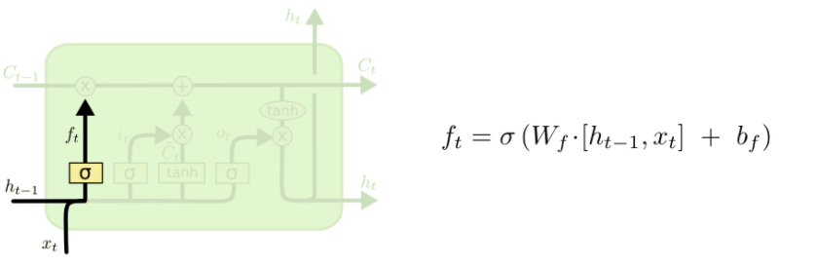
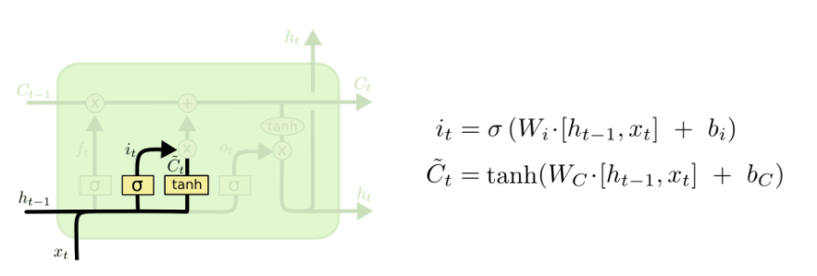
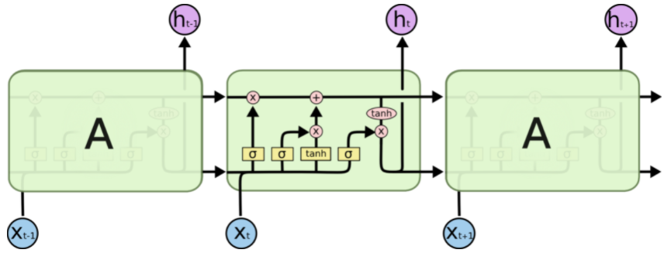
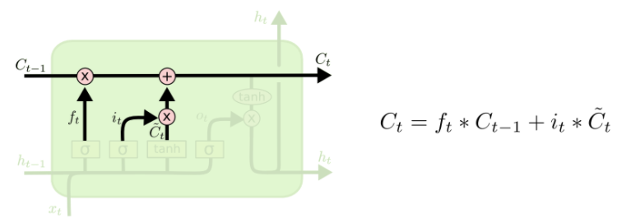
LSTM has three gates:
The input gate: The input gate adds information to the cell state
The forget gate: It removes the information that is no longer required by the model
The output gate: Output Gate at LSTM selects the information to be shown as output

Slide 13
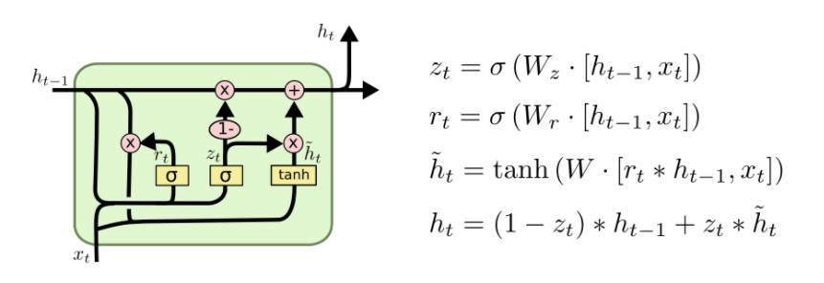
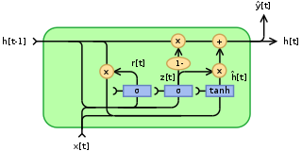
GRU (Gated Recurrent Unit ):
Gated recurrent units(GRU) are a gating mechanism in recurrent neural networks.GRU has fewer parameters than LSTM as it does not have an output gate. To solve the vanishing gradient problem of the standard recurrent neural networks , GRU uses update gate and reset gate .They decide which information should be passed on to the output.They can be trained to keep the information from long ago.
GRUs have update gate and reset gate .

Slide 14
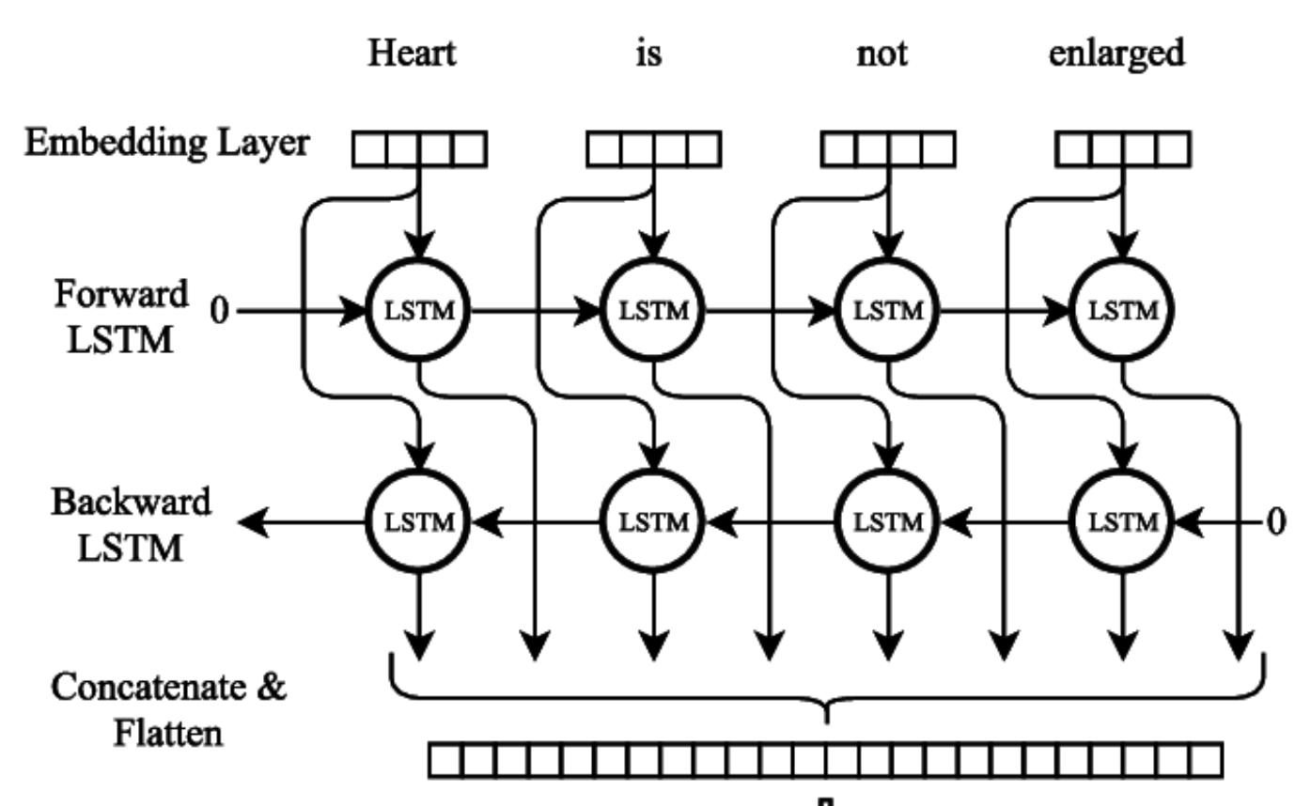
BI-Directional LSTM:-
Bi-directional lstm are an extension of traditional lstms that can improve model performance on sequence classification problems.In problems where all timesteps of the input sequence are available , Bi-directional lstm trains two instead of one lst on the input sequence.It involves duplicating the first recurrent neural layer in the network so that there are now two layer side -by-side, then providing the input as-is as input to the first recurrent neural layer and providing the reverse of the input sequence to the second recurrent neural layer.

Slide 15
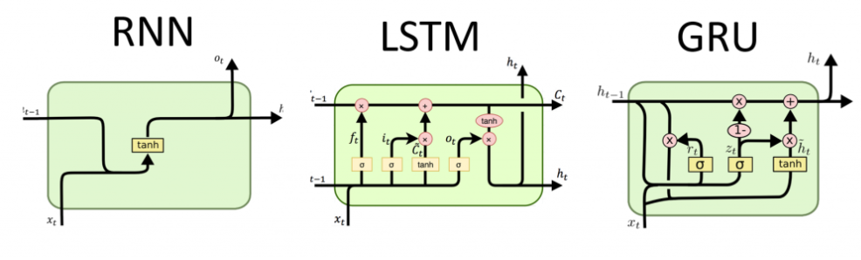

Slide 16
Model evaluation parameters :-
The efficiency of the models of all the machine learning techniques is evaluated by performance indices such as:
RMSE ( root mean square error )-
CC ( correlation coefficient )
PBIAS ( percentage bias )
NSEI ( Nash Sutcliffe efficiency index )

Slide 17
Model 1 was found to be best for predicting O3 and PM2.5 concentrations, whereas CO was best predicted by model 2.Now we will compare our results with LSTM to the results we got using other techniques:-
FOR O3:-
 | LSTM (model 1) | MOVING- AVERAGE | LINEAR- REGRESSION | KNN | PROPHET | Bi LSTM (model 1) | GRU (model 1)
RMSE | 1.540 | 36.315 | 35.099 | 33.09 | 35.242 | 1.417 | 1.380
CC | 0.986 | 0.070 | 0.456 | 0.502 | 0.395 | 0.987 | 0.990
PB | 0.000 | 0.234 | 0.045 | 0.150 | 0.308 | 0.000 | 0.000
NSE | 0.934 | 0.063 | 0.070 | 0.081 | 0.001 | 0.951 | 0.954
CONCLUSION: GRU(Model 1) is best for predicting O3. GRU and Bi LSTM has performed better than LSTM.

Slide 18
FOR PM2.5:-
 | LSTM (Model1) | MOVING- AVERAGE | LINEAR- REGRESSION | KNN | PROPHET | Bi LSTM (Model1) | GRU (Model2)
RMSE | 1.622 | 140.642 | 128.266 | 126.90 | 132.206 | 1.473 | 1.453
CC | 0.986 | 0.361 | 0.810 | 0.537 | 0.509 | 0.988 | 0.988
PB | 0.000 | 0.200 | 0.433 | 0.194 | 0.253 | 0.000 | 0.000
NSE | 0.937 | 0.056 | 0.166 | 0.184 | 0.114 | 0.947 | 0.949
CONCLUSION: GRU(Model 1) is best for predicting PM2.5. GRU and Bi LSTM has performed better than LSTM.

Slide 19
FOR NOx_Target:-
 | LSTM (model2) | MOVING- AVERAGE | LINEAR- REGRESSION | KNN | PROPHET | Bi LSTM (model 2) | GRU (model 2)
RMSE | 2.942 | 82.302 | 69.605 | 81.24 | 78.783 | 3.220 | 3.267
CC | 0.944 | 0.111 | 0.526 | 0.334 | 0.373 | 0.930 | 0.924
PB | 0.001 | 0.007 | 0.365 | 0.567 | 0.361 | 0.001 | 0.001
NSE | 0.942 | 0.014 | 0.278 | 0.011 | 0.070 | 0.748 | 0.741
CONCLUSION: LSTM(Model 2) is best for predicting NOx_Target. Others failed performed better than LSTM.

Slide 20
FOR CO_Target:-
 | LSTM (model 2) | MOVING- AVERAGE | LINEAR- REGRESSION | KNN | PROPHET | GRU (model 4) | Bi-LSTM (model 2)
RMSE | 1.444 | 1795.37 | 1931.801 | 2277.42 | 1555.56 | 1.453 | 1.416
CC | 0.890 | 0.149 | 0.310 | 0.380 | 0.191 | 0.990 | 0.989
PB | 0.000 | 0.734 | 0.750 | 0.846 | 0.410 | 0.001 | 0.000
NSE | 0.942 | 0.098 | 0.010 | 0.002 | 0.489 | 0.949 | 0.951
CONCLUSION: Bi-LSTM(Model 2) is best for predicting CO_Target. GRU and Bi LSTM has performed better than LSTM.

Slide 21
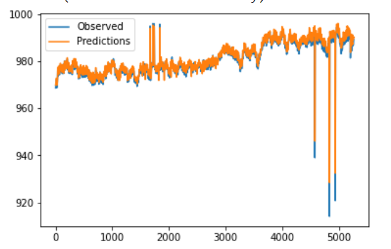
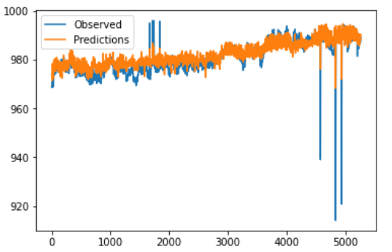
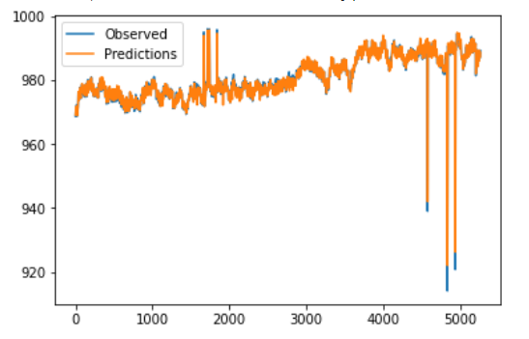
LSTM
Bi LSTM
GRU

Slide 22
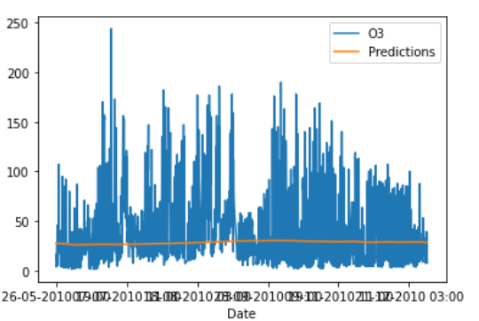
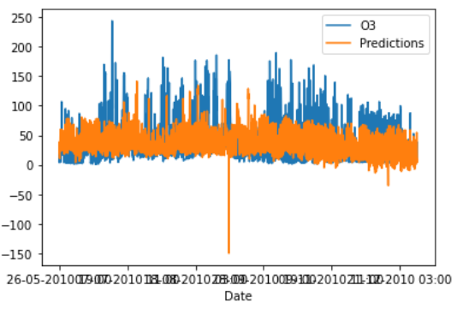
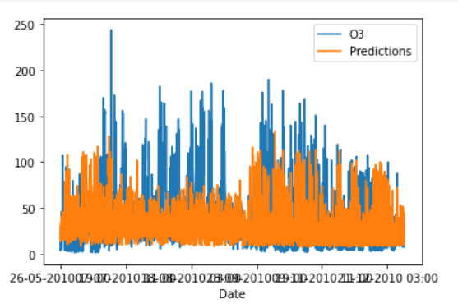
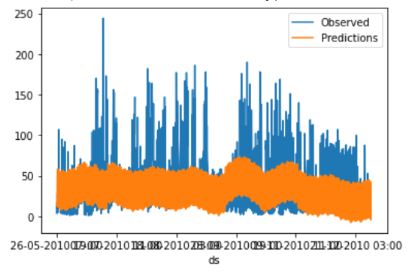
Moving Average
Linear Regression
kNN
Prophet

Slide 23
THANK YOU

