Slide 1

Topic: Data Preprocessing and Data Cleaning with Their Impact on Model Performance
NAME: TOUHID ALAM
ID: 22-46330-1
COURSE: MACHINE LEARNING
SECTION: B
COURSE FACULTY: MOHAMMAD SAEF ULLAH MIAH

Slide 2
OUTLINE
01
Introduction
02
Why Data Preprocessing?
03
Some Common Techniques of Data Preprocessing
04
Their Impact On Machine Learning Model
05
Conclussion
06
References

Slide 3
INTRODUCTION
Machine Learning is a Part of AI Where Machine learns to do some task from any input data.
Machine Learning Model works on the fed data.
Data preprocessing is a part of Machine Learning.
Data are preprocessed to fed to the model.
Sequential steps to prepare the raw data suitable for machine learning model.

Slide 4

WHY DATA PREPROCESSING?
01
Is the data qualityful?
02
Data maybe no feasible or consistent.
03
Handle irrelevant data or Reduce Data.
04
To ensure best performance from the machine.
05
Introduction of Big Data.
06
Core Stage of Machine Learning.

Slide 5
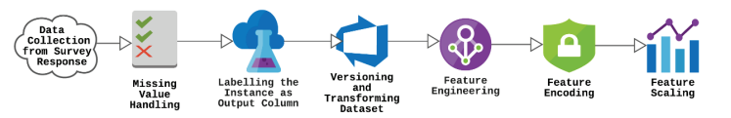
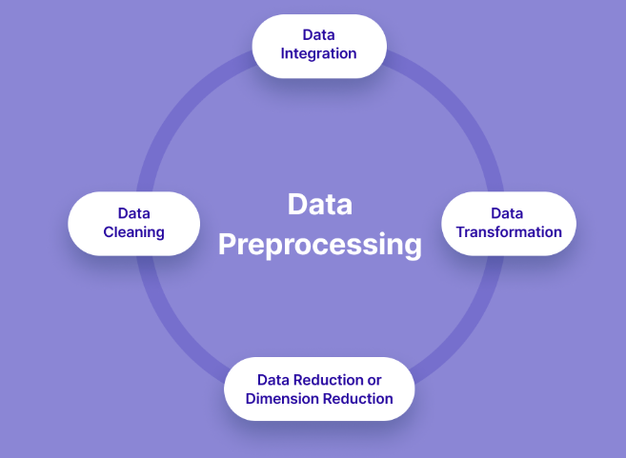
COMMON STEPS OF DATA PREPROCESSING
Data Collection.
Exploratory Data Analysis.
Data Cleaning.
Data Labeling.
Feature Engineering.
Data Balancing.
Splitting Data.
Figure 01: An Approach of Pre-processing of a dataset [6]
Figure 02: Common Steps of Data Preprocessing [7].

Slide 6
DATA COLLECTION
Depends on the purpose of the model.
Need to consider the Challengers.
Insufficient Labeled Data for New Applications and Deep Learning.
Data Must be Indexed and published for sharing.
Active Learning or Crowdsourcing (Survey).
Use Popular Online Database Platforms like Kaggle.
Integrate datasets if needed.

Slide 7
EXPLORATORY DATA ANALYSIS (EDA)
Dimensions of the dataset.
If there are any missing, abnormal values or outliers.
The type of attributes.
What kind of data we are working with.
Data Visualization for understanding the patters, trends and correlations within the dataset.
If any attribute not correlated with the target attribute.

Slide 8
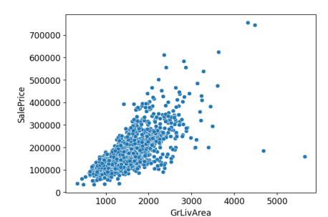
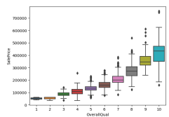
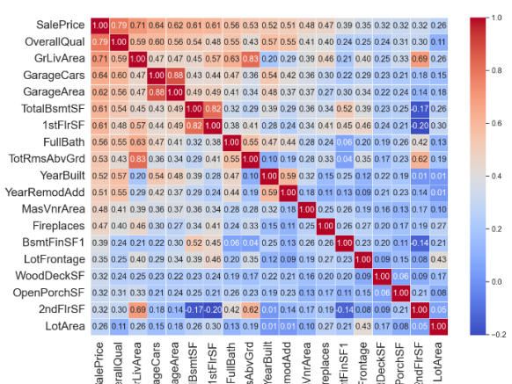
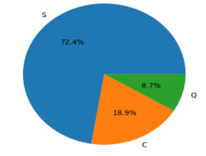
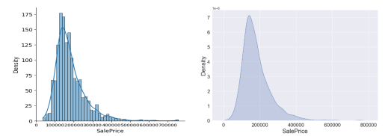
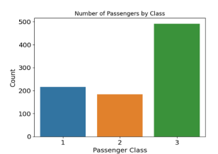
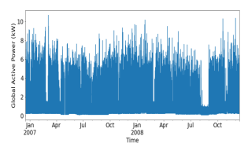
Common Data Visualization Techniques
Figure 03: Some Common Data Visualization Techniques [11].

Slide 9
DATA CLEANING
Missing Value
Noise Value
Outlier
Missing Value Types
MCAR, MAR, NMAR.
Deletion.
Apply algorithm like Mean/Mode Imputation, Hot and Cold Deck Imputation, Autoregressive, Maximum Likelihood or Fuzzy-rough set [12].
Anomalies of the dataset.
Causes Inaccuracies in performance.
Need to check type anomalies for noise values [12].
Regression or Clustering for solution.
Values That are different from others in range.
Boxplot.
Median Imputation for solution.

Slide 10
DATA LABELING
Determining The Features and the Target Attribute of the dataset.
FEATURE ENGINEERING
The process of creating new features or deleting or reducing the features.
Creating new features based on the nature of the data.
Reducing Features using PCA or LDA.
Normalization or Standardization.

Slide 11
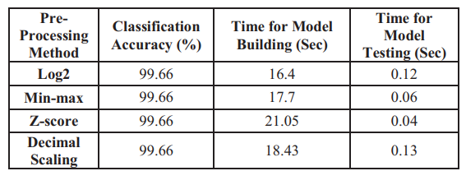
DATA TRANSFORMATION
Normalization
Standardrization
Uses Quantile to normalize the data.
Within the range of [0,1]
Min Max method or log scaling.
Mean of 0 and SD of 1.
No particular range.
Z-score.
Considered a part of Normalization.
Table 1. The accuracy and consumed time by the pre-processing normalization methods [5].
Table 1 shows the study of Obaid et al. where they used J48 CLASSIFIER and various transformation techniques for pre-processing.

Slide 12
ENCODING CATEGORICAL DATA
Convert The categorical data in Unique Numerical values.
One Hot Encoding.
DIMENSIONALITY REDUCTION
Some Feature may not have significant relation with the target attribute.
May need to reduce the time complexity of the dataset.
Principal Component Analysis (PCA) based on the variance in dataset and it uses linear Regression.
Linear Discriminant Analysis (LDA) for better classification.

Slide 13
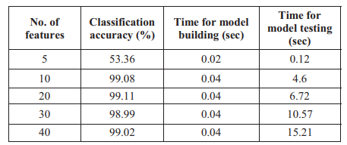
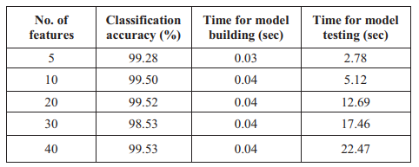
DIMENSIONALITY REDUCTION
In their research, Obaid et al. also showed the impact on the accuracy of the model when different number of features are used for the model using different dimensionality reduction methods on NSL-KDD dataset [5]. Table 2 and Table 3 show the result of their study
Table 2: Dimensional Reduction Results using LDA [5].
Table 3: Dimensional Reduction Results using PCA [5].

Slide 14
DATA BALANCING
Adjusting the distribution of data.
When one categorical target value is so much higher than another.
Useful to solve the biasness in the performance
Resampling Data
Synthetic Samples
Oversampling the target attribute with lower number of instance.
Under sampling the target attribute with higher number of instances
Must be randomly.
Create New sample data artificially.
Uses Minority Over-Sampling technique

Slide 15
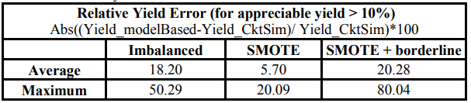
DATA BALANCING
Shaer et al. approaches to handle imbalance data with SMOTE and other techniques where they found machine gives 18% relative error rate for the imbalance data and only 5% relative error rate in predicting the yield estimation using SMOTE [14]. Table 4 shows their result.
Table 04: Yield Prediction Error [14].

Slide 16
SPLITTING DATA
Split the data for training the model, validate the model, and testing the model.
For training and testing 80-20.
In big data, the training ratio needs to be higher.
Particularly useful for checking the underfitting and overfitting in the model via testing the validation and test data.

Slide 17

CONCLUSSION
Data Preprocessing determines whether the data synchronously works with the model.
Need to choose the steps based on the data.
Processed in some structured steps.
Have particular impact on the model performance.

Slide 18
REFERENCES
[1] | S. Roy, P. Sharma, K. Nath, D. K. Bhattacharyya, and J. K. Kalita, “Pre-Processing: A Data Preparation Step,” in Encyclopedia of Bioinformatics and Computational Biology, Elsevier, 2019, pp. 463–471. doi: 10.1016/B978-0-12-809633-8.20457-3.
[2] | D. Rao, V. N. Gudivada, and V. V. Raghavan, “Data quality issues in big data,” in 2015 IEEE International Conference on Big Data (Big Data), Oct. 2015, pp. 2654–2660. doi: 10.1109/BigData.2015.7364065.
[3] | A. Juneja and N. N. Das, “Big Data Quality Framework: Pre-Processing Data in Weather Monitoring Application,” in 2019 International Conference on Machine Learning, Big Data, Cloud and Parallel Computing (COMITCon), Feb. 2019, pp. 559–563. doi: 10.1109/COMITCon.2019.8862267.
[4] | P. Zhang, F. Xiong, J. Gao, and J. Wang, “Data quality in big data processing: Issues, solutions and open problems,” in 2017 IEEE SmartWorld, Ubiquitous Intelligence & Computing, Advanced & Trusted Computed, Scalable Computing & Communications, Cloud & Big Data Computing, Internet of People and Smart City Innovation (SmartWorld/SCALCOM/UIC/ATC/CBDCom/IOP/SCI), Aug. 2017, pp. 1–7. doi: 10.1109/UIC-ATC.2017.8397554.
[5] | H. S. Obaid, S. A. Dheyab, and S. S. Sabry, “The Impact of Data Preprocessing Techniques and Dimensionality Reduction on the Accuracy of Machine Learning,” in 2019 9th Annual Information Technology, Electromechanical Engineering and Microelectronics Conference (IEMECON), Mar. 2019, pp. 279–283. doi: 10.1109/IEMECONX.2019.8877011.
[6] | M. Rahman, M. Hasan, M. M. Billah, and R. J. Sajuti, “Grading System Prediction of Educational Performance Analysis Using Data Mining Approach,” Malaysian Journal of Science and Advanced Technology, pp. 204–211, Nov. 2022, doi: 10.56532/mjsat.v2i4.96.
[7] | “Data Preprocessing in Machine Learning [Steps & Techniques].” Accessed: Jun. 13, 2024. [Online]. Available: https://www.v7labs.com/blog/data-preprocessing-guide, https://www.v7labs.com/blog/data-preprocessing-guide
[8] | Y. Roh, G. Heo, and S. E. Whang, “A Survey on Data Collection for Machine Learning: A Big Data - AI Integration Perspective,” IEEE Transactions on Knowledge and Data Engineering, vol. 33, no. 4, pp. 1328–1347, Apr. 2021, doi: 10.1109/TKDE.2019.2946162.
[9] | A. Kadadi, R. Agrawal, C. Nyamful, and R. Atiq, “Challenges of data integration and interoperability in big data,” in 2014 IEEE International Conference on Big Data (Big Data), Oct. 2014, pp. 38–40. doi: 10.1109/BigData.2014.7004486.
[10] | “Kaggle: Your Machine Learning and Data Science Community.” Accessed: Jun. 13, 2024. [Online]. Available: https://www.kaggle.com/
[11] | C. Yalim and H. Handley, “The Effectiveness of Visualization Techniques for Supporting Decision-Making,” Modeling, Simulation and Visualization Student Capstone Conference, Apr. 2023, [Online]. Available: https://digitalcommons.odu.edu/msvcapstone/2023/datascience/1
[12] | I. Pratama, A. E. Permanasari, I. Ardiyanto, and R. Indrayani, “A review of missing values handling methods on time-series data,” in 2016 International Conference on Information Technology Systems and Innovation (ICITSI), Oct. 2016, pp. 1–6. doi: 10.1109/ICITSI.2016.7858189.
[13] | “Handling Imbalanced Datasets in Machine Learning Projects.” Accessed: Jun. 13, 2024. [Online]. Available: https://www.linkedin.com/pulse/handling-imbalanced-datasets-machine-learning-projects-sandesh-patil
[14] | L. Shaer, R. Kanj, and R. Joshi, “Data Imbalance Handling Approaches for Accurate Statistical Modeling and Yield Analysis of Memory Designs,” in 2019 IEEE International Symposium on Circuits and Systems (ISCAS), May 2019, pp. 1–5. doi: 10.1109/ISCAS.2019.8702731.

Slide 19
THANK YOU

