Slide 1
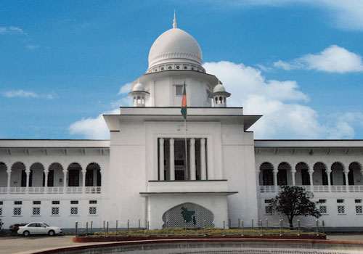
Management of
Judicial System
Database Design
Chowdhury Md Rakin Haider, 1005009
Shakil Ahmed, 1005014
Md Touhiduzzaman, 1005018
Shohan Al Jannat, 1005023
Tanzeer Hossain, 1005029
CSE , BUET

Slide 2
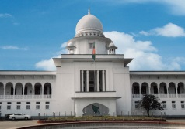
Outline
Complete ERD
Detailed Entity-Relationships
Database Schema
Database Triggers
Database Procedures

Slide 3
Complete ERD
Magistrate
Notification
Notification-From
Judged-By
Supplied-By
Order-FROM
Orders
Causelist
Judgment
Has
Supplied-Doc
Has
Under
Plaintiff
Plaintiff-for
Under
Case-Info
Courts
Accused
Accused-of
Compared-By
Zone-Under-Court
Copied-By
Witness
Witness-for
CS-for
Filed-By
Copy-maker
Works-At
Comparer
Works-at
Duty-Officer
ChargSheet
Court-Employee
Works-at
OC
Submitted-By
Police Station
Included-In
Zone
GRO

Slide 4
Trigger
Trigger Name |  | New_Case_Insertion
Time of Execution |  | After DO enters the new case details in the FIR form
Actions |  |  |  | Remarks
Commands | Attributes |  | Table(s)
Insert | All |  | Plaintiff | These attributes will be got from the case details submitted by the DO.
Insert | All |  | Witness
Insert | All |  | Accused

Slide 5
Trigger
Trigger Name |  | Chargesheet_Submission
Time of Execution |  | After OC submits the charge sheet
Actions |  |  |  | Remarks
Commands | Attributes |  | Table(s)
Update | Chargesheet_id |  | Case | Before submission of charge sheet, the chargesheet_id field would be set to null. but after this submission, this field will be updated to a number indicating the primary key of the Chargesheet table.

Slide 6
Trigger
Trigger Name |  | Cause_List_Generation
Time of Execution |  | After the clerk office receives the new case
Actions |  |  |  | Remarks
Commands | Attributes |  | Table(s)
Insert | caseId and courtId |  | Cause List | Cause list, in a case’s life cycle, contains the magistrate-court-case relationships, out of which the magistrate can be found from the court table by the court id.
Insert | All |  | Notification

Slide 7
Trigger
Trigger Name |  | Court_Assigned_Notification
Time of Execution |  | After the CMM shuffles the court list
Actions |  |  |  | Remarks
Commands | Attributes |  | Table(s)
Insert | All |  | Notification | The respective magistrates will be notified about his newly assigned court.

Slide 8
Trigger
Trigger Name |  | Insert_Supplied_Doc
Time of Execution |  | After a compared case document is saved to the supplied_doc table after all processes
Actions |  |  |  | Remarks
Commands | Attributes |  | Table(s)
Insert | Doc_Id, Supplier_id |  | Supplied_By | These values can be used for further verification later on.

Slide 9
Trigger
Trigger Name |  | Post_Order
Time of Execution
Actions |  |  |  | Remarks
Commands | Attributes |  | Table(s)

Slide 10
Procedures
Procedure Name | Insert_Case_Info.
Time of Execution | When a new case is filed
Input | Date, place, crime, forwarding time, distance from police station, access to GRO, access to CLO, received by CLO
Output
Apply On | Case, (Plaintiff, Accused, Witness)
Action | Remarks
Inserts all the information of a case. | This function gets all the necessary info as its parameter and then saves these in the database by SQL insert query.

Slide 11
Procedures
Procedure Name | Get_Case_List
Time of Execution | When GRO forwards the cases, CLO initiates cause list generation, CMM receives cases, copy maker copies and comparer compares any requested document
Input
Output | Case List
Apply On | Case, Charge-sheet, Order, Judgment
Action | Remarks
Returns all the information of all cases. | This function gets all the necessary info from the database by SQL selection query.

Slide 12
Procedures
Procedure Name | Update_Case_Documentation
Time of Execution
Input
Output
Apply On | Case
Action | Remarks

Slide 13
Procedures
Procedure Name | Insert_Charge_Sheet
Time of Execution | When the OC submits the charge sheet
Input | Submission_date, investigator_id, attachment
Output
Apply On | Chargesheet, Chargesheet_for, CS_Submitted_By (, Case)
Action | Remarks
Returns all the information of all cases. | This function gets all the necessary info from the database by SQL selection query.

Slide 14
Procedures
Procedure Name | Get_Magistrate_List
Time of Execution | When the clerk office initiates the generation of cause list, the CMM assigns court to magistrate, judgment documentation proceeds, compared document sent for approval
Input
Output | Magistrate_List
Apply On | Magistarte
Action | Remarks
Returns all the information of all magistrates. | This function gets all the necessary info from the database by SQL selection query.

Slide 15
Procedures
Procedure Name | Insert_Supplied_Doc
Time of Execution | When the copy maker copies requested case info and forwards to the comparer to compare
Input | Case_id, copy_maker_id, comparer_id, supplier_id, supplied_to_name
Output
Apply On | Supplied_doc, Copied_By, Compared_By, Supplied_By
Action | Remarks
Saves the copied document to be compared by the comparer

Slide 16

Thank You
Questions?

