Slide 1
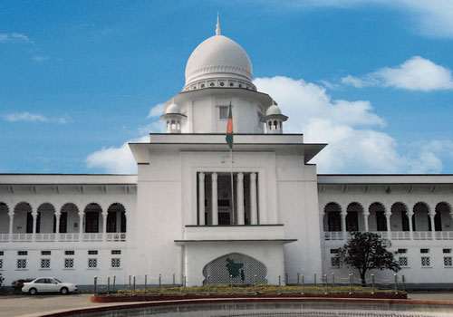
Management of Judicial System
Chowdhury Md Rakin Haider, 1005009
Shakil Ahmed, 1005014
Md Touhiduzzaman, 1005018
Shohan Al Jannat, 1005023
Tanzeer Hossain, 1005029
CSE , BUET
Notes:
Good Morning everyone. I am Rakin , proposing our project for Information System development sessional course. Ours is the project “Judicial Management System” .

Slide 2
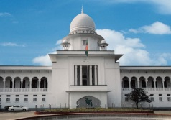
Baseline Problems Identification
Filling up the FIR
Forwarding the FIR to the GRO
Management & categorization of the cases by GRO
Assignment of the Magistrates by CMM
Generating the cause-list
Notifying the Magistrates
Generating the requested certified copies
Proper documentation of the trial phase
Managing & updating the running case records
Managing the huge amount of past case
Notes:
Objectives, problems to be faced in developing, current plan to overcome these

Slide 3
Preliminary Problem Statement
3
Brief Statements Problems | Urgency | Proposed Solution | Benefits
1. Filling up and forwarding the FIR to the GRO | ASAP | Automated FIR submission to the GRO from the Duty Officer, as soon as the case is filed | Manual labor and time saved with more accuracy
2. Management & categorization of the cases by GRO | 1 Month | GRO selects the category of the case and sends to CMM for Magistrate assignment through web-service | Manual labor and time saved with more accuracy
3. Assignment of the Magistrates by CMM | 2 Months | CMM assigns the respective Magistrate to a case, when they’re notified with an auto-generated cause-list | “
4. Notifying the Magistrates | 2 Months
5. Generating the cause-list | 1 Month
6. Generating the requested certified copies | 2 Months | Certified print-outs of the online documents | “

Slide 4
Preliminary Problem Statement
4
Brief Statements Problems | Urgency/Priority Rank | Proposed Solution | Benefits
7. Proper documentation of the trial phase | 2 Months / 3 | Greffier writes & updates case details | Manual labor and time saved with more accuracy
8. Managing & updating the running case records | 3 Months / 5 | Respective people updates the records in real time | “
9. Managing the huge amount of past case | 4 Months / 6 | Saving completed cases | Later benefits of the judges, lawyers and general public

Slide 5
Negotiation of Baseline Scope
5
Included Aspects of the System:
User Interface:
Police Station : Duty Officer
Magistrate Office:
Magistrate
GRO
CMM
Trial Phase:
Judge
Greffier

Slide 6
Negotiation of Baseline Scope
6
Included Aspects of the System:
Required Data:
Police Station: Duty Officer(s)
Cases: FIR, charge-sheet, witness, states classification and judgment record
Magistrates data
Cause list
Judge data

Slide 7
Negotiation of Baseline Scope
7
Included Aspects of the System:
FIR & charge-sheet flow maintenance
Jobs of the GRO
Jobs of the CMM
Trial phase documents maintenance
Completed cases’ documents maintenance for later uses (appeal, document witness etc.)

Slide 8
Negotiation of Baseline Scope
8
Not Included Aspects of the System:
Online request for the authenticated documents
Money transaction system for relative payments
Physical presence in the trial phase

Slide 9
Assessment of Baseline Project
9
Advantages:
Less paper works
Easier Management
Quickening the whole process
Pitfalls:
Hardware requirements
Trained & skilled personnel
Web service consumption
Security measures must be maintained

Slide 10
Schedule
10
Weeks | 1 | 2 | 3 | 4 | 5 | 6 | 7 | 8 | 9 | 10 | 11 | 12 | 13 | 14 | 15
Tasks
1. Survey
2. Planning
3. DB Design
4. DB Implementation & Static Data Entry
5. Sub-Systems Implementation
6. Merging
7. System Testing, Debugging & Deployment
14 Days
7 Days
21 Days
35 Days
28 Days
14 Days
14 Days

Slide 11
Thank You

