Slide 1
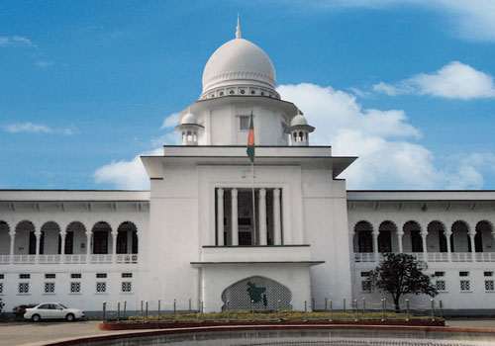
Management of
Judicial System
User Interface Design
Chowdhury Md Rakin Haider, 1005009
Shakil Ahmed, 1005014
Md Touhiduzzaman, 1005018
Shohan Al Jannat, 1005023
Tanzeer Hossain, 1005029
CSE , BUET

Slide 2

Subsystems
Police Station
Magistrate Office
Case Filing
CMM Court
Cause List Generation
Copy House
Trial Phase
Magistrate Assignment
Document Collection
Trial Documentation

Slide 3
Common
User
Interfaces

Slide 4
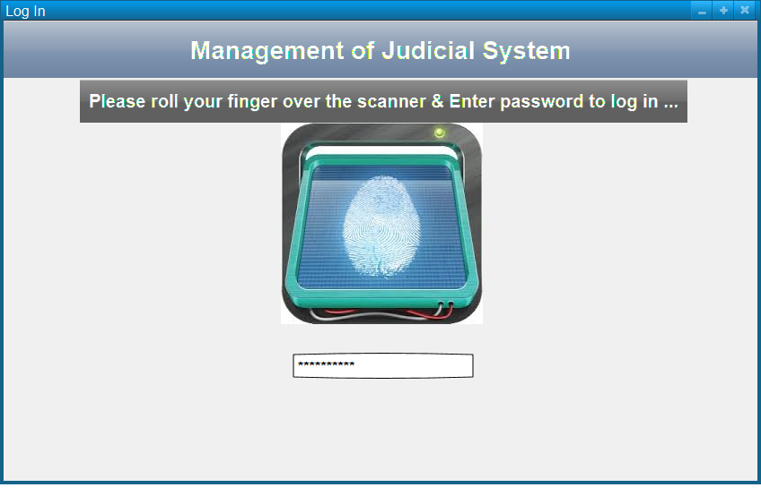
Log In UI

Slide 5
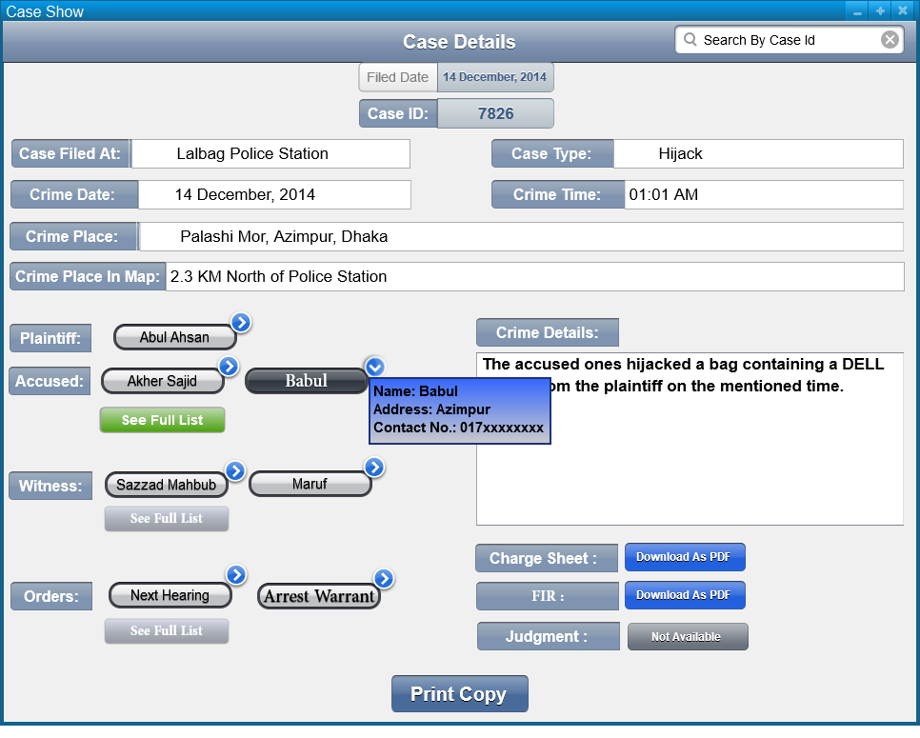
Case Details Show UI

Slide 6
Subsystem 1: Case Filing

Slide 7
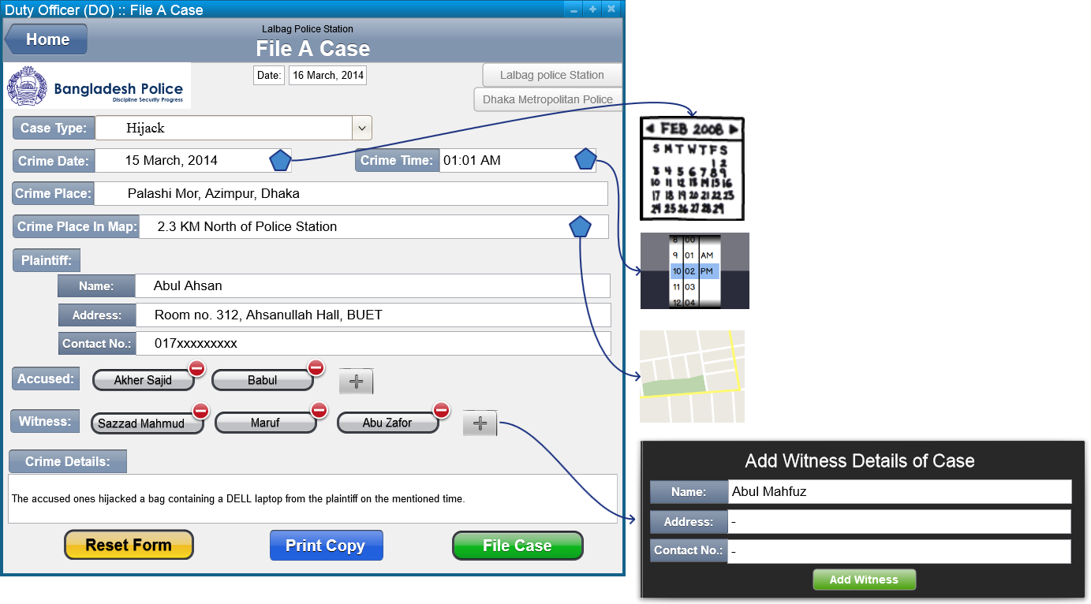
Subsystem 1: Case Filing
File A New Case UI:

Slide 8
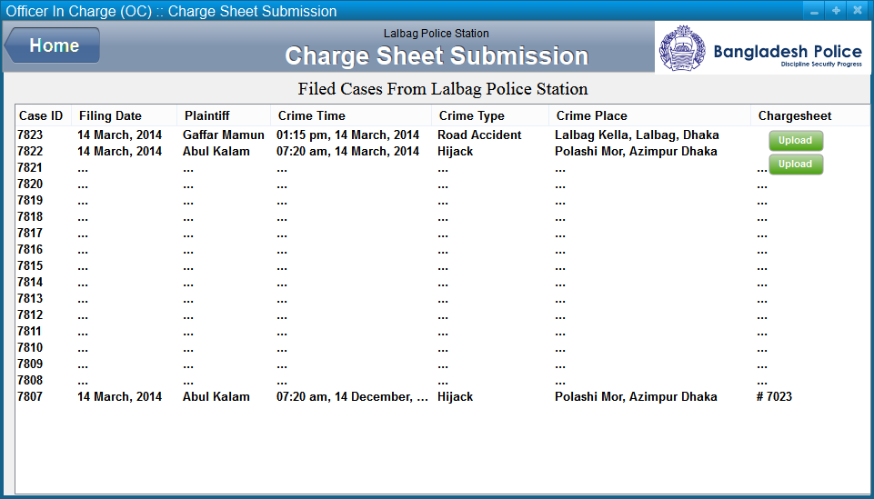
Subsystem 1: Case Filing
Charge-sheet Submission UI:
Log Out

Slide 9
Subsystem 2: Cause List Generation

Slide 10
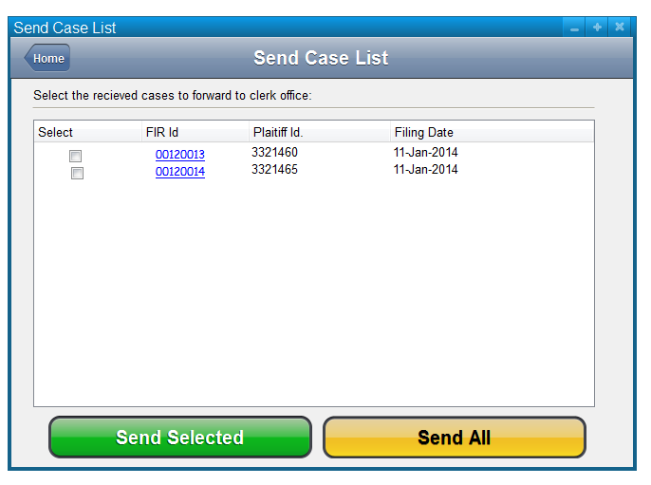
Subsystem 2: Cause List Generation
Case List Sending UI:
Log Out

Slide 11
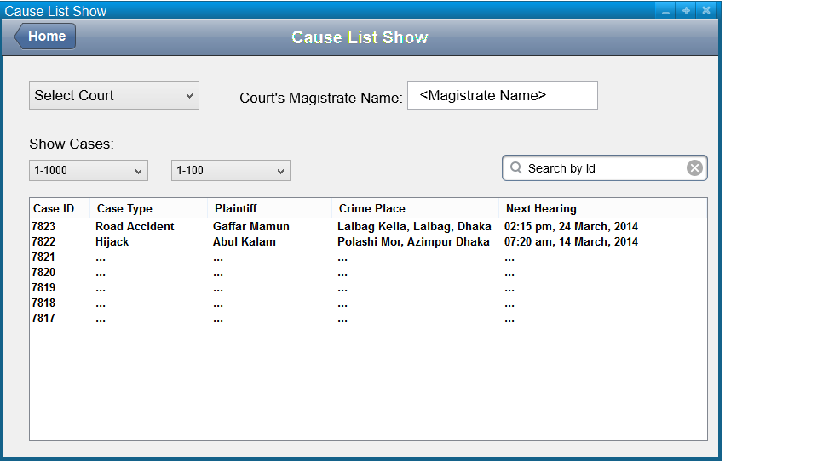
Subsystem 2: Cause List Generation
Cause List Show UI:
Log Out

Slide 12
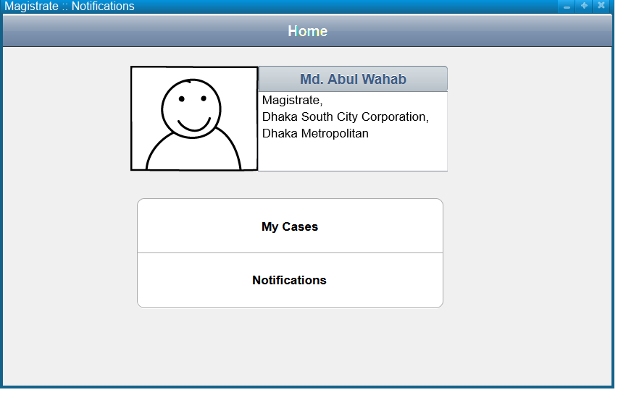
Subsystem 2: Cause List Generation
Magistrate Home UI:

Slide 13
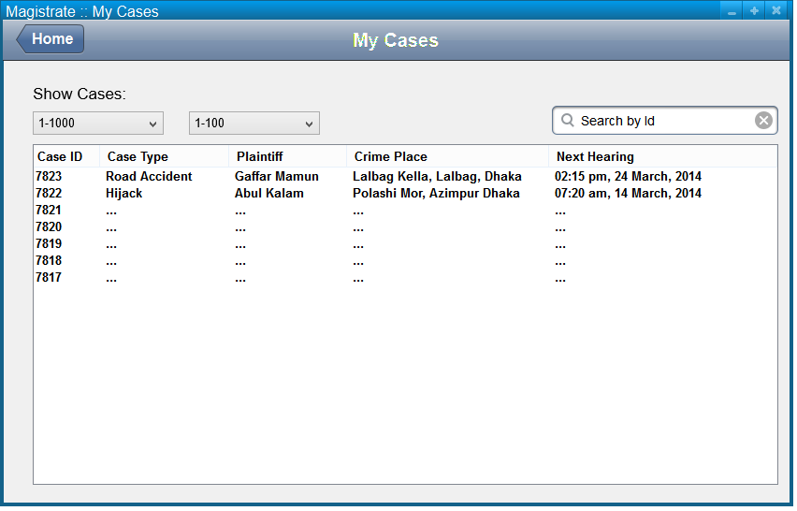
Subsystem 2: Cause List Generation
Magistrate’s Case List Showing UI:

Slide 14
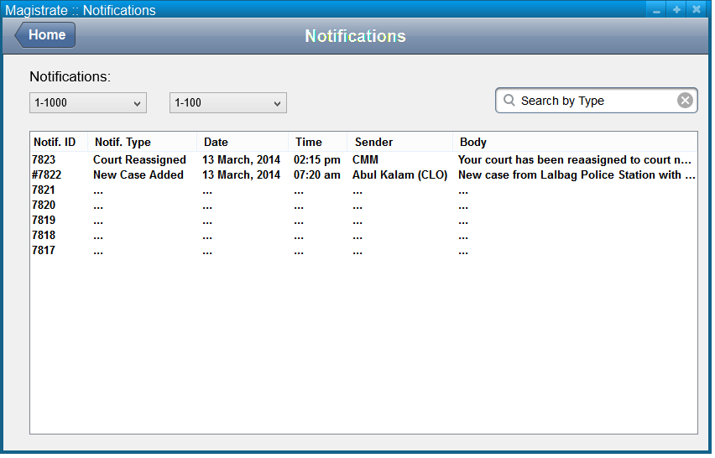
Subsystem 2: Cause List Generation
Magistrate’s Notification Showing UI:

Slide 15
Subsystem 3: Magistrate Assignment

Slide 16
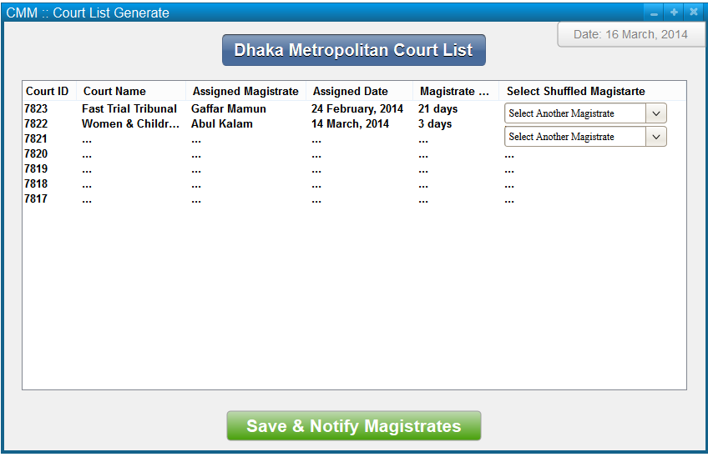
Subsystem 3: Magistrate Assignment
Court List Generation UI:

Slide 17
Subsystem 4: Document Collection

Slide 18
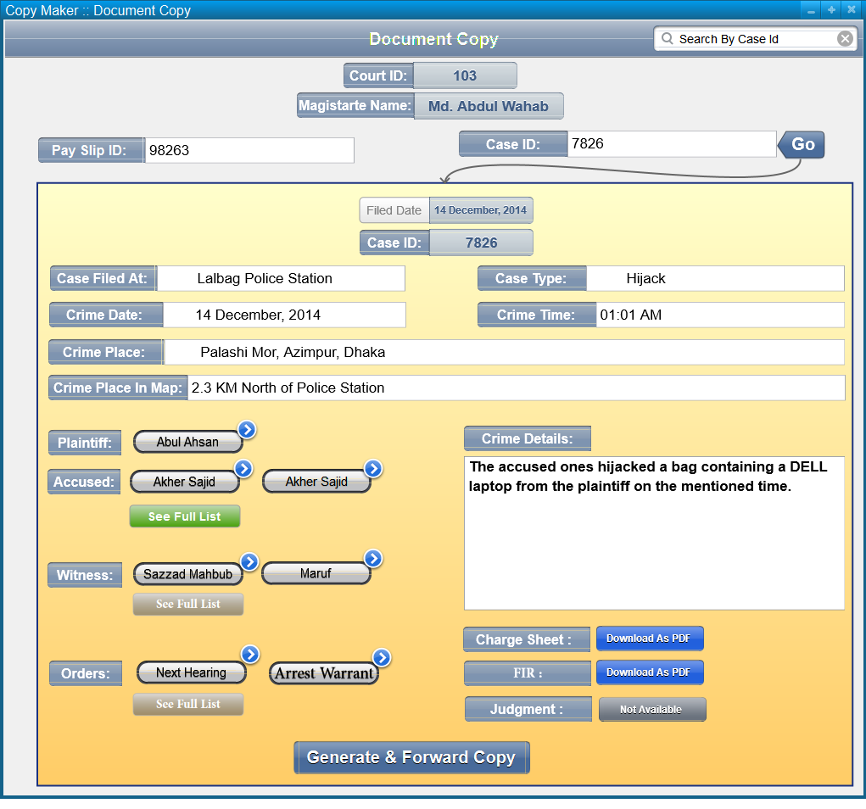
Subsystem 4: Document Collection
Document Copying UI:

Slide 19
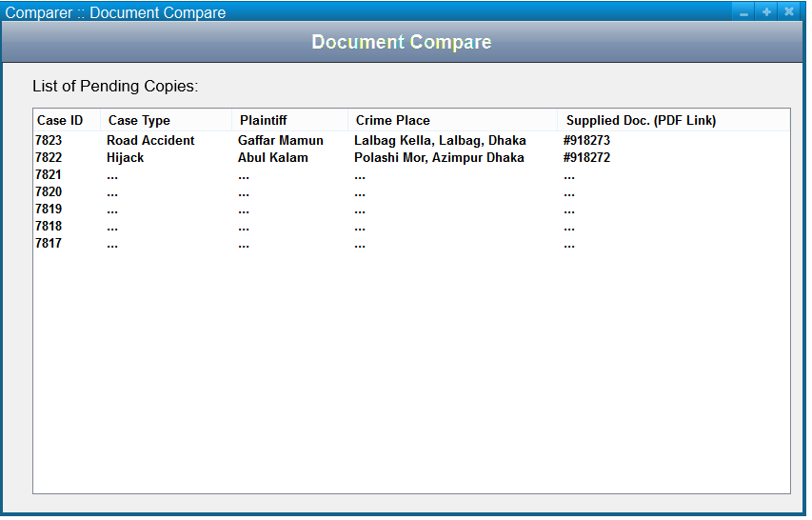
Subsystem 4: Document Collection
Document Compare UI:

Slide 20
Subsystem 5: Trial Documentation

Slide 21
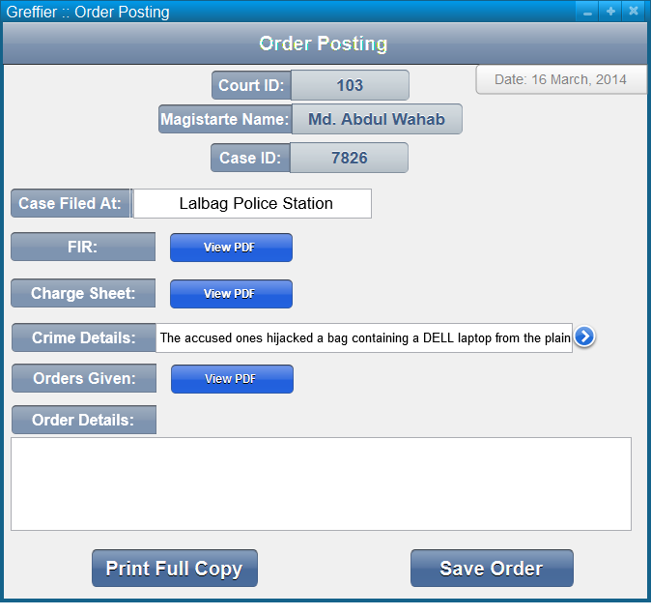
Subsystem 5: Trial Documentation
Order Posting UI:

Slide 22
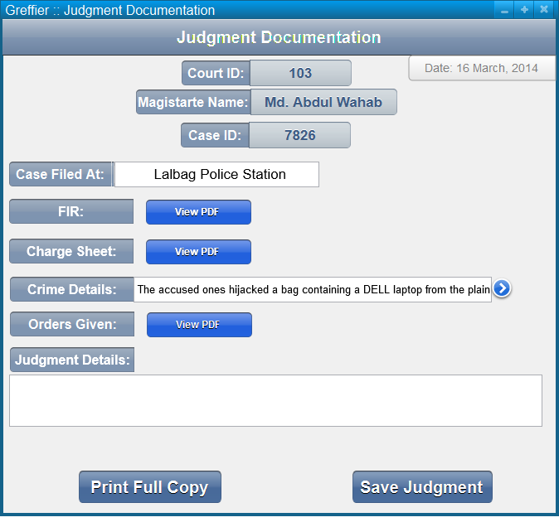
Subsystem 5: Trial Documentation
Judgment Documentation UI:

Slide 23

Thank You
Questions?

