Slide 1
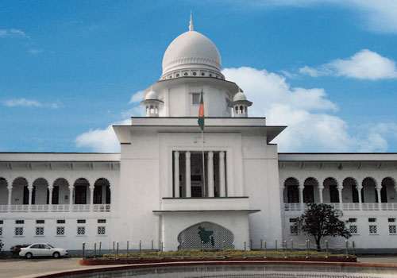
Management of
Judicial System
Database Design
Chowdhury Md Rakin Haider, 1005009
Shakil Ahmed, 1005014
Md Touhiduzzaman, 1005018
Shohan Al Jannat, 1005023
Tanzeer Hossain, 1005029
CSE , BUET

Slide 2

Outline
Subsystems
Respective Use-cases
According to each use case
Activity Diagram
Sequence Diagram
Respective State Diagrams

Slide 3
Subsystems
Police Station
Magistrate Office
Case Filing
CMM Court
Cause List Generation
Copy House
Trial Phase
Magistrate Assignment
Document Collection
Trial Documentation

Slide 4
Complete ERD

