Slide 1

Soundiation: User Manual
Last update: January 11, 2022
Contact: Tianquan Tang (tianquan@connect.hku.hk)
Version 1.0

Slide 2

GUI start
Soundiation runs on Microsoft Windows with MATLAB 2010a or above versions installed.
Soundiation supports parallel computation:
- Parallel computation greatly reduces computational time, depended on the cores number of computer.
- To enable parallel computation, we need to activate MATLAB parallel pool by simply typing
>> matlabpool; % for MATLAB 2010a
or
>> parpool;
on Command Window before running the GUI.
Start Soundiation in MATLAB:
- Set the Current Folder direction to “.\Soundiation\src”:
or type
>> addpath('<folderpath>\Soundiation\src’);
on Command Window to open the interface.
- Type
>> main_interface;
on Command Window to open the interface.

Slide 3
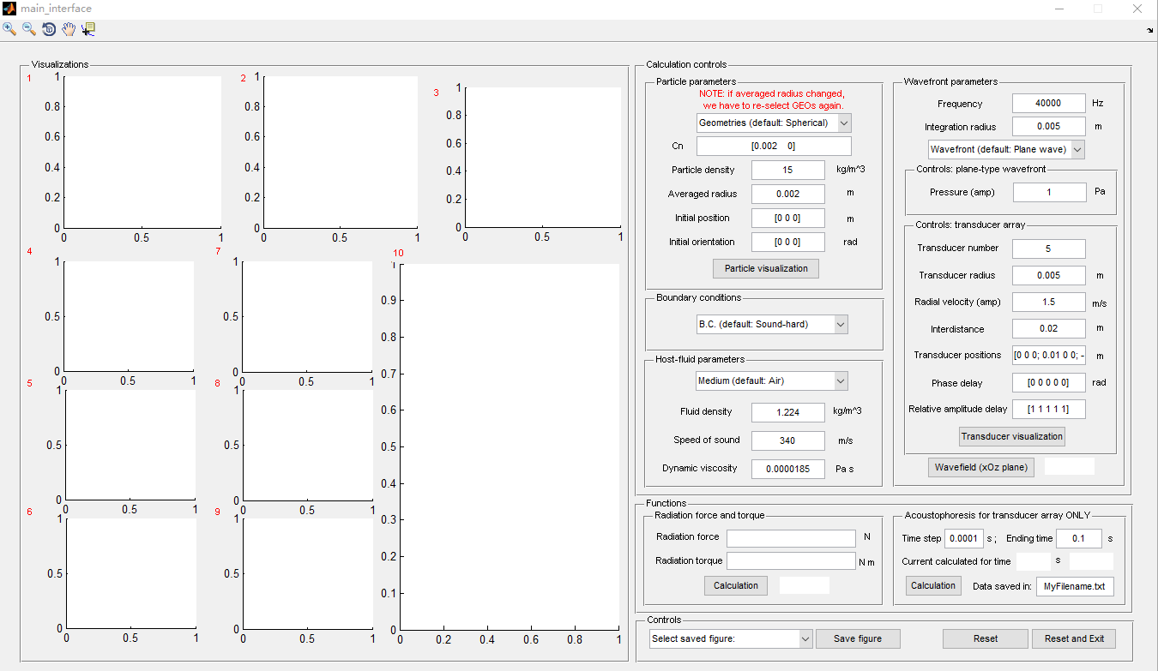
Main interface
1. Results visualization panel
2. Parametric control panel
3. Functional panel and Control panel

Slide 4
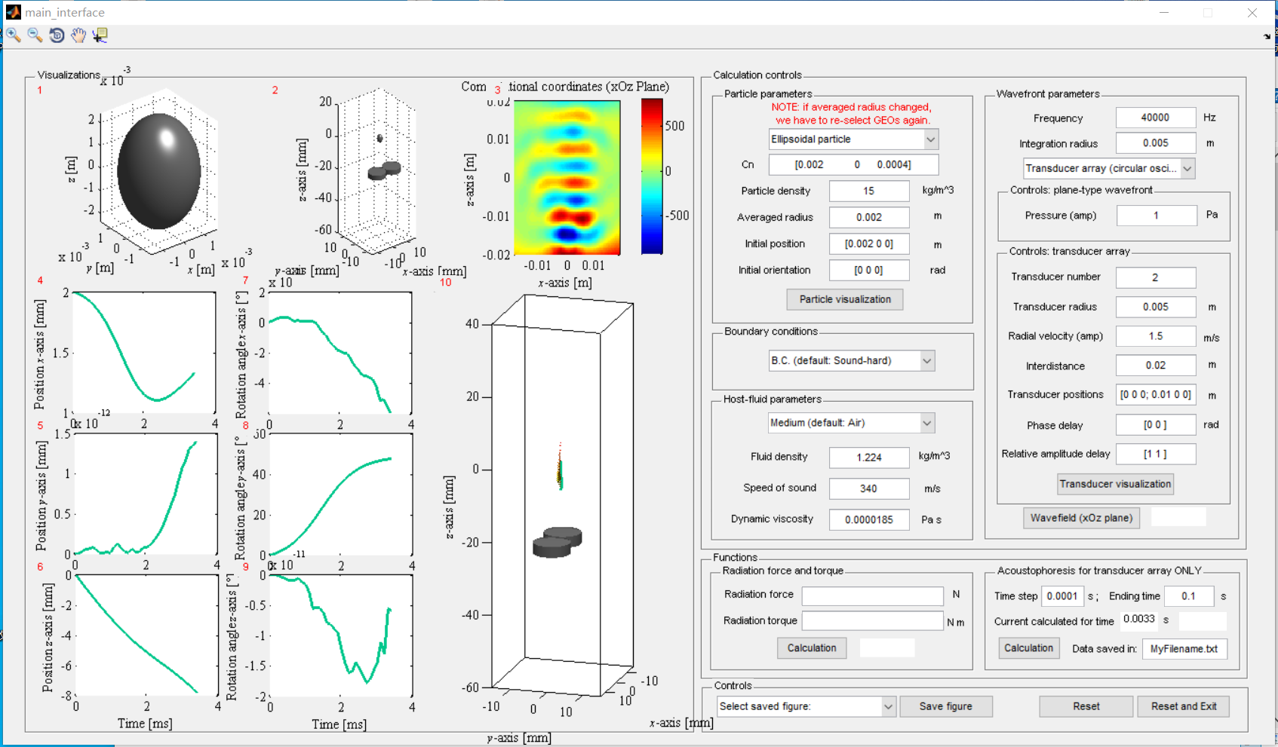
Result visualization panel
Figure 1:
Visualize the levitated particle.
Figure adjustment and data collection
Figure 3:
Visualize incident pressure wavefield.
Figure 2:
Visualize the position relationship between transducer array and the levitated particle.
(If Transducer array (circular oscillator) feature is selected)
Figure 10:
Visualize the time-variation trajectory.
The solid line and the arrows indicate the translational and rotational motions, respectively.
(If Transducer array (circular oscillator) feature is selected)
Figure 4 to Figure 9:
Visualize the time-variation position and orientation.
(If Transducer array (circular oscillator) feature is selected)

Slide 5
Parametric control panel (Overall)
Particle parameters:
Define the particle physical properties.
Wavefront parameters:
Define the incident wavefield.
Boundary conditions:
Define the boundary condition of the particle.
Medium parameters:
Define the medium physical properties.

Slide 6
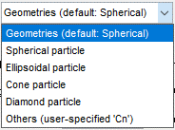
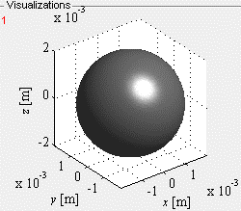
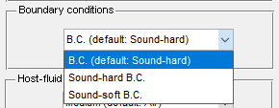
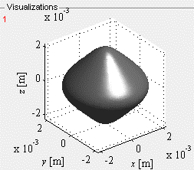
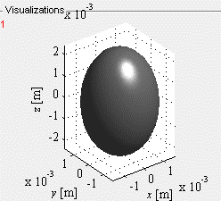
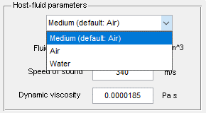
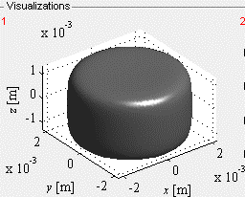
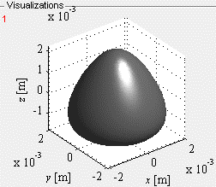
Parametric control panel (Particle & Medium parameters, and B.C.)
Boundary conditions:
there are two common options, sound-hard (Neumann) and sound-soft (Dirichlet) conditions.
Visualize the geometry based on “Particle parameters” in Figure 1 of “Result visualization panel”; at the same time, the particle geometric data is created and saved in “particle_data.stl”, which can be directly imported to COMSOL for further numerical calculations.
Cn: geometric mapping coefficients;
(The ‘Cn’ of four typical geometries of spherical, ellipsoidal, cone, and diamond particles are provided.
User can also self-specify the ‘Cn’ for more complex geometries)
Initial position&orientation: define the initial position of mass center of particle deviated from origin of Cartesian coordinates;
the initial angle between symmetric axis of particle and x-, y-, and z-axes.
Medium:
there are two common options, air and water medium.
The medium properties are automatically implanted once the “Medium popup menu” is selected.
User-specified mapping coefficient:
Cn = [0.002 0 -0.0005 0 -0.00025]

Slide 7
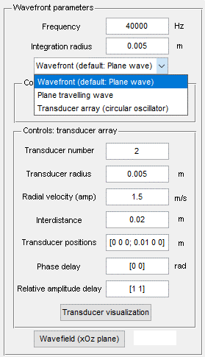

Parametric control panel (Wavefront parameters)
Visualize the particle-transducer system based on “Particle parameters” and “Controls: Transducer array” parameters in Figure 2 of “Result visualization panel”.
Frequency: set the operating frequency of incident wave.
Integration radius: define the spherical space that the acoustic fields are approximated by partial-wave expansion series;
(we found “integration radius $≈$ 0.005 m” can get a high accurate radiation force and torque through validating with the full three-dimensional numerical simulations in COMSOL)
Pressure (amp): set the pressure amplitude of the incident plane wave.
(ONLY activated when the “Wavefront popup menu” selects Plane travelling wave feature)
Radial velocity (amp): set the radial vibration amplitude of the circular oscillator of the transducers.
Interdistance: set the initial vertical distance between the coordinate origin and transducer array.
Transducer positions: set the initial positions of transducer. Each row gives the x-, y-, and z-positions of a transducer.
Phase&Relative amplitude delay: set the phase and amplitude parameters of the transducer array.
(The above parameters ONLY activated when the “Wavefront popup menu” selects Transducer array (circular oscillator) feature)
Visualize the acoustic pressure field in Figure 3 of “Result visualization panel”.

Slide 8
Functional panel and Control panel
Prediction of the radiation force and torque
Calculation the acoustophoretic process of the particle
Save figures and Reset parameters to default values

Slide 9
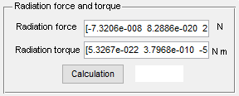
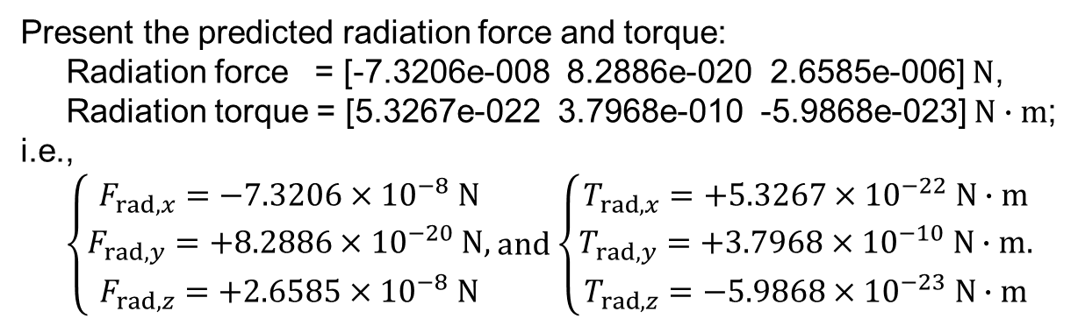
Functional panel
Present the predicted radiation force and torque:
Radiation force = [-7.3206e-008 8.2886e-020 2.6585e-006] $N$,
Radiation torque = [5.3267e-022 3.7968e-010 -5.9868e-023] $N∙m$;
i.e.,
$\left\{\begin{aligned}F_{rad,x}=−\text{7.3206}×{10}^{−8} N \\ F_{rad,y}=\text{+8}\text{.}\text{2886}×{10}^{−20} N, \\ F_{rad,z}=\text{+2.6585}×{10}^{−8} N\end{aligned}\right.$ and $\left\{\begin{aligned}T_{rad,x}=+5.3267×{10}^{−22} N∙m \\ T_{rad,y}=\text{+}\text{3.7968}×{10}^{−10} N∙m. \\ T_{rad,z}=−\text{5.98}68×{10}^{−23} N∙m\end{aligned}\right.$
Click on the “Calculation” button to predict the radiation force and torque.
Time step: set the time step for iterative calculation of the particle dynamics.
Ending time: set the ending moment.
Current calculated for time: indicate the progress of the calculation.
Data saved in: specify the fold direction to save the data of the particle position and orientation at different moments in file “MyFilename.txt”.
Note: when the vertical distance between the mass center of particle and transducer array (i.e., the interdistance) small than 0.01 mm, we stop the dynamic calculation and regard the particle cannot be trapped.
(The above parameters ONLY activated when the “Wavefront popup menu” selects Transducer array (circular oscillator) feature)
Click on the “Calculation” button to start the acoustophoretic prediction.

Slide 10
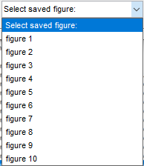
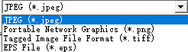
Control panel (Save figures, Reset and Exit)
Select a figure in “Select saved figure popup menu” and click on the “Save figure” button to save the selected figure.
Click on the “Reset” button to reset all parameters to default values.
Click on the “Reset and Exit” button to reset all parameters to default values and exit the GUI.
After clicking on the “Save figure” button, a new window will present.
The user need to specify a filename and format to save the selected figure. The software supports ‘*.jpeg’, ‘*.png’, ‘*.tiff’, and ‘*.eps’ formats.

Slide 11
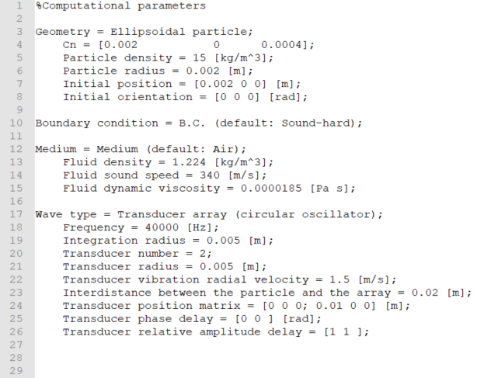
Template: saved data of particle acoustophoresis (MyFilename.txt)
Parameters saved in “MyFilename.txt”:
the saved computational parameters, including the particle parameters, the boundary condition, the medium parameters, and the wavefront parameters.

Slide 12
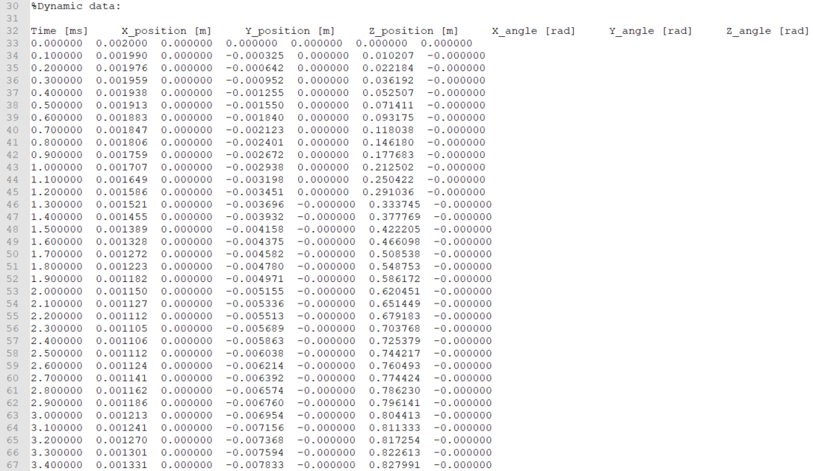
Template: saved data of particle acoustophoresis (MyFilename.txt)
Time-variant data saved in “MyFilename.txt”:
the saved position and orientation data of the particle in different moments.

