Slide 1
PRUDENTIA AI / RAG EXPLAINER
How RAG works
From governed documents to grounded answers
01
Prepare
02
Retrieve
03
Answer
Build searchable evidence
Find what is permitted
Cite what supports it
Notes:
Opening: RAG is the full path from controlled knowledge to a supported answer.
[Sources]
- docs/architecture-flows.md
- design.md
- PRODUCT.md

Slide 2
RAG is a chain, not a single model call
The model works from selected evidence and then checks the response.
01
02
03
Prepare
Retrieve
Answer
Files become verified chunks, embeddings, metadata, and provenance.
The query API routes sources and applies access and version filters.
Evidence is merged, checked, cited, or flagged when support is weak.
The useful output is an answer with a traceable reason.
02
Notes:
Explain the three stages as one continuous user experience.
[Sources]
- docs/architecture-flows.md
- design.md
- PRODUCT.md

Slide 3
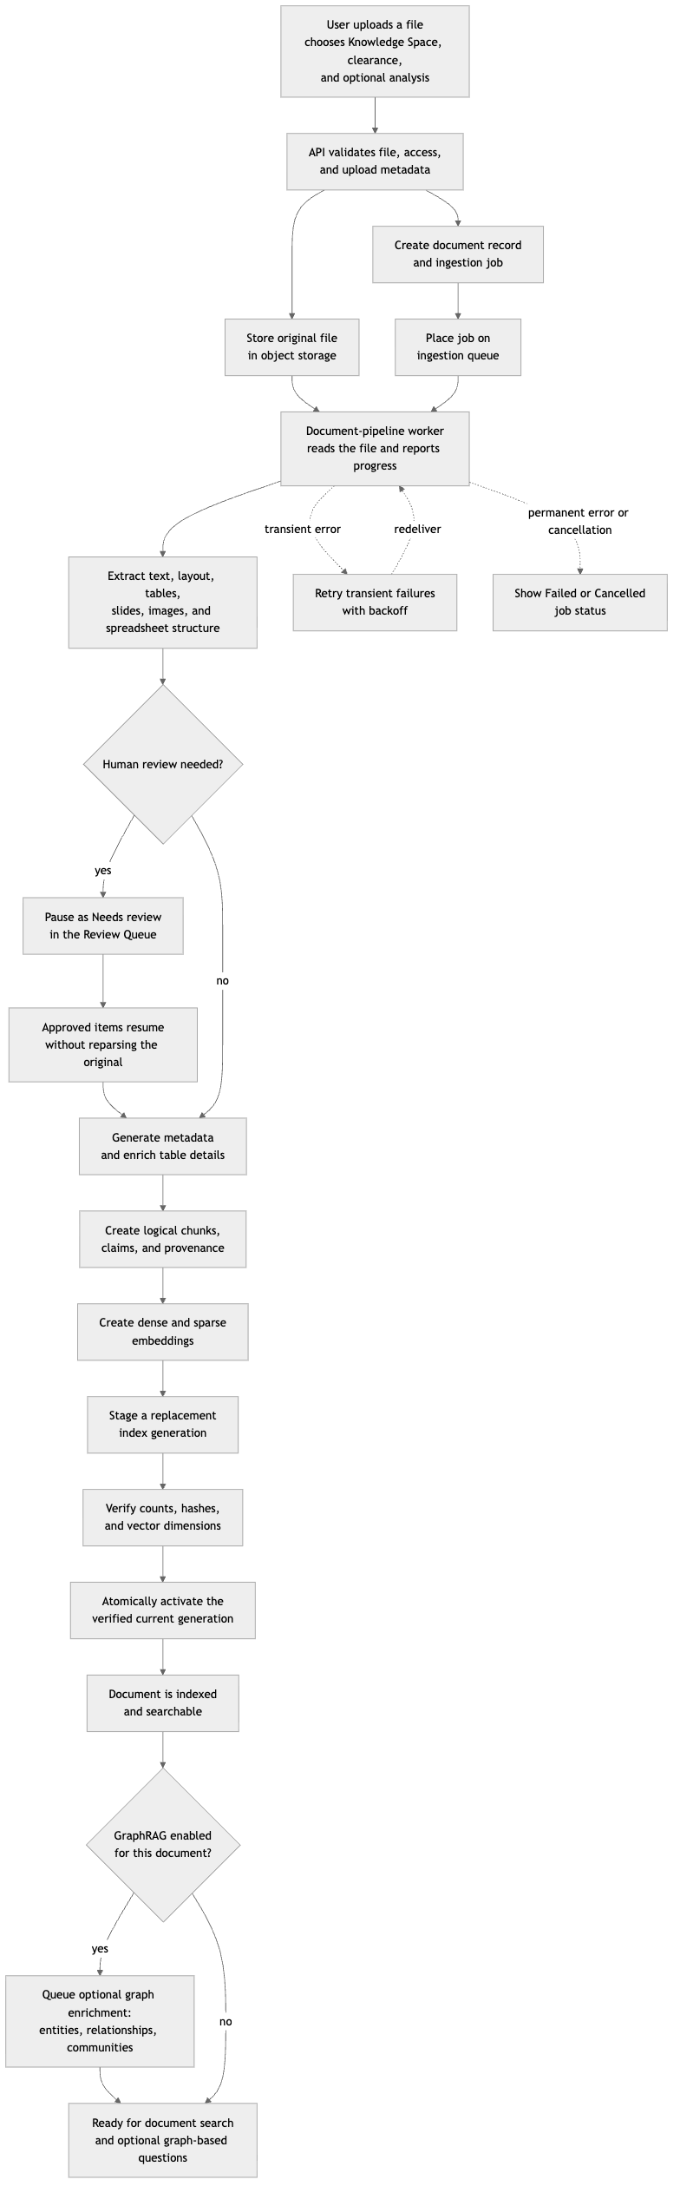
Ingestion prepares evidence before anyone asks
A file becomes searchable only after storage, worker processing, review when needed, chunking, embedding, verification, and activation.
01
Upload + validate
→ object storage
02
Extract + review
→ pipeline worker + human gate
03
Chunk + embed
→ vector + metadata stores
04
Verify + activate
→ current retrieval surface
Only the verified current generation becomes the retrieval surface.
03
Notes:
Use the exported ingestion flow as the detailed reference; the left side is the short version.
[Sources]
- docs/architecture-flows.md
- design.md
- PRODUCT.md

Slide 4
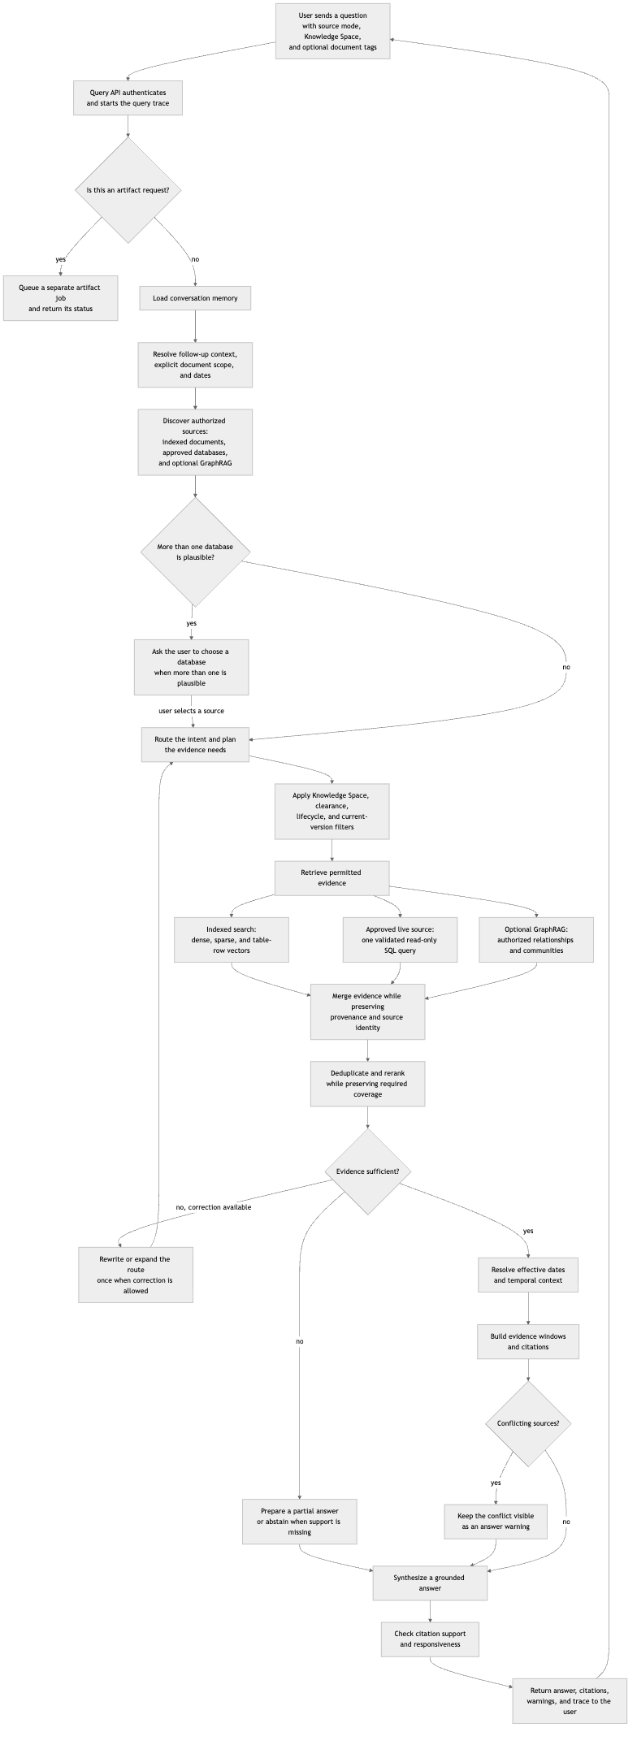
The query flow filters, finds, and checks
The query API routes the question, filters evidence before retrieval, and returns a cited answer.
Route
query API → documents, approved live data, or optional GraphRAG
Protect
Knowledge Space + RBAC + clearance + current-version filters before evidence leaves storage
Check
merge + rerank → verify + cite → flag uncertainty
Weak evidence → correct the route, answer partially, or abstain.
04
Notes:
Close on the user-visible contract: grounded answers include citations and visible uncertainty.
[Sources]
- docs/architecture-flows.md
- design.md
- PRODUCT.md

Slide 5
The controls make this RAG enterprise-ready
The retrieval model is only one part; governance keeps the answer safe, current, and inspectable.
01
Isolate
Knowledge Spaces separate teams, document scopes, and approved connector access.
02
Authorize
RBAC, space membership, clearance, and current-version filters govern every retrieval.
03
Govern
Provenance, document lifecycle, citations, and audit events keep evidence traceable.
04
Review + recover
Low-confidence OCR can pause for humans; durable jobs expose status, retries, and cancellation.
05
Measure + extend
Evaluation checks faithfulness; optional GraphRAG, live data, and artifacts expand the workflow.
A governed answer is not just relevant—it is permission-aware, current, and explainable.
05
Notes:
Use this slide to connect the RAG flow to the platform features that make it safe for enterprise use.
[Sources]
- docs/architecture-flows.md
- design.md
- PRODUCT.md

