Slide 1
2024 Challenge Sprint
Croquis

Slide 2
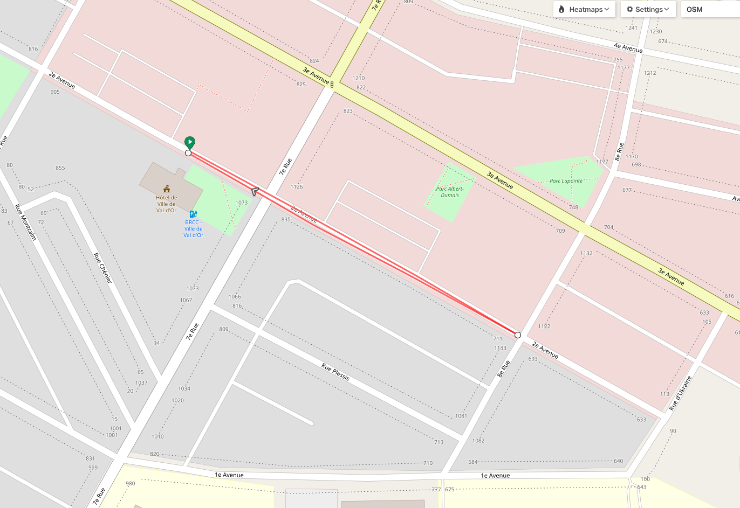

Slide 3


Slide 4


