Slide 1




People's Democratic republic of Algeria
Ministry of higher education and scientific research
University of mohamed chérif messaadia –souk ahras
University business incubator
Système éducatif
Adrross
Réalisé par : Bibe & Khadija
Supervisé par : Prof
Notes:
1

Slide 2
Table de Contenue
contexte
Problématique Et Motivation
01
02
Systeme Edicatif
03
05
Solutions
Conclusion
Partie Application Web & Partie Application Mobile
04
Conception et Implementation

Slide 3

Problématique Et Motivation
Formation pratique
1
The field of education in Algeria
Motivation
2
04

Slide 4




Problematic
La faible numérisation des tâches administratives
L'absence de communication, de collaboration et de coordination solides
Le système manuel de suivi des absences et de la présence des étudiants
L'absence de systèmes d'alerte robustes pour informer les parents
Le manque d'outils d'assistance pour la recommandation de ressources (cours, tâches, tests et examens).
04
Notes:
During our internship at the education academy of the Wilaya of Souk Shras and various edu cational institutions including « Abou Mohadjer Dinar » institution, we have observed several shortcomings in the existing educational system that warrant the need for a comprehensive solution.
4

Slide 5

Solutions
Une plateforme multiservices
01
Administration
02
Web Application Part
Ecole
Web Application Part
Systeme Edivatif
Parent App
Mobile Application
04
Etudiant App
03
Mobile Application
06

Slide 6

Conception
et Implementation
6
Notes:
6

Slide 7



Ecole(Web Application Part)
Objectif
1
02
Technologies
2
Outils
3
12

Slide 8
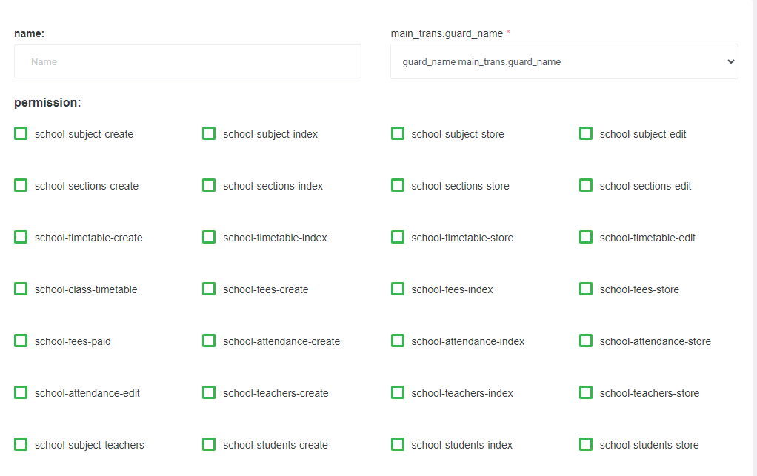
23

Slide 9
Mobile Part integration with Web Platform
Our mobile application "Adross" is integrated with our comprehensive "Darris Bi Dhakaa" web platform. The integration of mobile application, web application, and various backend services provides a synchronized experience across devices and platforms, offering various strengths for our users.
27

Slide 10
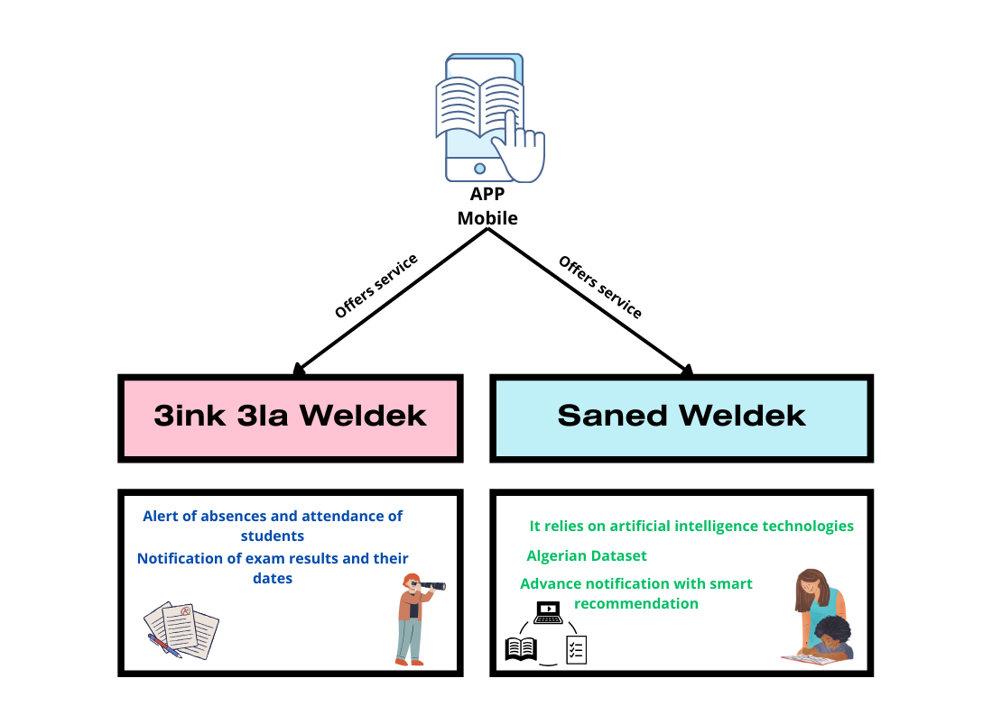
34

Slide 11


Mobile Application Part
3inek 3la Weldek
Purpose
1
supervising child’s absences and attendance at school plus Alerting parent about upcoming exams
02
Technologies
2
Tools
3
Alert of Students Absences and Attendance,Alert of
Teachers Absences,Notification of Exam Results and Dates
35

Slide 12
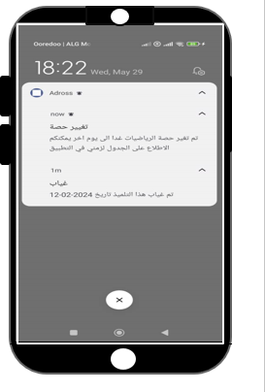
We also see here that the father was alerted by the application that his son was absent at such and such time on such and such day
the system also alerts father of the absence of teachers or changes in the time of lessons and classes
39

Slide 13
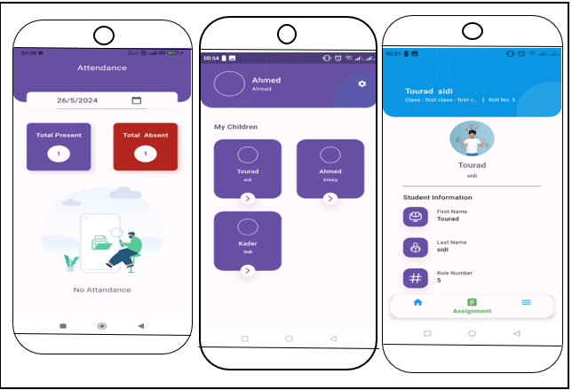
To summarize, our tool "3inek 3la Weldek" has various strengths that result in an enhanced user experience, personalized dashboard, advanced notifications, and robust data security measures. Each strong point is addressed as follows:
Enhanced User Experience ,Personalized Dashboard ,Advanced Notifications ,Data Security
40

Slide 14

Mobile Application Part
Saned Weldek
Purpose
1
02
Technologies
2
Tools
3
Huge lesson base,Personalized Recommendations,chedule and Exam Planning
41

Slide 15
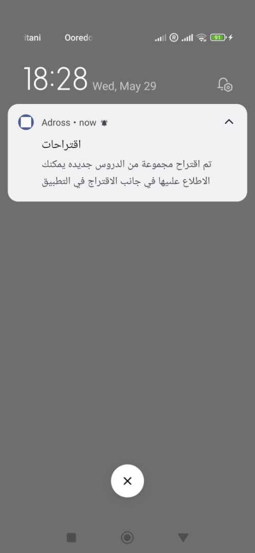
Saned Weldek is an AI-powered service aiming to enhance the educational experience for Algerian students and parents by delivering personalized support tailored to the local educational context
A huge recommendation system based on an Algerian information base (dataset)
It is linked to the student’s schedule provides them with recommendations before exams or lessons
43

Slide 16
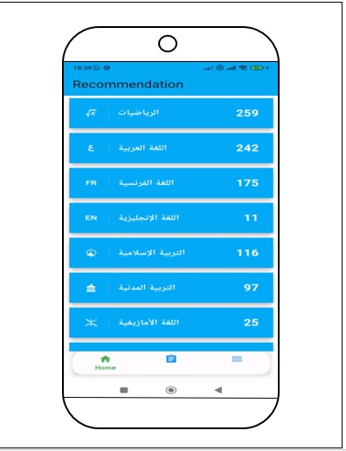
we have a section in the application that contains all the suggestions and recommendations for lessons and exams that the student can view at any time and whenever he wants
46

Slide 17
Future works
from content based to collaborative filtering
Editor using IA for teachers
52

Slide 18
Thank You Any Questions?

