Slide 1

Urban Pulse - Tourism & Culture Intelligence Platform
Sensing India's seasonal pulse: from monument footfall to festival demand
MILESTONE 1: DOMAIN FINALIZATION & FOUNDATION
TEAM - 1 Padma Priya Aditi Dhuria Madhusri Gone

Slide 2

Problem Statement
India's heritage sites and festivals form the cultural "pulse" of its cities - but this pulse is sensed only reactively. Monuments get overcrowded during festivals with no advance warning. Accessibility for senior citizens, disabled visitors, and low-income domestic tourists is rarely measured. Weather disruptions aren't factored into visitor planning. Tourism data stays siloed across ASI, state tourism boards, and the Ministry of Tourism.
Urban Pulse - Tourism & Culture aims to change that: a smart, data-driven platform that senses the real-time and seasonal health of India's tourism ecosystem, turning fragmented government data into actionable insight.

Slide 3
Problem Objectives
1
Real-Time Footfall Tracking
Track real-time monument footfall for both domestic and foreign visitors across India's heritage sites.
2
Seasonal Demand Sensing
Sense seasonal and festival-driven demand patterns to anticipate surges before they happen.
3
Site Utilization Analysis
Identify overcrowded vs. underutilized heritage sites to enable smarter resource distribution.
4
Economic Impact Quantification
Quantify economic impact across states to support evidence-based tourism policy.
5
Footfall Forecasting
Enable forecasting of future footfall by season and event calendar for proactive planning.

Slide 4
Project Scope
Out of Scope
In Scope
India-specific monument visitor data (domestic + foreign)
Festival and cultural mela participation & funding, state-wise
Seasonal and festival driven demand patterns
Accessibility indicators for vulnerable visitor groups
Galaxy schema data model (4 fact + 3 shared dimension tables)
Interactive dashboards - geospatial, trends, executive views
Global/cross-country tourism comparisons
Outbound travel (Indians traveling abroad)
Everyday commuter mobility (covered by the Mobility team)
Hotel occupancy and booking systems
Real-time IoT sensor deployment

Slide 5
Proposed Solution
A unified data intelligence platform connecting monument footfall and festival participation through a shared Galaxy schema, visualized in interactive dashboards.
Collect
Clean & Transform
Store
Visualize
Excel datasets
Python ETL Pipeline
Cloud PostgreSQL Via Supabase
Power BI & Looker Studio Dashboards
1
2
3
4
Each step in the pipeline is designed to be reproducible, cross-platform, and aligned with verified Government of India data sources - ensuring the platform is genuinely deployable, not just a prototype.

Slide 6





Technology Stack
Python (pandas)
ETL: extracting, cleaning, and transforming raw datasets into structured form.
Supabase
Free cloud PostgreSQL database - shared and cross-platform across Mac and Windows.
Power BI & Looker Studio and dbdiagram.io
Dashboard visualization and executive reporting for stakeholders & policymakers. Looker Studio is deployed as web based dashboard solution for seamless cross platform access on macOS
GitHub
Version control for scripts, schema docs, and team collaboration across the project lifecycle.
Supabase was chosen specifically because our team works across both Mac and Windows environments.

Slide 7
About Our Datasets
All data is sourced from verified Government of India portals and official ministry reports.
Source
Coverage
Used For
Ministry of Tourism / IITTM Report
Tourist places, entry fees
Fact_attractions
data.gov.in (DPPH
Scheme & NE)
State-wise festival funding (2014–2024)
Fact_festivals
data.tourism.gov.in
Monthly revenue & foreign arrivals (2019–2022)
fact_monthly_tourism
data.tourism.gov.in
FTAs by country, age demographics,
avg stay duration
fact_country_arrivals
Ministry of tourism/ASI
Master lookups for Time, Cities/States, and Foreign Countries
Dim_time, dim_location, dim_country

Slide 8
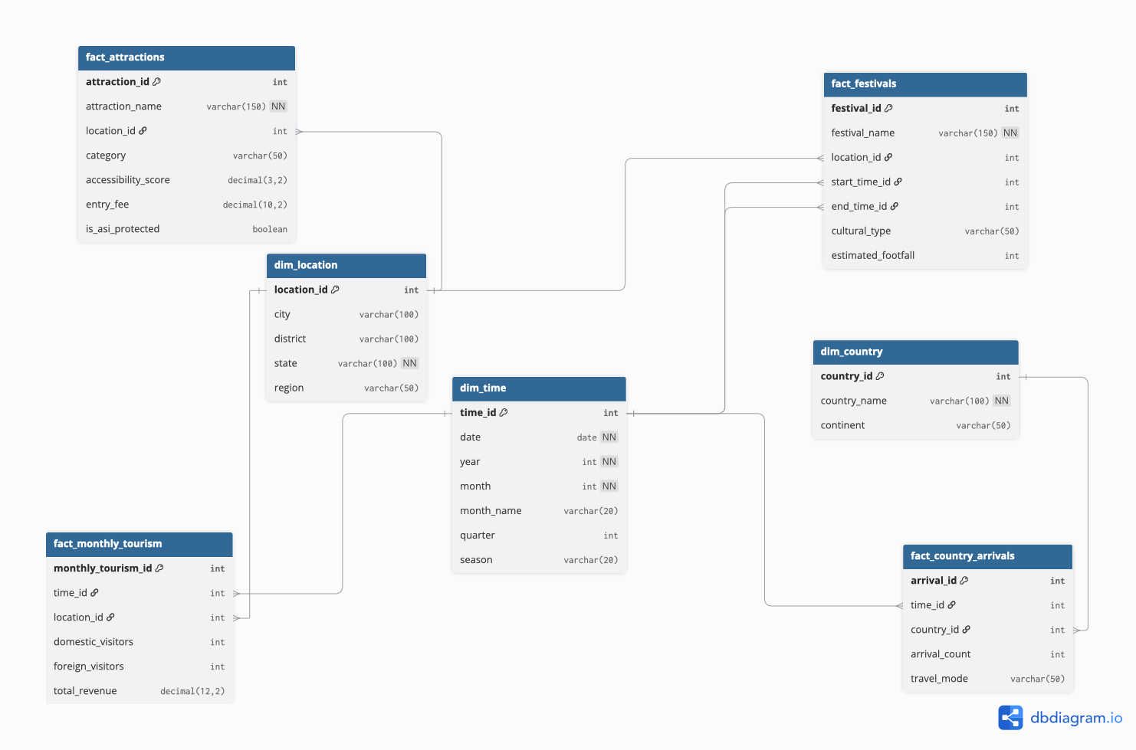

Methodology
Galaxy Schema (Fact Constellation)
We use a Galaxy Schema consisting of 4 Fact tables sharing 3 core Dimension tables:
Dimension Tables (Shared Context): dim_time, dim_location, and dim_country.
Fact Tables (Specific Metrics & Granularities): fact_attractions, fact_festivals, fact_monthly_tourism, and fact_country_arrivals.
We chose a Galaxy Schema because our domain spans multiple events at different levels of detail (point-in-time spot ratings vs. monthly revenue vs. demographic percentages). Structuring it this way prevents data duplication and keeps Power BI measures fast and accurate.
Database ER diagram modeled via dbdiagram.io.

Slide 9
Progress Snapshot
Database schema (4 fact, shared dimensions) modeled in dbdiagram.io and deployed on Supabase PostgreSQL

Slide 10
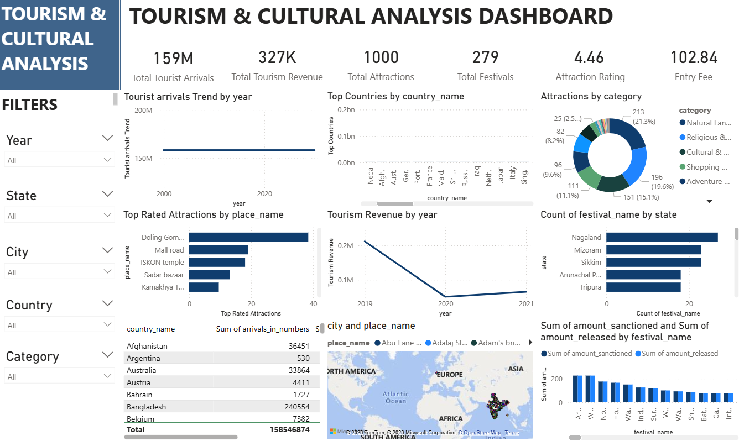

Slide 11
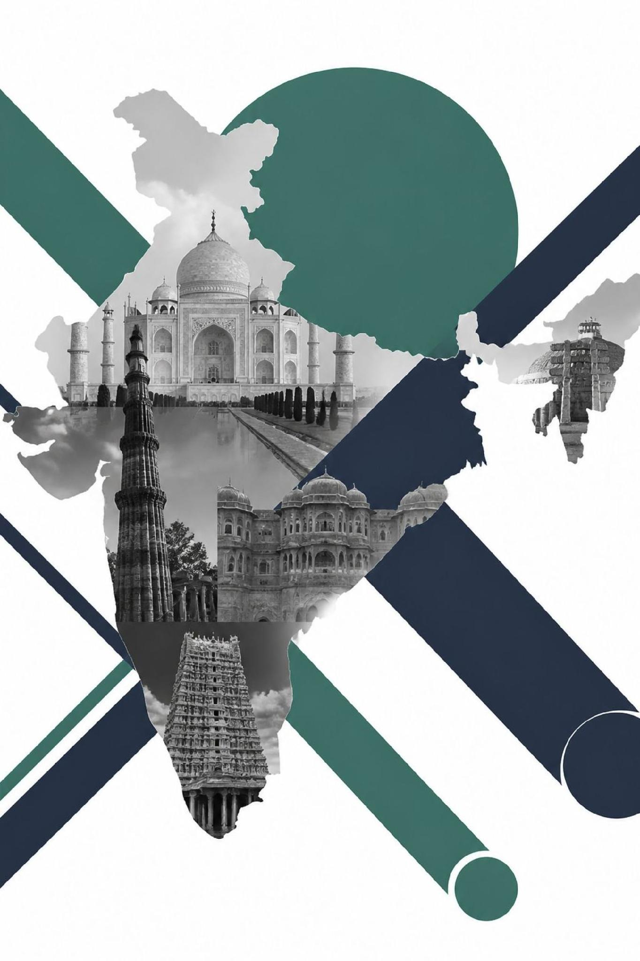

Expected Outcomes
Unified Dashboard
A single dashboard covering both monument footfall and festival participation - giving stakeholders a complete picture of India's cultural tourism ecosystem.
Seasonal Forecasting
Predictive models anticipating demand spikes by festival, season, and weather - enabling proactive planning rather than reactive crisis management.
Accessibility Insights
Highlighting gaps for seniors, disabled visitors, and low-income tourists - groups whose needs are rarely captured in existing tourism data.
Deployable Policy Model
A genuinely deployable model aligned with Dekho Apna Desh -and Swadesh Darshan - ready for adoption by state tourism boards and policymakers.

Slide 12
Conclusion
Tourism and Culture together form the living heritage layer of India's Urban Pulse - distinct from everyday mobility, yet built on the same core philosophy: sensing a city's pulse and turning fragmented data into actionable insight.
Verified Data
Galaxy Schema
Grounded in verified Government of India data from ASI, Ministry of Tourism, and Ministry of Culture.
Galaxy schema connects monument visits and festival participation through shared dimension tables.
Free & Cross-Platform
Deployable Use Case
Built on free, cross-platform tools - Supabase and Power BI - accessible to the entire team.
A genuinely deployable use case for state tourism boards and policymakers across India.
Urban Pulse - Tourism & Culture Intelligence Platform | Infosys Internship Project | Milestone 1

