Slide 1

USING DATA LOCATION TO IDENTIFY PLACES TO OPEN ART CAFE IN MOSCOW
Tatiana shumskaya

Slide 2
Identifying PLACES TO OPEN ART CAFE IN MOSCOW
Moscow is the capital of Russia and one of the largest cities in the world. Public catering sphere is growing steadily in Moscow. The aim of this project is to provide investors and business owners suitable areas, where they could potentially open a new Art café:
1. in location nearby theaters, museums, and galleries;
2. outside the city center, but as much close to the center as possible;
3. nearby one of metro stations.

Slide 3
Data sources
Foursquare API
Official website of the Moscow government
Python libraries (Pandas, Seaborn, Scikit-learn, Nominatum, Folium, etc)

Slide 4
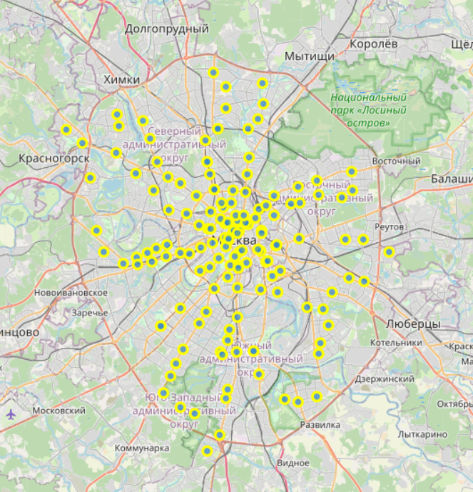
Data cleaning
Removed duplicates and redundant columns
Added geospatial data
Foursquare data added for each district

Slide 5
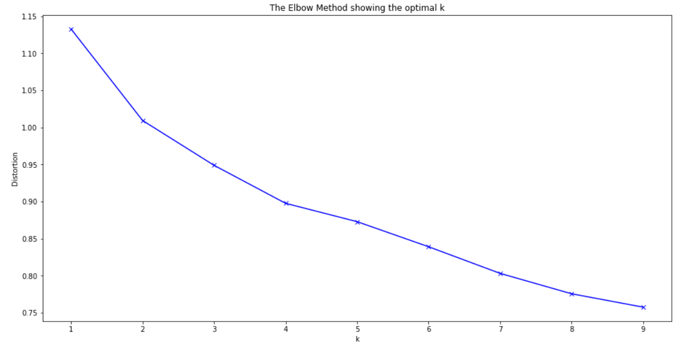
Exploratory Data Analysis
K-means method was used to explore each district and group them into clusters
Elbrow method to find the value for k (k=6)

Slide 6
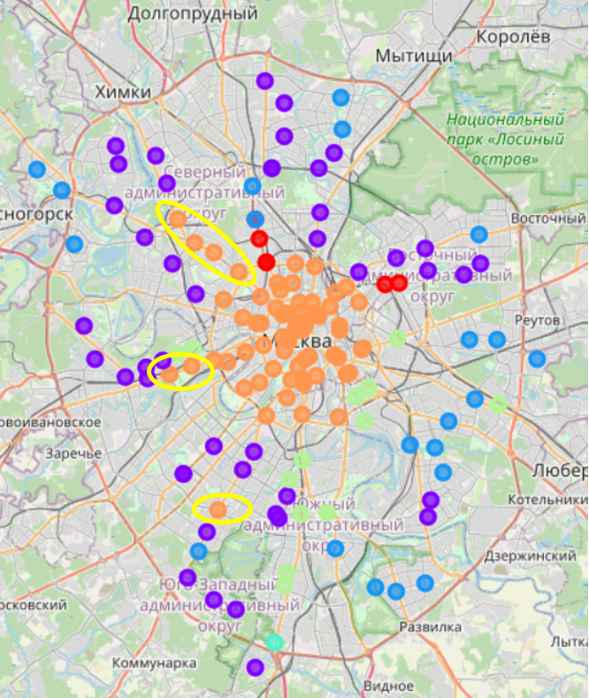
Results
Districts were grouped in 6 clusters
The best districts for opening art café were identified as
Metro Park Pobedy, Slavyansky Boulevard (Minskaya);
Metro station Kaluzhskaya;
Metro Dynamo, Airport, Sokol, Voikovskaya.

