Slide 1
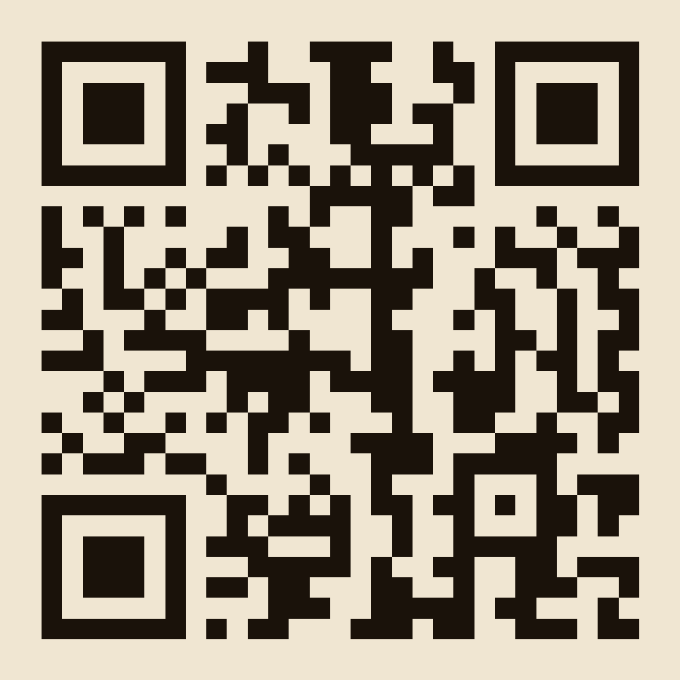
THOMSON BROS
MYSTERY MALT SERIES NO.5
BLIND WHISKY TASTING
START HERE
Scan the QR code
OR
Visit: thompsonbrostasting.onrender.com
Open the tasting dashboard once and keep it open throughout the evening.
Notes:
PLACEHOLDER QR + URL — replace assets/qr-placeholder.png and the two URL text boxes above with your real deployed Start-Here link before the event. See DEPLOYMENT.md.

Slide 2
FRIDAY WHISKY MAFIA
How Tonight Works
1
2
3
4
Join once
Taste in order
Guess & submit
Watch it unfold
Scan the QR code or visit the Start Here link and enter your name.
Six mystery malts, one at a time — nose, palate, finish, overall.
Guess the distillery and age for each dram, then submit on your phone.
Results, reveals and the leaderboard appear here on the big screen.
No leaderboard on your phone during the tasting — the suspense stays on the big screen.

Slide 3
MYSTERY MALT SERIES NO.5
WHISKY #1
Taste. Rate. Guess. Submit.
Already joined?
Use the tasting dashboard already open on your phone.
Joining late?
SCAN TO JOIN
Visit: thompsonbrostasting.onrender.com
Notes:
HOST CUE — after closing this round's submissions, switch to the live big-screen display (/display) for Group Results → Reveal → Leaderboard, then return here (or straight to Whisky #2) to open the next round.

Slide 4
MYSTERY MALT SERIES NO.5
WHISKY #2
Taste. Rate. Guess. Submit.
Already joined?
Use the tasting dashboard already open on your phone.
Joining late?
SCAN TO JOIN
Visit: thompsonbrostasting.onrender.com
Notes:
HOST CUE — after closing this round's submissions, switch to the live big-screen display (/display) for Group Results → Reveal → Leaderboard, then return here (or straight to Whisky #3) to open the next round.

Slide 5
MYSTERY MALT SERIES NO.5
WHISKY #3
Taste. Rate. Guess. Submit.
Already joined?
Use the tasting dashboard already open on your phone.
Joining late?
SCAN TO JOIN
Visit: thompsonbrostasting.onrender.com
Notes:
HOST CUE — after closing this round's submissions, switch to the live big-screen display (/display) for Group Results → Reveal → Leaderboard, then return here (or straight to Whisky #4) to open the next round.

Slide 6
MYSTERY MALT SERIES NO.5
WHISKY #4
Taste. Rate. Guess. Submit.
Already joined?
Use the tasting dashboard already open on your phone.
Joining late?
SCAN TO JOIN
Visit: thompsonbrostasting.onrender.com
Notes:
HOST CUE — after closing this round's submissions, switch to the live big-screen display (/display) for Group Results → Reveal → Leaderboard, then return here (or straight to Whisky #5) to open the next round.

Slide 7
MYSTERY MALT SERIES NO.5
WHISKY #5
Taste. Rate. Guess. Submit.
Already joined?
Use the tasting dashboard already open on your phone.
Joining late?
SCAN TO JOIN
Visit: thompsonbrostasting.onrender.com
Notes:
HOST CUE — after closing this round's submissions, switch to the live big-screen display (/display) for Group Results → Reveal → Leaderboard, then return here (or straight to Whisky #6) to open the next round.

Slide 8
MYSTERY MALT SERIES NO.5
WHISKY #6
Taste. Rate. Guess. Submit.
Already joined?
Use the tasting dashboard already open on your phone.
Joining late?
SCAN TO JOIN
Visit: thompsonbrostasting.onrender.com
Notes:
HOST CUE — after closing this round's submissions, switch to the live big-screen display (/display) for Group Results → Reveal → Leaderboard, then return here (or straight to Whisky #Final Results) to open the next round.

Slide 9
MYSTERY MALT SERIES NO.5
FINAL RESULTS
🥇 🥈 🥉
Winner, runner-up and third place appear live on the big-screen display.
Notes:
HOST CUE — switch to /display now that Whisky #6 has been revealed. It shows the podium plus event highlights (highest/lowest rated, most/least identified, total perfect guesses).

Slide 10
SLÀINTE MHATH
Thank you for tasting with us.
Friday Whisky Mafia · Thomson Bros Mystery Malt Series No.5

