Slide 1

AI & Machine Learning Week 2 Lecture 1.1

Slide 2
Git & GitHub
https://github.com/
https://git-scm.com/download/gui/windows

Slide 3
What is Git
Git is a distributed version control system designed to handle everything from small to very large projects with speed and efficiency. It allows multiple people to work on a project simultaneously without overwriting each other's changes

Slide 4
key aspects of Git
Version Control: Git keeps track of changes made to files over time, allowing you to revert to specific versions whenever needed.
Distributed System: Unlike centralized version control systems, every user has a complete copy of the repository, including its full history.
Branching and Merging: Git supports lightweight, fast branching and merging, which helps in organizing and managing changes. You can create separate branches for different features or bug fixes and merge them back into the main branch once they are ready.
Data Integrity: Git uses SHA-1 hashing to ensure the integrity of your data. Every file and commit is checksummed and retrieved by its checksum, ensuring that the content is stored securely.
Performance: Git is designed to be fast. Operations like committing, branching, merging, and comparing past versions are optimized for speed.

Slide 5
Setting Local Username and Email
git config --global user.name "Your Name“
git config --global user.email "your.email@example.com"

Slide 6
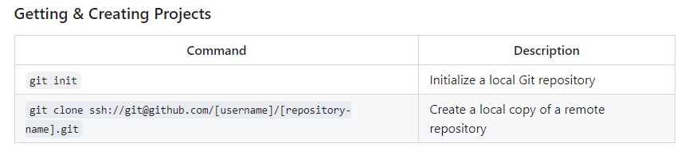
Git Commands

Slide 7
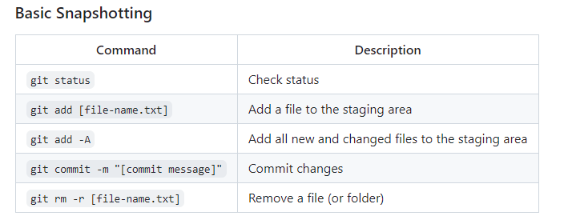

Slide 8
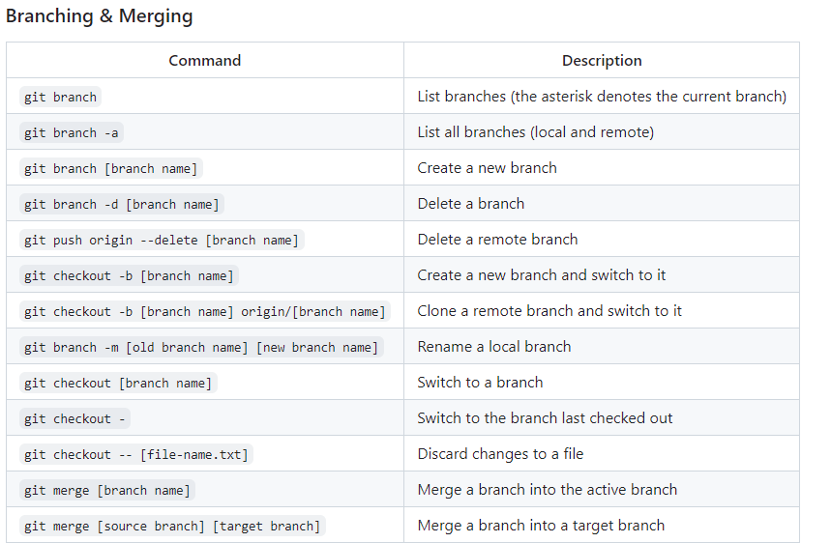

Slide 9
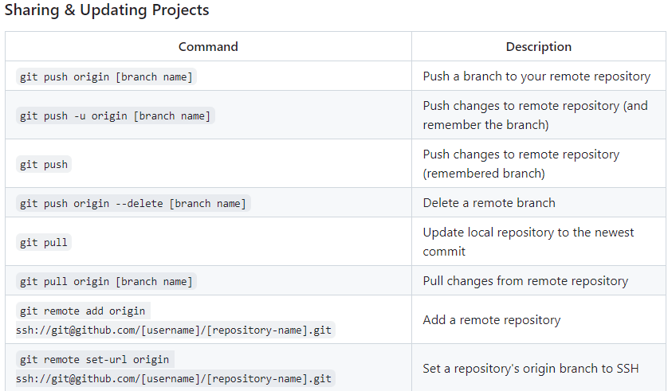

Slide 10
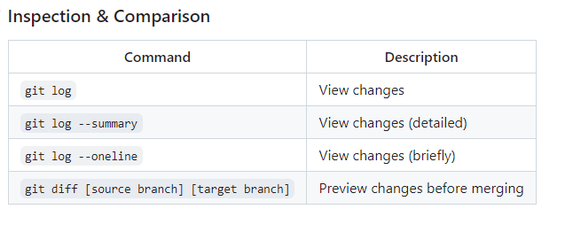

Slide 11
Common Git Commands
git init: Initializes a new Git repository.
git clone [url]: Clones an existing repository from a URL.
git add [file]: Adds files to the staging area.
git commit -m "message": Commits the staged changes with a message.
git status: Shows the current status of the repository.
git push [remote] [branch]: Pushes changes to a remote repository.
git pull [remote]: Fetches and merges changes from a remote repository.

Slide 12
What is GitHub?
GitHub is a web-based platform that uses Git for version control and provides a collaborative environment for developers

Slide 13
Common GitHub Features
Repository Hosting: GitHub hosts Git repositories online, making it easy to share code with others.
Collaboration Tools: GitHub provides tools like pull requests, code reviews, and issues to help teams collaborate more effectively.
Project Management: Tools like project boards, issues, and milestones help manage projects efficiently.
GitHub Actions: A feature that provides CI/CD (Continuous Integration/Continuous Deployment) capabilities to automate workflows.
Social Coding: GitHub fosters a community where developers can follow projects, contribute to open-source projects, and collaborate with others.
Documentation: GitHub Pages allow you to host documentation websites for your projects.
Security: GitHub offers tools for dependency vulnerability alerts, secret scanning, and more to ensure your code is secure

