Slide 1
Artificial intelligence & machine learning lecture #3
Understand natural language processing (NLP)
Understand document intelligence and knowledge mining
Understand generative AI
Challenges and risks with AI
Understand responsible AI

Slide 2
Understand natural language processing
Natural language processing (NLP) is the area of AI that deals with creating software that understands written and spoken language.

Slide 3
Understand natural language processing
NLP enables you to create software that can:
Analyze and interpret text in documents, email messages, and other sources.
Interpret spoken language, and synthesize speech responses.
Automatically translate spoken or written phrases between languages.
Interpret commands and determine appropriate actions.

Slide 4
Understand natural language processing
For example, Starship Commander is a virtual reality (VR) game from Human Interact that takes place in a science fiction world.
Video (https://www.microsoft.com/en-us/videoplayer/embed/RE4vyDj?postJsllMsg=true)

Slide 5
Natural language processing in Microsoft Azure
Microsoft's Azure AI Speech is another service that can be used to build natural language processing solutions
Azure AI Language features in the Azure Language Studio and Azure AI Speech features in the Azure Speech Studio.
https://azure.microsoft.com/en-us/pricing/purchase-options/azure-account?WT.mc_id=azure-azuredevtipsvideo-azureappsdev

Slide 6
Understand document intelligence and knowledge mining
Document Intelligence is the area of AI that deals with managing, processing, and using high volumes of a variety of data found in forms and documents.
enables you to create software that can automate processing for contracts, health documents, financial forms and more

Slide 7
Document intelligence in Microsoft Azure
Microsoft's Azure AI Document Intelligence to build solutions that manage and accelerate data collection from scanned documents

Slide 8
Document intelligence in Microsoft Azure
Features of Azure AI Document Intelligence help automate document processing in applications and workflows, enhance data-driven strategies, and enrich document search capabilities

Slide 9
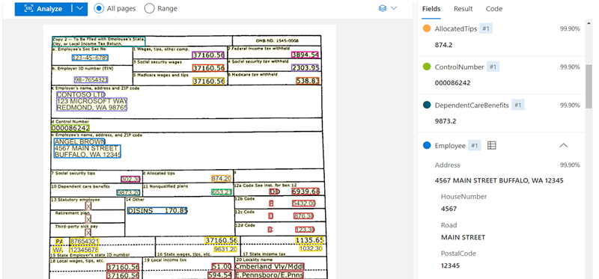

Slide 10
Knowledge Mining
Knowledge mining is the term used to describe solutions that involve extracting information from large volumes of often unstructured data to create a searchable knowledge store.

Slide 11
Knowledge mining in Microsoft Azure
One Microsoft knowledge mining solution is Azure AI Search, an enterprise, search solution that has tools for building indexes.

Slide 12
Knowledge mining in Microsoft Azure
Azure AI Search can utilize the built-in AI capabilities of Azure AI services such as image processing, document intelligence, and natural language processing to extract data.

Slide 13

Azure ai search

Slide 14
Understand generative AI
Generative AI describes a category of capabilities within AI that create original content.

Slide 15
Generative AI in Microsoft Azure
Azure OpenAI Service is Microsoft's cloud solution for deploying, customizing, and hosting generative AI models.

Slide 16
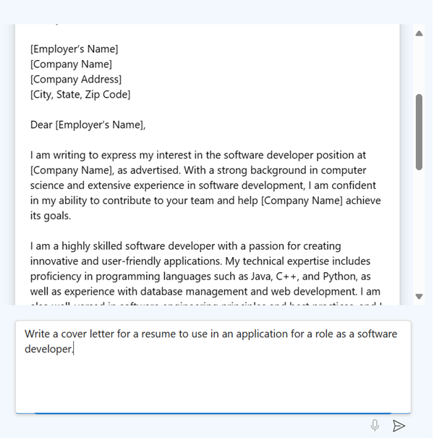
Generative AI in Microsoft Azure

Slide 17
Challenges and risks with AI
Artificial Intelligence is a powerful tool that can be used to greatly benefit the world. However, like any tool, it must be used responsibly.

Slide 18
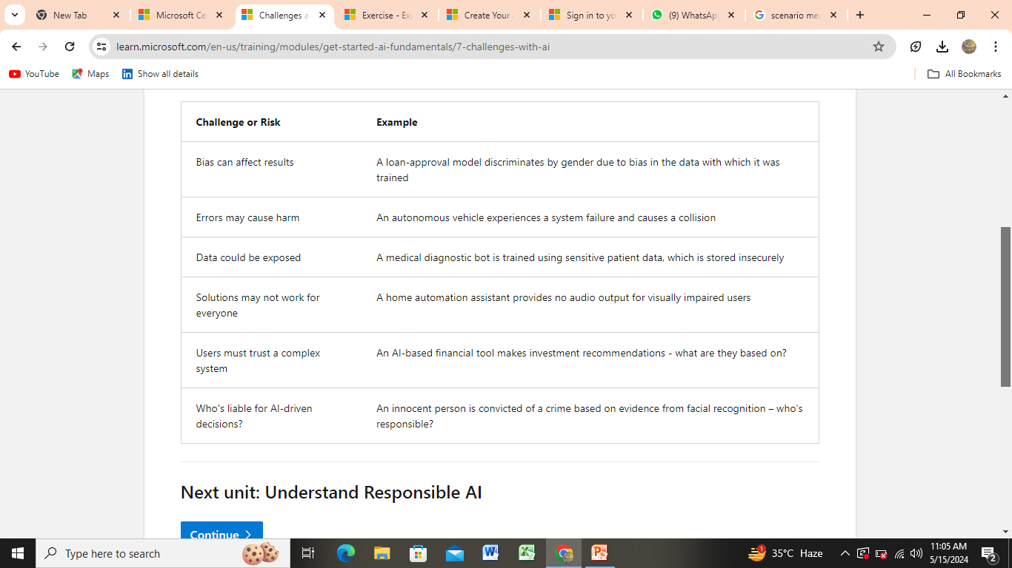
Challenges and risks with AI

Slide 19
Understand Responsible AI
At Microsoft, AI software development is guided by a set of six principles, designed to ensure that AI applications provide amazing solutions to difficult problems without any unintended negative consequences.

Slide 20
Understand Responsible AI
Fairness
Reliability and safety
Privacy and security
Inclusiveness
Transparency
Accountability
https://learn.microsoft.com/en-us/training/modules/get-started-ai-fundamentals/8a-understand-responsible-ai

Slide 21
Module #2
Fundamentals of machine learning

Slide 22
Fundamentals of machine learning
Machine learning is the basis for most modern artificial intelligence solutions. A familiarity with the core concepts on which machine learning is based is an important foundation for understanding AI.

Slide 23
Introduction
Machine learning is in many ways the intersection of two disciplines - data science and software engineering

Slide 24
What is machine learning?
Machine learning has its origins in statistics and mathematical modeling of data.
The fundamental idea of machine learning is to use data from past observations to predict unknown outcomes or values.

Slide 25
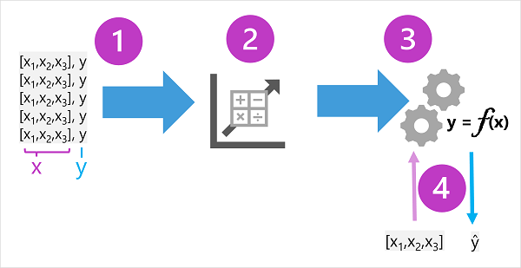
Machine learning as a function

Slide 26
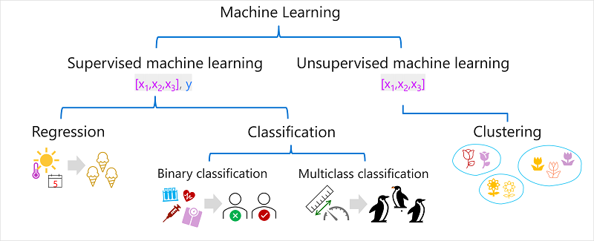
Types of machine learning

Slide 27
Supervised machine learning
machine learning algorithms in which the training data includes both feature values and known label values.

Slide 28
SUPERVISED MACHINE LEARNING ALGORITHMS:
Regression ( Linear, Logistic )
Decision Tree
KNN ( K- nearest neighbor )
SVM ( support vector machine )
Random forest

Slide 29
Supervised machine learning
Regression
Regression is a form of supervised machine learning in which the label predicted by the model is a numeric value.

Slide 30
Supervised machine learning
Classification
Classification is a form of supervised machine learning in which the label represents a categorization, or class

Slide 31
Unsupervised machine learning
Unsupervised machine learning involves training models using data that consists only of feature values without any known labels.

Slide 32
Unsupervised machine learning
Clustering
A clustering algorithm identifies similarities between observations based on their features, and groups them into discrete clusters

Slide 33
Regression
widely used when the dependent and independent variables are linked in a linear or non-linear fashion, and the target variable has a set of continuous values.
e.g. sales and advertising expenditures for a corporation,

Slide 34
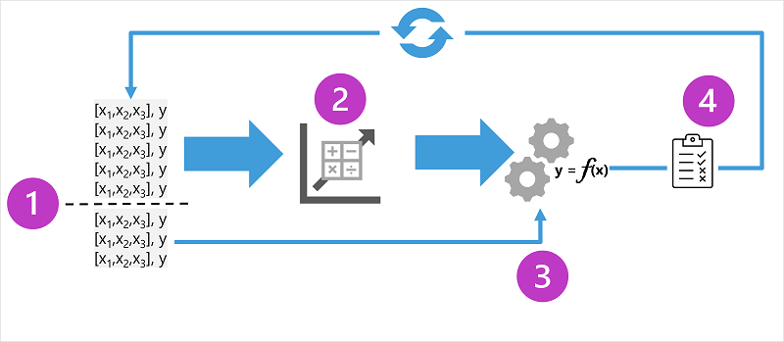
Regression

Slide 35
Linear REGRESSION
a linear connection between a dependent variable (Y) and an independent variable (X)
Linear REGRESSION
Y =mX+b

Slide 36
Linear REGRESSION
Y represent dependent variable
X represent independent variable
m is the slop of line ( how much y changes as changes X)
The value of intercept ( the value of Y when x=0)

Slide 37
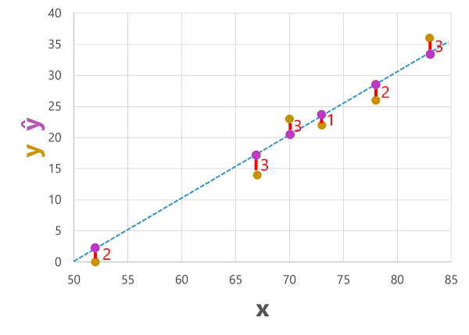
Linear Regression
Example of Linear regression with graph

Slide 38
LOGISTIC Regression
When the dependent variable is discrete, the logistic regression technique is applicable.
used to compute the probability of mutually exclusive occurrences such as pass/fail, true/false, 0/1, and so forth.
Disease detection, pass/fail decision

Slide 39
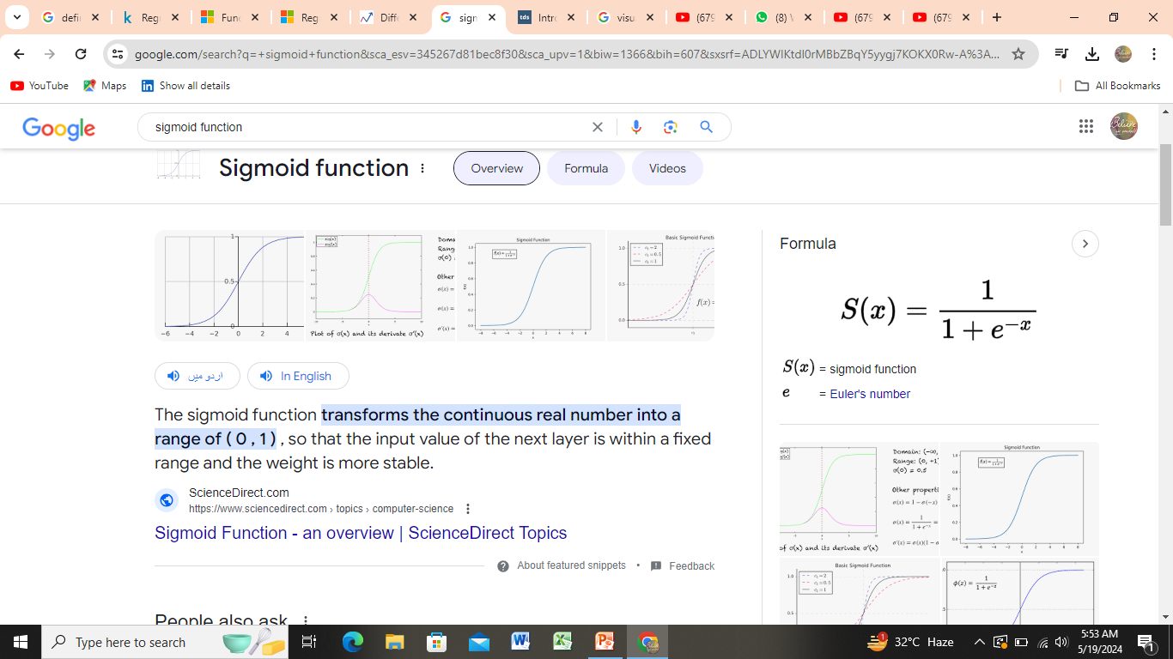
LOGISTIC Regression
Use sigmoid function
S(X) = Y= ( ranges between 0 and 1 )

Slide 40
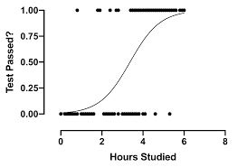
LOGISTIC Regression

Slide 41
LINEAER VS LOGISTIC REGRESSION:
Linear Regression is used to handle regression problems whereas Logistic regression is used to handle the classification problems.
Linear regression provides a continuous output but Logistic regression provides discreet output.

Slide 42
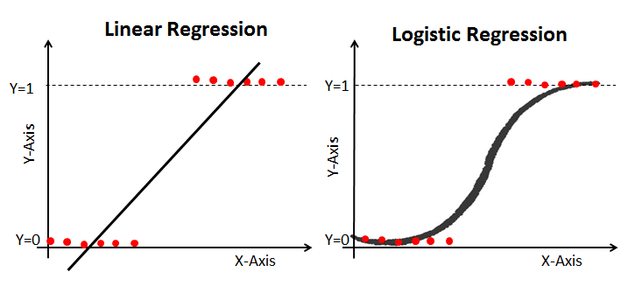
LINEAER VS LOGISTIC REGRESSION:

Slide 43
Regression evaluation metrics
common metrics that are used to evaluate a regression model.
Used to measure the accuracy of regression models

Slide 44
Regression evaluation metrics
There are some evaluation metrics that can help you determine whether the model’s predictions are accurate to a certain level of performance.

Slide 45
Regression evaluation metrics
Mean Absolute Error (MAE)
Mean Squared Error (MSE)
Root Mean Squared Error (RMSE)
Coefficient of determination (R²)

Slide 46
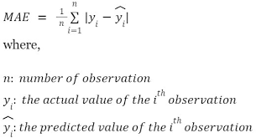
Mean Absolute Error (MAE)
Measure the average magnitude of errors in a set of predictions, without considering their direction.

Slide 47
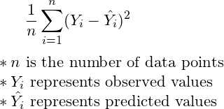
Mean Squared Error (MSE)
MSE measures the average of the squares of the errors – that is the averaged squared differences between the estimated values and the actual values.

Slide 48
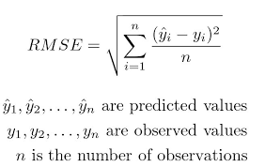
Root Mean Squared Error (RMSE)
RMSE is the square root of the mean of the squared errors. It’s the best way to quantify the size of error made by the model.

Slide 49
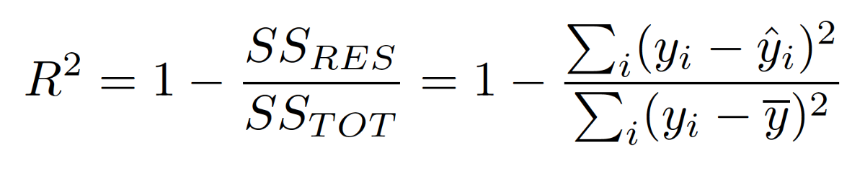
Coefficient of determination (R²)
R-squared is a statistical measure that represents the proportion of the variance for a dependent variable that's explained by an independent variable.

Slide 50
Video for regression evolution metrics
https://youtu.be/SH4soR1O7fY?t=142

Slide 51
Iterative training
In most real-world scenarios, a data scientist will use an iterative process to repeatedly train and evaluate a model

Slide 52
Binary classification
Binary classification algorithms are used to train a model that predicts one of two possible labels for a single class.
predicting true or false
Example

Slide 53
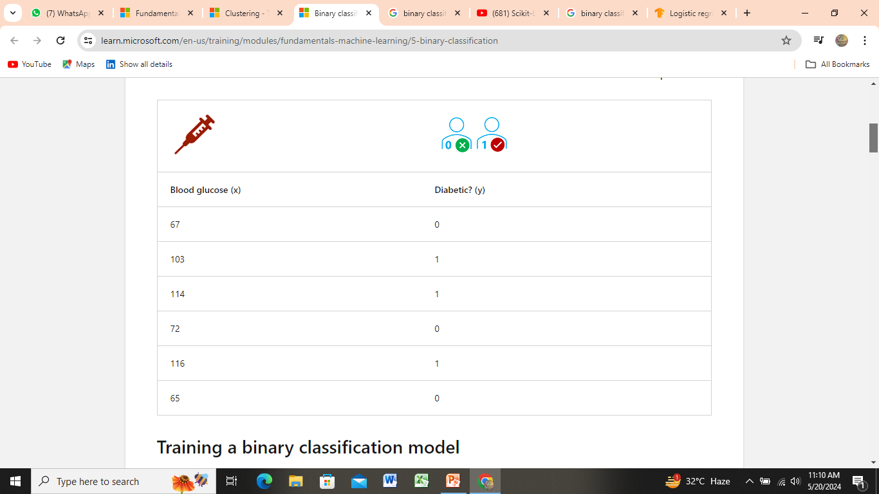
Binary classification

Slide 54
Binary classification
In machine learning logistic regression is used for classification, not regression. The important point is the logistic nature of the function it produces, which describes an S-shaped curve between a lower and upper value (0.0 and 1.0 when used for binary classification

Slide 55
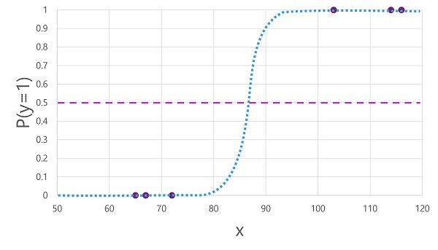

Slide 56
S-CURVED GRAPH
threshold lies at the mid-point for y (P(y) = 0.5).
For any values at this point or above, the model will predict true (1)
while for any values below this point it will predict false (0)

Slide 57
Binary classification evaluation metrics
The first step in calculating evaluation metrics for a binary classification model is usually to create a matrix of the number of correct and incorrect predictions for each possible class label.

Slide 58
confusion matrix
The arrangement of the confusion matrix is such that correct (true) predictions are shown in a diagonal line from top-left to bottom-right.
color-intensity is used to indicate the number of predictions in each cell

Slide 59
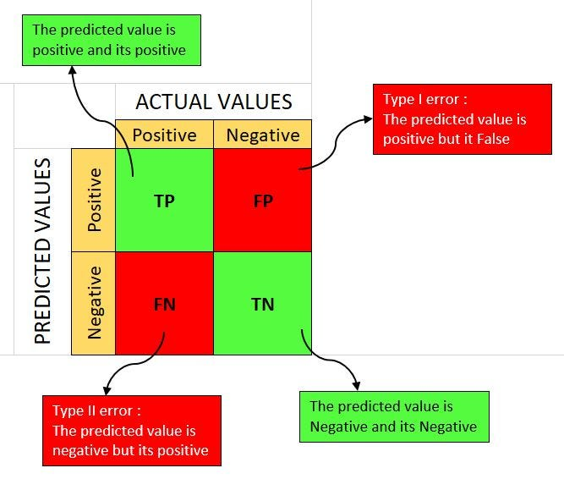
confusion matrix

Slide 60
confusion matrix
This visualization is called a confusion matrix, and it shows the prediction totals where:
ŷ=0 and y=0: True negatives (TN)
ŷ=1 and y=0: False positives (FP)
ŷ=0 and y=1: False negatives (FN)
ŷ=1 and y=1: True positives (TP)

Slide 61
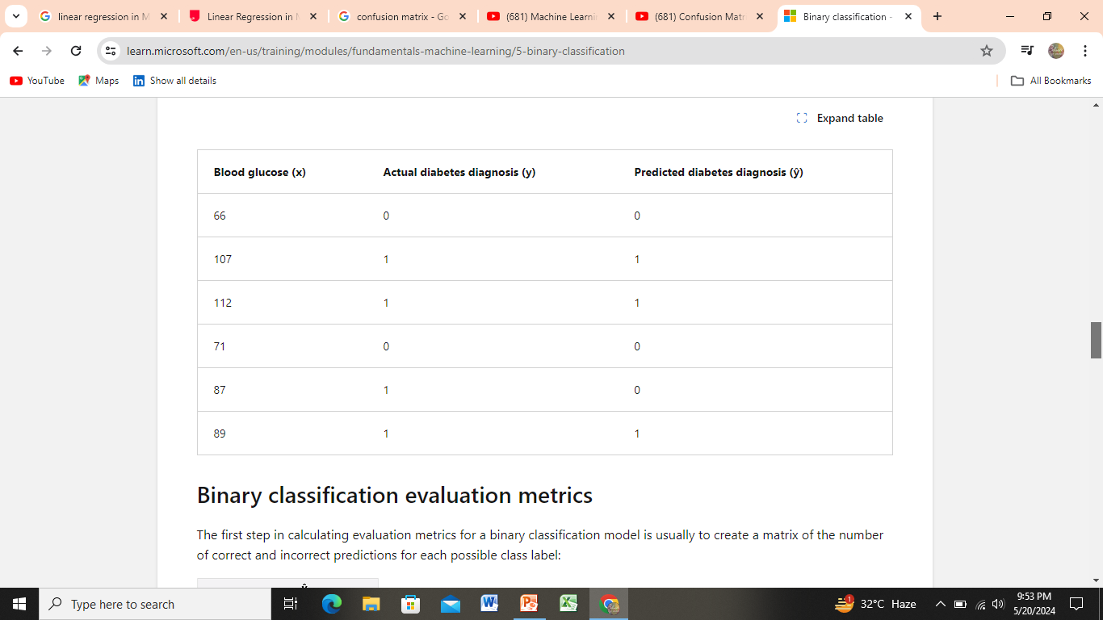
confusion matrix

Slide 62
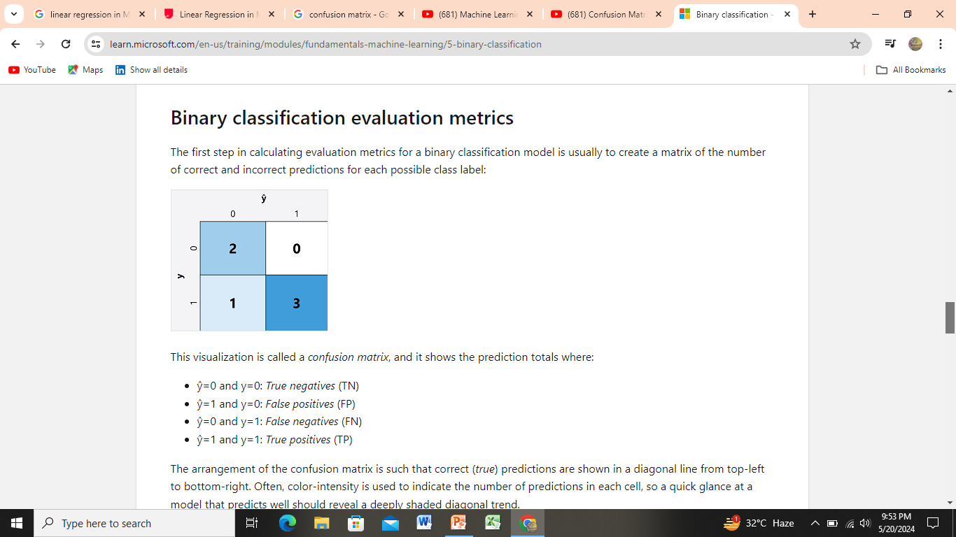
confusion matrix

Slide 63
Binary classification evaluation metrics
Accuracy
Recall
Precision
F1-score
Area Under the Curve (AUC)

Slide 64
Accuracy:
The simplest metric you can calculate from the confusion matrix is accuracy - the proportion of predictions that the model got right.
(TN+FN+FP+TP) =n
(TN+TP) ÷ n

Slide 65
Accuracy:
In the case of our diabetes example, the calculation is:
(2+3) ÷ (2+1+0+3)
= 5 ÷ 6
= 0.83
So for our validation data, the diabetes classification model produced correct predictions 83% of the time

Slide 66
ERROR RATE :
1- ACCURACY
FP+ FN / TOTAL
1-0.83
0.17

Slide 67
Recall
Recall is a metric that measures the proportion of positive cases that the model identified correctly.
The formula for recall is:
TP ÷ (TP+FN)

Slide 68
Recall
For our diabetes example:
3 ÷ (3+1)
= 3 ÷ 4
= 0.75
So our model correctly identified 75% of patients who have diabetes as having diabetes.

Slide 69
Precision
Precision is a similar metric to recall, but measures the proportion of predicted positive cases where the true label is actually positive.
In other words, what proportion of the patients predicted by the model to have diabetes actually have diabetes?
The formula for precision is:
TP ÷ (TP+FP)

Slide 70
Precision
For our diabetes example:
3 ÷ (3+0)
= 3 ÷ 3
= 1.0
So 100% of the patients predicted by our model to have diabetes do in fact have diabetes.

Slide 71
F1-score
F1-score is an overall metric that combined recall and precision.
The formula for F1-score is:
(2 x Precision x Recall) ÷ (Precision + Recall)

Slide 72
F1-score
harmonic mean of Precision and Recall and gives a better measure of the incorrectly classified cases than the Accuracy Metric.
Accuracy is used when the True Positives and True negatives are more important
F1-score is used when the False Negatives and False Positives are crucial

Slide 73
F1-score
For our diabetes example:
(2 x 1.0 x 0.75) ÷ (1.0 + 0.75)
= 1.5 ÷ 1.75
= 0.86

Slide 74
Area Under the Curve (AUC)
Another name for recall is the true positive rate (TPR), and there's an equivalent metric called the false positive rate (FPR)

Slide 75
Area Under the Curve (AUC)
if we were to change the threshold above which the model predicts true (1), it would affect the number of positive and negative predictions; and therefore change the TPR and FPR metrics.

Slide 76
Area Under the Curve (AUC)
These metrics are often used to evaluate a model by plotting a received operator characteristic (ROC) curve that compares the TPR and FPR for every possible threshold value between 0.0 and 1.0:

Slide 77
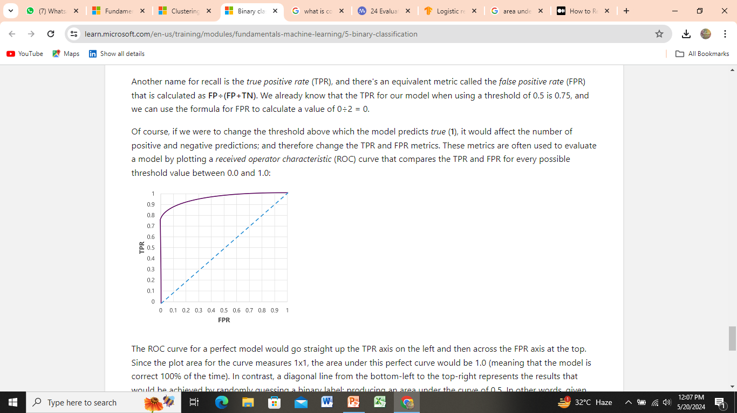
Area Under the Curve (AUC)

Slide 78
Video for ROC curve and AUC
https://youtu.be/QBVzZBsif20?t=187

Slide 79
Multiclass classification
it follows the same iterative train, validate, and evaluate process as regression and binary classification in which a subset of the training data is held back to validate the trained model.
Example

Slide 80
Training a multiclass classification model
To train a multiclass classification model, we need to use an algorithm to fit the training data to a function that calculates a probability value for each possible class.
One-vs-Rest (OvR) algorithms
Multinomial algorithms

Slide 81
One-vs-Rest (OvR) algorithms
One-vs-Rest algorithms train a binary classification function for each class, each calculating the probability that the observation is an example of the target class.
Each function calculates the probability of the observation being a specific class compared to any other class.

Slide 82
One-vs-Rest (OvR) algorithms
For example, given a multi-class classification problem with examples for each class ‘red,’ ‘blue,’ and ‘green‘.
Binary Classification Problem 1: red vs [blue, green]
Binary Classification Problem 2: blue vs [red, green]
Binary Classification Problem 3: green vs [red, blue]

Slide 83
Video for multiclass classification (OVR) Algorithm
https://youtu.be/wvMjy5rdBU8?t=9

Slide 84
Multinomial algorithms
As an alternative approach is to use a multinomial algorithm, which creates a single function that returns a multi-valued output

Slide 85
Multinomial algorithms
The output is a vector (an array of values) that contains the probability distribution for all possible classes
P(a|b) = (P(b|a} * P(a)) / P(b)

Slide 86
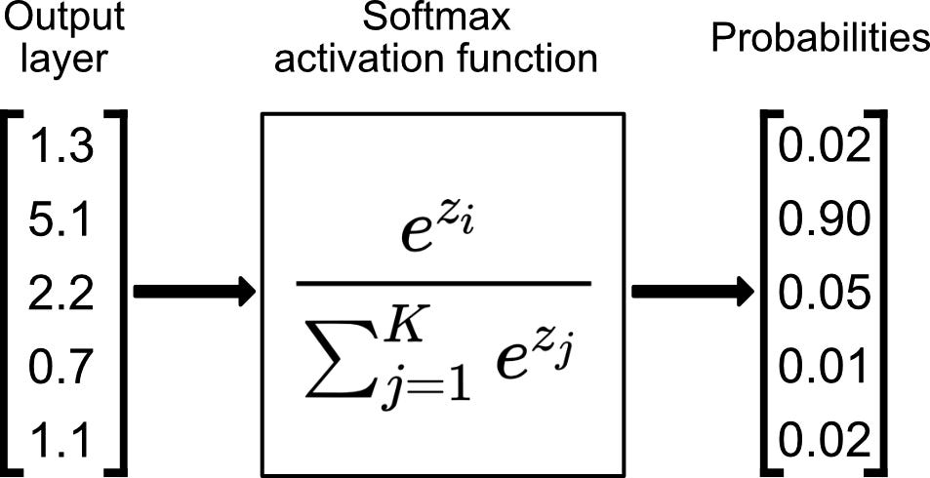
Multinomial algorithms

Slide 87
Evaluating a multiclass classification model
evaluate a multiclass classifier by calculating binary classification metrics for each individual class
Alternatively, you can calculate aggregate metrics that take all classes into account.

Slide 88
Evaluating a multiclass classification model
Draw confusion matrix for each class
Then do calculation for each class.
ACCURACY
PRECISION
RECALL
F-1 SCORE

Slide 89
Evaluating a multiclass classification model
To calculate the overall accuracy, recall, and precision metrics, you use the total of the TP, TN, FP, and FN metrics
Overall accuracy =(TP + TN) / (TP + TN + FP + FN)
Overall recall =TP ÷ (TP + FN)
Overall precision =TP ÷ (TP + FP)
Overall F1-score= (2 x Precision x Recall) ÷ (Precision + Recall)

Slide 90
Video for Confusion matrix for multiclass evaluation
https://youtu.be/gkNccYwtAbU?t=296

Slide 91
Clustering
Clustering is a form of unsupervised machine learning in which observations are grouped into clusters based on similarities in their data values, or features
Example ?

Slide 92
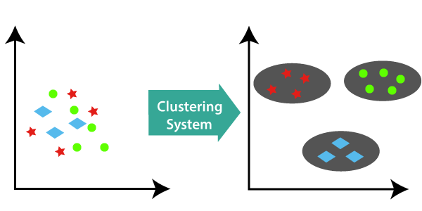

Slide 93
Training a clustering model
here are multiple algorithms you can use for clustering.
One of the most commonly used algorithms is K-Means clustering, which consists of the following steps:

Slide 94
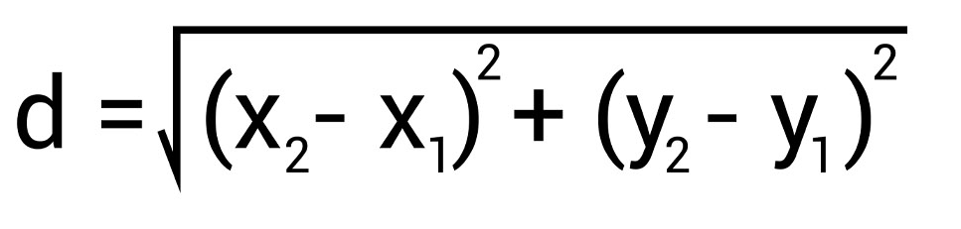
k-means clustering
take the clusters ( no. of clusters ) may be given in data.
take centroid of each cluster
Other values considers as observed vales (under consideration)
Use the Euclidean distance formula for distance measurement

Slide 95
K-Means
Write next observation after finding distance
w.r.t K1, K2
Write in cluster which is close (has less distance )
Update centroid after adding new observation in class.
Update centroid by taking the average value of points.

Slide 96
Evaluating a clustering model
There are multiple metrics that you can use to evaluate cluster separation, including:
Average distance to cluster center:
Average distance to other center:
Maximum distance to cluster center:
Silhouette:

Slide 97
Average distance to cluster center:
measures how close data points are to the centroid of their cluster.

Slide 98
Average distance to other center:
How close, on average, each point in the cluster is to the centroid of all other clusters.

Slide 99
Maximum distance to cluster center:
The furthest distance between a point in the cluster and its centroid.

Slide 100
Deep learning
Deep learning is an advanced form of machine learning that tries to emulate the way the human brain learns.
The key to deep learning is the creation of an artificial neural network that simulates electrochemical activity in biological neurons by using mathematical functions,

Slide 101
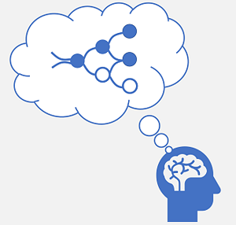
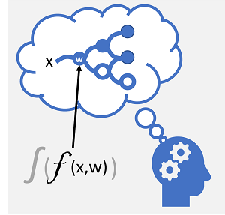

Slide 102
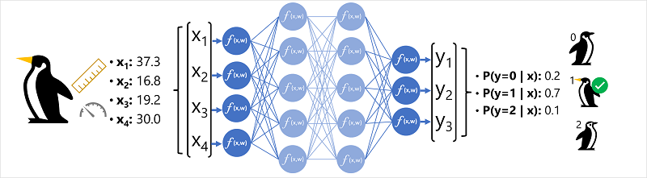
Example - Using deep learning for classification

Slide 103
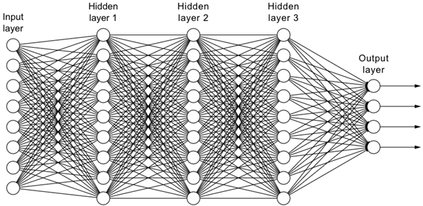
The Architecture of a Neural Network

Slide 104
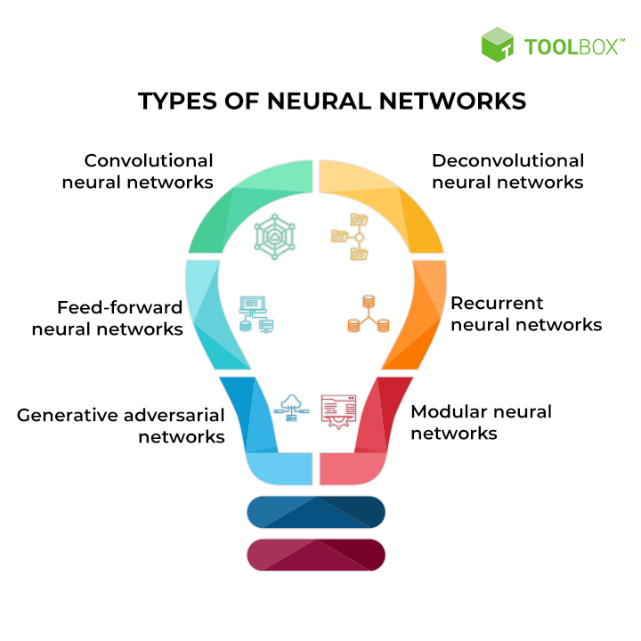

Slide 105
Types of neural network :
ANNs (Artificial Neural Networks) are helpful for solving complex problems.
CNNs (Convolution Neural Networks) are best for solving Computer Vision-related problems.
RNNs (Recurrent Neural Networks) are proficient in Natural Language Processing.

Slide 106
OVERFITTING & UNDERFITTING
Under fit models experience high bias—they give inaccurate results for both the training data and test set
On the other hand, over fit models experience high variance—they give accurate results for the training set but not for the test set.

Slide 107
Azure Machine Learning
Microsoft Azure Machine Learning is a cloud service for training, deploying, and managing machine learning models

Slide 108
Azure Machine Learning
designed to be used by data scientists, software engineers, devops professionals, and others to manage the end-to-end lifecycle of machine learning projects,
including:

Slide 109
Azure Machine Learning
Exploring data and preparing it for modeling.
Training and evaluating machine learning models.
Registering and managing trained models.
Deploying trained models for use by applications and services.
Reviewing and applying responsible AI principles and practices.

Slide 110
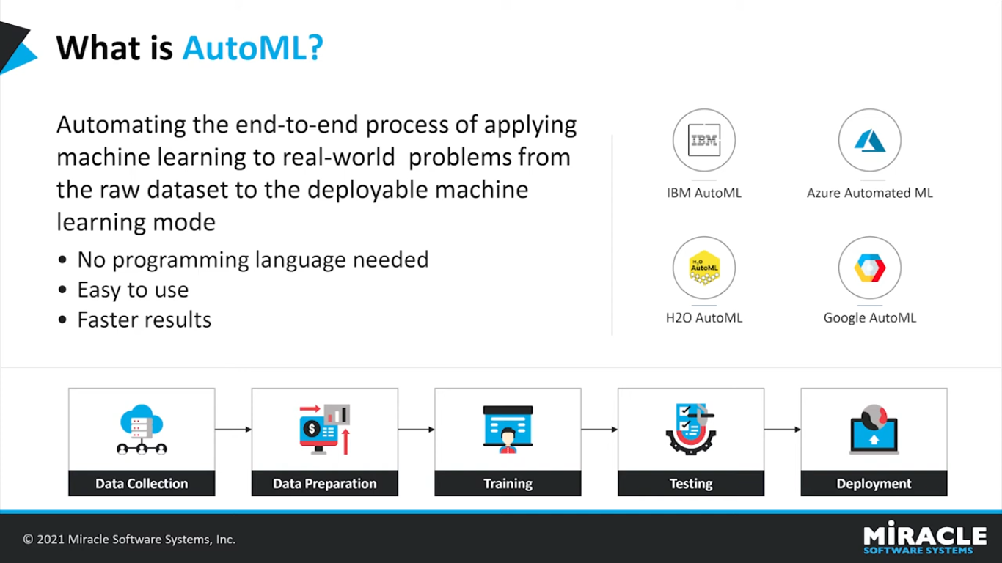

Slide 111
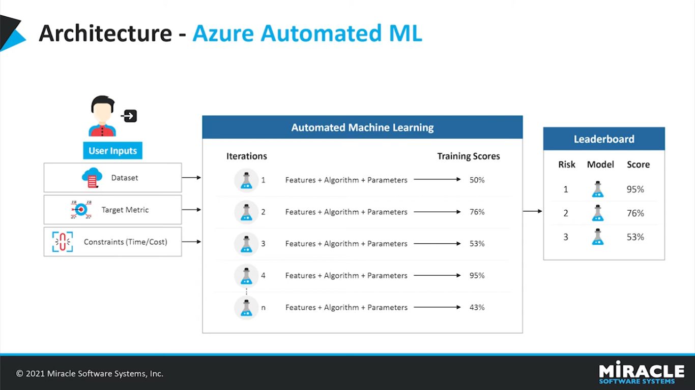

Slide 112
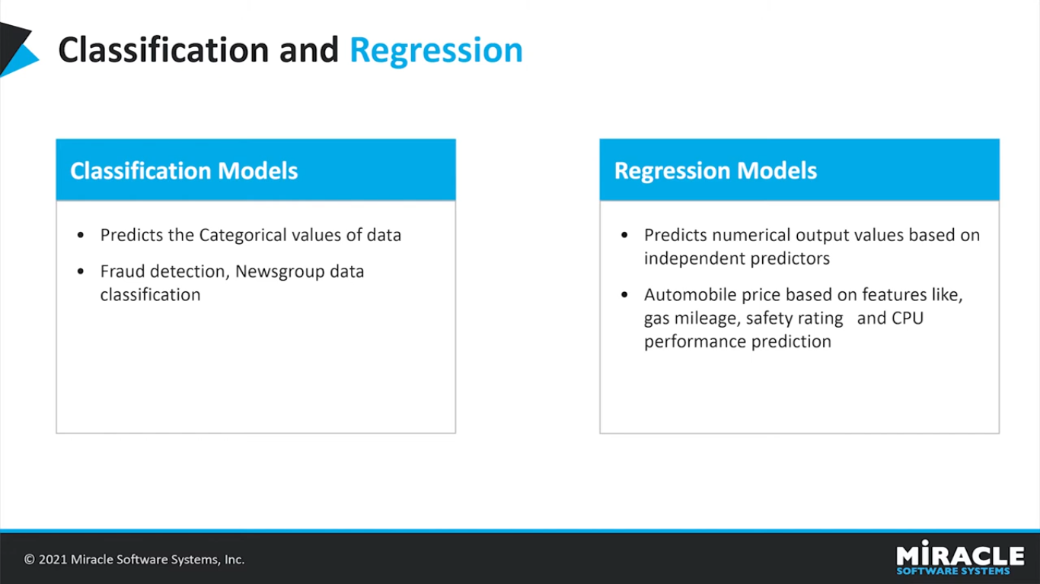

Slide 113
Features and capabilities of Azure Machine Learning
Centralized storage and management of datasets for model training and evaluation.
On-demand compute resources on which you can run machine learning jobs, such as training a model.

Slide 114
Automated machine learning (AutoML), which makes it easy to run multiple training jobs with different algorithms and parameters to find the best model for your data.
Built-in support for visualizing and evaluating metrics for responsible AI, including model explain ability, fairness assessment, and others.

Slide 115
Provisioning Azure Machine Learning resources
The primary resource required for Azure Machine Learning is an Azure Machine Learning workspace
Demo

Slide 116
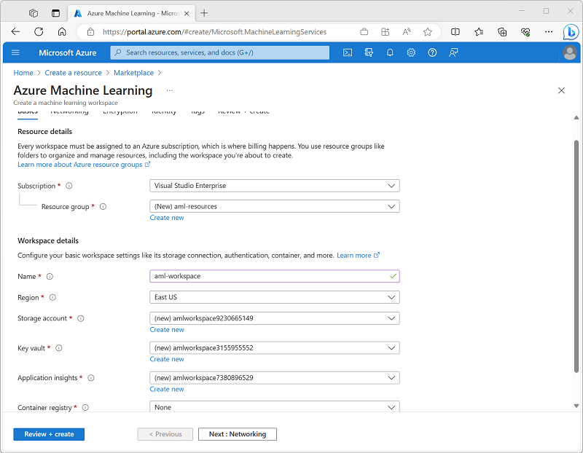

Slide 117
Azure Machine Learning studio
After you have provisioned an Azure Machine Learning workspace, you can use it in Azure Machine Learning studio
a browser-based portal for managing your machine learning resources and jobs.

Slide 118
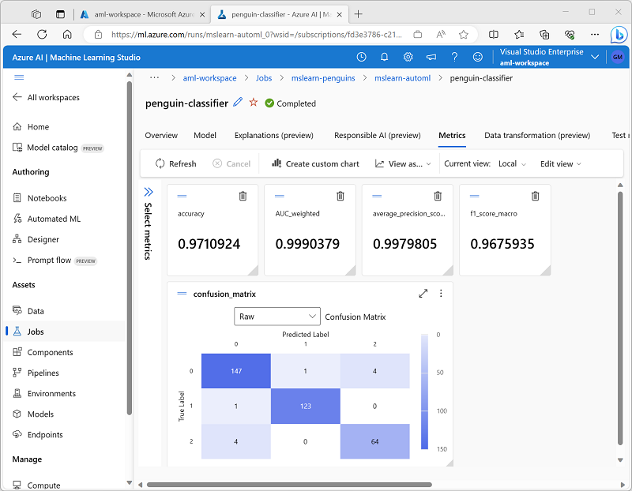

Slide 119
Azure Machine Learning studio:
Drag and drop tool for building machine learning models.
Cloud based tool that can be used to built models from scratch or to use pre -built models
Azure ML studio is a visual tool that does not require any coding knowledge to use.
It a great tool for beginners and experts alike.

Slide 120
import and explore data.
Create and use compute resources.
Run code in notebooks.
Use visual tools to create jobs and pipelines.
Use automated machine learning to train models.
View details of trained models, including evaluation metrics, responsible AI information, and training parameters.
Deploy trained models for on-request and batch inferencing.
Import and manage models from a comprehensive model catalog.

Slide 121
AZURE MACHINE LEARNING EXERCISE LAB

