Slide 1

AI & Machine Learning Week 3 Lecture

Slide 2
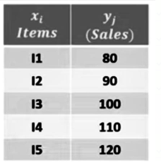
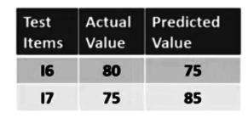
LINEAR REGRESSION MATRICS

Slide 3
Confusion Matrix
Predicted
Actual
165 | NO | YES
NO | TN (50) | FP (10) | 60
YES | FN (5) | TP (100) | 105
55
110

Slide 4
KNN k-nearest neighbors
X=(Math=6,CS=8,Pass=?
K=3
Math | CS | Result
4 | 3 | Fail
6 | 7 | Pass
7 | 8 | Pass
5 | 5 | Fail
8 | 8 | Pass

