Slide 1


Project RFM:
Client Segmentation and Product Recommendation
Project by :
Touseeq Danish
UCBL december 2024

Slide 2
Summary
INTRODUCTION
1. EXPLORATORY DATA ANALYSIS
2. PRE-PROCESSING OF DATA AND RFM
3. ARTIFICIAL INTELLIGENCE MODEL
4. APPLICATION DEVELOPMENT
CONCLUSION
RESSOURCES

Slide 3
INTRODUCTION
Context
In retail, understanding customer behavior is essential for creating personalized experiences and optimizing marketing efforts. Using customer data, companies can identify buying habits, predict future purchases, and recommend products that match their preferences. Using machine learning and data analytics, companies can not only understand what customers are doing now, but also predict what they will do next, helping to improve customer satisfaction and loyalty.
As part of this analysis, we worked with a sales dataset to study customer behavior. By performing tasks such as customer segmentation, clustering, and analyzing key metrics (such as recency, frequency, and monetary value), We sought to gain insights that can be used to make data-driven business decisions. The goal is to provide practical advice for companies to improve their customer engagement strategies.
In this report, we will describe the steps we took to explore the dataset, apply clustering techniques, and implement a machine learning application that predicts and recommends products based on customer profiles. We will also discuss the technologies used in the development and implementation of the app, including how we integrated explainable components to help users better understand their personalized recommendations.

Slide 4
Project
This project aims to use data analytics and machine learning techniques to understand customer behavior in a retail context. By analyzing transaction data, we seek to better understand customer purchasing habits, identify key metrics such as duration, frequency, and monetary value (RFM), and use clustering techniques to segment customers based on their purchasing habits. The goal is to develop a machine learning application that can predict customer behavior, recommend products, and provide a personalized shopping experience.
INTRODUCTION
Plan of Action:
This project focuses on analyzing customer behavior in retail using machine learning and data analytics. The process will take place in several key stages:
Exploratory Data Analysis and Data Cleaning: First, we will explore the dataset and prepare it for further use based on our needs and observations.
Customer Metric Calculation: We will calculate important metrics such as recency, frequency, and monetary value (RFM) to understand customer behavior and identify high-value customers.
Clustering and Segmentation: Using clustering algorithms (such as k-means), we will group customers based on their RFM scores to explore and segment customer profiles.
Explainable AI: To improve transparency, we will integrate explainable AI capabilities, helping users understand the logic behind recommendations.
Predictive Application Implementation:
We will developed an application that predicts customer behavior and recommends products based on their RFM profile. The application will be made available online for easy access.

Slide 5
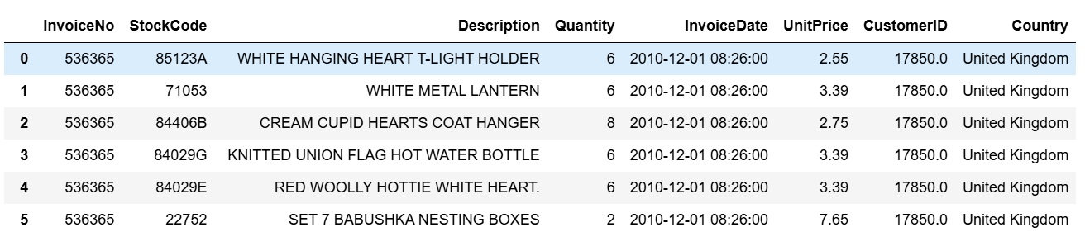
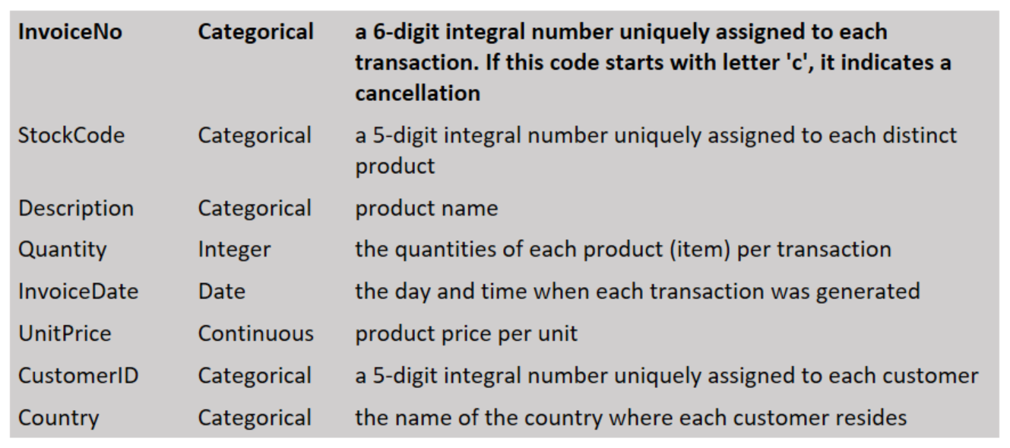
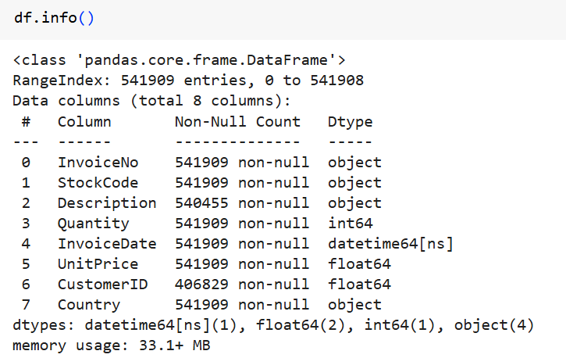
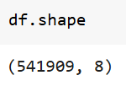
Exploratory data analysis (EDA) is the first step in understanding data and preparing it for further analysis. As part of this project, we will perform EDA on the dataset to uncover insights and clean it for further use. Below are the main steps of the EDA process:
Loading and inspecting the data:
The first task is to load the dataset and inspect its structure. We will check the raw data to understand the data format and identify obvious problems, such as missing values ​​or incorrect data types.
The dataset :
The columns are described as follows :
Dataset informations :
1. EXPLORATORY DATA ANALYSIS

Slide 6
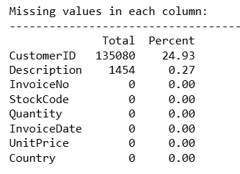
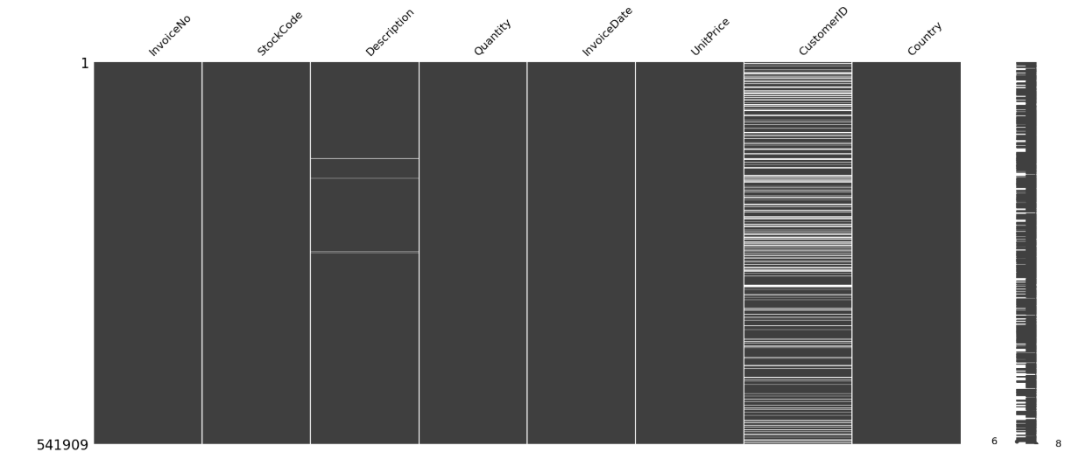
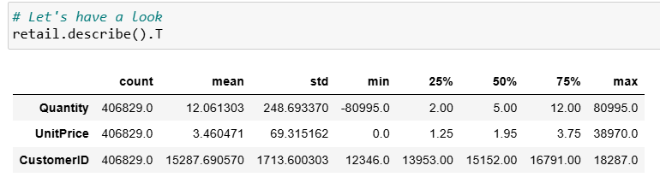
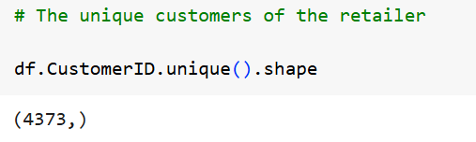
Missing values :
The missingno matrix reveals a substantial number of missing values in our dataset. Notably, 24.93% of Customer ID entries are absent, which requires careful consideration before taking any action. Simply dropping this column could lead to a significant loss of data, potentially skewing our analysis and resulting in biased outcomes.
After thorough investigation, we concluded that imputing values for the missing Customer IDs was not the optimal solution. The systematic nature of the missing data suggests a potential issue with data collection or management that should be addressed to improve future data quality. For the current analysis, to avoid introducing further bias, we have decided to proceed with deleting the rows with missing Customer IDs, despite the considerable data loss this entails.
After using .dropna() on the CustomerId column we can see the following stats :
Then checking how many customers they actually have :
1. EXPLORATORY DATA ANALYSIS

Slide 7
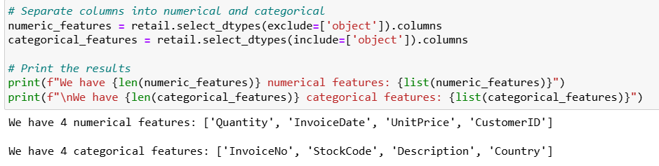
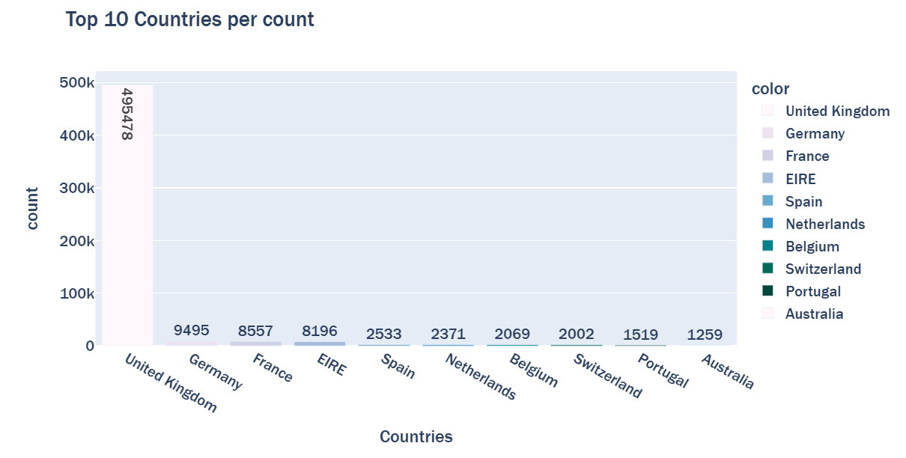
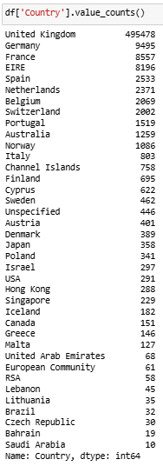
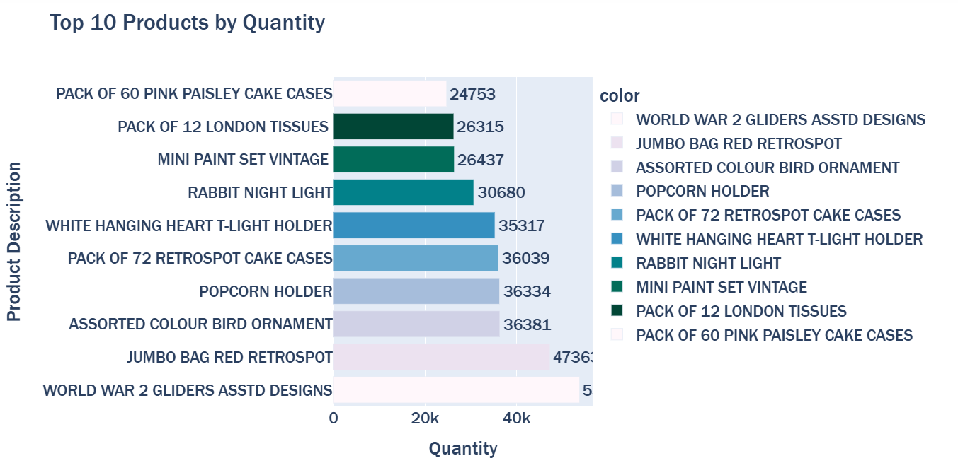
EDA with Data Visualisation
We will start by analyzing each variable individually. We will analyze categorical variables by checking their distribution and unique values. And we will analyze continuous variables, by checking their summary statistics, distributions, and identifying outliers.
Number of countries by number of customers count and Data Viz of the top 10 :
Data Viz of the top 10 products by quantity :
1. EXPLORATORY DATA ANALYSIS

Slide 8
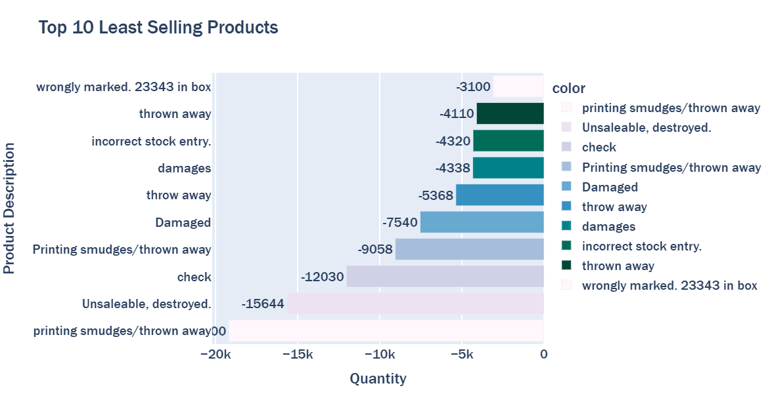
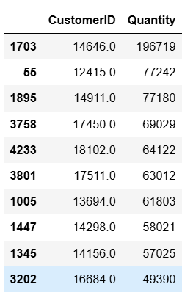
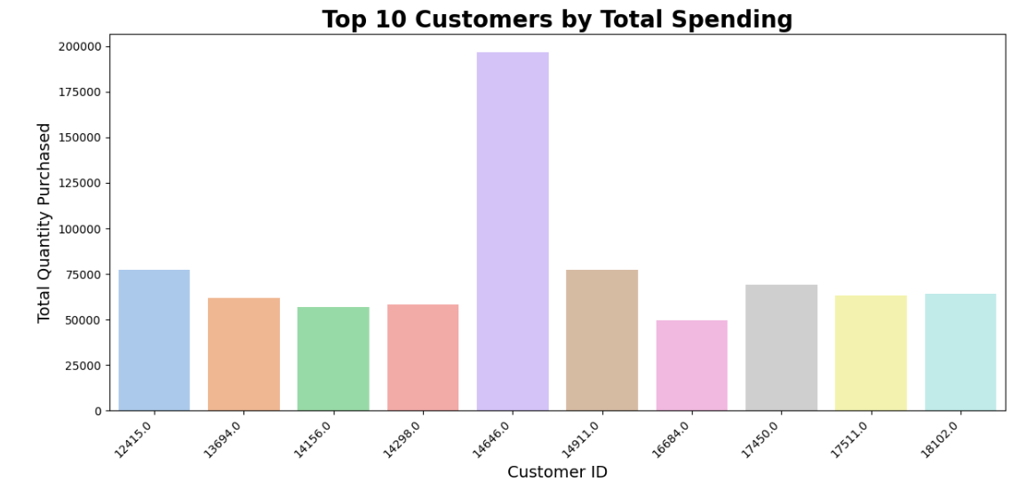
Data Viz of the top 10 least selling products by quantity :
There seem to be some damaged and not up-to-selling standard products in there. which means there may have been some return transactions in this data.
Data Viz of the top 10 Customers by Total Spending :
1. EXPLORATORY DATA ANALYSIS

Slide 9
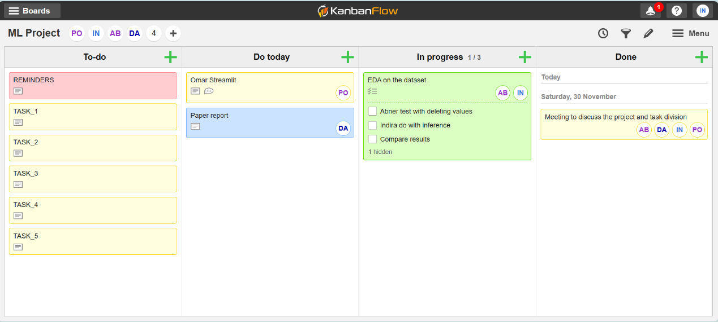
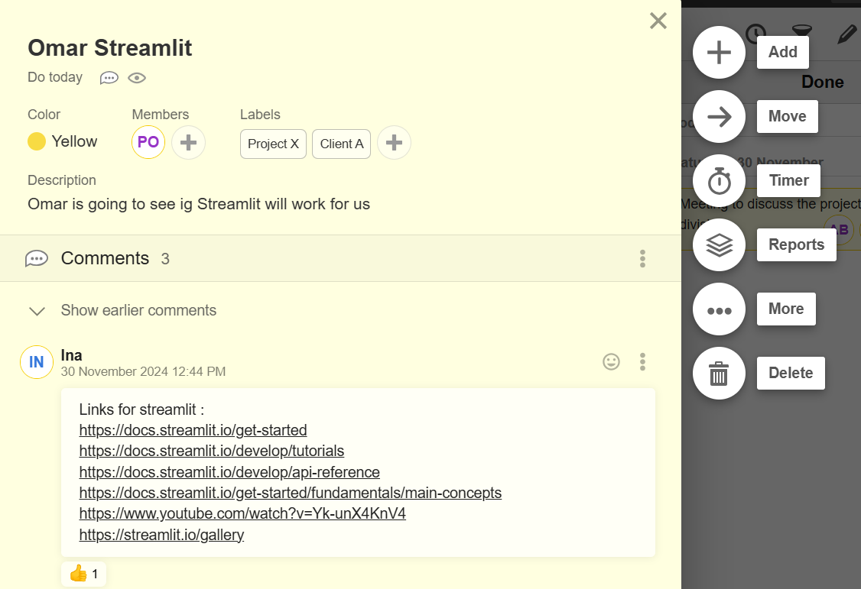
Organizational methodology and work environment
For this project, we established a structured and efficient work environment with clearly defined roles and responsibilities. Omar serves as the Project Manager, overseeing the final product (the application) and providing instructions to the team. Abner and Indira, as Data Scientists, focus on Exploratory Data Analysis (EDA) and model development. Danish plays a versatile role, initially working on the report and later assisting Omar with the application development.
We chose Flask as our web framework due to its reliability and scalability for application development. For analysis and model development, we utilize Google Colab and Jupyter Notebook running on Windows Subsystem for Linux (WSL). These tools provide the necessary computational resources for handling intensive tasks efficiently.
This combination of tools and technologies ensures smooth execution and testing throughout the project lifecycle, enabling us to meet the IT requirements and optimize the development process.
To stay on track and manage our time effectively, we adopted the Agile method using a tool named KanbanFlow. This method helps us break down tasks into focused chunks, which helps us stay on task longer and avoid distractions. By tracking the time spent on each task, we can identify areas that are taking longer than expected, which helps us adjust our approach and improve efficiency as we move forward with the project.
The management method used was as follows: TO-DO, DO TODAY, IN PROGRESS and DONE. We tag members that are in charge of the task and let them handle it their way. We shared links, code and insights by tagging the person on the task and putting it inside.
This setup allows us to collaborate more easily,
stay on track, and ensure all parts of the project
progress smoothly.

Slide 10
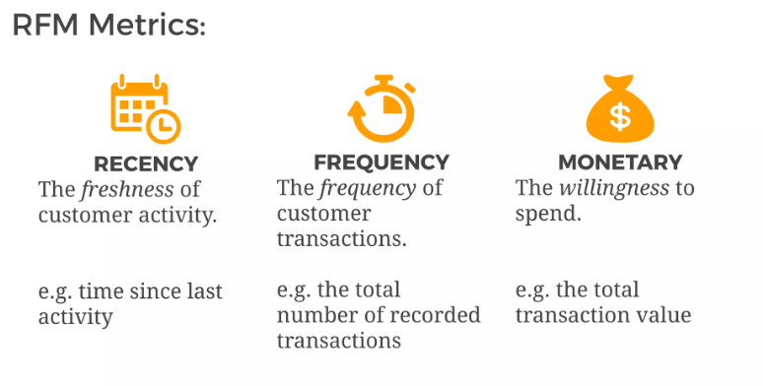
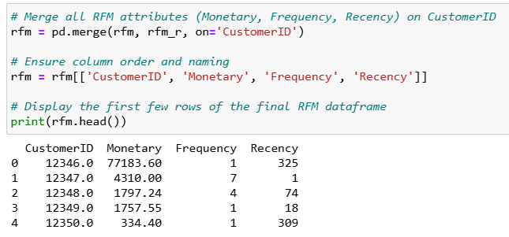
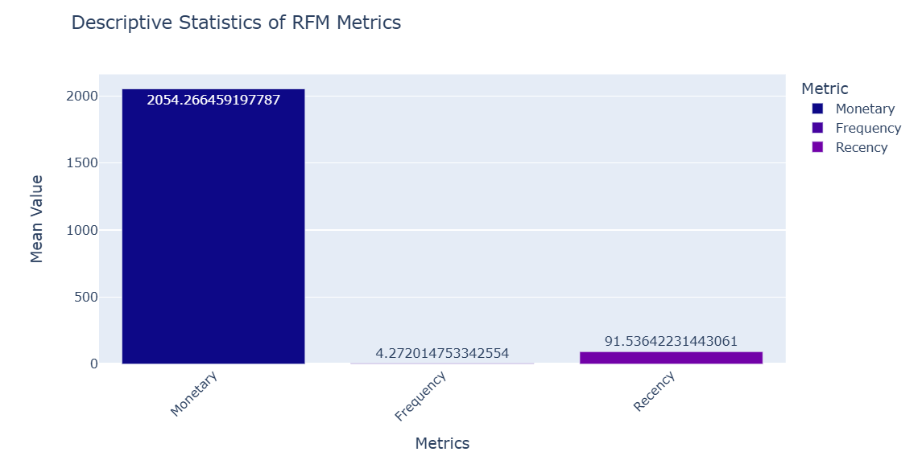
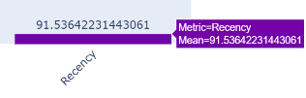
2. PRE-PROCESSING OF DATA and RFM
What Is RFM Analysis?
RFM stands for Recency, Frequency, and Monetary value. It is a method to analyze customer behavior and segment them into groups for better business decisions.
- Recency (R): How recently a customer made a purchase.
- Frequency (F): How often a customer makes purchases.
- Monetary Value (M): How much money a customer spends.
Why RFM Analysis?
Identify loyal customers.
Spot high-value customers.
Target lapsed customers with campaigns.
Data Preparation :
The first step is to organize customer transaction data into a table where each row represents a customer, and the columns are:
Customer ID
Recency: Days since the last purchase.
Frequency: Total number of transactions.
Monetary Value: Total amount spent
Since we don't have those values let's create them!
Import our transaction data.
Calculate:
  Recency: Find the difference between today's date and the last purchase date.
  Frequency: Count the number of transactions per customer.
  Monetary Value: Sum up the transaction amounts for each customer.
Merge all the RFM attributes into one dataset
Analyse them after applying some descriptive statistics.

Slide 11
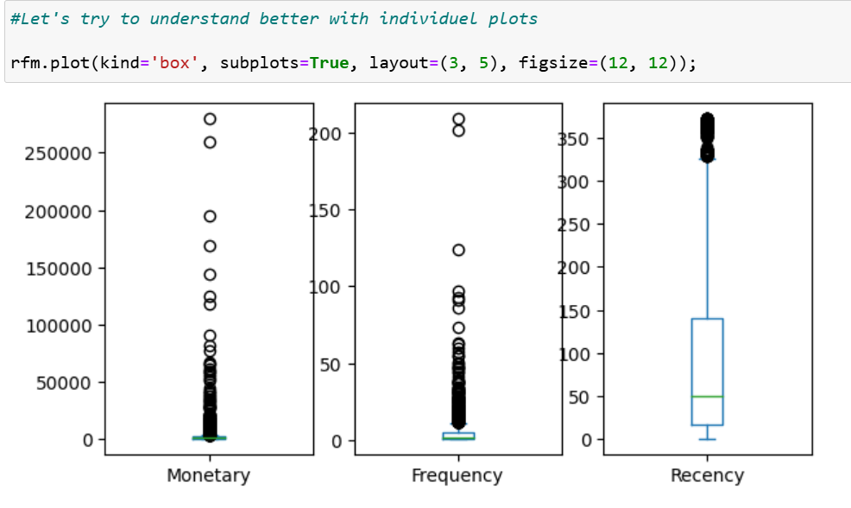
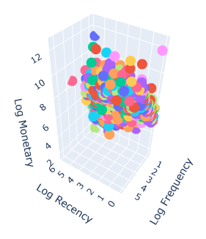
2. PRE-PROCESSING OF DATA and RFM
Data visualization of RFM
As a team, we believe that data visualization plays a key role in our data analysis process. It helps us to explain and understand the data before moving on to more complex tasks like training machine learning models. By visualizing the data, we can quickly spot anomalies or outliers, see how variables are distributed, and identify correlations between them.
This step is crucial for choosing the right preprocessing techniques and evaluating their effectiveness. In addition, data visualization helps us present our findings to non-technical stakeholders, allowing them to better understand the results and make informed decisions. In short, visualization improves the overall quality and understanding of data, leading to more efficient and accurate models.
We first tried to understand those better with boxplots as seen below and with distplots :
Final insights :
These insights are interesting, but they are presented individually. To gain a more comprehensive understanding, we need to combine them or develop a scoring system that allows us to visualize the data more effectively.
To effectively combine insights, we can create a scoring system that integrates both qualitative and quantitative data, allowing us to visualize and understand the information as a whole.
Then we decided to plot the customers RFM in a 3D plot where each axis is the log value of the previous metrics (after doing a log-transform on those metrics).
3D Plot of Customers by Log-Transformed RFM Metrics :

Slide 12
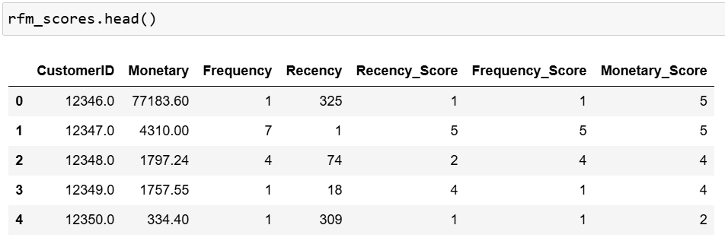
2. PRE-PROCESSING OF DATA and RFM
Scoring the RFM metrics:
We can calculate RFM (Recency, Frequency, and Monetary) scores in different ways, such as using percentiles, the 80/20 rule, or creating custom scores based on business needs. In this case, we will use percentiles for each RFM dimension.
To calculate percentiles, we sort customers based on a specific metric, divide them into equal groups, and assign labels to each group. For RFM, the labels will represent customer behavior:
Recency: from "Very Recent" to "Very Infrequent."
Frequency: from "Very Frequent" to "Very Infrequent."
Monetary: from "High Spending" to "Low Spending."
After assigning labels for each RFM dimension, we combine them to create an overall RFM label for each customer. For example, if a customer has a Recency score of 4, Frequency of 5, and Monetary of 3, their combined label could be "Recent-Very Frequent-Average Spending."
This method gives priority to customers who are more recent, since recent engagement is usually more valuable to businesses. Higher scores for Frequency and Monetary values are also important, as companies want to encourage more visits and higher spending.
We divide each RFM dimension into five groups, each containing 20% of the customers. This approach is based on the distribution of customer data, shown through boxplots, and helps highlight differences in customer behavior. This method allows us to make better decisions by clearly showing how customers compare in terms of recency, frequency, and spending.
Final RFM scores dataset :

Slide 13
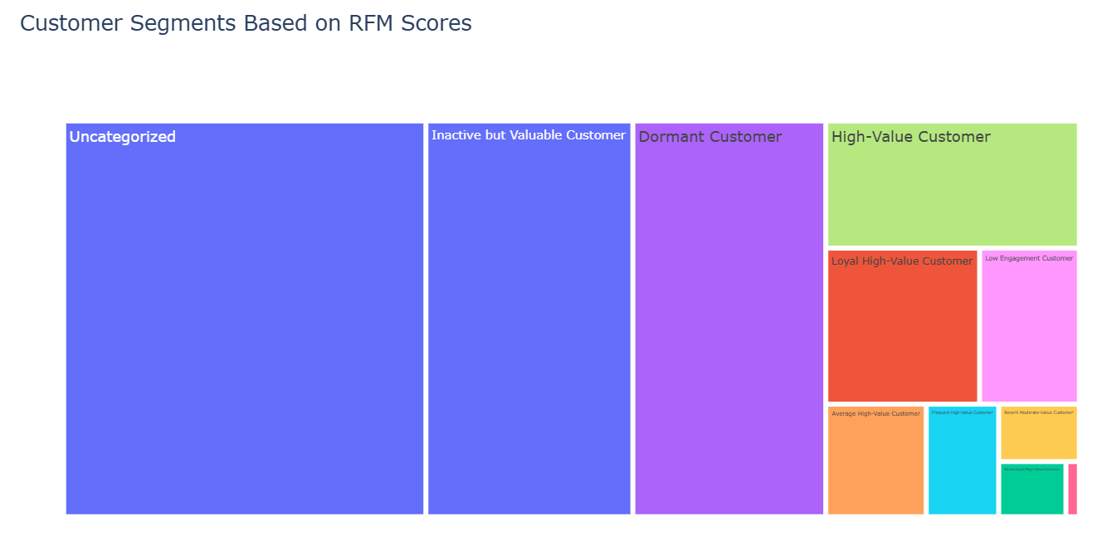
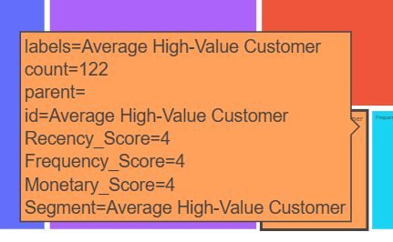
2. PRE-PROCESSING OF DATA and RFM
Data Viz of Customer Segments based on RFM scores :
Final observation :
The current RFM segmentation method oversimplifies customer behavior by relying on arbitrary thresholds for recency, frequency, and monetary values. This can lead to misrepresentations, such as categorizing a one-time high spender as a high-value customer. Furthermore, this static approach fails to adapt to changes in customer behavior or future trends.
To gain a more accurate understanding of customer value and improve decision-making, we should consider using K-means clustering. This method allows for more granular segmentation and can dynamically adjust to customer behaviors, providing deeper insights into our customer base.

Slide 14
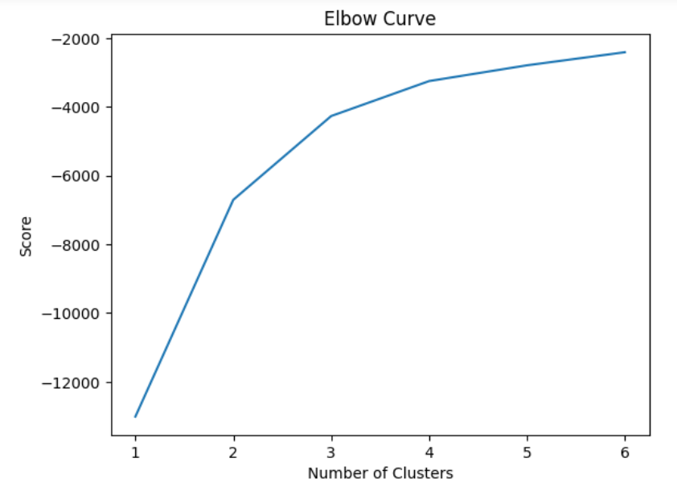
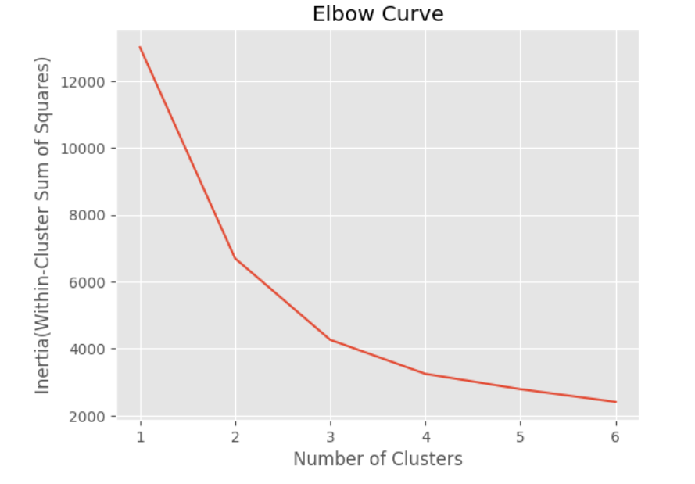
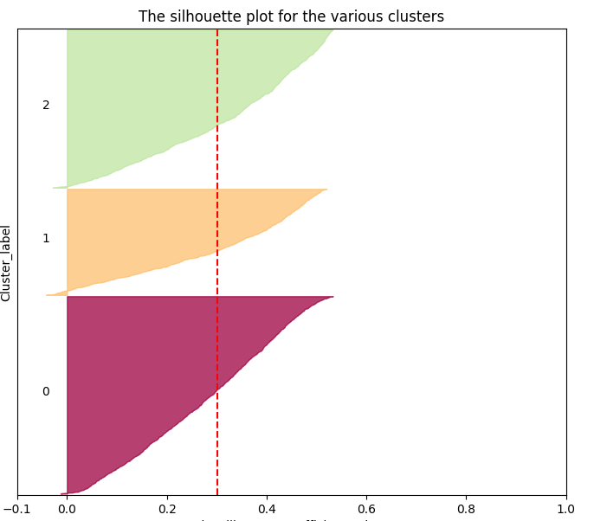
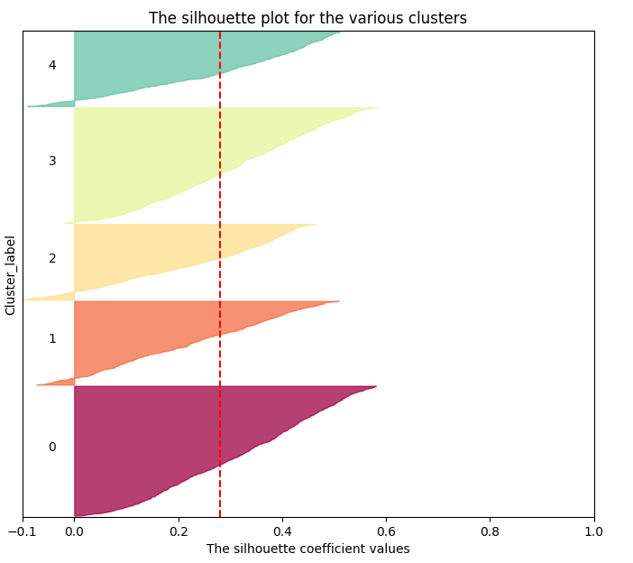
3. ARTIFICIAL INTELLIGENCE MODEL
Clustering with K-Means
We decided to explore different approaches to chose our number of clusters like the Elbow curve
and the Silhouette.
The best number of clusters seemed to be K=3 or K=5 so we decided to explore those two extensively.

Slide 15
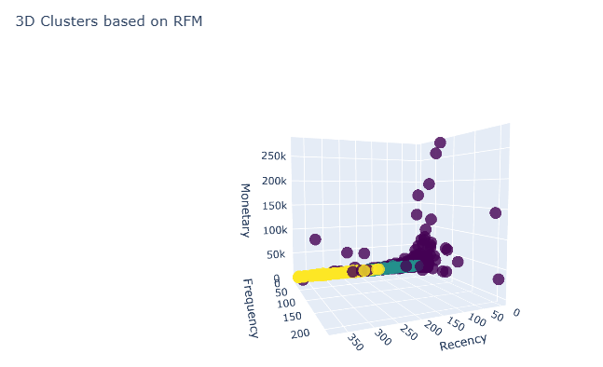
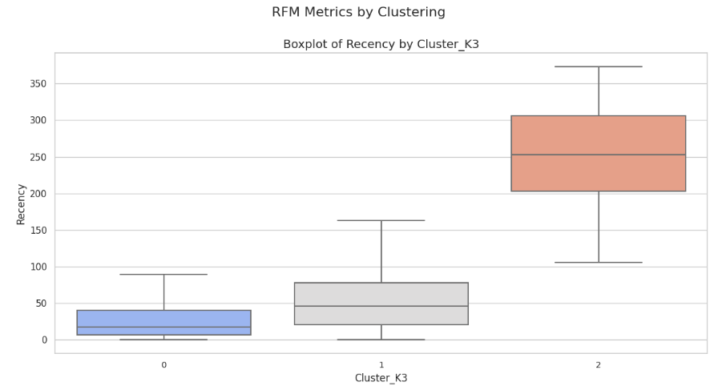
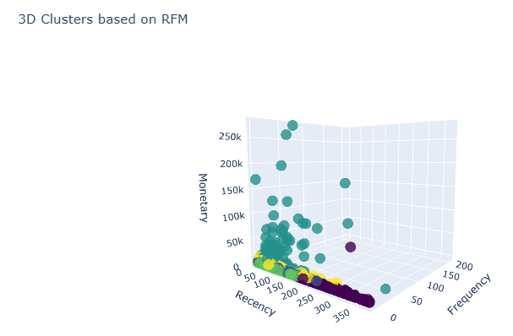
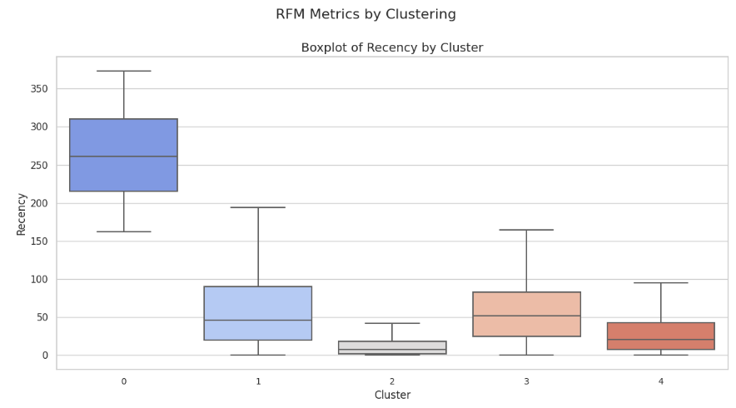
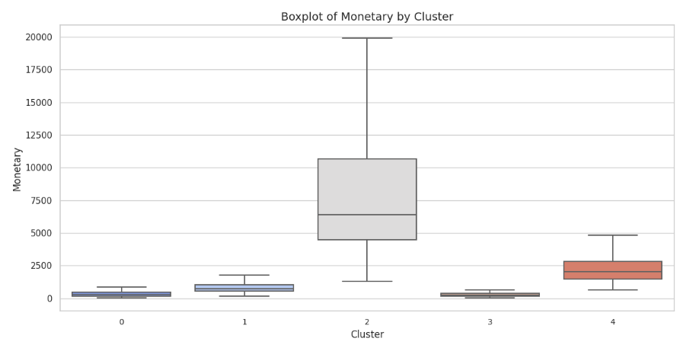
3. ARTIFICIAL INTELLIGENCE MODEL
RFM metrics applied on the clusters of the K-Means K=3 :
RFM metrics applied on the clusters of the K-Means K=5 :
The Model with 5 clusters seems to provide a more balanced segmentation that captures the diversity of customer behaviors, from the most loyal, high-value customers to the least engaged ones. This strategy will enable us to personalize marketing and target recommendations tailored to each cluster's needs. By classifying customers into these distinct groups, we can create specific engagement strategies to increase customer retention, loyalty, and overall revenue.

Slide 16
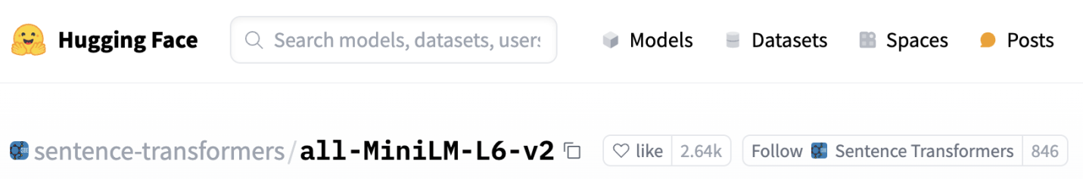
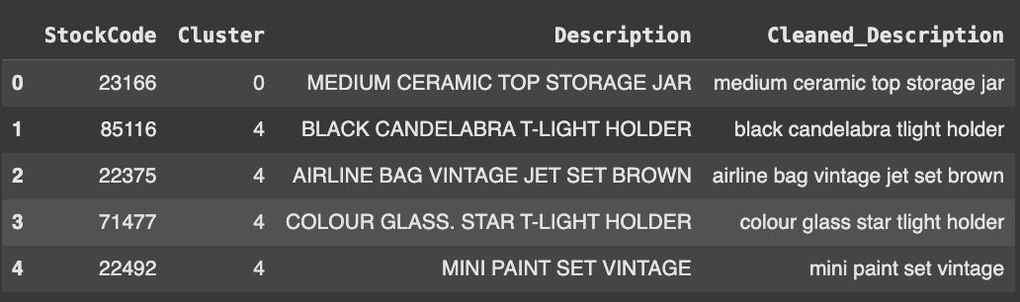
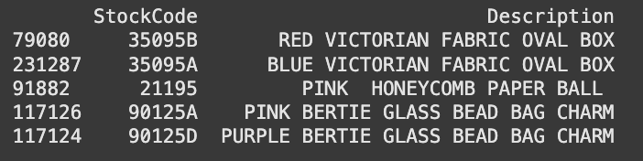
3. ARTIFICIAL INTELLIGENCE MODEL
As part of the recommendation system, we used the 'all-MiniLM-L6-v2' model, which is a transformer-based model designed to map sentences and paragraphs into a 384-dimensional dense vector space and can be used for tasks such as clustering or semantic search.
We leveraged the cluster value and the products associated with the customers in each cluster. We generated an embedding for each product description, with the aim of obtaining a representation of each cluster.
This way, we could identify products that were close to their centroid. For each cluster centroid, we calculated the cosine similarity with the embeddings of each product to find the top 10 most similar products.
However, the result were not as expected, as the top 3 recommended products were quite similar across different clusters.
This could be due to the fact that products from different clusters may have high similarity with the centroids of other clusters.
This phenomenon could also occur because, although the products have different descriptions in terms of exact words, the SentenceTransformers model can generate representations with similar semantic contexts.
Example of top 5
when the customer is
in the cluster 0
An improvement could have been to try another sentence-transformers model more specific to the product domain or to use a weighting approach when calculating similarities.

Slide 17
4. APPLICATION DEVELOPMENT
For our final application we decided to use the 5 clusters described in ourK-Means model which is based on customer behavior, that was segmented according to the Recency, Frequency, and Monetary (RFM) scores. Each cluster represents a different category of customer engagement and value. Here’s a breakdown of the 5 clusters we’ve created:
1. High-Value Customers (Cluster 0)
Description: These are the customers who are the most valuable to the business. They have high Recency, Frequency, and Monetary scores.
Profile:
  These customers have made recent purchases.
  They buy frequently and spend a significant amount.
They are the loyal and profitable customers who generate the most revenue.
2. Moderate-Value Customers (Cluster 1)
Description: These customers are valuable, but not as consistently engaged as high-value customers. They might have a moderate recency score or a moderate level of spending.
Profile:
  Customers who have bought more than once but aren’t buying as frequently.
  They may spend a good amount when they do make a purchase, but they aren’t as active as high-value customers.
They could be targeted with special offers to increase engagement.
3. Dormant or Low-Engagement Customers (Cluster 2)
Description: These are customers who have been inactive or have very low engagement with the business.
Profile:
  These customers have low Recency, meaning they haven't bought in a while.
  Their Frequency and Monetary scores are low, indicating that they don't engage much or don’t spend much when they do purchase.
These customers might need re-engagement strategies, such as retargeting ads or personalized offers to win them back.
4. Inactive but Valuable Customers (Cluster 3)
Description: These customers have low recency but have previously shown high frequency or high monetary value. They are not currently engaged, but they have the potential to be valuable again.
Profile:
  These customers have purchased frequently or spent large amounts, but they haven’t bought recently.
They could be considered high potential targets for reactivation. They may need a specific outreach strategy, like re-engagement campaigns offering discounts or new products
5. Churned Moderate-Value Customers (Cluster 4)
Description: These customers were once moderately valuable but have stopped buying or show low engagement. They have a moderate monetary or frequency score but a low recency score.
Profile:
  These customers were more engaged in the past but have recently gone inactive.
  They might still be valuable if re-engaged correctly, but they are at risk of churn.
They might need to be targeted with retargeting ads or loyalty rewards to bring them back.

Slide 18
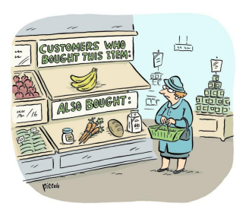
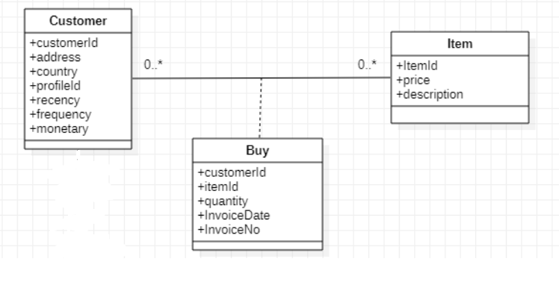
4. APPLICATION DEVELOPMENT
Summary of the 5 Clusters:
High-Value Customers: Recent, frequent, and high spenders — the most profitable group.
Moderate-Value Customers: Good spenders but not as frequent or recent. They represent potential growth.
Dormant or Low-Engagement Customers: Low interaction and purchase frequency. These customers are inactive and need re-engagement.
Inactive but Valuable Customers: Low recent activity but have historically shown value. They can be reactivated.
Churned Moderate-Value Customers: Moderate previous value but now dormant. They represent a risk of churn.
Why 5 Clusters?
These 5 clusters provide a balanced segmentation that captures the diversity of customer behaviors, from the most loyal, high-value customers to the least engaged ones. The strategy enables personalized marketing and targeted recommendations tailored to each cluster's needs. By classifying customers into these distinct groups, you can create specific engagement strategies to increase customer retention, loyalty, and overall revenue.
Our App and How the Recommendation System Works
The goal of the product recommendation application is to suggest products to customers based on their purchasing behavior, classified into Recency, Frequency, and Monetary (RFM) categories. This is done by grouping customers into clusters and offering recommendations for products that similar customers have purchased.
Process Flow:
Customer Input: A customer connects on our application system and then he chose a list of products they are interested in.
Backend Processing:
  Customer Profile Lookup: The system uses the Customer ID to retrieve the RFM score of the customer and their cluster (a group of customers with similar purchasing behaviors).
  Recommendation Generation: Based on the cluster the customer belongs to, the system retrieves the most popular products bought by other customers in the same group. It ensures that products the customer has already expressed interest in are excluded from the recommendations.
ERD for our database

Slide 19
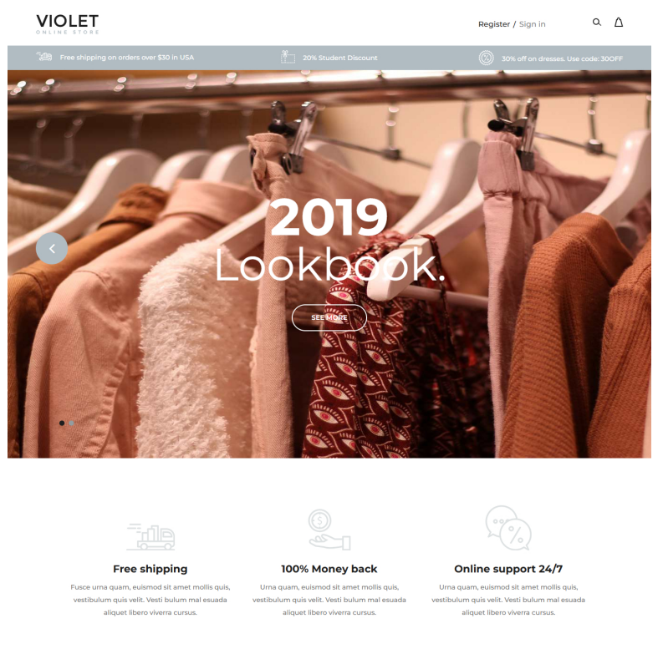
4. APPLICATION DEVELOPMENT
3. Recommendations Display: The backend returns two main outputs:
  The Customer's RFM Values (Recency, Frequency, and Monetary scores), which provide insight into the customer's purchasing behavior.
  A list of Recommended Products, based on the behaviors of similar customers.
4. Frontend Display: The customer sees:
  Their RFM profile (a description of their purchasing behavior).
  A list of products they may be interested in.
The welcome page of the application :

Slide 20
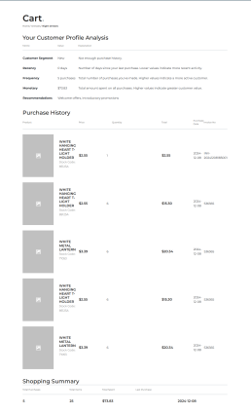
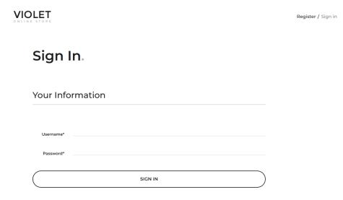
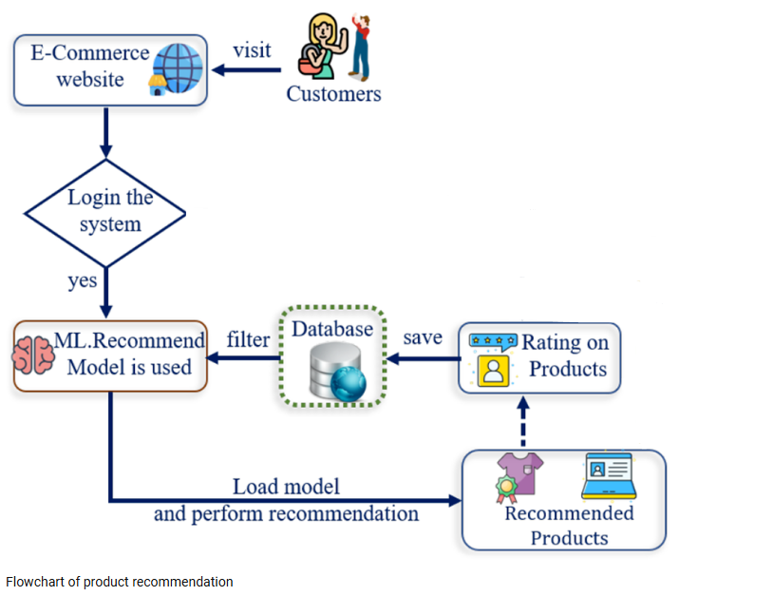
4. APPLICATION DEVELOPMENT
Pros and Cons of the System
Pros:
Personalized recommendations based on customer behavior
Data-driven insights using RFM analysis
Scalable approach for larger datasets
Simple implementation without complex machine learning models
Cons:
Highly dependent on data quality and completeness
Cold start problem for new customers
Lack of real-time preference adaptation based on new products
Explanation Alignment with the Code
The code implements RFM-based clustering and product recommendation by:
Handling RFM scores and transaction data
Clustering customers based on RFM scores
Recommending products based on cluster-specific frequent purchases
Code Efficiency
Areas for improvement:
Optimize cluster-based recommendation process
Enhance non-buyer identification efficiency
Consider distributed computation for better scalability
Function Design
The generate_cluster_recommendations function:
Groups similar customers
Handles non-buyers
Excludes products of existing interest
Provides relevant, personalized recommendations
Web Application Integration
Backend: Flask API processes customer data and generates recommendations
Frontend: HTML form for customer input
Pickle: Used for model persistence
The RFM-based system effectively personalizes product recommendations. While there's room for optimization, it provides a simple, scalable solution for tailoring suggestions based on customer behavior.

Slide 21
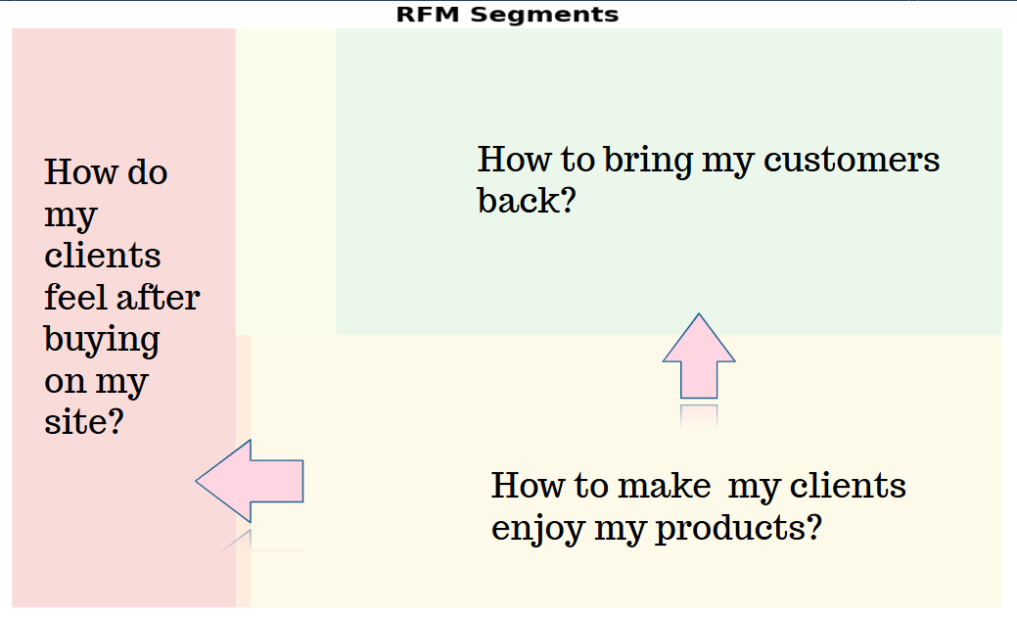
CONCLUSION
In conclusion, our RFM-based product recommendation system represents a powerful and innovative approach to personalized marketing. By leveraging customer purchasing behavior and advanced clustering techniques, we've created a solution that not only enhances the shopping experience but also drives business growth.
Key achievements of our system include:
Precise customer segmentation into 5 distinct clusters, enabling targeted marketing strategies
Personalized product recommendations that significantly increase the likelihood of purchase
A scalable and efficient design that can handle large datasets and integrate seamlessly with existing web platforms
Clear, actionable insights for marketing teams to tailor their efforts and re-engage customers effectively
While there's room for future optimizations, particularly in non-buyer identification and large-scale performance, the current system already provides a robust foundation for data-driven decision-making and customer-centric marketing.
By implementing this RFM-based approach, businesses can expect to see improved customer satisfaction, increased sales, and more efficient marketing spend. This project demonstrates the power of data analytics in transforming customer relationships and driving tangible business outcomes in the competitive e-commerce landscape.

Slide 22
Ressources
RFM Segmentation | PPT
https://towardsdatascience.com/recency-frequency-monetary-model-with-python-and-how-sephora-uses-it-to-optimize-their-google-d6a0707c5f17
https://guillaume-martin.github.io/rfm-segmentation-with-python.html
https://medium.com/@ilaydakursun/customer-segmentation-with-rfm-analysis-learn-more-about-your-customers-f12b348acbd
https://towardsdatascience.com/find-your-best-customers-with-customer-segmentation-in-python-61d602f9eee6
https://towardsdatascience.com/a-gentle-introduction-on-market-basket-analysis-association-rules-fa4b986a40ce
Flowchart of product recommendation | Download Scientific Diagram
https://www.slideshare.net/slideshow/rfm-segmentation/46901188

