Slide 1

Ethers & Epoxides
By
Prof.(DR.) RUPESH KUMAR
Department of Chemistry , Kirori Mal College
University of Delhi, Delhi -110007

Slide 2
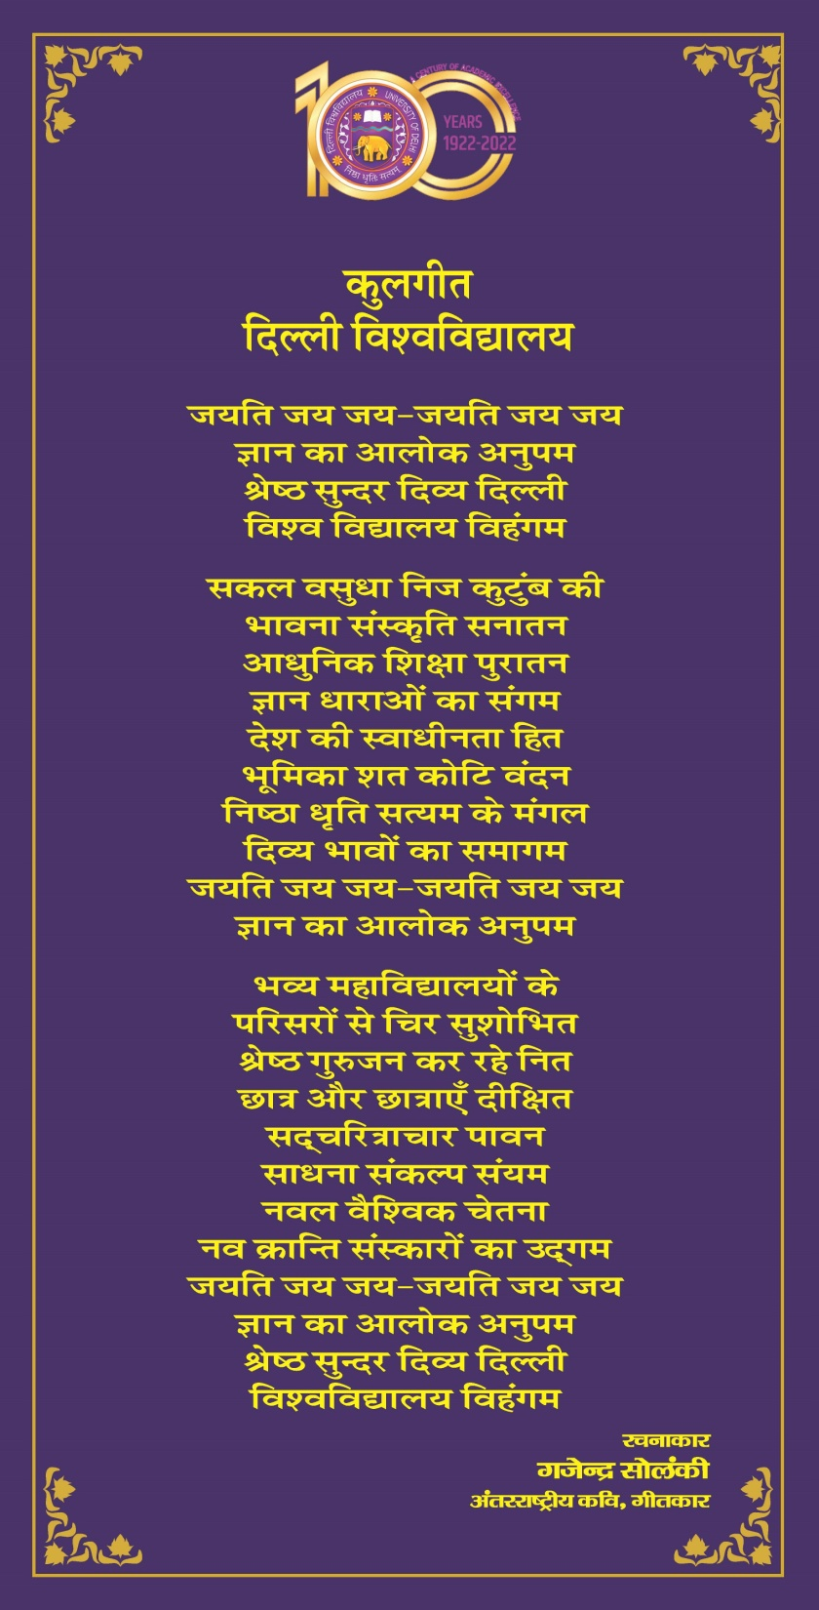

Slide 3
जननी जन्मभूमि, स्वर्ग से महान है। इसके वास्ते ये तन है, मन है और प्राण हैं।। इसके कण-कण में लिखा राम-कृष्ण नाम है। हुतात्माओं के रूधिर से भूमि शस्य-श्याम है। धर्म का ये धाम है, सदा इसे प्रणाम है। स्वतंत्र है धरा यहां, स्वतंत्र आसमान है। जननी जन्मभूमि, स्वर्ग से महान है।।1।। इसकी आन पर कभी जो बात कोई आ पड़े। इसके सामने जो जुल्म के पहाड़ हों खड़े।। शत्रु सब जहान हों, विरूद्ध विधि-विधान हो, मुकाबला करेंगे जब तक जान में ये जान है। जननी जन्मभूमि, स्वर्ग से महान है।।2।। इसकी गोद में हजारों गंगा-यमुना झूमती। इसके पर्वतों की चोटियां गगन को चूमती।। भूमि ये महान है, निराली इसकी शान है। इसकी जय-पताका ही स्वयं विजय-निशान है। जननी जन्मभूमि, स्वर्ग से महान है।।3।।

Slide 4
स्वयं अब जागकर हमको,जगाना देश है अपना जगाना देश है अपना, जगाना देश है अपना ॥ध्रु.॥ हमारे देश की मिट्टी हमें प्राणों से प्यारी है यहीं के अन्न जल वायु परम श्रद्धा हमारी है स्वभाषा है हमें प्यारी ओ प्यारा देश है अपना ॥1॥ जगाना देश है अपना जगाना देश है अपना समय है अब नहीं कोई गहन निद्रा में सोने का समय है एक होने का न मतभेदों में खोने का बढ़े बल राष्ट्र का जिससे वो करना मेल है अपना ॥2॥ जगाना देश है अपना जगाना देश है अपना जतन हो संगठित विद्यार्थी वो सक्रिय भाव भरने का जगाने राष्ट्र की भक्ति उत्तम कार्य करने का समुन्नत राष्ट्र हो भारत यही उद्देश्य है अपना ॥3॥ जगाना देश है अपना जगाना देश है अपना

Slide 5
Unit - IV: Alcohols, Phenols, Ethers & Epoxides (10 Hours)
Alcohols: Relative reactivity of 1°, 2°, 3° alcohols, reactions of alcohols with sodium,HX (Lucas test), esterification, oxidation (with PCC, alkaline KMnO4, acidic dichromate,conc. HNO3). Oppenauer oxidation; Diols: oxidation of diols by periodic acid and lead
tetraacetate, Pinacol-Pinacolone rearrangement.
Phenols: Preparation using Cumene hydroperoxide, Acidity and factors affecting it,
Kolbe’s–Schmidt reactions, Riemer-Tiemann reaction, Houben–Hoesch condensation,
Schotten–Baumann reaction, Fries and Claisen rearrangements and their mechanism.
Ethers and Epoxides: Acid and Base catalyzed cleavage reactions.

Slide 6
Ethers and Epoxides: Acid and Base catalyzed cleavage reactions.

Slide 8
Ethers are generally fairly unreactive (except for strained cyclic derivatives) and are therefore frequently used as solvents in organic reactions.
Some of these ether solvents are cyclic; they may even contain several ether functions.
All have common names.
Cyclic ethers are members of a class of cycloalkanes in which one or more carbons have been replaced by a heteroatom — in this case, oxygen.

Slide 10
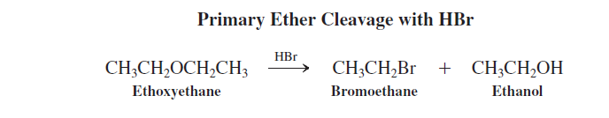
A more useful reaction is cleavage by strong acid.
The oxygen in ethers, like that in alcohols, may be protonated to generate alkyloxonium ions.
The subsequent reactivity of these ions depends on the alkyl substituents.
With primary groups and strong nucleophilic acids such as HBr, SN₂ displacement takes place.
The alcohol formed as the second product may in turn be attacked by additional HBr
to give more of the bromoalkane.

Slide 11
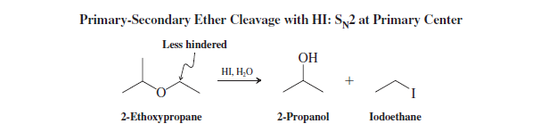
Oxonium ions derived from secondary ethers can transform by either SN2 or SN1 (E1) reactions, depending on the system and conditions .
For example, 2-ethoxypropane is protonated by aqueous HI and then converted into 2-propanol and iodoethane by selective attack by iodide at the less hindered primary center.

Slide 12
Tertiary butyl ethers function to protect alcohols
Ethers containing tertiary alkyl groups transform even in dilute acid to give intermediate tertiary carbocations, which are either trapped by SN_{l} processes, when good nucleophiles are present, or deprotonated in their absence:Because tertiary ethers are made under similarly mild conditions from alcohols/
they act as protecting groups for the hydroxy function. A protecting group renders a specific functionality in a molecule unreactive with respect to reagents and conditions that would normally transform it.
Such protection allows chemistry to be carried out elsewhere in a molecule without interference.

Slide 13
Oxacyclopropane is subject to bimolecular ring opening by anionic nucleophiles. Because of the symmetry of the substrate, substitution occurs to the same extent at either carbon. The reaction proceeds by nucleophilic attack, with the ether oxygen functioning as an intramolecular leaving group.
This SN2 transformation is unusual for two reasons. First, alkoxides are usually very poor leaving groups. Second, the leaving group does not actually “leave”; it stays bound to the molecule. The driving force is the release of strain as the ring opens.

Slide 14
Consider, for example, the reaction of 2,2-dimethyloxacyclopropane with methoxide. There are two possible reaction sites: at the primary carbon (a), to give 1-methoxy-2-methyl-2-propanol, and at the tertiary carbon (b), to yield 2-methoxy-2-methyl-1-propanol. Evidently, this system transforms solely through path a.
because, as we know, if there is more than one possibility, SN2 attack will be at the less substituted carbon center . This selectivity in the nucleophilic opening of substituted oxacyclopropanes is referred to as regioselectivity, because, of two possible and similar “regions,” the nucleophile attacks only one.

Slide 15
The highly reactive lithium aluminum hydride is able to open the rings of oxacyclopropanes, a reaction leading to alcohols.
Ordinary ethers, lacking the ring strain of oxacyclopropanes,
do not react with LiAlH₄. The reaction also proceeds by the SN₂ mechanism.
Thus, in unsymmetric systems, the hydride attacks the less substituted side; when the reacting carbon
constitutes a stereocenter, inversion is observed.

Slide 16
In contrast with haloalkanes (Section 8-8), oxacyclopropanes are sufficiently reactive electrophiles to be attacked by organometallic compounds.
Thus, Grignard reagents and alkyllithium compounds undergo 2-hydroxyethylation by ether ring opening, following the SN2 mechanism.
This reaction constitutes a two-carbon homologation of an alkyl chain, as opposed to the one-carbon homologation of alkyl organometallic reagents by formaldehyde.

Slide 17
Acids catalyze oxacyclopropane ring opening
Ring opening of oxacyclopropanes is also catalyzed by acids. The reaction in this case proceeds through initial cyclic alkyloxonium ion formation followed by ring opening as a
result of nucleophilic attack.
Thus, acid-catalyzed methanolysis of 2,2- dimethyloxacyclopropane proceeds by exclusive ring opening at the more hindered carbon.

Slide 18
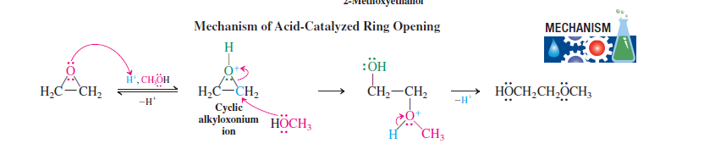

Slide 19
Why is the more hindered position attacked?
Protonation at the oxygen of the ether generates a reactive intermediate alkyloxonium ion with substantially polarized oxygen – carbon bonds. This polarization places partial positive charges on the ring carbons.
Because alkyl groups act as electron donors (Section 7-5), more positive charge is located on the tertiary than on the primary carbon.
You can see this difference in the electrostatic potential map in the margin, in which the molecule is viewed from the perspective of the attacking nucleophile.
The tertiary carbon at the bottom is more positive (blue) than the primary neighbor above (green). The proton in the back is strongly blue. The color-energy scale of this map was changed to make this subtle gradation in shading visible.

Slide 21
