Slide 1

Aromatic Hydrocarbons
By
Prof.(DR.) RUPESH KUMAR
Department of Chemistry , Kirori Mal College
University of Delhi, Delhi -110007
Prof.(Dr.)RUPESH KUMAR KMC DU

Slide 2


Slide 3

Dr.Rupesh Kumar KMC D.U.

Slide 4
स्वयं अब जागकर हमको,जगाना देश है अपना
जगाना देश है अपना, जगाना देश है अपना ॥ध्रु.॥
हमारे देश की मिट्टी हमें प्राणों से प्यारी है
यहीं के अन्न जल वायु परम श्रद्धा हमारी है
स्वभाषा है हमें प्यारी ओ प्यारा देश है अपना ॥1॥
जगाना देश है अपना जगाना देश है अपना
समय है अब नहीं कोई गहन निद्रा में सोने का
समय है एक होने का न मतभेदों में खोने का
बढ़े बल राष्ट्र का जिससे वो करना मेल है अपना ॥2॥
जगाना देश है अपना जगाना देश है अपना
जतन हो संगठित विद्यार्थी वो सक्रिय भाव भरने का
जगाने राष्ट्र की भक्ति उत्तम कार्य करने का
समुन्नत राष्ट्र हो भारत यही उद्देश्य है अपना ॥3॥
जगाना देश है अपना जगाना देश है अपना
Dr.RUPESH KUMAR KMC DU

Slide 5
जननी जन्मभूमि, स्वर्ग से महान है।
इसके वास्ते ये तन है, मन है और प्राण हैं।।
इसके कण-कण में लिखा राम-कृष्ण नाम है।
हुतात्माओं के रूधिर से भूमि शस्य-श्याम है।
धर्म का ये धाम है, सदा इसे प्रणाम है।
स्वतंत्र है धरा यहां, स्वतंत्र आसमान है।
जननी जन्मभूमि, स्वर्ग से महान है।।1।।
इसकी आन पर कभी जो बात कोई आ पड़े।
इसके सामने जो जुल्म के पहाड़ हों खड़े।।
शत्रु सब जहान हों, विरूद्ध विधि-विधान हो,
मुकाबला करेंगे जब तक जान में ये जान है।
जननी जन्मभूमि, स्वर्ग से महान है।।2।।
इसकी गोद में हजारों गंगा-यमुना झूमती।
इसके पर्वतों की चोटियां गगन को चूमती।।
भूमि ये महान है, निराली इसकी शान है।
इसकी जय-पताका ही स्वयं विजय-निशान है।
जननी जन्मभूमि, स्वर्ग से महान है।।3।।
Dr.RUPESH KUMAR KMC DU

Slide 6
Huckel’s Rule

Slide 7
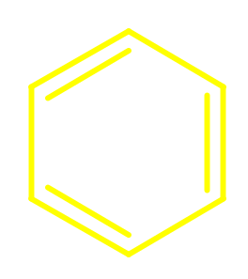

Requirements for Aromaticity
cyclic conjugation is necessary, but not sufficient
not
aromatic
not
aromatic
aromatic

Slide 8
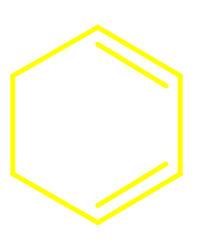

Heats of Hydrogenation
to give cyclohexane (kJ/mol)
120
231
208
heat of hydrogenation of benzene is 152 kJ/mol
less than 3 times heat of hydrogenation of
cyclohexene

Slide 9




Heats of Hydrogenation
to give cyclooctane (kJ/mol)
97
205
303
410
heat of hydrogenation of cyclooctatetraene is
more than 4 times heat of hydrogenation of
cyclooctene

Slide 10
Structure of Cyclobutadiene
structure of a stabilized derivative is characterized
by alternating short bonds and long bonds
(CH₃)₃C
C(CH₃)₃
138 pm
151 pm
(CH₃)₃C
CO₂CH₃

Slide 11
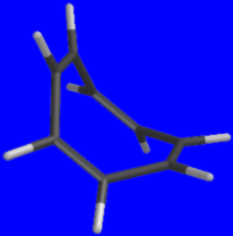
Structure of Cyclooctatetraene
cyclooctatetraene is not planar
has alternating long (146 pm)
and short (133 pm) bonds

Slide 12
Conclusion
there must be some factor in addition
to cyclic conjugation that determines
whether a molecule is aromatic or not

Slide 13
Hückel's Rule
among planar, monocyclic, completely
conjugated polyenes, only those with 4n + 2
π electrons possess special stability (are
aromatic)
n 4n+2
0 2
1 6
2 10
3 14
4 18

Slide 14
Hückel's Rule
among planar, monocyclic, completely
conjugated polyenes, only those with 4n + 2
π electrons possess special stability (are
aromatic)
n 4n+2
0 2
1 6 benzene!
2 10
3 14
4 18

Slide 15
Hückel's Rule
Hückel restricted his analysis to planar,
completely conjugated, monocyclic polyenes
he found that the π molecular orbitals of
these compounds had a distinctive pattern
one π orbital was lowest in energy, another
was highest in energy, and the others
were arranged in pairs between the highest
and the lowest

Slide 16
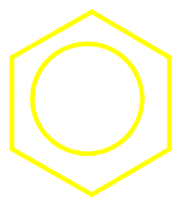
π-MOs of Benzene
Antibonding
Benzene
Bonding
6 p orbitals give 6 π orbitals
3 orbitals are bonding; 3 are antibonding

Slide 17
π-MOs of Benzene
Antibonding
Benzene
Bonding
6 π electrons fill all of the bonding orbitals
all π antibonding orbitals are empty

Slide 18

π-MOs of Cyclobutadiene
(square planar)
Antibonding
Cyclo-
butadiene
Bonding
4 p orbitals give 4π orbitals
1 orbital is bonding, one is antibonding, and 2
are nonbonding

Slide 19
π-MOs of Cyclobutadiene
(square planar)
Antibonding
Cyclo-
butadiene
Bonding
4 π electrons; bonding orbital is filled; other 2
π electrons singly occupy two nonbonding orbitals

Slide 20
π-MOs of Cyclooctatetraene
(square planar)
Antibonding
Cyclo-
octatetraene
Bonding
8 p orbitals give 8 π orbitals
3 orbitals are bonding, 3 are antibonding, and 2
are nonbonding

Slide 21
π-MOs of Cyclooctatetraene
(square planar)
Antibonding
Cyclo-
octatetraene
Bonding
8 π electrons; 3 bonding orbitals are filled; 2
nonbonding orbitals are each half-filled

Slide 22
π-Electron Requirement for Aromaticity
4 π electrons
6 π electrons
8 π electrons
not
aromatic
not
aromatic
aromatic

Slide 23
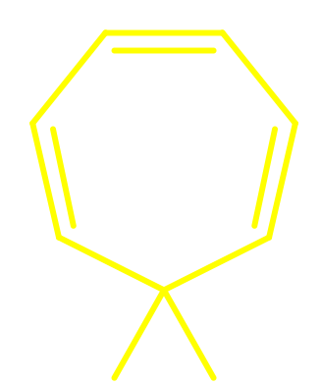
Completely Conjugated Polyenes
6 π electrons;
not completely
conjugated
6 π electrons;
completely conjugated
H
H
not
aromatic
aromatic

Slide 24
Annulenes
Annulenes are planar, monocyclic, completely
conjugated polyenes. That is, they are the
kind of hydrocarbons treated by Hückel's
rule.

Slide 25
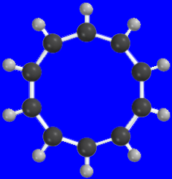
[10]Annulene
predicted to be aromatic by Hückel's rule,
but too much angle strain when planar and
all double bonds are cis
10-sided regular polygon has angles of 144°

Slide 26
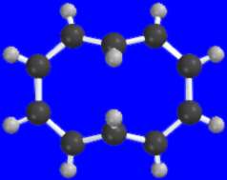
[10]Annulene
incorporating two trans double bonds into
the ring relieves angle strain but introduces
van der Waals strain into the structure and
causes the ring to be distorted from planarity

Slide 27
[10]Annulene
van der Waals
strain between
these two hydrogens
incorporating two trans double bonds into
the ring relieves angle strain but introduces
van der Waals strain into the structure and
causes the ring to be distorted from planarity

Slide 28
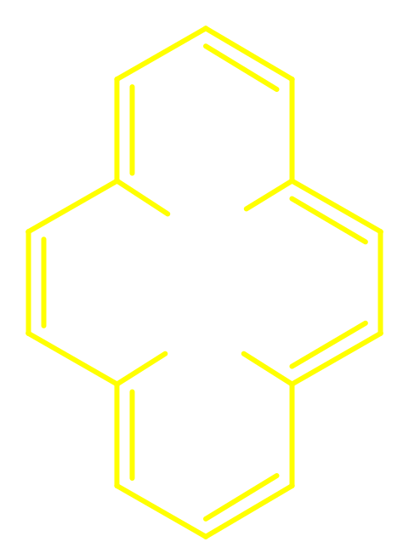
[14]Annulene
H
H
H
H
14 π electrons satisfies Hückel's rule
van der Waals strain between hydrogens inside
the ring

Slide 29
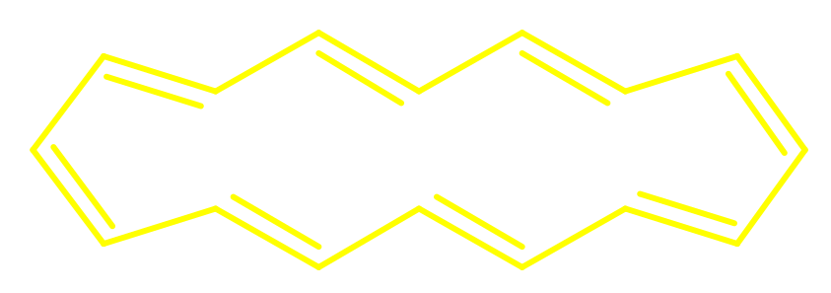
[16]Annulene
16 π electrons does not satisfy Hückel's rule
alternating short (134 pm) and long (146 pm) bonds
not aromatic

Slide 30
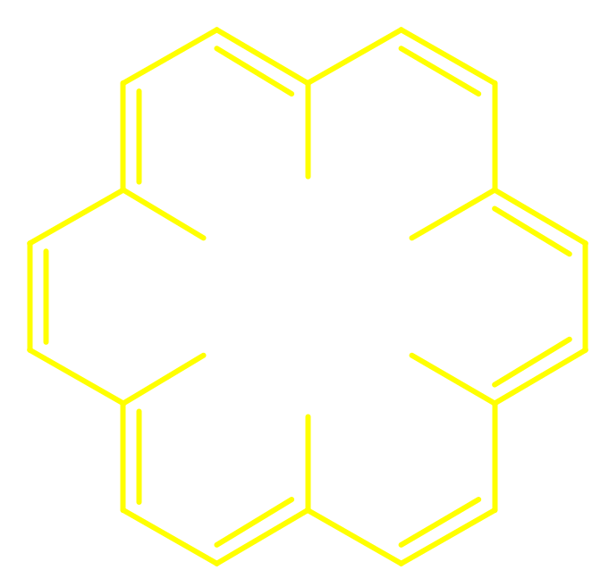
[18]Annulene
H
H
H
H
H
H
18 π electrons satisfies Hückel's rule
resonance energy = 418 kJ/mol
bond distances range between 137-143 pm

Slide 31
Aromatic Ions

Slide 32
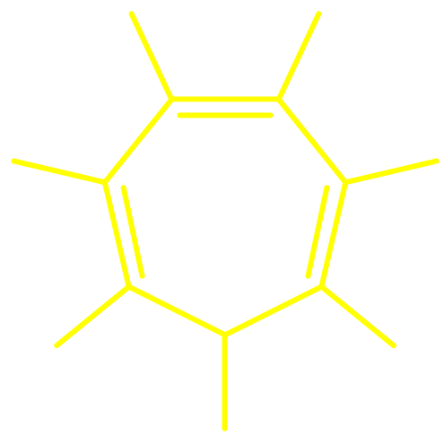
Cycloheptatrienyl Cation
H
H
6 π electrons delocalized
over 7 carbons
positive charge dispersed
over 7 carbons
very stable carbocation
also called tropylium cation
H
H
+
H
H
H

Slide 33
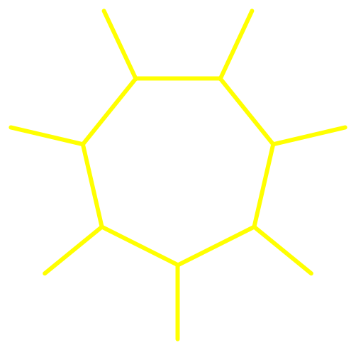
Cycloheptatrienyl Cation
H
H
H
H
H
H
H
H
+
+
H
H
H
H
H
H

Slide 34

Cycloheptatrienyl Cation
+
Br–
H
Br
Ionic
Covalent
Tropylium cation is so stable that tropylium
bromide is ionic rather than covalent.
mp 203 °C; soluble in water; insoluble in
diethyl ether

Slide 35
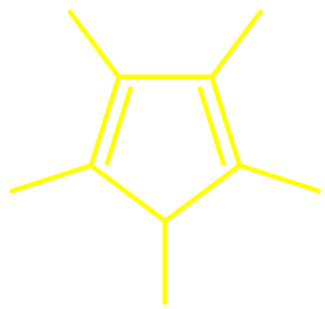
Cyclopentadienide Anion
H
H
6 π electrons delocalized
over 5 carbons
negative charge dispersed
over 5 carbons
stabilized anion
H
••
H
–
H

Slide 36
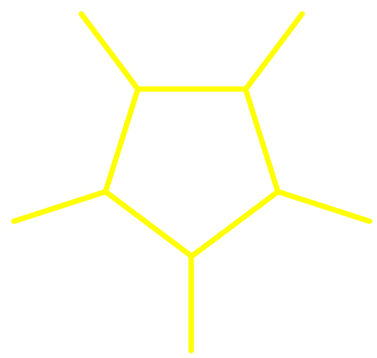
Cyclopentadienide Anion
H
H
H
H
–
H
••
H
H
H
–
H
H

Slide 37
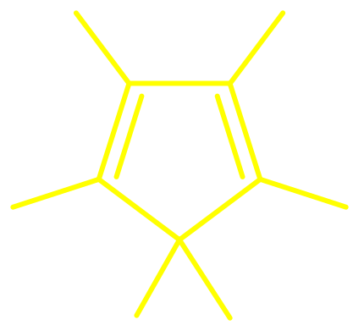
Acidity of Cyclopentadiene
H
H
H
H
H⁺
+
H
H
H
••
H
–
H
H
H
pK_{a} = 16
K_{a} = 10⁻¹⁶
Cyclopentadiene is unusually acidic for a hydrocarbon.
Increased acidity is due to stability of cyclopentadienide anion.

Slide 38
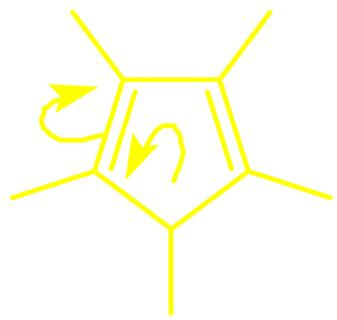
Electron Delocalization in Cyclopentadienide Anion
H
H
H
••
H
–
H

Slide 39
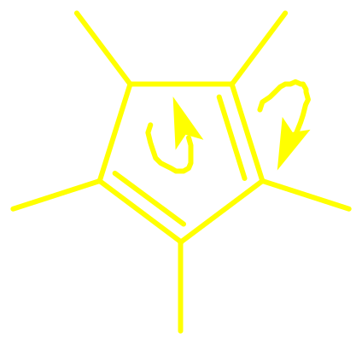
Electron Delocalization in Cyclopentadienide Anion
H
H
H
H
–
••
H
••
H
H
H
–
H
H

Slide 40
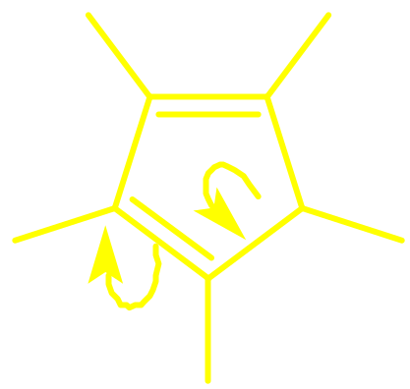
Electron Delocalization in Cyclopentadienide Anion
H
H
H
H
–
••
H
••
H
H
H
–
H
H
H
H
•
–
•
H
H
H

Slide 41
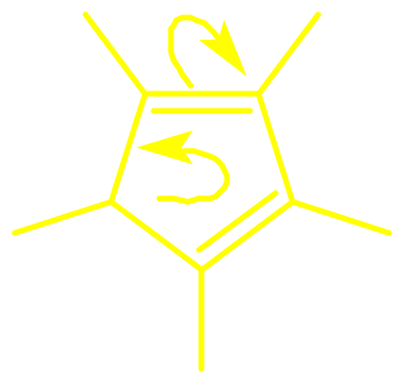
Electron Delocalization in Cyclopentadienide Anion
H
H
H
H
–
••
H
••
H
H
H
–
H
H
H
H
H
H
–
•
•
–
•
•
H
H
H
H
H
H

Slide 42
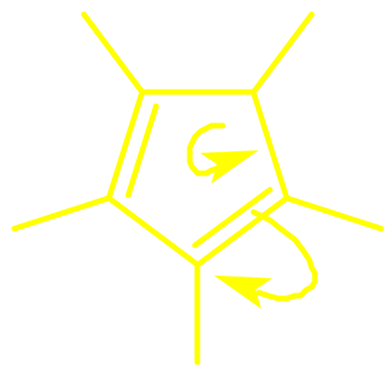
Electron Delocalization in Cyclopentadienide Anion
H
H
H
H
–
••
H
••
H
H
H
–
H
H
H
H
H
H
H
H
••
–
•
•
–
•
•
H
H
H
H
H
H
H
H
H

Slide 43
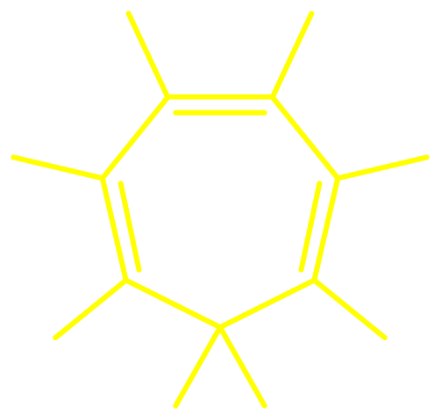
Compare Acidities of
Cyclopentadiene and Cycloheptatriene
H
H
H
H
H
H
H
H
H
H
H
H
H
H
H
pK_{a} = 16
K_{a} = 10⁻¹⁶
pK_{a} = 36
K_{a} = 10⁻³⁶

Slide 44
Compare Acidities of
Cyclopentadiene and Cycloheptatriene
H
H
H
H
H
H
H
••
H
–
••
H
–
H
H
H
Aromatic anion
6 π electrons
Anion not aromatic
8 π electrons

Slide 45


Cyclopropenyl Cation
H
H
H
H
+
+
also written as
H
H
n = 0
4n +2 = 2 π electrons

Slide 46
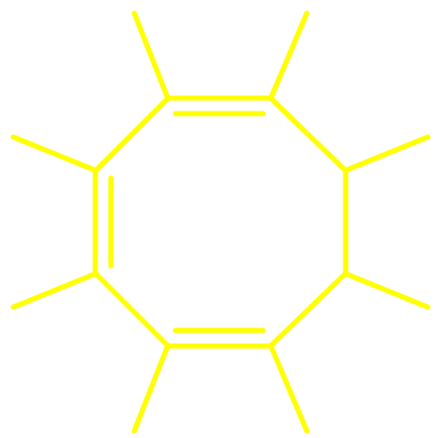
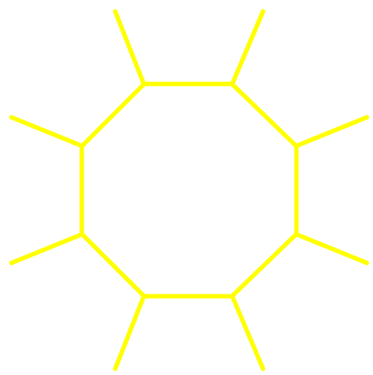
Cyclooctatetraene Dianion
H
H
H
H
H
–
H
H
H
••
also
written as
2–
H
••
H
H
H
–
H
H
H
H
n = 2
4n +2 = 10 π electrons

Slide 47
Heterocyclic Aromatic Compounds

Slide 48
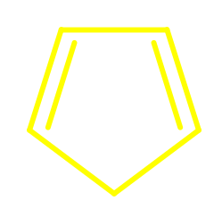
Examples
••
••
••
N
N
O
S
••
••
••
H
Pyridine
Pyrrole
Furan
Thiophene

Slide 49
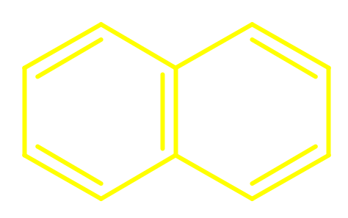
Examples
N
•
N
•
••
Quinoline
Isoquinoline

Slide 50
Pyridine
6 π electrons in ring
lone pair on nitrogen is in an
sp² hybridized orbital;
not part of π system of ring
N
••

Slide 51
Pyrrole
lone pair on nitrogen must be part
of ring π system if ring is to have
6 π electrons
lone pair must be in a p orbital
in order to overlap with ring π
system
••
N
H

Slide 52
Furan
two lone pairs on oxygen
one pair is in a p orbital and is part
of ring π system; other is in an
sp² hybridized orbital and is not
part of ring π system
••
O
••

Slide 53
Pyridine
6 π electrons in ring
lone pair on nitrogen is in an
sp² hybridized orbital;
not part of π system of ring
N
••

Slide 54
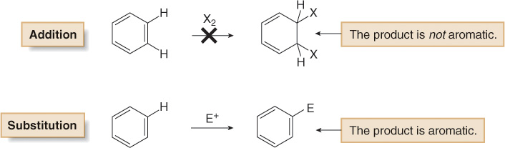
Benzene does not undergo addition reactions like other unsaturated hydrocarbons, because addition would yield a product that is not aromatic.
Substitution of a hydrogen keeps the aromatic ring intact.
There are five main examples of electrophilic aromatic substitution.

Slide 55
Pyrrole
lone pair on nitrogen must be part
of ring π system if ring is to have
6 π electrons
lone pair must be in a p orbital
in order to overlap with ring π
system
••
N
H

Slide 56
Furan
two lone pairs on oxygen
one pair is in a p orbital and is part
of ring π system; other is in an
sp² hybridized orbital and is not
part of ring π system
••
O
••

Slide 57
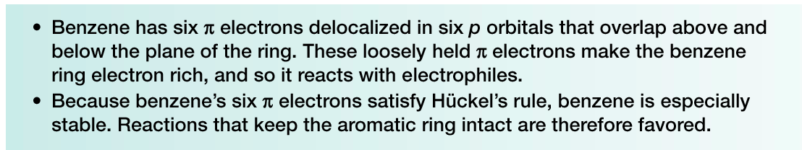
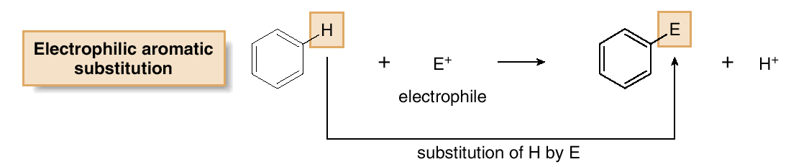
Electrophilic Aromatic Substitution
Background
The characteristic reaction of benzene is electrophilic aromatic substitution—a hydrogen atom is replaced by an electrophile.

Slide 58
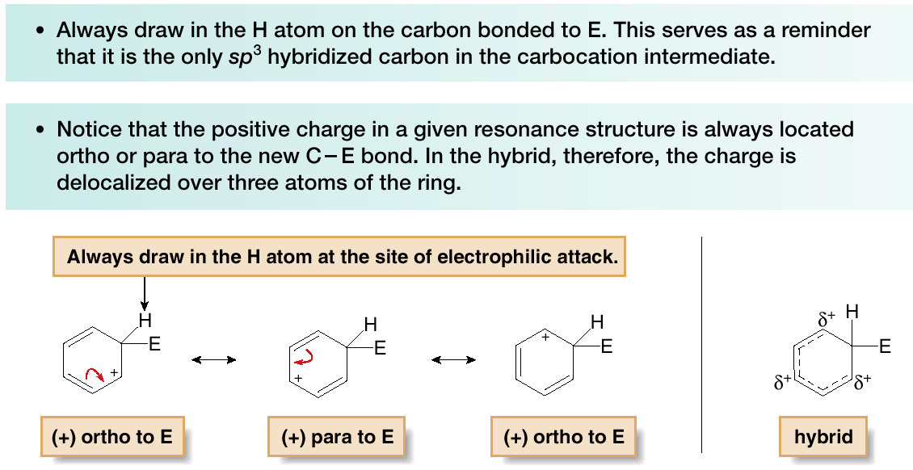
The first step in electrophilic aromatic substitution forms a carbocation, for which three resonance structures can be drawn. To help keep track of the location of the positive charge:

Slide 59
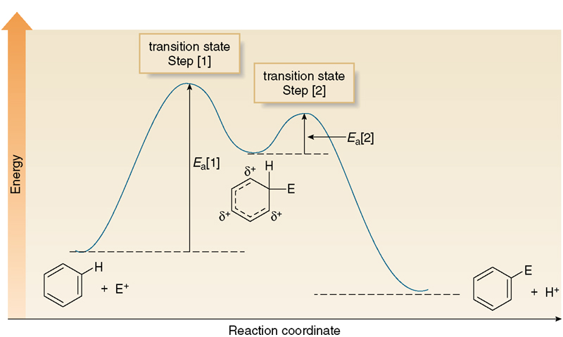
The energy changes in electrophilic aromatic substitution are shown below:

Slide 60
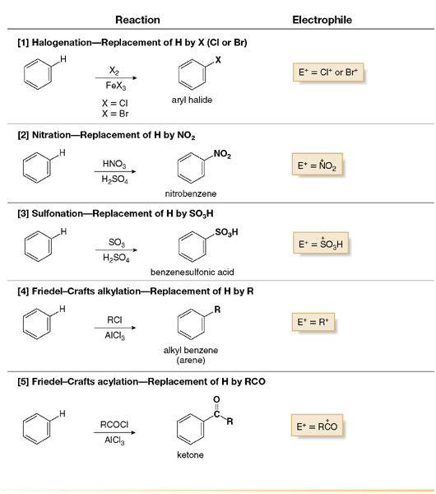

Slide 61
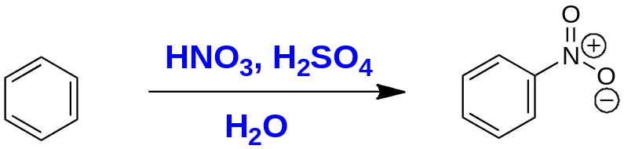
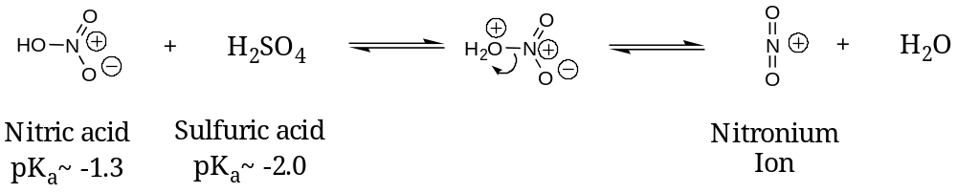
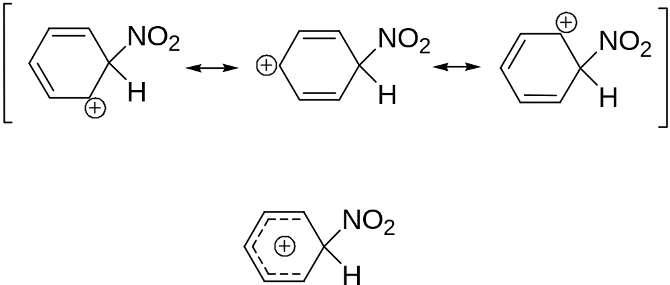
Nitration of Benzene

Slide 62
nitration
+
HO-NO₂ + H₂SO₄  H₂O-NO₂ + HSO₄⁻
+ +
H₂O-NO₂  H₂O + NO₂
H₂SO₄ + H₂O  HSO₄⁻ + H₃O⁺
HNO₃ + 2 H₂SO₄  H₃O⁺ + 2 HSO₄⁻ + NO₂⁺

Slide 63
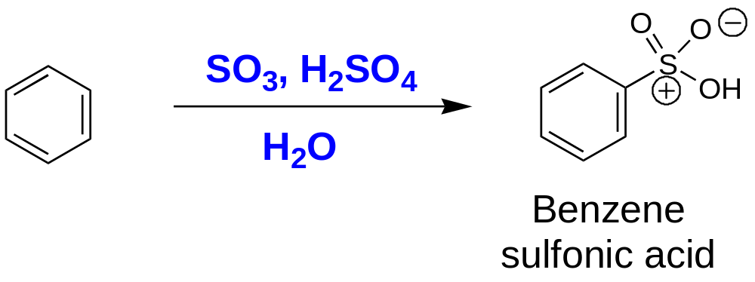

Slide 64
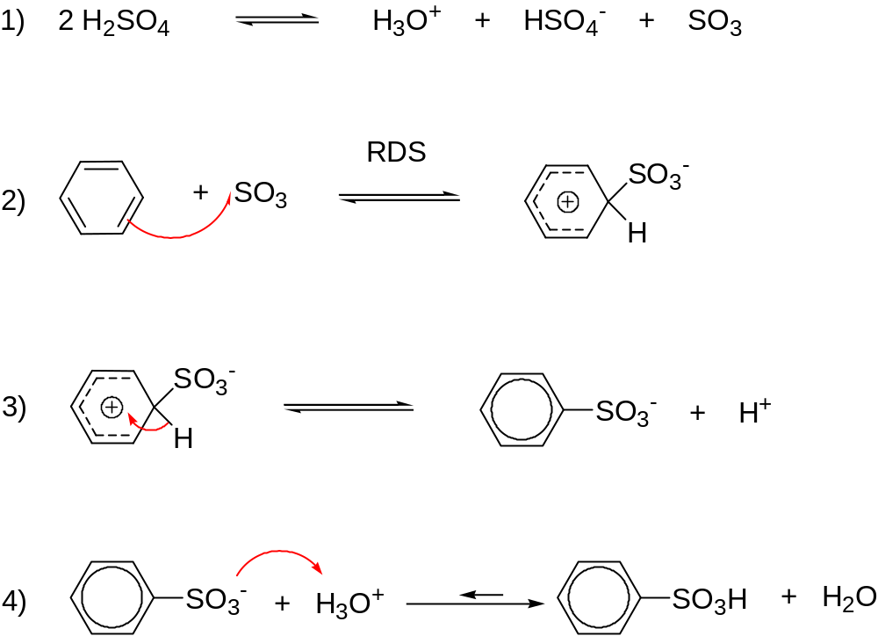
Mechanism for sulfonation:

Slide 65
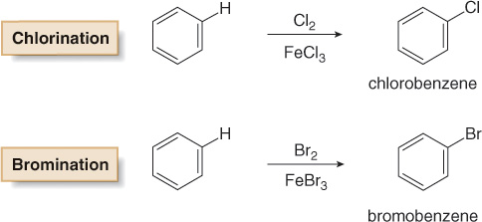
Halogenation
In halogenation, benzene reacts with Cl₂ or Br₂ in the presence of a Lewis acid catalyst, such as FeCl₃ or FeBr₃, to give the aryl halides chlorobenzene or bromobenzene respectively.
Analogous reactions with I₂ and F₂ are not synthetically useful because I₂ is too unreactive and F₂ reacts too violently.

Slide 66
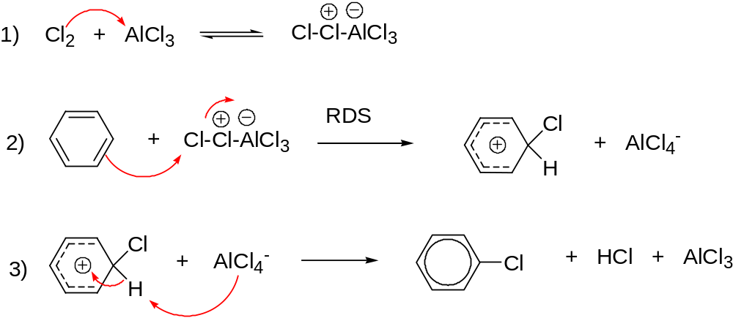
Mechanism for halogenation:

Slide 67
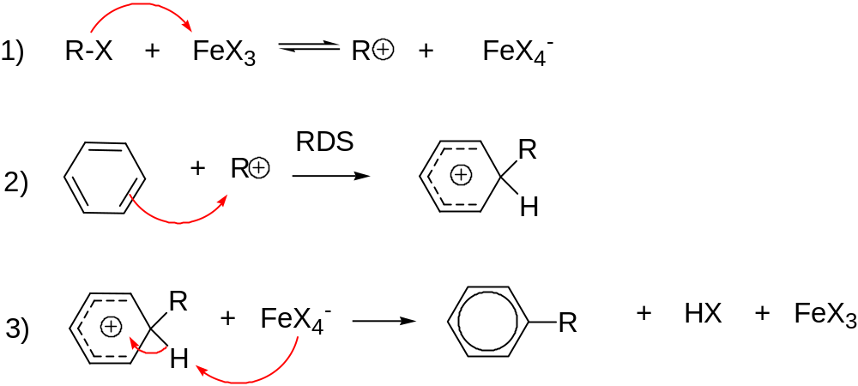
Mechanism for Friedel-Crafts alkylation:

Slide 68
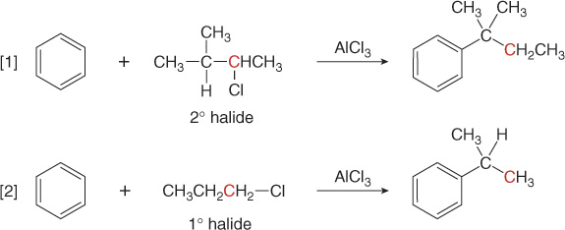
Rearrangements can occur.
These results can be explained by carbocation rearrangements.

Slide 69
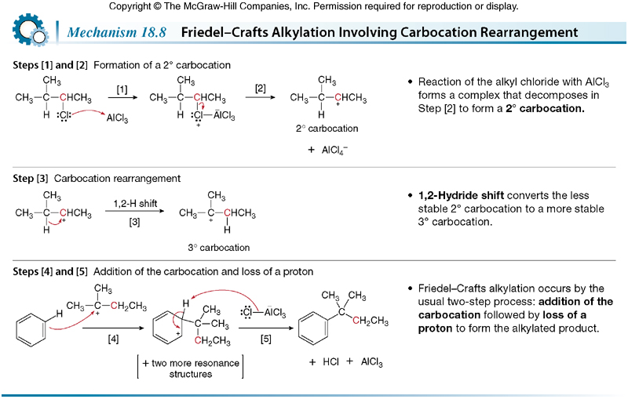

Slide 70
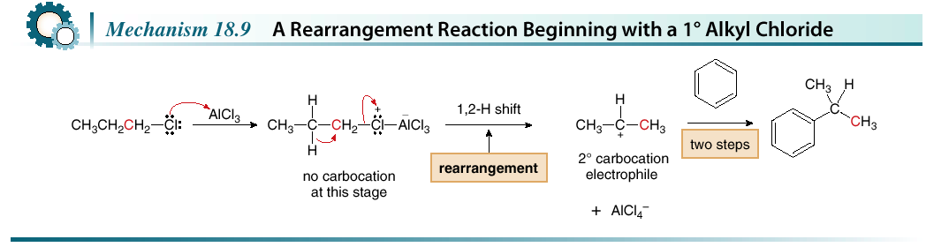
Rearrangements can occur even when no free carbocation is formed initially.

Slide 71
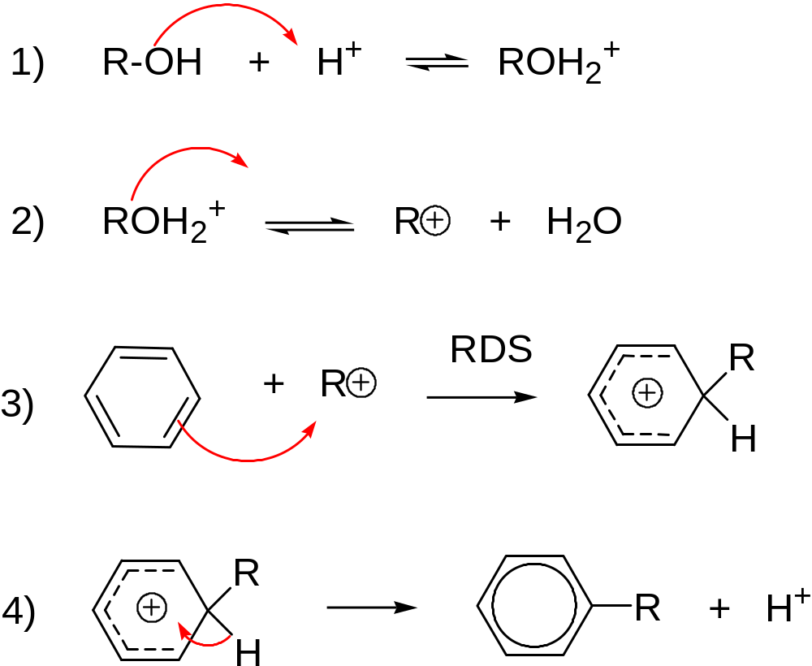
Mechanism for Friedel-Crafts with an alcohol & acid

Slide 72
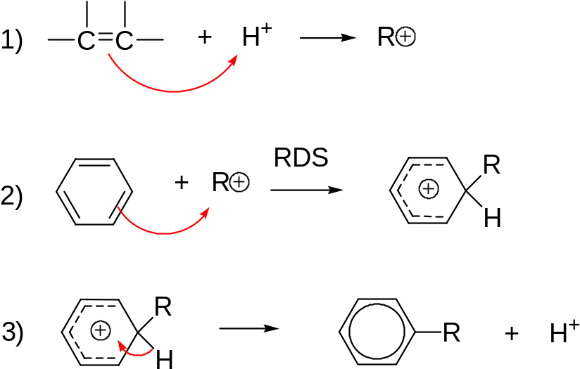
Mechanism for Friedel-Crafts with alkene & acid:
electrophile in Friedel-Crafts alkylation = carbocation

Slide 73
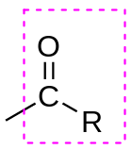
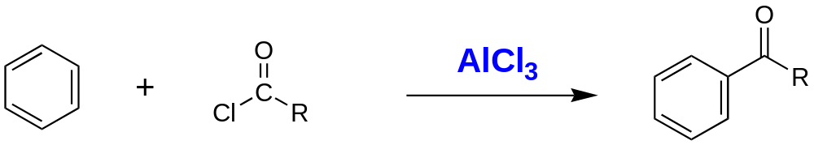
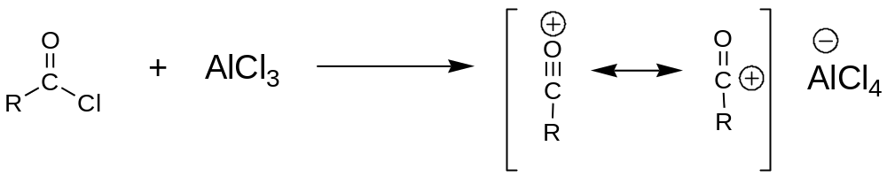
Friedel-Crafts Acylation of Benzene
acyl group
The acylated product is less reactive than benzene toward
electrophilic aromatic substitution. F-C acylation can be
stopped after one acyl group is added

Slide 74
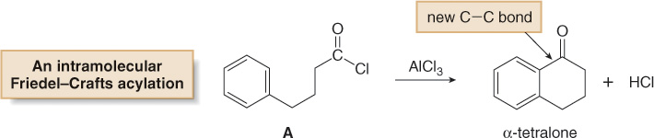
Starting materials that contain both a benzene ring and an electrophile are capable of intramolecular Friedel-Crafts reactions.

Slide 75
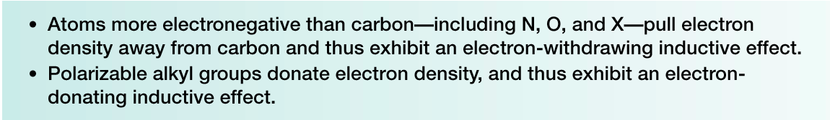
Substituted Benzenes
Many substituted benzene rings undergo electrophilic aromatic substitution.
Each substituent either increases or decreases the electron density in the benzene ring, and this affects the course of electrophilic aromatic substitution.

Slide 76
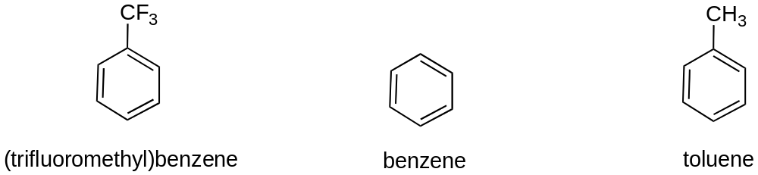
Rate and Regioselectivity in Electrophilic Aromatic
Substitution - The nature of a substituent already present on
the benzene ring affects the rate and regioselectivity (relative
position) of electrophilic aromatic substitution.
A substituent (-X) is said to be activating if the rate of electrophilic
aromatic substitution of the substituted benzene (C₆H₅X) is
faster than benzene.
A substituent (-X) is said to be deactivating if the rate of
electrophilic aromatic substitution of the substituted benzene
(C₆H₅X) is slower than benzene.
Relative rate of nitration:
2.5 x 10⁻⁵ 1 20-25
deactivating activating

Slide 77

A substituent (-X) is said to be an ortho-para director if it directs
an incoming electrophile to positions ortho and/or para to itself.
A substituent (-X) is said to be an meta director if it directs
an incoming electrophile to position meta to itself.

Slide 78


Substituents are characterized as either electron-donating or
electron-withdrawing and alter the electron density of the
aromatic ring through:
1. Inductive effects: ability of a substituent to donate or withdraw
electron density through σ-bonds due to electronegativity
differences and bond polarities of a functional group
2. Resonance effects: ability of a substituent to donate or
withdraw electrons through non-bonding pairs of electrons or
overlap π-bonds (conjugation).

Slide 79

The rate (activating or deactivating) and regiochemistry
(ortho-para vs meta directing) can be understood by examining
the influence of the substituent on the stability of the cyclohexa-
dienyl cation intermediate.
Rate and Regioselectivity in the Nitration of Toluene:
Regioselectivity: The carbocation intermediate from o- or
p-addition can be stabilized by the substituent through inductive
effects and hyperconjugation.

Slide 80

A CH₃ group directs electrophilic attack ortho and para to itself because an electron-donating inductive effect stabilizes the carbocation intermediate.

Slide 81

Activating groups increase the rate of electrophilic aromatic
substitution at all positions of the ring.
Partial rate factors - relative rate of electrophilic aromatic
substitution compared to benzene
Electron rich aromatic rings are more nucleophlic.
All activating group donate electrons through inductive effects
and/or resonance. Electron-donating groups stabilize the
carbocation intermediate of electrophilic aromatic substitution.

Slide 82

Rate and Regioselectivity in the Nitration of
(Trifluoromethyl)benzene - Regioselectivity: The carbocation
intermediate from o- or p-addition is destabilized by the
electron-withdrawing substituent. This directs addition to the
m-position.

Slide 83

Consider nitrobenzene—It reacts more slowly than benzene in all substitution reactions.
The electron-withdrawing NO₂ group deactivates the benzene ring to electrophilic attack.
The meta product predominates.
The NO₂ group is called a meta director.

Slide 84

With the NO₂ group (and all meta directors) meta attack occurs because attack at the ortho and para position gives a destabilized carbocation intermediate.

Slide 85

Dactivating groups decrease the rate of electrophilic aromatic
substitution at all positions of the ring.
Partial rate factors - relative rate of electrophilic aromatic
substitution compared to benzene
Electron deficient aromatic rings are less nucleophlic.
All deactivating group withdraw electrons through inductive
effects and/or resonance. Electron-withdrawing groups
destabilize the carbocation intermediate of electrophilic aromatic
substitution.

Slide 86


The inductive and resonance effects in compounds having the general structure C₆H₅-Y=Z (with Z more electronegative than Y) are both electron withdrawing.

Slide 87

Substituent Effects in Electrophilic Aromatic
Substitution: Activating Substituents
All activating substituents increase the rate of electrophilic
aromatic substitution and are ortho-para directors.
Nitration of phenol: the -OH is a very strong activating group

Slide 88

Considering inductive effects only, the NH₂ group withdraws electron density and CH₃ donates electron density.

Slide 89


Resonance effects are only observed with substituents containing lone pairs or π bonds.
An electron-donating resonance effect is observed whenever an atom Z having a lone pair of electrons is directly bonded to a benzene ring.

Slide 90

An NH₂ group directs electrophilic attack ortho and para to itself because the carbocation intermediate has additional resonance stabilization.

Slide 91

The energy diagrams below illustrate the effect of electron-withdrawing and electron-donating groups on the transition state energy of the rate-determining step.
Figure 18.6 Energy diagrams comparing the rate of electrophilic substitution of substituted benzenes

Slide 92


Substituents that have an O or N atom directly attached to the
aromatic ring are strong activators. Phenol, anisole, and anilines
are very strong activators and do not require strong Lewis Acid
catalysts to undergo electrophilic aromatic substutution.
-alkyl, -vinyl, -aryl -OH, -OCH₃, -NH₂
activators strong activators very strong activators
Substituent Effects in Electrophilic Aromatic
Substitution: Strongly Deactivating Substituents
Strong deactivators are meta directors
strong deactivators very strong deactivators

Slide 93

Substituent Effects in Electrophilic Aromatic
Substitution: Halogens - Halogens are deactivating because
they are strong electron withdrawing groups (inductive effect);
however, they have non-bonding pairs of electrons and can also
donate electrons (resonance effect), and are ortho-para directors.

Slide 94

An electron-withdrawing resonance effect is observed in substituted benzenes having the general structure C₆H₅-Y=Z, where Z is more electronegative than Y.
Seven resonance structures can be drawn for benzaldehyde (C₆H₅CHO). Because three of them place a positive charge on a carbon atom of the benzene ring, the CHO group withdraws electrons from the benzene ring by a resonance effect.

Slide 95

Multiple Substituent Effects - The individual directing
effect of each substituent must be considered in order to
determine the overall directing effect of a disubstituted
benzene toward further electrophilic substitution.

Slide 96


Figure 18.7
The reactivity and directing
effects of common substituted
benezenes

Slide 97


1. When the individual directing effects of the two groups
reinforce, further electrophilic substitution is directed to the
common position.
2. When the individual directing effects of two groups oppose, the
stronger activating group has the dominant influence; however,
mixtures of products are often produced.

Slide 98



Further substitution between two existing substituents
rarely occurs. Start with an ortho-disubstituted benzene to
synthesize 1,2,3-trisubstituted benzenes

