Slide 1
Carnegie Mellon University Africa
Case 3: Kigeme microgrid and Nyabiheke Hall | Spare-capacity briefing
Rasheed Adarijo and Toussaint Dukundimana | CMU 04-782 Energy Data Analytics | Data: from Kigeme and Nyabiheke Refuge Camp July 2019 to March 2020
Notes:
Both presenters. Open in 20 seconds, then go straight to slide 2: the question and the recommendation must land in the first minute.

Slide 2
Can the community solar systems carry more services?
Recommendation
Repair faulty fixtures first.
Add daytime load at Kigeme (10:00–15:00).
At the Hall , run new load only above 85% charge.
Buy no new panels, trackers, or batteries yet.
Repair CPE10, playground CPE4 and sockets, Streetlight 1; audit Nursery 2 wiring (Evidenced)
Add sockets only at Hall S1 and Playground S2 (Evidenced)
Source: Zenodo 4304799. Notebook sections 1 to 3 (audit, interval energy, sensitivity tests).
Notes:
Touissant. Stress that gaps were never filled and blanks never became zeros.

Slide 3
What we analysed, and how we kept it honest
Site | PV | Battery | Readings | Days (complete) | Logging step
Kigeme microgrid | 2.5 kWp | 21.1 kWh | 354,436 | 270 (230) | about 1 min
Nyabiheke Hall | 2.04 kWp | 10.6 kWh | 34,090 | 256 (256) | 15 min
< 0.1%
6 days
0.5%
2 to 5%
change in total energy from the duplicate-timestamp rule
Kigeme logging hole, 12 to 18 Sept; left as a gap, not filled
Kigeme: battery counters vs our integrated energy
Hall: same check, with more day-to-day scatter
Intervals longer than 10 min (Kigeme) or 30 min (Hall) count as gaps: no energy, no coverage.
A blank is never turned into zero; monthly numbers use complete days only (90% coverage or more).
Device meters are compared with system AC, never added to it.
Source: Zenodo 4304799. Notebook sections 1 to 3 (audit, interval energy, sensitivity tests).
Notes:
Touissant. Stress that gaps were never filled and blanks never became zeros.

Slide 4
The measure: does the system have energy to spare, when, and for how long?
Power
Storage
Refill
Can the inverter carry it at the same moment?
Can the battery carry it without dipping below a safe reserve?
Does the sun refill the battery by the next day?
We measure: Headroom below the inverter rating at 40 C (watts)
We measure: Battery charge at dawn above a 50 to 70% floor (kWh)
We measure: Share of days the battery returns to full
Why not the usual performance ratio? Both arrays are big for the load, so the controller throttles solar once the battery is full. A low ratio would show throttling, not faults.
Each new load is replayed hour by hour with and without it, plus a low-sun stress case (solar at 70%). Comparing the two cancels most model error.
Method: notebook sections 6, 9 and D. Unused PV = calibrated potential minus measured PV while the battery is full.
Notes:
Rasheed. This is the 'why this measure' slide. Say it in facility-manager words, not method words.

Slide 5
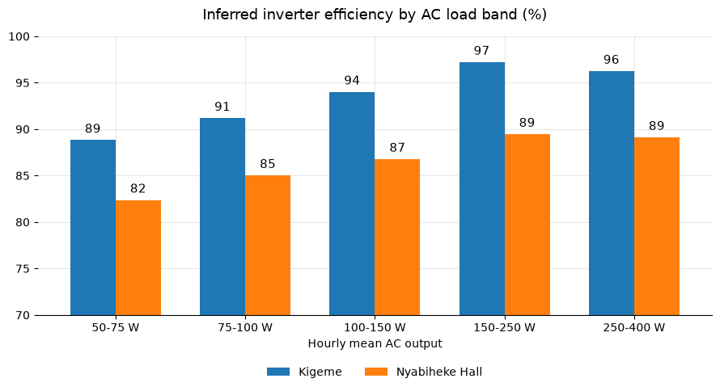
The equipment works; the Hall inverter is the open question
97%
controller efficiency, both sites
95% vs 85%
inverter efficiency, Kigeme vs Hall (inferred)
40% of Hall energy is delivered below 100 W, where inverters are weak (81%).
Above 250 W the Hall is still about 7 points lower (89% vs 96%). A DC-side measurement would settle it.
Hall inverter efficiency is inferred from an AC-only model (no DC sensor). Light load, model mismatch (48 V vs 24 V curve), or DC offset could explain it. A DC-side clamp meter would settle it.
Source: notebook section 3.1. Bands of hourly mean AC output with 20+ hours each. Efficiency inferred (no DC sensor at the inverter).
Notes:
Touissant. 97% controller at both sites. The Hall gap is partly light load, but not fully.

Slide 6
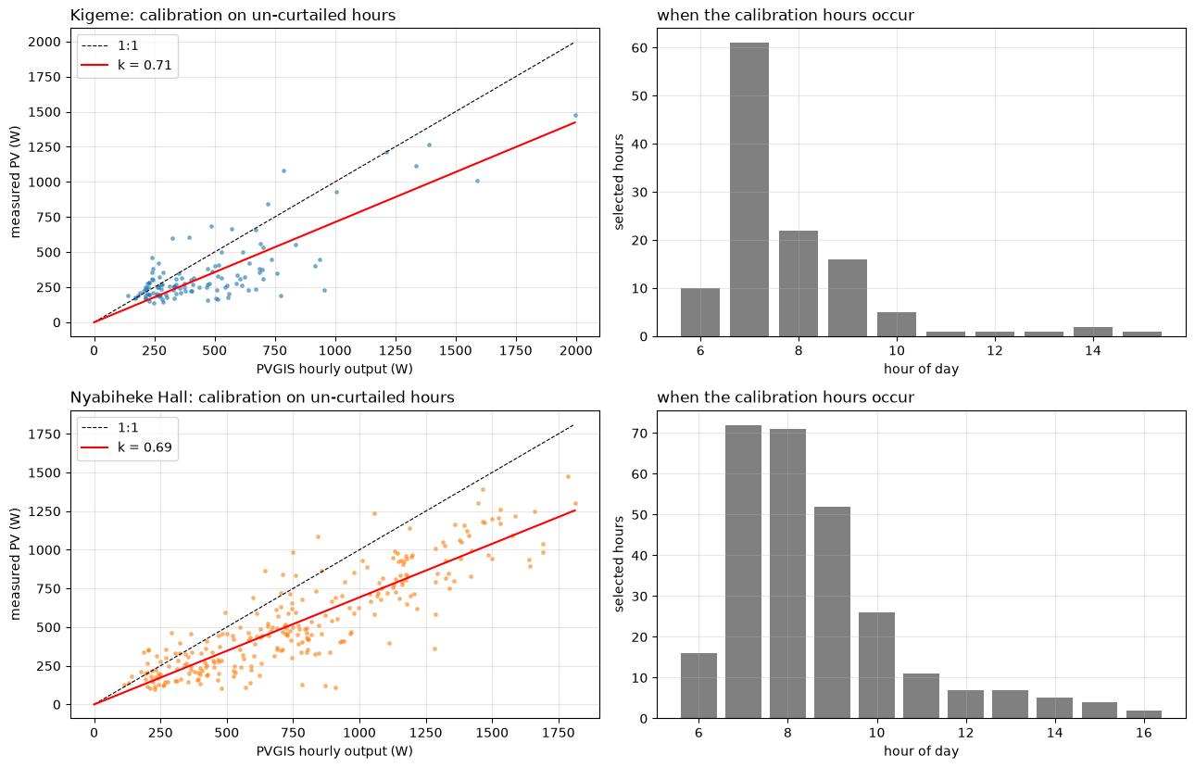
Low solar output is not a fault: panels deliver about 70% of the model at both sites
Statistic | Kigeme | Hall
Factor k (95% interval) | 0.71 (0.66-0.76) | 0.69 (0.68-0.71)
Error before (RMSE, W) | 218 | 310
Error after, cross-validated (W) | 152 | 156
Days used | 81 | 108
Caveat: calibration hours are mostly before 10:00 (battery is full by midday). The factor is weakly tested at midday, especially at Kigeme.
Left panels: measured vs modelled output (red line is the fitted factor). Right panels: hour of day of the hours used.
Source: notebook section 6. Calibration on un-curtailed hours only; clock shift of +1 h found by correlation test (0.79 and 0.88 at +1 h).
Notes:
Rasheed. Main message: do not send someone to inspect panels. The same factor at both sites points at the model assumptions (north-facing, 10 degrees).

Slide 7
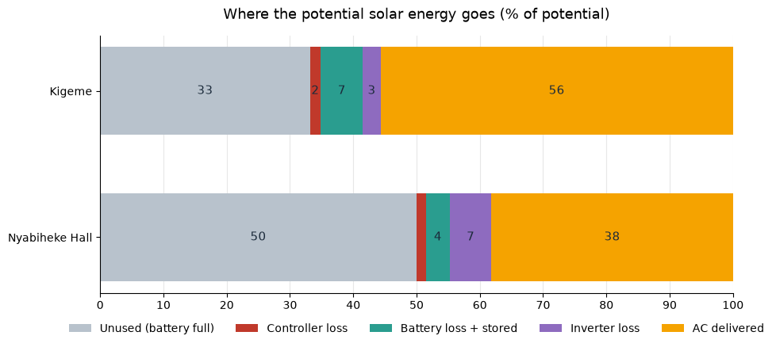
40 to 50% of the solar potential is switched off because the battery is already full
3.1
kWh/day spare at both sites (upper estimate)
3.7 / 1.6
kWh/day: Kigeme / Hall from measured PV (lower bound)
Direction of effect: Unused solar is likely understated because measured PV is already throttled. Lower bound understates the Hall.
Source: notebook section 6.1, complete days, PVGIS x k potential. Unused is an estimate, not a measurement.
Notes:
Touissant. This is the evidence that there is spare daytime energy at all.

Slide 8
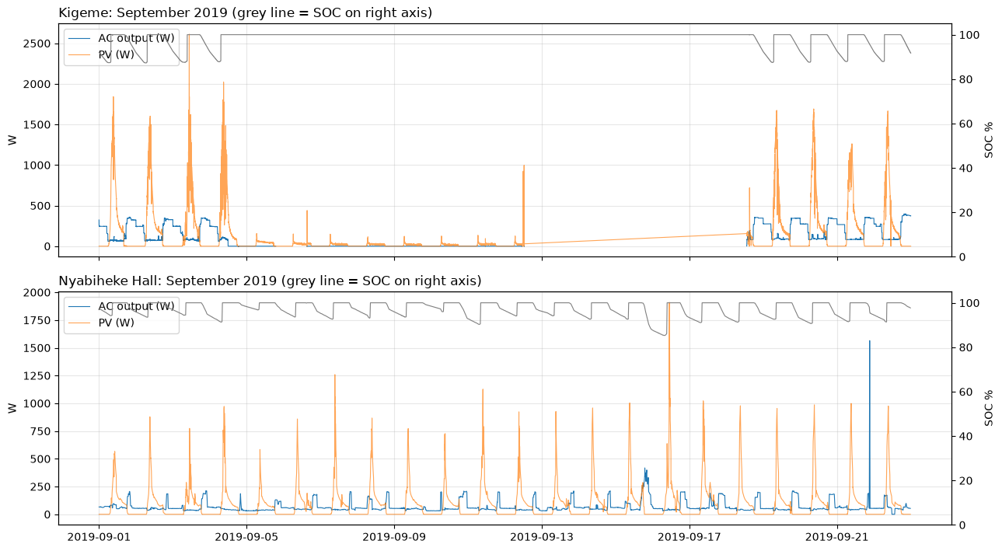
Kigeme lost about a week of AC output with a full battery: a fault, not a shortage
about 170 h ( 7 days)
AC recorded as zero at 100% battery charge
145 h
then no records at all (12 to 18 Sept)
Availability outside that week: 99% Kigeme, 99.9% Hall.
During the outage and other zero-output events, the batteries still had high charge levels
The week-long Kigeme outage occurred while battery charge remained high. Reliability issues were driven by faults, not a lack of solar energy
Likely a tripped inverter, breaker or switch-off. Only the logbook for that week can confirm.
Source: notebook section 7.1. Kigeme 5 to 12 September 2019. Screens, not root causes: no voltage or alarm channel exists.
Notes:
Touissant. Separate the recorded outage from the unobserved gap.

Slide 9
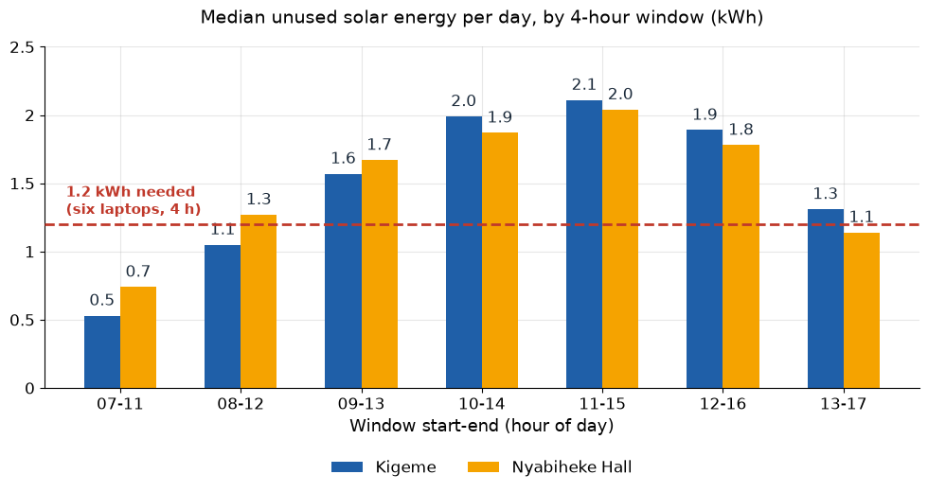
Spare solar sits at 10:00 to 15:00, not in the morning
70%
of days have 1.2 kWh or more spare in the best window (both sites)
about 0.2 kWh
spare on the worst 1 in 10 days (10th percentile)
So a daytime service will fail on roughly 3 days in 10 if it needs the full 1.2 kWh. That is why we propose a rule, not a guarantee.
Source: notebook section 6.1. Median unused PV within each 4-hour window, complete days. 1.2 kWh = six laptops for 4 h.
Notes:
Rasheed. The earlier draft said 07:00 to 12:00. The data moved us to 10:00 to 15:00.

Slide 10
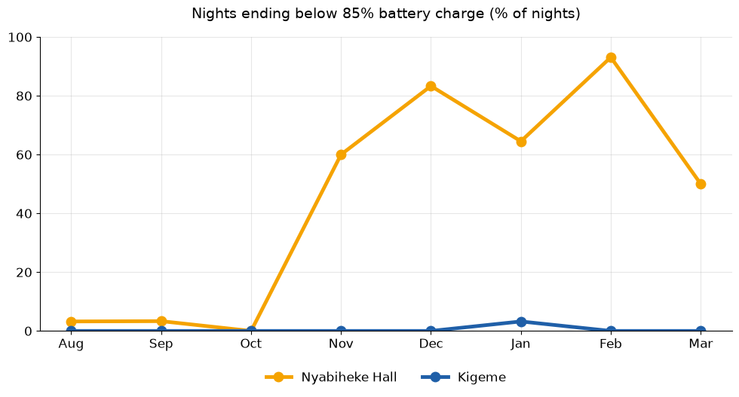
The Hall battery is comfortable until November, then the margin shrinks
0.95 to 2.15
Hall weekly mean demand, first to last week (kWh/day)
42%
Hall lowest charge (25 Nov): weak sun and demand 60% above normal
Kigeme never fell below about 79%. No zero output occurred at low charge, so there was no lost service, only a thinner margin.
Even at its lowest level, Kigeme's battery remained well charged, ensuring uninterrupted service
Kigeme never experienced power loss due to a low battery, indicating sufficient energy capacity
Source: notebook sections 5 and 8. Share of nights ending below 85% battery charge, by month. SOC is a monitor estimate (plus or minus 10 points).
Notes:
Touissant. Demand roughly doubled over the record. This is the reason the Hall needs the 85% rule.

Slide 11
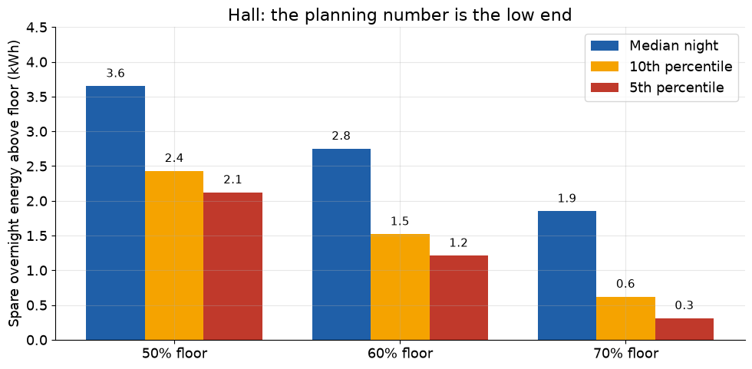
The Hall's planning number is the low end: 0.3 to 3.7 kWh, depending on the reserve floor
6.0 kWh
headroom with a generous 30% floor and all months averaged
about 1 kWh
error from plus or minus 10 SOC points on a 10.6 kWh battery (our arithmetic)
A 1.2 kWh daytime load is the same size as the uncertainty in the Hall's battery reading.
Flipping the reserve floor from 50% to 70% everything else fixed changes Hall spare from 2.1 to 0.3 kWh (5th percentile). The planning number is 0.3–3.7 kWh.
Why the floor matters: A higher floor keeps more reserve for cloudy days but leaves less spare for new services. The facility manager chooses the floor; the spare energy follows
Source: notebook section D.2 (256 Hall mornings; median dawn charge 90.4%, 5th percentile 73.4%; inverter efficiency 0.85).
Notes:
Rasheed. One reserve floor is a design choice. Show how much the answer swings.

Slide 12
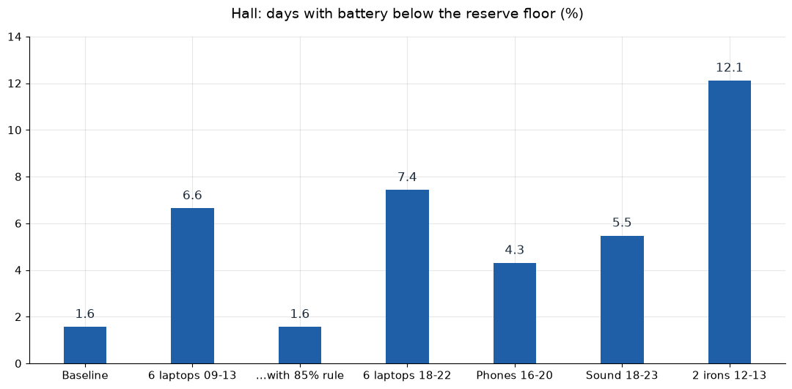
At the Hall, six laptops without a rule push the battery below its floor 4x more often
1.6%
days below floor with the 85% rule: same as baseline
85%
of the laptop service still delivered under the rule
Low-sun stress, no rule: 20% of days below floor, 30 kWh unserved.
Kigeme: 0% days below floor in all cases; full-recharge days fall 95% to 84%.
Source: notebook section 9.1, replay with load added; floor 50%. With-rule scenario runs the load only while charge is 85% or higher.
Notes:
Rasheed. Stress case: solar at 70%.

Slide 13
Power is not the limit for laptops or phones, but irons are out at Kigeme
Scenario | Kigeme headroom (W, 5th pct) | Kigeme time over limit | Hall headroom (W, 5th pct) | Hall time over limit
6 laptops 09-13 | 767 | 0.1% | 1,882 | 0%
6 laptops 18-22 | 535 | 0% | 1,277 | 0%
Phone charging 16-20 | 549 | 0% | 1,317 | 0%
Sound system 200 W, 18-23 | n/a | n/a | 1,288 | 0%
1 iron 12-13 | 781 | 100% | 1,896 | 0.01%
2 irons 12-13 | 781 | 100% | 1,896 | 7.3%
Kigeme's 99.9th percentile draw is about 400 W, but isolated spikes reach about 3.1 kW. The rating in the case table may be incomplete, so Kigeme power conclusions are provisional.
Linking those spikes to irons is circumstantial: the dataset has no appliance log.
Source: notebook sections 9 and D.4. 40 C inverter rating: Kigeme about 900 W, Hall 2,200 W. Hourly data hides start-up surges.
Notes:
Touissant. The surge caveat matters: Kigeme AC peaks reach 3.1 kW against a 960 W continuous limit.

Slide 14
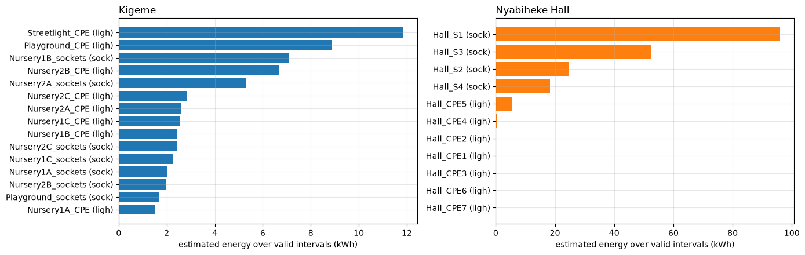
Service is limited by repairs and sockets, not by energy
2.6% vs 0.5%
anomalous device-weeks, Kigeme (59 of 2,261) vs Hall (4 of 870)
27 of 93 weeks
CPE10 (Nursery 2B) confirmed dark, since 29 Oct 2019
5% / 23%
About 95% of Kigeme's load is not attributed to any meter, so we cannot judge needs per device there.
Each extra metered socket costs 50 to 75 Wh/day. Ten sockets use 0.5 to 0.75 kWh/day, about what the phone charging they enable would draw.
Sound system and chairs are facilities needs that power data cannot size.
share of system AC that meters explain: Kigeme / Hall
Part B. Anomaly = device-week dark more than 95% and 25+ points above its own baseline. 63 anomalies (59 Kigeme, 4 Hall).
Notes:
Touissant. Say plainly that the cluster bootstrap in B.6 has not been run in the notebook output.

Slide 15
Our question, and what we recommend
Question (Q3): Could spare capacity support additional services with limited investment? Q1 (is it performing?) and Q2 (is it meeting needs?) tell us whether that is safe.
1
Repair first
2
Add daytime load only
3
Buy nothing yet
Fix the dark fixtures (Nursery 2B CPE10, playground, Streetlight 1) before adding anything. Lost service is the cheapest capacity to recover.
New services run 10:00 to 15:00. Kigeme first. The Hall only with a rule: run when battery charge is 85% or higher.
No extra panels, trackers or batteries now. Avoid evening loads and irons at Kigeme. Re-check the Hall after a second Nov to Feb season.
Basis: Part E of the combined notebook (answers to Q1 to Q3).
Notes:
Rasheed, first minute. Read the question, then the three actions. Name the audience: the Kigeme and Hall site managers and the mini-grid operator.

Slide 16
What our evidence cannot settle
Open question | Alternative explanations still possible | What would settle it
Why the Hall inverter is 85% efficient | Light load; model mismatch (48 V unit vs 24 V curve); DC-side sensor offset; real loss | Clamp meter at the DC terminals
Whether the batteries are healthy | SOC is off by about 10 points; apparent capacity is 1.5x nameplate; 9 months is too short to see ageing | Monitor settings vs nameplate (21.1 vs 19.2 kWh); direct capacity test
How much solar is truly unused | k = 0.7 fitted mostly on mornings; geometry assumed; throttling inferred, not logged | Surveyed tilt and azimuth; controller state log
What caused the Kigeme outage | Inverter off, breaker, fault, or one event vs two; unseen 145 h | Logbook, inverter event log
Whether people's needs are met | Electricity data cannot show access, attendance or satisfaction | Checksheets, user feedback
Whether the Kigeme-Hall fault gap is real | Different buildings, exposure and how easily faults get noticed; weekly flags are not independent | Run the cluster bootstrap
Source: notebook E.3 (limitations) and sections 3.1, 5, 6, 7. Confidence labels follow the notebook.
Notes:
Both. Say it plainly. 'We could not establish that' is a good answer when true.

Slide 17
Recommendation, constraints and gaps, and uncertainty
What to do
Constraints and gaps
Uncertainty
Repair CPE10, playground CPE4 and sockets, Streetlight 1; audit Nursery 2 wiring (Evidenced)
Add daytime load at 10:00 to 15:00, Kigeme first (Evidenced)
Hall: run new load only above 85% charge (Evidenced)
Add sockets only at Hall S1 and Playground S2 (Evidenced)
Do not buy panels, trackers or storage yet (Judgment)
No evening loads; irons only after upsizing Kigeme's inverter
Hall demand doubled and the Nov to Feb margin is thin
95% of Kigeme load is unmetered
No voltage, alarm, appliance or user-feedback data
9 months only; hourly replay misses surges
Unused solar: 1.6 to 3.7 kWh/day (Hall) is a range, not a measurement
Hall headroom: 0.3 to 3.7 kWh by floor choice
Battery charge reads plus or minus 10 points
Fault-rate gap: suggestive until bootstrap is run
Would change our advice: a second Nov to Feb season with Hall demand still rising
Confidence: Evidenced = computed from the data; Judgment = our reading. See notebook E.2 for all 13 actions.
Notes:
Both present. Rasheed: Do. Touissant: Constraints and Uncertainty. End by inviting questions.

Slide 18
Backup: likely questions and our direct answers
Question | Direct answer
Is the system broken? | No. Controller 97%, Kigeme inverter 95%. The faults are specific fixtures and one outage week.
Why not add more panels or batteries? | 40 to 50% of potential solar is already unused. Storage matters only at the Hall, and only if demand keeps rising.
Is the Hall inverter faulty? | We could not establish that. 85% is partly light load; a DC measurement would decide.
Is the battery degrading? | We could not establish that. Capacity reads 1.5x nameplate, so the monitor is unreliable, not proven healthy or worn.
Why Kigeme first, when the Hall has fewer faults? | Bigger battery (21.1 vs 10.6 kWh), steady demand, and the Hall's margin shrinks in Nov to Feb.
Is the fault gap statistically real? | Naive test says yes (p = 0.0001), but weeks are not independent. The bootstrap check is not yet run.
Backup slide for Q&A.
Notes:
Use these as starting points. If we do not know, say: we could not establish that from this data.

