Slide 1
1
Attachment,
as a graph
54 videos of Heidi Priebe's work on attachment theory, taken apart into something you can ask questions of — and three ways to use it.
touyette.github.io/AS-KG
Notes:
A derivative index of her work. All credit for the ideas is hers.

Slide 2
2
THE PROBLEM
Video is linear. Ideas are not.
You cannot ask a video what connects to what.
A strategy explained in one video
is the mirror of one explained in another.
The practice that unwinds both
is in a third.
Recognising yourself in it
means holding all of that at once — which is exactly what someone in the middle of a hard relationship cannot do.
The material is not the problem — it is very good. The shape is.

Slide 3
3
WHAT IT IS
Every idea is a node. Every link says how.
Deactivating Strategies mirrors Hyperactivating Strategies @ 6:05
Not "these are related". The avoidant move and the anxious move are the same move — one scanning for cost, the other for signs the bond is at risk. And the claim carries the video and the second where she says it, so you can check her rather than take my word for it.
616 nodes
one per idea, each with its own page
2411 links
sixteen kinds: what fires, defends, heals, mirrors
54 videos
every claim traced to one, at a timestamp
5 loops
found by searching, not asserted

Slide 4
4
HOW TO USE IT
Two ways in
Pick by what you are doing. The first is a website and needs nothing installed; the second runs on your own machine.
1
2
the explorer
the assistant
Reading around
Talking it through
You want to understand a pattern and follow it outward — on your own, at your own pace.
You have a situation and want to be asked about it rather than lectured at.
Neither will tell you your attachment style, score you, or diagnose anyone. That is a design decision, not an omission.

Slide 5
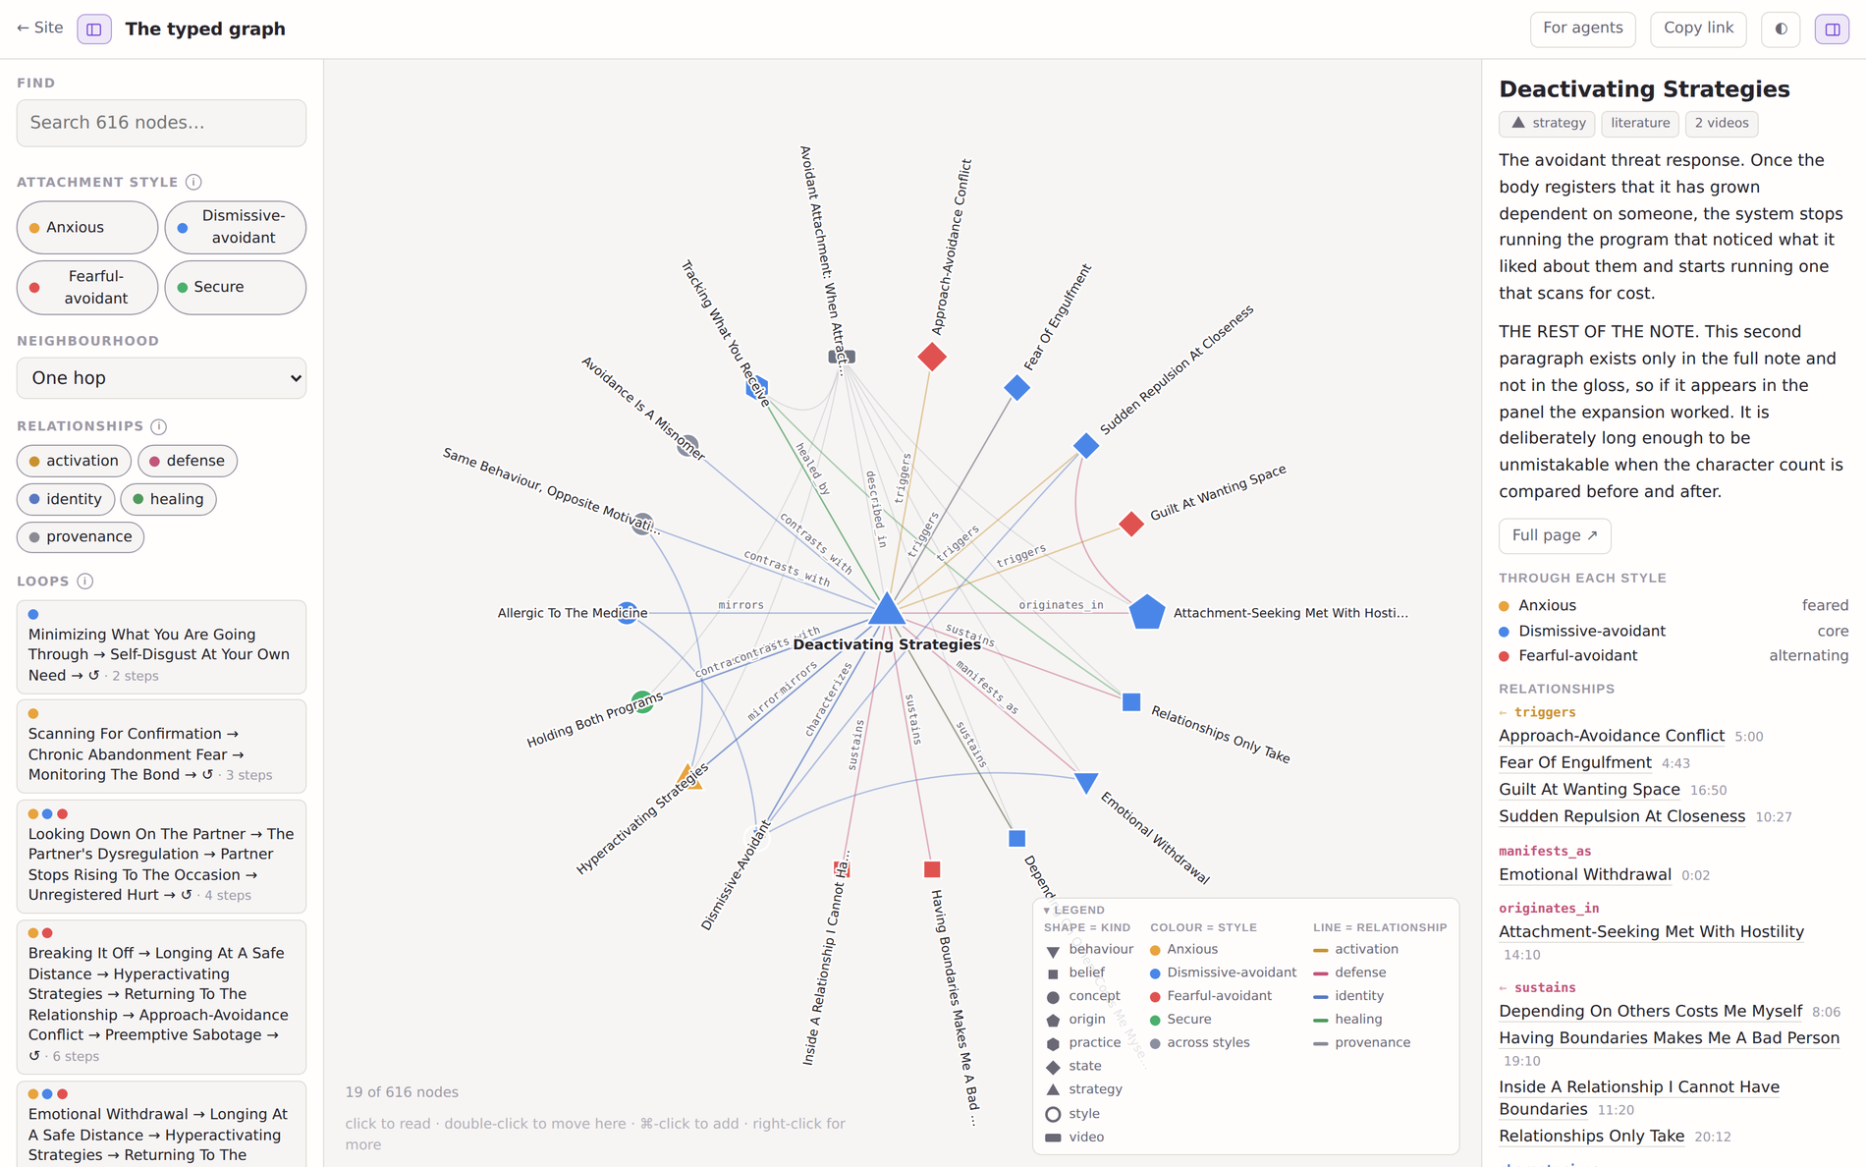
5
WAY ONE
Read around an idea
Colour is the style
Blue avoidant, orange anxious, red fearful-avoidant, green secure. Grey belongs to more than one.
Shape is the kind of idea
Triangle a strategy, diamond a state, square a belief, pentagon a developmental origin.
It never draws everything
One idea and its neighbours. A 616-node hairball tells you nothing.
Click reads, double-click moves
So you can read your way around without losing your place.
touyette.github.io/AS-KG/typed-graph/

Slide 6
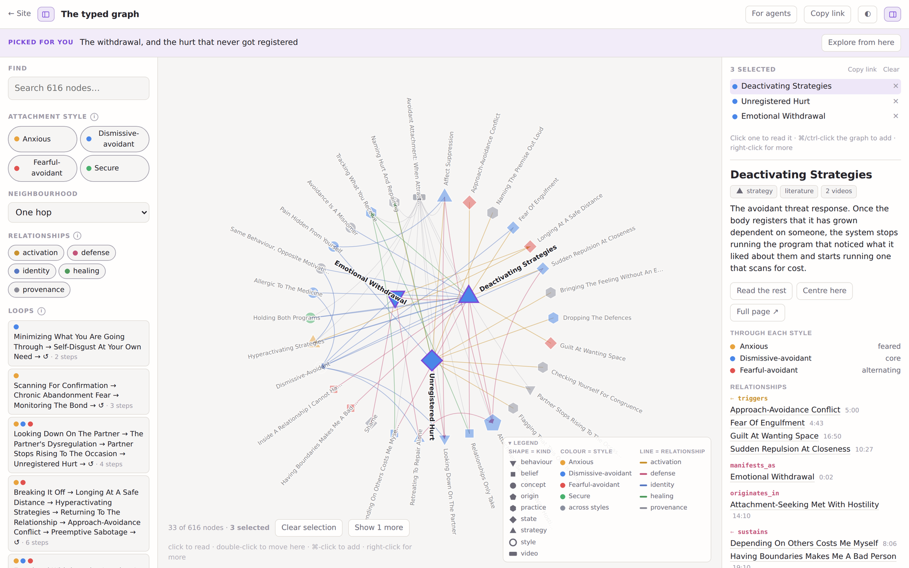
6
WAY TWO
Talk it through with an assistant
Three commands
git clone
github.com/touyette/AS-KG
cd AS-KG
claude
It reads the briefing first
AGENTS.md tells it what the material is for, what to read, and the rules it works inside. You do not have to prompt any of that.
It shows its working
A window opens with the nodes it is drawing on, so you can read the material yourself instead of taking its summary.
Nothing leaves your machine
No account and no service. The corpus, the rules and the tools are all in the folder you downloaded.
Works with Claude Code, Codex, or anything else that can read files and run a command.

Slide 7
7
WHAT THAT IS LIKE
It asks before it explains
A real first exchange, shortened. The order is the safety mechanism, not a manner: a reading offered to someone who has not been heard arrives as a verdict from a stranger.
you
I’m dating an avoidant guy and I want it to go well. Sometimes I struggle to feel connected to him, and I tend to feel like it’s my fault.
it
That sounds like a hard spot — you want it to work, and when the connection does not land you are the one absorbing it. Before I say anything about patterns, three questions.
it
— Is it a vibe, or something concrete: going quiet, cancelling, pulling back after good moments?
— Is there anything that, if a friend described it, you would flag as a real problem rather than "not very expressive"?
— How new is new, and does the distance cluster around particular moments?
It also said it would not build a picture of him from her side of the conversation — he is not there to correct it. That is one of the eight rules, and it holds without being asked for.

Slide 8
8
WHY A GRAPH AT ALL
The loops are the point
Cycles are found by searching the causal links, not asserted. Nobody wrote this one down — the notes were written separately, from different videos.
Looking Down On The Partner
The Partner's Dysregulation
Partner Stops Rising To The Occasion
Unregistered Hurt
and round again
It alternates between the two people
A closed pattern needs no new fuel
which is why it survives good intentions — each is responding reasonably to the step before.
so "where can this be broken" is a better question than "whose fault is it", and the healing links answer it.

Slide 9
9
THE CONSTRAINTS
Eight rules it cannot talk its way out of
They ship inside the file the assistant reads first, not in a prompt someone has to remember to paste. The first is enforced in code: the validator rejects any flow where a reframe step sits before its safety gate.
1
Screen before you reframe
2
Never tell anyone their style
Establish nothing real is happening first.
Recognition, not classification.
3
If they say no, it was no
4
Never type an absent partner
They know their life better than the graph does.
They are not there to correct it.
5
Cite it or do not say it
6
No diagnosis, no quiz, no scoring
Untraceable claims are flagged or dropped.
Nothing that outputs a category.
7
Hand off in a crisis
8
Not therapy, no expertise claimed
That needs a person, not a decision tree.
It inherits the ceiling of its source.

Slide 10
10
HONESTY
What this is not
One person’s corpus
Not a survey of attachment research. Where she diverges from the literature, the graph records her rather than adjudicating.
Not a diagnosis or a test
Nothing outputs a category. If something built on this ever scores you, that is a bug in it, not a feature of the graph.
Not therapy
She states her own position plainly — largely self-taught, not an expert. Anything built on the corpus inherits that ceiling.
103 nodes are unverified
Marked "literature" because she presents them as standard attachment theory. Checking them against the primary sources is parked, and labelled as such.
Attachment styles are a framework for self-understanding, not a diagnosis, a personality type, or a fixed trait. Nothing here is therapy or a substitute for it. If you are working through something difficult, a qualified therapist is the right place for it.

Slide 11
11
START HERE
Two links
Browse the graph
Search for something you recognise and follow it outward.
touyette.github.io/AS-KG/typed-graph/
Run it yourself
Clone it, open it with Claude Code or Codex, and say what is going on.
github.com/touyette/AS-KG
All credit for the ideas belongs to Heidi Priebe — youtube.com/@heidipriebe1
This is an index into her work, built to help someone re-find it rather than replace watching it. No note reproduces her words. The notes were written by hand from the transcripts; the graph, the site, this deck and the checks that keep them honest were built with Claude Code, and every count on these slides is read out of the graph at build time rather than typed in.

