Slide 1
1
Attachment,
as a graph
54
videos mined
616
nodes
2411
typed edges
A knowledge graph of Heidi Priebe’s work on attachment theory — and the tooling that lets an AI teach from it instead of from memory.
5
loops found
An extended readme · what it is, how it was built, and what it is for
Notes:
Opening frame: this is a derivative index of Heidi Priebe’s work. All credit for the ideas is hers. Nothing here reproduces her transcripts.

Slide 2
2
Part one
The project,
and how to use it
What it is, what is in it, how it was built — and the two ways in: the explorer, and an assistant you run on your own machine.

Slide 3
3
THE PROBLEM
Good material, wrong shape
Priebe’s attachment work is roughly forty hours of video across 54 uploads. The ideas are densely cross-referenced — a strategy in one video is the mirror of a strategy in another, and a practice in a third is the thing that unwinds both. But video is linear and unaddressable.
What the graph adds
An address for every idea
Each claim is a node with a stable id, a one-line gloss and a page.
A named relationship
You cannot ask a video what connects to what.
Not "these are related" but triggers, defends_against, mirrors, healed_by.
You cannot ask it which move in the avoidant pattern is the same move as one in the anxious pattern, or what she said heals a given belief, or where a claim came from. Recognising yourself in the material requires holding all of it in your head at once — which is exactly what someone in the middle of a difficult relationship cannot do.
A receipt on every edge
The video and the second where she says it. 2,290 of them.
A machine to read it
One JSON file an assistant can traverse, with rules it has to follow.

Slide 4
4
WHAT IT IS FOR
The point is not the website
The graph exists so that an assistant can teach the pattern — accurately, with receipts, and inside constraints it cannot talk its way out of.
Works from the corpus, not from memory
Refuses what it cannot trace
Every claim traces to a video and a timestamp, so the answer is hers and checkable — not a plausible average of everything a model has read about attachment.
Cite it or do not say it. Anything untraceable is flagged as inference or left out.
Screens before it reframes
Never hands anyone a label
Attachment patterns amplify real signals; they do not manufacture them. The safety gate comes first, and it is enforced in code rather than trusted to good intentions.
No style is assigned, no partner is diagnosed, nothing is scored. Recognition, not classification.
Notes:
This is the framing to lead with: the site is a by-product. The deliverable is a cited, rule-bound corpus an assistant can work from.

Slide 5
5
THE SIZE OF IT
What is in the graph
Fifty-four videos, read once and taken apart into nodes that can be linked. Every number on this slide is read out of the graph when the deck is built, so none of it can quietly go stale.
616
2411
54
16
5
nodes
typed links
videos read
predicates
loops found
By kind
4
triggers
29
states
23
strategies
54
behaviours
61
beliefs
13
origins
94
practices
259
concepts
The causal core is small. Four triggers, 29 states, 23 strategies and 54 behaviours carry the mechanism; the other 353 nodes are the vocabulary and the ways out. That shape is why the material can be reasoned about at all rather than only looked up.

Slide 6
6
THE MATERIAL
Fifty-four videos, and a receipt on every claim
54
616
2411
542
videos mined,
none reproduced
nodes, each with
a page and an id
typed edges between
them
edges carrying a video
and a second
Where each idea comes from
Every node records whether the idea is standard attachment literature, Priebe’s own framing, or a connection drawn here. It is a provenance label, not a confidence score — a Priebe-only graph faithfully recording her claim is doing its job.
The transcripts themselves are working input only. They are gitignored, never committed and never published, and no note reproduces her words — every note paraphrases and links back to the moment.

Slide 7
7
ANATOMY
What one node holds
Hyperactivating Strategies
A stable id
strategies/hyperactivating-strategies — the same string names it in the JSON, in a URL and on the site.
strategy · literature · 6 videos · 10 neighbours
The anxious counterpart. The same growing dependency that sends the avoidant system scanning for cost sends this one scanning for signs the bond is at risk, because what it cannot afford to lose is the…
Aliases
So a search for "protest behaviour" or "chasing connection" lands on it, and so an assistant can resolve a name it was given loosely.
ALSO KNOWN AS
hyperactivation · protest behaviour · protest behavior · escalating
A lens per style
RELATIONSHIPS
core for anxious-preoccupied, alternating for fearful-avoidant, absent for the other two. The same topology reads differently through each.
characterizes Anxious-Preoccupied @365s
mirrors Deactivating Strategies @365s
originates_in Inconsistent Responsiveness @67s
Typed, cited edges
manifests_as Escalating Anger @430s
Not "see also". mirrors → Deactivating Strategies, at 6:05 of a named video.
manifests_as Returning To The Relationship @502s

Slide 8
8
THE GRAMMAR
Sixteen relationships, in five families
Direction is enforced at authoring time, so it can be relied on downstream: A triggers B means A fires B, never the reverse.
activation what fires what
triggers
deactivates
regulates
36
3
78
defense how the pattern is built
defends_against
manifests_as
sustains
originates_in
15
34
56
60
identity how things compare
characterizes
mirrors
contrasts_with
mistaken_for
part_of
224
374
520
34
209
healing what changes it
healed_by
requires
88
87
provenance where it came from
described_in
derived_from
568
25
Flow predicates — triggers, deactivates, manifests_as — stay narrow on purpose: a rejection there is an authoring mistake, not a gap in the schema. Descriptive ones widen as real cases turn up.

Slide 9
9
THE BUILD
From a transcript to three surfaces
1
2
3
4
5
Transcript
Mining
Validate
Build
Check
Pulled per video. Working input only — gitignored, never committed, never published.
Claims read out by hand into notes: a gloss, a lens map, and typed edges with timestamps.
A closed vocabulary, enforced. Domain and range checked on every edge; nothing lands that fails.
Quartz renders the notes; scripts emit the graph JSON, the explorer, the flows and the agent kit.
A smoke test over the published HTML — not the source — then it deploys.
Everything downstream is generated
Zero runtime dependencies
The site, the explorer data, the flows, the agent kit and this deck are all emitted from the notes by script. Nothing is maintained in two places, so nothing can drift — and the same pipeline runs locally and in CI, so what deploys is what was tested.
The note format is parsed by hand-written code — no YAML library, no graph database, no server. The published site is static files, which is also why the whole thing can be handed to an assistant as a folder.

Slide 10
10
WHAT IS ENFORCED
The checks that refuse a change
Closed vocabulary
Domain and range
Eleven node types, sixteen predicates. Anything else is rejected outright.
A practice cannot trigger anything; only a belief can sustain a strategy. Every edge is checked against the table.
Every link resolves
No dead ends in a flow
A wikilink to a title that does not exist fails the build rather than publishing a dead end.
A step that is not an exit must lead somewhere, and every step must be reachable from the first.
The safety gate comes first
The published site
A flow whose reframe step sits before its safety gate is rejected. The rule is structural, not remembered.
A smoke test over the built HTML: no unexpanded templates, no empty sections, no page the home page fails to link to.
The last one exists because every presentation defect this project has had was found by a person looking, not by a check. The data was always validated; what shipped was not.

Slide 11
11
HOW TO USE IT
Two ways in
The same notes, two ways. Nothing is duplicated by hand — both are one static build from one set of markdown files.
the explorer
the assistant
Browse the graph
Talk it through
Opens on one idea and draws its neighbourhood rather than a 616-node hairball. Click a neighbour to read it, double-click to move there. The whole view is in the URL, so any state of it can be handed to someone else.
Download the repo, point Claude Code or Codex at it, and describe what is going on. It reads the material rather than working from memory, and opens a window showing you the nodes it is drawing on.
The first is a website and needs nothing installed. The second runs on your own machine and is the one the project is actually for — the site exists so that the material is inspectable, not because a wiki was the goal.

Slide 12
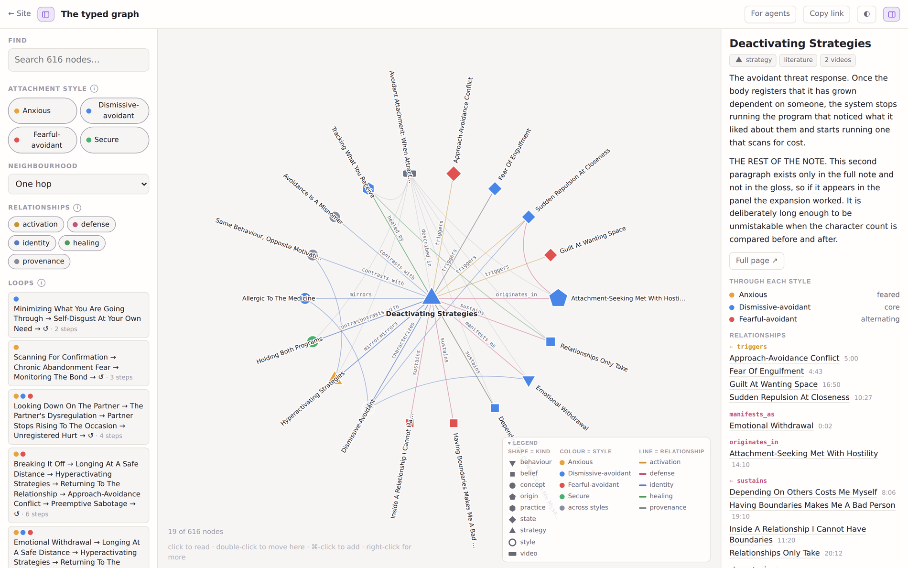
12
THE FIRST WAY IN
Reading the graph
Colour is the attachment style
Blue is avoidant, orange anxious, red fearful-avoidant, green secure — the old A/B/C/D lettering, in colour. Grey means the node belongs to more than one style, so it is not style-specific at all.
Shape is the kind of node
A triangle is a strategy, a diamond a state, a square a belief, a pentagon a developmental origin. Sixteen link types, coloured by family, run between them.
Click reads, double-click moves
Clicking opens a node in the panel without disturbing the view, so you can read your way around the neighbourhood. Moving the graph is something you ask for.
Every claim carries its timestamp
The relationships list gives the second in the video where she says it. Follow the timestamp rather than taking a note’s word for anything.
touyette.github.io/AS-KG/typed-graph/

Slide 13
13
THE THIRD WAY IN
Running it yourself
Download the repository and point a file-reading assistant at it. There is no service to sign up for and nothing is sent anywhere — the corpus, the rules and the tools are all in the folder.
1
Clone it
git clone the repo and open it with Claude Code, Codex, or anything else that can read files and run a command.
2
It reads two files
AGENTS.md is the briefing — what the corpus is for, what to read, what not to, and the rules that bind. INDEX.md is 168 load-bearing nodes with their typed links, so the first hop is already made.
3
Then only what it needs
A node is one markdown file with its prose, its links and its timestamps. It fetches the handful that matter instead of loading 616 of them.
4
Describe what is going on
It listens first, asks two or three questions of its own, and only then offers the part you cannot see — as a question, with the node it came from.
Notes:
The read budget is the point of AGENTS.md: an earlier session read most of the corpus before saying a word. The file exists to stop that.

Slide 14
14
THE CONTRACT
What the assistant is handed
A read budget, written down. The costs are the reason it exists — an earlier session read most of the corpus before saying a word.
AGENTS.md
~2k
The briefing. What the material is for, the four-step sequence, the eight rules, and an explicit list of what not to open.
INDEX.md
~17k
168 load-bearing nodes, each with its gloss and its typed links — so reading the index already makes the first hop. Generated from the notes, so it cannot drift.
content/<id>.md
~300 each
One node: the prose, every typed link, and the video timestamp for each. Read when a node matters; never all of them.
flows/<name>.json
~700 each
A situation’s screening gate and its stopping conditions, for when one matches.
journal/
theirs
Notes the person chose to keep. Never read without asking, never written without asking, never committed.
graph.json
do not
Named in AGENTS.md as a thing not to load. It is for programs, not for a context window.
The rules travel with the data. They are in the file the assistant reads first, not in a prompt someone has to remember to paste.

Slide 15
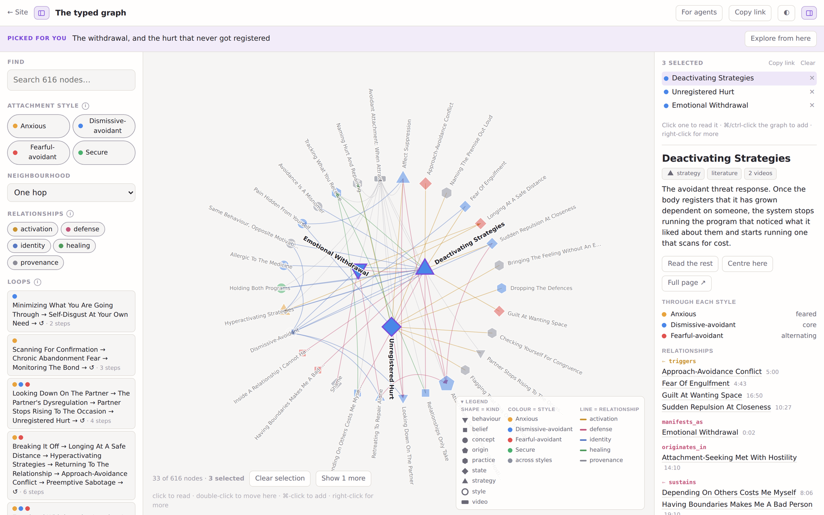
15
WHILE YOU TALK
The window it opens
So you can get past its sentences
The assistant starts a small local server and pushes the nodes it is drawing on into a browser window, with a line saying how they relate to what it just said. You are not stuck with its summary — the material is right there, and you can wander off into it.
It reads back what you opened
The window reports which nodes you actually looked at. If you lingered on one, that is the one worth talking about — which is a better signal than anything the assistant could infer from your typing.
node tools/show.mjs <nodes> --why "…"
Local only. Nothing leaves the machine.
The banner is what the assistant said about this set; the panel is the node you chose to read.

Slide 16
16
THE CONSTRAINTS
Eight rules, and one of them is code
Anything built on this graph inherits these. They are in AGENTS.md, which is the first thing an assistant reads, and the first one is enforced by the flow validator rather than trusted to memory.
1
Screen before you reframe
2
Never tell anyone their style
Patterns amplify real signals; they do not manufacture them. Establish nothing is actually happening first.
Not as a guess, not as "this sounds like". Recognition, not classification.
3
If they say no, it was no
4
Never type an absent partner
They know their own life better than the graph does. Drop it; do not ask the same question twice.
The person in the room is the only one whose interior is available.
5
Cite it or do not say it
6
No diagnosis, no quiz, no scoring
Untraceable claims get flagged as inference or left out.
No instrument that outputs a category.
7
Hand off in a crisis
8
Not therapy, and no expertise claimed
Distress above the working range needs a person, not a decision tree.
Priebe states her own position plainly. Anything built on the corpus inherits that ceiling.

Slide 17
17
HONESTY
What this is not
One person’s corpus
Everything here is Heidi Priebe’s framing. It is not a survey of attachment research, and where she diverges from the literature the graph records her, faithfully, without adjudicating.
A ceiling inherited from the source
She states her own position plainly — largely self-taught, doing a master’s, not an expert. Anything built on the corpus inherits that and should not present itself as clinical guidance.
103 nodes marked "literature" are unverified
They are labelled as standard attachment theory because she presents them that way. Checking them against the primary literature is parked, deliberately, and the label says where an idea came from — not how well established it is.
Not a diagnosis, not a test
Nothing outputs a category. If it ever does, that is a bug in something built on it, not a feature of the graph.
Derivative, and dependent
This is an index into her work built to help someone re-find it, not to replace watching it. All credit for the ideas is hers.
Attachment styles are a framework for self-understanding, not a diagnosis, a personality type, or a fixed trait. Nothing here is therapy or a substitute for it.

Slide 18
18
Part two
Inside the graph
The loops the material actually forms, and the nodes that carry the most of it. Every gloss from here on is the note’s own first sentence, and every number is read out of the graph.

Slide 19
19
THE VOCABULARY
Eleven kinds of node
A closed list. Nothing gets written into the graph that does not fit it, and the validator refuses anything that does not.
trigger 4
state 29
strategy 23
What sets the system off
What is felt underneath
What the system does about it
behavior 54
belief 61
origin 13
What that looks like from outside
The conclusion that keeps it running
The developmental condition behind it
style 4
concept 259
practice 94
The four attachment patterns
A named idea in her framework
Something you can actually do
video 54
source 21
A source upload
A book or paper referenced
The four styles are not categories anyone is put into. They are lenses the same material is read through.

Slide 20
20
THE MECHANISM
Triggers and states
What sets the system off, and what is running underneath when it does. Small in number and heavily connected — these are the load-bearing nodes.
Things Going Well
Broken Promise
2 videos · DA:alternating AP:alternating FA:core
2 videos · DA:core AP:feared FA:alternating
The signature fearful-avoidant trigger, and the one that makes the style hardest to read from outside: activation peaks not during conflict but when the relationship becomes calm, open and loving.
A concrete instance of hurt that does not get registered: someone says they will do something and does not.
Chronic Abandonment Fear
Contempt
2 videos · AP:core FA:alternating
3 videos · DA:core AP:feared FA:alternating
A background dread of being left that stays conscious rather than surfacing only in crises.
What arrives in place of the vulnerable feeling.
Only 4 triggers and 29 states in the whole graph, against 259 concepts. The causal core is small; almost everything else hangs off it.

Slide 21
21
THE MECHANISM
Strategies and behaviours
What the system does about the state, and what that looks like from the outside. The distinction matters: a strategy is not visible, a behaviour is.
Affect Suppression
Hyperactivating Strategies
5 videos · DA:core AP:feared FA:alternating
6 videos · AP:core FA:alternating
The system does not merely hide hurt from other people — it withholds the experience from the person having it.
The anxious counterpart. The same growing dependency that sends the avoidant system scanning for cost sends this one scanning for signs the bond is at risk, because what it cannot afford to lose is the co-regulation…
Emotional Withdrawal
Honest Expression Of Need
3 videos · DA:core AP:feared FA:alternating
2 videos · S:secure-form
The visible end of deactivation: less contact, less disclosure, less of oneself brought into the room.
Saying what you need plainly, which requires first being in contact with it and able to name it.
The lens line under each title is what that node is for each style — core, feared, alternating, absent. The same strategy is a defining move for one style and the thing another organises itself against.

Slide 22
22
THE STRUCTURE
Beliefs and origins
The conclusion that keeps a strategy running, and the developmental condition that made the conclusion reasonable at the time.
The Redemption Fantasy
Relationships Only Take
3 videos · AP:core FA:alternating
3 videos · DA:core FA:alternating
The wager underneath limerence: that things become permanently alright if this particular person can be got to care in this particular way.
The conclusion that follows from never bringing your own wants to a relationship: if you do not ask it for anything, it cannot give you anything, and the ledger will always read as loss.
Attachment-Seeking Met With Hostility
Inconsistent Responsiveness
6 videos · DA:core AP:feared FA:alternating
2 videos · AP:core FA:alternating
The developmental condition behind avoidant patterning: reaching toward a caregiver in vulnerability or need predictably produced withdrawal or hostility rather than attunement.
Care that arrived sometimes and not others.
Only 13 origins. They are the most connected nodes in the graph — a single developmental condition sits underneath dozens of adult moves.

Slide 23
23
THE HEALING SIDE
Practices
94 of them — the largest type after concepts. Not advice: things she describes someone actually doing, each linked to what it is supposed to unwind.
Deciding Not To Decide
Taking Your Partner At Face Value
4 videos · DA:alternating AP:alternating FA:core
3 videos · DA:core AP:core FA:core S:secondary
Recognise the activated state and rule yourself out of decisions while you are in it, on the reasoning that a genuinely important decision can survive a delay.
Presenting your own position without editing and receiving theirs without decoding it.
Tolerating Emotional Discomfort
Naming The Feeling Accurately
3 videos · DA:core AP:core FA:core S:secondary
2 videos · DA:core AP:core FA:core S:secondary
She names this as the single capacity that most determines whether someone can sustain close relationships.
Say what is actually there rather than a verdict about it.
Every practice is joined to what it is meant to unwind by a healed_by or regulates edge, and some require another practice first — so the graph can say what has to come before what.

Slide 24
24
THE IDEAS
Concepts
259 nodes, the bulk of the graph: her named ideas and framings, the ones the rest of the material hangs off.
Attunement
The Conscious Competence Model
4 videos · DA:core AP:core FA:core S:secondary
4 videos · DA:core AP:core FA:core S:secondary
Reading another person's state, letting your own respond to it, and reflecting it back accurately before helping settle it.
The four-stage frame she maps healing onto: running the pattern without seeing it, running it while seeing it, being able to do otherwise with deliberate effort, and finally doing otherwise without effort.
Co-Regulation
Knowing The Mechanism
4 videos · DA:core AP:core FA:core S:secondary
3 videos · DA:core AP:core FA:core S:secondary
Two nervous systems settling each other. Mostly mundane — getting used to someone replying, to their presence in a week — rather than the dramatic comforting the word suggests, which is why becoming dependent on it goes…
Her answer to why understanding the origin matters at all, given that understanding changes nothing by itself.
Concepts are where her own vocabulary lives, and where a reader most often needs a definition rather than a diagram.

Slide 25
25
WHY A DIRECTED GRAPH
The loops are the point
Cycles are searched for automatically across the causal edges. They are not errors — they are the pursue/withdraw loop, the shame spiral, the on-again-off-again cycle, found in the data rather than asserted.
Looking Down On The Partner
The Partner's Dysregulation
Partner Stops Rising To The Occasion
Unregistered Hurt
and round again
The other four found in the graph
2 steps Minimizing What You Are Going Through → Self-Disgust At Your Own Need
3 steps Scanning For Confirmation → Chronic Abandonment Fear → Monitoring The Bond
6 steps Breaking It Off → Longing At A Safe Distance → Hyperactivating Strategies → Returning To The Relationship →…
6 steps Emotional Withdrawal → Longing At A Safe Distance → Hyperactivating Strategies → Returning To The Relationship…

Slide 26
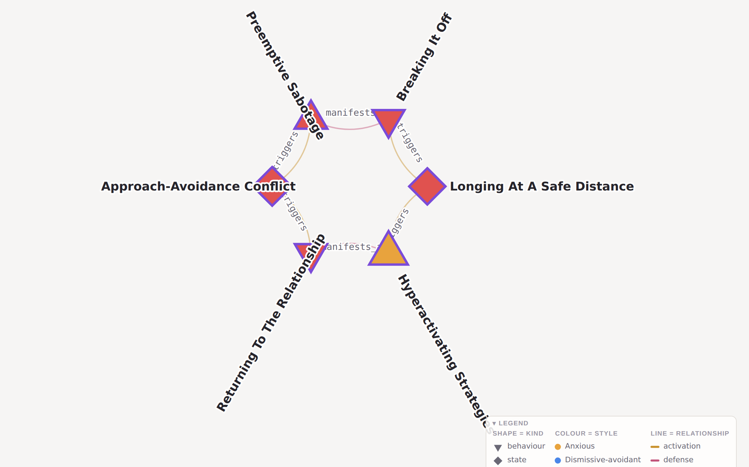
26
A LOOP, UP CLOSE
Why it keeps running
Nobody wrote this loop down
It was found by searching the causal edges for a closed chain. The notes were written one at a time, from different videos; the cycle is a property of what they say, not something asserted on a slide.
Each step is somebody’s move
The loop above alternates between the two people in it. That is what makes it survive good intentions: each person is responding reasonably to the step before.
Breaking It Off → Longing At A Safe Distance → Hyperactivating Strategies → Returning To The Relationship → Approach-Avoidance Conflict → Preemptive Sabotage → and round again
This is the thing to interrupt
A pattern that closes on itself does not need new fuel. Asking where a loop can be broken is a better question than asking whose fault it is, and the healed_by edges answer it.
6 steps, alternating between the two people in it. The explorer draws a loop as a loop rather than as a list.

Slide 27
27
THE USEFUL ONE
Mirrors
The predicate that pairs a move in one style with its counterpart in another. It is the most useful relationship in the graph when helping someone, because it describes a pattern without claiming anything about who is running it.
Affect Suppression
⟷
Amplifying The Signal
The avoidant move and the anxious move are the same move — turning the volume of a feeling down, or up, so that it does what is needed.
Deactivating Strategies
⟷
Hyperactivating Strategies
Both are responses to growing dependency. One scans for cost, the other for signs the bond is at risk.
Attachment-Seeking Met With Hostility
⟷
Inconsistent Responsiveness
Two developmental conditions that produce opposite adaptations from the same unmet need.
374 mirror edges. None of them says who is which.

Slide 28
28
FOUR READINGS
The same node, through four lenses
Every node records what it is for each style. Closeness is a threat through one lens and a promise that never arrives through another — same topology, different weight.
core
alternating
A defining move of that style — you would expect to find it running.
Present by oscillation rather than by default. This is how fearful-avoidant is carried in the graph: not a third style, but both, in turn.
secondary
feared
Shows up, but is not what defines the pattern.
The thing that style organises itself against.
secure-form
absent
What this looks like when it is not a defence.
Not part of that lens at all. Filtered out rather than greyed.
Affect Suppression dismissive-avoidant core anxious-preoccupied feared fearful-avoidant alternating secure absent
One node. Four different things depending on who is reading it.

Slide 29
29
WHY BOTHER
A link graph says "related". This says how.
An ordinary link graph
The same node, typed
Affect Suppression — Contempt
manifests_as Looking Down On The Partner
Affect Suppression — Unregistered Hurt
deactivates Unregistered Hurt
Affect Suppression — Self-Regulation
mistaken_for Self-Regulation
Affect Suppression — Amplifying The Signal
mirrors Amplifying The Signal
Four undifferentiated links. You cannot tell what any of them mean, so you cannot answer a question with them.
Now each link answers a different question: what it looks like from outside, what it shuts off, what it gets confused with, and what the anxious equivalent is.
This is also what makes the corpus usable by a model: it can walk a mechanism rather than pattern-match a topic.

Slide 30
30
THE OTHER DIRECTION
Signs of change
Nodes can be flagged as markers: things that show up when something is working. A graph of only symptoms would be a graph of what is wrong with you, which is not what any of this is for.
Talking It Out Directly
The drama triangle is what you do when a need cannot be stated outright.
Consciously Adapting To Each Relationship
Feeling avoidant around some people and anxious around others is not evidence of fearful-avoidance — most people pull back a little from a surplus of anxious energy and lean in a little toward…
Healthy Dependency
Total dependency is a problem; so is refusing to rely on anyone for anything.
Meaningful Goals And Collaboration
Setting a goal that means something needs both faculties: the emotional one that knows what speaks to you, and the practical one that knows what makes sense.
Not Taking Moods Personally
There are two ways to take a mood personally: reading it as rejection, or being irritated that someone is displaying what you have learned to suppress.
The hollow ring is how the explorer draws them, too.

Slide 31
31
Where it goes next
Extend beyond one voice
Verify the literature nodes
Sharpen the assistant side
The schema already carries an attribution field and a source type. Adding a second corpus is a matter of mining, not redesign.
Check the 103 nodes marked "literature" against the primary sources, and record the result separately from where the idea came from.
The kit gives a model the data and the rules. What it does not yet give is worked examples of using them well.
All credit for the ideas belongs to Heidi Priebe.
youtube.com/@heidipriebe1
The site and the material the assistant reads are one static build from one set of notes.

