Slide 1
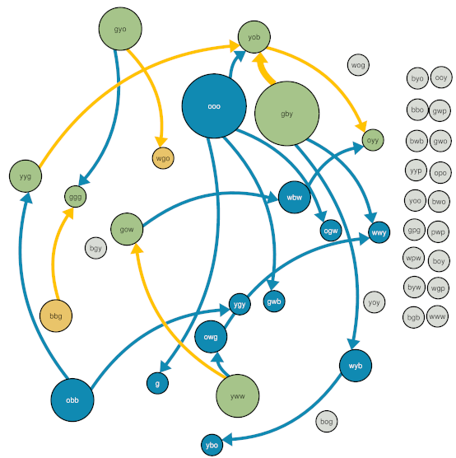
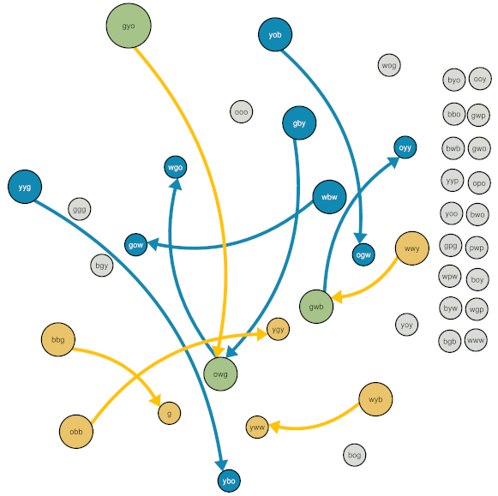
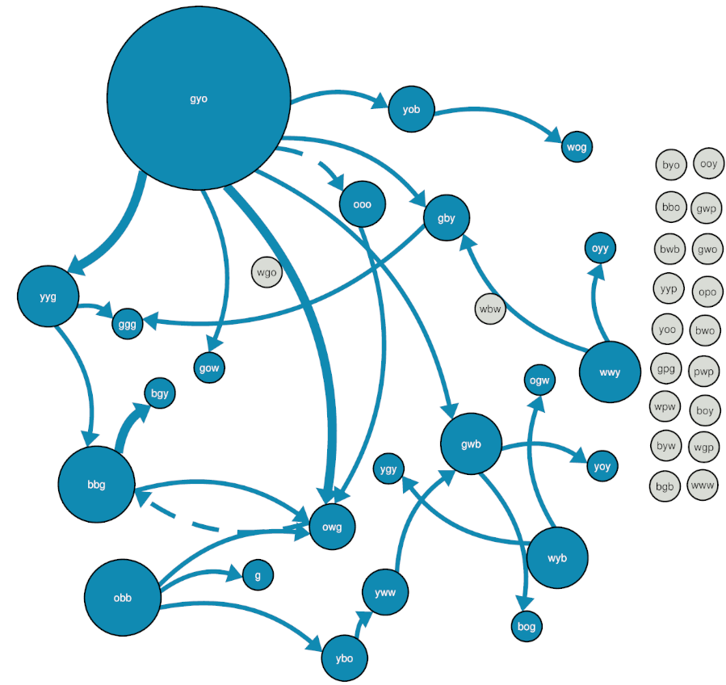
Colony 42 (Choice)
Interacted with light nest
Interacted with dark nest
Tandem run (blue = to dark nest, yellow = to light nest)
Interacted with both nests
Transport (blue = to dark nest, yellow = to light nest)
Not involved in tandem runs or transports
Node size and edge width = out-strength

Slide 2
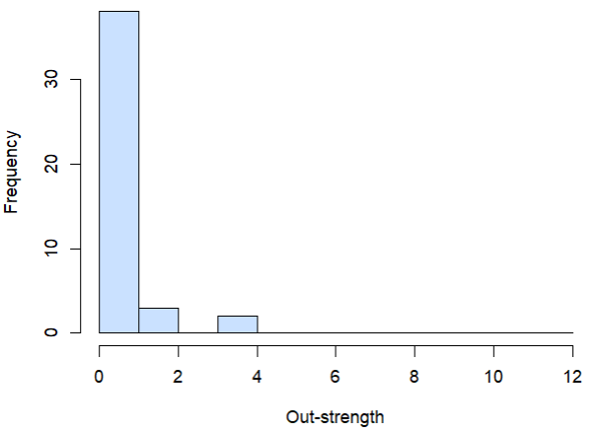
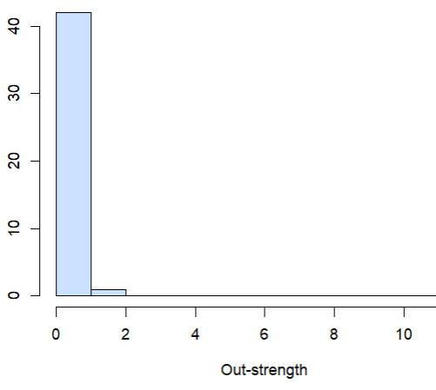
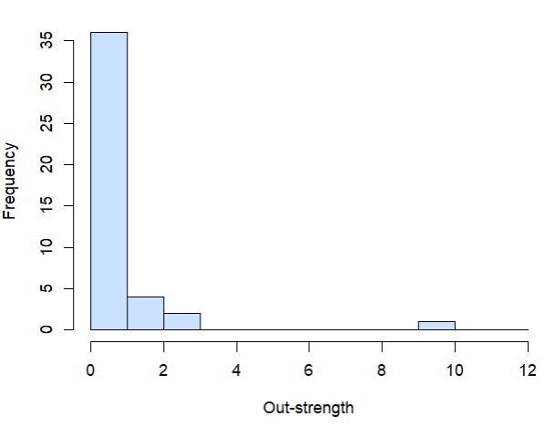
Colony 42 (Choice) Out-strength distributions

Slide 3
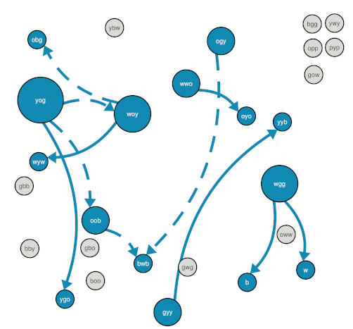
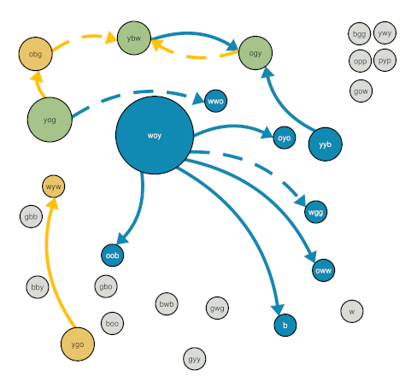
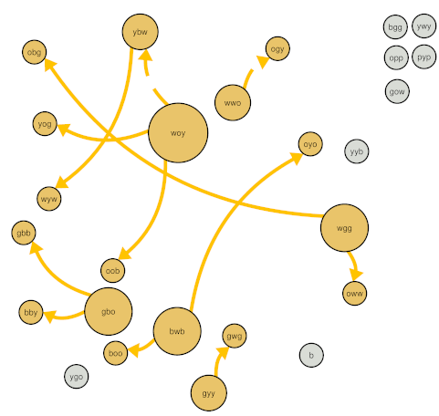
Colony 55 (Choice)
Interacted with light nest
Interacted with dark nest
Tandem run (blue = to dark nest, yellow = to light nest)
Interacted with both nests
Transport (blue = to dark nest, yellow = to light nest)
Not involved in tandem runs or transports
Node size and edge width = out-strength

Slide 4
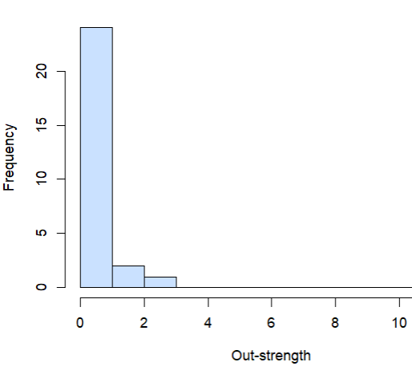
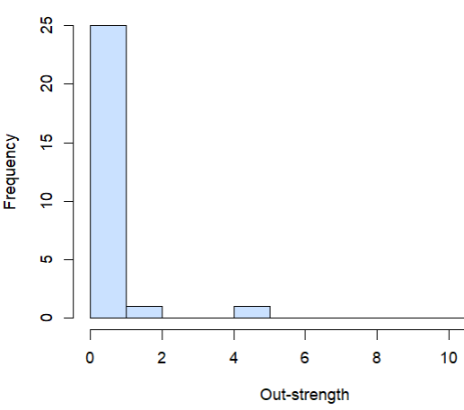
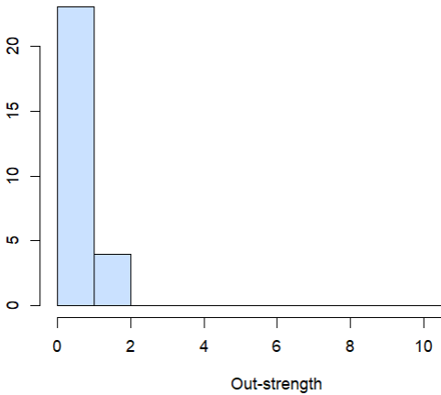
Colony 55 (Choice) Out-strength distributions

Slide 5
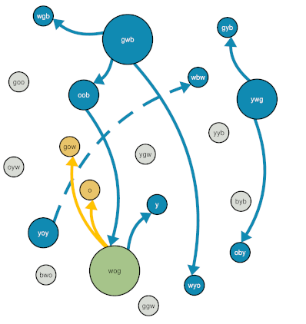
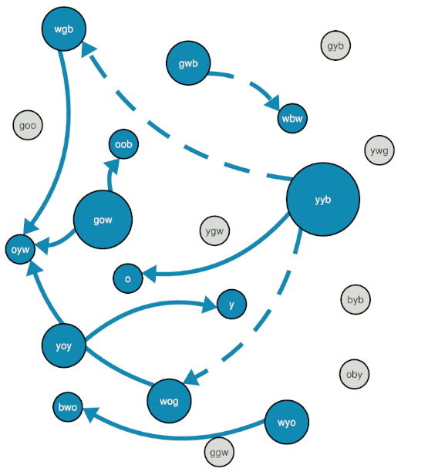
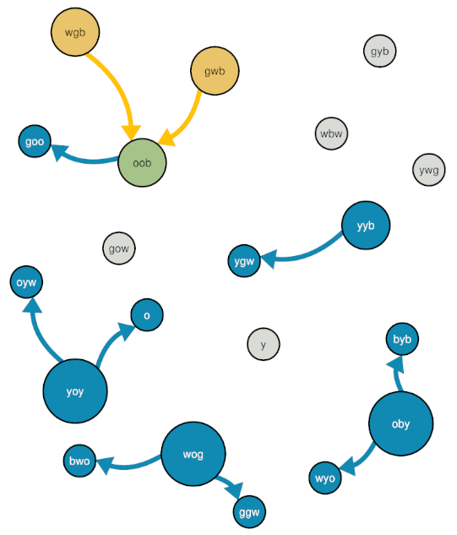


Colony 41 (Choice)
Interacted with light nest
Interacted with dark nest
Tandem run (blue = to dark nest, yellow = to light nest)
Interacted with both nests
Transport (blue = to dark nest, yellow = to light nest)
Not involved in tandem runs or transports
Node size and edge width = out-strength

Slide 6
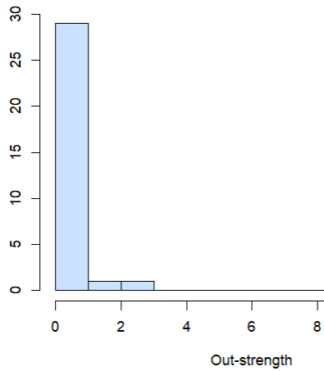
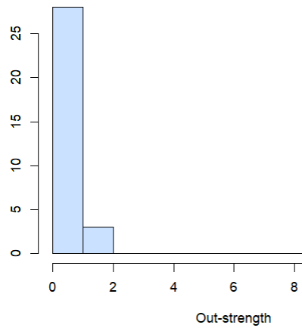
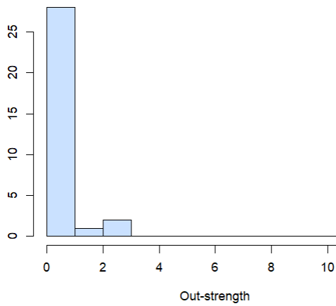
Colony 41 (Choice) Out-strength distributions

Slide 7
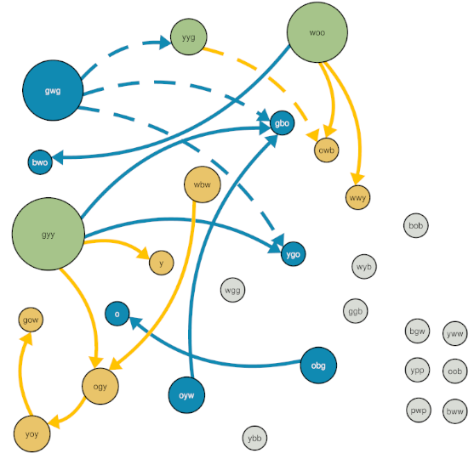
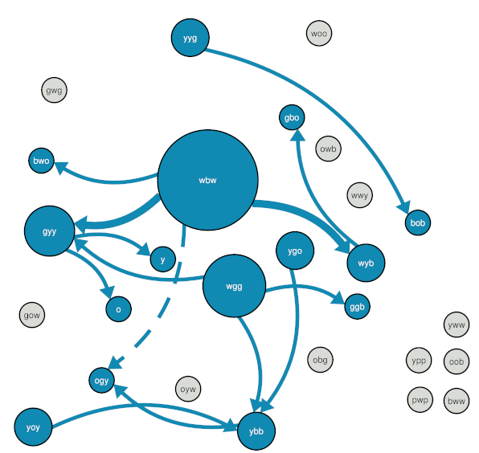
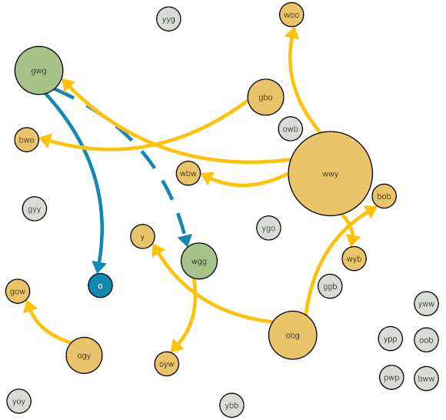
Colony 53 (Choice)
Interacted with light nest
Interacted with dark nest
Tandem run (blue = to dark nest, yellow = to light nest)
Interacted with both nests
Transport (blue = to dark nest, yellow = to light nest)
Not involved in tandem runs or transports
Node size and edge width = out-strength

Slide 8
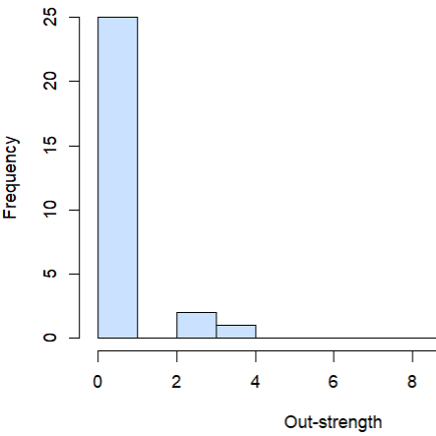
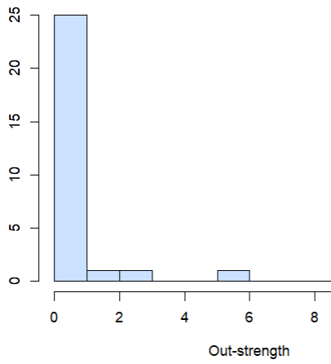
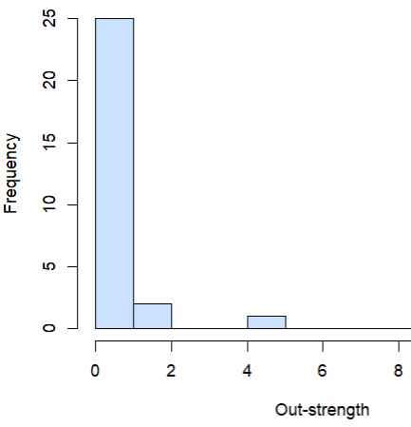
Colony 53 (Choice) Out-strength distributions

Slide 9
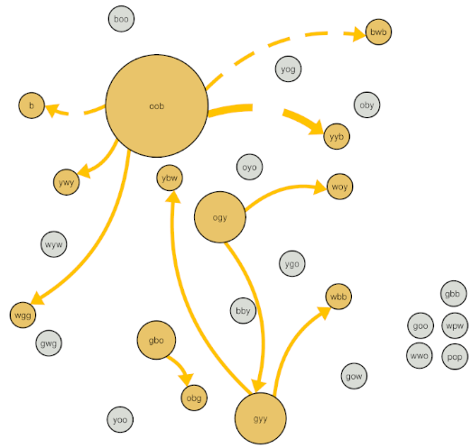
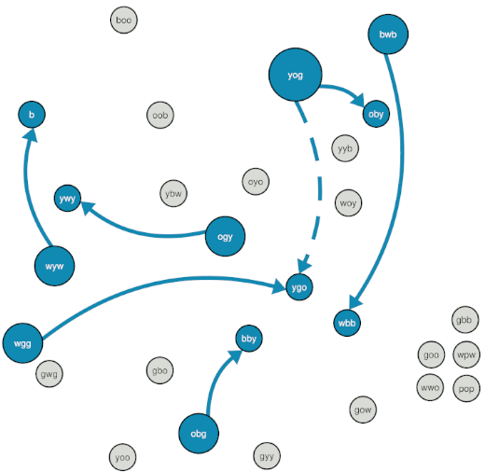
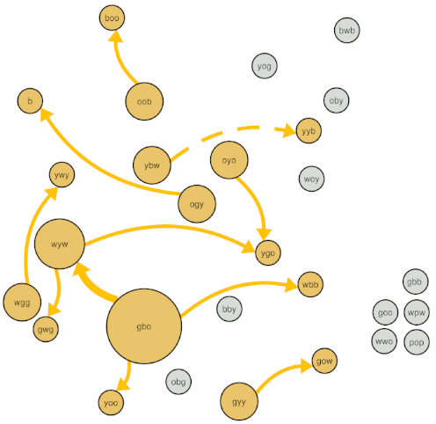
Colony 60 (No-Choice)
Interacted with light nest
Interacted with dark nest
Tandem run (blue = to dark nest, yellow = to light nest)
Interacted with both nests
Transport (blue = to dark nest, yellow = to light nest)
Not involved in tandem runs or transports
Node size and edge width = out-strength

Slide 10
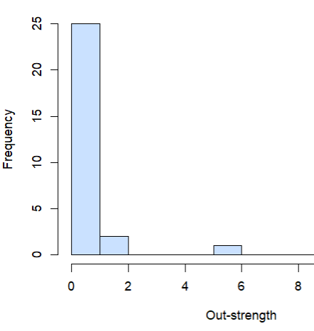
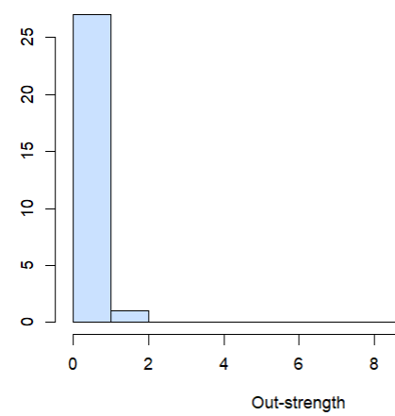
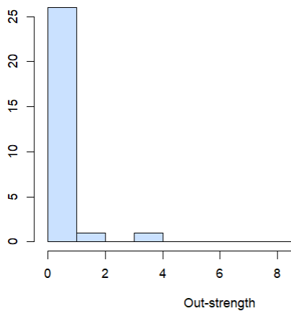
Colony 60 (No Choice) Out-strength distributions

Slide 11
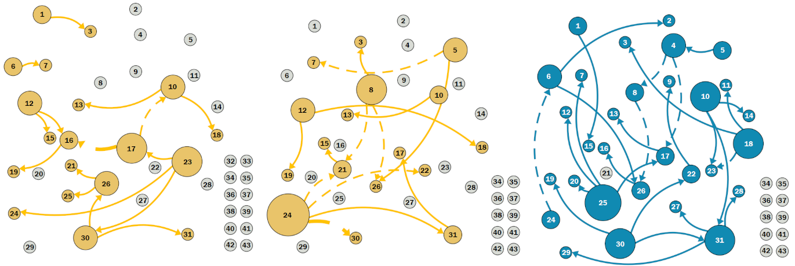
Colony 59 (No-Choice) Node size and edge width = out-strength

Slide 12
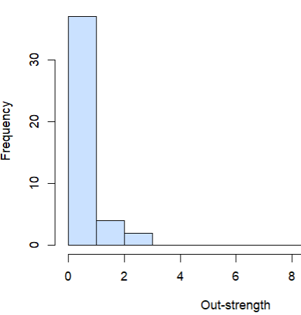
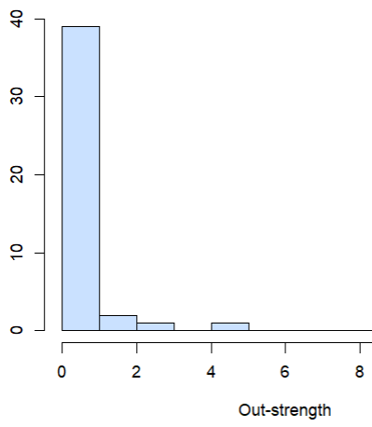
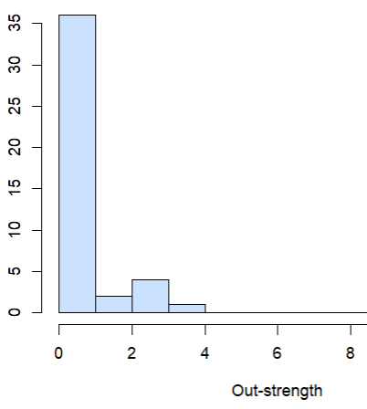
Colony 59 (No Choice) Out-strength distributions

Slide 13
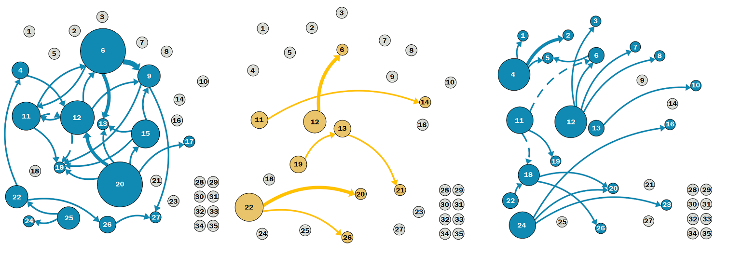
Colony 45 (No-Choice) Node size and edge width = out-strength

Slide 14
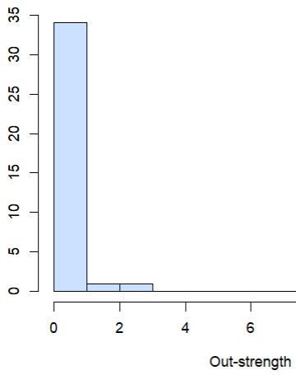
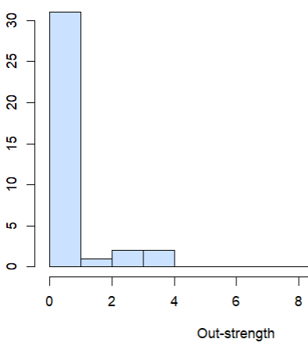
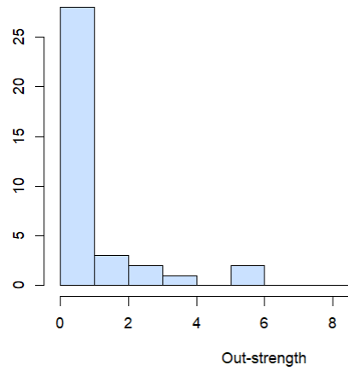
Colony 45 (No Choice) Out-strength distributions

Slide 15
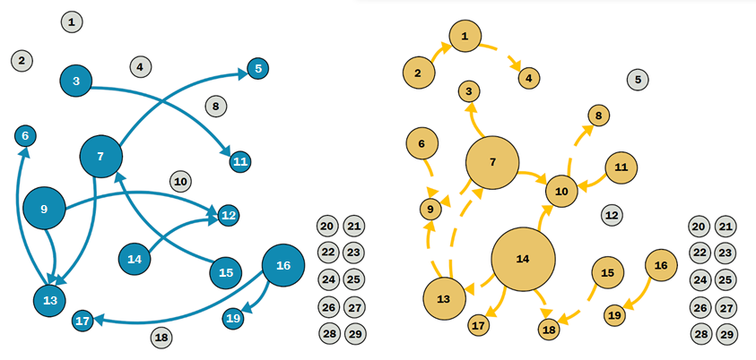
Colony 47 (No-Choice) Node size and edge width = out-strength Data from Trial #1 not recoverable due to missing videos

Slide 16
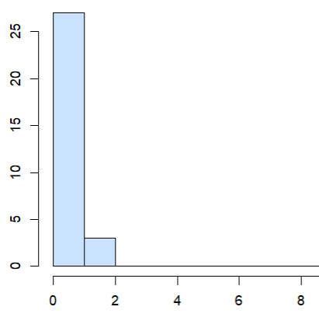
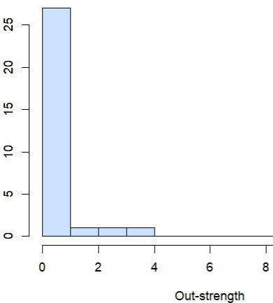
Colony 47 (No Choice) Out-strength distributions Data from Trial #1 not recoverable due to missing videos

Slide 17
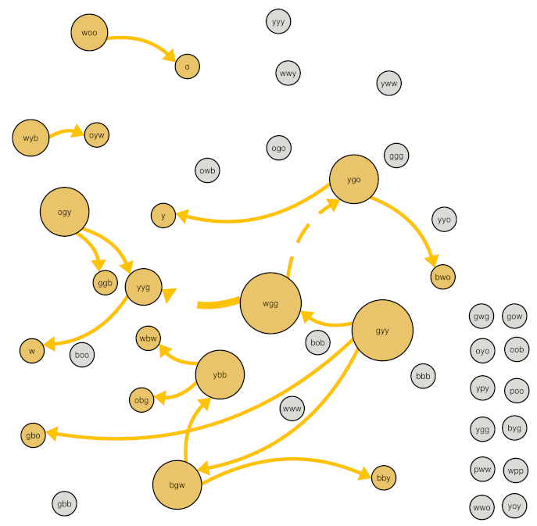
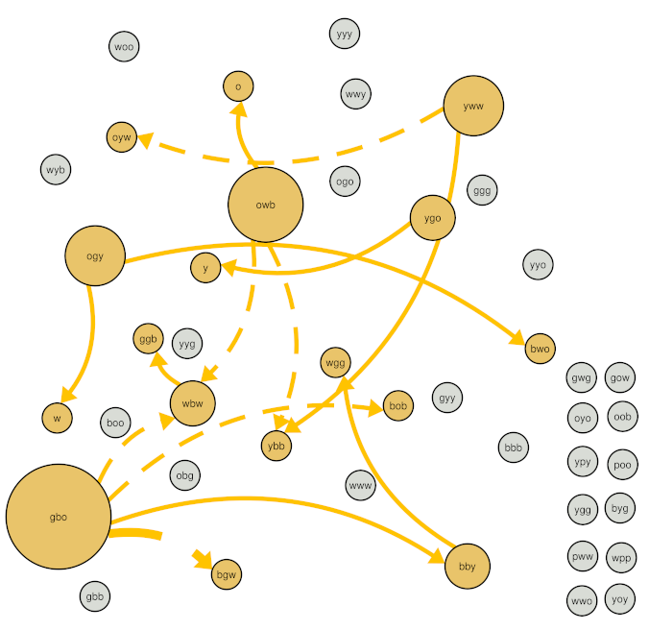
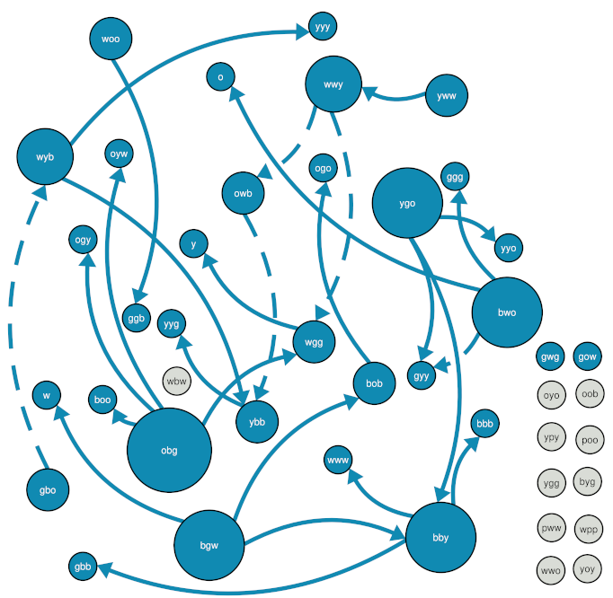
Colony 59 (No-Choice) Node size and edge width = out-strength

Slide 18
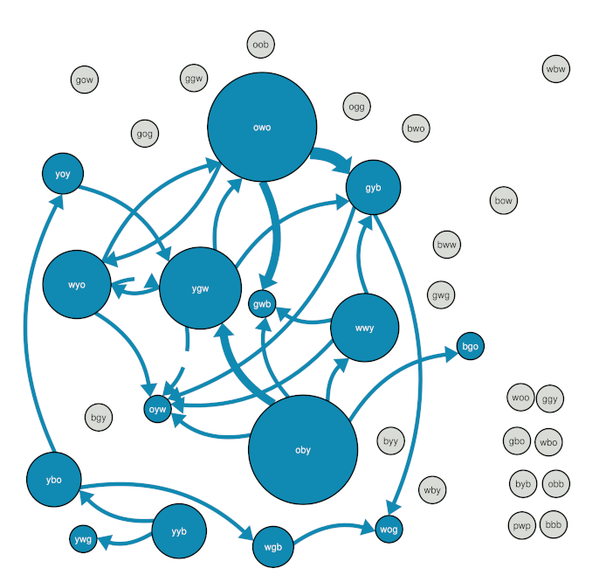
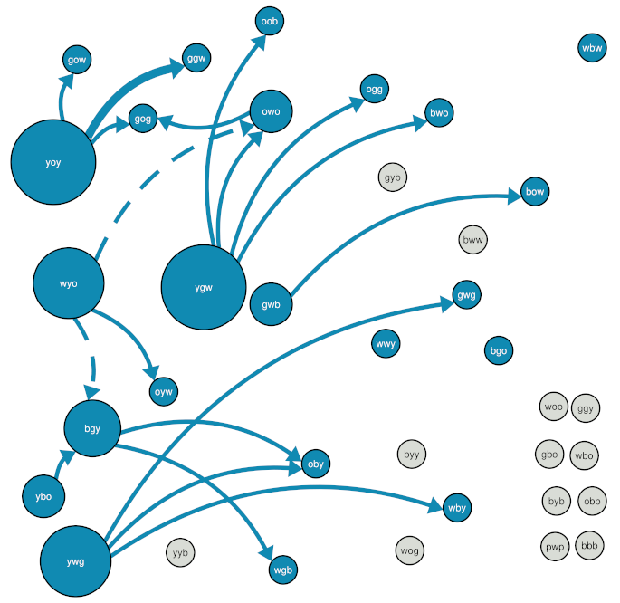
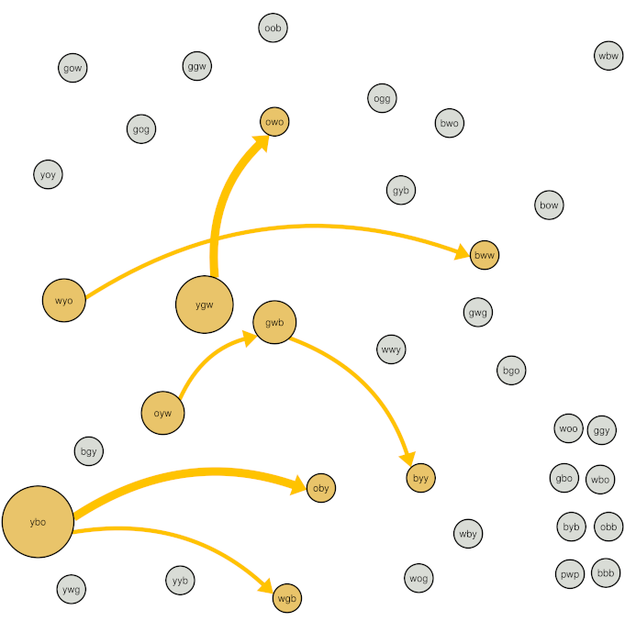
Colony 45 (No-Choice) Node size and edge width = out-strength

Slide 19
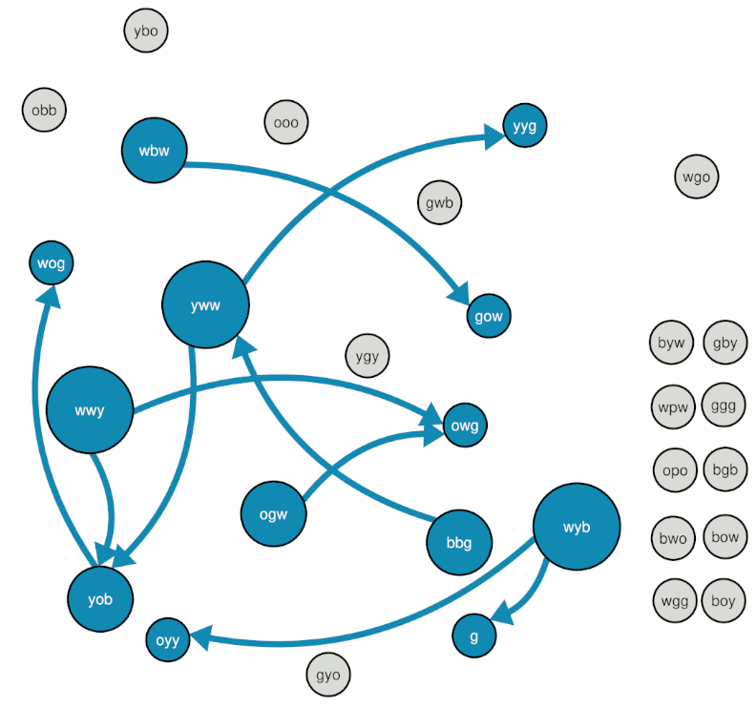
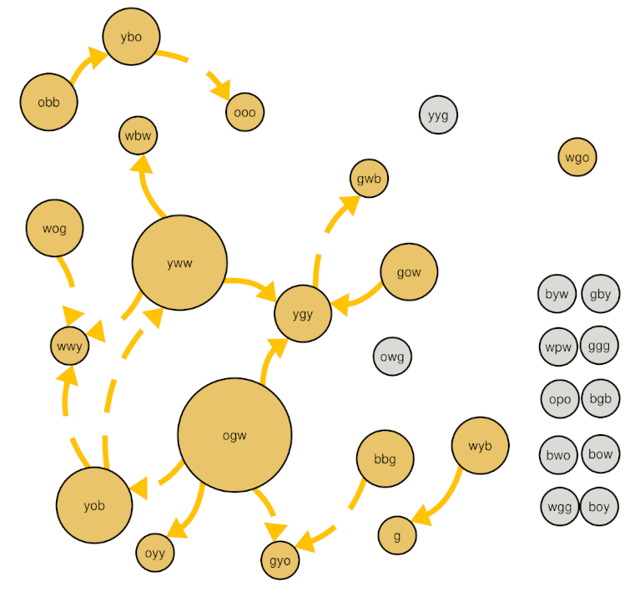
Colony 47 (No-Choice) Node size and edge width = out-strength Data from Trial #1 not recoverable due to missing videos

