Slide 1

FINAL REVIEW | EXPLORATORY DATA ANALYSIS
ETHUSDT.P 30-Minute Strategy:
Backtest Engine, Trade-Outcome EDA and Validated Optimization
A TradingView-exact Python backtester, exploratory analysis of 3,692 trades over 6.7 years,
and a fee-aware optimization checked on held-out data
Team 23: Suvansh • Mudit • Jacob
25BAI0252 • 25BAI0077 • 25BAI0110

Slide 2
OVERVIEW
Abstract
2/21
We built a Python backtest engine that reproduces TradingView's order-execution rules exactly, and used it to study a rule-based strategy on Binance ETHUSDT perpetual futures (30-minute bars, Nov 2019 - Aug 2026, 118,040 bars).
Every trade is stored with a full snapshot of its indicators at entry. Exploratory data analysis - quintile binning, correlation, subgroup and time-series analysis - showed where the strategy loses: one entry type, long-held trades and high-volatility entries. Fees turn a +227% gross result into -142% net.
Four rules derived from those findings, chosen by a sweep that must work on both 2019-23 and 2024-26, give +92% net with a drawdown cut from 198 to 40 points.
118,040
3,692
-142% → +92%
198 → 40
30m bars analysed
baseline trades studied
net return, baseline → optimized
max drawdown (points)
Exploratory Data Analysis - Final Review | Team 23

Slide 3
BACKGROUND
Literature Survey
3/21
▪ Backtest overfitting [1, 2]. Bailey et al. show that testing many variants on one window makes an inflated in-sample result almost certain; out-of-sample performance then collapses.
▪ Walk-forward / hold-out validation [3]. Pardo: fit on one period, judge on another, and only trust parameters that hold up on both.
▪ Exploratory Data Analysis [4]. Tukey: look at distributions, groups and outliers before modelling. Binning and subgroup comparison find structure that a single correlation number hides.
▪ Technical indicators [5, 6]. Wilder's ATR and DMI and Bollinger's bands are the standard, published building blocks used here, at their default settings.
▪ Risk-adjusted metrics [7]. Calmar ratio (return / max drawdown) rewards strategies that survive bad periods, not just ones with a high final number.
▪ Execution realism [8, 9]. TradingView's broker emulator has documented intrabar fill and tick-rounding rules; Binance charges 0.05% taker fee per side. Ignoring either makes a backtest wrong.
Exploratory Data Analysis - Final Review | Team 23

Slide 4
MOTIVATION
Problem Identification
4/21
▪ Strategies are usually tuned and judged in one tool on one period - nobody checks whether the edge holds across the full 6.7-year history.
▪ TradingView's Strategy Tester shows only totals (net profit, win rate, drawdown). It cannot say which market conditions at entry lead to wins or losses.
▪ Most retail backtests ignore trading fees. On a 30-minute strategy with thousands of trades, fees decide whether it makes or loses money.
▪ "Improving" a strategy by trying many settings easily overfits - a fair process needs a held-out check.
Exploratory Data Analysis - Final Review | Team 23

Slide 5
GOALS
Objectives
5/21
▪ Build a Python backtest engine that follows TradingView's execution rules exactly.
▪ Validate the engine trade-for-trade against a real TradingView trade export.
▪ Create a per-trade dataset: outcome + every indicator value at entry, gross and net of fees.
▪ Explore it with EDA - quintiles, correlation, subgroups, yearly breakdown - to find where losses come from.
▪ Optimize return-to-drawdown with rules that come from the EDA, scored on two separate periods.
▪ Package everything as a one-click, offline, reproducible demo.
Exploratory Data Analysis - Final Review | Team 23

Slide 6
CONTEXT
Existing Systems
6/21
Tool | What it does well | Gap for this project
TradingView Strategy Tester | Fast visual backtests, Pine Script | Totals only; no per-trade indicator export
Backtrader / Zipline | General Python backtesting | Fill rules differ from TradingView; results don't match
Excel / manual analysis | Easy to inspect | Does not scale to 118k bars / 3.7k trades
Exchange PnL reports | Real fees and fills | Only for trades already taken; no what-if
None of these combine TradingView-exact fills, a per-trade indicator dataset, fee-aware results and a fit/holdout optimizer in one pipeline - that is the gap this project fills.
Exploratory Data Analysis - Final Review | Team 23

Slide 7
SOLUTION
Proposed System
7/21
▪ Data layer: resumable downloader for Binance USD-M 30m candles; thin first-listing bars trimmed.
▪ Signal layer: TradingView-exact indicator maths (EMA, RMA, SMA, stdev, stochastic, DMI, ATR, tick rounding).
▪ Engine: one position at a time, next-bar-open fills, TradingView's intrabar TP/SL path rule, fees, and switchable rule variants (time-stop, volatility cap, trigger skip, ATR brackets).
▪ Validation: diffs every engine trade against a TradingView "List of trades" export.
▪ EDA layer: one row per trade with the full indicator snapshot; six analyses and charts.
▪ Optimizer: 200-candidate sweep ranked by the worse of the 2019-23 and 2024-26 Calmar ratios.
Exploratory Data Analysis - Final Review | Team 23

Slide 8
PIPELINE
Architecture / System Flow
8/21
Binance API
30m OHLCV
2019-2026
Signals
indicators.py
signals.py
Backtest Engine
engine.py
(fills + fees)
Validation
vs TradingView
export
Trade Dataset
1 row / trade
+ indicators
EDA
eda.py
6 analyses
Optimizer
optimize.py
fit / holdout
→
→
→
→
→
→
Data flows one way. Each stage only reads the previous stage's output, so each can be checked on its own: indicators against TradingView's formulas, engine trades against a real TradingView export, and EDA / optimizer results by re-running one command.
The optimizer feeds rule ideas back into the engine as configuration presets (baseline, optimized) - the strategy code itself is never edited to chase a result.
Exploratory Data Analysis - Final Review | Team 23

Slide 9
IMPLEMENTATION
Modules Description
9/21
fetch_binance_data.py
Downloads full ETHUSDT.P 30m history from Binance's public API; resumable, gap-checked.
indicators.py
TradingView-exact ta.* functions: ema, rma, sma, stdev, stoch, true range, DMI, crossover, tick rounding.
signals.py
Strategy rules: bb_cross (trend-aligned mean reversion) and dmi_trend (trend continuation); TP/SL levels.
engine.py
Sequential backtester: next-bar fills, intrabar TP/SL path, fees, time-stop, ATR cap, trigger skip, ATR brackets.
main.py
CLI: --preset baseline | optimized; writes one row per trade with the indicator snapshot.
validate.py
Trade-by-trade diff against a TradingView export (handles its timezone and two-rows-per-trade layout).
eda.py
Equity, yearly, trigger, quintile, correlation and holding-time analyses + text summary.
optimize.py
200-candidate sweep; Calmar on 2019-23 and 2024-26, ranked by the worse of the two.
Exploratory Data Analysis - Final Review | Team 23

Slide 10
METHODOLOGY
Dataset and Strategy Rules
10/21
Dataset
Source | Binance USD-M Futures public API
Instrument | ETHUSDT perpetual (ETHUSDT.P)
Timeframe | 30-minute candles
Period | 27 Nov 2019 - 21 Aug 2026
Rows | 118,040 bars (OHLCV + trade count)
Costs | 0.05% taker fee per side (0.10% round trip)
Baseline strategy (standard settings)
▪ bb_cross: uptrend (EMA50 > EMA200) + close crosses back above lower Bollinger band (20, 2) + Stochastic %K(14) < 25 → long. Mirror for short.
▪ dmi_trend: +DI - -DI (14) crosses above +20 with price above EMA50 → long. Mirror for short.
▪ Exit: fixed 1.5% take-profit / 1.5% stop-loss bracket.
▪ Execution: signal on bar close, fill at next bar's open, one position at a time.
Exploratory Data Analysis - Final Review | Team 23

Slide 11
CORRECTNESS
Engine Validation against TradingView
11/21
▪ Method: ran a reference strategy in both TradingView and our engine on the same data, then compared entry time, exit time, prices and return for every trade.
▪ Intrabar rule: when TP and SL are both inside one candle, TradingView assumes open → nearer extreme → farther extreme. The engine copies this.
▪ Tick rounding: limit prices round toward a better fill, stops toward never triggering early - matched TradingView's exit prices to the cent.
▪ Bugs caught: TradingView exports in the account's timezone (New York, DST-aware), not UTC; one indicator had a sign error. Both invisible without trade-level checking.
1,858 / 1,864
trades matched a TradingView
export exactly (99.7%)
2 bugs
found only because of the diff:
timezone + formula sign
Exploratory Data Analysis - Final Review | Team 23

Slide 12
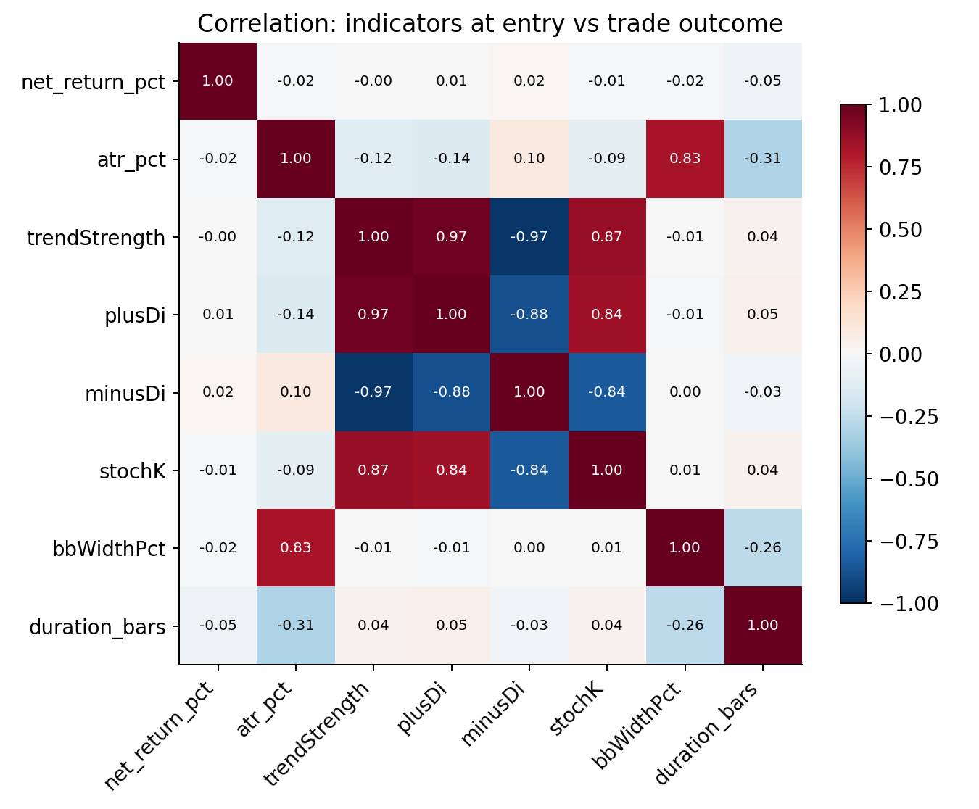
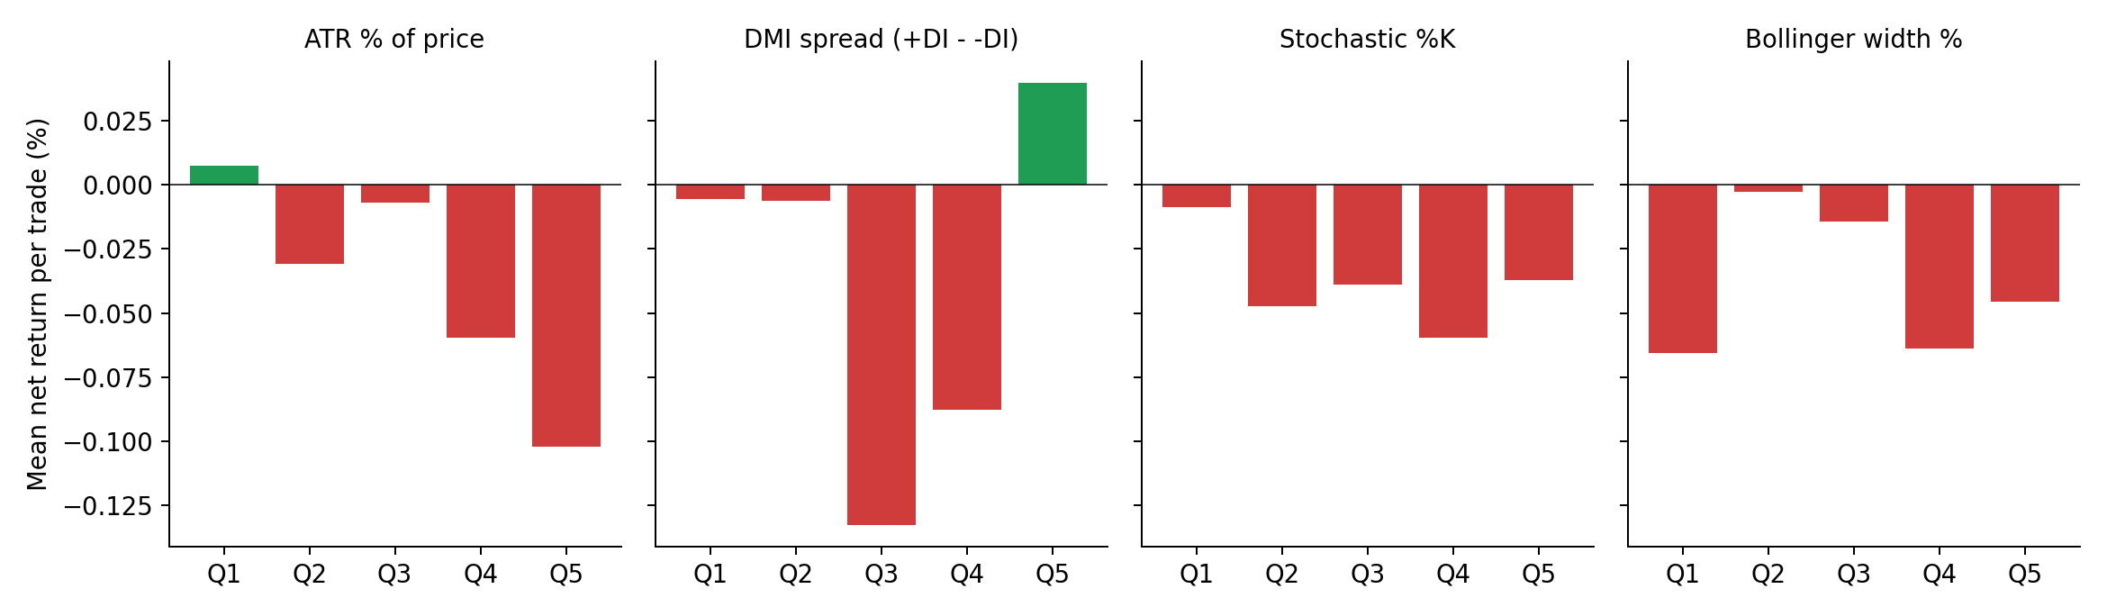
EDA 1/3
Correlation Hides It, Binning Finds It
12/21
▪ Every indicator's linear correlation with the trade result is near zero (|r| ≤ 0.05).
▪ Split into quintiles, a clear pattern appears: the most volatile entries (ATR% Q5) lose -0.10% per trade, the calmest (Q1) are the only positive group.
▪ DMI: only the strongest-trend quintile (Q5) makes money.
▪ Lesson: a non-linear relationship needs binning, not just correlation.
Exploratory Data Analysis - Final Review | Team 23

Slide 13
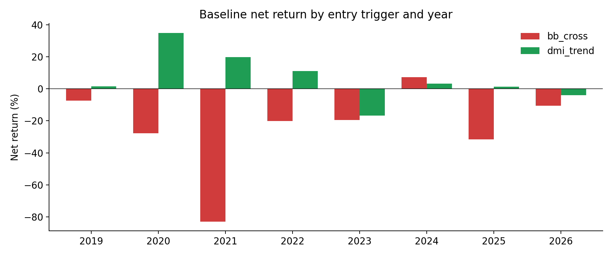
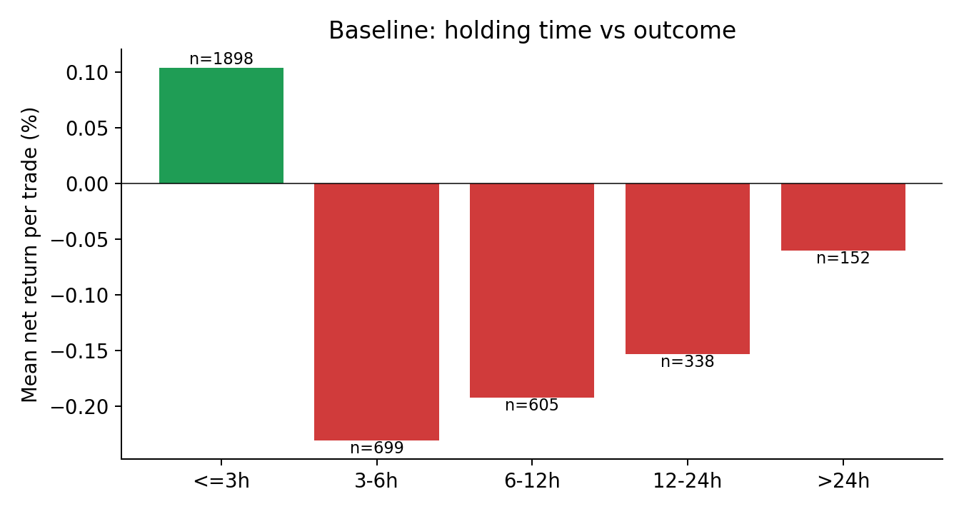
EDA 2/3
Which Trades Lose Money
13/21
Trigger | Trades | Win rate | Mean net / trade
bb_cross | 934 | 46.5% | -0.206%
dmi_trend | 2,758 | 54.0% | +0.018%
▪ bb_cross loses money in 7 of 8 years - it is a structural loser, not bad luck.
▪ Trades closed within 3 h make +0.10%; every longer bucket loses (-0.06% to -0.23%).
▪ If a trade hasn't hit TP fast, it usually won't.
Exploratory Data Analysis - Final Review | Team 23

Slide 14
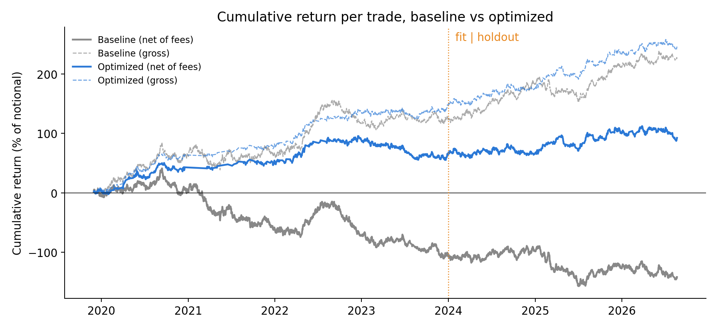
EDA 3/3
The Fee Effect: Gross vs Net
14/21
+227.5%
baseline, gross (before fees)
-141.7%
baseline, net of 0.10% per trade
3,692 trades × 0.10% = 369 points of fees. Average gross edge is only +0.06% per trade, so fees wipe it out. Fewer, better trades matter more than more trades.
Exploratory Data Analysis - Final Review | Team 23

Slide 15
OPTIMIZATION
From EDA Findings to Rules
15/21
EDA finding | Rule added | Grid tested
bb_cross loses in 7 of 8 years | Skip bb_cross entries | on / off
Trades open > 3 h lose | Time-stop after N bars | none, 12, 24, 48
Volatile ATR% quintile is worst | Skip entry if ATR% > cap | none, 0.6, 0.8, 1.0, 1.3
Fixed % ignores volatility | TP / SL as ATR multiples | fixed, 2/2, 3/2, 2/3, 4/3
▪ 200 candidates (2 × 4 × 5 × 5), each scored separately on 2019-2023 (fit) and 2024-2026 (holdout).
▪ Ranked by the worse of the two Calmar ratios - a rule set cannot win by being great on one half and bad on the other.
▪ Winner: skip bb_cross + 24-bar (12 h) time-stop + ATR cap 0.8% + TP 4×ATR / SL 3×ATR. Worst-half Calmar 1.07 (baseline: -0.71).
Exploratory Data Analysis - Final Review | Team 23

Slide 16
RESULTS
Baseline vs Optimized (net of fees)
16/21
 | Trades | Win rate | Gross | Net | Max DD | Calmar | Fit 19-23 | Holdout 24-26 | +ve years
Baseline | 3,692 | 52.1% | +227.5% | -141.7% | 198.1 | -0.72 | -0.71 | -0.51 | 2 / 8
Optimized | 1,534 | 46.3% | +245.8% | +92.4% | 40.3 | 2.29 | 1.60 | 1.07 | 6 / 8
+234 pts
-80%
-58%
both halves
net return improvement
max drawdown (198 → 40)
trades (less fee drag)
positive Calmar (fit and holdout)
Win rate goes down (52% → 46%) while profit goes up: the ATR bracket lets winners run to 4×ATR and cuts losers at 3×ATR, so the average win is larger than the average loss. Win rate alone is a misleading metric - a key EDA takeaway.
Exploratory Data Analysis - Final Review | Team 23

Slide 17
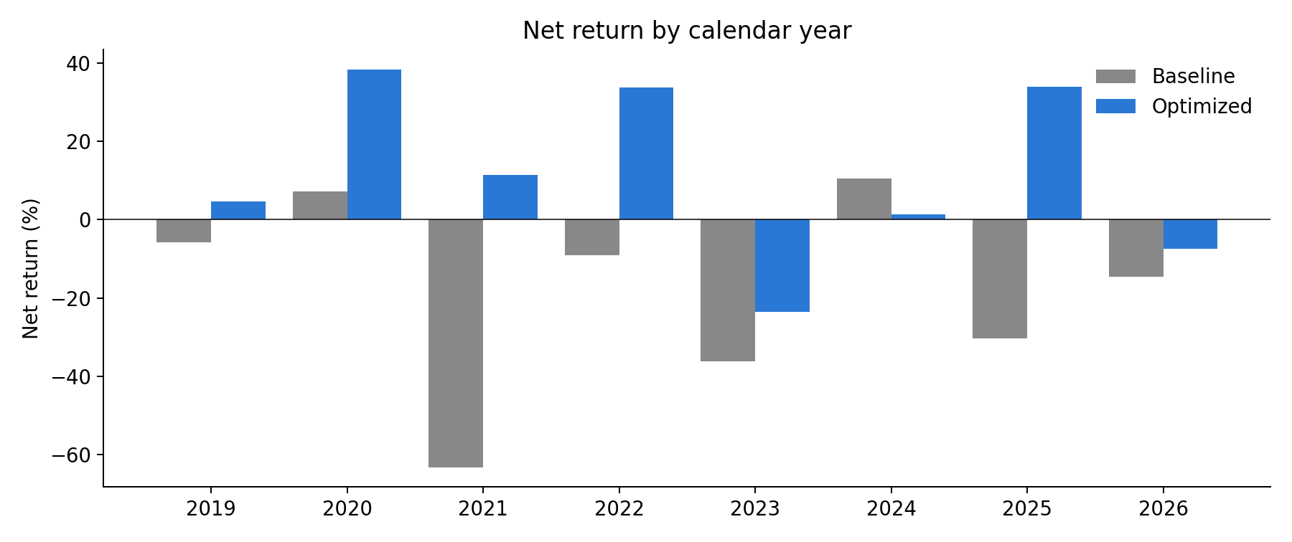
RESULTS
Year-by-Year Robustness
17/21
Year | Baseline | Optimized
2019* | -5.8 | +4.6
2020 | +7.2 | +38.3
2021 | -63.2 | +11.4
2022 | -9.1 | +33.8
2023 | -36.2 | -23.5
2024 | +10.4 | +1.3
2025 | -30.4 | +33.9
2026* | -14.6 | -7.4
Net return % per calendar year (*partial years). The optimized rules are positive in 6 of 8 years versus 2 of 8. 2023 (a quiet, range-bound year) is still negative - an honest limitation: the trend trigger needs trends.
Exploratory Data Analysis - Final Review | Team 23

Slide 18
DEMO
Live Demonstration
18/21
1
Double-click run_demo.bat
Installs pandas / numpy / matplotlib; data is bundled - works offline.
2
Baseline backtest
118,040 bars → 3,692 trades → output/trades_with_indicators.csv
3
Optimized backtest
Same engine, optimized preset → 1,534 trades
4
EDA
eda.py writes 6 charts to figures/ and the summary table to output/eda_summary.txt
5
(Optional) optimize.py
Re-runs the 200-candidate fit/holdout sweep → output/optimize_sweep.csv
Exploratory Data Analysis - Final Review | Team 23

Slide 19
SUMMARY
Conclusion
19/21
▪ Correct engine first: matching TradingView trade-for-trade caught two silent bugs that would have made every later analysis wrong.
▪ EDA explains the losses: one entry type, slow trades and high-volatility entries - found with binning and subgroups, not visible in correlation.
▪ Fees are decisive: a strategy with +227% gross loses 142% net. Any short-timeframe backtest must report both.
▪ Disciplined optimization works: 4 EDA-based rules, chosen on the worse of two periods, turn -142% into +92% net and cut drawdown by 80%.
▪ Honest limits: 2 of 8 years still negative; no funding rates or slippage; past data does not guarantee future results.
Exploratory Data Analysis - Final Review | Team 23

Slide 20
NEXT STEPS
Future Work
20/21
▪ Funding rates and slippage added to the cost model for fully realistic net results.
▪ Rolling walk-forward (re-fit every year, test on the next) instead of a single fit/holdout split.
▪ More markets - run the same rules on BTC, SOL and other coins to test whether findings generalise.
▪ Machine-learning filter trained on the per-trade indicator dataset to score entries before taking them.
▪ Paper trading via the Binance testnet to compare live fills with the backtest.
▪ Interactive dashboard to explore trades and EDA results without code.
Exploratory Data Analysis - Final Review | Team 23

Slide 21
REFERENCES
References
21/21
[1] D. H. Bailey, J. M. Borwein, M. Lopez de Prado, Q. J. Zhu, "Pseudo-Mathematics and Financial Charlatanism: The Effects of Backtest Overfitting on Out-of-Sample Performance," Notices of the AMS, 61(5), 2014.
[2] D. H. Bailey, M. Lopez de Prado, "The Deflated Sharpe Ratio," Journal of Portfolio Management, 40(5), 2014.
[3] R. Pardo, The Evaluation and Optimization of Trading Strategies, 2nd ed., Wiley, 2008.
[4] J. W. Tukey, Exploratory Data Analysis, Addison-Wesley, 1977.
[5] J. W. Wilder, New Concepts in Technical Trading Systems, Trend Research, 1978.
[6] J. Bollinger, Bollinger on Bollinger Bands, McGraw-Hill, 2001.
[7] T. W. Young, "Calmar Ratio: A Smoother Tool," Futures, 20(1), 1991.
[8] TradingView, Pine Script v5 User Manual - Strategies (broker emulator), tradingview.com/pine-script-docs.
[9] Binance, USD-M Futures API documentation and fee schedule, developers.binance.com.
Exploratory Data Analysis - Final Review | Team 23

Slide 22
Thank You
Questions?
Team 23 • Suvansh • Mudit • Jacob

