Slide 1

haven.
HOUSING AND VISIBILITY EDINBURGH NETWORK
Making the hidden costs and barriers of renting in Edinburgh visible
Notes:
Introduce yourself and the module. Haven stands for Housing And Visibility Edinburgh Network: a prototype decision-support tool that helps renters see what a listing doesn’t tell them before they commit to a property. The logo is Edinburgh’s castle rock and a tenement gable under a low sun: the city we built Haven for, and the idea of finding a place of refuge in it.

Slide 2
Listings show the rent, not what living there involves
THE PROBLEM
Hidden costs
Personal barriers
Hard-to-see condition
Council tax and energy bills rarely appear in a listing, yet they can turn an affordable rent into an unaffordable home.
A single step or an unreliable lift can rule a home out for a disabled renter, and accessible homes are scarce (EHRC, 2018).
Damp and mould seldom show in listing photos, yet they are linked to respiratory illness and asthma (WHO, 2009).
Notes:
A listing gives asking rent, bedrooms and a location. What a renter actually needs to judge is spread across many sources or not visible at all. Three gaps: the true monthly cost, whether the home and its routes work for this particular person, and condition problems such as damp that photos hide. Akerlof’s “market for lemons” describes exactly this: when one side can’t judge quality, the market serves them badly.

Slide 3
Scotland is under severe housing pressure
WHY IT MATTERS
40,688
17,240
34%
+46%
homelessness applications in Scotland in 2024–25
households in temporary accommodation, a record, including 10,180 children
of Scottish households were in fuel poverty in 2023
advertised two-bed rents in Lothian, 2010 to 2019
Scottish Government (2025)
Scottish Government (2024)
Scottish Government (2019)
Scottish Government (2025)
Edinburgh declared a housing emergency in November 2023 (City of Edinburgh Council, 2024), and severe “core” homelessness in Scotland rose 11% from 2020 (Watts-Cobbe et al., 2024).
Notes:
Every wrong move costs more when the market is this tight. Homelessness applications were 40,688 in 2024–25, and on 31 March 2025 a record 17,240 households were in temporary accommodation, including 10,180 children. A third of households are in fuel poverty, so energy costs are not a footnote. Advertised two-bed rents in Lothian rose about 46% between 2010 and 2019. Edinburgh became the first Scottish council to declare a housing emergency in November 2023, and the Homelessness Monitor (Heriot-Watt) found core homelessness up 11% since 2020. Haven can’t fix supply, but it can help renters avoid committing to a home they can’t afford or can’t use.

Slide 4




Haven turns a listing into evidence a renter can act on
OUR APPROACH
True cost
Suitability
Screening
Explanation
Calculation
Transparent rules
Scoped ML
Plain language
Rent, council tax and modelled energy costs against the renter’s budget
Steps, lifts and walking or wheelchair routes against the renter’s needs
Flags possible damp, mould or entrance steps in uploaded photos
What works, what may not, and what to check before signing
Evidence before prediction: every result shows its source and uncertainty, and Haven can answer “insufficient evidence” rather than guess.
Notes:
Each question gets the simplest method that can answer it. Cost is arithmetic from public data: Edinburgh council tax bands, the Ofgem price cap and EPC-based energy use. Suitability is a set of transparent rules against the renter’s profile, using OpenStreetMap and openrouteservice routes. Machine learning is reserved for things you can’t calculate, like spotting possible damp in a photo, and it must be able to abstain. The output is a report, not a score: it supports the renter’s judgement and never certifies a property as safe or accessible.

Slide 5






Tech stack and architecture
HOW IT FITS TOGETHER
Web app
REST / JSON
Haven API
Postgres
React 19 · TypeScript · Vite · Tailwind CSS
Python 3.12 · FastAPI · Pydantic · SQLModel
Tiger Cloud · TimescaleDB · profiles · reports · uploads
Cost
Rules
Location
Screening
Explain
sign-in
Reference data
Ofgem · EPC · council tax · rent statistics
photo · prompt → JSON
Auth0
Accounts for saved and assisted features
verifies JWT
Google Gemini API
Location data
Photo screening · optional report wording
OpenStreetMap · openrouteservice routes
Tooling: uv · ruff · mypy · pytest · GitHub Actions CI · Docker Compose · OpenAPI contract with Prism mock
ML workspace: synthetic test documents · document-extraction evaluation · labelled photo evaluation planned
Notes:
Three layers. The React and TypeScript front end talks to a FastAPI backend over a typed OpenAPI contract; a Prism mock server let the front end be built before the engines existed. Inside the API are separate engines for cost, accessibility rules, location, screening and plain-language explanation. Reference data (Ofgem price cap, Scottish EPC data, Edinburgh council tax and Scottish Government rent statistics) is ingested by scripts with its source and date recorded. Location data comes from OpenStreetMap and openrouteservice walking and wheelchair routes. Auth0 handles sign-in, and the API checks the access token. Postgres on Tiger Cloud stores profiles, reports, uploads and saved homes. Photo screening uses the Google Gemini API: after a local photo-quality check, the photo is resized, stripped of metadata and sent to Gemini, which rates possible damp, mould and entrance steps as structured JSON. Haven never shows a confidence score for these ratings and drops any wording that sounds like a diagnosis. Gemini can optionally reword report sentences, and the reworded version is rejected if it changes what is cited. The separate ML workspace holds synthetic test documents and the evaluation harness for document extraction; evaluating Gemini against labelled Edinburgh photos and a null baseline is the next step, so its ratings are presented as things to check, not findings.

Slide 6
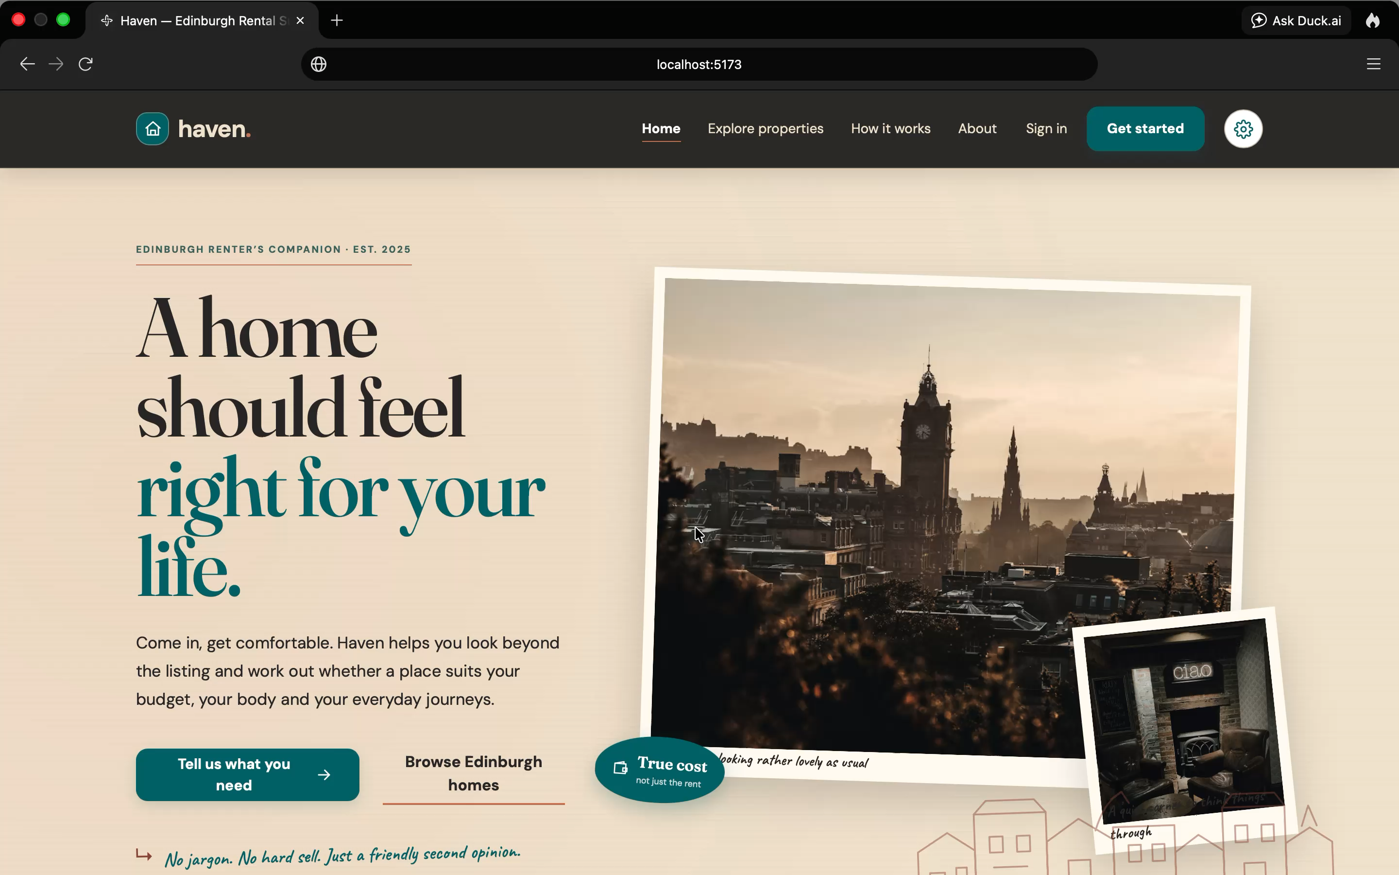
Demo
Notes:
Switch to the live app. Suggested path (about 3 minutes): create a renter profile with a budget and step-free access needs, pick an illustrative Edinburgh property, show the true monthly cost against the budget, show the suitability checks and routes, upload a sample photo for screening, then open the final report with its sources and “what to check before signing”.

Slide 7
What it takes to reach production
NEXT STEPS
1
2
3
4
Screening models
Deploy and operate
Security
Test with renters
Build a consented Edinburgh test set; ship a model only if it beats the null baseline
Hosting, CI/CD, monitoring, and scheduled refreshes of quarterly data such as the price cap
Production Auth0 tenant, shared rate limits in Redis, managed and rotated secrets
Usability and accessibility testing with disabled and student renters; legal review
Notes:
Haven is a working prototype, not a product. To get to production: first, real data. The properties are fictional seed data, so we need user-entered listings or a licensed feed, and some sources (the council tax PDF) have no open licence yet. Second, persistence: the Tiger Cloud Postgres database is connected but has no schema; uploads still go to local disk. Third, the screening models: they need a consented, anonymised Edinburgh evaluation set and must beat a null baseline before going live. Fourth, security: a production Auth0 tenant with a custom domain, rate limits moved from memory to Redis, and proper secret management. Fifth, deployment and operations, including refreshing data like the Ofgem price cap every quarter. Finally, test with real renters, especially disabled renters, and get legal review of the disclaimers.

Slide 8
References
Akerlof, G.A. (1970) ‘The market for “lemons”: quality uncertainty and the market mechanism’, The Quarterly Journal of Economics, 84(3), pp. 488–500.
City of Edinburgh Council (2024) Housing Emergency Action Plan. Edinburgh: City of Edinburgh Council.
Equality and Human Rights Commission (2018) Housing and disabled people: Scotland’s hidden crisis. Glasgow: EHRC.
Scottish Government (2019) Private Sector Rent Statistics, Scotland, 2010 to 2019. Edinburgh: Scottish Government.
Scottish Government (2024) Scottish House Condition Survey: 2023 Key Findings. Edinburgh: Scottish Government.
Scottish Government (2025) Homelessness in Scotland: 2024–25. Edinburgh: Scottish Government.
Watts-Cobbe, B., Bramley, G., McMordie, L., Pawson, H., Young, G. and Fitzpatrick, S. (2024) The Homelessness Monitor: Scotland 2024. London: Crisis.
World Health Organization (2009) WHO guidelines for indoor air quality: dampness and mould. Copenhagen: WHO Regional Office for Europe.
Notes:
Harvard style. Akerlof, the Homelessness Monitor (Heriot-Watt University researchers) and the WHO guidelines are the academic and scientific sources; the Scottish Government figures are official statistics.

Slide 9






The Team Responsible For Haven
Stephen Olaluwoye
Emma White
Charlie Bloomfield
Scan a code to connect with us on LinkedIn
Notes:
Thank the audience and introduce each team member. Invite people to scan the QR codes to connect on LinkedIn, then open the floor to questions.

