Slide 1
Should we change the launch message next week?
DATA ANALYSIS AND VISUALIZATION · MIDTERM PROJECT
Social-media sentiment analysis for a new F&B product launch, using 1.6 million tweets from Sentiment140
Group VibeCoding_Expert
Ngo Lam Tien (leader) · Nguyen Cong Thanh · Nguyen Le Nhat Tam · Ngo Binh Minh
Lecturer: Ho Thi Linh, Ph.D. · Ton Duc Thang University · 16 October 2026
Notes:
Speaker: Ngo Lam Tien. Good morning. Our group played the social listening team of an F&B brand that has just launched a new product. Reactions in launch week were mixed, and marketing asked one question: should we change the message next week? In the next twelve minutes we answer it with the four types of analytics from the course.

Slide 2
One business question, four analytical questions
THE DECISION
Marketing needs a yes/no decision within days. We broke it down with the four types of analytics from Chapter 1, and fixed four hypotheses before looking at any result.
1
Descriptive What happened?
2
Diagnostic Why did it happen?
How big is the F&B conversation, what is it about, and how negative is it compared with all tweets?
Which aspects of the experience and which moments go together with negative tweets?
3
Predictive What will happen?
4
Prescriptive What should we do?
Can a model trained on past weeks label next week's tweets reliably?
Which message changes, how much impact, and when should the team be alerted?
Hypotheses: H1 service & waiting · H2 price & value · H3 morning caffeine differ from the rest of F&B · H4 launch-week lift differs from baseline. Practical threshold: ≥ 5 pp.
Notes:
Speaker: Ngo Lam Tien. Following Chapter 1, we turned the broad question into four data questions, one per type of analytics. We also wrote four hypotheses down in advance and a practical threshold of five percentage points, because with this many tweets almost everything is statistically significant.

Slide 3
Keep the core message, fix three pain points
EXECUTIVE SUMMARY
−5.1 pp
p = 0.37
0.896
3
F&B tweets are less negative than all tweets (negative lift)
Launch week is no different from the baseline weeks (H4)
ROC-AUC of our model on the unseen next week
product issues to fix: availability, service, price
Recommendation
No rewrite: the mixed reactions are the normal mix of the category, not a launch backlash.
Targeted fixes where tweets are most negative: availability (+45.3 pp), price (+5.6 pp), service (+5.4 pp, evening +10.2 pp).
Creative around trying and sharing; daily monitoring with an alert limit of +1.5 pp.
Notes:
Speaker: Ngo Lam Tien. Here is the answer first. The F&B conversation is about five points less negative than Twitter, launch week looks like any other week, and our model predicts next week with an AUC of 0.896. So we do not recommend rewriting the message. Instead we target three pain points. The rest of the talk shows the evidence.

Slide 4
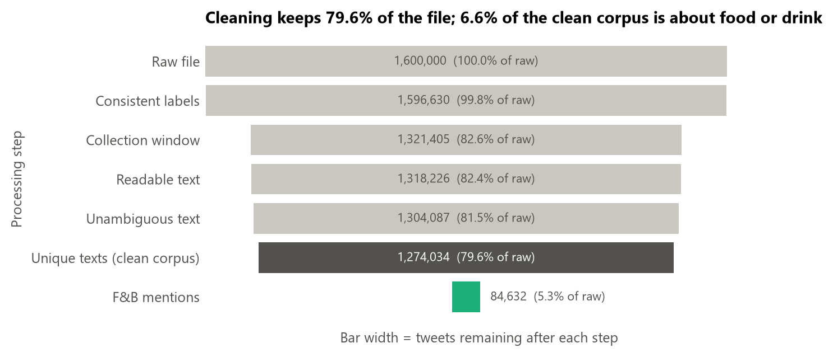
1.6 million tweets, one usable F&B stream
DATA
Source
Sentiment140 (Go et al., 2009), Kaggle copy: 1,600,000 tweets, Apr-Jun 2009, 659,775 users
Labels
From emoticons (0 = negative, 4 = positive); no neutral class; emoticons removed from the text
Coverage
Only 48 of 81 days contain tweets; every timestamp is in Pacific time
Proxy
Food & drink tweets stand in for the brand's category conversation: 6 categories, 41 brands
Check
210-tweet stratified review: dictionary precision 89.0% (95% CI 84.8-93.3%), AI-assisted
Cleaning keeps 1,274,034 tweets (79.6%); 84,632 of them are about food or drink.
Notes:
Speaker: Nguyen Cong Thanh. Sentiment140 is 1.6 million tweets labelled automatically by emoticons. It is not about one brand, so we use the 84,632 food-and-drink tweets as the category conversation in which a new product would be discussed. A manual review of 210 tweets, done with AI assistance, shows the keyword filter is right about 89 percent of the time.

Slide 5
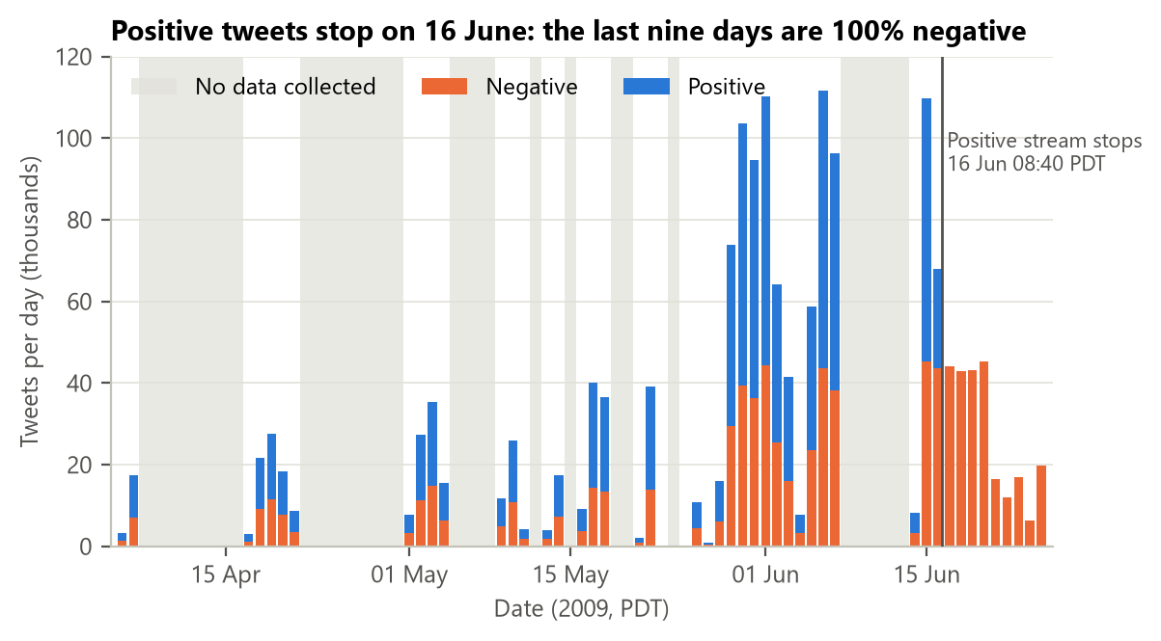
A trap in the file: positive tweets stop on 16 June
DATA QUALITY
275,225
tweets after 16 June 08:40 PDT, and 100% of them are negative
Removed from every analysis: keeping them would fake a sentiment collapse.
Also removed: 1,685 contradictory ids and 30,053 repeated texts (bots).
Positive and negative were collected separately, so we compare groups (lift, odds ratios), never absolute shares.
Notes:
Speaker: Nguyen Cong Thanh. Before cleaning we plotted tweets per day and label. After 8:40 on 16 June the file only contains negative tweets: the collector simply stopped searching for happy emoticons. We removed that tail. This also tells us the overall positive-negative ratio is an artifact, so from here on we always compare groups, as Chapter 3 teaches with raw numbers versus rates.

Slide 6
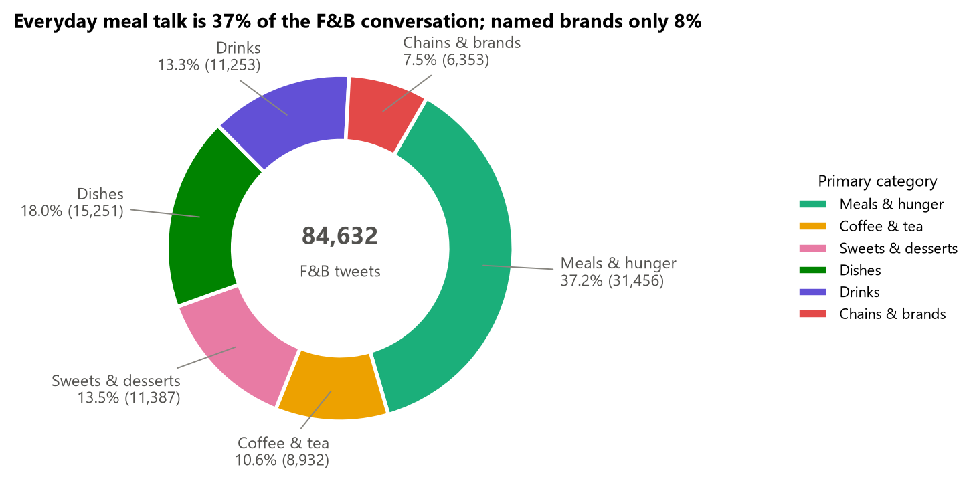
F&B talk is everyday, and less negative than Twitter
DESCRIPTIVE ANALYTICS
Only 7.5% of F&B tweets name a brand. The F&B lift stays near −5 pp in every period (launch week −5.4 pp, baseline −5.1 pp).
Notes:
Speaker: Nguyen Cong Thanh. More than a third of the conversation is everyday meal talk, and only 7.5 percent names a brand, so a brand that listens only for its own name misses most of it. On the right, F&B tweets are about five points less negative than all tweets, and launch week is no exception.

Slide 7
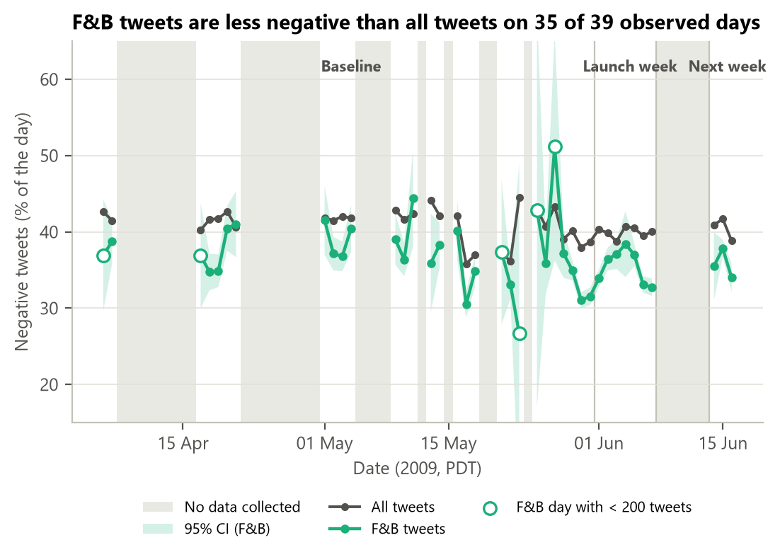
Launch week looks like any other week
DESCRIPTIVE ANALYTICS
35 of 39
observed days with F&B less negative than all tweets
The spikes are days with fewer than 200 F&B tweets: wide CIs, not events.
Brands: 20 of 41 make up 80% of mentions; Starbucks alone 20%.
Negative tweets are 1.3 words longer, but Cohen's d = 0.20 (small).
Notes:
Speaker: Nguyen Cong Thanh. Over time the F&B line stays below the all-tweets line on 35 of 39 days. The few spikes happen on days with very few tweets, where the confidence band is wide, so we do not read them as events. Nothing special happens in launch week. Tam will now look for the reasons behind the negative tweets.

Slide 8
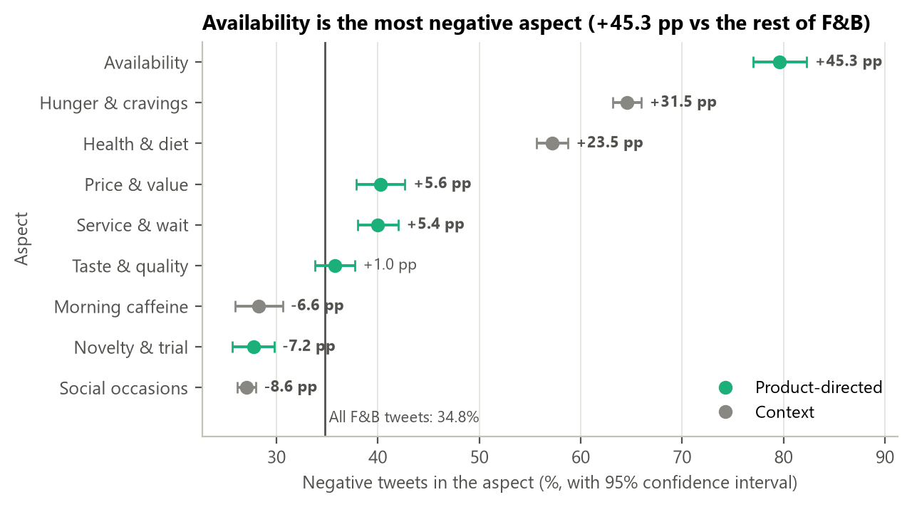
Availability, price and service drive negative talk
DIAGNOSTIC ANALYTICS
Hypotheses (Holm-corrected)
H1
Service & wait
+5.4 pp supported
H2
Price & value
+5.6 pp supported
H3
Morning caffeine
−6.6 pp supported
H4
Launch vs baseline
−0.3 pp, p = 0.37 not supported
Logistic regression (holding other factors and the day fixed): availability OR 7.2, novelty OR 0.66.
Notes:
Speaker: Nguyen Le Nhat Tam. For each aspect we compared its negative share with the rest of F&B, with 95 percent confidence intervals from Chapter 4. Availability problems are 45 points more negative. Price and service pass our 5-point threshold. Trying something new is actually more positive. H1 to H3 hold after the Holm correction; H4 does not, so launch week did not change the picture. The logistic regression confirms availability with an odds ratio of 7.2.

Slide 9
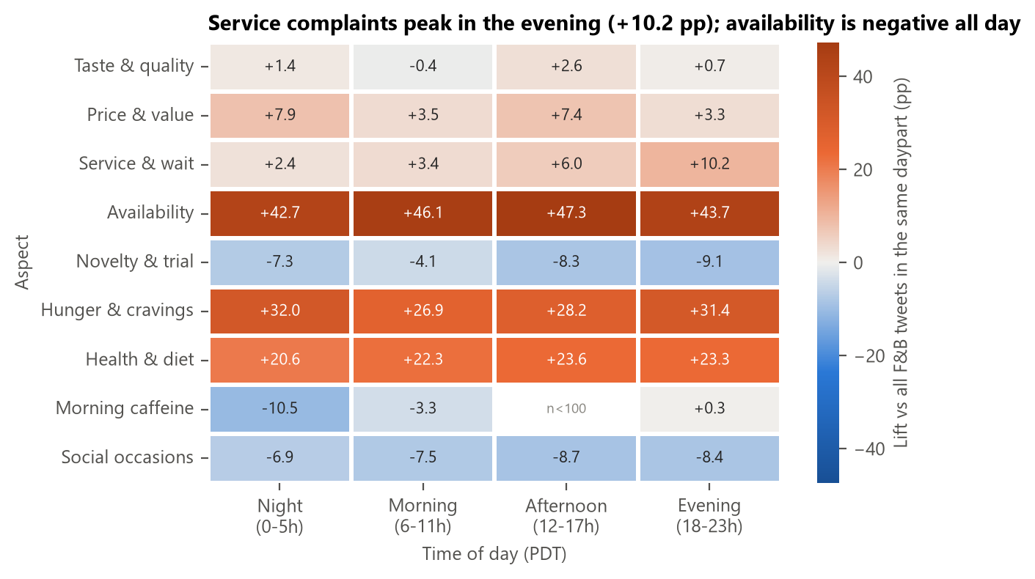
Complaints depend on the moment, not only the product
DIAGNOSTIC ANALYTICS
Service complaints peak in the evening (+10.2 pp); food around work and breaks is +13.7 pp, while home, family and morning moments are clearly positive.
Notes:
Speaker: Nguyen Le Nhat Tam. Two views of when negativity happens. The heatmap shows service complaints are worst in the evening. The topic model, NMF on the tweets with food words removed, finds the moments people talk about: food around work and breaks is almost 14 points more negative, while cooking at home, family weekends and mornings are positive. Minh will now show whether we can predict next week.

Slide 10
Trained on the past, tested on next week
PREDICTIVE ANALYTICS
Train
6 Apr - 31 May · 653,345 tweets
Validation
1 - 7 Jun (launch week) · 469,953 tweets
Gap
8 - 13 Jun · no data
Test
14 - 16 Jun (next week) · 150,736, used once
Why split by time and not at random?
BASELINE
ADVANCED
Matches real use: the model is trained on the past and applied to next week.
No leakage between days that share topics and conversations.
Reveals drift; a random split hides it (Chapter 7: prediction refers to future values).
Multinomial Naive Bayes
Logistic Regression
Word counts, 47,118 words, alpha tuned on validation (3.0). The classic baseline for this dataset.
TF-IDF of words and word pairs (300,000 terms), C tuned (2.0), class weights, threshold 0.44 chosen on validation.
Notes:
Speaker: Ngo Binh Minh. The model will be used on tweets that do not exist yet, so we split by time: train on April and May, tune on launch week, and test once on the next week. A random split would mix tweets from the same days and overstate performance. We compare a Naive Bayes baseline with Logistic Regression on TF-IDF of words and word pairs, which can capture negation like 'not bad'.

Slide 11
Logistic Regression wins on every metric
PREDICTIVE ANALYTICS
+4.4 pp
accuracy gain (McNemar, p < 0.001): about 440 fewer mislabelled tweets per 10,000
Robustness
Random 80/20 split: AUC 0.903, a little optimistic.
F&B tweets only: AUC 0.886.
Model trained on F&B only: 0.862, so the general model is better.
New users score the same as known users (0.895 vs 0.896).
Notes:
Speaker: Ngo Binh Minh. On the untouched test week, Logistic Regression reaches 81 percent accuracy and an AUC of 0.896, against 0.846 for Naive Bayes. Because both models label the same tweets, we used McNemar's test rather than a two-proportion test: the gain of 4.4 points is significant. The random split looks slightly better, which is exactly the optimism a time split protects us from.

Slide 12
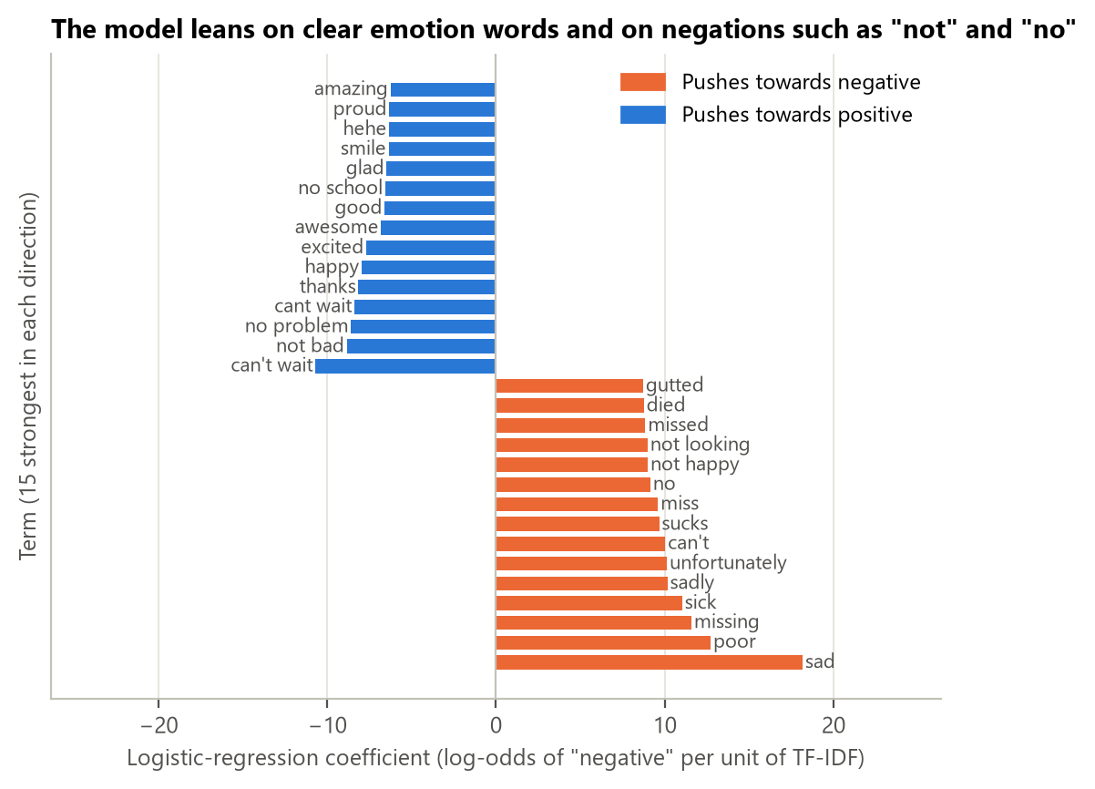
The model is readable, not a black box
MODEL INTERPRETATION
Example 1: availability complaint
“i am so sad!! i ran out of orange juice boohoo!”
sad, boohoo, so sad, ran out push towards negative. P(negative) = 1.00
Example 2: negation handled by word pairs
“that's not bad at all, as long as there's a smash cake…”
The pair “not bad” outweighs “not” and “bad”. P(negative) = 0.06
Notes:
Speaker: Ngo Binh Minh. We read the coefficients like regression slopes in Chapter 7: emotion words such as sad or sucks push towards negative, while 'can't wait' and 'not bad' push towards positive. For one tweet, coefficient times TF-IDF gives each word's contribution, the linear version of SHAP. In the second example, the word pair 'not bad' cancels 'not' and 'bad', something a single-word model cannot do.

Slide 13
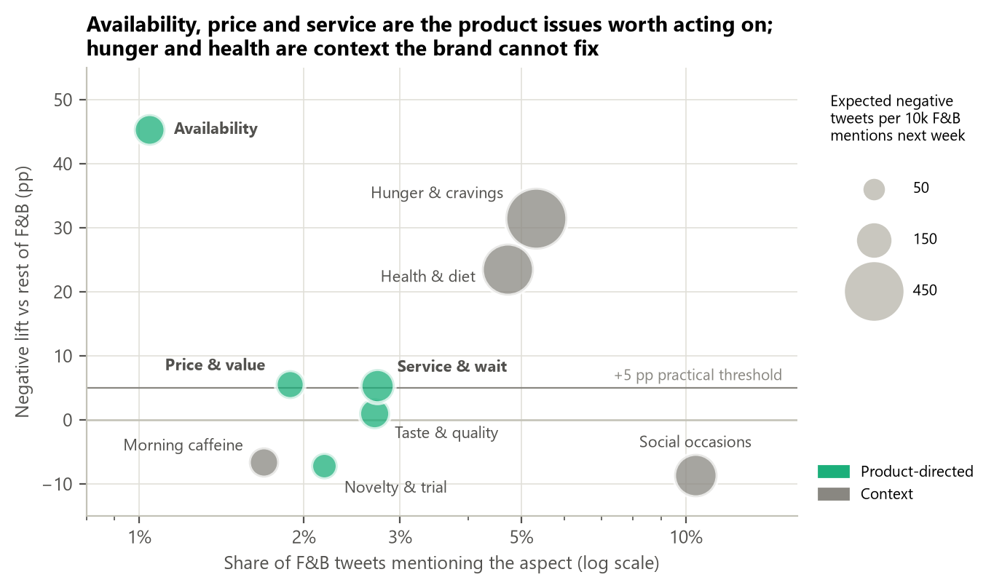
Decision rule: targeted adjustments, not a rewrite
PRESCRIPTIVE ANALYTICS
Rule written before the results
Rewrite the message
if launch week is significantly and practically more negative (H4)
Not met: H4 −0.3 pp, p = 0.37
Targeted adjustments
if a product aspect is ≥ 5 pp more negative, whole CI above 0
Met: availability, service, price
Keep and monitor
otherwise
Notes:
Speaker: Ngo Lam Tien. To stay honest we fixed the decision rule before looking at this chapter's results. A rewrite needed H4; it failed. Targeted adjustments needed a product aspect at least five points worse with its whole interval above zero; availability, service and price meet that. The priority matrix combines all three layers: share of voice, negative lift and the number of negative tweets the model expects next week.

Slide 14
Six recommendations, each backed by numbers
PRESCRIPTIVE ANALYTICS
R1
Keep the core message
R2
Add an availability message
R3
Fix service, evenings first
Launch lift −5.4 pp ≈ baseline; H4 p = 0.37; next week estimated 38.2% (true 36.8%)
1.0% of tweets but 79.6% negative (+45.3 pp), OR 7.2; ~108 negative per 10k next week
+5.4 pp (CI +3.3 to +7.4), evening +10.2 pp; ~129 negative per 10k next week
R4
Reframe price as value
R5
Creative on trying and sharing
R6
Monitor daily
+5.6 pp (CI +3.2 to +8.0), OR 1.21; trial offer, bundle or coupon
Novelty −7.2 pp, social −8.6 pp, morning −6.6 pp; avoid work-stress framing (+13.7 pp)
Classifier AUC 0.896, catches 84% of complaints; alert if daily lift > +1.5 pp
Notes:
Speaker: Ngo Lam Tien. Each recommendation quotes descriptive, diagnostic and predictive evidence, as the assignment asks. R1 keeps the message. R2 to R4 target the three pain points: tell people where to find the product, speed up service in the evening, and frame price as value. R5 builds creative around trying and sharing. R6 is daily monitoring, which Minh will show in the dashboard.

Slide 15
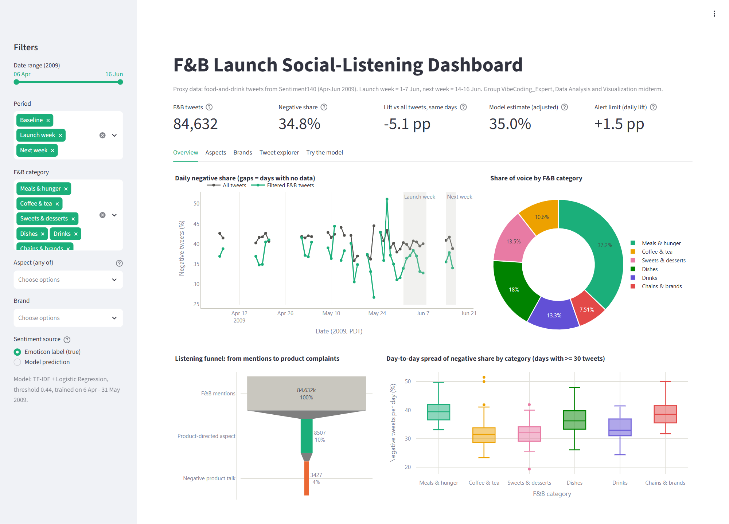
What-if, alert rule and a live dashboard
MONITORING
−0.7 pp
overall negativity if all three gaps were closed: act locally, set targets per aspect
+1.5 pp
alert limit (baseline mean + 2 SD): 1 false alarm in 23 days, 0 in launch or next week
Streamlit dashboard
Filters, KPI tiles, trend, aspects, brands, tweet explorer and a live “try the model” tab.
Notes:
Speaker: Ngo Binh Minh. Two numbers keep expectations realistic. Fixing all three issues lowers overall negativity by only about 0.7 points, because they are small slices of the conversation, so the team should set targets per aspect. The alert limit of +1.5 points would have fired once in 23 baseline days and never in launch or next week. [Live demo: run 'streamlit run dashboard/app.py', filter Availability, then type a tweet in 'Try the model'.]

Slide 16
Keep the message, fix the moments that hurt
1
Descriptive F&B talk is everyday and 5.1 pp less negative than Twitter; launch week is normal.
Limitations
Proxy data from 2009, not one real launch
Emoticon labels, no neutral class
Collection gaps; Pacific-time stamps
Filter precision 89% (AI-assisted check)
Associations, not causes: confirm with an A/B test
2
Diagnostic Availability, price and service drive complaints; trying and sharing are positive.
3
Predictive Logistic Regression beats Naive Bayes on an unseen week: AUC 0.896 vs 0.846.
4
Prescriptive Targeted adjustments R2-R5 and daily monitoring with a +1.5 pp alert limit.
Team Tien: problem, prescriptive, slides · Thanh: data, descriptive · Tam: diagnostic, conclusion · Minh: predictive, dashboard
Thank you. Questions?
Notes:
Speaker: Ngo Lam Tien. To conclude: launch week looked normal, so we keep the message, fix availability, service and price, build the creative around trying and sharing, and monitor daily. Our main limits are the proxy data and the emoticon labels; with real brand data the next step is an A/B test of the new messages. Thank you, we are happy to take questions.

Slide 17
Hypothesis tests H1-H4
APPENDIX A
 | Comparison | Difference | 95% CI (pp) | Holm p | Cohen's h | Verdict
H1 | Service & wait vs rest of F&B | +5.4 pp | +3.3 to +7.4 | < 0.001 | +0.11 | Supported
H2 | Price & value vs rest of F&B | +5.6 pp | +3.2 to +8.0 | < 0.001 | +0.12 | Supported
H3 | Morning caffeine vs rest of F&B | −6.6 pp | -9.0 to -4.3 | < 0.001 | −0.14 | Supported
H4 | Launch-week lift vs baseline (diff-in-diff) | −0.3 pp | -1.0 to +0.4 | 0.37 | n/a | Not supported
Notes:
Backup slide for questions about the tests. Two-proportion z-tests (Chapter 5) with CIs for the difference of two proportions (Chapter 4); Holm correction across the four tests; H4 uses a difference-in-differences of the F&B lift.

Slide 18
Robustness of Logistic Regression
APPENDIX B
Evaluation | Tweets | Accuracy | Negative F1 | ROC-AUC
Main result: time split, all test tweets | 150,736 | 0.810 | 0.785 | 0.896
Random 80/20 split (comparison only) | 254,807 | 0.820 | 0.789 | 0.903
Time split, F&B test tweets only | 9,527 | 0.811 | 0.758 | 0.886
Users already seen in training | 88,298 | 0.811 | 0.778 | 0.896
Users never seen in training | 62,438 | 0.809 | 0.793 | 0.895
Model trained on F&B tweets only | 9,527 | 0.774 | 0.726 | 0.862
Notes:
Backup slide: the random split overstates AUC slightly; the general model beats an F&B-only model; no user memorisation.

Slide 19
Cleaning log
APPENDIX C
Step | Rows before | Removed | Rows after | Reason
Consistent labels | 1,600,000 | 3,370 | 1,596,630 | Same id labelled positive and negative
Collection window | 1,596,630 | 275,225 | 1,321,405 | After 16 Jun 08:40 only negatives were collected
Readable text | 1,321,405 | 3,179 | 1,318,226 | No words left after removing links and users
Unambiguous text | 1,318,226 | 14,139 | 1,304,087 | Same normalised text with both labels
Unique texts | 1,304,087 | 30,053 | 1,274,034 | Repeated texts (bots, spam)
Notes:
Backup slide: every cleaning step and its reason.

